Slide 1
CSIS 115 Database Design and Applications for Business
Dr. Meg Fryling
“Dr. Meg”
Fall 2012
@SienaDrMeg
#csis115

Slide 2
Agenda
Quiz
Homework (see next slide)
Project Part II Appointments
Chapter 6: Translating ER Diagrams to Relations
Conceptual design to physical database

Slide 3
Homework
See Course Schedule for Readings!
Project – Part II (Rewrite)
Due Weds, 10/31 by start of class
Midterm is Mon, 11/5
Will discuss format as we get closer
May bring a “cheat sheet”
8.5x11, handwritten, both sides, must use your own!

Slide 4
Project ER Diagram
Make an appointment with to go over your project ER Diagram
Go to Doodle Poll to select appt day/time
http://www.doodle.com/z549que58ybwc3cd
Pick a timeslot by start of class Monday (10/22)
If you cannot make any of these times you must let me know by the end of this week so we can find an alternate time.

Slide 5
Chapter 6 Transforming data models (ER Diagrams) into database designs
What is involved?

Slide 6
Chapter 6 Objectives
To understand how to transform data (ER) models into database designs
Represent strong and weak (ID-dependent) entities as tables
Add attributes and identify primary keys
Determine required: (NOT NULL)
Determine default values
Determine data constraints
Determine datatype: char, integer, etc.

Slide 7
Chapter 6 Objectives
Use of referential integrity constraints and actions
Establish relationships between entities
1:1, 1:N, and N:M
Foreign keys
Enforcing minimum cardinalities
Foreign keys and constraints

Slide 8
Phase 1 - Overview
Phase 1: Tables, keys, attributes
Create a table for each Entity
The identifier is a good start for the PK
BUT there might be better options
Determine if a surrogate key is needed
All other attributes become columns in the table
for now leave data type as text length 255 for all

Slide 9
Phase 1: Create a Table for Each Entity
EMPLOYEE (EmployeeNumber, EmployeeName, Phone, Email, HireDate, ReviewDate, EmpCode)
Primary key is designated by the key symbol

Slide 10
Phase 1: Select the Primary Key
The ideal primary key is short, numeric, and fixed.
Surrogate keys meet the ideal, but typically have no meaning to users.
Created by database (e.g. autonumber)
unique for table

Slide 11
Now, you do it!
Blackboard
Assignments > In-Class Activities > 5 – ER (Conceptual) to DB (Physical)
Phase 1 only
Note: For now, leave all data types the default (i.e. text, 255 length)

Slide 12
Phase 2 - Overview
Phase 2: data type, NULL, other constraints
Pick most appropriate way to represent each attribute.
Determine which attributes are NOT NULL.
Sometimes we relax that condition when loading data into a database
Identify default value, if any
Identify any other data constraints

Slide 13
Phase 2: Specify Column Properties, Null Status
Null status indicates if the value of the column can be NULL
In Microsoft Access we control this by setting Required to yes or no (see next slide)

Slide 14
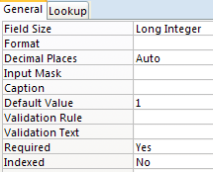
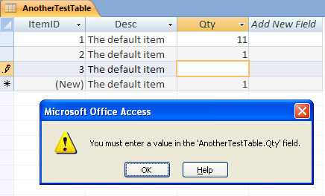
NULL status

Slide 15
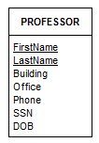
Highline University Example
Which fields do we want to make required (not null)?

Slide 16
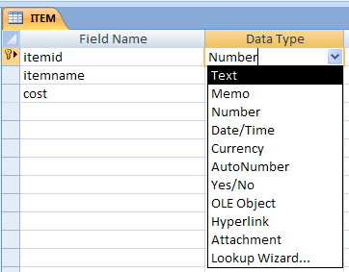
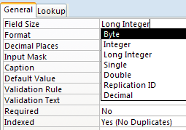
Phase 2: Specify data types ACCESS type: NUMBER
Storage implications for Number:
Byte: 8 bits: 0..255
Integer: 2 bytes: 64K
Long Integer: 4 bytes : 4 billion
Single: 4 bytes
Double: 8 bytes
Default Value
For numbers with decimal points (e.g. GPA)

Slide 17
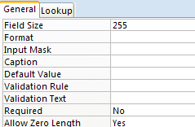
Phase 2: ACCESS data type: Text
Storage implications for text:
Fixed in size, up to 255 bytes (characters). Default Value is 255.
Note: data types do vary a bit depending on the database (e.g. SQL Server, MySQL, Oracle)

Slide 18
Phase 2: ACCESS basic data types: Others

Slide 19
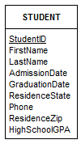
Highline University Example
Open Highland University Database
This entity has already been converted to a table
Update Table
Set appropriate data types
See previous slide!
Any fields you would require (not null)? Do so!

Slide 20
Phase 2: Specify Column Properties: Default Value
A default value is the value supplied by the DBMS when a new row is created.

Slide 21
Highline University Example
Let’s say 95% our students come from NY.
What default value might you add? Do it!

Slide 22
Column Properties: Data Constraints
Data constraints are limitations on data values
Domain constraint
Validation Rule (Validation Text)
column values must be in a given set of specific values: “Red”, “Green”, ”Blue”
Range constraint
Validation Rule (Validation Text)
column values must be within a given range of values: between 1 and 1000

Slide 23
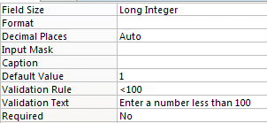
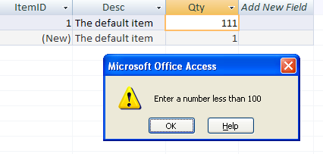
Domain or range constraint
Notes:
See Highland University database for examples

Slide 24
Highline University Example
Let’s say we only include a high school GPA if it was between 3.5 and 4.0
How would we enforce that? Do it!

Slide 25
Column Properties: Data Constraints
Data constraints are limitations on data values
Data format constraints
Input Mask
Text or Date field types only
Zip in 12211-0101 format
Phone in (518) 555-5151 format

Slide 26
Highline University Example
What data format constraints make sense here?
Date data types
Input masks

Slide 27
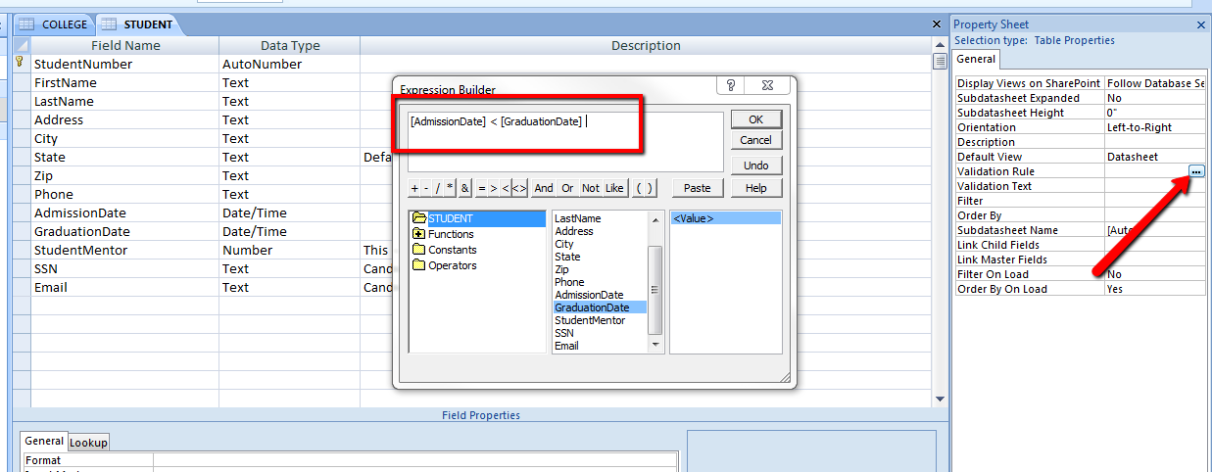
Intrarelation Constraint

Slide 28
Highline University Example
Add an intrarelation constraint that ensures graduation date is after admission date.
Hint: See previous slide

Slide 29
Now, you do it!
Blackboard
Assignments > In-Class Activities > 5 – ER (Conceptual) to DB (Physical)
Phase 2 only

