Slide 1
CSIS 115 Database Design and Applications for Business
Dr. Meg Fryling
“Dr. Meg”
Fall 2012
@SienaDrMeg
#csis115

Slide 2
Agenda
Quiz Review
Homework (see next slide)
Project Part II Appointments
Chapter 6: Translating ER Diagrams to Relations
Conceptual design to physical database

Slide 3
Homework
See Course Schedule for Readings?
Project – Part II (Rewrite)
Due Weds, 10/31 by start of class
Midterm is Mon, 11/5
Will discuss format as we get closer
May bring a “cheat sheet”
8.5x11, handwritten, both sides, must use your own!

Slide 4
Project ER Diagram
Make an appointment with to go over your project ER Diagram
Go to Doodle Poll to select appt day/time
http://www.doodle.com/z549que58ybwc3cd
Pick a timeslot by start of class Monday (10/22)
If you cannot make any of these times you must let me know by the end of this week so we can find an alternate time.

Slide 5
The ideal primary key is _____.
A) short
B) numeric
C) fixed
D) A and B
E) A, B and C
Notes:
Answer: E

Slide 6
A surrogate key should be considered when ________.
A) a relationship is M:N
B) a composite key is required
C) the key contains a lengthy text field
D) the key contains a number
E) an index needs to be created
Notes:
Answer: C

Slide 7
Phase 2 - Overview
Phase 2: data type, NULL, other constraints
Pick most appropriate way to represent each attribute.
Determine which attributes are NOT NULL.
Sometimes we relax that condition when loading data into a database
Identify default value, if any
Identify any other data constraints

Slide 8
Now, you do it!
Blackboard
Assignments > In-Class Activities > 5 – ER (Conceptual) to DB (Physical)
Phase 2 only

Slide 9
Column Properties: Data Constraints
Data constraints are limitations on data values
Domain constraint
Validation Rule (Validation Text)
column values must be in a given set of specific values: “Red”, “Green”, ”Blue”
Range constraint
Validation Rule (Validation Text)
column values must be within a given range of values: between 1 and 1000

Slide 10
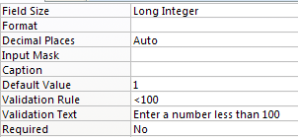
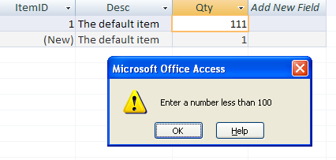
Domain or range constraint
Notes:
See Highland University database for examples

Slide 11
Column Properties: Data Constraints
Data constraints are limitations on data values
Data format constraints
Input Mask
Text or Date field types only
Zip in 12211-0101 format
Phone in (518) 555-5151 format

Slide 12
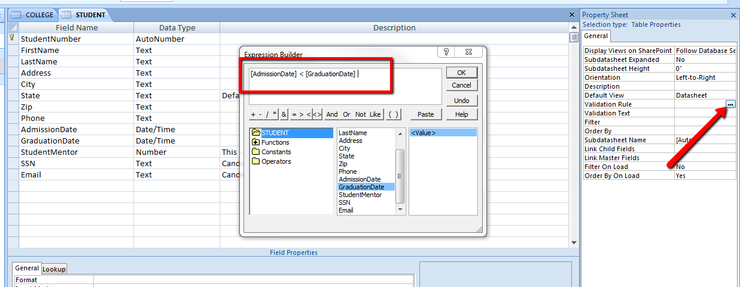
Intrarelation Constraint

Slide 13
Highline University Example
Open STUDENT table
Update data types to appropriate values and sizes
Make fields required as appropriate
Add default value of NY for Residence State

Slide 14
Highline University Example
Open STUDENT table
Add input mask for Phone and ResidenceZip
Add validation rule so GPA is between 2.5 and 3
Add validation rule so Admission Date is greater than today’s date
Hint: use Date() Access function
Add an intrarelation constraint that ensures graduation date is after admission date.
Hint: See next slide
Notes:
>Date()

Slide 15
Phase 2: Verify Normalization
The tables should be normalized based on the data model.
Verify that all tables are at least in
BCNF or 3rd NF
No worries, more about this later!
Chapters 3 & 4

Slide 16
Phase 3 - Overview
Phase 3: create relationships
Between strong and weak (ID-dependent) entities
PK for parent is already part of child table’s PK so no FK required
Between strong entities
1:1 add PK of first table as PK or FK of second table
1:N add PK of parent table as foreign key on child (many) table
M:N create join/intersection table with PK of both tables
Other attributes in JOIN table makes it an ASSOCIATION pattern.
Recursive relationships
1:1 or 1:N add FK, which will link back to PK of same table
M:N create join/intersection table
Enforce referential integrity (select cascade updates/deletes as appropriate)

Slide 17
See “Translating ER Diagrams to Access”
Blackboard
Assignments > In-Class Activities > 5 – ER (Conceptual) to DB (Physical)

Slide 18
Phase 3: Create Relationships: 1:1 Strong Entity Relationships
Place the key of one entity in the other entity as a foreign key.
Either design will work—no parent, no child.
Minimum cardinality considerations may be important.
O-M will require a different design than M-O so one design will likely be preferable.
More about this later…
Notes:
See Highland University relationship between STUDENT and PARKING_PASS

Slide 19
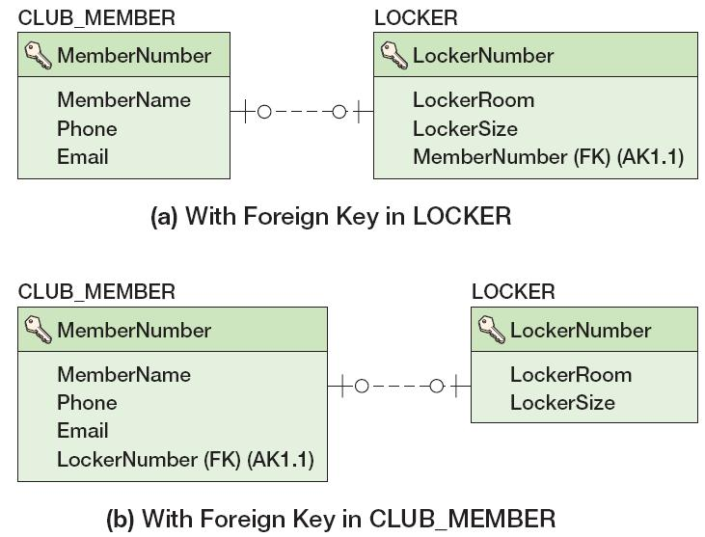
Create Relationships: 1:1 Strong Entity Relationships
Notes:
Because these have optional-optional relationship we can put the foreign key in either place.

Slide 20
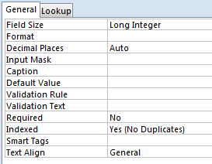
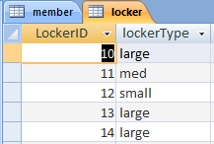
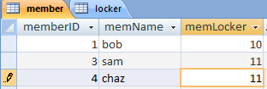
Enforcing 1:1 with Indexed No Dups
Notes:
See Highland University relationship between STUDENT and PARKING_PASS

Slide 21
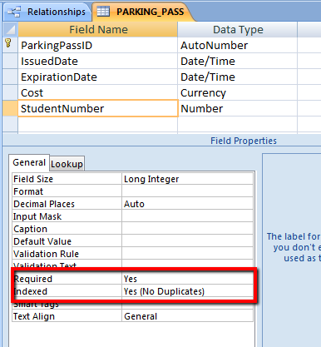
Notes:
Indexed = Yes (No Duplicates)
Establishes that this is a 1:1 relationship – Yes (Duplicates OK) would be for 1:N
Required = Yes
-Enforces the minimum cardinality of 1 (required) on the first entity – for optional min cardinality this would be left set to No
NOTE: There is no way, without programming, to enforce a minimum cardinality of 1 on child (or second entities).

Slide 22
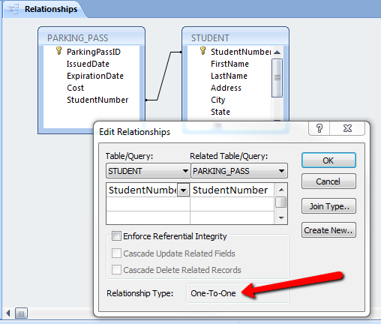

Slide 23
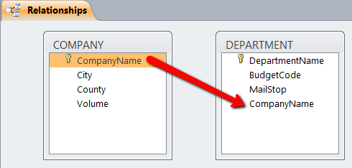
Referential Integrity
Referential Integrity - No (unchecked)
Can update/delete record and “break” relationship between related records ☹
Referential Integrity - Yes (checked)
Cannot orphan child/related records
Either prohibit update/delete OR update/delete child records as well OR remove FK value from child record (if not required)

Slide 24
Cascading Updates and Deletes
A cascading update occurs when a change to the parent’s primary key is applied to the child’s foreign key.
Surrogate keys never change and there is no need for cascading updates when using them (won’t hurt anything to select the checkbox though)
A cascading delete occurs when associated child rows are deleted along with the deletion of a parent row.
For strong entities, generally do not cascade deletes.
For weak entities, generally do cascade deletes.

