Slide 1


CSIS-110
Introduction to
Computer Science
Dr. Meg Fryling
“Dr. Meg”
Fall 2012
@SienaDrMeg
#csis110

Slide 2
Lecture Seven Agenda
Questions?
Assignments
CSI Chapter 4 – Data Representation
  RGB and hex -> binary -> decimal conversion
CSI Chapter 5 - Gates and Circuits

Slide 3
Assignments
Readings: See course scheduled on syllabus
  The textbook readings are going to help you with homeworks AND labs
Homework 1
  Was due today at the start of class
Homework 2
  Due Weds 10/10 at the START of class (note typo on the homework sheet)
Lab 2
  Due at START of lab 3
  Coming to lab late does NOT extend your due date

Slide 4
Representing Images and Graphics
Color is expressed as an RGB (red-green-blue) value--three numbers that indicate the relative contribution of each of these three primary colors
An RGB value of (255, 255, 0) maximizes the contribution of red and green, and minimizes the contribution of blue, which results in a bright yellow

Slide 5
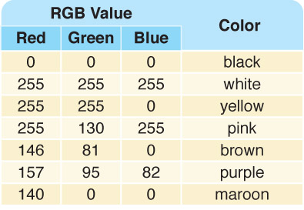
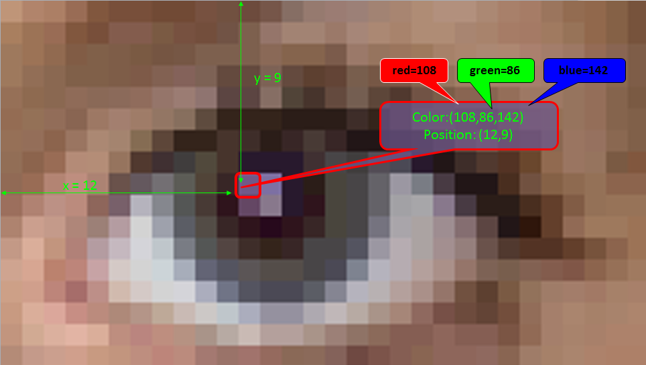
Representing Images and Graphics
A few TrueColor
RGB values and
the colors they
represent

Slide 6

Nerds are Sexy!
What is the RBG value for #FF0000?
Notes:
Source: http://programmerryangosling.tumblr.com/
F = 1111
F = 1111
11111111 = 255 (decimal)

Slide 7
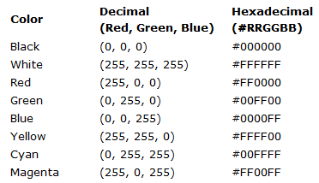
Common Colors
Notes:
http://www.w3schools.com/html/html_colornames.asp

Slide 8
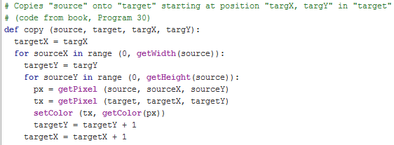

Nested Loops

Slide 9
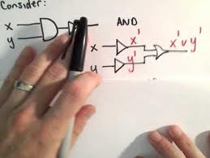
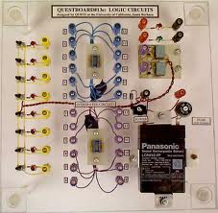
Chapter 5
Gates and Circuits

Slide 10

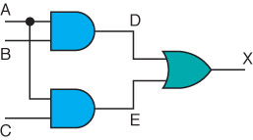
Computers and Electricity
Gate
A device that performs a basic operation on
electrical signals
Takes in 1 or more signals as input and returns 1 output
Circuits
Gates combined to perform
more complicated tasks

Slide 11
Computers and Electricity
How do we describe the behavior of gates and circuits?
Boolean expressions
Uses Boolean algebra, a mathematical notation for expressing two-valued logic
Logic diagrams
A graphical representation of a circuit; each gate has its
own symbol
Truth tables
A table showing all possible input values and the associated
output values

Slide 12
Gates
Six types of gates
  NOT
  AND
  OR
  XOR
  NAND
  NOR
Typically, logic diagrams are black and white with gates distinguished only by their shape
We use color for emphasis (and fun)

Slide 13
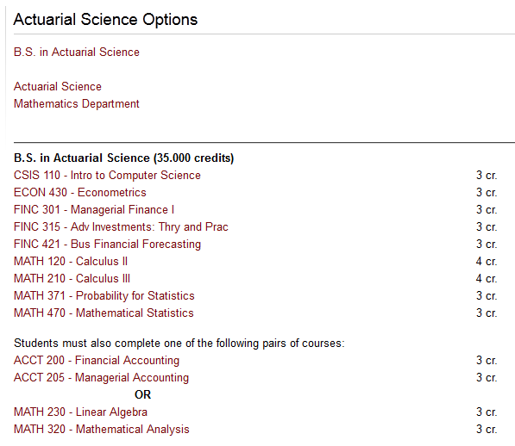
Boolean Expressions

Slide 14
Boolean Expressions
Assume that A = true, B = false, and C = false
Evaluate each expression below (i.e., state whether it is TRUE or FALSE)
  NOT A
    Also written as A’
  ( A OR B )
    Also written as A + B
  ( A AND B )
    Also written as A*B, A∙B, AB

Slide 15

Worksheet
Questions 1-2
Remember:
  NOT operation is represented by ‘
    AKA inverter
  AND operation is represented by * or ∙
    When no operation exists between input values, AND is assumed (e.g. AB)
  OR operation is represented by +

Slide 16
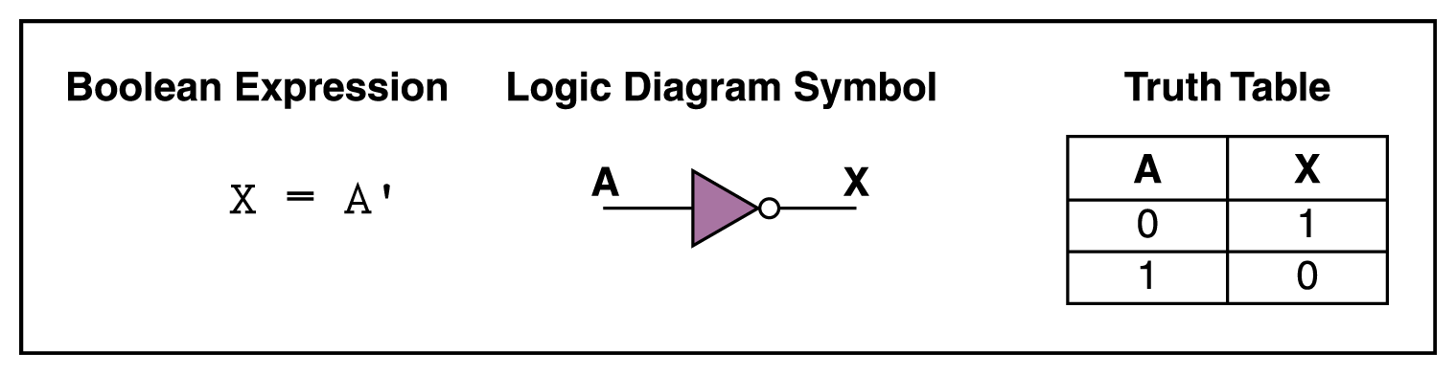
NOT Gate
A NOT gate accepts one input signal (0 or 1)
and returns the opposite signal as output
Question 3
Truth Table
A | X
0
1
Note: Number of rows in my Truth Table = 2^{n} where n is the number of inputs
Figure 4.1 Various representations of a NOT gate

Slide 17
NOT Gate
A NOT gate accepts one input signal (0 or 1) and returns the opposite signal as output
Figure 4.1 Various representations of a NOT gate

Slide 18
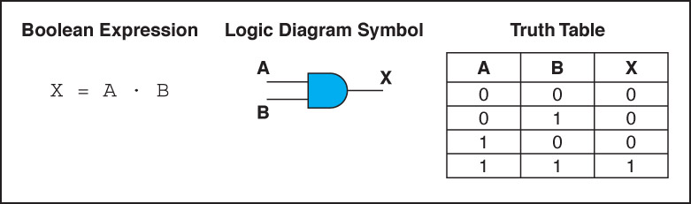
AND Gate
An AND gate accepts two input signals
If both are 1, the output is 1; otherwise,
the output is 0
Question 4
?
Truth Table
Figure 4.2 Various representations of an AND gate
Notes:
There are 2^n possible input combinations for a gate with n inputs, so there are 2^n rows in the truth table that describes it.

Slide 19

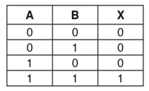
Remember to draw your truth tables as if you were counting in binary

Slide 20
AND Gate
An AND gate accepts two input signals
If both are 1, the output is 1; otherwise,
the output is 0
Figure 4.2 Various representations of an AND gate

Slide 21
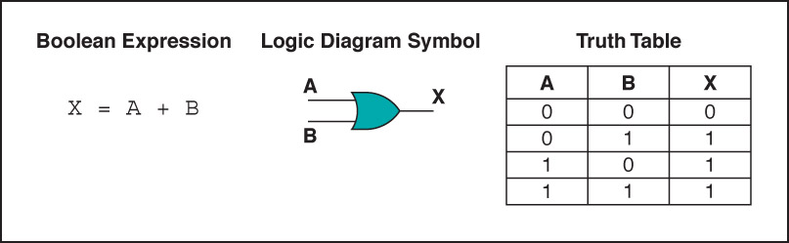
OR Gate
An OR gate accepts two input signals
If both are 0, the output is 0; otherwise,
the output is 1
Question 5
Truth Table
A | B | X
Figure 4.3 Various representations of an OR gate

Slide 22
OR Gate
An OR gate accepts two input signals
If both are 0, the output is 0; otherwise,
the output is 1
Figure 4.3 Various representations of an OR gate

Slide 23
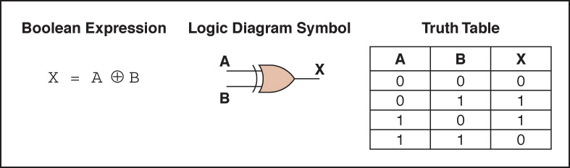
XOR Gate
An XOR gate accepts two input signals
If both are the same, the output is 0;
otherwise, the output is 1
Question 6
Truth Table
A | B | X
Figure 4.4 Various representations of an XOR gate
Notes:
Note the difference between the XOR gate
and the OR gate; they differ only in one
input situation
When both input signals are 1, the OR gate produces a 1 and the XOR produces a 0
XOR is called the exclusive OR

Slide 24
XOR Gate
An XOR gate accepts two input signals
If both are the same, the output is 0; otherwise,
the output is 1
Figure 4.4 Various representations of an XOR gate

Slide 25
XOR Gate
Note the difference between the XOR gate
and the OR gate; they differ only in one
input situation
When both input signals are 1, the OR gate produces a 1 and the XOR produces a 0
XOR is called the exclusive OR

Slide 26
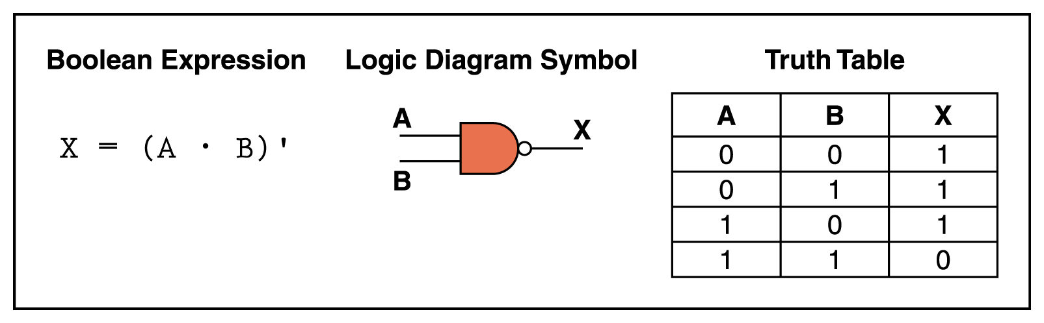
NAND Gate
The NAND gate accepts two input signals
If both are 1, the output is 0;
otherwise, the output is 1
Question 7
Truth Table
A | B | X
Figure 4.5 Various representations of a NAND gate

Slide 27
NAND Gate
The NAND gate accepts two input signals
If both are 1, the output is 0; otherwise,
the output is 1
Figure 4.5 Various representations of a NAND gate

Slide 28
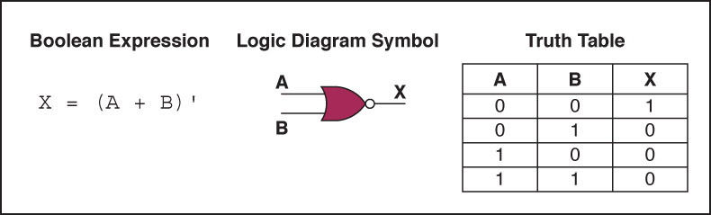
NOR Gate
The NOR gate accepts two input signals
If both are 0, the output is 1; otherwise,
the output is 0
Question 8
Truth Table
A | B | X
Figure 4.6 Various representations of a NOR gate

Slide 29
NOR Gate
The NOR gate accepts two input signals
If both are 0, the output is 1; otherwise,
the output is 0
Figure 4.6 Various representations of a NOR gate

Slide 30
Review of Gate Processing
A NOT gate inverts its single input
An AND gate produces 1 if both input values are 1
An OR gate produces 0 if both input values are 0
An XOR gate produces 0 if input values are the same
A NAND gate produces 0 if both inputs are 1
A NOR gate produces a 1 if both inputs are 0

Slide 31
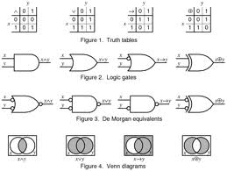
Notes:
Source: https://en.wikipedia.org/wiki/Boolean_algebra_%28logic%29

Slide 32
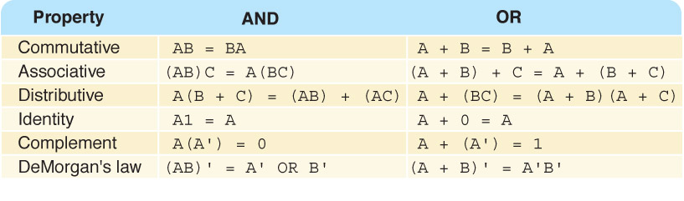
Properties of Boolean Algebra

