Slide 1
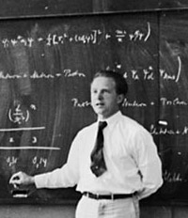
CHAPTER 7 The Hydrogen Atom
7.1 Application of the Schrödinger Equation to the Hydrogen Atom
7.2 Solution of the Schrödinger Equation for Hydrogen
7.3 Quantum Numbers
7.4 Magnetic Effects on Atomic Spectra–The Zeeman Effect
7.5 Intrinsic Spin
7.6 Energy Levels and Electron Probabilities
Werner Heisenberg
(1901-1976)
The atom of modern physics can be symbolized only through a partial differential equation in an abstract space of many dimensions. All its qualities are inferential; no material properties can be directly attributed to it. An understanding of the atomic world in that primary sensuous fashion…is impossible.
- Werner Heisenberg
Prof. Rick Trebino, Georgia Tech, www.frog.gatech.edu
Notes:
http://dir.niehs.nih.gov/ethics/images/photo-heisenberg.jpg

Slide 2
7.1: Application of the Schrödinger Equation to the Hydrogen Atom
The potential energy of the electron-proton system is electrostatic:
For Hydrogen-like atoms (He⁺ or Li⁺⁺), replace e² with Ze² (where Z is the atomic number).
The three-dimensional time-dependent Schrödinger Equation:
which becomes the three-dimensional time-independent Schrödinger Equation:

Slide 3
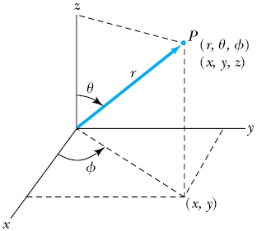
Spherical Coordinates
The potential (central force) V(r) depends only on the distance r between the proton and electron, where .
As a result of this radial symmetry, we must transform to spherical coordinates:
Polar angle
The inverse relations:
Azimuthal angle

Slide 4
The Schrödinger Equation in Spherical Coordinates
Transformed into spherical coordinates, the Schrödinger equation becomes:
Also, use the reduced mass μ instead of the electron mass m

Slide 5
Separable Solution
The wave function ψ is a function of r, θ, φ. This is a potentially complicated function.
Assume optimistically that ψ is separable, that is, a product of three functions, each of one variable only:
This would make life much simpler—and it turns out to work!

Slide 6
7.2: Solution of the Schrödinger Equation for Hydrogen
Start with Schrodinger’s Equation:
Substitute:
Multiply both sides by −r² sin²θ / R f g:

Slide 7
Solution of the Schrödinger Equation for H
r and θ appear only on the left side and φ appears only on the right side.
The left side of the equation cannot change as φ changes.
The right side cannot change with either r or θ.
Each side needs to be equal to a constant for the equation to be true.
Set the constant to be −m_{ℓ}²
Azimuthal-angle equation
Sines and cosines satisfy this equation, but it’s convenient to choose a complex exponential:
g(φ) = exp(im_{ℓ}φ)

Slide 8
Quantization of m_{ℓ}
g(φ) = exp(im_{ℓ}φ)
exp(im_{ℓ}φ) satisfies the azimuthal equation for any value of m_{ℓ}.
But a type of boundary condition exists because φ and φ + 2π are actually the same angle, so:
So:
Canceling:
m_{ℓ} must be an integer (positive or negative) for this to be true.

Slide 9
Solution of the Schrödinger Equation for H
Now replace by −m_{ℓ}²:
Divide by sin²θ and rearrange it:
Now, the left side depends only on r, and the right side depends only on θ. We can use the same trick again!
Set each side equal to the constant ℓ(ℓ + 1).

Slide 10
Separation of the Schrödinger Equation for H
Set each side equal to the constant ℓ(ℓ + 1).
The Associated Laguerre equation
Radial equation
Polar-angle equation
We’ve separated the Schrödinger equation into three ordinary second-order differential equations, each containing only one variable.

Slide 11
Solution of the Radial Equation for H
The radial equation is called the associated Laguerre equation and the solutions R are called associated Laguerre functions. There are infinitely many of them, for values of n = 1, 2, 3, …
Assume that the ground state has n = 1 and ℓ = 0. Let’s find this solution.
The radial equation becomes:
The derivative of yields two terms:

Slide 12
Solution of the Radial Equation for H
Try a solution
A is a normalization constant.
a₀ is a constant with the dimension of length.
Take derivatives of R and insert them into the radial equation.
To satisfy this equation for any r, both expressions in parentheses must be zero.
Set the second expression equal to zero and solve for a₀:
Set the first expression equal to zero and solve for E:
Both are equal to the Bohr results!

Slide 13
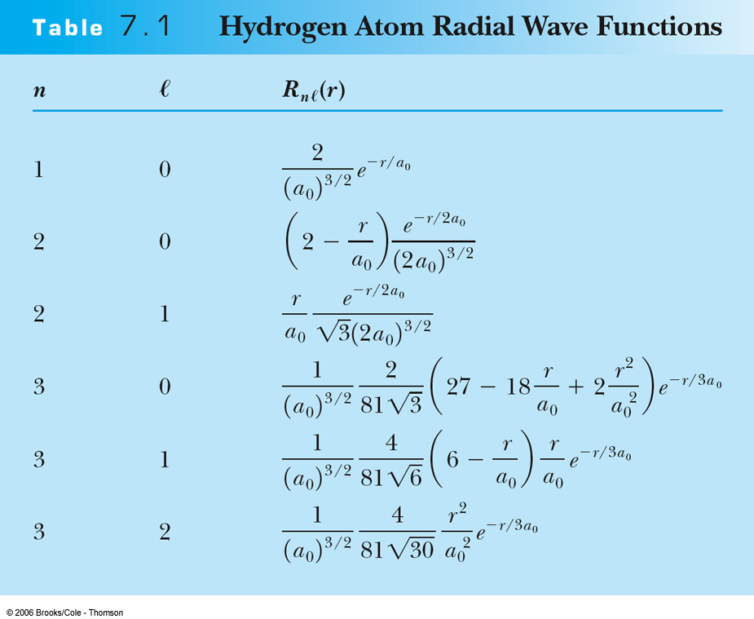
Hydrogen-Atom Radial Wave Functions
The solutions R to the radial equation are called Associated Laguerre functions.
There are infinitely many of them, for values of n = 1, 2, 3, … and ℓ < n.

Slide 14
The Polar-Angle Equation
Polar-angle equation
Note the presence of m_{ℓ}. Recall that the solutions to the azimuthal equation, exp(im_{ℓ}φ), also involve m_{ℓ}.
So solutions to the polar- and azimuthal-angle equations are linked.
We usually group these solutions together into functions called Spherical Harmonics:
Spherical harmonics
Solutions to the polar-angle equation above involve sums and products of sines and cosines.

Slide 15
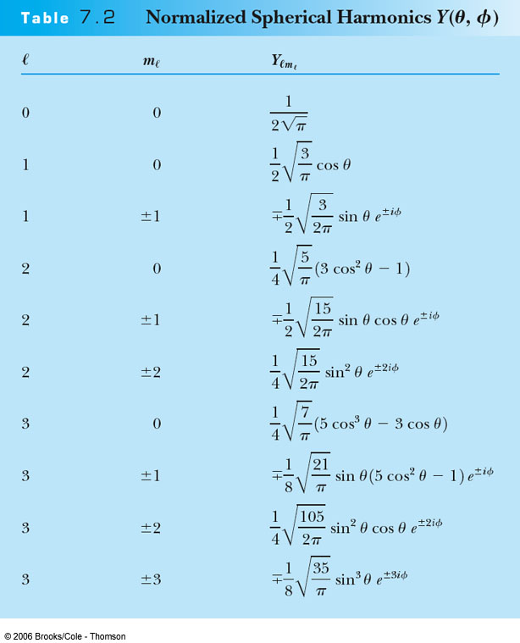
Normalized Spherical Harmonics
Spherical harmonics are the solutions to the combination polar- and azimuthal-angle equations.

Slide 16
Complete Solution of the Radial, Angular, and Azimuthal Equations
The total wave function is the product of the radial wave function R_{nℓ} and the spherical harmonics Y_{ℓm} and so depends on n, ℓ, and m_{ℓ}.
The wave function becomes:
_{ℓ}
where only certain values of n, ℓ, and m_{ℓ} are allowed.

Slide 17
7.3: Quantum Numbers
The three quantum numbers:
n: Principal quantum number
ℓ : Orbital angular momentum quantum number
m_{ℓ}: Magnetic (azimuthal) quantum number
The restrictions for the quantum numbers:
n = 1, 2, 3, 4, . . .
ℓ = 0, 1, 2, 3, . . . , n − 1
m_{ℓ} = − ℓ, − ℓ + 1, . . . , 0, 1, . . . , ℓ − 1, ℓ
n > 0
ℓ < n
|m_{ℓ}| ≤ ℓ
The energy levels are:
Equivalently:

Slide 18
Probability Distribution Functions
We use the wave functions to calculate the probability distributions of the electrons.
The electron is spread out over space and its position is not well defined.
We may use the radial wave function R(r) to calculate radial probability distributions of the electron.
The probability of finding the electron in a differential volume element dx dy dz is:
where the differential volume element in spherical polar coordinates is

Slide 19
Probability Distribution Functions
At the moment, we’ll consider only the radial dependence.
So we should integrate over all values of θ and φ:
The θ and φ integrals are just constants.
So the radial probability density is P(r) = r² |R(r)|² and it depends only on n and ℓ.

Slide 20
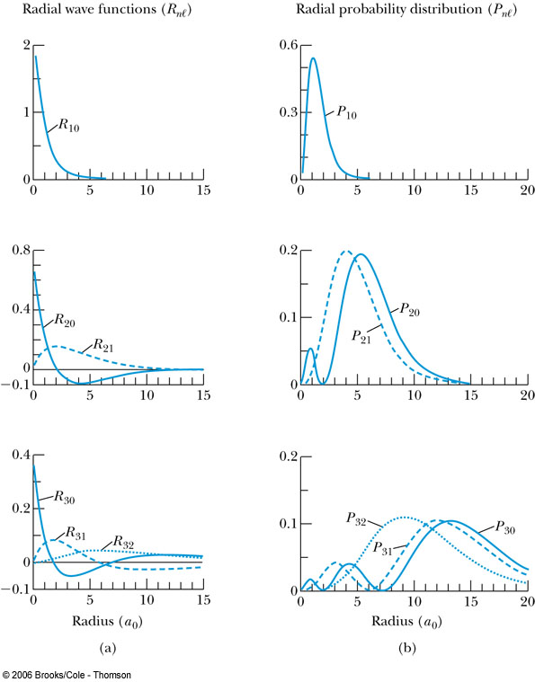
Probability Distribution Functions
R(r) and P(r) for the lowest-lying states of the hydrogen atom.
Note that R_{n0} is maximal at r = 0! But the r² factor reduces the probability there to 0. Nevertheless, there’s a nonzero probability that the electron is inside the nucleus.

Slide 21
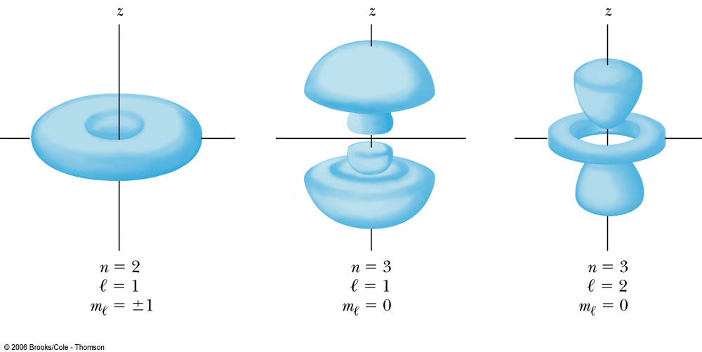
Probability Distribution Functions
The probability density for the hydrogen atom for three different electron states.

Slide 22
Orbital Angular Momentum Quantum Number ℓ
Energy levels are degenerate with respect to ℓ (the energy is independent of ℓ).
Physicists use letter names for the various ℓ values:
ℓ = 0 1 2 3 4 5 . . .
Letter = s p d f g h . . .
Atomic states are usually referred to by their values of n and ℓ.
A state with n = 2 and ℓ = 1 is called a 2p state.

Slide 23
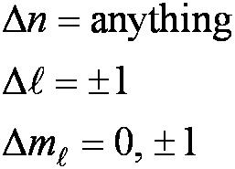
7.6: Energy Levels and Electron Probabilities
For hydrogen, the energy level depends on the prin-cipal quantum number n.
An electron can make a transition from a state of any n value to any other.
But what about the ℓ and m_{ℓ} quantum numbers? It turns out that only some transitions are allowed.

Slide 24
Selection Rules
We can use the wave functions to calculate transition probabilities for the electron to change from one state to another.
The probability is proportional to the mag square of the dipole moment:
Allowed transitions:
Electrons that absorb or emit photons can change states only when Δℓ = ±1 and Δm_{ℓ} = 0, ±1.
Forbidden transitions:
Other transitions are possible but occur with much smaller probabilities.
where Ψ_{i} and Ψ_{f} are the initial and final states of the transition.

Slide 25
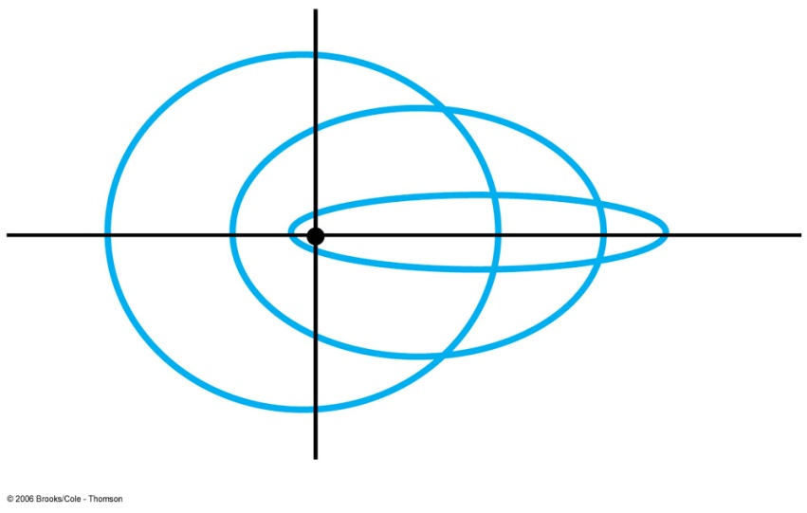
Orbital Angular Momentum Quantum Number ℓ
Classically, the orbital angular momentum is with L = m v_{orbital} r.
But quantum-mechanically, the total orbital angular momentum L is related to ℓ by:
In an ℓ = 0 state:
This disagrees with Bohr’s semi- classical planetary model of electrons orbiting a nucleus, for which L = nħ, where n = 1, 2, …
Classical orbits—which don’t exist in quantum mechanics

Slide 26
Orbital Magnetic Quantum Number m_{ℓ}
Possible total angular momentum directions when ℓ = 2
Recall that m_{ℓ} is an integer. It determines the z component of L:
Example: ℓ = 2:
Only certain orientations of are possible.
And (except when ℓ = 0) we just don’t (and cannot!) know L_{x} and L_{y}!

Slide 27
Rough derivation of ‹L²› = ℓ(ℓ+1)ħ²
We expect the average of the angular momentum components squared to be the same due to spherical symmetry:
But
Averaging over all m_{ℓ} values (assuming each is equally likely):
because:

Slide 28
7.4: Magnetic Effects—The Zeeman Effect
In 1896, the Dutch physicist Pieter Zeeman showed that spectral lines emitted by atoms in a magnetic field split into multiple energy levels.
Think of an electron as an orbiting circular current loop of I = dq / dt around the nucleus. If the period is T = 2π r / v, then:
I = -e/T = -e/(2π r / v) = -e v /(2π r)
Nucleus
The current loop has a magnetic moment μ = IA:
where L = mvr is the magnitude of the orbital angular momentum.
= [-e v /(2π r)] π r² = [-e/2m] mrv
Notes:
Image from http://www.physics.sjsu.edu/becker/physics51/mag_field.htm

Slide 29
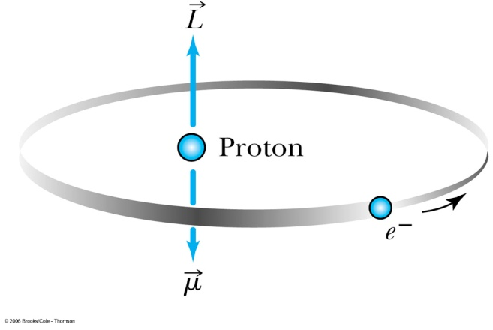
The Zeeman Effect
The potential energy due to the magnetic field is:
If the magnetic field is in the z-direction, all that matters is the z-component of μ:
where μ_{B} = eħ / 2m is called the Bohr magneton.

Slide 30
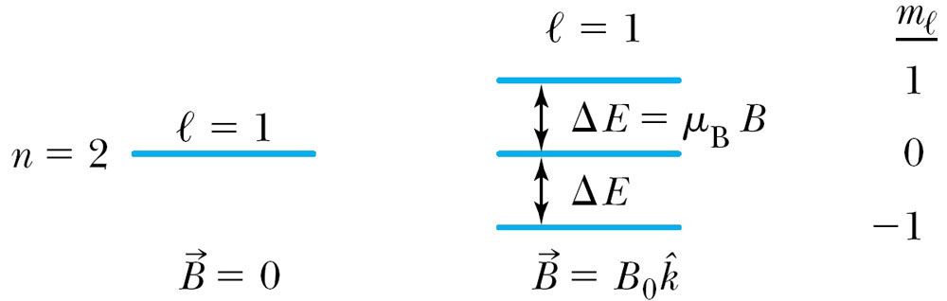
The Zeeman Effect
Technically, we need to go back to the Schrödinger Equation and re-solve it with this new term in the total energy.
We find that a magnetic field splits the m_{ℓ} levels. The potential energy is quantized and now also depends on the magnetic quantum number m_{ℓ}.
When a magnetic field is applied, the 2p level of atomic hydrogen is split into three different energy states with energy difference of ΔE = μ_{B}B Δm_{ℓ}.
m_{ℓ} | Energy
1 | E₀ + μ_{B}B
0 | E₀
−1 | E₀ − μ_{B}B

Slide 31
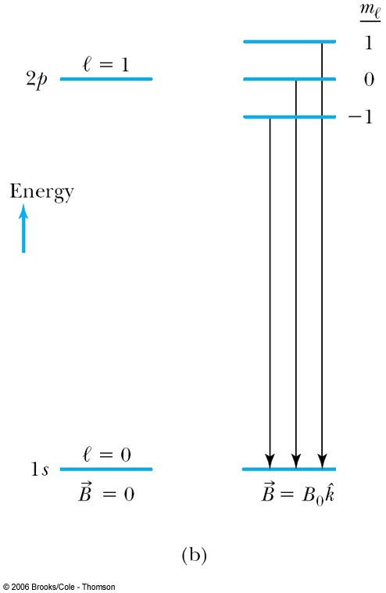
The Zeeman Effect
Magnetic field = 0 Magnetic field ≠ 0
An electron with angular momentum generates a magnetic field, which has lower energy when aligned antiparallel to an applied magnetic field than when aligned parallel to it.
So, for example, the transition from 2p to 1s is split by a magnetic field.

Slide 32
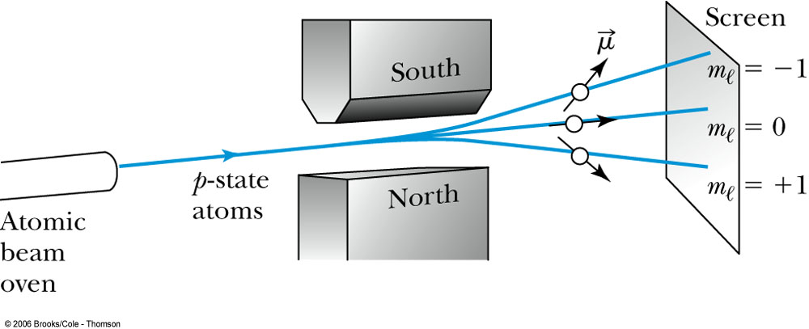
The Zeeman Effect
An atomic beam of particles in the ℓ = 1 state pass through a magnetic field along the z direction.
The m_{ℓ} = +1 state will be deflected down, the m_{ℓ} = −1 state up, and the m_{ℓ} = 0 state will be undeflected.

Slide 33
7.5: Intrinsic Spin
In 1925, grad students, Samuel Goudsmit and George Uhlenbeck, in Holland proposed that the electron must have an intrinsic angular momentum and therefore a magnetic moment.
In order to explain pairs of spectral lines where theory predicted only one, Goudsmit and Uhlenbeck proposed that the electron must have an intrinsic spin quantum number s = ½.
This seems reasonable, but Paul Ehrenfest showed that, if so, the surface of the spinning electron would be moving faster than the speed of light! Nevertheless, electrons do have spin.

Slide 34
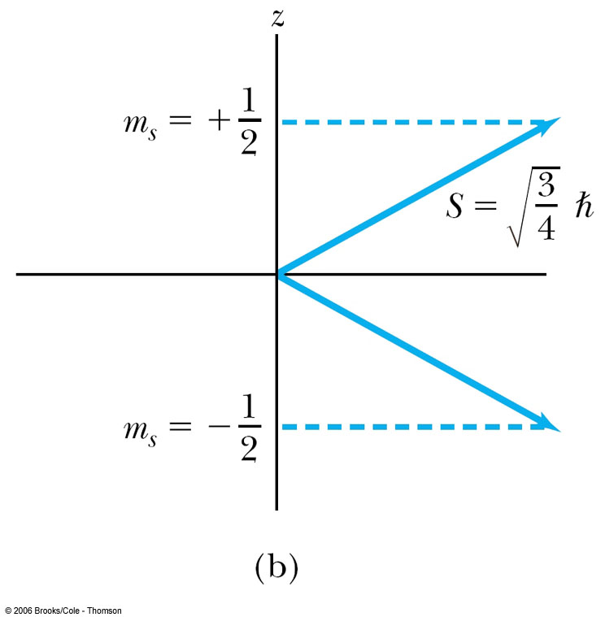
Intrinsic Spin
The spinning electron reacts similarly to the orbiting electron in a magnetic field.
The magnetic spin quantum number m_{s} has only two values, m_{s} = ±½.
And S_{z} = m_{s} ħ.
The electron’s spin is either “up” (m_{s} = +½) or “down” (m_{s} = −½) and can never be spinning with its axis exactly along the z axis.

Slide 35
Writing H atom states in the bra-ket notation
The bra-ket notation provides a convenient short-hand notation for H states. Since n, ℓ, m_{ℓ}, and m_{s} determine the state, we can write a state as a ket:
There’s no need to write the value of s, since it’s always ½ for electrons.
The specific mathematical functions involved are well known, so everyone knows what this means.
And when relevant, we can write the bra form for the complex conjugate, as well:

Slide 36
What about S_{x} and S_{y}?
As with L_{x} and L_{y}, quantum mechanics says that, no matter how hard we try, we can’t also measure them!
If we did, we’d measure ±½ ħ, just as we’d find for S_{z}.
But then this measurement would perturb S_{z}, which would then become unknown!
The total spin is , so it’d be tempting to conclude that every component of the electron’s spin is either “up” (+½ ħ) or “down” (m_{s} = −½ ħ). But this is not the case! Instead, they’re undetermined. We’ll see next that the uncertainty in each unmeasured component is equal to their maximum possible magnitude (½ ħ)!

Slide 37
Generalized Uncertainty Principle
Define the Commutator of two operators, A and B:
If this quantity is zero, we say A and B “commute.”
Then the uncertainty relation between the two corresponding observables will be:
So if A and B commute, the two observables can be measured simultaneously. If not, they can’t.
Example:
So:
and

Slide 38
Uncertainty in angular momentum and spin
We’ve seen that the total and z-components of angular momentum and spin are knowable precisely. And the x and y-components aren’t. Here’s why. It turns out that:
and
Using:
We find:
So there’s an uncertainty relation between the x and y components of orbital angular momentum (unless m = 0). And the same for spin.
Measurement of one perturbs the other.

Slide 39
Two Types of Uncertainty in Quantum Mechanics
1. Some quantities (e.g., energy levels) can, at least in principle, be computed precisely, but some cannot (e.g., L_{x}, L_{y}, S_{x}, S_{y}).
Even if a quantity can, in principle, be computed precisely, the accuracy of its measured value can still be limited by the Uncertainty Principle. For example, energies can only be measured to an accuracy of ħ /Δt, where Δt is how long we spend doing the measurement.
2. And there is another type of uncertainty: we often simply don’t know which state an atom is in.
For example, suppose we have a batch of, say, 100 atoms, which we excite with just one photon. Only one atom is excited, but which one? We might say that each atom has a 1% chance of being in an excited state and a 99% chance of being in the ground state. This is called a superposition state.

Slide 40
Superpositions of states
Excited level, E₂
Stationary states are stationary. But an atom can be in a superposition of two stationary states, and this state moves.
ΔE = hν
Energy
Ground level, E₁
where |a_{i}|² is the probability that the atom is in state i.
Interestingly, this lack of knowledge means that the atom is vibrating:
Vibrations occur at the frequency difference between the two levels.

Slide 41
Combining quantum mechanics with special relativity
In 1926, Oskar Klein and Walter Gordon proposed a wave equation to describe relativistic particles.
They began with the relativistic equation relating energy, momentum, and rest mass:
Use operators to derive a relativistic wave equation just as we did for Schrödinger’s nonrelativistic equation:
Substituting:

Slide 42
The Klein-Gordon equation
In three dimensions:
This equation accurately describes spinless particles, like the neutral pion. Unfortunately, it doesn’t accurately describe effects involving spin.

Slide 43
The Dirac Equation
The Dirac equation was formulated by British physicist Paul Dirac in 1928. It’s based on a slight variation of the relativistic energy equation:
This yields a differential equation that’s 1st-order in time.
yielding:
where:
ψ = ψ(x,t) is a complex four-component wave-function vector,
p_{k} are the momentum operators in the Schrödinger theory, and
α_{k} and β are specialized 4×4 matrices.
The Dirac Equation fully accounts for special relativity and spin in quantum mechanics.

Slide 44
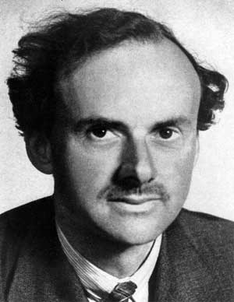
Anti-matter
Dirac’s equation is complicated, but it accurately describes all measurements made on all systems!
Its most interesting feature is that it predicts negative-energy solutions in free space!
This can be interpreted as meaning that the vacuum is filled with an infinite sea of electrons with negative energies.
Exciting an electron from the “sea,” leaves behind a hole with negative energy, that is, the positron, denoted by e⁺.
Paul Dirac (1902-1984)
Electron & positron
Vacuum
Positron!
E
0
Notes:
Photo of Dirac: http://images.google.com/imgres?imgurl=http://epress.anu.edu.au/maverick/html/fig-3-1.jpg&imgrefurl=http://epress.anu.edu.au/maverick/mobile_devices/ch03.html&h=388&w=300&sz=14&hl=en&start=1&um=1&tbnid=1qSjUNOIRbLizM:&tbnh=123&tbnw=95&prev=/images%3Fq%3Dpaul%2Bdirac%26um%3D1%26hl%3Den%26rlz%3D1T4GFRC_enUS212US212
Other is from TRex.

Slide 45
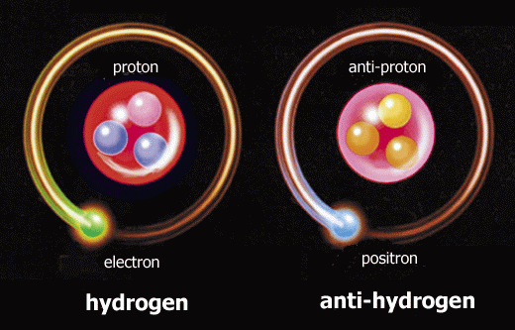
Anti-particles
Dirac’s theory yields anti-particles for all particles, which:
Have the same mass and lifetime as their associated particles.
Have the same magnitude but opposite sign for such physical quantities as electric charge and various quantum numbers.
All particles, even neutral ones, have anti-particles (with some exceptions like the neutral pion, whose anti-particle is itself).
Notes:
http://www.zmescience.com/research/antimatter-captured-cern-lhc-18112010/

