Slide 1
INFS 472 Overview Concepts

Slide 2
Why Study Information Systems?
Managers CANNOT totally rely on Information Systems (IS) experts
½ of IS concept is “information”
Managers decide what is “information”
IS experts focus on “systems” and have reputed inabilities to make information decisions (www.standishgroup.com studies)
Must meet ½ Way:
Managers bring information to systems
IS experts bring systems to information

Slide 3
Why Managers Need to Participate:
IT spending accounts for more than 50% of the capital-goods dollars in the US.
US companies spend $7,500 per employee on IT and use is growing exponentially.
As managers decide which activities receive funding, it is essential that they have a basic grounding in managing and using IS.

Slide 4
Information Systems …
must be managed as a critical resource enable/require changes in the way people work together integrate with almost every aspect of business enable business opportunities and new strategies can be used to combat business challenges from competitors

Slide 5
Information Systems …
are now integrated into almost every aspect of business.
place information in the hands of associates so that decisions can be made closer to the customer.
helps simplify processes such as moving goods, stocking shelves and communicating with suppliers.

Slide 6
Potential of Ignorance of IS
What if a Manager Doesn’t Participate?
Profits = Revenue – Expenses.
Decisions about IS have a direct impact on business profits.
Enhance product (effectiveness) ➔ increase revenue
Reduce costs of producing the product (efficiency)
Not considering IT business & organizational strategy leads to one of three consequences:
IS that fail to support business goals
IS the fail to support organizational systems
A misalignment between bus. and org. strategies

Slide 7
BASIC ASSUMPTIONS
Managers must be knowledgeable participants in IS decisions
The roles of the GM and the IS manager are distinct
Information Systems should not be the “tail” wagging the business activity “dog”

Slide 8
BASIC ASSUMPT’NS 2
Functions, Activities, and Processes are not equal concepts
Functional viewpoint (classic HR, Ops, Acct’g, Finance, Marketing/Sales, …)
Activities (“what” must be done to produce something of value)
Processes (“how” something of value is produced)
The reason organizations exist is to create economic value to stakeholders:
Customers
Employees
Stockholders
Communities/Society

Slide 9
Relationship of MIS to Organizational Structure?
Greater
Importance
of External
Information
Longer
Time
Horizon
Less
Structured
Problems
More
Summarized
Information
EIS
Strategic
Mgmnt
Human Resources
DSS
Tactical
Mgmnt
Production
MRS
Finance
Marketing
Business
Functions
Operations
Mgmnt

Slide 10
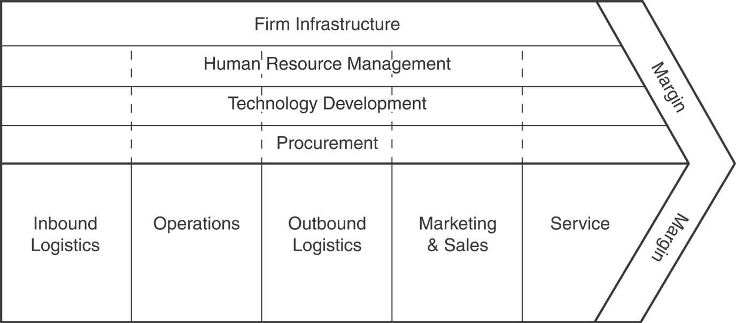
Porter’s Value Chain

Slide 11
DSS Perspective
Feedback
Loop
Information
Subsystem
External
Data
Information
Management
Subsystem
Internal
Data
Corrective
Inputs
Operations
Subsystem
Inputs
Outputs
Value Chain
Organization
Environment

Slide 12
Data, Information and Knowledge
 | Data | Information | Knowledge
Definition | Simple Observations of the sate of the world | Data endowed with relevance and purpose | Info from the human mind (includes reflection, etc)
Characteristic | Easily structured “ captured “ transferred Often quantified Mere facts | Requires unit of analysis Data that has been processed Human mediation necessary | Hard to structure Difficult to capture on machines Often tacit Hard to transfer
Example | Daily inventory reports of all inventory items sent to CEO of large manufacturing company | Daily inventory report of items below economic order quality levels sent to inventory manager (IM) | IM knows which items need to be reordered in light of related potential problems

Slide 13
Information Characteristics across Hierarchical Levels
 | Top Management | Middle Management | Supervisory & Lower-Level Management
Time Horizon | Long: years | Medium: weeks, months, years | Short: day to day
Level of Detail | Highly aggregated Less accurate More predicted | Summarized Integrated Often financial | Very detailed Very accurate Often nonfinancial
Orientation | Primarily external | Primarily internal with limited external | Internal
Decision | Extremely judgmental Uses creativity and analytic skills | Relatively judgmental | Heavy reliance on rules

Slide 14
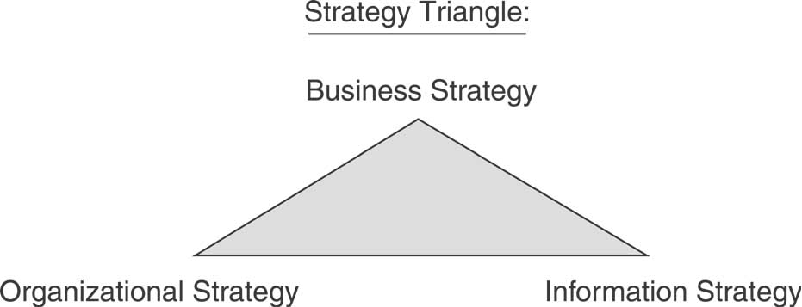
BUSINESS STRATEGY FRAMEWORKS

Slide 15
A Business Strategy is:
A well-articulated vision of where the business (enterprise) seeks to go and how it expects to get there
It is the form by which a business communicates its goals
The following are examples of well-accepted models of business strategy

Slide 16
Business Strategy Frameworks
Frameworks provide a template for analysis with competitive advantage as the assumed goal
Two Examples:
Porter’s Generic Strategies Framework (and its variants)
Hypercompetition and the New 7-S’s framework (D’Aveni)

Slide 17
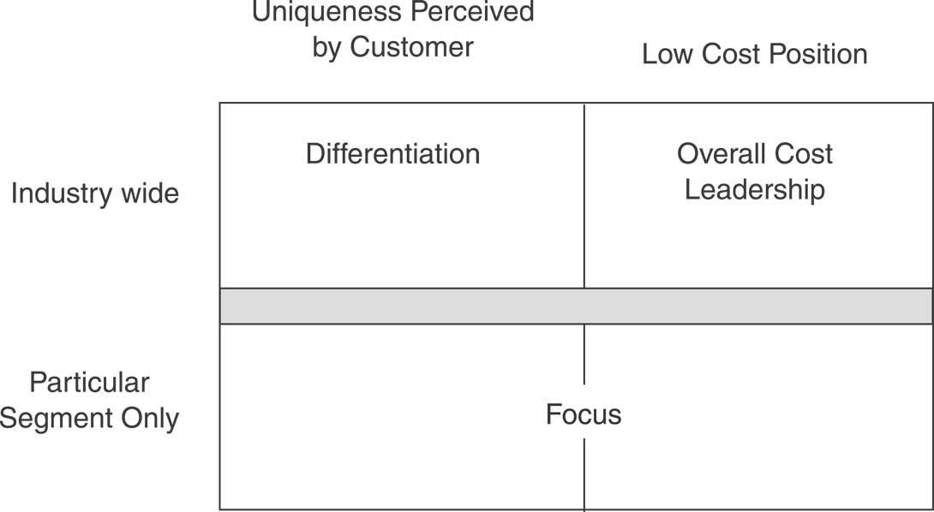
Porter’s Competitive Strategy
Figure 1.2 3 Strategies for Achieving C.A

Slide 18
Porter’s Competitive Strategies
Cost leadership: be the cheapest
Differentiation: focus on making your product stand out for non-cost reasons
Focus: occupy narrow market niche where the products/services can stand out by virtue of their cost leadership or differentiation.

Slide 19
Hypercompetition (D’Aveni)
Sustained competitive advantage is not possible
Only temporary advantages exist, created by a company’s speed and aggressiveness.
This assumes:
Every advantage becomes eroded
Sustaining an advantage uses too much time and resources
Instead, companies must seek to stay ahead of its competitors by creating temporary advantages
These are done in small steps over short competitive cycles. Focus on creating the next temp. advantage before current benefits erode

Slide 20
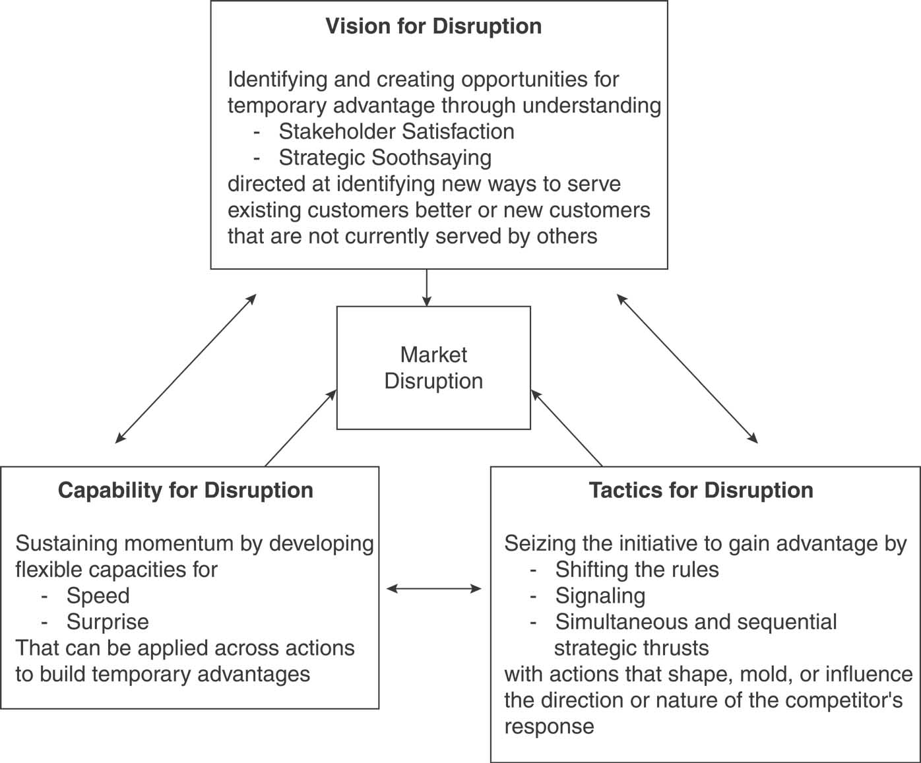
Hypercompetition (D’Aveni)

Slide 21
7-S’s
Superior stakeholder satisfaction: maximize cust. satisfaction by adding value strategically
Strategic soothsaying: use new knowledge to predict new windows of opportunity
Positioning for speed: prepare the org. to react as fast as possible
Positioning for surprise: surprise competitors
Shifting the rules of competition: serve customers in novel ways
Signaling strategic intent: communicate intensions in order to stall competitors
Simultaneous and sequential strategic thrusts: take steps to stun and confuse competitors in order to disrupt or block their efforts

Slide 22
Example:
Hypercompetition (D’Aveni)
At General Electric, Jack Welch, implemented a DYB (“Destroy Your Business”) approach by placing employees in the shoes of competitors to highlight weaknesses and find fresh ways of meeting customer needs.
Similarly GE’s Medical Systems Division used DYB to respond to the challenges posed by the Internet.

Slide 23
ORGANIZATIONAL STRATEGY Managerial Imperative

Slide 24
Organizational Strategy
What is the culture of the organization?
Effectiveness- or efficiency-driven?
How much aversion to risk?
Can you identify and rank-order a list of values?
What are the important structures and reporting relationships within the organization?
Hierarchical? Matrix? Network?
Geographic? Divisional? Functional?
What are the characteristics, experiences and skill levels of the people within the organization?
What are the valuable business activities?
What are the business processes supporting those activities?
What control systems are in place? (Management Capability Maturity Model)

Slide 25
IS STRATEGY Technological Imperative

Slide 26
IS Strategy – SDLC
How best to fit technology to the business activity task?
What technologies are appropriate?
What is the current information infrastructure?
Define the IS Project: What are the steps in the systems development life cycle?
What control systems are in place? (SEI Capability Maturity Model)

Slide 27
Business Change Logic
Organizational Vision/Mission/Goals/Objectives
As Is
Business Strategy
To Be
Activities
Activities
Business
Organizational Strategy
Systems analysis
IS
Programs,
Data Models
Programs,
Data Models
IS Strategy

Slide 28
Fill in the 9 labels
Organizational Vision/Mission/Goals/Objectives
1.
2.
3.
6.
6.
4.
7.
Systems analysis
5.
8.
8.
9.

Slide 29
Course Overview
Management Support Systems
Business
Strategy
Organizational
Strategy (Work
Processes)
Management
Support
Systems
Support
Decision
Support
Systems
Business
Strategy
Decision
Making
Special DSS
KM,
CRM
& SCM
DSS Enhancements
Systems Analysis & Design
Integrative DSS
Business Intelligence

