Slide 1
HTML & CSS (Super Quick Overview)
INFO 257 Supplement

Slide 2
Outline
HTML Markup
CSS Styling
Website Folder Structures

Slide 3
Before we start…
Big Picture
HTML
CSS
JavaScript
(Client Side)
Interaction
Styling
Structure

Slide 4
HT MARKUP L
We markup a document by tagging certain “pieces” of it in order to build a logical, hierarchical structure.
My Title
My First Paragraph
My Second Paragraph
-first item of list
-second item of list
<h1>My Title</h1>
<p>My First Paragraph</p>
<p>My Second Paragraph</p>
<ul>
<li>first item of list</li>
<li>second item of list</li>
</ul>

Slide 5
Tag Anatomy
Open/Close Tags <h1>My Title</h1>
Self Contained Tags <img src=“mypic.jpeg” />
Some Popular Tags:
h1, h2, p, a, img, ul, ol, li Content
div, span Positioning/Grouping
table, tr, td, th Tables
form, input, select Forms

Slide 6
Attributes
<img src=“mypic.jpeg” alt=“My Picture” />
<p class=“firstParagraph”>My Paragraph</p>
Important attributes
id = “ “ | Each element can have an id attribute. The value of each id attribute must be unique in each html document (people tend to break this rule though, which is not good practice)
class=“ “ | Each element can have a class attribute. Multiple elements can be part of the same class. This is a good way of identifying a group of elements. An element can have multiple classes CORRECT: <p class=“group1 group2 group3”></p> INCORRECT: <p class=“group1” class=“group2” class=“group3”></p>

Slide 7
Why Attributes?
Some are necessary
<img src=“mypic.jpeg” alt=“My Picture” />
<a href=“http://www.google.com”>Google</a>
Some are optional but helpful when we need some way of identifying specific elements for styling (CSS) or interaction (JavaScript)
<p class=“firstParagraph”>My First Paragraph</p>
TIP – You can create your own attributes! This is not strictly standards compliant but it works!
Why do this? You can identify elements using attributes other than “id” or “class” in both CSS and JavasScript.
<p myattribute=“whatever”></p>

Slide 8
DOM
What do we mean by Hierarchical Structure?
When we markup our document, we are really identifying & constructing elements that build a “document tree,” which we refer to as the Document Object Model (DOM)
html
head
body
h1
p
p
ul
li
li

Slide 9
Basic HTML
<!DOCTYPE html PUBLIC "-//W3C//DTD XHTML 1.0 Transitional//EN" "http://www.w3.org/TR/xhtml1/DTD/xhtml1-transitional.dtd">
<html xmlns="http://www.w3.org/1999/xhtml">
<head>
<title>My Website Title</title>
</head>
<body>
<h1>Header</h1>
<p>Hello World</p>
</body>
</html>
DEMO

Slide 10
Important HTML Elements (at least for this class)
form
table
Submitting Data to Server
Displaying Tabular Data
First Name
First Name | Last Name | Is Cool?
Arian | Shams | Yes
Someone | Else | No
Birth Date
Is Cool?
Gender
Male
Female
Favorite Movie
--Select One--

Slide 11
table
<table>
<tr>
<th>First Name</th>
<th>Last name</th>
</tr>
<tr>
<td>Arian</td>
<td>Shams</td>
</tr>
<tr>
<td>Someone</td>
<td>Else</td>
</tr>
</table>
First Name | Last Name
Arian | Shams
Someone | Else
FYI: You can put tables within tables, but that can get very messy very quickly.

Slide 12
form
<form method=“post” action=“form-process.php”>
<input type=“text” name=“firstName” />
<input type=“checkbox” value=“true” name=“isCool” />
<input type=“radio” name=“gender” value=“male” />
<input type=“radio” name=“gender” value=“female” />
<select name=“movie”>
<option value=“”>-Select-</option>
<option value=“1”>mov1</option>
<option value=“2”>mov2</option>
</select>
<input type=“submit” value=“Save” />
</form>
Male
Female
-Select-
Save

Slide 13
CSS
Style
Header
My First Paragraph
My Second Paragraph
Header
My First Paragraph
My Second Paragraph
img
img
Crap
Beautiful-er

Slide 14
CSS Overview
CSS is based on styling rules
We apply these styling rules to elements in the DOM
In order to apply the styling rules, we have to select the element(s) to apply the rules to
css selector
{
property : value;
property : value;
…
}
.firstParagraph
{
color: red;
font-weight: bold;
}
Example

Slide 15
CSS Selectors
Select by element type | p
Select by class | .firstParagraph
Select by id | #someID
Select by attribute | input[type=“text”] h1[myCustomAttr=“myValue”]
Multi selection | h1, h2, h3
Descendent selection | p ul li #someID p #someID .firstParagraph img
:Pseudo selection | a:hover OR #someID:hover input:focus a:visited
Direct child selection | #someID > p

Slide 16
Cascading & Precedence
What if we have an element
<p class=“firstParagraph”>Blah</p>
And we have the following CSS rules
p{color:blue; font-size: 12px;}
.firstParagraph{color:red;}

Slide 17
Popular CSS Properties
Property | Example Values
font-family | Arial, “Century Gothic”;
font-size | 12px; 2em; 200%
border | 1px solid #CCC;
height | 100px;
width | 100px;
max-height | 100px;
color | blue; #A3A3A3; #CCC; rgb(255,255,255);
position | absolute; relative; fixed;
float | left; right; none;
clear | left; right; both; none;
display | inline; block; none;
overflow | visible; hidden; scroll; auto;
padding | 10px; 5px 3px; 1px 2px 3px 4px;
margin | Same as padding
background-image | url(/pics/backgroundpic.jpeg)
background-color | blue; #C3C3D2; rgb(144,231,89)
background-repeat | repeat; no-repeat; repeat-x; repeat-y;
visibility | hidden; visible;
z-index | 100;

Slide 18
Applying CSS
3 Ways
Link to it within your html (head)
<link rel="stylesheet" href=“path to your css” />
Write CSS within your html via the “style element”
<style type="text/css">css rules</style>
Add “style” attribute to individual elements
<p style=“css rules”>Blah</p>

Slide 19
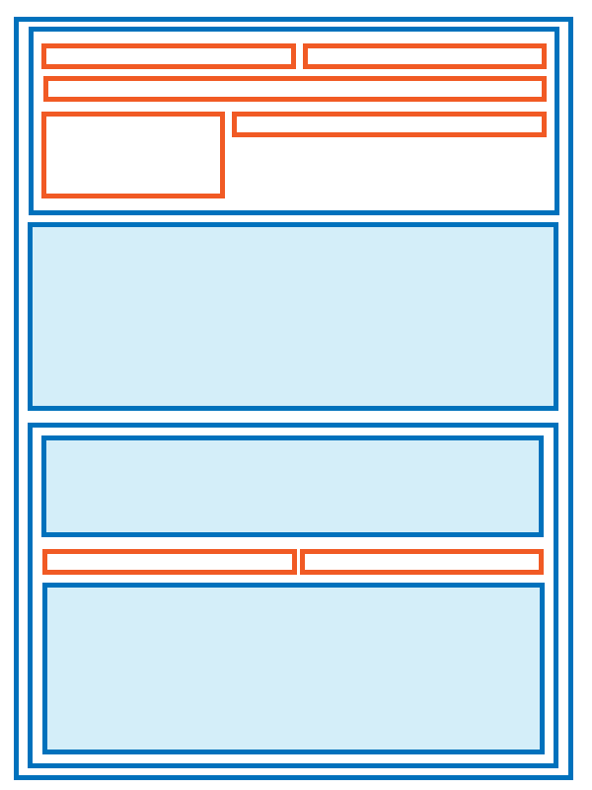
Document Flow
Each element is either inline or block
Inline elements are rendered horizontally on the page, one right after another (like a chain). There is no “new line” break between inline elements.
Inline Elements: a, img, strong, em, “text”, span, …
Block elements are rendered vertically on the page, on a new line (like blocks).
Block Elements: div, form, table, h1, p, ol, ul
FYI: you change the default “display” option of an element via css (i.e. display: block)

Slide 20
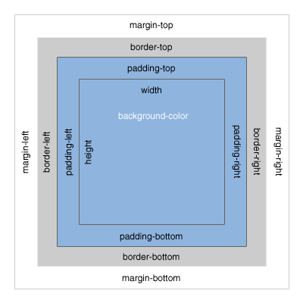
CSS Box Model
http://www.mandalatv.net/itp/drivebys/css/

Slide 21
Positioning
Positioning is (best) done by CSS
Relative
Shift element relative to where it would be in normal Document Flow. Note, normal document flow is not disturbed via the shift.
Absolute
Absolutely position an element by specifying the exact pixel coordinates on the screen relative to a “relative” parent element. Note, positioning an element absolutely takes it out of document flow.
Fixed
Absolutely position an element on the screen relative to the browser window. The element will not change its location, even if you scroll. Note, positioning an element via Fixed takes it out of document flow.
Float
Float elements to the left or right of the normal document flow. Better to show this through example…

Slide 22
Positioning (Strategy)
Strategy → Wrap the elements that you want to position (like the menu bar or main content) and then position that wrapper. You can wrap a group of elements with the <div> tag.
960px rule
margin: 0 auto;

Slide 23
Chrome Tool
DEMO
In Chrome, right click > Inspect element
OR
CTRL (or CMD) + SHIFT + I

Slide 24
Website Folder Structure Traditional Structure
Root
index.html
assets
about
courses
css
js
index.html
history.html
I257
I202
I205
index.html
syllabi.html
main.css
jquery.js
images

Slide 25
Absolute & Relative Paths
Absolute Paths
Start at the root and navigate to the page you want
Absolute paths start with “/”
Relative Paths
Start at whatever page you are currently on (the context page) and navigate to the page you want
Go Back 1 directory = “../”
Demo
You can use either absolute or relative paths. I suggest using absolute paths since they are easier to understand and you don’t have to worry about weird things that might happen if you try to link to things like images via your css which you link to from your html document.
Paths are used quite a bit… <img src=“…”>, <a href=“…”>, linking to css, linking to js, linking from css such as background-image, etc

Slide 26
Questions?

