Slide 1
A little MORE on JavaScript
EVERYTHING you need to know is here:http://www.w3schools.com/js/js_examples.asp

Slide 2
alert function!
<html>
<head>
<title>Alerts Example</title>
</head>
<body>
<script type="text/javascript">
alert('First alert.');
alert('Second alert.');
</script>
</body>
</html>

Slide 3
variables
<html>
<head>
<title>Arithmetic Example</title>
</head>
<body id="the_body">
<script type="text/javascript">
var x = 5;
var y = 7;
var z = x + y;
document.write(z);
</script>
</body>
</html>

Slide 4
DOM
Document Object Model (DOM for short) is a reference for all the objects used to represent a web page
is exposed to Javascript by way of the "document" object
If you check the DOM, you'll see that the document object contains a property named 'URL' which gives the URL of the page
getElementById() method, returns the object which represents the element with the given id

Slide 5
DOM stuff
Do you think you could
GRAB an image from a web page
SWAP it out with another image
??

Slide 6
“woah ya”… example
<html>
<head>
<title>Javascript DOM Image Example</title>
</head>
<body>
<img src="neutral_face.png" id=”stoic" />
<script type="text/javascript">
alert('Click when ready');
var x = document.getElementById(’stoic');
x.src = 'smiley_face.png';
</script>
</body>
</html>

Slide 7
What is that code doing?
The variable x is actually unnecessary.
document.getElementById() actually returns an object which we could use the . operator on directly.
"document.getElementById(’stoic').src" would have worked
This sort of . chaining is very common in Javascript.
If you move the Javascript above the <img> tag, it will NOT WORK!!!
the script is executed before the browser knows that the tag even exists!

Slide 8
NICE---”onclick”!!!
Most tags support an "onclick" attribute.
The value of this attribute is a snippet of Javascript that is to be run whenever the element is clicked on.
The Javascript within this attribute has access to the special "this" keyword which refers to the containing element.

Slide 9
example
<html>
<head>
<title>Javascript DOM Image Example</title>
</head>
<body>
<img src="neutral_face.png"
onclick="this.src = 'smiley_face.png';" />
</body>
</html>

Slide 10
http://www.w3schools.com/js/default.asp
<!DOCTYPE html>
<html>
<head>
<script>
function displayDate() {
document.getElementById("demo").innerHTML=Date();
}
</script>
</head>
<body>
<h1>My First JavaScript</h1>
<p id="demo">This is a paragraph.</p>
<button type="button" onclick="displayDate()">Display Date</button>
</body>
</html>

Slide 11
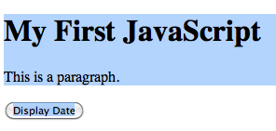
Example output (at first!)

Slide 12
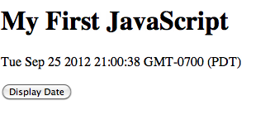
After click…

Slide 13
killer vars!
<!DOCTYPE html>
<html>
<body>
<p id="demo"></p>
<script>
var r=Math.random();
var x=document.getElementById("demo")
if (r>0.5) {
x.innerHTML="<a href='http://w3schools.com'>Visit W3Schools</a>";
} else {
x.innerHTML="<a href='http://wwf.org'>Visit WWF</a>";
}
</script>
</body>
</html>

Slide 14
functions!
<!DOCTYPE html>
<html>
<body>
<p>This example calls a function which perfoms a calculation, and returns the result:</p>
<p id="demo"></p>
<script>
function myFunction(a,b) {
return a*b;
}
document.getElementById("demo").innerHTML=myFunction(4,3);
</script>
</body>
</html>

Slide 15
example output

Slide 16
looping??!
<!DOCTYPE html>
<html>
<body>
<p>Click the button to loop through a block of code five times.</p>
<button onclick="myFunction()">Try it</button>
<p id="demo"></p>
<script>
function myFunction() {
var x="",i;
for (i=0;i<5;i++) {
x=x + "The number is " + i + "<br />";
}
document.getElementById("demo").innerHTML=x;
}
</script>
</body>
</html>

Slide 17
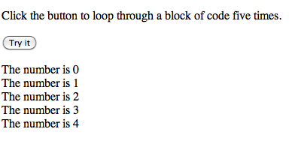
example output

Slide 18
Writing to a form?!?
http://www.google.com
try this at the console:
document.forms[0]['q'].value='stackoverflow’;
document.forms[0].submit()

