Slide 1
Google App Engine
An Example!

Slide 2
Schedule
Today: AppEngine and Python
Wednesday: Review and CES!
Friday Quiz!!!
Next week:
DEMO MADNESS!!!
Approx 20 people per class…
2minutes each!
Laptop will be available for URL!

Slide 3
Course Admin notes!
ONE more lab next week!
Check your grades on Connex!
No final exam
But final project is due Friday Nov 30!

Slide 4
Google App Engine
no charge, no commitment
run an application on a server…
Python, Java, Go tutorials online
build an App Engine application using Python
use the "webapp2" web application framework
use the App Engine datastore
Integrate with Google Accounts for user authentication
use Jinja2 templates with your app
(upload your app to App Engine)

Slide 5
The Development Environment
download an SDK
start editing files!
EXAMPLE
https://developers.google.com/appengine/docs/python/gettingstartedpython27/
Python script responds to a request on the server!
Creates an HTTP header that describes the content and the message Hello, world!.

Slide 6
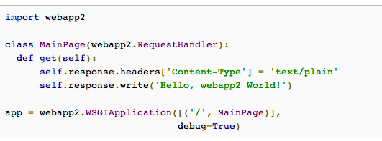
Sample!

Slide 7
Configuration File…
app.yaml
"Yet Another Markup Language",
"YAML Ain't Markup Language"
among other things, this file describes which handler scripts should be used for which URLs.

Slide 8
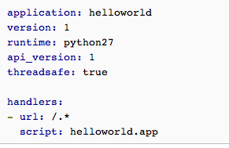
app.yaml

Slide 9
Say WHAT?!
application identifier is helloworld
version number 1. App Engine will retain previous versions, and let you roll back to a previous version using the administrative console
runs in the python27 runtime environment
threadsafe so the same instance can handle several simultaneous requests.
requests to a URL whose path matches the regular expression /.* (all URLs) should be handled by the app object in the helloworld module.

Slide 10
Show time!
a handler script and configuration file mapping every URL to the handler, the application is complete!
you can now test it with the web server included with the App Engine SDK.
Google App Engine Launcher,
you can set up the application by selecting the File menu, Add Existing Application..., then selecting the helloworld directory
select the application in the app list, click the Run button to start the application, then click the Browse button to view it.
clicking Browse simply loads (or reloads) http://localhost:8080/ in your default web browser.

Slide 11
The Launcher…

Slide 12
webapp2
App Engine includes a simple web application framework, called webapp2
A webapp2 application has two parts:
one or more RequestHandler classes that process requests and build responses
a WSGIApplication instance that routes incoming requests to handlers based on the URL

Slide 13
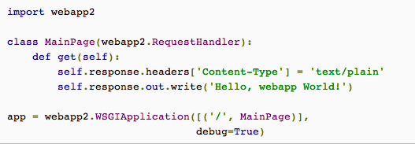
In the code again…

Slide 14
what does it all mean?
one request handler, MainPage, mapped to the root URL (/)
webapp2 receives an HTTP GET request to the URL /, it instantiates the MainPage class and calls the get method.
information about the request is available using self.request. Typically, the method sets properties on self.response to prepare the response, then exits. webapp2 sends a response based on the final state of the MainPage instance.

Slide 15
The Users API
user = users.get_current_user()
returns the User object for the user. Otherwise, it returns None.
if user:
self.response.headers['Content-Type'] = 'text/plain'
self.response.out.write('Hello, ' + user.nickname())
If the user has signed in, display a personalized message, using the nickname associated with the user's account
else:
self.redirect(users.create_login_url(self.request.uri))
If the user has not signed in, tell webapp2 to redirect the user's browser to the Google account sign-in screen.

Slide 16
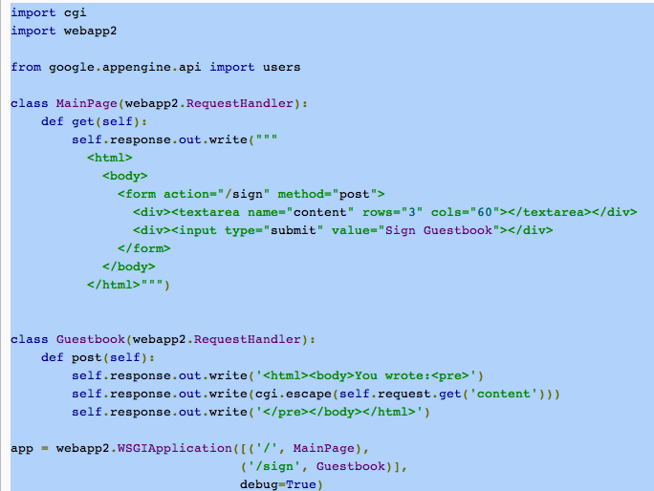
Handling Web Forms with webapp2

Slide 17
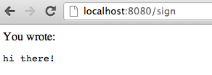
Holy cow!

Slide 18
How?
This version has two handlers:
MainPage, mapped to the URL /, displays a web form.
Guestbook, mapped to the URL /sign, displays the data submitted by the web form.
The Guestbook handler has a post() method instead of a get() method. This is because the form displayed by MainPage uses the HTTP POST method (method="post") to submit the form data
gets the form data from self.request
it uses cgi.escape() to escape HTML special characters to their character entity equivalents. cgi is a module in the standard Python library

Slide 19
Restricted version of Python
Note: The App Engine environment includes the entire Python 2.7 standard library.
not all actions are allowed
App Engine applications run in a restricted environment that allows App Engine to scale them safely.
For example, low-level calls to the operating system, networking operations, and some filesystem operations are not allowed.

Slide 20
Using the Datastore
Storing data in a scalable web application can be tricky!
A user could be interacting with any of dozens of web servers at a given time, and the user's next request could go to a different web server than the previous request.
All web servers need to be interacting with data that is also spread out across dozens of machines, possibly in different locations around the world!
App Engine's infrastructure takes care of all of the distribution, replication, and load balancing of data behind a simple API—and you get a powerful query engine and transactions as well.

Slide 21
Have you HRD?
App Engine's data repository, the High Replication Datastore (HRD), uses the Paxos algorithm to replicate data across multiple data centers.
Data is written to the Datastore in objects known as entities.
each entity has a key that uniquely identifies it. An entity can optionally designate another entity as its parent; the first entity is a child of the parent entity. The entities in the Datastore thus form a hierarchically structured space similar to the directory structure of a file system. An entity's parent, parent's parent, and so on recursively, are its ancestors; its children, children's children, and so on, are its descendants. An entity without a parent is a root entity.

Slide 22
consistency…
the Datastore is extremely resilient in the face of catastrophic failure, but its consistency guarantees may differ from what you're familiar with.
entities descended from a common ancestor are said to belong to the same entity group
queries over multiple entity groups may return stale, eventually consistent results, those limited to a single entity group always return up-to-date, strongly consistent results.
see Structuring Data for Strong Consistency.

Slide 23
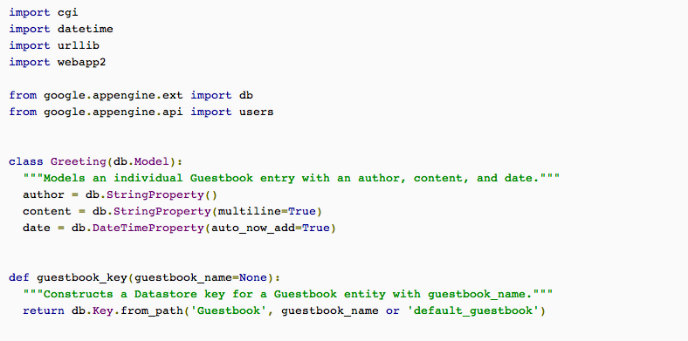
DS example (1)

Slide 24
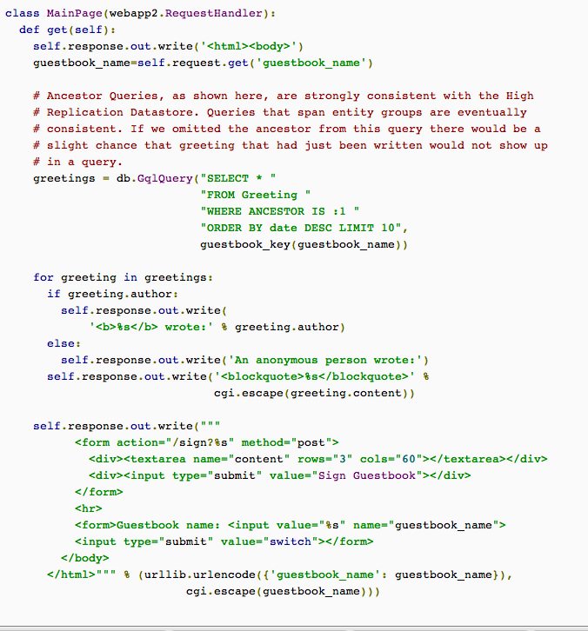

Slide 25
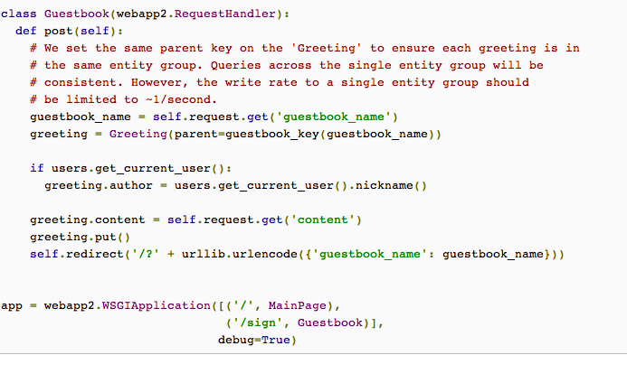

Slide 26
Storing greetings
For the guestbook application, we want to store greetings posted by users
Each greeting includes the author's name, the message content, and the date and time the message was posted so we can display messages in chronological order.
greeting.put()

Slide 27
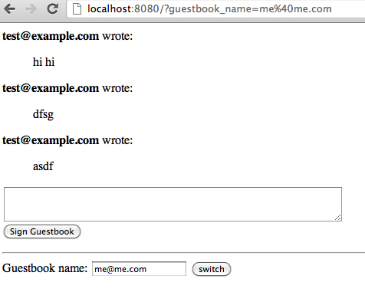
Note the URL

Slide 28
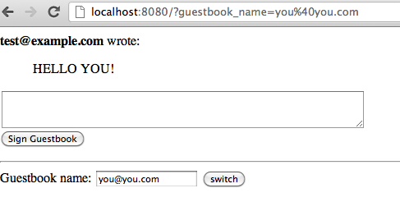
you%40you.com (hex ASCII!)

Slide 29
For the guestbook application, we want to store greetings posted by users. Each greeting includes the author's name, the message content, and the date and time the message was posted so we can display messages in chronological order
from google.appengine.ext import db
The following defines a data model for a greeting:
class Greeting(db.Model):
author = db.StringProperty()
content = db.StringProperty(multiline=True)
date = db.DateTimeProperty(auto_now_add=True)

Slide 30
Getting the greetings…

