Slide 1
Common Value Auctions

Slide 2
Coin auction
What’s for sale: the coins in this jar.
Second price sealed bid auction.
Write down your bid.

Slide 3
Coin auction
What’s for sale: the coins in this jar.
Second price sealed bid auction.
What if one person gets to count the coins.
Does this change your bid? Why?

Slide 4
The winner’s curse
Winning the jar means that everyone else in the class was more pessimistic about its contents.
Winning is “bad news”
If you had an initial estimate of $10, seeing everyone else drop out first (especially the person with good information!) should cause you to revise your estimate downward.
Equilibrium bidding should account for this.

Slide 5
Common Value Auctions
Today we will look at “common value” auction settings, where bidders have differential information about the value of the item being sold.
Three main issues
Strategic bidding and the winner’s curse
Information aggregation and “price discovery”
Selling strategies and information disclosure

Slide 6
Imperfect Estimate Model
Two bidders with common value v.
v is drawn at random from a known distribution.
Bidder 1 receives a “signal” s₁ (correlated with v)
Bidder 2 receives a signal s₂
Signals provide information about v, but not perfect.
Second price sealed bid, or ascending auction
How should bidders account for the winner’s curse?

Slide 7
Equilibrium bidding
Let p(s) = E[v|s_{i}=s and s_{j}=s] = E[v|s,s] (increasing in s)
Claim: In the equilibrium of the ascending auction, bidder i should drop out at the price p(s_{i})=E[v|s_{i},s_{i}].
Explanation:
If both bidders follow strategy, then if j drops out first, i is happy.
Why? This means that s_{j} < s_{i}, and auction price is p(s_{j})=E[v|s_{j},s_{j}].
So i expects a profit because E[v|s_{i},s_{j}] > E[v|s_{j},s_{j}] = p(s_{j}).
But if i was to stay in too long and win at p>p(s_{i}), she’d be unhappy.
Why? This means that s_{j} > s_{i}, and auction price is p(s_{j})=E[v|s_{j},s_{j}].
So i expects a loss because E[v|s_{i},s_{j}] < E[v|s_{j},s_{j}] = p(s_{j}).

Slide 8
Second price / Ascending Auction
Strategy: bid p(s_{i}) =E[v|s_{i},s_{i}]
0
p(s_{i})
1
If opponent drops out here, win and pay p(s_{j}).
p(s_{j})=E[v|s_{j},s_{j}] for s_{j}<s_{i}.
As E[v|s_{i},s_{j}]>E[v|s_{j},s_{j}], expected value is greater than payment, so make a profit from winning.
If opponent drops out here, win and pay p(s_{j}).
p(s_{j})=E[v|s_{j},s_{j}] for s_{j}>s_{i}.
As E[v|s_{i},s_{j}]<E[v|s_{j},s_{j}], expected value is less than payment, so would make a loss from winning.

Slide 9
Derivation of equilibrium
Consider candidate equilibrium in which a bidder with signal s_{i} plans to drop out at b(s_{i}), where b is increasing in s_{i}. So bidders stay in longer with higher estimates.
If i wins at price p, then j had a signal s_{j} such that p=b(s_{j}), or s_{j}=b⁻¹(p). So i’s expected profit is E[v|s_{i},s_{j}=b⁻¹(p)]-p.
If it is optimal for i to drop out at b(s_{i}), then i must want to win at any lower price and not win at any higher price, so at p= b(s_{i}), we must have E[v|s_{i},s_{j}=b⁻¹(p)]=p.
Substituting for p, we get b(s_{i})=E[v|s_{i},s_{j}=s_{i}].

Slide 10
Winner’s or Loser’s Curse?
How does accounting for the information of other’s affect your estimate of the item value?
Case 1: 10 bidders, 1 item.
Winning means other signals were all lower.
Case 2: 10 bidders, 9 items.
Losing means other signals were all higher.

Slide 11
Not just uncertainty
The logic of common values comes from the fact that other bidders may have information that is relevant for your value, not just from the value being uncertain.
Suppose we’re bidding for the jar of coins…
I know there are exactly 650 pennies.
But I think there’s a fifty percent chance I’ll lose the jar.
My value of winning is less than 650 ($3.25 if risk-neutral).
But I don’t care about the other bidders’ estimates (except insofar as bidders with high estimates drive up the auction price).

Slide 12
Revenue equivalence?
If bidders have “correlated” estimates of a common value item, an open auction leads to higher revenue than sealed bid auction. (Paul Milgrom and Robert Weber)
Idea
In either case, the high estimate bidder will win.
In a first price sealed bid auction, the payment will be a function of the winner’s estimate, but given the winner’s estimate, it won’t depend on the estimate of the second highest bidder.
In an ascending auction, the payment will depend on the second highest estimate, which is correlated with the winner’s estimate.
This “linkage” reduces the winner’s profit and increases revenue!

Slide 13
Providing Information to Bidders
Deciding how much information to provide to bidders – e.g. what information to disclose if you are selling a house, or a company – can be a tricky issue.
Milgrom-Weber “linkage principle” – under certain conditions seller should provide information to alleviate the winner’s curse and connect the price more closely to the true value.
In other cases, giving bidders the opportunity to become informed can create informational asymmetries – seller does better to keep bidders in the dark.

Slide 14
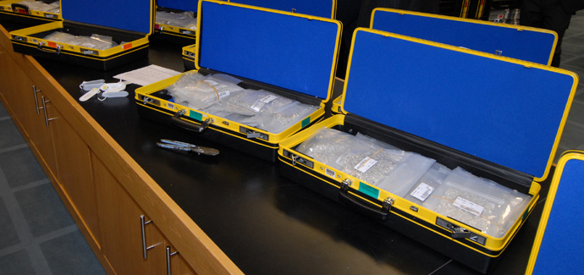
De Beers Diamond Example
De Beers sells a large fraction of the world’s uncut diamonds: at one point, 85%.
It sells these diamonds at regularly scheduled “sights”.
Each buyer is given a box of diamonds and a price. He or she must decide whether to buy the whole box at that price.
What is the rationale for having so little inspection and pricing of individual items?
De Beers “sight” boxes

Slide 15
Information aggregation
How many miles is it to drive from New York to Chicago?
Answer

Slide 16
Information aggregation
Suppose we have many bidders, and each has an independent estimate s_{i} = v+e_{i.}
Median of the bidder’s estimates s_{i} is likely to be a very good estimate of v. Why?
Median(s_{i}) = Median(v+e_{i}) = v+Median(e_{i}) ≈ v.
“The wisdom of crowds”; Galton example.

Slide 17
Information aggregation
Suppose we have many bidders, and each has an independent estimate s_{i} = v+e_{i.}
If many bidders compete in an auction, is the resulting price a good estimate of v?
Potentially YES!, auction price can aggregate information.
First shown by Stanford profs. Wilson, Milgrom.
Let’s go through a somewhat loose sketch of the argument.

Slide 18
Why Information Aggregation?
Assume N bidders, K=N/2 items, top K bids win and pay K+1st bid.
Equilibrium bidding: bid so that if you “just” win, you’ll “just” want to win (else should raise/lower bid).
b(s_{i}) = E[v|s_{i} is tied for Kth highest of N]
≈ E[v | s_{i} is median signal] (assume N large)
= E[v | v+median(e)= s_{i}]
= s_{i}
Price will be b(s_{K+1})=s_{K+1}, where s_{K+1} is K+1st highest signal.
So the auction price will be approximately the median signal!

Slide 19
Information Aggregation
If value if v, signals will be distributed around v – and if there are enough bidders, the true value will be close to the median signal.
vL
vH

Slide 20
Common values in practice
Many auctions have some “common value” aspect
Treasury bill auctions – everyone may have a guess about the trading price after the auction, but no one knows for sure. Same for IPOs and new debt issuance.
Timber auctions: what kind of timber is actually out there on the tract that’s being sold.
Oil lease auctions: oil is under the Gulf of Mexico, bidders do independent seismic studies – each has valuable information.

Slide 21
OCS Auctions
The US government auctions the right to drill for oil on the outer continental shelf.
Value of oil is similar to the different bidders, but no one knows how much oil there is, or if there’s none.
Prior to the auction, the bidders do seismic studies.
Two kinds of sale
“Wildcat sale” - new territory being sold
“Drainage sale” - territory adjacent to existing tract.
These are like the “wallet auctions” we ran in class!

Slide 22
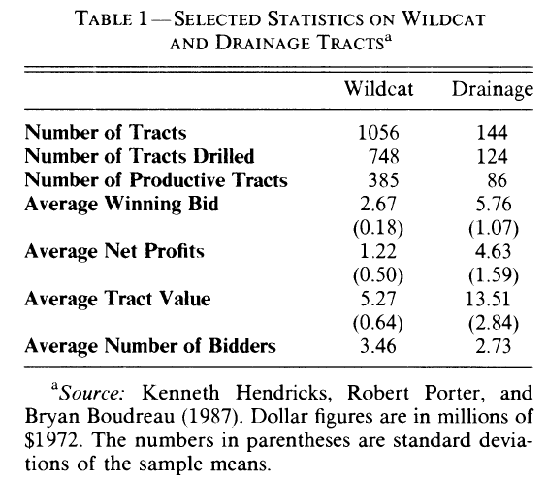
Wildcat vs Drainage

Slide 23
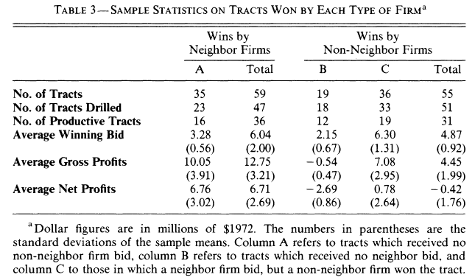
Drainage sales

Slide 24
Explaining the Results
Comparing wildcat and drainage sales
Wildcat sales yield low profits => competition.
Drainage sales are profitable, but only for “insiders” => insiders have an advantage.

Slide 25
Internet Advertising
Internet advertisers often can identify people or profile their behavior and then bid to show them ads.
Concern in some advertising auctions
Sophisticated advertisers potentially can “cherry-pick” the best opportunities by bidding high only for those impressions.
Less sophisticated advertisers who submit the same bid for good and bad opportunities might be left with only the bad ones.
Example: the Yahoo! - “Happy Meal” contract.

Slide 26
Akerlof Lemons Model
Note the parallel with the Akerlof lemons model...
Seller has a car that is either a “peach” or a “lemon”
Seller values a peach at 80 and a lemon at 20.
Buyer values a peach at 100 and a lemon at 50.
Ideally, car would trade either way, at a price either between 80 and 100, or between 20 and 50.
But what if seller knows the value and buyer doesn’t?
For concreteness, assume that peach/lemon equally likely.

Slide 27
Lemons model, cont.
Recall buyer values are 100/50, sellers are 80/20.
At a price p>80, seller will sell even if the car is a peach. But buyer won’t pay 80 for a 50/50 chance at a peach.
At a price p<80, seller will only sell if the car is a lemon. Knowing this, buyer will only be willing to pay 50.
So market price will be between 20 and 50 and only lemons will trade.
How does this story connect with common value model?

Slide 28
Summary
Many auctions have a “common value” flavor.
In common value settings:
The event of winning reveals information about opponent estimates, and bidders must account for this.
Auctions that aggregate participant information into the price can yield more revenue.
If there are many bidders, the resulting price can be a useful indicator of the item’s value.
The distribution of information is very important.

