Slide 1
Chapter 9 Physical Equilibria
9-3 Colligative Properties & Binary Liquid Mixture
依數性質及兩種成分的混合液體

Slide 2
9-3 學習重點
Molality、molarity及mole fraction的換算練習
使用Raoult‘s Law計算蒸汽壓下降
利用molality計算凝固點下降或沸點上升；及利用凝固點下降或沸點上升計算溶質的分子量
利用molarity計算滲透壓；及利用滲透壓計算溶質的分子量
計算兩種成分的理想混合液體平衡時氣液相莫爾分率的差別
利用液相莫爾分率的差別解釋蒸餾現象
解釋非理想混合液體平衡蒸汽壓的變化及共沸混和物的存在

Slide 3
何謂「依數性質 Colligative Properties 」
有些特定的物理變化與溶質的重量莫耳濃度（molality）成正比，而與溶質的性質無關。
Notes:
依數性質：有些特定的物理變化與溶質的重量莫耳濃度成正比，而與溶質的性質無關。
如：以凝固點下降或沸點上升為例，下降的幅度只與溶質的重量莫耳濃度成正比，而與溶質的性質無關。
如：滲透壓也是具有相同的性質。

Slide 4
何謂重量莫耳濃度（molality）？
重量莫耳濃度（ｍ, molality）：
溶質的莫耳數／溶劑的質量（仟克）
體積莫耳濃度（Ｍ, molarity）：
溶質的莫耳數／溶液的體積（升）
溶質的莫耳分率 x_{solute}：
溶質的莫耳數／（溶質的莫耳數＋溶劑的莫爾數）
Notes:
依數性質：當某特定的物理變化與溶質的濃度成正比，而與溶質的性質無關。
如：以凝固點下降或沸點上升為例，下降的幅度只與溶質的濃度成正比，而與溶質的性質無關。
如：滲透壓也是具有相同的性質。

Slide 5
Molality的換算練習
What is the molality of benzene, C₆H₆, dissolve in toluene, C₆H₅CH₃, in a solution for which the mole fraction of benzene is 0.15?
Find the molality of sucrose (蔗糖), C₁₂H₂₂O₁₁, in 1.06M C₁₂H₂₂O₁₁(aq) which is known to have density 1.14 g/mL.

Slide 6
沸點上升的拉午耳 (Raoult)觀點
無論沸點上升或凝固點下降皆源自於少量的非揮發性溶質溶在溶液中，使得溶劑的蒸汽壓的下降。而此蒸汽壓下降的公式即是拉午耳定律（Raoult‘s Law）：
Raoult‘s Law：
P ＝x_{solvent} P_{pure}
P : 溶液的蒸汽壓
P_{pure} : 純溶劑的蒸汽壓
x_{solvent}：溶劑的莫爾分率

Slide 7
拉午耳定律的練習題
Calculate the vapor pressure of water at 20℃ in a solution prepared by dissolving 10.00 g of the nonelectrolyte sucrose, C₁₂H₂₂O₁₁, in 100.0 g of water.

Slide 8
理想溶液：拉午耳定律的基本假設
在理想溶液中，溶劑與溶質的作用力等於溶劑本身的互相作用力或溶劑本身的互相作用力
ΔH_{sol} = 0
理想溶液的熱力學
ΔG_{sol} = ΔH_{sol} － T ΔS_{sol}
ΔG_{sol} = － T ΔS_{sol}
由於
固體溶在液體大部分是 ΔS_{sol} > 0
ΔG_{sol} (= G_{solution}-G_{liquid})<0
G_{solution} < G_{liquid}
因此平衡時
G_{vapor} = G_{liquid} 大，P_{vapor} 大
G_{vapor} = G_{solution} 小，P_{vapor}小

Slide 9
沸點上升的熱力學觀點
純物質的液體在沸點時
G_{liquid} = G_{vapor}(liquid)
當固體溶在液體形成理想液體，在其沸點時
G_{solution} = G_{vapor}(solution)
因為 G_{solution} < G_{liquid}
G_{vapor}(solution) < G_{vapor}(liquid)
G_{solution}-G_{liquid} = ΔH_{sol} － T ΔS_{sol}
G_{solution}-G_{liquid} = － T ΔS_{sol}
G_{solution} = G_{liquid} － T ΔS_{sol}

Slide 10
比較「沸點上升」與「凝固點下降」
Notes:
「沸點上升」：Boiling-Point Elevation
「凝固點下降」：Freezing-Point Depressing

Slide 11
「沸點上升」與「凝固點下降」的數學公式
沸點上升的溫度＝
k_{b}．重量莫耳濃度
k_{b} ：Boiling-Point Constant
凝固點下降的溫度＝
k_{f} ．重量莫耳濃度
k_{f} ： Freezing-Point Constant

Slide 12
「凝固點下降」的練習一
請算出重量莫爾分率0.2 mol/kg可待因（強效止痛藥 codeine，C₁₈H₂₁NO₃）在苯溶劑中的凝固點。
Notes:
凝固點下降的溫度＝k_{f} ．重量莫耳濃度=5.12*0.2=1.024
凝固點=5.5-1.024=4.5

Slide 13
「凝固點下降」的練習二
一化學家要鑑定人類體內的某一賀爾蒙的分子量。他將0.546 g賀爾蒙溶在15 g的苯中，凝固點下降0.24℃，請問此賀爾蒙的分子量為何？
Notes:
冰點降低測定法, cryoscopy ：利用凝固點下降測量分子量
(0.546/MW)/0.015*5.12=0.24; MW=776.533 g/mol

Slide 14
電解質的「凝固點下降」效應
凝固點下降的溫度＝i k_{f}×重量莫耳濃度
k_{f} ： Freezing-Point Constant
i ： van’t Hoff i factor
當所有的離子完全解離（在比較稀的溶液中）
i = 1 for 非電解質溶液（nonelectrolytes solution）
i = 2 for MX，如NaCl
i = 3 for MX₂，如CaCl₂
當溶液中電解質無法完全解離，如5%解離的弱酸溶液（醋酸）
i = 0.95+0.05*2 = 1.05

Slide 15
Quiz
Which of the following compound has the lowest freezing point?
2.0 m sodium perchlorate
1.0 m potassium phosphate
1.5 m aluminum nitrate
1.0 m aluminum sulfate
1.5 m magnesium phosphate
monohydrate
NaClO₄·H₂O
monohydrate
K₃PO₄·H₂O
nonahydrate
Al(NO₃)₃·9H₂O
16-hydrate
Al₂(SO₄)₃·16H₂O
Mg₃(PO₄)₂

Slide 16
滲透 Osmosis 的熱力學觀點
起始狀態（initial state）：
左側： liquid state
右側：solution state（假設理想液體）
G_{liquid} > G_{solution}

Slide 17
滲透壓 Π 平衡的熱力學觀點
滲透壓是在溶液濃度較高這一邊所施的壓力
滲透壓是一種依數性質，在稀薄溶液中和溶質體積莫爾濃度成正比，而和粒子種類無關
Notes:
滲透壓 οσμοτιχ πρεσσυρε

Slide 18
實際的儀器

Slide 19
細胞上滲透壓Π的平衡
Π(血漿) ＝Π(紅血球內)
Π(血漿) > Π(紅血球內)
Π(血漿) < Π(紅血球內)

Slide 20
滲透壓 Π 平衡的數學公式
van’t Hoff Equation
Π = i RTc
i： van’t Hoff i factor
R：gas constant
T：absolute temperature
c ：體積莫耳濃度（Ｍ, molarity）

Slide 21
滲透壓的練習一
在25℃，血液的滲透壓Π為7.7 atm，需多少濃度的食鹽水才能與血液的滲透壓等壓呢？
Notes:
Π= i RTc → 7.7=2*0.08206*298.15*c; c=0.15736 mol/L
When the solvent contains a maximum quantity of solute, the resulting solution is said to be saturated. The saturation point varies according to the solute. For example, 100 grams of pure water at 25°C (77°F) can dissolve no more than 35.92 grams of NaCl to form a stable saturated solution, but this same amount of water at 25°C dissolves only 0.0013 grams of calcium carbonate. The solubility in these examples is expressed in grams of solute per 100 grams of water, but any suitable units could be used. Water can dissolve any amount of a solute less than that required for a saturated solution. Tables of the solubilities of many substances can be found in various chemistry texts Read more: Solution Chemistry - Chemistry Encyclopedia - water, examples, metal, gas, number, salt, property http://www.chemistryexplained.com/Ru-Sp/Solution-Chemistry.html#ixzz1oIpXQwyv

Slide 22
osmometry, 滲透壓測定法的練習
A solution, whose volume is 100 cm³, prepared by dissolving 0.52 g of polystyrene in benzene showed an osmotic pressure of 3.12 Torr at 25 °C.
Calculate the average molar mass of the polymer, which is a nonelectrolyte.
Calculate the freezing-point depression of the solution. The freezing-point constant of benzene is 5.12 K kg mol⁻¹, and the density of benzene 0.88 g cm⁻³.
Notes:
(1) Π= i RTc → 3.12/760=(0.52/MW)/0.1*298.15*0.082*1; MW=30952 g/mol
(2) ΔT_{f} = k_{f}m = 5.12 * (0.52/30952)/(100*0.88e-3) = 9.77e-4 K
滲透壓法則是適用于分子量幾萬到上百萬的高分子體系的。冰點降低法適用於小於350℃的汽油、煤油和輕柴油餾分

Slide 23
兩種成分的理想混合液體
P_{A} ＝x_{A, liquid} P_{A, pure}
P_{B} ＝x_{B, liquid} P_{B, pure}
P_{total} (total vapor pressure)
＝P_{B} + P_{A}
＝ x_{A, liquid} P_{A, pure} + x_{B, liquid} P_{B, pure}

Slide 24
計算混合容液的蒸汽壓
What is the vapor pressure of each component at 25℃ and the total vapor pressure of a mixture in which 1/3 molecules are benzene (x_{benzene, liquid} =1/3, x_{toluene, liquid} = 2/3)? The vapor pressures of benzene and toluene at 25℃ are 94.6 and 29.1 Torr, respectively.
Notes:
P(benzene, vapor)=94.6/3=31.533 Torr
P(toluene, vapor)=29.1*2/3=19.4 Torr

Slide 25
圖示解答

Slide 26
理想混合液體平衡時的氣相的 x

Slide 27
平衡時氣液相莫爾分率的差別
Find the mole fraction of benzene at 25℃ in the vapor of a solution of benzene in toluene in which the mole fraction of benzene in liquid is 1/3.
Notes:
X(benzene, vapor)=31.533/(31.533+19.4)=0.619
X(toluene, vapor)=19.4/(31.533+19.4)=0.381

Slide 28
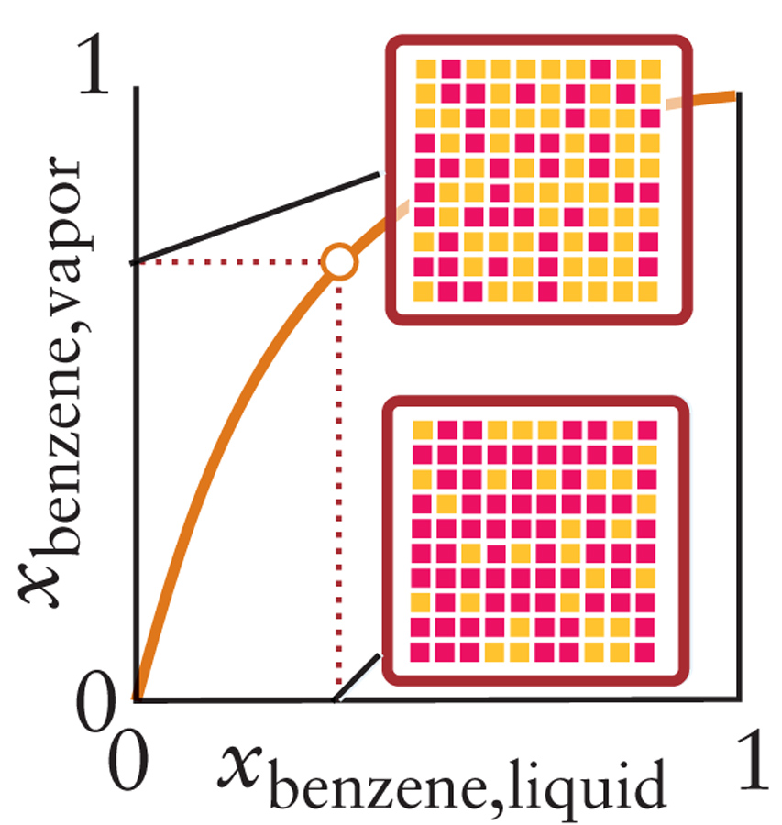
圖示解答

Slide 29
混合溶液汽液相平衡圖

Slide 30
蒸餾的原理

Slide 31
蒸餾塔的構造
F
E
D
C
B
A

Slide 32
非理想混合液體平衡時的蒸汽壓
ΔH_{mix} > 0
ΔH_{mix} < 0
Notes:
Endothermic Mixing (ΔH_{mix} > 0) 代表ethanol不喜歡與benzene在一起，故需要外來能量迫使他們混和。
Exothermic Mixing (ΔH_{mix} < 0) 代表acetone喜歡與chloroform在一起，故當他們混和在一起時釋放能量。

Slide 33
Aceton-Chloroform

Slide 34
共沸混合物 （Azeotropes) positive deviation
Notes:
Azeotropic Point 共沸點

Slide 35
共沸混合物 （Azeotropes) negative deviation
Notes:
Azeotropic Point 共沸點

Slide 36
Problem
Which of the following mixture would you expect to show a positive deviation, negative deviation, or no deviation from Raoult’s law? Explain you conclusion
HBr and H₂O
HF and H₂O
CH₃OH and C₂H₅OH
HCOOH and benzene
C₆H₁₄ and H₂O
Cyclopentane, C₅H₁₀, and cyclohexane, C₆H₁₂

Slide 37
HBr and H₂O
126℃
100℃
-67℃
H₂O
HBr

Slide 38
HCOOH and Benzene
101℃
80.1℃
71℃
Benzene
HCOOH

Slide 39
C₅H₁₀ and C₆H₁₂

Slide 40
物理平衡的應用：萃取法 Extraction

Slide 41
液相層析法 Liquid Chromatography

Slide 42
氣相層析法 Gas Chromatography

Slide 43
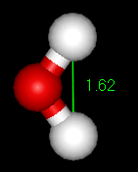
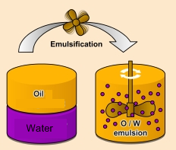
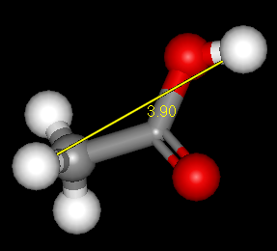
膠體 Colloids
膠體：溶質顆粒粒子大小介於 1nm~1000nm (1 μm)之間
H₂O 直徑
~ 2.75 Å
~0.275 nm
醋酸直徑
~ 5 Å
~0.5 nm
Notes:
flocculate
1. 使(土壤)結成小團塊
2. 使(雲)成毛狀團塊
coagulation
凝結;凝結物
sedimentation
沈澱作用;沈降

Slide 44
膠體的種類

Slide 45
乳劑 Emulsion is a colloid!

Slide 46
Ice cream is a colloid!

Slide 47
Ice Cream

Slide 48
玻尿酸 Hyaluronic Acid

Slide 49
課後問題
Cellulose is a primary structural material in plants. Its molecules consist of long chains of thousands of carbon atoms, most of which have –OH groups attached. Give one reason why, although cellulos can form numerous hydrogen bonds to water, it is insoluble in water.

Slide 50
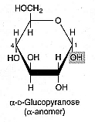
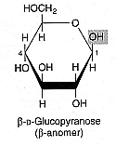
澱粉Starch和纖維素Cellulose
澱粉
纖維素

