Slide 1
Chapter 10 Chemical Equilibria
10-1 Reactions at Equilibrium

Slide 2
10-1 學習重點
如何由反應自由能求出反應商數？如何由標準反應自由能求出平衡常數？什麼是反應商數？反應商數與平衡常數的關係。
知道反應方程式與平衡常數的基本運算關係
由活度（activity）表示平衡常數，因此平衡常數是無單位！如何表示活度，如氣體、溶液、純液體及固體？
標準反應焓與標準反應熵如何影響平衡常數的大小？
由Q與K的大小關係預測化學平衡時的反應程度，及由ΔG_{r}°來預測化學反應的程度
從Q或是G的極小值來預測化學反應的方向

Slide 3
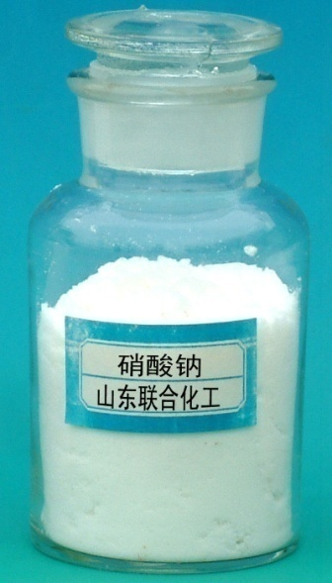
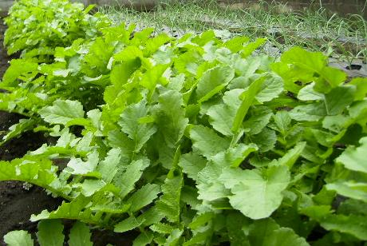
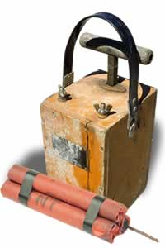
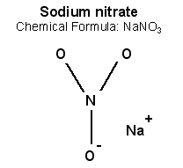
氮元素的需求
氮肥
炸藥：
硝化甘油
硝化棉
TNT

Slide 4
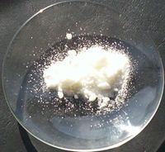
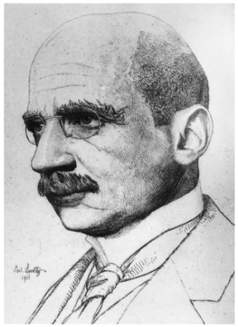
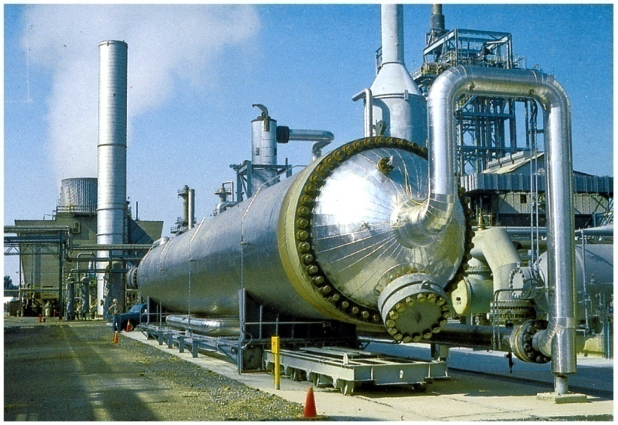
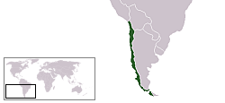
氮元素的來源：硝石 或 哈伯法
量不敷使用
通路不穩定
智利「硝石」

Slide 5
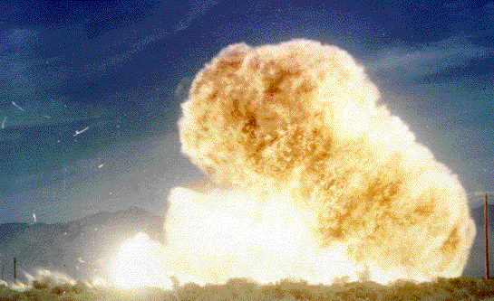
固氮反應的歷史
1795年有人試圖在常壓下進行氮、氫合成氨合成，後來又有人在50個大氣壓下試驗，結果都失敗了。
19世紀下半葉，物理化學的巨大進展（勒沙特列原理），使人們認識到由氮、氫合成氨的反應是可逆的，增加壓力將使反應推向生成氨的方向：提高溫度會將反應移向相反的方向，然而溫度過低又使反應速度過小 。
法國化學家勒沙特列 (Henri Le Chatelier 1850-1936) 第一個試圖進行高壓合成氨的實驗，但是由於氮氫混和氣中混進了氧氣，引起了爆炸，使他與當時的化學家放棄了這一危險的實驗。
Notes:
Le Chatelier in 1901 attempted the direct combination of the two gases at a pressure of 200 atmospheres using Thenard's temperature. The mixture of gases was forced by an air compressor into a steel Berthelot bomb, where they and the reduced iron catalyst were heated by a platinum spiral. An accidental contamination of the reaction chamber with air resulted in an explosion which blew fragments of the steel container through the floor and ceiling. Le Chatelier abandoned the project, and less than five years later, Haber and Claude were successful in producing ammonia on a commercial scale, acknowledging that the account of Le Chatelier's failed attempt had accelerated their research. Near the end of his life, Le Chatelier wrote, "I let the discovery of the ammonia synthesis slip through my hands. It was the greatest blunder of my scientific career."
Early in the twentieth century several chemists tried and failed to produce ammonia from atmospheric nitrogen. The enormous technical problems associated with the process were first solved by German chemist Fritz Haber (with the invaluable help of Robert Le Rossignol, who developed and built the necessary high-pressure devices). They first demonstrated their success in the summer of 1909, producing ammonia from air drop by drop, at the rate of about a cup every two hours. The process was purchased by the German chemical company BASF, which assigned Carl Bosch the difficult task of scaling up Haber's tabletop machine to industrial-level production.^{[2]} Haber and Bosch were later awarded Nobel prizes, in 1918 and 1931 respectively, for their work in overcoming the chemical and engineering problems posed by the use of large-scale, continuous-flow, high-pressure technology. Ammonia was first manufactured using the Haber process on an industrial scale in 1913 in BASF's Oppau plant in Germany. During World War I, production was shifted from fertilizer to explosives, particularly through the conversion of ammonia into a synthetic form of Chile saltpeter, which could then be changed into other substances for the production of gunpowder and high explosives (the Allies had access to large amounts of saltpeter from natural nitrate deposits in Chile that belonged almost totally to British industries; Germany had to produce its own). It has been suggested that without this process, Germany would not have fought in the war,^{[7]} or would have had to surrender years earlier.

Slide 6
固氮反應的熱力學資料
 | ΔH_{f}。 (kJ/mole) | S。(J/K/mole) | ΔG_{f}。(kJ/mole)
N₂(g) | 0 | 191.61 | 0
H₂ (g) | 0 | 130.68 | 0
NH₃ (g) | -46.11 | 192.45 | -16.45
Notes:
ΔHr= -46.11 *2 – 0*3 – 0*1 = -92.22 kJ/mol
ΔSr= 192.45*2 – 130.68*3 – 191.61*1 = -198.75 J/K/mol
ΔGr= -16.45 *2 – 0*3 – 0*1 = -32.9 kJ/mol

Slide 7
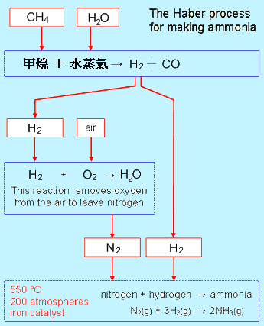
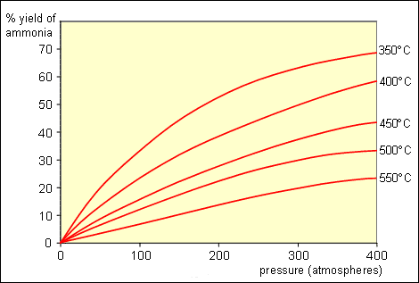
哈伯的成就

Slide 8
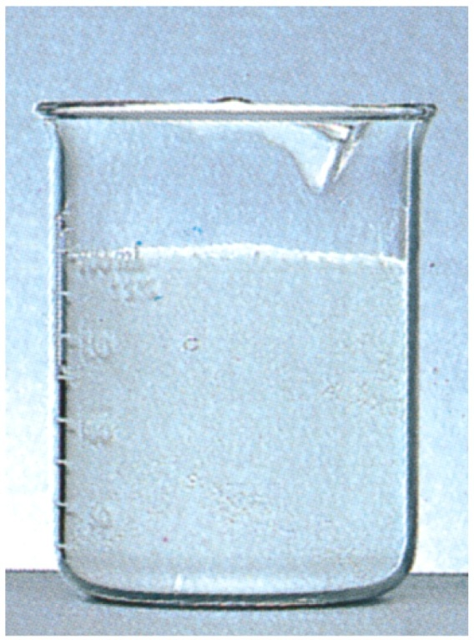
如何使化學反應完全進行
爆炸
葡萄糖氧化反應

Slide 9
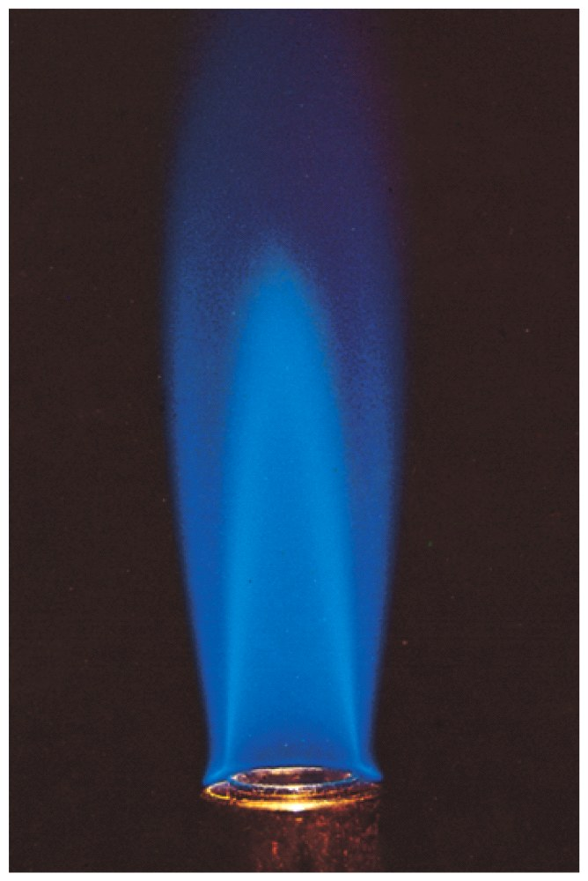
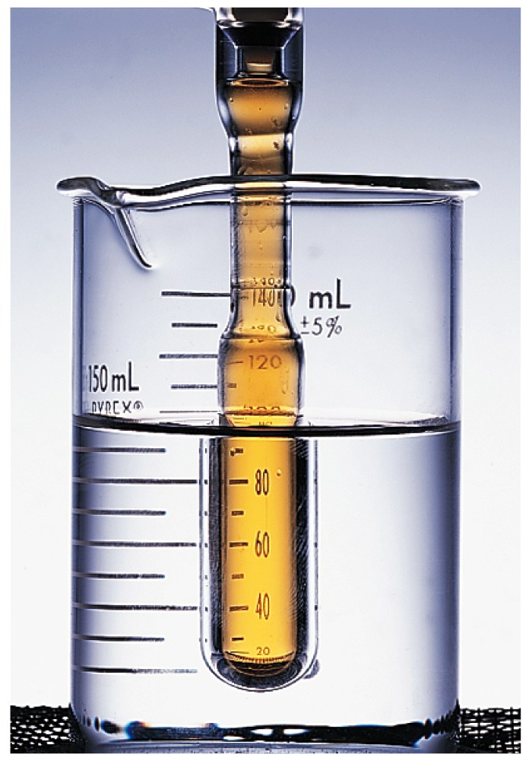
什麼是化學反應平衡？
葡萄糖氧化反應
甲烷燃燒反應
C₆H₁₂O₆ + O₂
→ CO₂ + 2H₂O
CH₄ + 2O₂ → CO₂ + 2H₂O
2 NO₂ (g) ↔ N₂O₄ (g)
Notes:
化學反應其實也是平衡現象

Slide 10
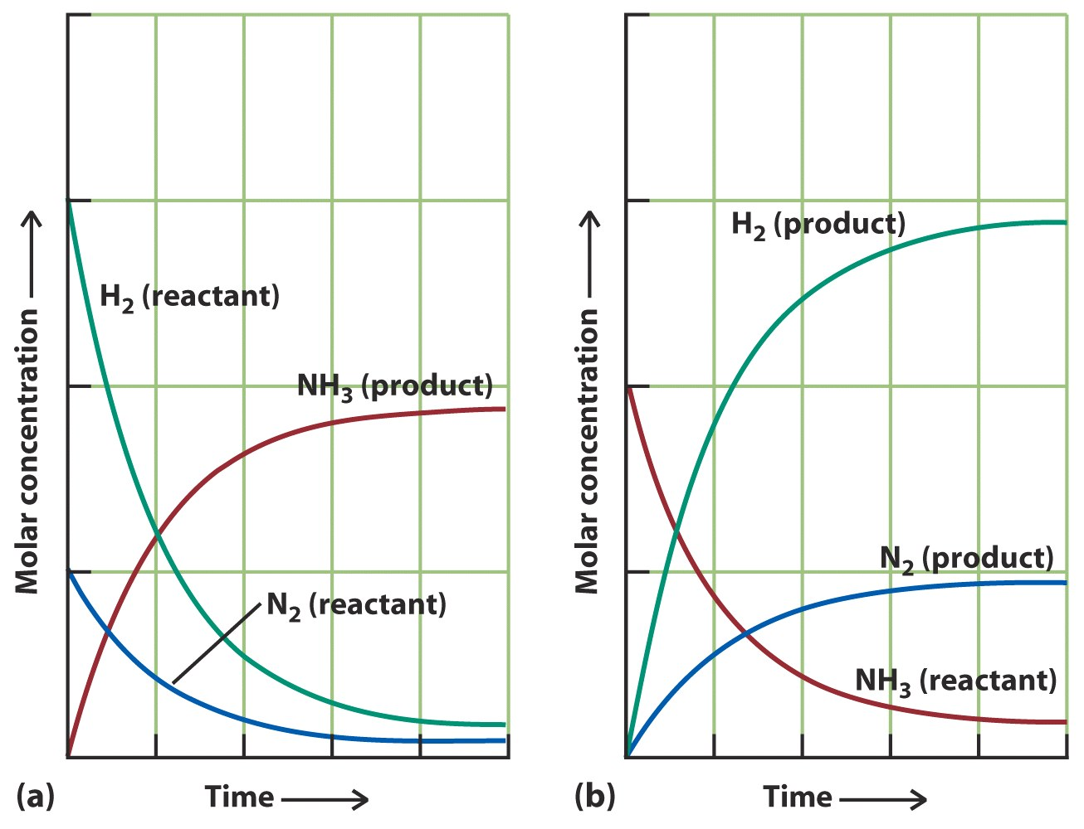
從實驗觀點看化學平衡
Notes:
化學反應平衡其實就是可逆反應

Slide 11
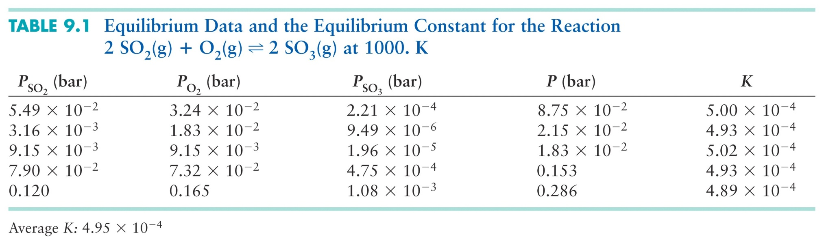
質量作用定律（實驗歸納法）
Notes:
化學動力學的基本定律。由挪威科學家古爾德貝格(Cato M. Guldberg)和瓦格(Peter Waage)於1864∼1879年提出。該定律說明，任何簡單化學反應的速率或速度和反應物質質量方次的乘積成正比，而每一反應物質量的方次等於該物質參與反應的分子數。這樣，對於反應物為X、Y、Z，參與反應的相應分子數為α、β、γ，生成物為P的反應，可用平衡的化學方程式αX＋βY＋γZ→P來表示，其反應速率(r)的數學式為︰r=k(CX)α(CY)β(Cz)γ。方程中k為比例常數，稱為比反應速率或速度常數。Cs代表X、Y、Z的相應的濃度(莫耳/升)。所有化學反應速率的定量方程式均以質量作用定律為基礎。 （取自中文版大英百科全書）

Slide 12
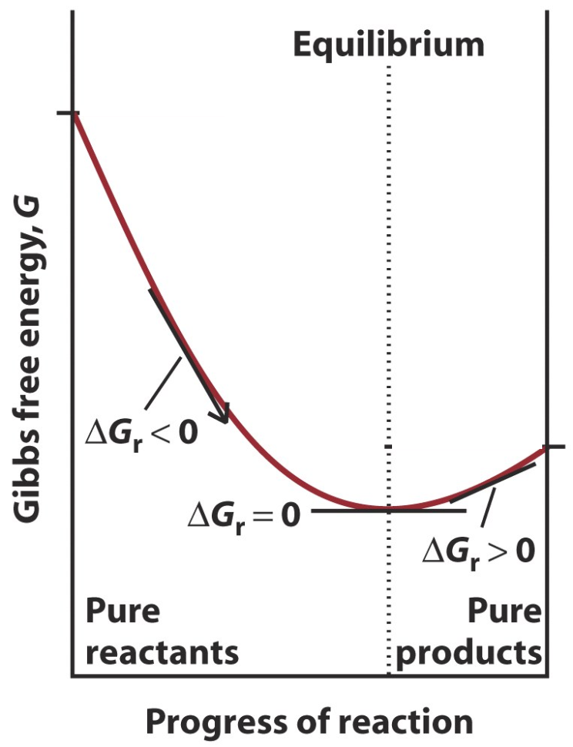
從熱力學觀點看化學平衡
反應物 → 產物
化學反應自由能 ΔG_{r} =
ΣnG_{m}(產物products) －
ΣnG_{m}(反應物reactants)
  ΔG_{r}<0 正向反應
  ΔG_{r}=0 平衡
  ΔG_{r}<0 逆向反應

Slide 13
ΔG_{r}與反應商數Q(reaction quotient)

Slide 14
反應商數Q與平衡常數K
當ΔG_{r}< 0，Q與K關係如何？
當ΔG_{r}= 0，Q與K關係如何？
當ΔG_{r}> 0，Q與K關係如何？

Slide 15
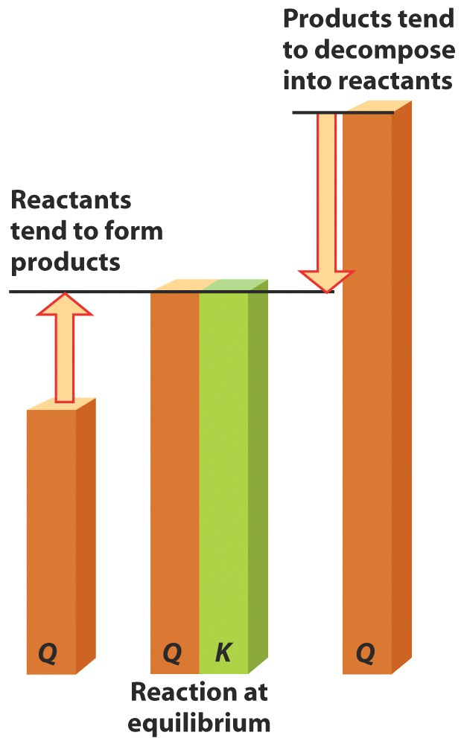
從Q來預測化學反應的方向
Q > K：化學反應朝向反方向，形成反應物
Q < K：化學反應朝向正方向，形成產物
Q = K：化學平衡

Slide 16
作業 10.17
At 400K, the reaction constant for N₂(g)+3H₂(g)→2NH₃(g) is K=41. At 400K, the reactor contains the partial pressures of N₂, H₂, and NH₃ are 4.2, 1.8 and 21bar.
  What is the reaction free energy in the container?
  What is the spontaneous direction of the reaction under these conditions?

Slide 17
練習
A mixture of hydrogen, iodine, and hydrogen iodine, each at 55kPa, was introduced into a container heated to 783K. At this temperature, K=46 for H₂(g) + I₂ (g) → 2HI(g). Predict whether HI has a tendency to form or to decompose into H₂ (g) and I₂ (g).

Slide 18
作業 10.38
The equilibrium constant for the reaction 2SO₂(g)+O₂(g)→2SO₃(g) has the value K=2.5×10¹⁰ at 500K? Find the value of the following reaction at 500K
  SO₂(g) + 1/2O₂(g) → SO₃(g)
  3SO₂(g) + 3/2O₂(g) → 3SO₃(g)
  SO₃(g) → SO₂(g) + 1/2O₂(g)

Slide 19
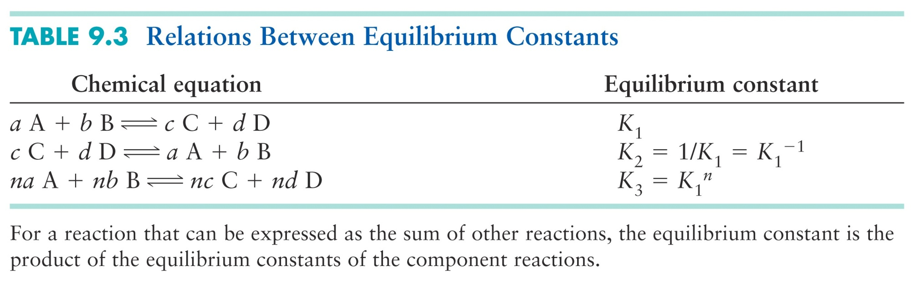
平衡常數的基本運算關係

Slide 20
Example
The concentration of the oxides of nitrogen are monitored in air-pollution reports. At 298K,
  NO(g) + ½ O₂(g) → NO₂(g) K=1.3×10⁶
  ½ N₂(g) + ½ O₂(g) → NO(g) K=6.5×10⁻¹⁶
  Find the equilibrium constant K for the reaction N₂(g) + 2O₂(g) → 2NO₂(g)

Slide 21
下列平衡常數的單位為何
N₂(g) + 2O₂(g) → 2NO₂(g)
As₂S_{3(s)} + NO₃⁻_{(aq)} → H₃AsO_{4(aq)} + S_{(s)} +NO_{(g)}

Slide 22
自由能與活度Activity
反應物 → 產物
化學反應自由能 ：
ΔG_{r} =
ΣnG_{m}(產物products) －
ΣnG_{m}(反應物reactants)
請導出稀釋溶液中溶質自由能與活度的關係式。
請導出純固體與純液體自由能與活度的關係式。

Slide 23
活度Activity
對於理想氣體中氣體J的活度：
  a_{J} = P_{J}/P°, where P° = 1 bar. → a_{J} = P_{J}
對於稀釋溶液中溶質的活度 ：
  a_{J} = [J]/c°, where c° = 1 M → a_{J} = [J]
對於純固體與純液體：
  a_{J} = 1

Slide 24
平衡常數（dimensionless）

Slide 25
練習一

Slide 26
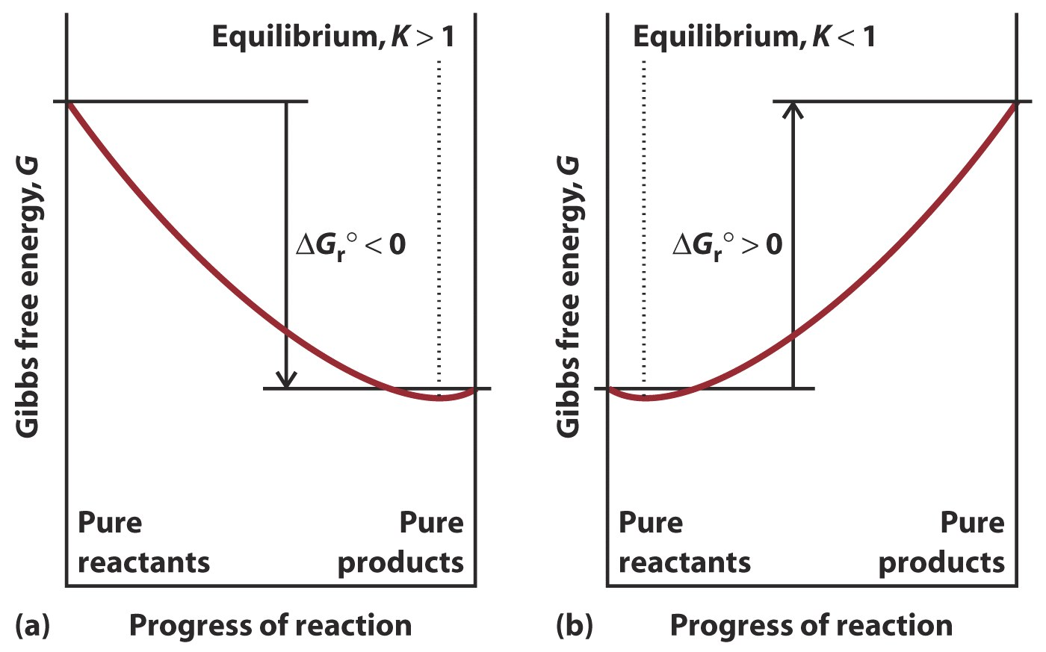
從G的極小值來預測化學反應的方向

Slide 27
作業 10.23
If Q=1.0 for N₂(g) + O₂(g) → 2NO(g) at 25℃, will the reaction have a tendency to form products or reactants or will it be at equilibrium?

Slide 28
平衡常數K與ΔH_{r}°、 ΔS_{r}°
吸熱反應：
  ΔH_{r}° >0，若ΔS_{r}° ≦0，K < 1
  ΔH_{r}° >0，若ΔS_{r}° >> 0，K > 1
放熱反應
  通常ΔH_{r}° << 0，K>>1；除非 |ΔH_{r}°|的值很小，而且ΔS_{r}° << 0。

Slide 29
Problem
The distribution of Na⁺ ions across a typical biological membrane is 10 mM inside the cell and 140mM outside the cell. At equilibrium the concentrations would be equal, but in a living cell the ions are not at equilibrium.
  What is the standard Gibbs free energy difference for Na⁺ ions across the membrane at 37℃?
  What is the Gibbs free energy difference for Na⁺ ions moving from inside to outside of the in a living cell at 37℃?

Slide 30
複習化學平衡問題一
At 25°C how large an increase in concentration would be necessary to increase the free energy of a compound in aqueous solution by 5 kJ/mol ?

Slide 31
複習化學平衡問題二
What value of the reaction quotient would be changed to give a +40.0 kJ/mol contribution to the reaction free energy at 25°C?

