Slide 1
Intro to FRC Control System
The Basics
Team 4302 – The Robophins

Slide 2
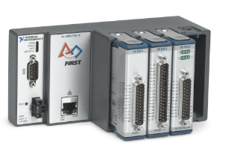
CRIO
The brain: The NXT of FRC
Connects from: Router
Connects to: Digital Sidecar

Slide 3
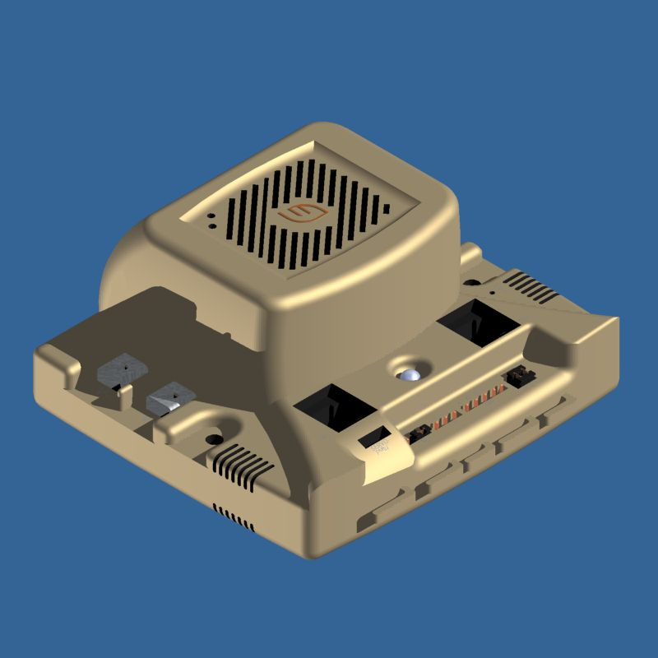
Jaguar
Connection between the cRIO and the motors.
Connects from: Digital Sidecar
Connects to: Motors (any)
Pros:
  Finer control
  Overcurrent protection
Cons:
  Less power
Cost: $110 (On sale for $59)

Slide 4
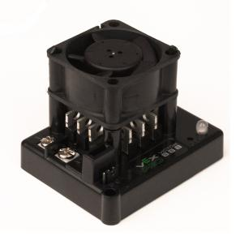
Victor
Another speed controller
Connects to any motor
Pros:
  More Power
Cons:
  Less fine control
  Overcurrent failure
Cost: $60

Slide 5
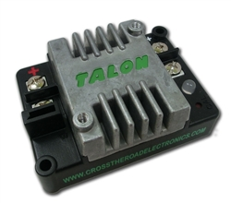
Talon
New speed controller
More durable – Less chance of failure
Debris resistant coating.
Smaller
Higher load
Cheap: $50

Slide 6
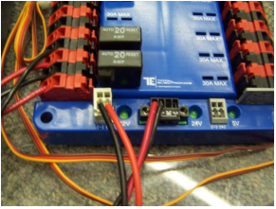
Power Distribution Board
The heart
Connects from: Master breaker
Connects to: cRIO, Motor Controllers

Slide 7
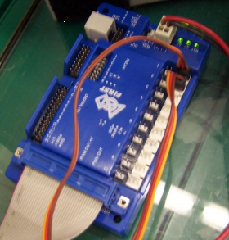
Digital Sidecar
The Spinal Cord
  Routes input/ouput to digital accessories
  Connects from cRIO, PDB
  Connects to I/O devices:
    Motor controller (For PWM – variable speed)
    Servos,
    Sensors (?)

Slide 8
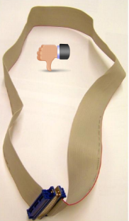
The Cable + Email blasts
Last year, the cable in the kit was assembled incorrectly for all teams
Email blast was sent out informing teams of the issue
Email blasts relay crucial information to team

Slide 9
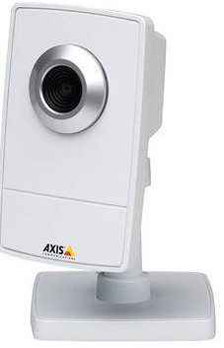
Camera
Network camera transmits footage to driver station
Connects from: PDB (Ethernet port on board)
Can be used to locate elements on the field
  Rebound Rumble: Basketball hoop backboard sensing

Slide 10
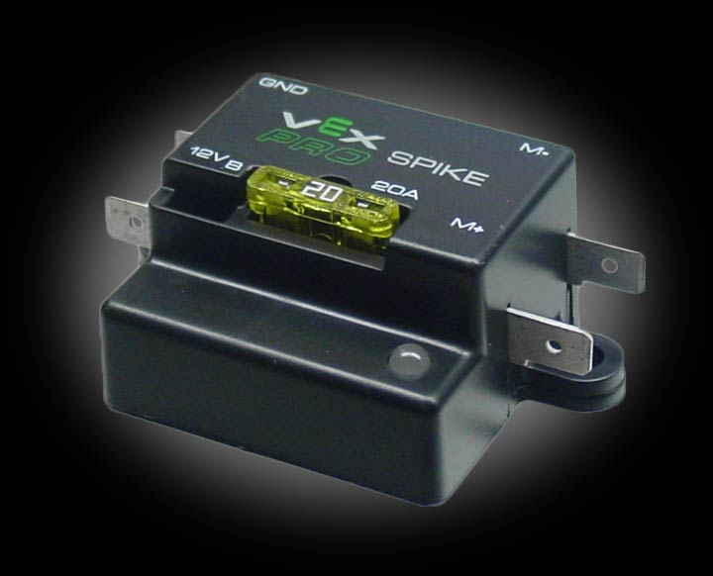
Spike Relay
Basic motor relay (No PWM)
For driving window motors.
Not allowed to drive all motors.

Slide 11
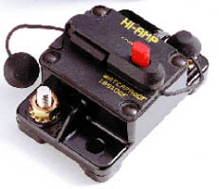
Master Breaker
Connects from: Battery
Connects to: Power Distribution Board
On/Off switch for robot
Prevents overcurrent

Slide 12
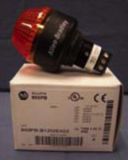
Status light
Indicates robot status
  Solid blink– Autonomous
  Normal blink – Teleop
  Slow blink – Disabled (but robot powered on)
Connects from: Power Distribution board

