Slide 1
CS 480: Database Systems
Lecture 18
February 25, 2013

Slide 2
Combine Schemas?
INSTRUCTOR(ID,name,dept_name,salary)
DEPARTMENT(dept_name, building, budget)
Waste of space
(redundancy)
Updates to dept data
are cumbersome.
Loss of dept data if all
instructors of that dept
are deleted.
Difficult representation
of a department that does
not have an instructor yet.

Slide 3
Combine Schemas?
INSTRUCTOR(ID,name,dept_name,salary)
DEPARTMENT(dept_name, building, budget)
Suppose we combine instructor and department into inst_dept
Waste of space
(redundancy)
Updates to dept data
are cumbersome.
Loss of dept data if all
instructors of that dept
are deleted.
Difficult representation
of a department that does
not have an instructor yet.

Slide 4
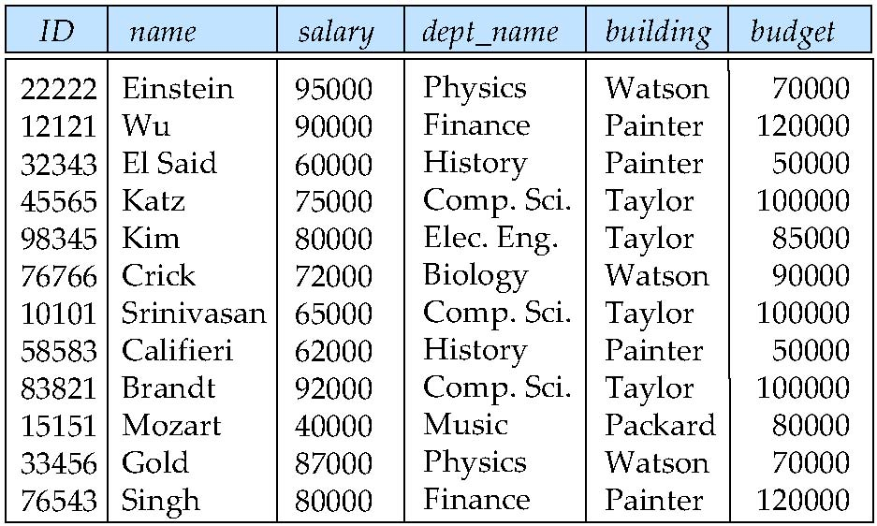
Combine Schemas?
INSTRUCTOR(ID,name,dept_name,salary)
DEPARTMENT(dept_name, building, budget)
Suppose we combine instructor and department into inst_dept
Are there any problems with this design decision?
Waste of space
(redundancy)
Updates to dept data
are cumbersome.
Loss of dept data if all
instructors of that dept
are deleted.
Difficult representation
of a department that does
not have an instructor yet.

Slide 5
Combine Schemas?
INSTRUCTOR(ID,name,dept_name,salary)
DEPARTMENT(dept_name, building, budget)
Suppose we combine instructor and department into inst_dept
Are there any problems with this design decision?
Waste of space
(redundancy)
Updates to dept data
are cumbersome.
Loss of dept data if all
instructors of that dept
are deleted.
Difficult representation
of a department that does
not have an instructor yet.

Slide 6
Combine Schemas?
INSTRUCTOR(ID,name,dept_name,salary)
DEPARTMENT(dept_name, building, budget)
Suppose we combine instructor and department into inst_dept
Are there any problems with this design decision?
Waste of space
(redundancy)
Updates to dept data
are cumbersome.
Loss of dept data if all
instructors of that dept
are deleted.
Difficult representation
of a department that does
not have an instructor yet.

Slide 7
Combine Schemas?
INSTRUCTOR(ID,name,dept_name,salary)
DEPARTMENT(dept_name, building, budget)
Suppose we combine instructor and department into inst_dept
Are there any problems with this design decision?
Waste of space
(redundancy)
Updates to dept data
are cumbersome.
Loss of dept data if all
instructors of that dept
are deleted.
Difficult representation
of a department that does
not have an instructor yet.

Slide 8
Combine Schemas?
INSTRUCTOR(ID,name,dept_name,salary)
DEPARTMENT(dept_name, building, budget)
Suppose we combine instructor and department into inst_dept
Are there any problems with this design decision?
Waste of space
(redundancy)
Updates to dept data
are cumbersome.
Loss of dept data if all
instructors of that dept
are deleted.
Difficult representation
of a department that does
not have an instructor yet.
Notes:
Even if you put in nulls, then there are problems when answering how many instructors in a dept (the one with null values for instructor will be counted as an instructor).

Slide 9
A good combined schema
Consider combining relations
  sec_class(sec_id, building, room_number) and
  section(course_id, sec_id, semester, year)
  into one relation
  section(course_id, sec_id, semester, year,
  building, room_number)
Notes:
Understanding the root of this problem will help us

Slide 10
A good combined schema
Consider combining relations
  sec_class(sec_id, building, room_number) and
  section(course_id, sec_id, semester, year)
  into one relation
  section(course_id, sec_id, semester, year,
  building, room_number)
No repetition in this case
What makes this a good combined schema and the previous one a bad schema?
Notes:
The root of this problem lies in what we will call functional dependencies. They will be what we use to formally determine whether a schema is “good” or not.
Multiple definitions of this “good”

Slide 11
Smaller Schemas?
inst_dept(ID,name,dept_name,salary, building, budget)
Suppose we had started with inst_dept. How would we know to split it up (decompose) into instructor and department?
  Notice that information is being repeated?
  Works for this simple example, not in general
    Sometimes this repetition could be a coincidence
We need a systematic way of recognizing these pitfalls for large datasets or relations with many attributes that could have many data dependencies.
Notes:
We will later identify the rule that will tell us that we should decompose inst_dept.

Slide 12
Smaller Schemas?
inst_dept(ID,name,dept_name,salary, building, budget)
We need to be able to specify a rule “if there were a schema (dept_name, building, budget), then dept_name would be a candidate key”.
Denote as a functional dependency:
dept_name → building, budget
In inst_dept, because dept_name is not a candidate key, the building and budget of a department may have to be repeated.
  This indicates the need to decompose inst_dept
Notes:
We will later identify the rule that will tell us that we should decompose inst_dept.

Slide 13
Smaller Schemas
Not all decompositions are good. Suppose we decompose
employee(ID, name, street, city, salary) into
employee1 (ID, name)
employee2 (name, street, city, salary)
This is a lossy decomposition because information about the database may be lost.

Slide 14
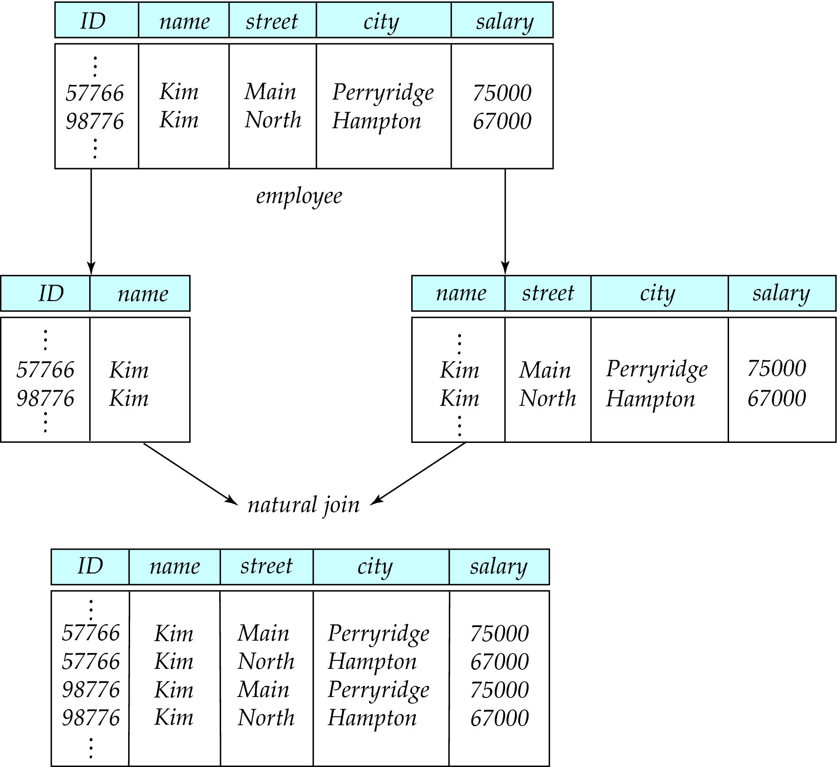
Lossy Decomposition
Notes:
Loss comes from the fact that now we don’t know where each Kim really lives.

Slide 15
Example of a Loss-less Decomposition
Lossless join decomposition
Decomposition of R = (A, B, C)
R₁ = (A, B) R₂ = (B, C)
A
B
C
A
B
B
C
α
β
1
2
A
B
α
β
1
2
1
2
A
B
r
∏_{A,B}(r)
∏_{B,C}(r)
∏_{A} (r) ∏_{B} (r)
A
B
C
α
β
1
2
A
B

Slide 16
Relational Database Design
Goal is to devise a theory for deciding whether a particular relation R is in “good” form.
In the case that a relation R is not in “good” form, decompose it into a set of relations {R₁, R₂, ..., R_{n}} such that:
  each relation is in good form
  the decomposition is a lossless-join decomposition
Our theory is based on:
  functional dependencies
  keys

Slide 17
Functional Dependencies
A database models set of entities and relationships in the real world.
There are usually constraints on the data in the real world. Legal instances of the databases conform to these constraints.
For example, a university database has what types of constraints?

Slide 18
Functional Dependencies
A database models set of entities and relationships in the real world.
There are usually constraints on the data in the real world. Legal instances of the databases conform to these constraints.
For example, a university database has the following constraints:
  Students and instructors are uniquely identified by ID.
  Each student and instructor has only one name.
  Each student is (primarily) associated with only one department.
  Each department has only one value for budget.

Slide 19
Functional Dependencies
Constraints on the set of legal relations.
Require that the value for a certain set of attributes determines uniquely the value for another set of attributes.
A functional dependency is a generalization of the notion of a key.
Notes:
Legal relations, relations that conform to the constraints given by the dependencies

Slide 20
Functional Dependencies
Let R be a relation schema
α ⊆ R and β ⊆ R
The functional dependency
α → β
holds on R if and only if for any legal relations r(R), whenever any two tuples t₁ and t₂ of r agree on the attributes α, they also agree on the attributes β. That is,
t₁[α] = t₂ [α] ⇒ t₁[β ] = t₂ [β ]

Slide 21
Functional Dependencies
Let R be a relation schema
α ⊆ R and β ⊆ R
The functional dependency
α → β
holds on R if and only if for any legal relations r(R), whenever any two tuples t₁ and t₂ of r agree on the attributes α, they also agree on the attributes β. That is,
t₁[α] = t₂ [α] ⇒ t₁[β ] = t₂ [β ]
Example: Consider r(A,B) with the following instance of r.
4
1 5
3 7
Notes:
Which functional dependencies hold?

Slide 22
Functional Dependencies
Let R be a relation schema
α ⊆ R and β ⊆ R
The functional dependency
α → β
holds on R if and only if for any legal relations r(R), whenever any two tuples t₁ and t₂ of r agree on the attributes α, they also agree on the attributes β. That is,
t₁[α] = t₂ [α] ⇒ t₁[β ] = t₂ [β ]
Example: Consider r(A,B ) with the following instance of r.
On this instance, A → B does NOT hold, but B → A does hold.
We then say that B functionally determines A or that A functionally depends on B.
4
1 5
3 7

Slide 23
Example
ENROL(id,course,grade)
  {id} → {grade}?

Slide 24
Example
ENROL(id,course,grade)
  {id} → {grade}? No.
  {id,course} → {grade}
  {course} → {course}
  {id,course} → {id}

Slide 25
Functional Dependencies
K is a superkey for relation schema R if and only if K → R
K is a candidate key for R if and only if
  K → R, and
  for no α ⊂ K, α → R
Functional dependencies allow us to express constraints that cannot be expressed using superkeys. Consider the schema:
inst_dept (ID, name, salary, dept_name, building, budget ).
We expect these functional dependencies to hold:
dept_name→ building
and ID → building
but would not expect the following to hold:
dept_name → salary
Notes:
Candidate key is minimal

Slide 26
Use of Functional Dependencies
We use functional dependencies to:

Slide 27
Use of Functional Dependencies
We use functional dependencies to:
  test relations to see if they are legal under a given set of functional dependencies.
    If a relation r is legal under a set F of functional dependencies, we say that r satisfies F.

Slide 28
Use of Functional Dependencies
We use functional dependencies to:
  test relations to see if they are legal under a given set of functional dependencies.
    If a relation r is legal under a set F of functional dependencies, we say that r satisfies F.
  specify constraints on the set of legal relations
    We say that F holds on R if all legal relations on R satisfy the set of functional dependencies F.

Slide 29
Use of Functional Dependencies
We use functional dependencies to:
  test relations to see if they are legal under a given set of functional dependencies.
    If a relation r is legal under a set F of functional dependencies, we say that r satisfies F.
  specify constraints on the set of legal relations
    We say that F holds on R if all legal relations on R satisfy the set of functional dependencies F.
Note: A specific instance of a relation schema may satisfy a functional dependency even if the functional dependency does not hold on all legal instances.
  For example, a specific instance of instructor may, by chance, satisfy
  name → ID.

Slide 30
Remarks on FD’s
A functional dependency, A → B, holds for a scheme R, not a particular relation r(R).
A → B is a property of the system that the database is modeling.
We will address the question of “what does one do with functional dependencies?” and not “how does one find the functional dependencies that hold?”

Slide 31
Trivial Functional Dependencies
A functional dependency is trivial if it is satisfied by all instances of a relation
  Example:
    ID, name → ID
    name → name
  In general, α → β is trivial if β ⊆ α

Slide 32
Closure of a Set of Functional Dependencies
Given a set F of functional dependencies, there are certain other functional dependencies that are logically implied by F.
  For example: If A → B and B → C, then we can infer that A → C
The set of all functional dependencies logically implied by F is the closure of F.
We denote the closure of F by F⁺.
F⁺ is a superset of F.
Notes:
This is something else we will be using later in our study of functional dependencies

