Slide 1
MATLAB Overview
MATLAB is a software package for high performance numerical computation and visualization. Its name is an abbreviation of Matrix Laboratory.
MATLAB is particularly suited for dealing with vectors and matrices.
Most common and powerful tool for engineering analysis
Tutorials
http://www.mathworks.com/academia/student_center/tutorials/launchpad.html
http://web.mit.edu/afs/.athena/astaff/project/logos/olh/Math/Matlab/TOC.html
http://www.cyclismo.org/tutorial/matlab/
Command window link after installation

Slide 2
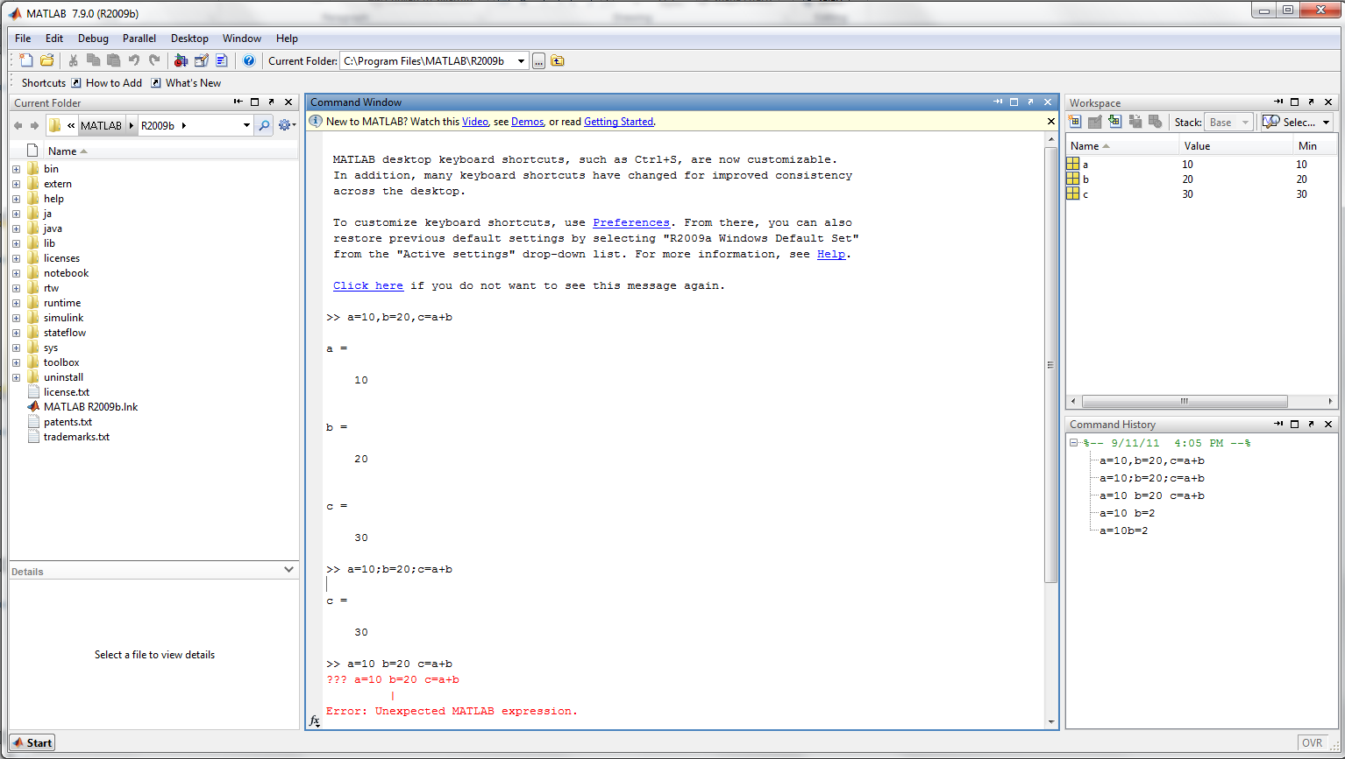
User Interface
To bring up MATLAB, click on Start/All Programs/Matlab

Slide 3
Help system
Demo
Function
Search
Help function

Slide 4
Files and Paths
Workspace and .m file
Paths
Any related function or files must be in the same path!
Naming conventions
File name_1
NameName
Do not space
Do not use parameter with number (a, b, 1, a1…) Creates confusion when naming variables.

Slide 5
Commands and Expressions
Enter, delete and answer
Commas, semicolons and parentheses
Arithmetic operations
Order of precedence

Slide 6
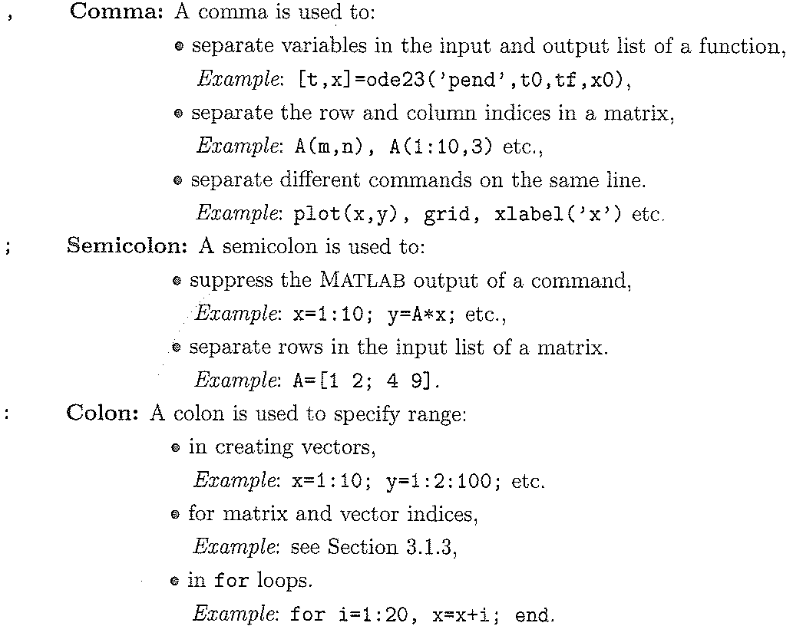
Punctuation Marks & Other Symbols

Slide 7
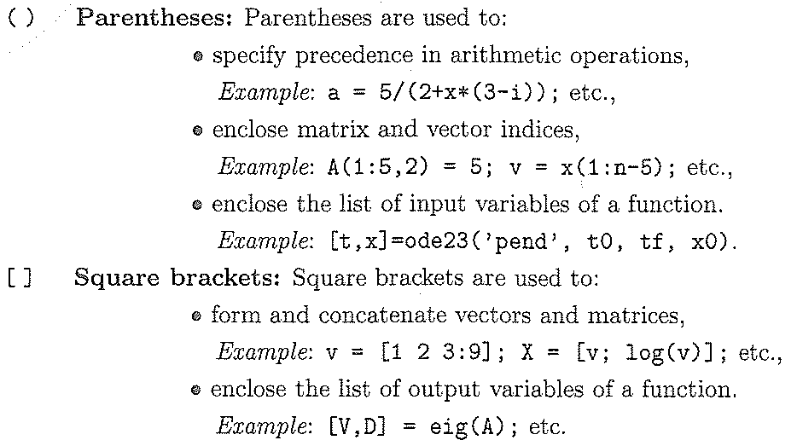
Punctuation Marks & Other Symbols

Slide 8
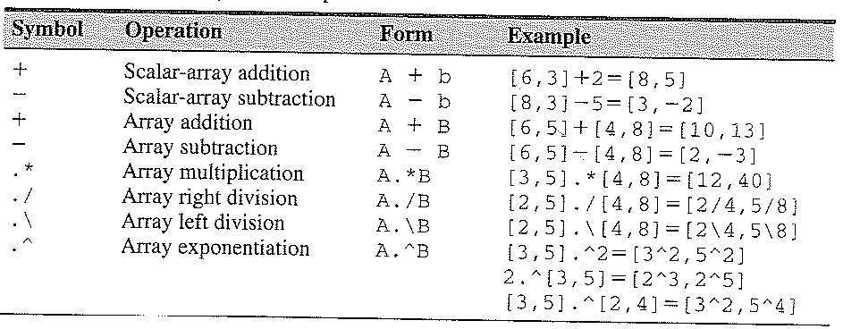
Numerical (Matrix & Array) Operations

Slide 9
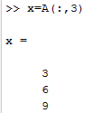
Matrix
Creating matrix
Referring matrix
A(row#, column#)
A(：, 3) and A(2, 1：2)
Matrix operations
A+B (A and B have the same row dimension and col dimension)
A*B (A is m*n matrix, B is n*k matrix, A*B is m*k matrix)
Combination (commas and semicolons)

Slide 10
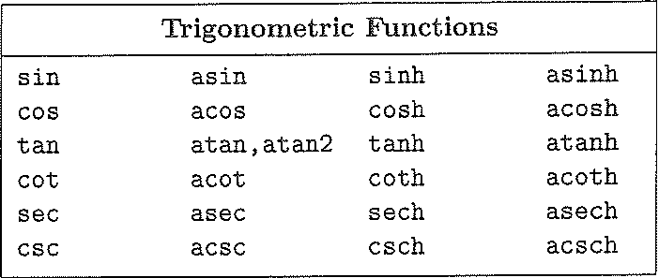
Arrays and Functions
Collection of numbers--vectors or matrix
Creating arrays
Manually type in
U=[0:1:10]
Built-in functions

Slide 11
Function and Form within Matlab
Function | MATLAB form
$$e^{x}$$ | exp(x)
$$\ln{x}$$ | log(x)
$\log_{10}^{}$x | log10(x)
$$\cos{x}$$ | cos(x)
$$\sin{x}$$ | sin(x)
$$\tan{x}$$ | tan(x)
$$\cos^{−1}{x}$$ | acos(x)

Slide 12
Order of Precedence

Slide 13
Arrays and Plots
Plot
One graph
$y=5sin{x,x=[0,6]}$
Multiple graphs
$y=2\sqrt{x}{,z=4sin{3x,x=[0,5]}}$
line type: - : -. -- + . * d s p h v ^ < >
line color: y r g b w k m c
Subplot
Subplot (m,n,k)
3D graph
mesh and surf

Slide 14
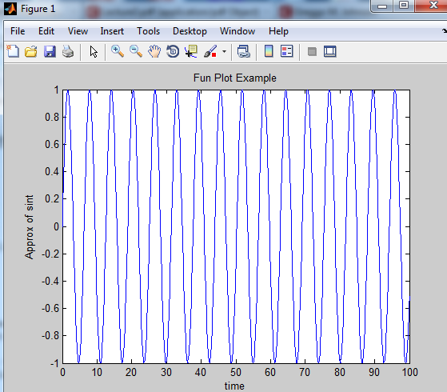
Arrays and Plots
Plot $y=sin{x,x=[0,100]}$

Slide 15
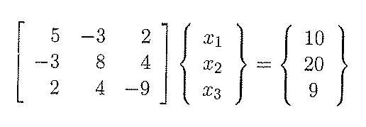
Programming in MATLAB: Scripts & Functions
Script Files: A script file is an ‘M-file’ with a set of valid MATLAB commands in it. It is executed by typing the name without the ‘.m’ extension. Purpose → benefit of not having to retype commands in command window
Lets solve the following system of linear equations:

Slide 16
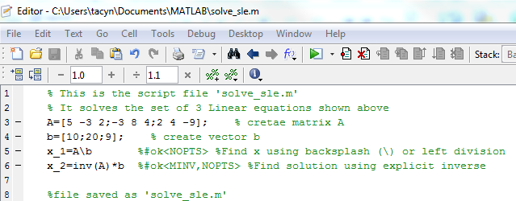
Programming in MATLAB: Script Files Cont.
Lets solve the following system of linear equations:
Create M-file form File>New>Script

Slide 17
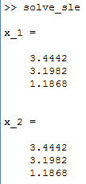
Programming in MATLAB: Script Files Cont.
Lets solve the following system of linear equations:
Enter solve_sle
into command window

Slide 18
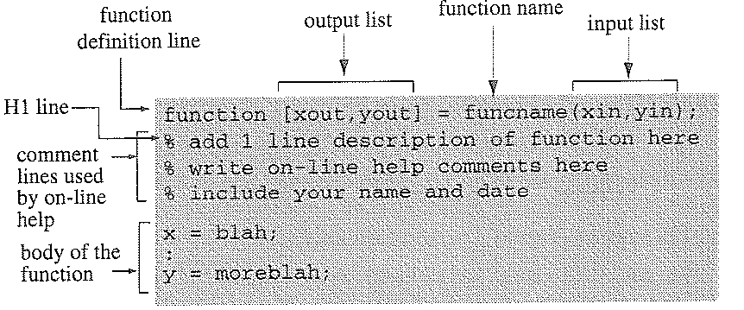
Programming in MATLAB: Scripts & Functions
Function Files: A Function file is another type of ‘M-file’ , except that the variables in the function file are all local. (ie. subroutines) Function files are useful when you need to repeat a set of commands several times.
A function file begins with a function definition line with well-defined list of inputs and outputs.
function[output variables] = function_name(input variables);

Slide 19
Solving ODEs in MATLAB: using solver Functions
We will generally use ODE45 function
The Matlab ode solvers will generally be better than anything you would program yourself
They are able to estimate the error in the solution at each time step, and decide whether to not the time step is too large (error to high) or too small (inefficient) However we can rely on default settings.
ODE45 (an explicit Runge-Kutta method) is efficient, but can become unstable with stiff systems (slow transient behavior). The important thing to note is that ode45 can only solve first order ODEs. Hence to solve a higher order ODEs, we must convert the higher order ODE to a set (or array) of first order ODEs.

Slide 20
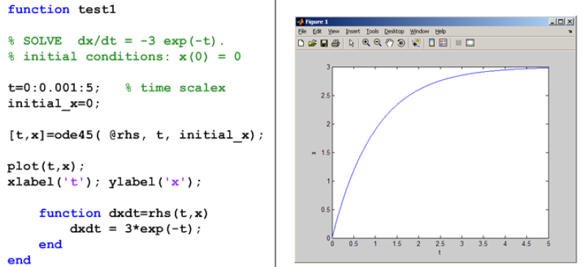
Matlab ODE Example

Slide 21
Matlab 2nd order ODE Example

Slide 22
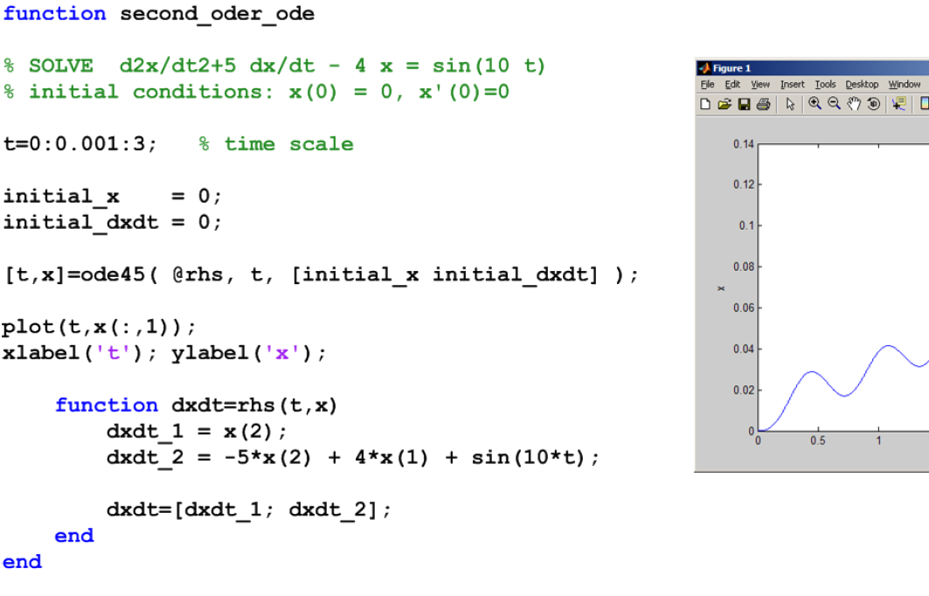
Matlab 2nd order ODE Example

