Slide 1
Chapter 6
Bandwidth Utilization:
Multiplexing and Spreading
Copyright © The McGraw-Hill Companies, Inc. Permission required for reproduction or display.

Slide 2
Note
Bandwidth utilization is the wise use of available bandwidth to achieve specific goals.
Efficiency can be achieved by multiplexing; privacy and anti-jamming can be achieved by spreading.

Slide 3
6-1 MULTIPLEXING
Whenever the bandwidth of a medium linking two devices is greater than the bandwidth needs of the devices, the link can be shared. Multiplexing is the set of techniques that allows the simultaneous transmission of multiple signals across a single data link. As data and telecommunications use increases, so does traffic.
Topics discussed in this section:
Frequency-Division Multiplexing Wavelength-Division Multiplexing Synchronous Time-Division Multiplexing

Slide 4
Figure 6.1 Dividing a link into channels

Slide 5
Figure 6.2 Categories of multiplexing

Slide 6
Figure 6.3 Frequency-division multiplexing

Slide 7
Note
FDM is an analog multiplexing technique that combines analog signals.

Slide 8
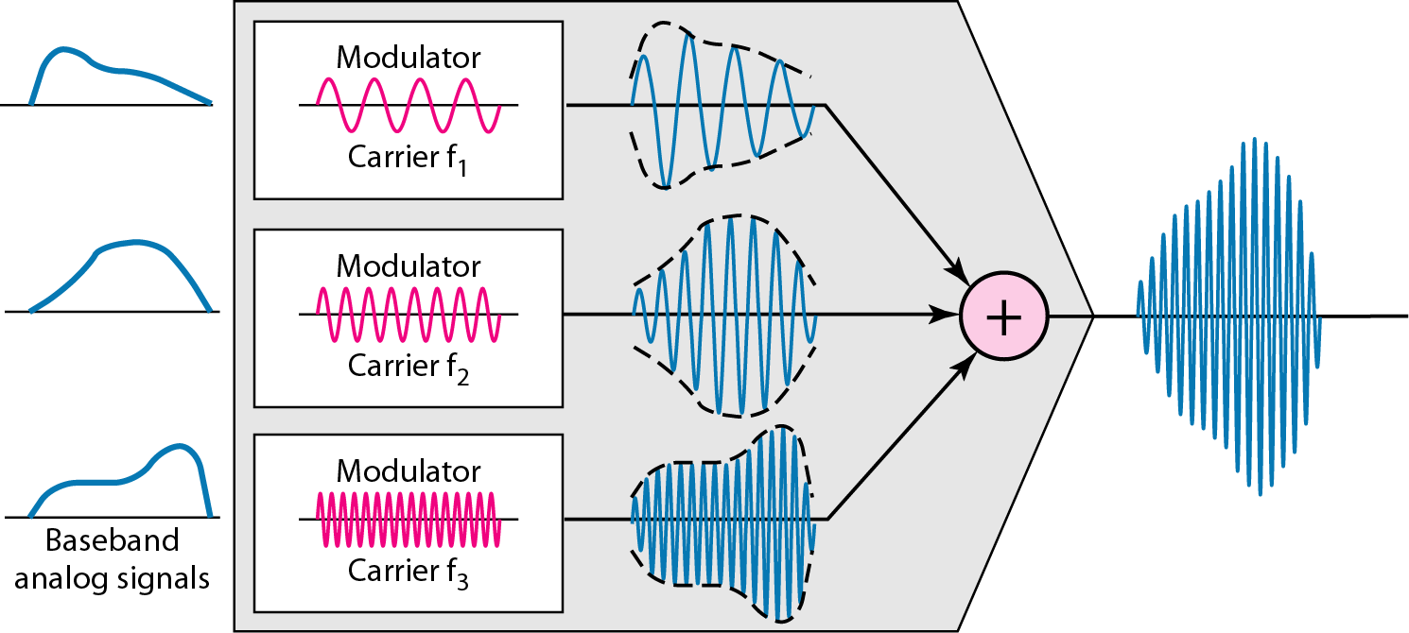
Figure 6.4 FDM process

Slide 9
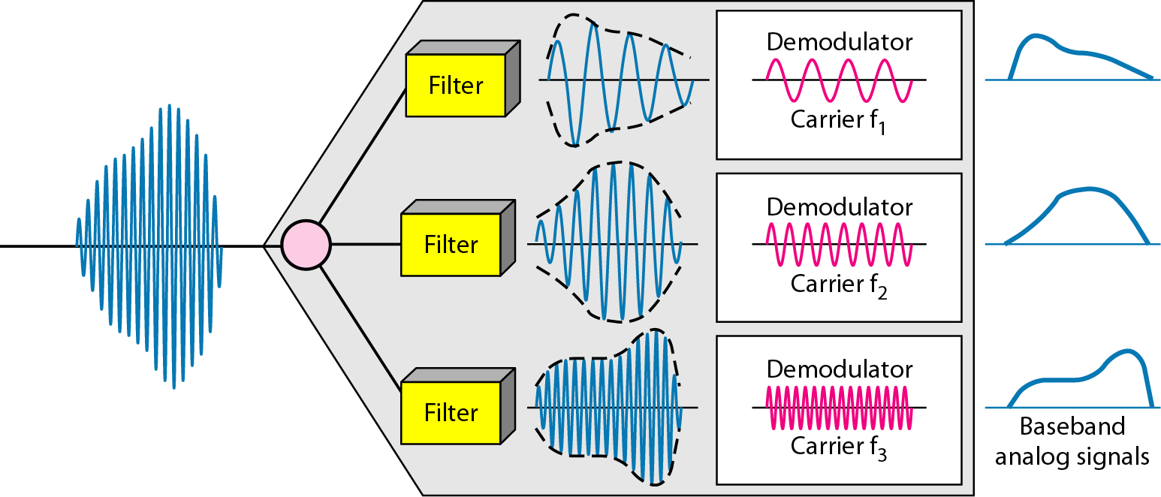
Figure 6.5 FDM demultiplexing example

Slide 10
Example 6.1
Assume that a voice channel occupies a bandwidth of 4 kHz. We need to combine three voice channels into a link with a bandwidth of 12 kHz, from 20 to 32 kHz. Show the configuration, using the frequency domain. Assume there are no guard bands.
.

Slide 11
Example 6.1
Assume that a voice channel occupies a bandwidth of 4 kHz. We need to combine three voice channels into a link with a bandwidth of 12 kHz, from 20 to 32 kHz. Show the configuration, using the frequency domain. Assume there are no guard bands.
Solution
We shift (modulate) each of the three voice channels to a different bandwidth, as shown in Figure 6.6 (Shown in next slide). We use the 20- to 24-kHz bandwidth for the first channel, the 24- to 28-kHz bandwidth for the second channel, and the 28- to 32-kHz bandwidth for the third one. Then we combine them as shown in Figure 6.6

Slide 12
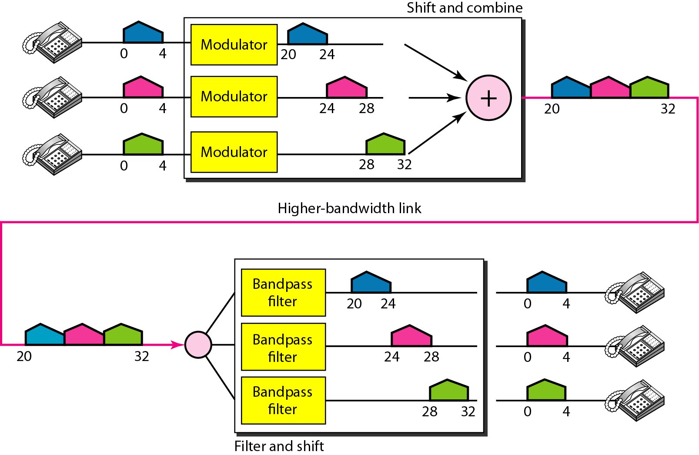
Figure 6.6 Example 6.1

Slide 13
Example 6.2
Five channels, each with a 100-kHz bandwidth, are to be multiplexed together. What is the minimum bandwidth of the link if there is a need for a guard band of 10 kHz between the channels to prevent interference?

Slide 14
Example 6.2
Five channels, each with a 100-kHz bandwidth, are to be multiplexed together. What is the minimum bandwidth of the link if there is a need for a guard band of 10 kHz between the channels to prevent interference?
Solution
For five channels, we need at least four guard bands. This means that the required bandwidth is at least
5 × 100 + 4 × 10 = 540 kHz,
as shown in Figure 6.7.

Slide 15
Figure 6.7 Example 6.2

Slide 16
Figure 6.10 Wavelength-division multiplexing

Slide 17
Note
WDM is an analog multiplexing technique to combine optical signals.

Slide 18
Figure 6.11 Prisms in wavelength-division multiplexing and demultiplexing

Slide 19
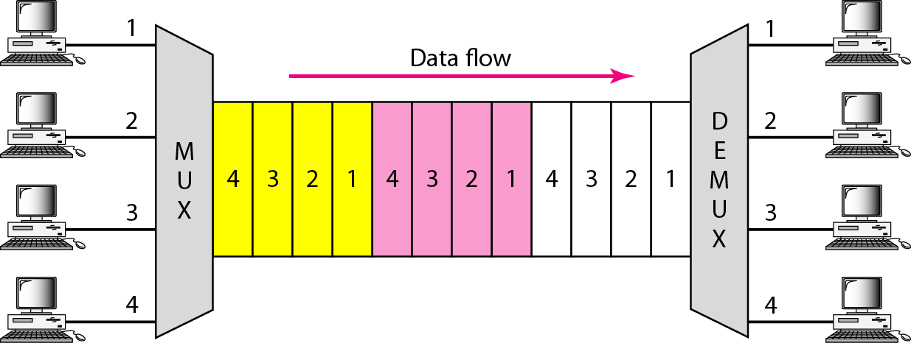
Figure 6.12 TDM

Slide 20
Note
TDM is a digital multiplexing technique for combining several low-rate channels into one high-rate one.

Slide 21
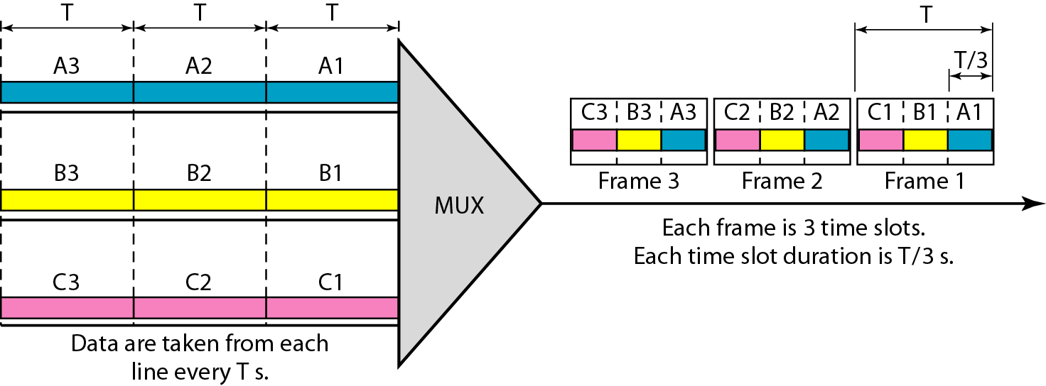
Figure 6.13 Synchronous time-division multiplexing

Slide 22
Interleaving in Synchronous TDM

Slide 23
Example 6.5
In Figure 6.13, the data rate for each input connection is 3 kbps. If 1 bit at a time is multiplexed (a unit is 1 bit), what is the duration of (a) each input slot, (b) each output slot, and (c) each frame?

Slide 24
Example 6.5
In Figure 6.13, the data rate for each input connection is 3 kbps. If 1 bit at a time is multiplexed (a unit is 1 bit), what is the duration of (a) each input slot, (b) each output slot, and (c) each frame?
Solution
We can answer the questions as follows:
a. The data rate of each input connection is 1 kbps. This means that the bit duration is 1/1000 s or 1 ms. The duration of the input time slot is 1 ms (same as bit duration).

Slide 25
Example 6.5 (continued)
b. The duration of each output time slot is one-third of the input time slot. This means that the duration of the output time slot is 1/3 ms.
c. Each frame carries three output time slots. So the duration of a frame is 3 × 1/3 ms, or 1 ms. The duration of a frame is the same as the duration of an input unit.

Slide 26
Example 6.6
Figure 6.14 shows synchronous TDM with a data stream for each input and one data stream for the output. The unit of data is 1 bit. Find (a) the input bit duration, (b) the output bit duration, (c) the output bit rate, and (d) the output frame rate.
Solution
We can answer the questions as follows:
a. The input bit duration is the inverse of the bit rate: 1/1 Mbps = 1 μs.
b. The output bit duration is one-fourth of the input bit duration, or ¼ μs.

Slide 27
Example 6.6 (continued)
c. The output bit rate is the inverse of the output bit duration or 1/(4μs) or 4 Mbps. This can also be deduced from the fact that the output rate is 4 times as fast as any input rate; so the output rate = 4 × 1 Mbps = 4 Mbps.
d. The frame rate is always the same as any input rate. So the frame rate is 1,000,000 frames per second. Because we are sending 4 bits in each frame, we can verify the result of the previous question by multiplying the frame rate by the number of bits per frame.

Slide 28
Figure 6.14 Example 6.6

Slide 29
Example 6.8
Four channels are multiplexed using TDM. If each channel sends 100 bytes /s and we multiplex 1 byte per channel, show the frame traveling on the link, the size of the frame, the duration of a frame, the frame rate, and the bit rate for the link.
Solution
The multiplexer is shown in Figure 6.16. Each frame carries 1 byte from each channel; the size of each frame, therefore, is 4 bytes, or 32 bits. Because each channel is sending 100 bytes/s and a frame carries 1 byte from each channel, the frame rate must be 100 frames per second. The bit rate is 100 × 32, or 3200 bps.

Slide 30
Figure 6.16 Example 6.8

Slide 31
Example 6.9
A multiplexer combines four 100-kbps channels using a time slot of 2 bits. Show the output with four arbitrary inputs. What is the frame rate? What is the frame duration? What is the bit rate? What is the bit duration?
Solution
Figure 6.17 shows the output for four arbitrary inputs. The link carries 50,000 frames per second. The frame duration is therefore 1/50,000 s or 20 μs. The frame rate is 50,000 frames per second, and each frame carries 8 bits; the bit rate is 50,000 × 8 = 400,000 bits or 400 kbps. The bit duration is 1/400,000 s, or 2.5 μs.

Slide 32
Figure 6.17 Example 6.9

Slide 33
Example 6.11
Two channels, one with a bit rate of 100 kbps and another with a bit rate of 200 kbps, are to be multiplexed. How this can be achieved? What is the frame rate? What is the frame duration? What is the bit rate of the link?
Solution
We can allocate one slot to the first channel and two slots to the second channel. Each frame carries 3 bits. The frame rate is 100,000 frames per second because it carries 1 bit from the first channel. The bit rate is 100,000 frames/s × 3 bits per frame, or 300 kbps.

