Slide 1
The Object-Oriented Design Process
Chapter 2

Slide 2
Chapter Topics
From Problem to Code
The Object and Class Concepts
Identifying Classes
Identifying Responsibilities
Relationships Between Classes
Use Cases
CRC Cards
UML Class Diagrams
Sequence Diagrams
State Diagrams
Using javadoc for Design Documentation
Case Study: A Voice Mail System

Slide 3
From Problem to Code
Analysis
Design
Implementation

Slide 4
Analysis Phase
The result of the analysis phase is a Functional Specification which as the following characteristics
It completely defines the tasks to be performed
it is free from internal contradictions
it is readable both by experts in the problem domain and by software developers
it is reviewable by diverse interested parties
it can be tested against reality

Slide 5
Analysis Phase Artifacts:
Functional Specification – an organized and detailed description of how the system works
can be the JavaDoc if the descriptions are good.
Use Case Diagrams – a visual table of contents for the functional specification.
identifies actors, uses, dependencies, exceptions, and extensions.

Slide 6
Use Case
Capture the functional requirements of a system
Describe the interactions between the actors and the system.
Vocabulary:
actor – has a goal in using the system – can be a person or another system or an organization
goal – what the actor wants to achieve by interacting with the system

Slide 7
For each Use Case
Describe the steps involved in an interaction between an actor and the system beginning with the primary actor
Start with the main success scenario (happy path)
Look for alternative paths
exceptions – what can go wrong?
extensions – what other goals might come into play?

Slide 8
Use Case Example
ATM System:
User Initiates Transaction
includes swipe card
includes enter pin
withdraw funds case (happy path):
user specifies an amount
ATM verifies user account balance
Bank adjusts user balance (include case)
ATM dispenses cash
Bank adjusts available cash (include case)
ATM offers to print receipt (extends case)

Slide 9
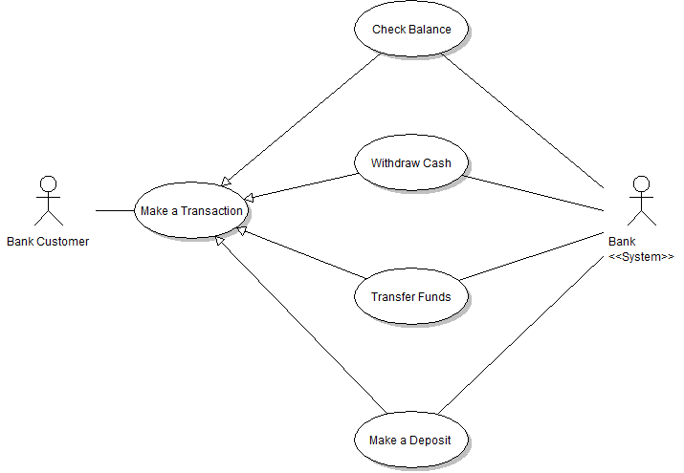
Use Case Diagram

Slide 10
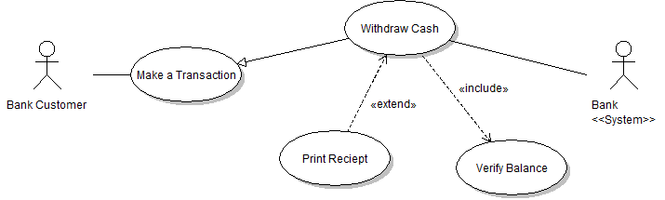
Use Case Diagram
include relationships are required subcases
extend relationships are optional subcases

Slide 11
The Design Phase
Goals:
Identify the classes
Identify the responsibilities of these classes
Identify the relationships among these classes
This process is iterative rather than linear.

Slide 12
Design Process Artifacts
A textual description of the classes and their most important responsibilities
Diagrams of the relationships among the classes
Diagrams of important usage scenarios
State diagrams of objects whose behavior is highly state dependent
A good design cuts implementation time greatly.

Slide 13
Implementation Phase
Goal is coding, testing, and deployment
individual classes are unit tested – to make sure all accessors (observers), mutators, and constructors work properly
complex objects are integration tested – to make sure that they work correctly with their constituent objects.
Beta testing is then done by non programmer users to make sure that the software performs "in the wild"

Slide 14
Objects and Classes
Objects are entities that have
State – the current value of each attribute
Behavior – the permitted operations on those attributes
Identity – the uniqueness of the object
Class describes a collection of similar (but unique) objects.
Class must include the possible states and the operations available.

Slide 15
Identifying Classes
A simple rule of thumb is to create classes from the nouns in the functional specification.
Our sample exercise for this process in this chapter will be a voice mail system.
During the semester you will use all of your knowledge to analyze, design and implement a card game (solitaire) with a GUI front end. Learning all you need to know to implement it will take some time.

Slide 16
A Voice Mail System
Typical nouns associated with this system would be:
mailbox
message
user
passcode
extension
menu
Some of these will make reasonable classes
Class names should be singular form nouns

Slide 17
Identifying Classes II
Focus on concepts not implementation
a MessageQueue stores messages
queue is FIFO structure like a line at the checkout counter. New customer comes into the queue from the rear. Customers exit from the front.
Don't worry about how to implement it.

Slide 18
Beyond the Nouns
tangible things – Button
agents – Scanner
events and transactions – mouseClick
users and roles – stand in for humans such as Administrator
systems – model a subsystem for initialization or shutdown for example
system interfaces and devices – a window or a database for example
foundational classes – those provided by the language such as String, Date, Stack, Queue and many more

Slide 19
Identifying Responsibilities
correspond to the verbs in the functional specification
responsibilities must belong to a single class
for our example:
Behavior of MessageQueue:
Add message to tail
Remove message from head
Test whether queue is empty
Test whether queue is full
messages are: recorded, played, deleted
users log in
passcodes are checked

Slide 20
Dependency Relationships
C depends on D: Method of C manipulates objects of D
Example: Mailbox depends on Message
If C doesn't use D, then C can be developed without knowing about D

Slide 21
Coupling
Minimize dependency: reduce coupling
Example: Replace void print() // prints to System.out with String getText() // can print anywhere
Removes dependence on System, PrintStream

Slide 22
Aggregation
Object of a class contains objects of another class
Example: MessageQueue aggregates Messages
Example: Mailbox aggregates MessageQueue
Implemented through instance fields

Slide 23
Multiplicities
1 : 1 or 1 : 0...1 relationship: public class Mailbox { . . . private Greeting myGreeting; }
1 : n relationship: public class MessageQueue { . . . private ArrayList<Message> elements; }

Slide 24
Inheritance
More general class = superclass
More specialized class = subclass
Subclass supports all method interfaces of superclass (but implementations may differ)
Subclass may have added methods, added state
Subclass inherits from superclass
Example: ForwardedMessage inherits from Message
Example: Greeting does not inherit from Message (Can't store greetings in mailbox)

Slide 25
Use Cases
Analysis technique
Each use case focuses on a specific scenario
Use case = sequence of actions
Action = interaction between actor and computer system
Each action yields a result
Each result has a value to one of the actors
Use variations for exceptional situations

Slide 26
Sample Use Case
Caller dials main number of voice mail system
System speaks prompt Enter mailbox number followed by #
User types extension number
System speaks You have reached mailbox xxxx. Please leave a message now
Caller speaks message
Caller hangs up
System places message in mailbox

Slide 27
Sample Use Case -- Variations
1.1 In step 3, user enters invalid extension number 1.2. Voice mail system speaks You have typed an invalid mailbox number. 1.3. Continue with step 2.

Slide 28
Variation #2
2.1. After step 4, caller hangs up instead of speaking message 2.3. Voice mail system discards empty message

Slide 29
CRC Cards
CRC = Classes, Responsibilities, Collaborators
Developed by Beck and Cunningham
Use an index card for each class
Class name on top of card
Responsibilities on left
Collaborators on right

Slide 30
CRC Cards

Slide 31
CRC Cards
Responsibilities should be high level
1 - 3 responsibilities per card
Collaborators are for the class, not for each responsibility

Slide 32
Walkthroughs
Use case: "Leave a message"
Caller connects to voice mail system
Caller dials extension number
"Someone" must locate mailbox
Neither Mailbox nor Message can do this
New class: MailSystem
Responsibility: manage mailboxes

Slide 33
Walkthroughs

Slide 34
UML Diagrams
UML = Unified Modeling Language
Unifies notations developed by the "3 Amigos" Booch, Rumbaugh, Jacobson
Many diagram types
We'll use three types:
Class Diagrams
Sequence Diagrams
State Diagrams

Slide 35
Class Diagrams
Rectangle with class name
Optional compartments
Attributes
Methods
Include only key attributes and methods

Slide 36
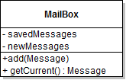
Class Diagrams
Notes:
u

Slide 37
Class Relationships

Slide 38
Violet UML Tool

Slide 39
Multiplicities
any number (0 or more): *
one or more: 1..*
zero or one: 0..1
exactly one: 1

Slide 40
Composition
Special form of aggregation
Contained objects don't exist outside container
Example: message queues permanently contained in mail box

Slide 41
Association
Some designers don't like aggregation
More general association relationship
Association can have roles

Slide 42
Association
Some associations are bidirectional
Can navigate from either class to the other
Example: Course has set of students, student has set of courses
Some associations are directed
Navigation is unidirectional
Example: Message doesn't know about message queue containing it

Slide 43
Interface Types
Interface type describes a set of methods
No implementation, no state
Class implements interface if it implements its methods
In UML, use stereotype «interface»

Slide 44
Tips
Use UML to inform, not to impress
Don't draw a single monster diagram
Each diagram must have a specific purpose
Omit inessential details

Slide 45
Sequence Diagrams
Each diagram shows dynamics of scenario
Object diagram: class name underlined

Slide 46
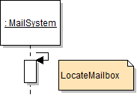
Self call

Slide 47
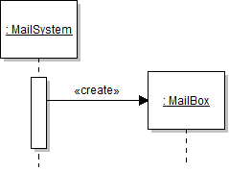
Object Construction

Slide 48
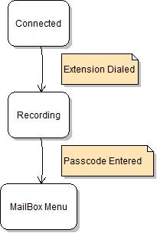
State Diagram

Slide 49
Design Documentation
Recommendation: Use Javadoc comments Leave methods blank (stubs) /** Adds a message to the end of the new
messages. @param aMessage a Message object */ public void addMessage(Message aMessage) { }
Don't compile file, just run Javadoc
Makes a good starting point for code later

Slide 50
Case Study: Voice Mail System
Use text for voice, phone keys, hangup
1 2 ... 0 # on a single line means key
H on a single line means "hang up"
All other inputs mean voice
In GUI program, will use buttons for keys (see ch. 4)

Slide 51
Use Case: Reach an Extension
User dials main number of system
System speaks prompt Enter mailbox number followed by #
User types extension number
System speaks You have reached mailbox xxxx. Please leave a message now

Slide 52
Use Case: Leave a Message
Caller carries out Reach an Extension
Caller speaks message
Caller hangs up
System places message in mailbox

Slide 53
Use Case: Log in
Mailbox owner carries out Reach an Extension
Mailbox owner types password and # (Default password = mailbox number. To change, see Change the Passcode)
System plays mailbox menu: Enter 1 to retrieve your messages. Enter 2 to change your passcode. Enter 3 to change your greeting.

Slide 54
Use Case: Retrieve Messages
Mailbox owner carries out Log in
Mailbox owner selects "retrieve messages" menu option
System plays message menu: Press 1 to listen to the current message Press 2 to delete the current message Press 3 to save the current message Press 4 to return to the mailbox menu
Mailbox owner selects "listen to current message"
System plays current new message, or, if no more new messages, current old message. Note: Message is played, not removed from queue
System plays message menu
User selects "delete current message". Message is removed.
Continue with step 3.

Slide 55
Use Case: Retrieve Messages
Variation #1
1.1. Start at Step 6 1.2. User selects "save current message". Message is removed from new queue and appended to old queue 1.3. Continue with step 3.

Slide 56
Use Case: Change the Greeting
Mailbox owner carries out Log in
Mailbox owner selects "change greeting" menu option
Mailbox owner speaks new greeting
Mailbox owner presses #
System sets new greeting

Slide 57
Use Case: Change the Greeting
Mailbox owner carries out Log in
Mailbox owner selects "change greeting" menu option
Mailbox owner speaks new greeting
Mailbox owner presses #
System sets new greeting

Slide 58
Use Case: Change the Greeting
Variation #1: Hang up before confirmation
1.1. Start at step 3. 1.2. Mailbox owner hangs up. 1.3. System keeps old greeting.

Slide 59
Use Case: Change the Passcode
Mailbox owner carries out Log in
Mailbox owner selects "change passcode" menu option
Mailbox owner dials new passcode
Mailbox owner presses #
System sets new passcode

Slide 60
Use Case: Change the Passcode
Variation #1: Hang up before confirmation
1.1. Start at step 3. 1.2. Mailbox owner hangs up. 1.3. System keeps old passcode.

Slide 61
CRC Cards for Voice Mail System
Some obvious classes:
Mailbox
Message
MailSystem

Slide 62
Initial CRC Cards: Mailbox

Slide 63
Initial CRC Cards: MessageQueue

Slide 64
Initial CRC Cards: MailSystem

Slide 65
Telephone
Who interacts with user?
Telephone takes button presses, voice input
Telephone speaks output to user

Slide 66
Telephone

Slide 67
Connection
With whom does Telephone communicate
With MailSystem?
What if there are multiple telephones?
Each connection can be in different state (dialing, recording, retrieving messages,...)
Should mail system keep track of all connection states?
Better to give this responsibility to a new class

Slide 68
Connection

Slide 69
Analyze Use Case: Leave a message
User dials extension. Telephone sends number to Connection (Add collaborator Telephone to Connection)
Connection asks MailSystem to find matching Mailbox
Connection asks Mailbox for greeting (Add responsibility "manage greeting" to Mailbox, add collaborator Mailbox to Connection)
Connection asks Telephone to play greeting
User speaks greeting. Telephone asks Connection to record it. (Add responsibility "record voice input" to Connection)
User hangs up. Telephone notifies Connection.
Connection constructs Message (Add card for Message class, add collaborator Message to Connection)
Connection adds Message to Mailbox

Slide 70
Result of Use Case Analysis

Slide 71
Result of Use Case Analysis

Slide 72
Result of Use Case Analysis

Slide 73
Result of Use Case Analysis

Slide 74
Analyze Use Case: Retrieve messages
User types in passcode. Telephone notifies Connection
Connection asks Mailbox to check passcode. (Add responsibility "manage passcode" to Mailbox)
Connection sets current mailbox and asks Telephone to speak menu
User selects "retrieve messages". Telephone passes key to Connection
Connection asks Telephone to speak menu
User selects "listen to current message". Telephone passes key to Connection
Connection gets first message from current mailbox. (Add "retrieve messages" to responsibility of Mailbox). Connection asks Telephone to speak message
Connection asks Telephone to speak menu
User selects "save current message". Telephone passes key to Connection
Connection tells Mailbox to save message (Modify responsibility of Mailbox to "retrieve,save,delete messages")
Connection asks Telephone to speak menu

Slide 75
Result of Use Case Analysis

Slide 76
CRC Summary
One card per class
Responsibilities at high level
Use scenario walkthroughs to fill in cards
Usually, the first design isn't perfect. (You just saw the author's third design of the mail system)

Slide 77
UML Class Diagram for Mail System
CRC collaborators yield dependencies
Mailbox depends on MessageQueue
Message doesn't depends on Mailbox
Connection depends on Telephone, MailSystem, Message, Mailbox
Telephone depends on Connection

Slide 78
Dependency Relationships

Slide 79
Aggregation Relationships
A mail system has mailboxes
A mailbox has two message queues
A message queue has some number of messages
A connection has a current mailbox.
A connection has references to a mail system and a telephone

Slide 80
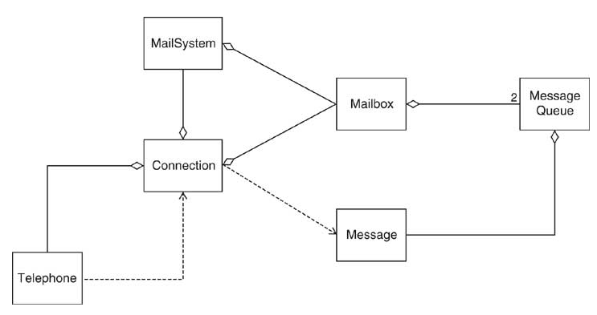
UML Class Diagram for Voice Mail System

Slide 81
Sequence Diagram for Use Case: Leave a message

Slide 82
Interpreting a Sequence Diagram
Each key press results in separate call to dial, but only one is shown
Connection wants to get greeting to play
Each mailbox knows its greeting
Connection must find mailbox object: Call findMailbox on MailSystem object
Parameters are not displayed (e.g. mailbox number)
Return values are not displayed (e.g. found mailbox)
Note that connection holds on to that mailbox over multiple calls

Slide 83
Sequence Diagram for Use Case: Retrieve messages

Slide 84
Connection State Diagram

Slide 85
Homework
trace the code (handout)
see how the Use Cases match up to the CRC cards
see how the CRC cards match up to the code.
get a good understanding for how this process works...
use the connection state diagram to attempt a run of the program

