Slide 1
Interface types and Polymorphism
Chapter 4

Slide 2
Chapter Topics
Displaying an Image
Polymorphism
The Comparable Interface
The Comparator Interface
Anonymous Classes
Frames and User Interface Components
User Interface Actions
Timers
Drawing Shapes
Designing an Interface

Slide 3
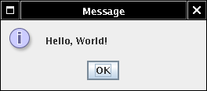
Displaying an Image
Use JOptionPane to display message: JOptionPane.showMessageDialog(null, "Hello, World!");
Note icon to the left

Slide 4
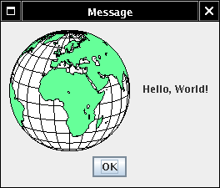
Displaying an Image
Can specify arbitrary image file JOptionPane.showMessageDialog( null,"Hello, World!", "Message", JOptionPane.INFORMATION_MESSAGE, new ImageIcon("globe.gif"));

Slide 5
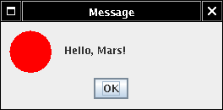
Displaying an Image
What if we don't want to generate an image file?
Fortunately, can use any class that implements Icon interface type
ImageIcon is one such class
Easy to supply your own class

Slide 6
The Icon Interface Type
public interface Icon { int getIconWidth(); int getIconHeight(); void paintIcon(Component c,
Graphics g, int x, int y) }

Slide 7
Interface Types
No implementation
Implementing class must supply implementation of all methods
Ch4/icon2/MarsIcon.java
showMessageDialog expects Icon object
Ok to pass MarsIcon
Ch4/icon2/IconTester.java

Slide 8
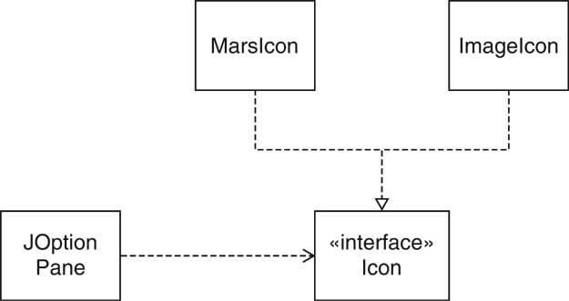
The Icon Interface Type and Implementing Classes

Slide 9
Polymorphism
public static void showMessageDialog(...Icon anIcon)
showMessageDialog shows
icon
message
OK button
showMessageDialog must compute size of dialog
width = icon width + message size + blank size
How do we know the icon width? int width = anIcon.getIconWidth();

Slide 10
Polymorphism
showMessageDialog doesn't know which icon is passed
ImageIcon?
MarsIcon?
. . .?
The actual type of anIcon is not Icon
There are no objects of type Icon
anIcon belongs to a class that implements Icon
That class defines a getIconWidth method

Slide 11
A Variable of Interface Type

Slide 12
Polymorphism
Which getIconWidth method is called?
Could be
MarsIcon.getIconWidth
ImageIcon.getIconWidth
. . .
Depends on object to which anIcon reference points, e.g. showMessageDialog(..., new MarsIcon(50))
Polymorphism: Select different methods according to actual object type

Slide 13
Benefits of Polymorphism
Loose coupling
showMessageDialog decoupled from ImageIcon
Doesn't need to know about image processing
Extensibility
Client can supply new icon types

Slide 14
The Comparable Interface Type
Collections has static sort method: ArrayList<E> a = . . . Collections.sort(a);
Objects in list must implement the Comparable interface type public interface Comparable<T> { int compareTo(T other); } Interface is parameterized (like ArrayList) Type parameter is type of other

Slide 15
The Comparable Interface Type
object1.compareTo(object2) returns
Negative number if object1 less than object2
0 if objects identical
Positive number if object1 greater than object2
sort method compares and rearranges elements if (object1.compareTo(object2) > 0) . . .
String class implements Comparable<String> interface type: lexicographic (dictionary) order
Country class: compare countries by area Ch4/sort1/Country.java Ch4/sort1/CountrySortTester.java

Slide 16
The Comparator interface type
How can we sort countries by name?
Can't implement Comparable twice!
Comparator interface type gives added flexibility public interface Comparator<T> { int compare(T obj1, T obj2); }
Pass comparator object to sort: Collections.sort(list, comp);

Slide 17
The Comparator interface type
Ch4/sort2/CountryComparatorByName.java Ch4/sort2/ComparatorTester.java
Comparator object is a function object
This particular comparator object has no state
State can be useful, e.g. flag to sort in ascending or descending order

Slide 18
Anonymous Classes
No need to name objects that are used only once Collections.sort(countries, new CountryComparatorByName());
No need to name classes that are used only once Comparator<Country> comp = new Comparator<Country>() { public int compare(Country country1,
Country country2) { return
country1.getName().compareTo(country2.getName()); } };

Slide 19
Anonymous Classes
anonymous new expression:
defines anonymous class that implements Comparator
defines compare method of that class
constructs one object of that class
Cryptic syntax for very useful feature

Slide 20
Anonymous Classes
Commonly used in factory methods: public static Comparator<Country> comparatorByName() { return new Comparator<Country>() { public int compare(Country country1,
Country country2) { . . . } }; }
Collections.sort(a, Country.comparatorByName());
Neat arrangement if multiple comparators make sense (by name, by area code, ...)

Slide 21
Frames
Frame window has decorations title bar
close box
provided by windowing system
JFrame frame = new JFrame(); frame.pack(); frame.setDefaultCloseOperation(
JFrame.EXIT_ON_CLOSE);
frame.setVisible(true);

Slide 22
Adding Components
Construct components JButton helloButton = new JButton("Say Hello");
Set frame layout frame.setLayout(new FlowLayout());
Add components to frame frame.add(helloButton);
Ch4/frame/FrameTester.java

Slide 23
User Interface Actions
Previous program's buttons don't have any effect
Add listener object(s) to button
Belong to class implementing ActionListener interface type public interface ActionListener { int actionPerformed(ActionEvent event); }
Listeners are notified when button is clicked

Slide 24
User Interface Actions
Add action code into actionPerformed method
Gloss over routine code
helloButton.addActionListener(new ActionListener() { public void actionPerformed(ActionEvent event) { textField.setText("Hello, World"); } }
);
When button is clicked, text field is set

Slide 25
Accessing Variables from Enclosing Scope
Remarkable: Inner class can access variables from enclosing scope e.g. textField
Can access enclosing instance fields, local variables
Local variables must be marked final final JTextField textField = ...;

Slide 26
User Interface Actions
Constructor attaches listener: helloButton.addActionListener(listener);
Button remembers all listeners
When button clicked, button notifies listeners listener.actionPerformed(event);
Listener sets text of text field textField.setText("Hello, World!");
Ch4/action1/ActionTester.java

Slide 27
Constructing Related Actions
Write helper method that constructs objects
Pass variable information as parameters
Declare parameters final
public static ActionListener
createGreetingButtonListener( final String message) { return new ActionListener(){ public void actionPerformed(ActionEvent
event) { textField.setText(message); } }; }

Slide 28
Timers
Supply delay, action listener ActionListener listener = ...; final int DELAY = 1000; // 1000 millisec = 1 sec Timer t = new Timer(DELAY, listener); t.start();
Action listener called when delay elapsed Ch4/timer/TimerTester.java

Slide 29
Drawing Shapes
paintIcon method receives graphics context of type
Graphics Actually a Graphics2D object in modern Java versions public void paintIcon(Component c,
Graphics g, int x, int y) { Graphics2D g2 = (Graphics2D)g; . . . } Can draw any object that implements Shape interface Shape s = . . .; g2.draw(s);

Slide 30
Drawing Rectangles and Ellipses
Rectangle2D.Double constructed with
top left corner
width
height
g2.draw(new Rectangle2D.Double(x, y, width,
height));
For Ellipse2D.Double, specify bounding box

Slide 31
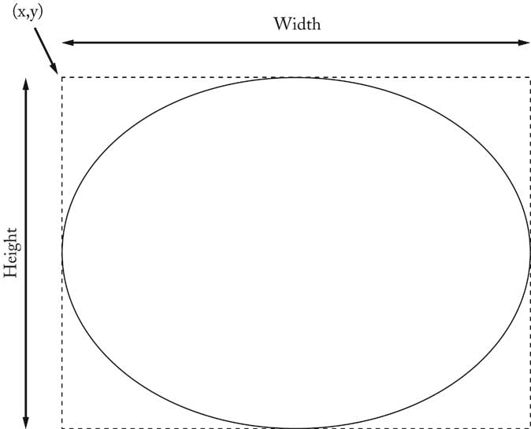
Drawing Ellipses

Slide 32
Drawing Line Segments
Point2D.Double is a point in the plane Line2D.Double joins to points
Point2D.Double start = new
Point2D.Double(x1, y1); Point2D.Double end = new
Point2D.Double(x2, y2); Shape segment = new
Line2D.Double(start, end); g2.draw(segment);

Slide 33
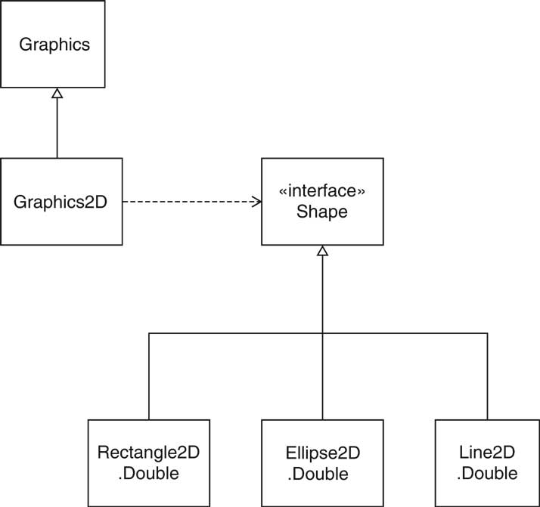
Relationship Between Shape Classes

Slide 34
Drawing Text
g2.drawString(text, x, y);
x, y are base point coordinates

Slide 35
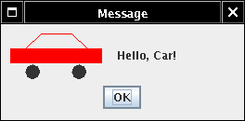
Filling Shapes
Fill interior of shape g2.fill(shape);
Set color for fills or strokes: g2.setColor(Color.red);
Program that draws car Ch4/icon3/CarIcon.java

Slide 36
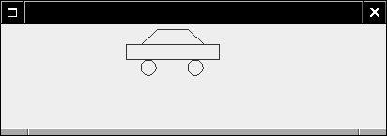
Defining a New Interface Type
Use timer to move car shapes
Draw car with CarShape
Two responsibilities:
Draw shape
Move shape
Define new interface type MoveableShape

Slide 37
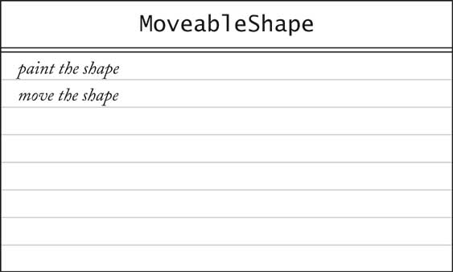
CRC Card for the MoveableShape Interface Type

Slide 38
Defining a New Interface Type
Name the methods to conform to standard library
public interface MoveableShape { void draw(Graphics2D g2); void translate(int dx, int dy); }
CarShape class implements MoveableShape
public class CarShape implements MoveableShape { public void translate(int dx, int dy) { x += dx; y += dy; } . . . }

Slide 39
Implementing the Animation
Label contains icon that draws shape
Timer action moves shape, calls repaint on label
Label needs Icon, we have MoveableShape
Supply ShapeIcon adapter class
ShapeIcon.paintIcon calls MoveableShape.draw

Slide 40
Implementing the Animation
Ch4/animation/MoveableShape.java
Ch4/animation/ShapeIcon.java
Ch4/animation/AnimationTester.java
Ch4/animation/CarShape.java

Slide 41
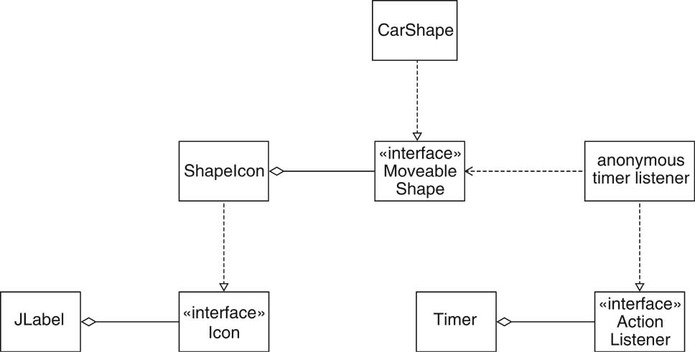
Implementing the Animation

