Slide 1
Pattern and GUI Programming
Chapter 5

Slide 2
Chapter Topics
Iterators
The Pattern Concept
The OBSERVER Pattern
Layout Managers and the STRATEGY Pattern
Components, Containers, and the COMPOSITE Pattern
Scroll Bars and the DECORATOR Pattern
How to Recognize Patterns
Putting Patterns to Work

Slide 3
List Iterators
LinkedList<String> list = . . .; ListIterator<String> iterator = list.listIterator(); while (iterator.hasNext()) { String current = iterator.next(); . . . } Why iterators?

Slide 4
Classical List Data Structure
Traverse links directly Link currentLink = list.head; while (currentLink != null) { Object current = currentLink.data; currentLink = currentLink.next; }
Exposes implementation
Error-prone

Slide 5
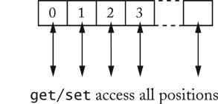
High-Level View of Data Structures
Queue
Array with Random Access

Slide 6
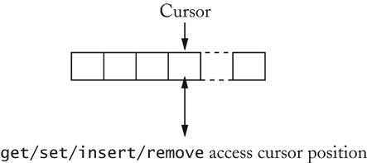
List with Cursor
for (list.reset(); list.hasNext(); list.next()) { Object x = list.get(); . . . } Disadvantage: Only one cursor per list
Iterator is superior concept

Slide 7
The Pattern Concept
History: Architectural Patterns
Christopher Alexander
Each pattern has
a short name
a brief description of the context
a lengthy description of the problem
a prescription for the solution

Slide 8
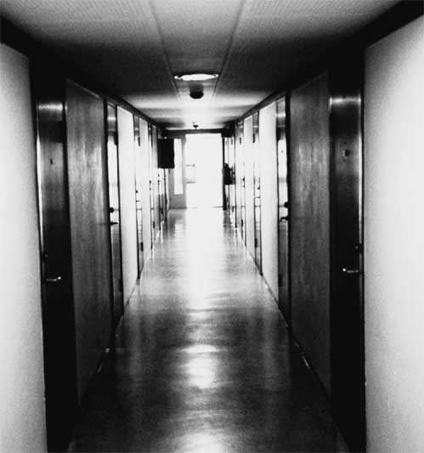
Short Passages Pattern

Slide 9
Short Passages Pattern
Context
"...Long, sterile corridors set the scene for everything bad about modern architecture..."
Problem
a lengthy description of the problem, including
a depressing picture
issues of light and furniture
research about patient anxiety in hospitals
research that suggests that corridors over 50 ft are considered uncomfortable

Slide 10
Short Passages Pattern
Solution
Keep passages short. Make them as much like rooms as possible, with carpets or wood on the floor, furniture, bookshelves, beautiful windows. Make them generous in shape and always give them plenty of light; the best corridors and passages of all are those which have windows along an entire wall.

Slide 11
Short Passages Pattern

Slide 12
Iterator Pattern
Context
An aggregate object contains element objects
Clients need access to the element objects
The aggregate object should not expose its internal structure
Multiple clients may want independent access

Slide 13
Iterator Pattern
Solution
Define an iterator that fetches one element at a time
Each iterator object keeps track of the position of the next element
If there are several aggregate/iterator variations, it is best if the aggregate and iterator classes realize common interface types.

Slide 14
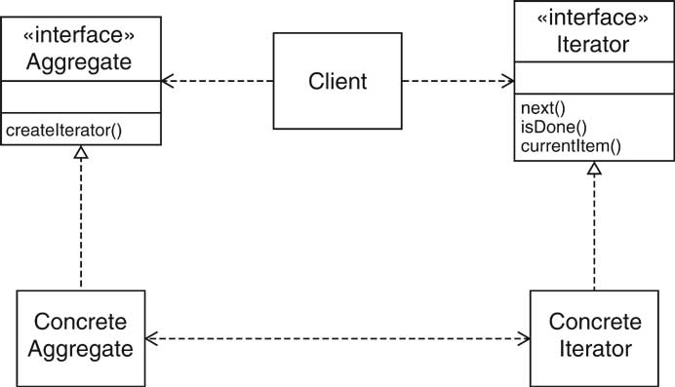
Iterator Pattern

Slide 15
Iterator Pattern
Names in pattern are examples
Names differ in each occurrence of pattern
Name in Design Pattern | Actual Name (linked lists)
Aggregate | List
ConcreteAggregate | LinkedList
Iterator | ListIterator
ConcreteIterator | anonymous class implementing ListIterator
createIterator() | listIterator()
next() | next()
isDone() | opposite of hasNext()
currentItem() | return value of hasNext()

Slide 16
Model/View/Controller
Some programs have multiple editable views
Example: HTML Editor
WYSIWYG view
structure view
source view
Editing one view updates the other
Updates seem instantaneous

Slide 17
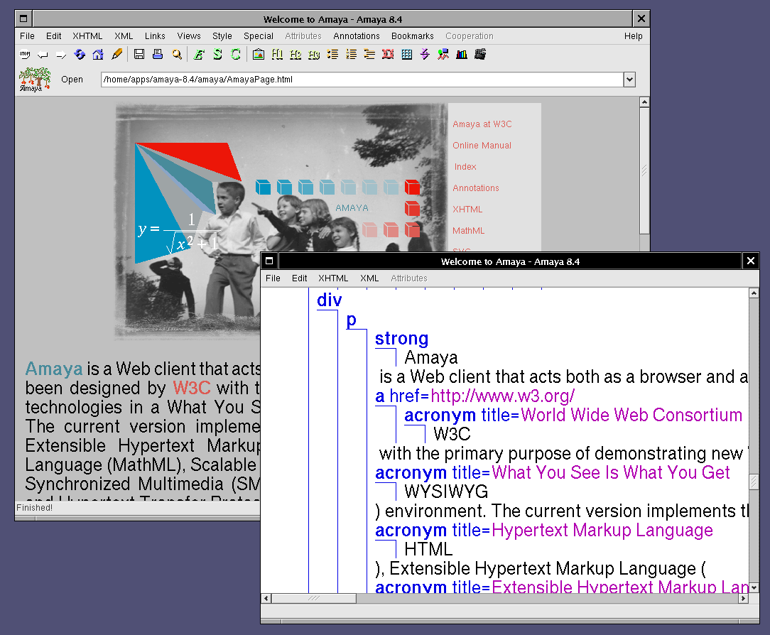
Model/View/Controller

Slide 18
Model/View/Controller
Model: data structure, no visual representation
Views: visual representations
Controllers: user interaction

Slide 19
Model/View/Controller
Views/controllers update model
Model tells views that data has changed
Views redraw themselves

Slide 20
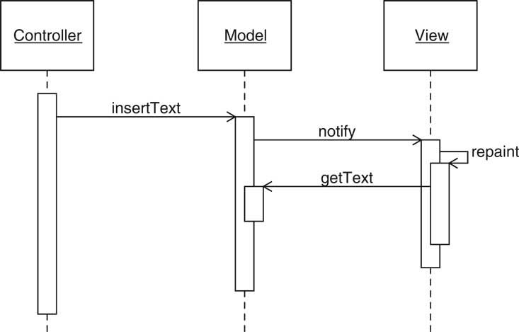
Model/View/Controller

Slide 21
Observer Pattern
Model notifies views when something interesting happens
Button notifies action listeners when something interesting happens
Views attach themselves to model in order to be notified
Action listeners attach themselves to button in order to be notified
Generalize: Observers attach themselves to subject

Slide 22
Observer Pattern
Context
An object, called the subject, is source of events
One or more observer objects want to be notified when such an event occurs.
Solution
Define an observer interface type. All concrete observers implement it.
The subject maintains a collection of observers.
The subject supplies methods for attaching and detaching observers.
Whenever an event occurs, the subject notifies all observers.

Slide 23
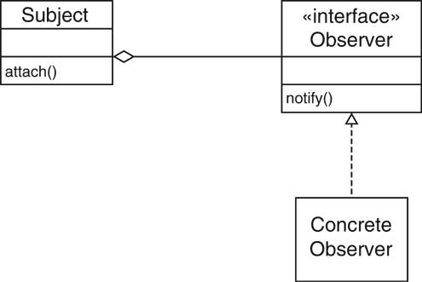
Observer Pattern

Slide 24
Names in Observer Pattern
Name in Design Pattern | Actual Name (Swing buttons)
Subject | JButton
Observer | ActionListener
ConcreteObserver | the class that implements the ActionListener interface type
attach() | addActionListener()
notify() | actionPerformed()

Slide 25
Layout Managers
User interfaces made up of components
Components placed in containers
Container needs to arrange components
Swing doesn't use hard-coded pixel coordinates
Advantages:
Can switch "look and feel"
Can internationalize strings
Layout manager controls arrangement

Slide 26
Layout Managers
FlowLayout: left to right, start new row when full
BoxLayout: left to right or top to bottom
BorderLayout: 5 areas, Center, North, South, East, West
GridLayout: grid, all components have same size
GridBagLayout: complex, like HTML table

Slide 27
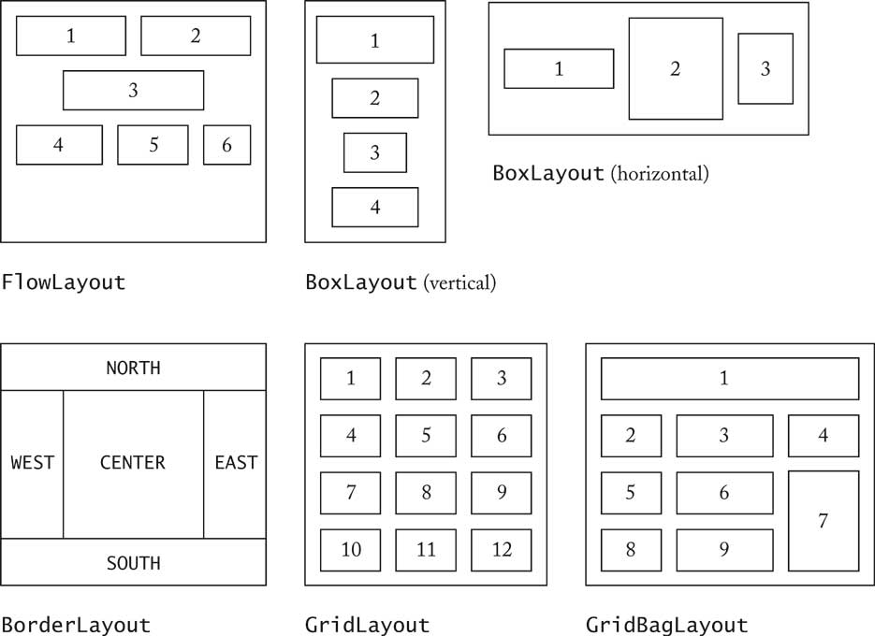
Layout Managers

Slide 28
Layout Managers
Set layout manager JPanel keyPanel = new JPanel(); keyPanel.setLayout(new GridLayout(4, 3));
Add components for (int i = 0; i < 12; i++) keyPanel.add(button[i]);

Slide 29
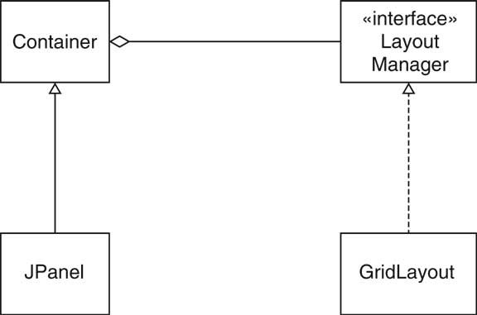
Layout Managers

Slide 30
Voice Mail System GUI
Same backend as text-based system
Only Telephone class changes
Buttons for keypad
Text areas for microphone, speaker

Slide 31
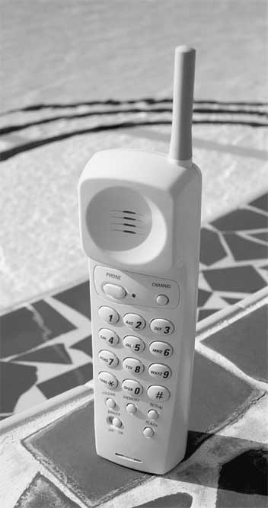
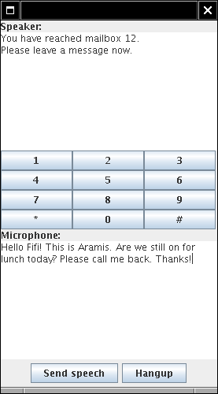
Voice Mail System GUI

Slide 32
Voice Mail System GUI
Arrange keys in panel with GridLayout: JPanel keyPanel = new JPanel(); keyPanel.setLayout(new GridLayout(4, 3)); for (int i = 0; i < 12; i++) { JButton keyButton = new JButton(...); keyPanel.add(keyButton); keyButton.addActionListener(...); }

Slide 33
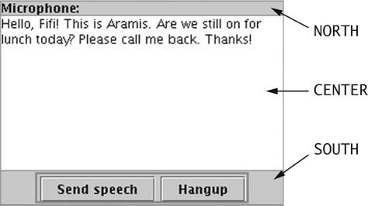
Voice Mail System GUI
Panel with BorderLayout for speaker JPanel speakerPanel = new JPanel(); speakerPanel.setLayout(new BorderLayout()); speakerPanel.add(new JLabel("Speaker:"), BorderLayout.NORTH); speakerField = new JTextArea(10, 25); speakerPanel.add(speakerField, BorderLayout.CENTER);

Slide 34
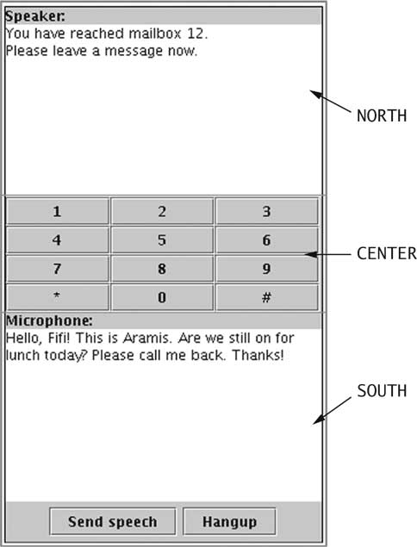
Voice Mail System GUI
Add speaker, keypads, and microphone panel to frame
Frame already has BorderLayout
Ch5/mailgui/Telephone.java

Slide 35
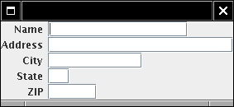
Custom Layout Manager
Form layout
Odd-numbered components right aligned
Even-numbered components left aligned
Implement LayoutManager interface type

Slide 36
The LayoutManager Interface Type
public interface LayoutManager { void layoutContainer(Container parent); Dimension minimumLayoutSize(Container parent); Dimension preferredLayoutSize(Container parent); void addLayoutComponent(String name, Component comp); void removeLayoutComponent(Component comp); }

Slide 37
Form Layout
Ch5/layout/FormLayout.java Ch5/layout/FormLayoutTester.java
Note: Can use GridBagLayout to achieve the same effect

Slide 38
Strategy Pattern
Pluggable strategy for layout management
Layout manager object responsible for executing concrete strategy
Generalizes to Strategy Design Pattern
Other manifestation: Comparators Comparator<Country> comp = new CountryComparatorByName(); Collections.sort(countries, comp);

Slide 39
Strategy Pattern
Context
A class can benefit from different variants for an algorithm
Clients sometimes want to replace standard algorithms with custom versions
Solution
Define an interface type that is an abstraction for the algorithm
Actual strategy classes realize this interface type.
Clients can supply strategy objects
Whenever the algorithm needs to be executed, the context class calls the appropriate methods of the strategy object

Slide 40
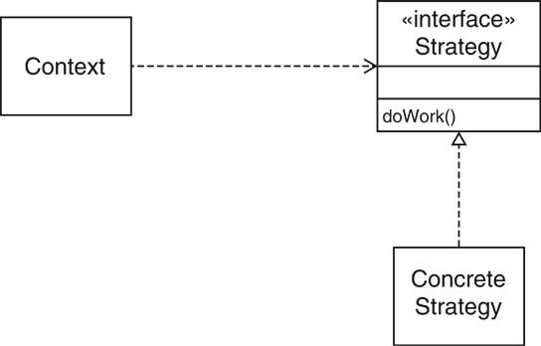
Strategy Pattern

Slide 41
Strategy Pattern: Layout Management
Name in Design Pattern | Actual Name (layout management)
Context | Container
Strategy | LayoutManager
ConcreteStrategy | a layout manager such as BorderLayout
doWork() | a method such as layoutContainer

Slide 42
Strategy Pattern: Sorting
Name in Design Pattern | Actual Name (sorting)
Context | Collections
Strategy | Comparator
ConcreteStrategy | a class that implements Comparator
doWork() | compare

Slide 43
Containers and Components
Containers collect GUI components
Sometimes, want to add a container to another container
Container should be a component
Composite design pattern
Composite method typically invoke component methods
E.g. Container.getPreferredSize invokes getPreferredSize of components

Slide 44
Composite Pattern
Context
Primitive objects can be combined to composite objects
Clients treat a composite object as a primitive object
Solution
Define an interface type that is an abstraction for the primitive objects
Composite object collects primitive objects
Composite and primitive classes implement same interface type.
When implementing a method from the interface type, the composite class applies the method to its primitive objects and combines the results

Slide 45
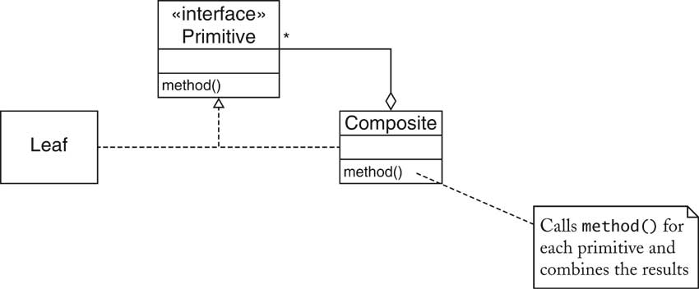
Composite Pattern

Slide 46
Composite Pattern
Name in Design Pattern | Actual Name (AWT components)
Primitive | Component
Composite | Container
Leaf | a component without children (e.g. JButton)
method() | a method of Component (e.g. getPreferredSize)

Slide 47
Scroll Bars
Scroll bars can be attached to components
Approach #1: Component class can turn on scroll bars
Approach #2: Scroll bars can surround component JScrollPane pane = new JScrollPane(component);
Swing uses approach #2
JScrollPane is again a component

Slide 48
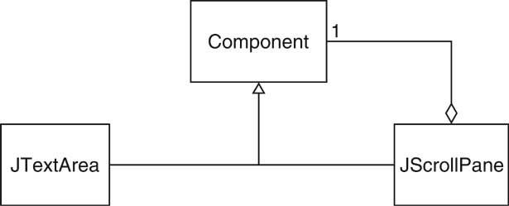
Scroll Bars

Slide 49
Decorator Pattern
Context
Component objects can be decorated (visually or behaviorally enhanced)
The decorated object can be used in the same way as the undecorated object
The component class does not want to take on the responsibility of the decoration
There may be an open-ended set of possible decorations

Slide 50
Decorator Pattern
Solution
Define an interface type that is an abstraction for the component
Concrete component classes realize this interface type.
Decorator classes also realize this interface type.
A decorator object manages the component object that it decorates
When implementing a method from the component interface type, the decorator class applies the method to the decorated component and combines the result with the effect of the decoration.

Slide 51
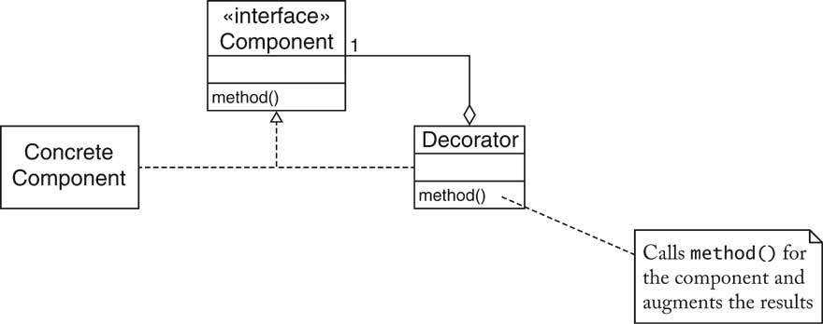
Decorator Pattern

Slide 52
Decorator Pattern: Scroll Bars
Name in Design Pattern | Actual Name (scroll bars)
Component | Component
ConcreteComponent | JTextArea
Decorator | JScrollPane
method() | a method of Component (e.g. paint)

Slide 53
Streams
InputStreamReader reader = new InputStreamReader(System.in); BufferedReader console = new
BufferedReader(reader);
BufferedReader takes a Reader and adds buffering
Result is another Reader: Decorator pattern
Many other decorators in stream library, e.g. PrintWriter

Slide 54
Decorator Pattern: Input Streams
Name in Design Pattern | Actual Name (input streams)
Component | Reader
ConcreteComponent | InputStreamReader
Decorator | BufferedReader
method() | read

Slide 55
How to Recognize Patterns
Look at the intent of the pattern
E.g. COMPOSITE has different intent than DECORATOR
Remember common uses (e.g. STRATEGY for layout managers)
Not everything that is strategic is an example of STRATEGY pattern
Use context and solution as "litmus test"

Slide 56
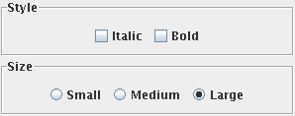
Litmus Test
Can add border to Swing component Border b = new EtchedBorder() component.setBorder(b);
Undeniably decorative
Is it an example of DECORATOR?

Slide 57
Litmus Test
Component objects can be decorated (visually or behaviorally enhanced) PASS
The decorated object can be used in the same way as the undecorated object PASS
The component class does not want to take on the responsibility of the decoration FAIL--the component class has setBorder method
There may be an open-ended set of possible decorations

Slide 58
Putting Patterns to Work
Invoice contains line items Line item has description, price Interface type LineItem: Ch5/invoice/LineItem.java Product is a concrete class that implements this interface: Ch5/invoice/Product.java

Slide 59
Bundles
Bundle = set of related items with description+price E.g. stereo system with tuner, amplifier, CD player + speakers
A bundle has line items
A bundle is a line item COMPOSITE pattern
Ch5/invoice/Bundle.java (look at getPrice)

Slide 60
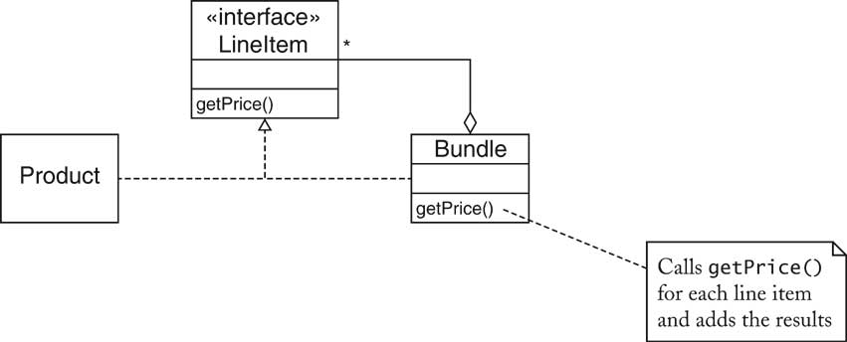
Bundles

Slide 61
Discounted Items
Store may give discount for an item
Discounted item is again an item
DECORATOR pattern
Ch5/invoice/DiscountedItem.java (look at getPrice)
Alternative design: add discount to LineItem

Slide 62
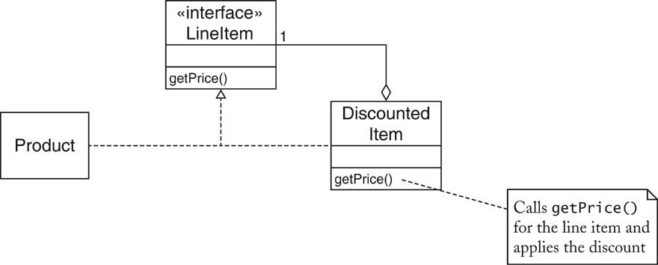
Discounted Items

Slide 63
Model/View Separation
GUI has commands to add items to invoice
GUI displays invoice
Decouple input from display
Display wants to know when invoice is modified
Display doesn't care which command modified invoice
OBSERVER pattern

Slide 64
Change Listeners
Use standard ChangeListener interface type public interface ChangeListener { void stateChanged(ChangeEvent event); } Invoice collects ArrayList of change listeners When the invoice changes, it notifies all listeners: ChangeEvent event = new ChangeEvent(this); for (ChangeListener listener : listeners) listener.stateChanged(event);

Slide 65
Change Listeners
Display adds itself as a change listener to the invoice Display updates itself when invoice object changes state final Invoice invoice = new Invoice(); final JTextArea textArea = new JTextArea(20, 40); ChangeListener listener = new ChangeListener() { public void stateChanged(ChangeEvent event) { textArea.setText(...); } };

Slide 66
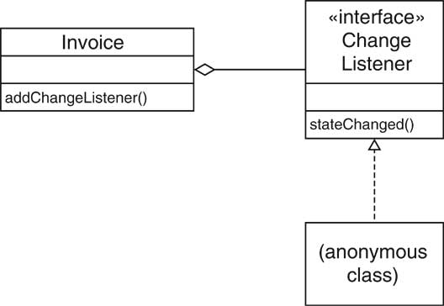
Observing the Invoice

Slide 67
Iterating Through Invoice Items
Invoice collect line items
Clients need to iterate over line items
Don't want to expose ArrayList
May change (e.g. if storing invoices in database)
ITERATOR pattern

Slide 68
Iterators
Use standard Iterator interface type public interface Iterator<LineItem> { boolean hasNext(); LineItem next(); void remove(); }
remove is "optional operation" (see ch. 8)
implement to throw UnsupportedException
implement hasNext/next manually to show inner workings
Ch5/invoice/Invoice.java

Slide 69
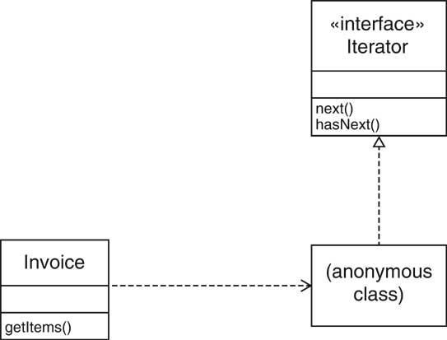
Iterators

Slide 70
Formatting Invoices
Simple format: dump into text area
May not be good enough,
E.g. HTML tags for display in browser
Want to allow for multiple formatting algorithms
STRATEGY pattern

Slide 71
Formatting Invoices
ch5/invoice/InvoiceFormatter.java
ch5/invoice/SimpleFormatter.java
ch5/invoice/InvoiceTester.java

Slide 72
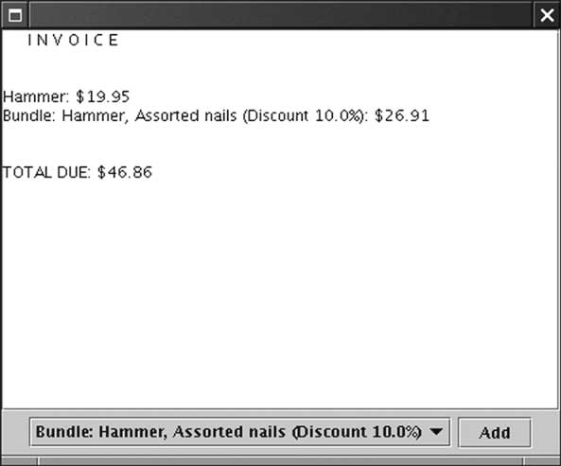
Formatting Invoices

Slide 73
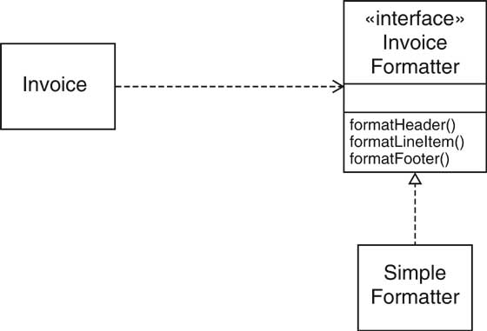
Formatting Invoices

