Slide 1
Mobile Application Development
CS 101 Fall 2013
Prof. Elizabeth White

Slide 2
Mobile Devices – The Good
Always with the user
Increasingly powerful
Typically GPS capable
Typically have accelerometer
Several types of wireless communication
Many apps are free or low-cost

Slide 3
Mobile Devices – The Not-So-Good
Limited screen size and colors
Limited battery life
Limited processor speed
Limited and slow network access
Limited or awkward input: soft keyboard, phone keypad, touch screen, or stylus
Limited web browser functionality
Often inconsistent platforms across devices

Slide 4
Mobile Applications
What are they?
Any application that runs on a mobile device
Types
Web apps: run in a web browser
HTML, JavaScript, Flash, server-side components, etc.
Native: compiled binaries for the device

Slide 5
Native App Development Environments
Java ME
.NET Compact Framework (C++, C#, VB.NET) for Windows Mobile
Symbian (C++)
BlackBerry (Java)
Android (Java)
iPhone (Objective-C)
Is having so many choices a good thing?
Notes:
HTC Zero is the first Android device that supports Flash http://www.adobe.com/devnet/devices/articles/htchero.html
iPhone does not support Flash
Adobe has software that allows developers to convert Flash into iPhone apps
http://mashable.com/2009/10/05/iphone-flash/
BREW: Binary Runtime Environment Wireless
Proprietary mobile device platform developed by Qualcomm.Development
language is C with C++ interfaces.
Certification and development process is expensive.

Slide 6
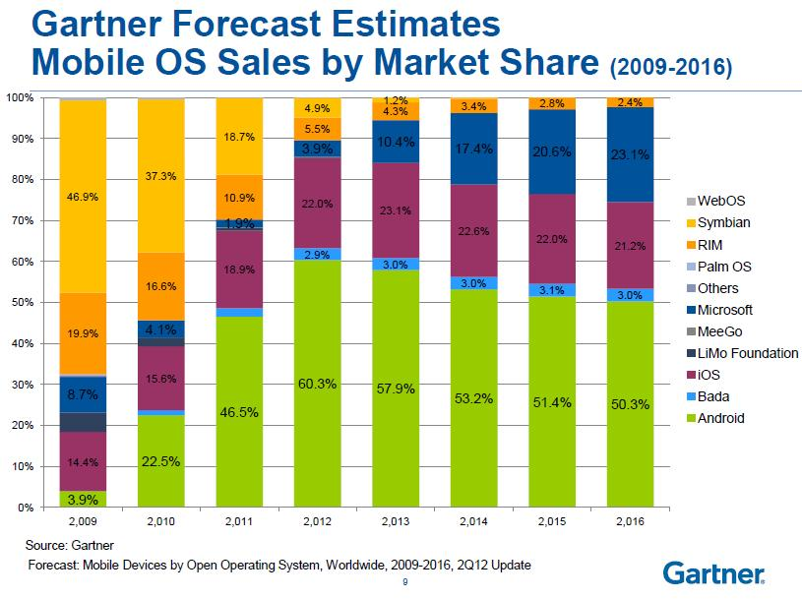

Slide 7
Development Environments
Most platforms have an SDK that you can download and build against
Every platform has an emulator that you can use to test your apps
Most emulators are configurable to match a variety of mobile devices
Various screen sizes, memory limitations, etc.

Slide 8
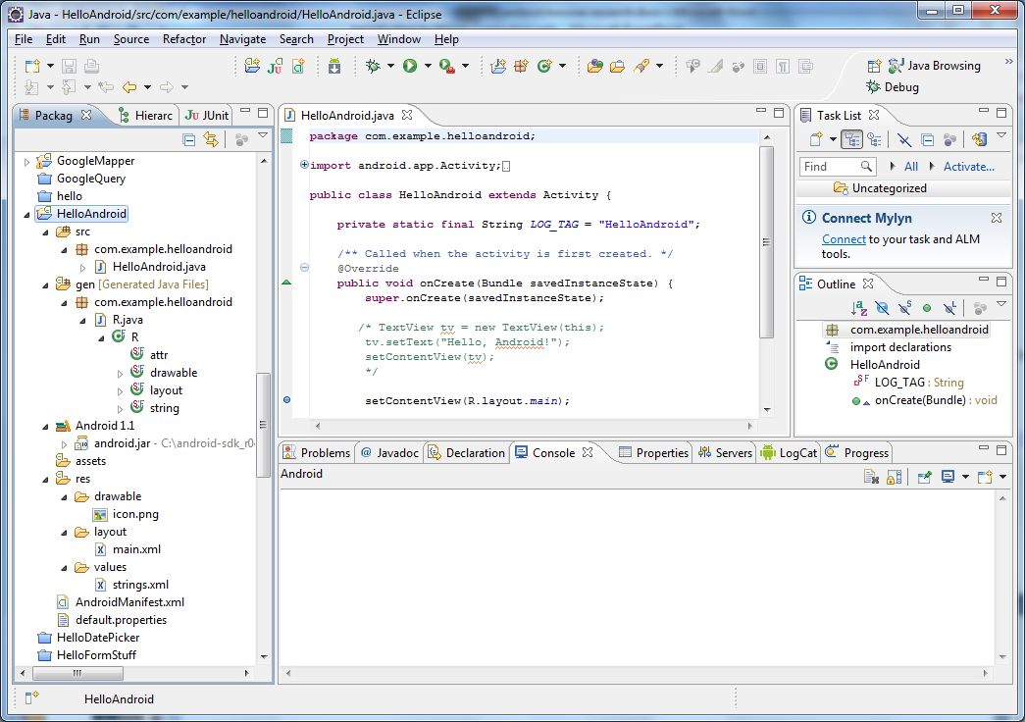
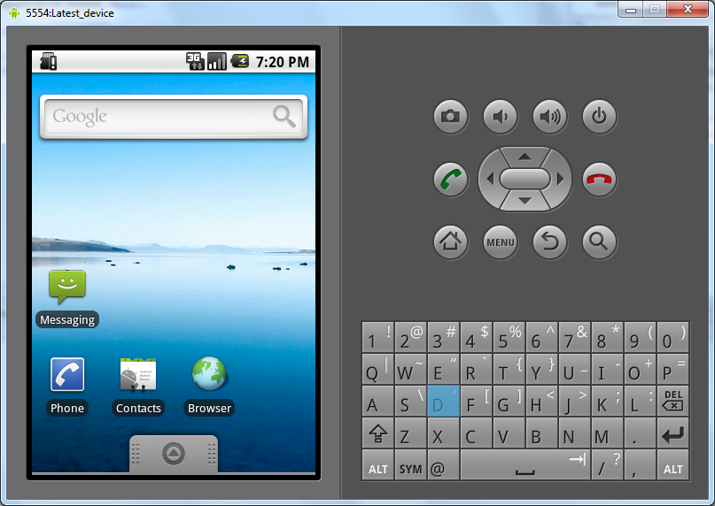
Eclipse and Android Emulator

Slide 9
What is Android?
A software stack for mobile devices
Operating system,
middleware
key applications
Use Android SDK (Java) to create applications
Libraries & development tools

Slide 10
Android APIs
Name | Version | Levels | Released
 | 1.0, 1.1 | 1,2 | 9/2008
Cupcake | 1.5 | 3 | 4/2009
Donut | 1.6 | 4 | 9/2009
Eclair | 2.0, 2.0.1, 2.1 | 5,6,7 | 10/2009
Froyo | 2.2-2.2.3 | 8 | 5/2010
Gingerbread | 2.3-2.3.2, 2.3.3-2.3.7 | 9,10 | 12/2010
Honeycomb | 3.0, 3.1,3.2 | 11,12,13 | 2/2011
Ice Cream Sandwich | 4.0-4.0.2, 4.0.3-4.0.4 | 14,15 | 10/2011
Jellybean | 4.1, 4.2, 4.3 | 16, 17, 18 | 6/2012
KitKat | 4.4 | 19

Slide 11
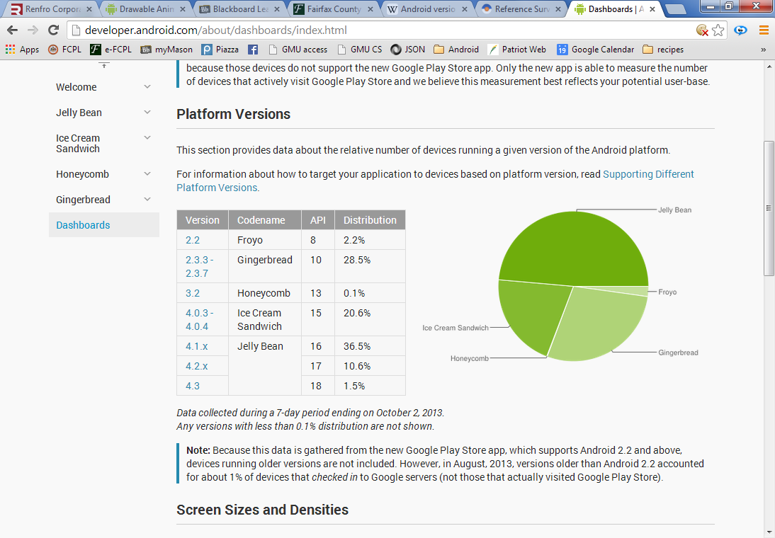
Android APIs

Slide 12
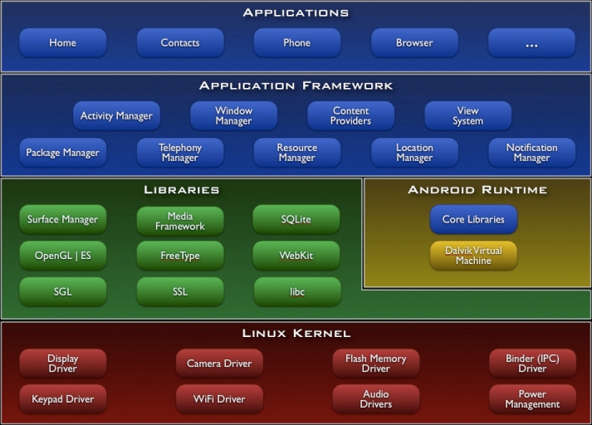
Android Architecture

Slide 13
Linux Kernel
Abstraction Layer between HW & SW
Provides services such as
Security
Memory & process management
Network stack
Device driver model
Android-specific components
Android shared memory
Power management
Alarm driver
Low memory killer
kernel debugger & logger

Slide 14
Native Libraries
libc – C/C++ custom implementation – optimized for embedded use
Media Framework – supports standard video, audio, …
SQLite – lightweight transactional data store, backend for most platform data
OpenGL/ES – graphics libraries

Slide 15
Android Runtime
Core Libraries
android.*, java.*, javax.*, …
does not include all the standard Java SDK classes
Dalvik Virtual Machine
Applications written in Java
Do not run on the JVM
VM designed to run on a handset: Slow CPU, little RAM (~10mb at runtime), limited battery life

Slide 16
Application Framework
Window Manager
Manages top-level window’s look & behavior
View System
lists, grid, text boxes, buttons, …
Content Providers
Inter-application data sharing
Activity Manager
Application lifecycle and common navigation stack

Slide 17
Application Framework
Package Manager
Manages application packages
Telephony manager
State of telephony services
Resource Manager
deals with non-code resources: strings, graphics, layout files
Location Manager
System location services
Notification Manager
Notify users when events occur

Slide 18
Applications
Standard apps including:
Home – main screen
Contacts
Phone
browser
email
Written primarily in Java and XML
.apk files

Slide 19
Developing Apps
Event based Programming
User interface a key element!
Elements of design – widgets, views, view groups…
Wiring
Differing screen size
Several key component classes:
Activities
Services
Broadcast receivers
Content providers

Slide 20
Developing Apps
Data – SQLite, files, shared preferences
Networking – wireless, cellular, bluetooth
Client/server interactions
Concurrency
App Lifecycle
Saving/restoring state when apps are interrupted.
Background processing
Thread safety

Slide 21
Developing Apps
Sensors
Multimedia
Graphics
Location Services

Slide 22
Mobile devices are easily exploited by hackers because they
have limited resources in terms of processing power, memory and energy consumption;
have hardware parts that are tightly integrated, making it difficult to identify the source of abnormal behaviors
lack built-in protection mechanisms to detect malware, due to resource limitations

Slide 23
Protected APIs
Uses a permission based system for some system resources:
Camera functions
Location data (GPS)
Bluetooth functions
Telephony functions
SMS/MMS functions
Network/data connections
Can’t use these resources unless permission has been requested.

Slide 24
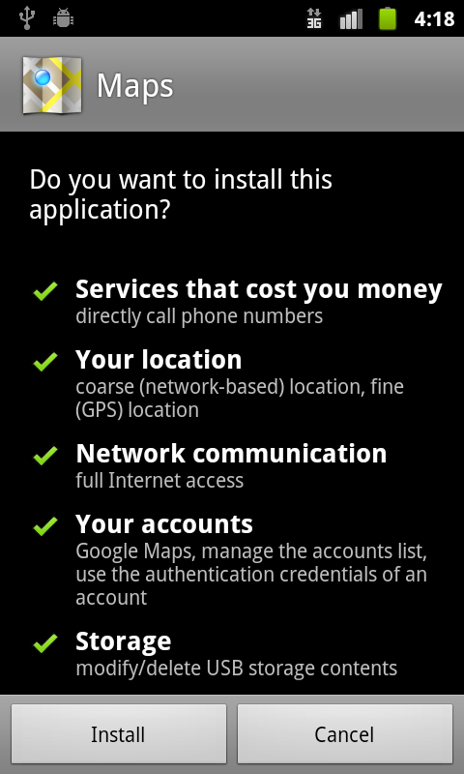
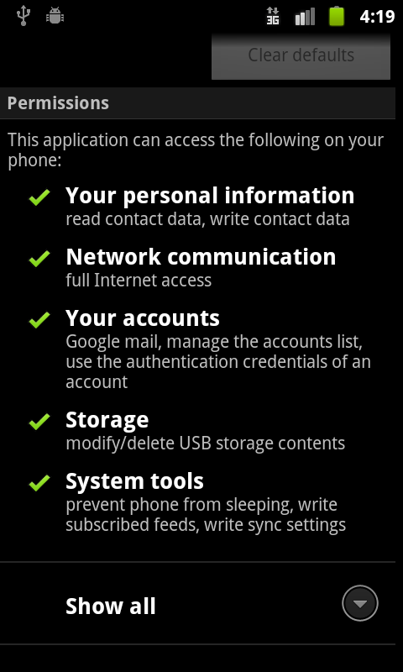

Slide 25
In spite of all of this …
As the number of devices continues to increase and as we evolve toward a small number of OS, the target is very tempting to hackers.
Malware is any kind of hostile, intrusive or annoying software or program code designed to use a device without the owner’s consent.

Slide 26
Attack Methods
Wireless – eavesdropping on wireless transmissions
Break-in attacks – take over device by exploiting programming errors (buffer overflow, format string vulnerabilities)
Infrastructure attacks – using phone, email, SMS in a variety of ways including DOS, use of premium services,…
Trojan – additional functionality added to existing app – re-issued as an update
Battery exhaustion – using resources (like GPS) that require a lot of power.
Social Engineering based attacks – phishing, …
Botnets – set of devices that are controlled by an attacker

