Slide 1
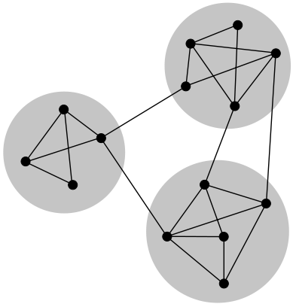
Introduction to Complex Networks
Information Systems Engineering
‎‎372-2-5503 (2013 A)
Mr. Guy Rapaprot
Dr. Rami Puzis

Slide 2
Community Structure
What is Community Structure?
Detecting Communities using Edge Removal (Girvan-Newman algorithm)
Detecting Communities by
Modularity Maximization
Detecting Communities by Label Propagation
Summary
Bibliography
Glossary
List of Algorithms
List of Definitions

Slide 3
What is Community Structure?
Let's make it clear: It's not clustering coefficient!
Clustering
  The extent to which vertices tend to cluster together.
  The extent to which neighbors of a vertex tend to connect between themselves
“Two of your friends will have a greater probability of knowing one another than will two people chosen at random from the population, on account of their common acquaintance with you.
Notes:
Taken from: Girvan, Michelle, and Mark EJ Newman. "Community structure in social and biological networks." Proceedings of the National Academy of Sciences 99.12 (2002): 7821-7826.

Slide 4
What is Community Structure?
Community:
  fellowship or organized society
  small, social unit of any size that shares common values
  in small communities people are well acquainted with each other
A subset of vertices such that the vertex–vertex connections within the subset are dense, but connections from the subset outside are loose.

Slide 5
What is Community Structure in Complex Networks?
It's not graph partitioning either...
A typical problem in graph partitioning is the division of a set of tasks between the processors of a parallel computer so as to minimize the necessary amount of interprocessor communication. In such an application the number of processors is usually known in advance and at least an approximate figure for the number of tasks that each processor can handle. Thus we know the number and size of the groups into which the network is to be split. Also, the goal is usually to find the best division of the network regardless of whether a good division even exists; there is little point in an algorithm or method that fails to divide the network in some cases.
Community structure detection, by contrast, is perhaps best thought of as a data analysis technique used to shed light on the structure of large-scale network data sets, such as social networks, internet and web data, or biochemical networks. Community detection methods normally assume that the network of interest divides naturally into subgroups and the experimenter’s job is to find those groups. The number and size of the groups is thus determined by the network itself and not by the experimenter. Moreover, community structure methods may explicitly admit the possibility that no good division of the network exists, an outcome that is itself considered to be of interest for the light it sheds on the topology of the network.
Notes:
Taken from: "Modularity and community structure in networks", M.E.J Newman, 2006

Slide 6
Motivation for Detecting Communities in Complex Networks
Example: Elite Instant Coffee - 2012 Campaign

Slide 7

Motivation
You can advertise by paying a handful of celebrities... Or by taking photos of 985 "anonymous" people.
What is more effective?
Notes:
Photographs and details courtesy of Racheli Otmazgin (the woman who appears in them).

Slide 8

Motivation
The assumption in this campaign is that a lot of people personally know a person who was photographed for this campaign.
Notes:
Photographs and details courtesy of Racheli Otmazgin (the woman who appears in them).
In this particular case - Racheli is the girlfriend of Grisha Klots, my former flatmate and a close friend.

Slide 9

Motivation
While we can relate this campaign to Small-World and Epidemics Propagation, we can also consider it as a case of correctly picking individuals from multiple communities.
Notes:
Taken from Elite's website for this campaign:
http://www.elite-names.co.il

Slide 10
Motivation
The ability to detect community structure in a network could clearly have practical applications.
Communities in a social network might represent real social groupings, perhaps groups of interest;
Communities in a citation network might represent scientific domains;
Communities in a metabolic network might represent cycles and other functional groupings;
Communities on the web might represent pages on related topics.
Being able to identify these communities could help us to understand and exploit these networks more effectively.

Slide 11
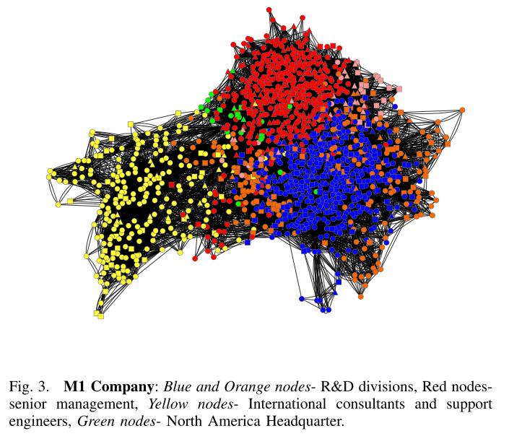
Organization mining
For each node in the organization social network, we eight centrality measures were calculated:
Degree),
Closeness
Betweenness
Eigvector
HITS
PageRank
Communicability
Load
Notes:
Communicability centrality, also called subgraph centrality, of a node n is the sum of closed walks of all lengths starting and ending at node n.
Authority and hub centralities for the vertices in the graph

Slide 12
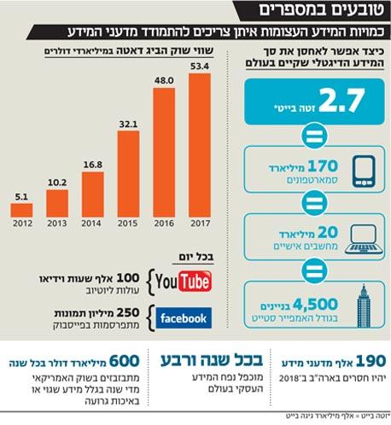
Motivation
לידע האנושי דרוש כלבויניק
"מדען ביג דאטה, שמנתח את כמויות המידע האינסופיות שמיוצרות ומוציא מהן משהו בעל ערך, הוא כנראה המקצוע המבוקש של השנים הקרובות. [...]לתפקיד נדרשים כישורים של איש שיווק, אנתרופולוג ופסיכולוג, עדיין אין מסגרות שמכשירות עובדים לתפקיד".
הראל עילם, כלכליסט,02.12.2012
http://www.calcalist.co.il/internet/articles/0,7340,L-3589269,00.html

Slide 13
Class Activity: Detecting Communities (Top-Down)
Let's consider the following graph:
Nodes - students in class.
Edges - anything we can think of: acquaintance, same birthplace, hobbies, etc.
Iteratively, we'll choose and remove an edge, notating the sequence of removals.
Eventually, the graph will break down into singleton communities. If we keep track on our steps, we can stop elsewhere and define the components as communities.

Slide 14
Class Activity: Detecting Communities (Bottom-Up)
Let's consider the following graph:
Nodes - students in class.
Edges - anything we can think of: acquaintance, same birthplace, hobbies, etc.
Start with a graph of singletons; at each iteration, add an edge connecting two unconnected components.
Eventually, a spanning-tree of the original graph will emerge. If we keep track on our steps, we can stop elsewhere and define the components as communities.

Slide 15
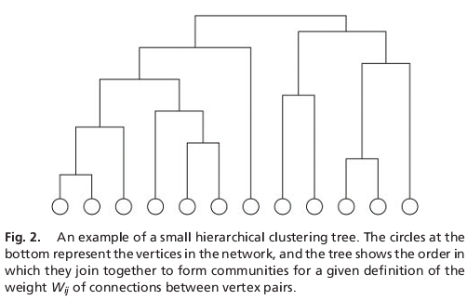
Class Activity: Detecting Communities
We can join separate nodes or decompose a graph into communities.
Questions arising:
Efficient
algorithms?
Qualitative
evaluation of
such partitions?
Interpretation
of results?

Slide 16
Attempts at a Formal Definition
Here are some attempts:
Chain of adjacent cliques: two k-cliques are adjacent if they share k-1 nodes.
K-Clan: a group of nodes with diameter of k.
K-Club: a group of nodes being the maximal subgraph with diameter of k.
For each vertex i in a group, the in-group degree > the out-group degree...
...and more.
There is no commonly accepted formal definition.
The quality of the detected community structure is evaluated based on common sense or a golden standard.
Notes:
Taken from "Near Linear Time Algorithm to Detect Community Structure in Large-Scale Networks" - Raghavan, Albert, Kumara (2007)
http://arxiv.org/abs/0709.2938

Slide 17
Methodology
The community-detection problem does not necessarily have a single, analytical solution. In such cases, we:
Obtain sample, real-world network data where we can agreeably identify communities.
Design a community-detection algorithm.
Execute the algorithm with the data: measure the quality of the prediction.
Improve as necessary.
For QA: Null models, random graphs.
Notes:
Null model: http://en.wikipedia.org/wiki/Null_model

Slide 18
Benchmark Data: Zachary's Karate Club
The ‘‘karate club’’ network of Zachary shows the pattern of friendships between the members of a karate club at an American university in the 1970s. This observation was made by anthropologist Wayne W. Zachary.
Shortly after the observation and construction of the network, the club in question split in two as a result of an internal dispute.
We are interested in community detection algorithms that can predict the split in accordance with the real data.
Original paper: http://www1.ind.ku.dk/complexLearning/zachary1977.pdf
Notes:
An alternative benchmark is the "College Football" dataset:
"College Football. As a further test of our algorithm, we turn to the world of United States college football. (Football here means American football, not soccer.) The network we look at is a representation of the schedule of Division I games for the 2000 season: vertices in the graph represent teams (identified by their college names) and edges represent regular-season games between the two teams they connect. What makes this network interesting is that it incorporates a known community structure. The teams are divided into conferences containing around 8–12 teams each. Games are more frequent between members of the same conference than between members of different conferences, with teams playing an average of about seven intraconference games and four interconference games in the 2000 season. Interconference play is not uniformly distributed; teams that are geographically close to one another but belong to different conferences are more likely to play one another than teams separated by large geographic distances." (Girvan-Newman, 2002)

Slide 19
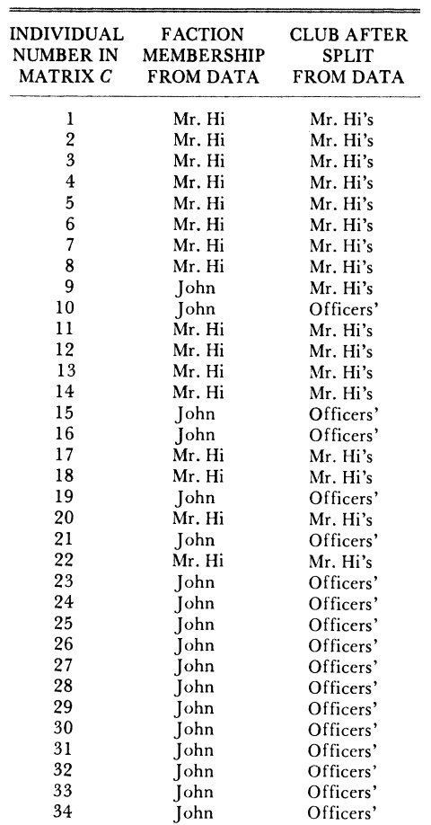
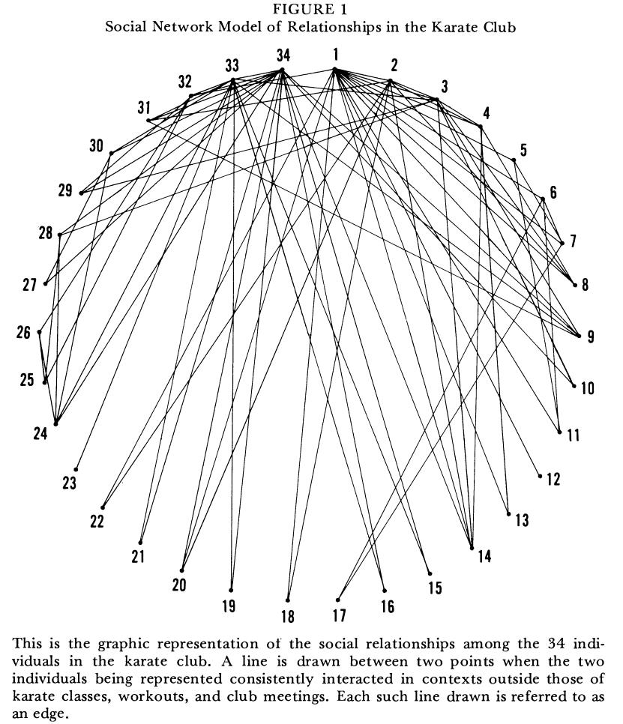
Notes:
From Zachary's paper (pages 2-3):
The karate club was observed for a period of three years, from 1970 to 1972. In addition to direct observation, the history of the club prior to the period of the study was reconstructed through informants and club records in the university archives. During the period of observation, the club maintained between 50 and 100 members, and its activities included social affairs (parties, dances, banquets, etc.) as well as regularly scheduled karate lessons. The political organization of the club was informal, and while there was a constitution and four officers, most decisions were made by consensus at club meetings. For its classes, the club employed a part-time karate instructor, who will be referred to as Mr. Hi*.
At the beginning of the study there was an incipient conflict between the club president, John A., and Mr. Hi over the price of karate lessons. Mr. Hi, who wished to raise prices, claimed the authority to set his own lesson fees, since he was the instructor. John A., who wished to stabilize prices, claimed the authority to set the lesson fees since he was the club's chief administrator.
As time passed the entire club became divided over this issue, and the conflict became translated into ideological terms by most club members. The supporters of Mr. Hi saw him as a fatherly figure who was their spiritual and physical mentor, and who was only trying to meet his own physical needs after seeing to theirs. The supporters of John A. and the other officers saw Mr. Hi as a paid employee who was trying to coerce his way into a higher salary. After a series of increasingly sharp factional confrontations over the price of lessons, the officers, led by John A., fired Mr. Hi for attempting to raise lesson prices unilaterally. The supporters of Mr. Hi retaliated by resigning and forming a new organization headed by Mr. Hi, thus completing the fission of the club.
During the factional confrontations which preceded the fission, the club meeting remained the setting for decision making. If, at a given meeting, one faction held a majority, it would attempt to pass resolutions and decisions favorable to its ideological position. The other faction would then retaliate at a future meeting when it held the majority, by repealing the unfavorable decisions and substituting ones favorable to itself. Thus, the outcome of any crisis was determined by which faction was able to "stack" the meetings most successfully.
The factions were merely ideological groupings, however, and were never organizationally crystallized. There was an overt sentiment in the club that there was no political division, and the factions were not named or even recognized to exist by club members. Rather, they were merely groups which emerged from the existing network of friendship among club members at times of political crisis because of ideological differences. There was no attempt by anyone to organize or direct political strategies of the groups, and, in general, there was no barrier to interaction between members of opposing factions. Only at times of direct political conflict did individuals selectively interact with others who shared the same ideological position, to the exclusion of those holding other positions. This selective association during confrontations is what brought the factions together only at crisis moments.
Political crisis, then, also had the effect of strengthening the friendship bonds within these ideological groups, and weakening the bonds between them, by the pattern of selective reinforcement. A series of political crises, like that which preceded the fission had the effect of "pulling" apart the network of friendship ties which held the club together, until the group completely and formally separated.
* All names given are pseudonyms in order to protect the informants' anonymity. For similar reasons, the exact location of the study is not given.

Slide 20
Simplifications
During this lecture we will discuss algorithms which handle only the following networks:
Connected (a few disconnected components surely do not belong to the same community).
Undirected.
Unweighted.
For some algorithms, generalizations for direction and weight exist; however, they will not be included in the scope of this lecture.

Slide 21
Detecting Communities using
Edge Removal
(Girvan-Newman algorithm)
Girvan and Newman are Professors of physics from the Universities of Maryland and Michigan (respectively) working on complex networks.
Notes:
Read more in Wikipedia:
http://en.wikipedia.org/wiki/Girvan%E2%80%93Newman_algorithm
More on Girvan:
http://www.networks.umd.edu/networks/Home.html
More on Newman:
http://www-personal.umich.edu/~mejn/

Slide 22
Girvan-Newman: Intuition
"Instead of trying to construct a measure that tells us which edges are most central to communities, we focus instead on those edges that are least central, the edges that are most "between"" communities.
Rather than constructing communities by adding the strongest edges to an initially empty vertex set, we construct them by progressively removing edges from the original graph.
Notes:
Taken from: Girvan, Michelle, and Mark EJ Newman. "Community structure in social and biological networks." Proceedings of the National Academy of Sciences 99.12 (2002): 7821-7826.

Slide 23
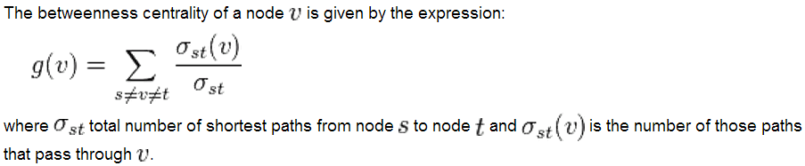
Girvan-Newman: Edge Betweenness
A natural extension of betweenness to edges is obtained by replacing σ(s,t|v) in the deﬁnition of vertex betweenness by
σ(s,t|e), the number of shortest (s,t)-paths containing the edge e.

Slide 24
Girvan-Newman: The Algorithm
The betweenness of all existing edges in the network is calculated first. (how?)
The edge with the highest betweenness is removed.
The betweenness of all edges affected by the removal is recalculated.
Steps 2 and 3 are repeated until no edges remain.
Notes:
(Wikipedia description)
The hierarchical clustering method is based on assigning a weight for every edge and placing these edges into an initially empty network, starting from edges with strong weights and progressing towards the weakest ones. The edges with the greatest weights within the community are the most central ones. Although traditional in community detection, the method presents some pathologies. One of them for instance, is the inability to classify in a community a node which is connected to the network with only one edge.
The Girvan–Newman algorithm works the opposite way. Instead of trying to construct a measure that tells us which edges are the most central to communities, it focuses on these edges that are least central, the edges that are most "between" communities. The communities are detected by progressively removing edges from the original graph, rather than by adding the strongest edges to an initially empty network.
Vertex betweenness has been studied in the past as a measure of the centrality and influence of nodes in networks. For any node, vertex betweenness is defined as the number of shortest paths between pairs of nodes that run through it. It is a measure of the influence of a node over the flow of information between other nodes, especially in cases where information flow over a network primarily follows the shortest available path. The Girvan–Newman algorithm extends this definition to the case of edges, defining the "edge betweenness" of an edge as the number of shortest paths between pairs of nodes that run along it. If there is more than one shortest path between a pair of nodes, each path is assigned equal weight such that the total weight of all of the paths is equal to unity. If a network contains communities or groups that are only loosely connected by a few intergroup edges, then all shortest paths between different communities must go along one of these few edges. Thus, the edges connecting communities will have high edge betweenness (at least one of them). By removing these edges, the groups are separated from one another and so the underlying community structure of the network is revealed.
The algorithm's steps for community detection are summarized below
1. The betweenness of all existing edges in the network is calculated first.
//how? http://www.sciencedirect.com/science/article/pii/S0378873307000731
2. The edge with the highest betweenness is removed.
3. The betweenness of all edges affected by the removal is recalculated.
Steps 2 and 3 are repeated until no edges remain.
The fact that the only betweennesses being recalculated are only the ones which are affected by the removal, may lessen the running time of the process' simulation in computers. However, the betweenness centrality must be recalculated with each step, or severe errors occur. The reason is that the network adapts itself to the new conditions set after the edge removal. For instance, if two communities are connected by more than one edge, then there is no guarantee that all of these edges will have high betweenness. According to the method, we know that at least one of them will have, but nothing more than that is known. By recalculating betweennesses after the removal of each edge, it is ensured that at least one of the remaining edges between two communities will always have a high value.
The end result of the Girvan–Newman algorithm is a dendrogram. As the Girvan–Newman algorithm runs, the dendrogram is produced from the top down (i.e. the network splits up into different communities with the successive removal of links). The leaves of the dendrogram are individual nodes.

Slide 25
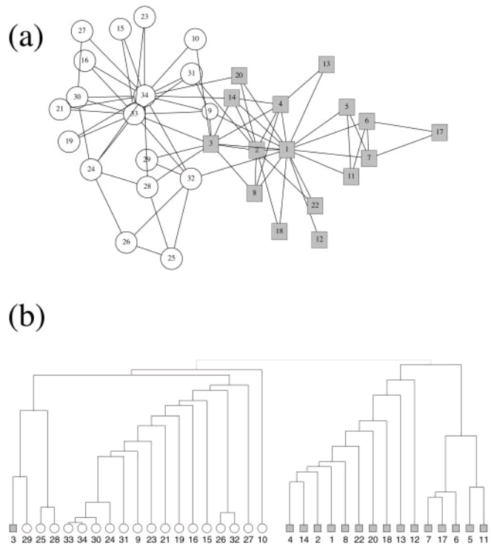
(a) The friendship network from Zachary’s karate club study as described in the text. Nodes associated with the club administrator’s faction are drawn as circles, those associated with the instructor’s faction are drawn as squares.
(b) Hierarchical tree showing the complete community structure for the network calculated by using the algorithm presented in this article. The initial split of the network into two groups is in agreement with the actual factions observed by Zachary, with the exception that node 3 is misclassified.

Slide 26
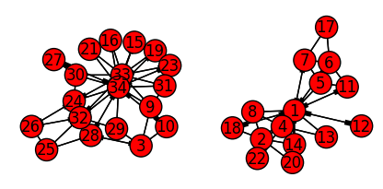
Implementation
"On variants of shortest-path betweenness centrality and their generic computation" - Brandes (2007).
~40 lines of Python code congruent to the pseudo-code in the article
Results identical to Girvan-Newman!
Notes:
Note that in Brandes' paper, if your Graph is undirected it should be transformed to a directed graph, with an undirected edge such as (u,v) resulting in two directed edges (u,v) and (v,u).
Visualization performed using matplotlib and pyplot (which networkx uses for plotting).

Slide 27
Girvan-Newman Algorithm: Summary
In its simplest and fastest form - worst-case time O(m²n) on a network with m edges and n vertices, or O(n³) on a sparse graph*.
Does not scale well for networks with millions of vertices.
*one for which m scales with n in the limit of large n, which covers essentially all networks of current scientific interest, with the possible exception of food webs.

Slide 28
Detecting Communities by
Modularity Maximization

Slide 29
Modularity: Intuition
"A good division of a network into communities is not merely one in which there are few edges between communities; it is one in which there are fewer than expected edges between communities. If the number of edges between two groups is only what one would expect on the basis of random chance, then few thoughtful observers would claim this constitutes evidence of meaningful community structure. On the other hand, if the number of edges between groups is significantly less than we expect by chance, or equivalent if the number within groups is significantly more, then it is reasonable to conclude that something interesting is going on.
"This idea, that true community structure in a network corresponds to a statistically surprising arrangement of edges, can be quantified by using the measure known as modularity. The modularity is, up to a multiplicative constant, the number of edges falling within groups minus the expected number in an equivalent network with edges placed at random."
Notes:
"Fast algorithm for detecting community structure in networks" (M. E. J. Newman, 2003)
http://arxiv.org/abs/cond-mat/0309508

Slide 30
Modularity: Definition
To test whether a particular division is meaningful we define a quality function or "modularity" Q as follows.
Let e_{ij} be the fraction of edges in the network that connect vertices in group i to those in group j and let a_{i}=Σ_{j}e_{ij} . Then, Q=Σ_{i}(e_{ii}-a_{i}²) is the fraction of edges that fall within communities, minus the expected value of the same quantity if edges fall at random without regard to community structure.

Slide 31
Modularity: Definition
"Let e_{ij} be the fraction of edges in the network that connect vertices in group i to those in group j and let a_{i}=Σ_{j}e_{ij} . Then, Q=Σ_{i}(e_{ii}-a_{i}²)"
Calculating e_{ii}: count how many edges are connecting only nodes within group i.
Calculating a_{i}²: summarize the degrees of all vertices in group i, and bring to the 2nd power.
Actual implementation is different for the sake of space-time complexity.

Slide 32
Modularity: Motivation
If a high value of Q represents a good community division, why not simply optimize Q over all possible divisions to find the best one?
By doing this, we can avoid the iterative removal of edges and cut straight to the chase.
The problem is that true optimization of Q is very costly.
Various approximate optimization methods are available: simulated annealing, genetic algorithms, greedy algorithms, etc.

Slide 33
Modularity Maximization Greedy Algorithm (Newman)
For a graph with n vertices and m edges:
Define n singleton communities.
While not all nodes belong to a single community:
  For each edge m, if adding m will connect disconnected components, calculate the ∆Q of m's addition.
  For the highest ∆Q calculated, join the two communities.
The result is a dendrogram, a tree that shows the order of the joins. Cuts through this dendrogram at different levels give divisions of the network into larger or smaller numbers of communities and, as with the GN algorithm, we can select the best cut by looking for the maximal value of Q.
Notes:
(yes, it's the same one - Girvan's associate...)

Slide 34
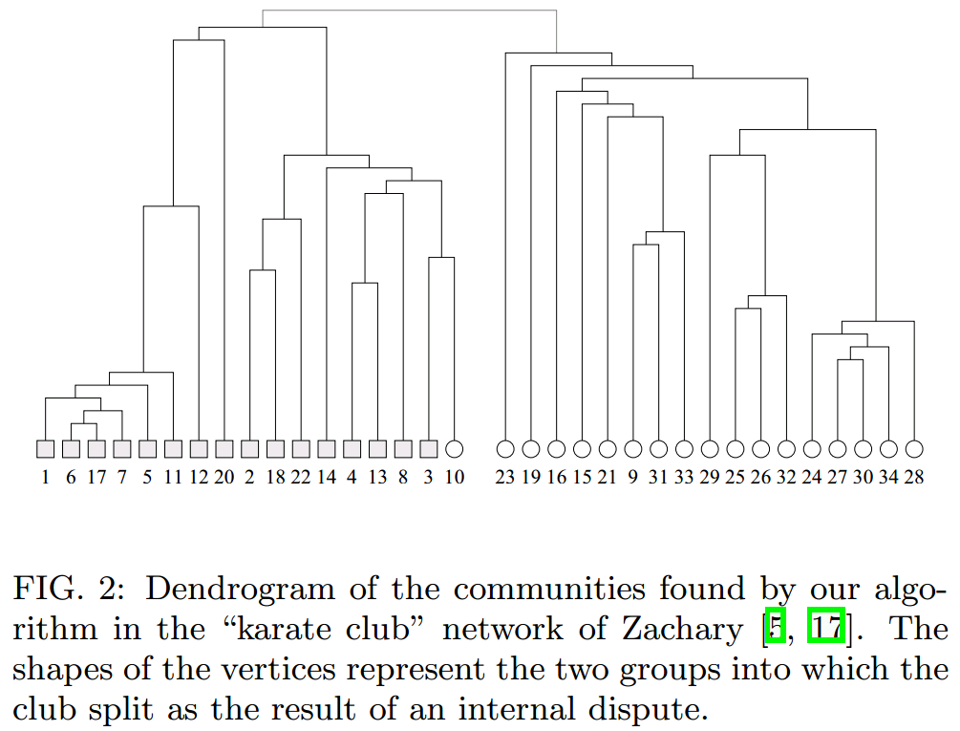

Slide 35
Space-Time Complexity
Each step: worst-case time O(m+n).
A maximum of (n-1) steps to join n communities.
Thus: O((m+n)n) or O(n²) for sparse graphs.
Since the joining of a pair of communities between which there are no edges at all can never result in an increase in Q, we need only consider those pairs between which there are edges, of which there will at any time be at most m, where m is again the number of edges in the graph. The change in Q upon joining two communities is given by ∆Q = e_{ij} + e_{ji} − 2a_{i}a_{j} = 2(e_{ij} − a_{i}a_{j} ), which can clearly be calculated in constant time. Following a join, some of the matrix elements e_{ij} must be updated by adding together the rows and columns corresponding to the joined communities, which takes worst-case time O(n). Thus each step of the algorithm takes worst-case time O(m + n). There are a maximum of n − 1 join operations necessary to construct the complete dendrogram and hence the entire algorithm runs in time O((m + n)n), or O(n²) on a sparse graph. The algorithm has the added advantage of calculating the value of Q as it goes along, making it especially simple to find the optimal community structure.

Slide 36
Implementation
Efficient implementations rely on mathematical programming or on wise use of data structures:
"Modularity-Maximizing Graph Communities via Mathematical Programming" - Agarwal, Kempe (2007)
http://arxiv.org/abs/0710.2533
"Finding community structure in very large networks" - Clauset, Newman, Moore 2004
http://arxiv.org/abs/cond-mat/0408187

Slide 37
Limits of Modularity Maximization based algorithms
Fortunato and Barthélemy: "...modularity maximization is characterized by two concurrent biases: the tendency to merge small clusters and to split large ones. We have seen that it is usually very difficult, and often impossible, to tune the resolution such to avoid both biases simultaneously."
Agarwal and Kempe: designed two mathematical-programming based algorithms that "[provide] a useful upper bound on the best possible modularity." (LP and VP Relaxation)
Notes:
Agarwal and Kempe's two algorithms were dubbed "LP Relaxation" and "VP Relaxation". In their bases, they describe the modularity maximization problem as an attempt to maximize a solution to a linear function, or to maximize a solution to a quadratic function (aka to a 2nd degree polynom). More can be read on Agarwal and Kempe (2007).

Slide 38
An alternative to Modularity?
Introducing Surprise(S):
Given a partition into communities, Surprise compares the number of links within and between communities in that partition with the expected number of them in a random network with the same distribution of nodes per communities. In this manner, S evaluates, at the same time, both the number of nodes and links.
Notes:
From http://en.wikipedia.org/wiki/Surprise_(networks) :
Given a partition into communities, Surprise compares the number of links within and between communities in that partition with the expected number of them in a random network with the same distribution of nodes per communities. In this manner, S evaluates, at the same time, both the number of nodes and links.
The analysis of community structure in networks is of great importance in many scientific fields and, therefore, how to optimally detect these communities has been object of research in recent years. In 2004, Newman and Girvan proposed the modularity Q as a benefit function to evaluate the quality of the partition into communities of a network. Q has been widely used and cited in hundreds of articles. However, a few years later, Fortunato and Barth?lemy demonstrated that Q suffers a resolution limit.[3] That is, the measure is unable to detect communities smaller than a certain threshold, which is determined by the size of the network. Although several attempts to avoid this limitation have been proposed, none of them solves it in a general manner.
In 2011, Aldecoa and Marin presented Surprise and showed how its maximization finds qualitatively better partitions than those obtained by maximizing Q. Besides its empirical superior performance, S has obvious theoretical advantages over Q and Q-based indexes. While these measures evaluate the quality of the partition based on the density of links, regardless of the number of nodes; S takes into account both the number of nodes and links. Moreover, Q computes the quality of the partition by summing the individual qualities of the different communities. On the contrary, S evaluates the quality of the whole partition at the same time.

Slide 39
Detecting Communities by
Label Propagation

Slide 40
Label Propagation: Intuition
"As we will show, the advantage of this algorithm over the other methods is its simplicity and time efficiency. The algorithm uses the network structure to guide its progress and does not optimize any specific chosen measure of community strengths."

Slide 41
Label Propagation (Raghavan, Albert, Kumara)
Initialize the labels at all nodes in the network. For a given node x, C_{x}(0) = x.
Initialize t = 1.
Arrange the nodes in the network in a random order and set it to X.
For each x in X chosen in that specific order, let
f here returns the label occurring with the highest frequency among neighbors and ties are broken uniformly randomly.
If every node has a label that the maximum number of their neighbors have, then stop the algorithm. Else, increment t and goto 3.

Slide 42
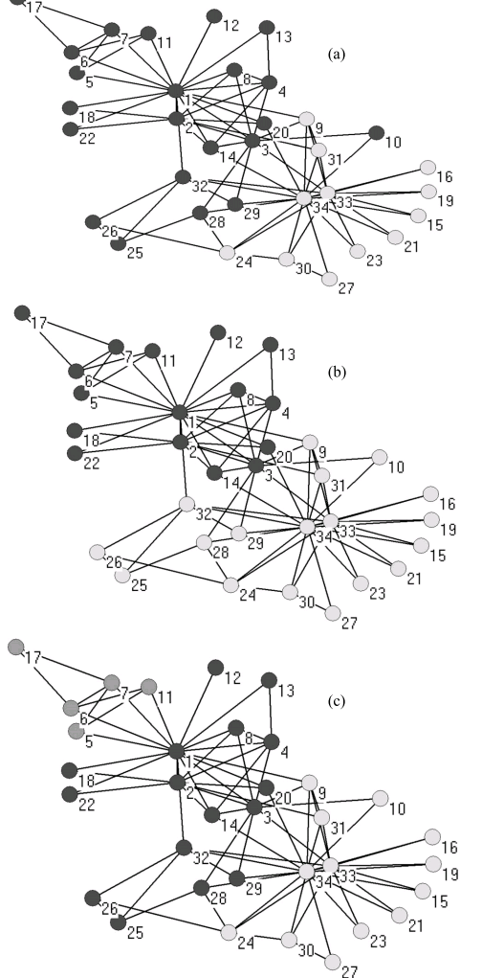
Results on Zachary's
Karate Club network
Note that these are
3 different solutions
which have to be resolved
into a single solution.

Slide 43
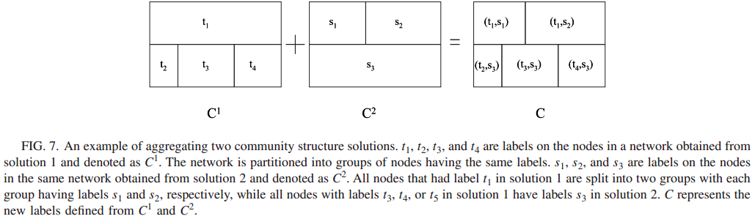
Label Propagation:
Aggregating Solutions
Different solutions to the same network can be resolved by aggregating the labels as follows:

Slide 44
Label Propagation:
Time Complexity
It takes a near-linear time for the algorithm to run to its completion.
Initializing every node with unique labels requires O(n) time.
Each iteration of the label propagation algorithm takes linear time in the number of edges O(m).
At each node x, we first group the neighbors according to their labels O(d_{x}). We then pick the group of maximum size and assign its label to x, requiring a worst-case time of O(d_{x}). This process is repeated at all nodes and hence an overall time is O(m) for each iteration.

Slide 45
Summary

Slide 46
Summary
Communities are groups of vertices which are densely-connected between themselves and loosely connected to others.
There are different approaches for community detection relying on the network structure:
  Removal of bridging edges (betweenness);
  Maximizing a quality measure (such as Modularity);
  Competitive diffusion methods (label propagation).
A good algorithm is measured not only by the quality of its solutions, but also by its space-time performance, as network data is unusually big (constants matter).
There are benchmark datasets to test an algorithm's quality in the complex networks research community.
Notes:
Constants matter: due to the huge size of networks algorithms' performance is measured not only by complexity.
If an (simple) algorithm outperforms another one by a factor of 2 this may save you a week of computations.
and a factor of 100 may turn an infeasible task into a feasible one.

Slide 47
Bibliography
Introduction, Edge Removal (Girvan-Newman)
"Community structure in social and biological networks" - Girvan, Newman (2002)
http://www.ncbi.nlm.nih.gov/pmc/articles/PMC122977/
"On variants of shortest-path betweenness centrality and their generic computation" - Brandes (2007)
http://www.sciencedirect.com/science/article/pii/S0378873307000731
Modularity Maximization
"Fast algorithm for detecting community structure in networks" - Newman (2003)
http://arxiv.org/abs/cond-mat/0309508v1
"Modularity-Maximizing Graph Communities via Mathematical Programming" - Agarwal, Kempe (2007)
http://arxiv.org/abs/0710.2533
"Finding community structure in very large networks" - Clauset, Newman, Moore 2004
http://arxiv.org/abs/cond-mat/0408187
"Resolution limit in community detection" - Santo Fortunato and Marc Barthélemy (2007)
http://www.pnas.org/content/104/1/36.abstract
Label Propagation
"Near linear time algorithm to detect community structures in large-scale networks" - Raghavan, Albert, Kumara (2007)
http://arxiv.org/abs/0709.2938

Slide 48
Glossary
http://en.wikipedia.org/wiki/Community_structure
http://en.wikipedia.org/wiki/Betweenness_centrality
http://en.wikipedia.org/wiki/Dendrogram
http://en.wikipedia.org/wiki/Modularity_(networks)

Slide 49
List of Algorithms
Girvan-Newman's Edge Removal Algorithm (based on Edge Betweenness)
Newman's Greedy Algorithm (based on Modularity Maximization)
Raghavan, Albert, Kumara's
Label Propagation Algorithm

Slide 50


List of Definitions (and Formulas)
Edge Betweenness: σ(s,t|e), the number of shortest (s,t)-paths containing the edge e.
Modularity: Let e_{ij} be the fraction of edges in the network that connect vertices in group i to those in group j and let a_{i}=Σ_{j}e_{ij} .
Then, Q=Σ_{i}(e_{ii}-a_{i}²) .

