Slide 1
How Android Starts an App
Karthik Dantu and Steve Ko

Slide 2
Administrivia
Show us your build!
Which file did you modify to change the build id?
Assignment3 is due next week.

Slide 3
Today: How Android Starts an App
Why?
A good example to start with in order to understand the source (I think)
Getting deeper with the source
Not quite straightforward to understand
Goal: giving you enough pointers so you can navigate the source yourself.

Slide 4
Things You Need to Know
Android Programming Model
Launcher is implemented with this model.
Android IPC mechanisms
ActivityManager uses IPC mechanisms.
Zygote

Slide 5
Android Programming Model
No main()
Four main components: Activity, Service, ContentProvider, BroadcastReceiver
You need to implement at least one of them to write an Android app.
Event-driven

Slide 6
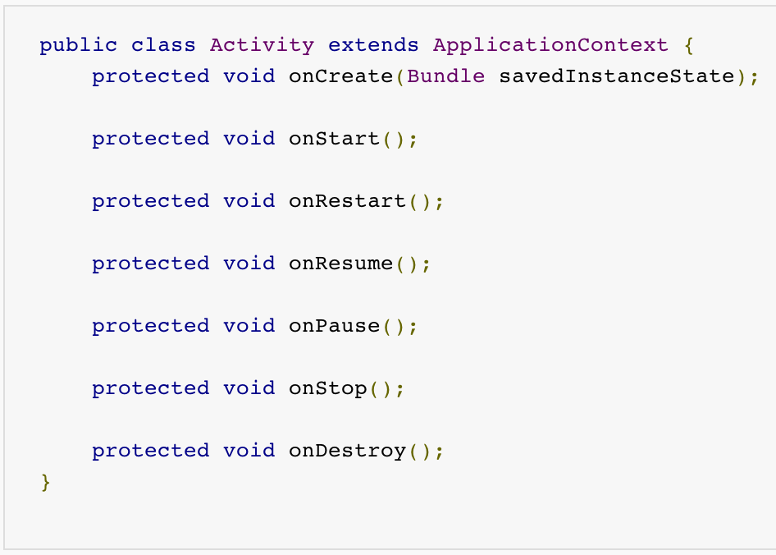
Example - Activity

Slide 7
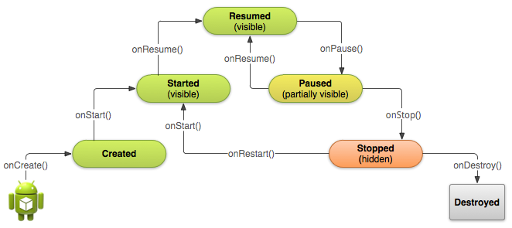
Example - Activity

Slide 8
Android IPC Mechanisms
Android relies heavily on IPC mechanisms.
This goes with the event-driven programming model.
Three main mechanisms
Intent
Binder
Looper-Handler

Slide 9
Intent
You can think of it as a message or a command.
Main fields
Action (e.g., ACTION_VIEW) and Data
Many system events are communicated as intents.
E.g., ACTION_BATTERY_CHANGED, ACTION_POWER_CONNECTED, etc.
A reasonable strategy for code navigation
Locate where the switch-case code is for different actions

Slide 10
Binder
The main IPC mechanism on Android
Binder enables method calls across process boundaries.
Caller side: A proxy and marshalling code
Callee side: A stub and unmarshalling code
Two ways to use it.
Automatic proxy & stub generation (.aidl)
Manual proxy & stub implementation

Slide 11
Binder with .aidl
.aidl defines the interface.
Naming convention: I*.aidl.
E.g., IPackageManager.aidl
The stub compiler generates I*.java
E.g., IPackageManager.java
This is part of the build process, i.e., you will not find I*.java file in the source (unless you’ve compiled already, then it’s under out/).
It contains I*.Stub abstract class
E.g., abstract class IPackageManager.Stub

Slide 12
Binder with .aidl
A Stub class should be extended.
This is the actual implementation for IPC calls.
E.g., class PackageManagerService extends IPackageManager.Stub
Callers can use the interface to make IPC calls.
Callers can import classes in I*.java and use Stub.asInterface() when making IPC calls.
E.g., IPackageManager.Stub.asInterface() returns an object for making IPC calls.

Slide 13
Binder with .aidl
A reasonable strategy for code navigation
If you encounter a call using an object returned from .asInterface() call, it’s a Binder call.
Don’t worry about marshalling/unmarshalling code, e.g., onTransact().
Find the class that extends the Stub class. (Use croot;jgrep)

Slide 14
Binder without .aidl
Manual implementation of the interface, marshalling/unmarshalling, and methods.
E.g., IActivityManager.java defines the interface for accessing ActivityManager.
abstract class ActivityManagerNative implements IActivityManager and has the marshalling/unmarshalling code.
There’s a class that extends ActivityManagerNative and provide the actual callee-side implementation.

Slide 15
Binder without .aidl
A reasonable strategy for code navigation
Manual implementation typically follows the ActivityManager example.
Interface file → abstract class → extended class
E.g., startActivity() goes through this flow of classes.

Slide 16
Looper-Handler
Looper is a per-thread message loop.
Looper.prepare()
Looper.loop()
A Handler is shared by two threads to send/receive messages.
Looper-Hanlder is used in the app control process to handle various messages.

Slide 17
Zygote
C++ (e.g., app_main.cpp) and Java (e,g., ZygoteInit.java)
Starts at boot.
ZygoteInit.java manages a domain socket and listens to incoming VM creation requests.
This uses ZygoteConnection.java.
Main flow
Forks a new VM instance.
Loads the class that has the process’s main().
Calls the main().

Slide 18
Code Flow for App Start
Launcher sends an intent to start an activity.
startActivity() is a Binder call to ActivityManager.
ActivityManager sends a process fork request.
This request uses a socket to Zygote.
Zygote forks a new VM instance that loads ActivityThread.
ActivityThread has the real main() for an app.

Slide 19
Code Flow for App Start
ActivityThread calls the app’s onCreate()
ActivityThread notifies ActivityManager.
ActivityManager makes a Binder call to ActivityThread to start the app (i.e., call onStart()).

Slide 20
Code Navigation
Let’s see the code!

