Slide 1
More on IPC Mechanisms
Karthik Dantu and Steve Ko

Slide 2
Administrivia
Have you done your assignment? Show us!
Assignment 4 (the last assignment) will be out soon and due in two weeks.

Slide 3
Today: More on IPC Mechanisms
Why?
Fundamental building blocks of the Android framework
Last time was from the user’s (i.e., programmer’s) perspective to understand other framework components.
Today’s about the internals.
Goal: Understanding the framework structure and IPC mechanisms

Slide 4
Today: More on IPC Mechanisms
We will look at two IPC mechanisms.
Looper-handler
Binder
Resources:
AOSP
“Embedded Android”
“Deep Dive into Android IPC/Binder Framework” http://events.linuxfoundation.org/images/stories/slides/abs2013_gargentas.pdf

Slide 5
Looper-Handler
Looper is a per-thread message loop.
Handler processes messages.

Slide 6
Looper Architecture
Thread
Looper
Message Queue
Message
Message
Message
Handler
Handler
Handler

Slide 7
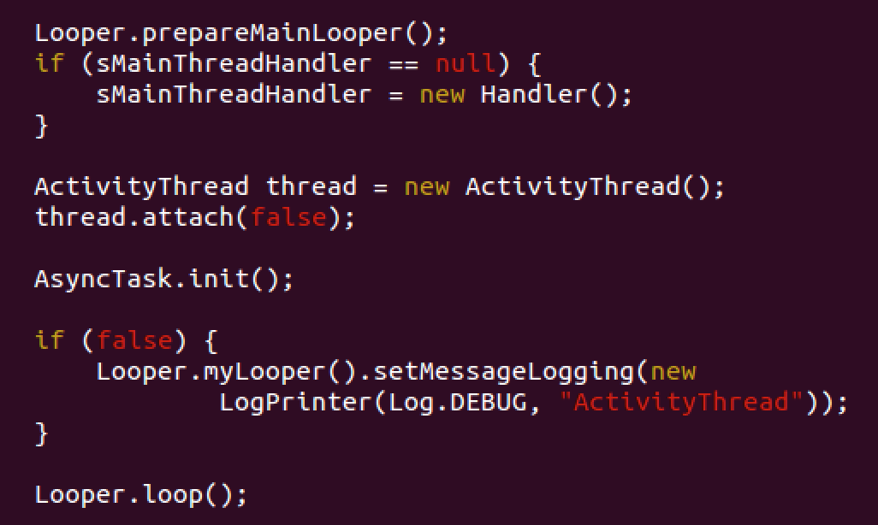
Looper Protocol: ActivityThread.java

Slide 8
Looper
Looper.prepare()

Slide 9
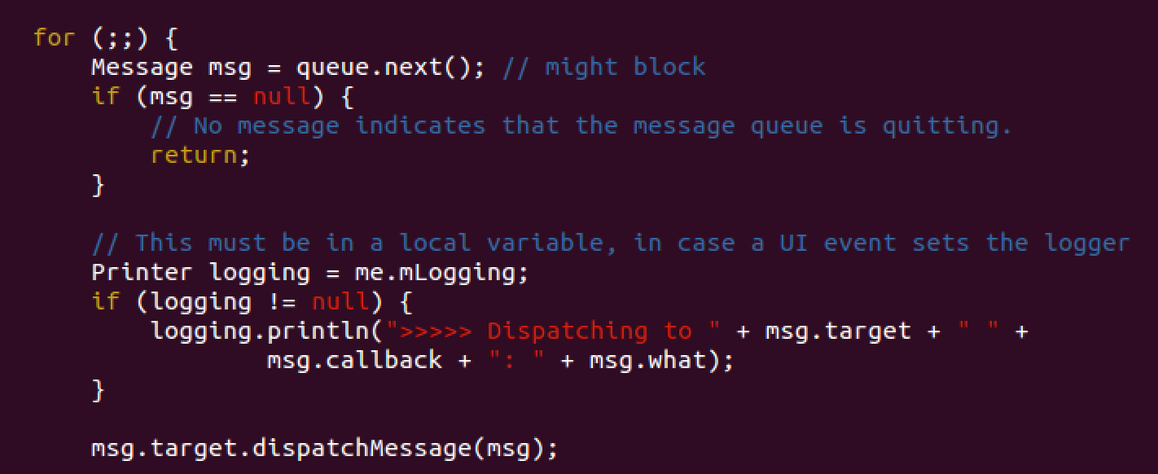
Looper
Looper.loop()

Slide 10
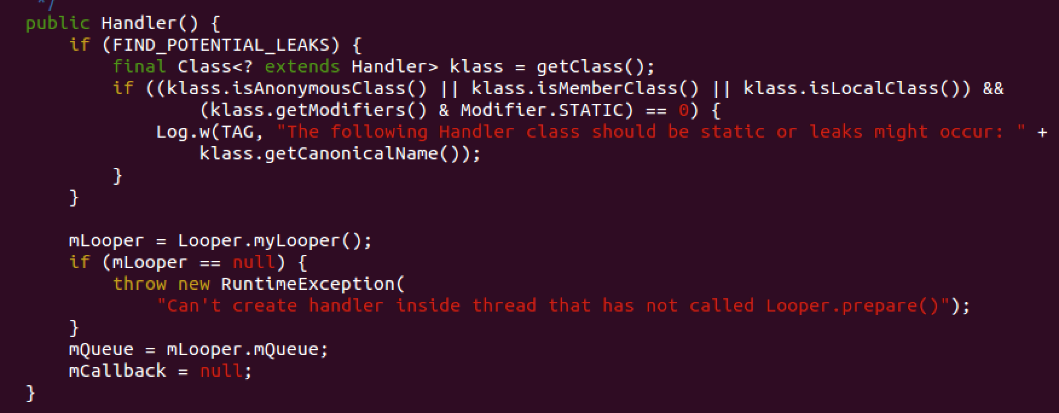
Handler

Slide 11
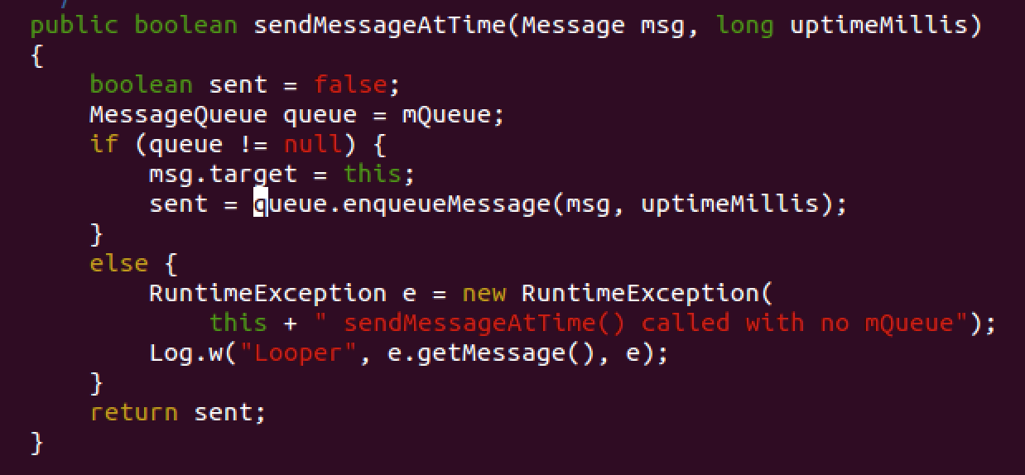
Handler.sendMessage()

Slide 12
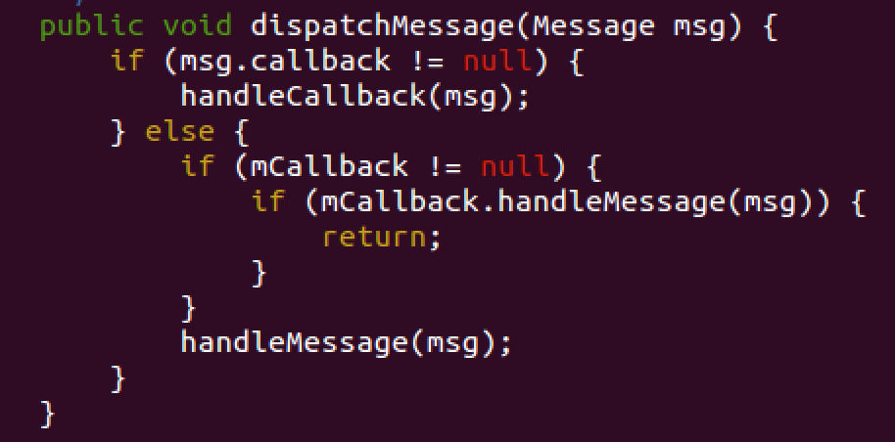
Handler.dispatchMessage()

Slide 13
Binder
From OpenBinder
Enables two things for IPC
Directory of available IPC calls
Communication mechanism

Slide 14
Architecture
Context Manager (servicemanager.c)
Process A
Process B
Client
IBinder
AIDL
Binder
Proxy
AIDL
IBinder
Stub
Binder Token
Binder Service
Binder Driver (/dev/binder)

Slide 15
Context Manager
A special Binder object (handle #0)
The directory of all Binder-ready processes
On Android, ServiceManager becomes this context manager for Binder.
servicemanager.c
binder_become_context_manager(): Registers itself with the kernel Binder module as the context manager.
binder_loop() starts a message loop that listens to the commands from kernel Binder module.

Slide 16
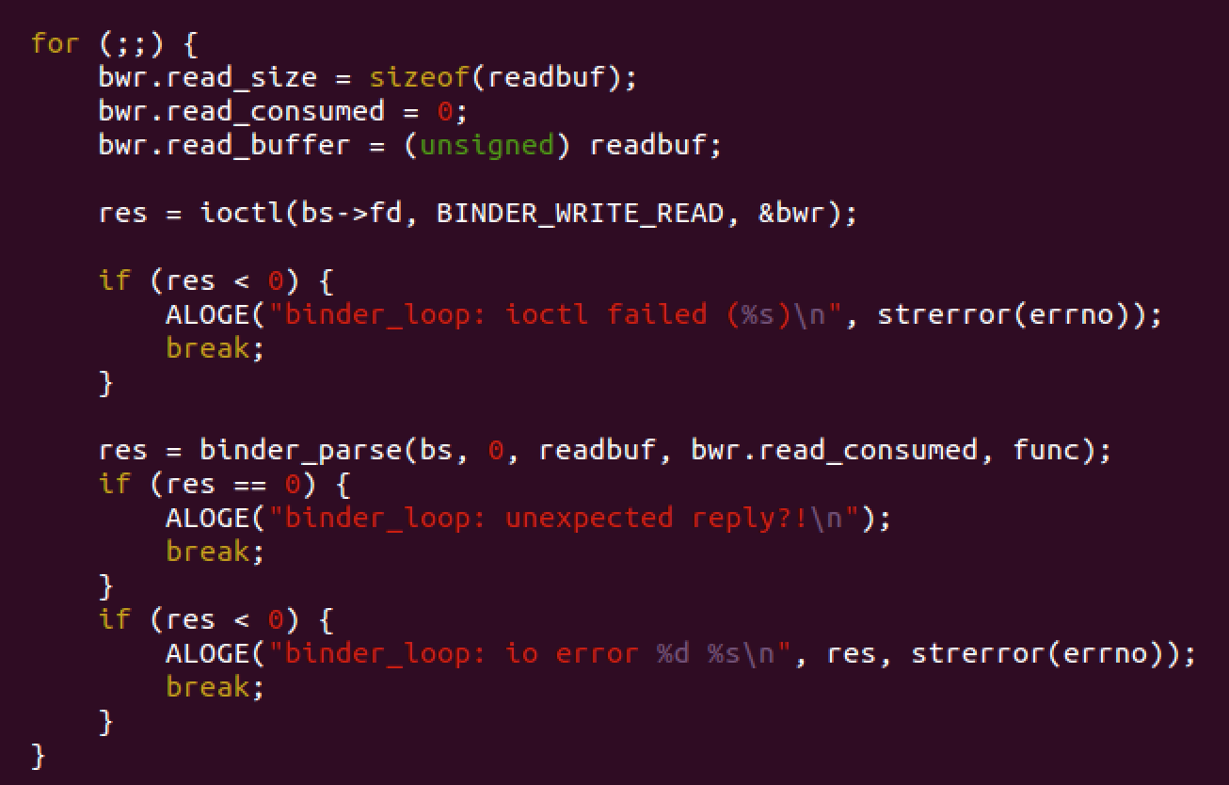
ServiceManager

Slide 17
Registering with Service Manager
System Server
Runs many services, e.g., Activity Manager, Power Manager, etc.
Calls ServiceManager’s addService()
Service Manager
Maintains directories for registered remote objects
Returns a handle for remote object upon lookup
App
Can use Context’s getSystemService() or ServiceManager’s getService() to lookup and get the handle
Binder Driver (/dev/binder)

Slide 18
Registering with Service Manager
Binder-ready processes can add themselves to the directory with ServiceManager.addService().
For example, SystemServer (SystemServer.java) adds (and runs) most of the default system services at boot using ServiceManager.addService().
SystemServer starts from ZygoteInit.java.
There are other services that start from other servers, e.g., MediaServer (frameworks/av/media/mediaserver)

Slide 19
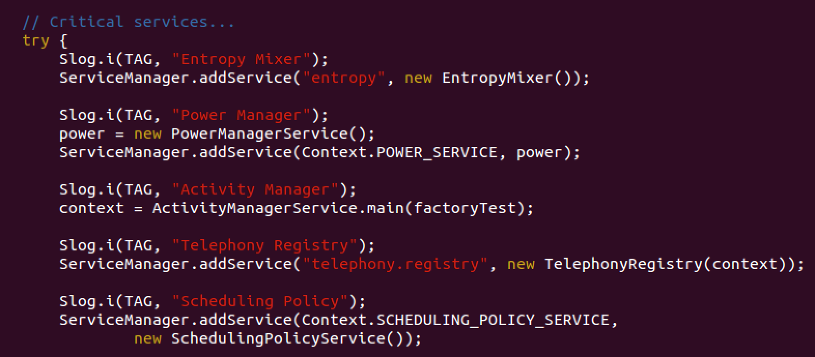
SystemServer.java

Slide 20
Accessing Service Manager
Context.getSystemService(String name)
Apps calls this first to get the handle for a service manager (handle #0).
E.g., getSystemService(Context.ACTIVITY_SERVICE)
This call goes to servicemanager (servicemanager.c) which looks up its directory of services and returns an appropriate handle.
You could also use ServiceManager.getService() and call asInterface().
This is essentially Context.getSystemService().

Slide 21
Typical HW Access Flow
App
APIs
android.* (/frameworks/base/core/*)
Binder
System Service (/frameworks/base/services/java/*)
JNI
System Service Native (/frameworks/base/services/jni/*)
Hardware Interface (/hardware/libhardware/*)
Vender-Provided Libraries (/device/<vendor>/<device>/*)
Kernel Modules (/dev/*)

Slide 22
Binder Communication Mechanism
From last lecture:
Proxy & Stub implement marshalling & unmarshalling.
Parcel
Marshalling/unmarshalling data structure
android.os.Parcel
transact() & onTransact()
Marshalling & unmarshalling implementation

Slide 23
Binder Communication Mechanism
libbinder (/frameworks/native/libs/binder)
Provides JNI interface to Java Binder classes.
Communicates with /dev/binder through ioctl()
ioctl(binderFD, BINDER_WRITE_READ, &bwd)

Slide 24
Data Structure for ioctl
struct binder_write_read {
signed long write_size;
signed long write_consumed;
unsigned long write_buffer;
signed long read_size;
signed long read_consumed;
unsigned long read_buffer;
};

Slide 25
/dev/binder
Kernel module
/drivers/staging/android/binder.c (& .h)
~3500 lines
BTW, /drivers/staging/android/* has a lot of the android Linux code (not all, e.g., wakelock).
static long binder_ioctl(struct file *filp, unsigned int cmd, unsigned long arg)
Handles ioctl() calls from the userspace.

Slide 26
Summary
Looper
A thread-local
Maintains a message queue
Handler
Associates with a Looper
Handles messages
Binder
Main mechanism for the framework
User-level & kernel-level components

