Slide 1
New Modes of Human-Assisted Policy Learning
Kshitij Judah
Oregon State University
Joint work with
Saikat Roy, Alan Fern, Tom Dietterich
Notes:
1

Slide 2
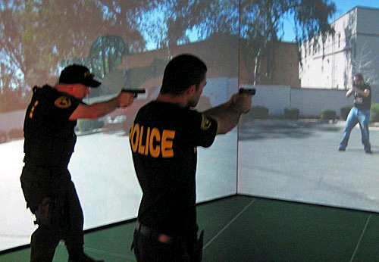
Customizable Simulators
Allow end users to teach behaviors to agents in complex simulation environments
Immersive real-time training
Notes:
Many applications require ability to teach sequential decision policies to computer agents. Customizable simulators is one such application where we would like to teach complex behaviors to computer agents so as to create realistic training scenarios for the users of the simulators.
Here, we would like to teach a complex criminal-like behavior to a computer agent in order to simulate a realistic disarm and arrest practice scenario.

Slide 3
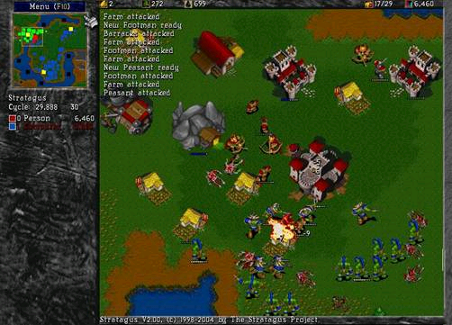
Training Game Assistants/Opponents
3
Notes:
Another example is to be able to teach new game playing behaviors to computer players in a game environment.
We want end-users to be able to teach such new behaviors in a natural and efficient way (i.e. not by reprogramming the agent’s behavior).

Slide 4
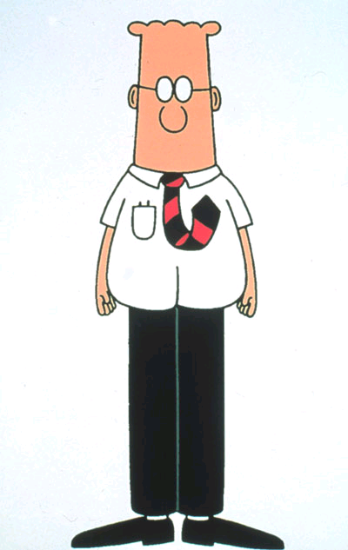

  Goal: allow non-programmers to train computer agents for sequential decision making
End-User Teacher
Computer Student
natural instruction
natural questions &
explanations
Focus on naturalness and efficiency w.r.t. teacher
Notes:
Goal: allow non-programmers to

Slide 5
  Autonomous Planning: teacher simply provides task description in some formal language (e.g. PDDL)
Here are the rules of chess ….
Go figure it out.

Slide 6
  Reinforcement Learning: teacher simply provides reward/goal and practice environment
Your goal is to win.
Now go practice.

Slide 7
  Imitation Learning: teacher provides demonstrations of the desired behavior
Here are 100 grandmaster chess games.
Try to play like them.

Slide 8
A Frustrated Teacher-Student Relationship
PDDL ???
Reward Function ???
Why is it doing that ???
I have so much more to say!!!
This is too hard, more guidance please …
May I ask a question?
Notes:
All these existing techniques for teaching policies to computer agents create a frustrated teacher-student relationship.
From the teacher’s point of view, the frustration comes due to lack of natural ways to specify the desired behavior or policy. Teacher’s are constrained to either learn a formal language, or learn how to design a precise reward function or be limited to just providing full demonstrations.
Teacher’s often would like to express much more in a natural manner.
From the computer student’s point of view, the inefficiency comes from the inability to ask questions to the teacher or request more guidance.

Slide 9
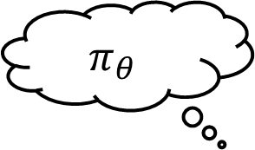

New Modes of Policy Learning
Today’s Talk: some baby steps
  Focus on learning parameterized reactive policies $π_{θ}$
  Defined by parameter vector $θ$
$$π_{θ}$$
Action Critiques
Active Imitation Learning
Notes:
Today’s talk is about some small steps that we have taken to address these limitations of the existing techniques.
As a first step in this direction, we restrict ourselves on teaching parameterized reactive policies to a computer student.
Reactive policies are still applicable on a wide range of domains and it is good to be able to learn such policies from end-users effectively.
I will talk about how a teacher can provide action critiques to an RL agent who aims to learn such a parameterized reactive policy.
Then I will talk about how a student can request one step action demonstrations from a teacher in an imitation learning setting.

Slide 10
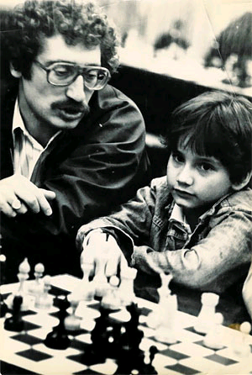
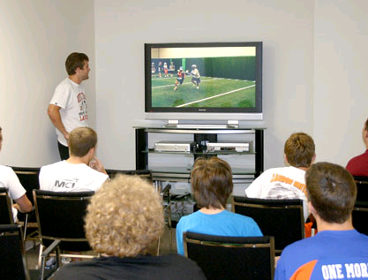
Reinforcement Learning via Practice and Critique Advice
[Judah et. al., AAAI-10]
Notes:
First part of the talk is on RL via practice and critique advice.
You can say that it is inspired by how teachers teach human students, e.g. a teacher teaching a child student how to play chess, or a coach teaching a team how to play football …
There is an initial lesson. Then students practice the task on their own. Then later on the teacher critiques at places where the student is still making mistakes in order to improve student’s behavior. Then student practices more keeping teacher’s critique in mind and so forth.

Slide 11

Reinforcement Learning
PROBLEM: RL takes a long time (millions of episodes) to learn good behavior for hard problems, if it can learn at all
Teacher
critique
observed behavior
State & Reward
Practice
Environment
Action
RESEARCH QUESTION: Can we synergistically integrate teacher critiques and practice (via RL) to effectively learn?
Notes:
RL can take millions of episodes or practice sessions to learn good behavior
We introduce a teacher in the RL loop where the teacher can observe student practice the task and can critique at places where the student is still making mistakes. Or even commend the student at places where it did the right thing. E.g. a coach watching his team play and then later on critique places where mistakes were made.

Slide 12
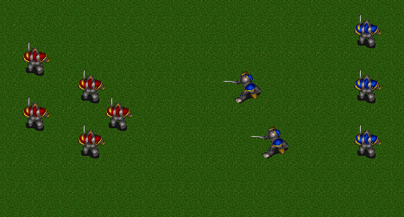
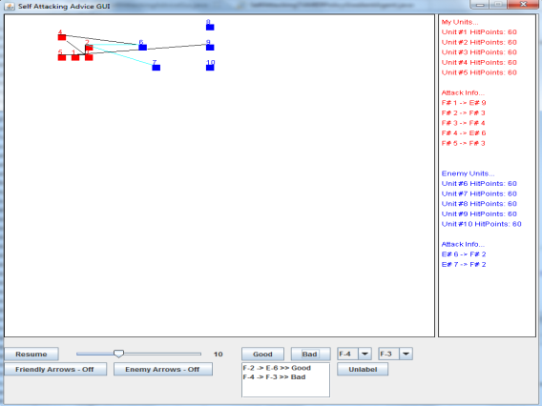
Student-Teacher Protocol
In state s_{i} action a_{i} is bad, whereas action a_{j} is good.
Autonomous Practice Session
Teacher
Critique Session
Advice Interface
Teacher Periodically Observes
& Critiques Behavior
Notes:
Our setup alternates between two sessions: practice, where experience is gathered and critique where teacher sees agents best behavior (greedy policy) and gives critique.
Mention little bit about Wargus picture while talking about practice session.
Mention what we assume about incompleteness of critique data.

Slide 13



Solution Approach: Selecting $θ$
Practice Session
Critique Session
Advice Interface
Practice Trajectory Data
Critique Data
???
Policy Parameters θ
Notes:
We want a solution approach to select \theta based on experience data T and critique data C.

Slide 14
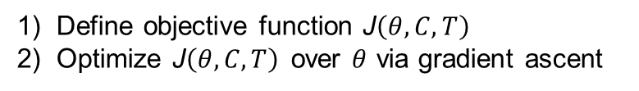
Solution Approach: Selecting $θ$
Practice Session
Critique Session
Advice Interface
Practice Trajectory Data
Critique Data
1) Define objective function J$\left(θ,C,T\right)$
2) Optimize J$\left(θ,C,T\right)$over $θ$ via gradient ascent
Policy Parameters θ
Notes:
Our solution approach to selecting \theta is based on defining an objective function J(\theta) using trajectory and critique data and optimizing it using gradient ascent to obtain \theta. Before we look into how J is defined, lets quickly go over gradient ascent optimization procedure.

Slide 15
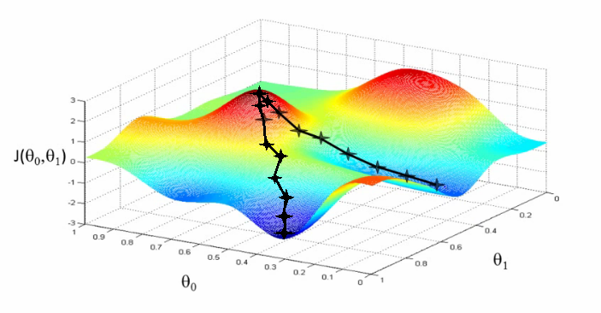


Aside: Gradient Ascent
global maximum
Local maximum
  Initialize to a random value
  Repeat until stopping condition
  Can be shown to converge to local optima

Slide 16
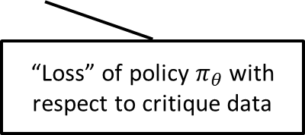
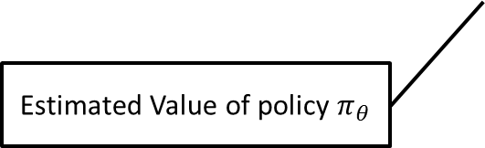
Solution Approach: Selecting $θ$
Practice Session
Critique Session
Advice Interface
Practice Trajectory Data
Critique Data
Estimated Value of policy $π_{θ}$
Tradeoff parameter
“Loss” of policy $π_{θ}$ with
respect to critique data

Slide 17


Critique Data Objective: L(θ,C)
Some good
actions
Some bad actions
Advice Interface
Some actions unlabeled
Imagine: Our teacher is an Ideal Teacher (Provides All Good Actions)
Set of all
Good
actions
All actions are equally
good
Advice Interface
Any action not in O(s_{i}) is suboptimal according to Ideal Teacher
Ideal Teacher
Notes:
Remind them about the incompleteness of the critique data.
Then say that imagine our teacher were an ideal teacher …

Slide 18
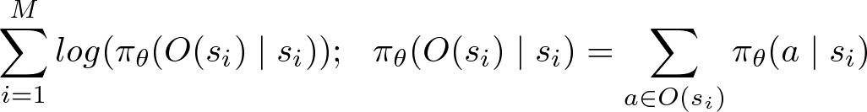
‘Any Label Learning’ (ALL)
Learning Goal: Find a probabilistic policy, or classifier, that has a high probability of returning an action in O(s) when applied to s.
ALL Log-likelihood (L_{ALL}(θ,C)) :
Probability of selecting an action in O(S_{i}) given state s_{i}
Imagine: Our teacher is an Ideal Teacher (Provides All Good Actions)
Set of all
Good
actions
All actions are equally
good
Advice Interface
Any action not in O(s_{i}) is suboptimal according to Ideal Teacher
Ideal Teacher

Slide 19


Critique Data Objective: L(θ,C)
Coming back to reality: Not All Teachers are Ideal !
and provide partial evidence about O(s_{i})
Advice Interface
What about the naïve approach of treating as the true set O(s_{i}) ?
Difficulties:
  When there are actions outside of that are equally good compared to those in , the learning problem becomes even harder.
  We want a principled way of handling the situation where either or can be empty.

Slide 20



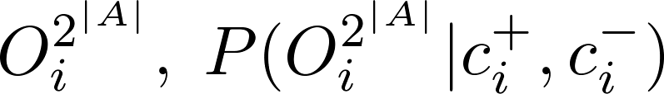


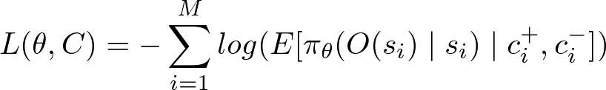

Expected Any-Label Learning
and provide partial evidence about O(s_{i})
User Model
Assume independence
among different states.
…
From corresponding
for all states
, we can get:
Expected ALL Log-likelihood :
The Gradient of has a compact closed form.
Notes:
We can get the distribution P(ALL) for each such any-label-learning problem using state independence and the user model.
Expected loss is nothing but the negative log of expected value of all such any-label-learning problems.

Slide 21
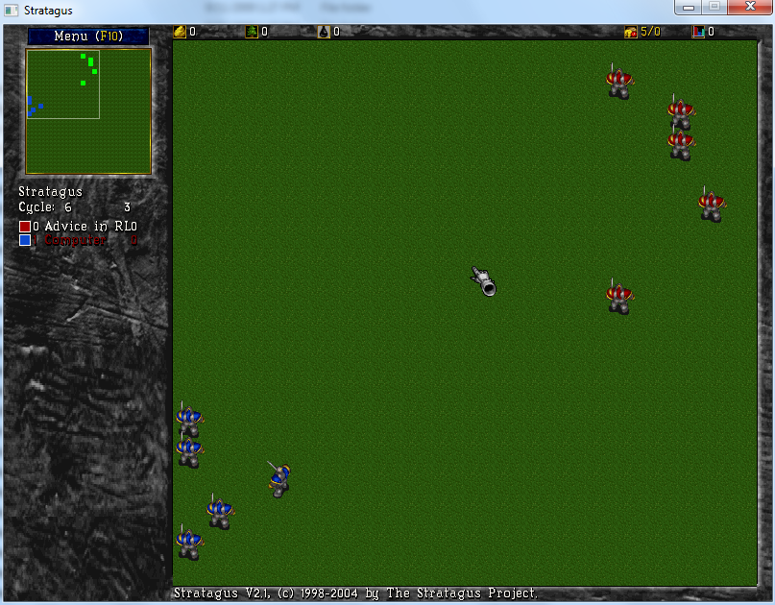
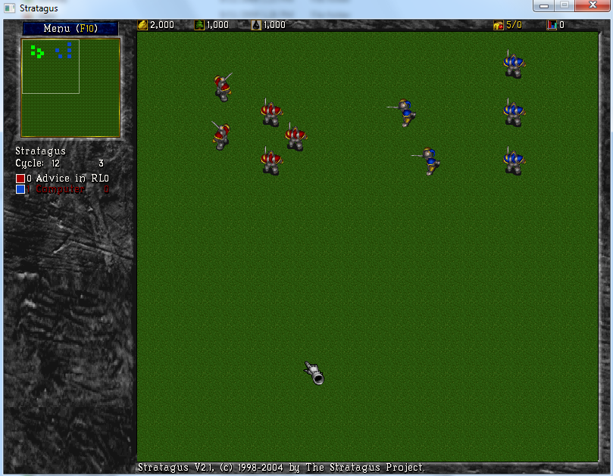
Experiments: Teaching Tactical Battle Micromanagement
Map 1
Map 2
Our Domain: Micro-management in tactical battles in the Real Time Strategy (RTS) game of Wargus.
5 friendly footmen against a group of 5 enemy footmen (Wargus AI).
Two battle maps, which differed only in the initial placement of the units.
Both maps had winning strategies for the friendly team and are of roughly the same difficulty.
Notes:
Evaluated 3 Learning Systems:
Pure RL, corresponds to removing the critique stage from our algorithm and setting λ=1.
Pure Supervised, corresponds to removing practice stage from our algorithm and setting λ=0.
Combined System, which learns from both types of data according to our algorithm.

Slide 22

Advice Interface
Difficulty:
  Fast pace and multiple units acting in parallel
Our setup:
  Provide end-users with an Advice Interface that allows to watch a battle and pause at any moment.
Notes:
Difficulty: Fast pace and multiple units acting in parallel
Makes providing real-time numeric feedback as in the TAMER system (Knox and Stone 2009) difficult.
It is also difficult to provide demonstrations due to the inherent difficulty of the control.
Our setup: Provide end-users with an interface that allows to watch a battle and pause at any moment. The user can then scroll back and forth within the episode and mark any possible action of any agent as good or bad.
Available actions for each military unit are to attack any of the units on the map (enemy or friendly) giving a total of 9 actions per unit.

Slide 23
Demo
Notes:
Difficulty: Fast pace and multiple units acting in parallel
Makes providing real-time numeric feedback as in the TAMER system (Knox and Stone 2009) difficult.
It is also difficult to provide demonstrations due to the inherent difficulty of the control.
Our setup: Provide end-users with an interface that allows to watch a battle and pause at any moment. The user can then scroll back and forth within the episode and mark any possible action of any agent as good or bad.
Available actions for each military unit are to attack any of the units on the map (enemy or friendly) giving a total of 9 actions per unit.

Slide 24
User Study: Teaching Tactical Battle Micromanagement
Goal is to evaluate two systems
  Supervised System = no practice session
  Combined System = includes practice and critique
The user study involved 10 end-users
  6 with CS background
  4 no CS background
Each user trained both the supervised and combined systems
  30 minutes total for supervised
  60 minutes for combined due to additional time for practice
Since repeated runs are not practical results are qualitative
To provide statistical results we first present simulated experiments
Notes:
We attempted to maintain a balance between which map and learning system was used first by each user.

Slide 25
Simulated Experiments
After user study, selected the worst and best performing users on each map when training the combined system
Total Critique data: User#1: 36, User#2: 91, User#3: 115, User#4: 33.
For each user: divide critique data into 4 equal sized segments creating four data-sets per user containing 25%, 50%, 75%, and 100% of their respective critique data.
We provided the combined system with each of these data sets and allowed it to practice for 100 episodes. All results are averaged over 5 runs.
Notes:
We first present results of simulated experiments conducted using real critique data from our user-studies to test learning capability with varying amount of critique and practice data
This time difference is intended to give the users the chance of providing roughly the same amount of advice in both cases.
Note that in a real training scenario, an end-user would not be confined to the system during the practice stages, as they are in the user study, meaning that the practice sessions will typically have lower cost to the user in reality than in the user study. It also means that we necessarily had to use shorter practice stages than might typically be used in a real application. In our studies, practice session times ranged from 3 to 7 minutes depending on the amount of data and convergence rate of gradient descent.

Slide 26
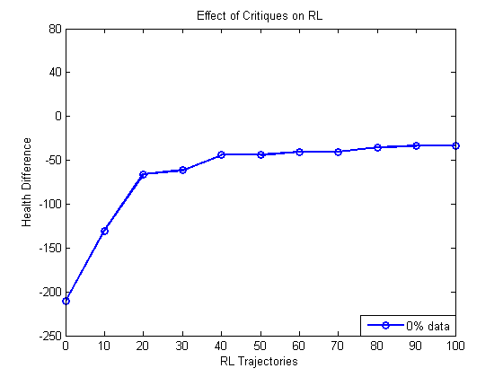
Simulated Experiments Results:
Benefit of Critiques (User #1)
  RL is unable to learn a winning policy (i.e. achieve a positive value).

Slide 27
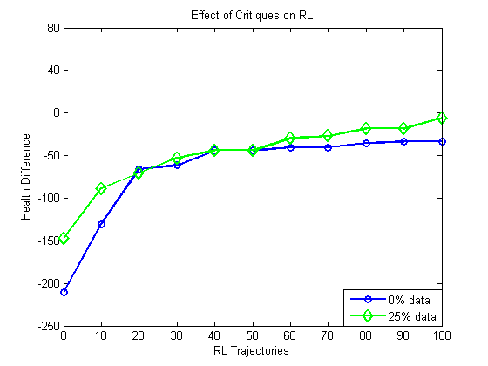
Simulated Experiments Results:
Benefit of Critiques (User #1)
  With more critiques performance increases a little bit.

Slide 28
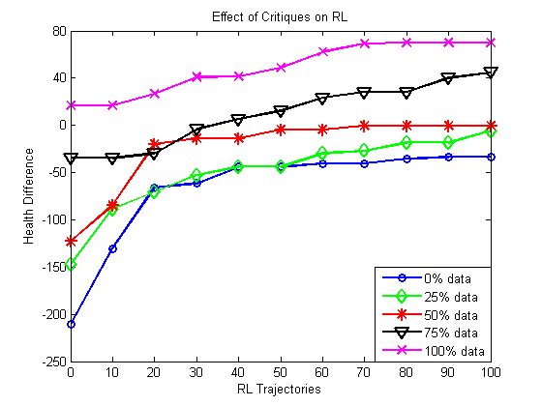
Simulated Experiments Results:
Benefit of Critiques (User #1)
  As the amount of critique data increases, the performance improves for a fixed number of practice episodes.
  RL did not go past 12 health difference on any map even after 500 trajectories.

Slide 29
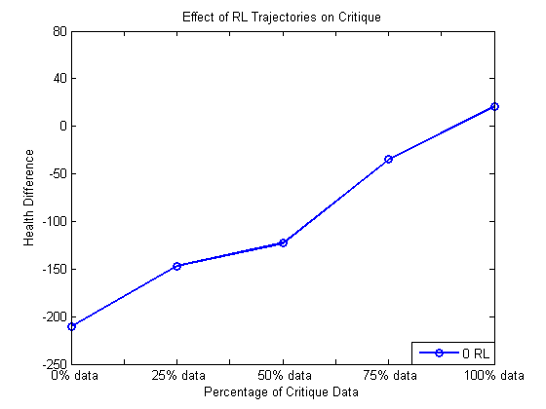
Simulated Experiments Results:
Benefit of Practice (User #1)
  Even with no practice, the critique data was sufficient to outperform RL.
  RL did not go past 12 health difference.

Slide 30
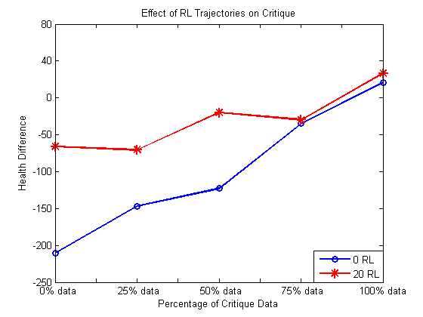
Simulated Experiments Results:
Benefit of Practice (User #1)
  With more practice performance increases too.

Slide 31
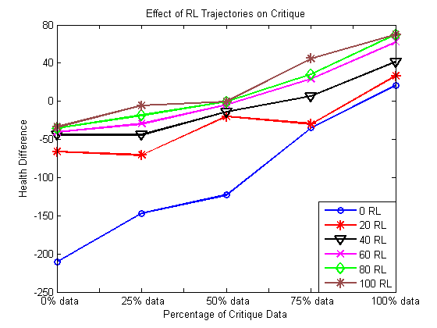
Simulated Experiments Results:
Benefit of Practice (User #1)
  Our approach is able to leverage practice episodes in order to improve the effectiveness on a given amount of critique data.
Notes:
1. Thus simulated exps show the benefit of using both forms of data over just using only one form of data of either type.

Slide 32
Results for Actual User Study
Goal is to evaluate two systems
  Supervised System = no practice session
  Combined System = includes practice and critique
The user study involved 10 end-users
  6 with CS background
  4 no CS background
Each user trained both the supervised and combined systems
  30 minutes total for supervised
  60 minutes for combined due to additional time for practice
Notes:
We attempted to maintain a balance between which map and learning system was used first by each user.

Slide 33
Results of User Study

Slide 34
Results of User Study
winning
Crushing win
Comparing to RL:
  9 out of 10 users achieved 50 or more performance using Supervised System
  6 out of 10 users achieved 50 or more performance using Combined System
  RL did not go past 12 health difference on any map even after 500 trajectories.
  Users effectively performed better than RL using either the Supervised or Combined Systems.

Slide 35
Qualitative Results
Not all teachers were as successful as others
  Not a complete success story.
Most significant user complaints:
  Tired of waiting during practice (only an issue in user study)
  Sometimes after practice students do worse than before
  Sometimes students seem to forget critique advice
  Can be tedious to look through full trajectories
Notes:
Nevertheless, in general, it is likely that with our current combined system, users will experience occasional decreases in performance after practice and perceive that the system has not taken their critiques into account. A lesson from this study is that such behavior can be detrimental to the user experience and the overall performance achieved.

Slide 36
Reducing Teacher Effort
Its tedious to look through full trajectories.
Which critiques will be most helpful ???
Action Critiques
Active Imitation Learning
Active Imitation Learning via Reduction to I.I.D. Active Learning
[Judah et. al., UAI-12]
Notes:
Say that a similar issue arises in the imitation learning setting where users may feel that it is tedious to provide full demonstrations.
We tried to make such interactions more efficient for the user by having the student request one-step action demonstrations rather than the teacher examining or providing full demonstrations.
We showed the effectiveness of such an approach in the imitation learning setting. We call the approach active imitation learning.

Slide 37
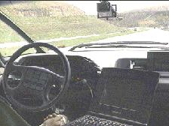
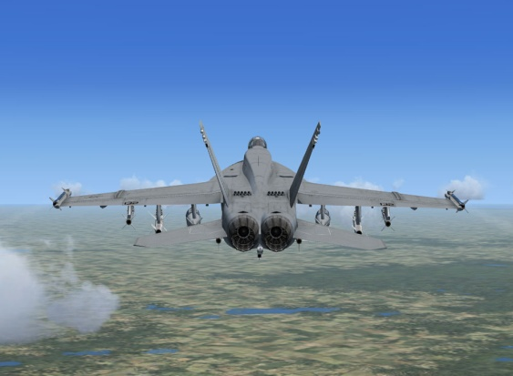
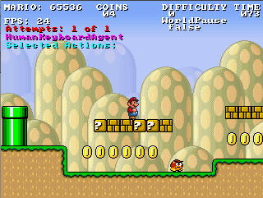
Passive Imitation Learning
Machine
Learning
Algorithm
Teacher
Trajectories
Policy
Learner
GOAL: Teacher wants to teach policy to the learner
Car driving
Flight simulation
Electronic games
[Pomerleau, 89]
[Sammut et. al., 92]
[Ross and Bagnell, 2010]

Slide 38
Passive Imitation Learning
Machine
Learning
Algorithm
Teacher
Trajectories
Policy
Learner
DRAWBACK:
Generating full trajectories can be tedious and sometimes impractical.
Teaching tactical battle micromanagement via demonstrations
Notes:
Don’t say wargus, just say we want to create a controller for rts game, we will have to demo how to play game and its tedious to control each unit at each timestep.
Same problem has been found in other domains where people have reported that providing demos is hard.
2. Plus there are other issues with passive setting e.g. demonstrations can be highly redundant and because it is difficult to provide full demonstrations, it places a bar on who can be considered as an expert.

Slide 39


Active Imitation Learning
correct action to take in is
Dynamics
Simulator
(No rewards)
Select Best
Action Query
Learner
Teacher
Current Training data
(s, a) pairs
GOAL: Learn teacher policy using as few queries as possible
Notes:
We consider an alternate form for imitation learning.

Slide 40
Key Questions
Can we show that active imitation learning can be more efficient than passive?
  Theoretically
  Empirically
Consider standard i.i.d. learning (non-sequential decision making) :
for example learning to classify emails as spam or non-spam
  Many empirically effective active learners have been developed
  Theoretically active learning can be exponentially more efficient !
Can these results carry over to imitation learning?
Our Approach: “reduce” active imitation learning to i.i.d. active learning
Notes:
Say where we define label complexity of passive imit learning as # of actions taken by the teacher while demonstrating how to perform the task, because that’s the amount of labeled data that is given to the passive iid learner.

Slide 41




I.I.D. Active Learning
Unlabeled data distribution
True label is
Select Best
Query
Teacher
i.i.d. active learner
Current Training data
pairs
Notes:
Say that we are interested in knowing how many labeled examples are needed to achieve learning goal. Then show passive label complexity. Then show active setup and active label complexity.
Say in active setup, the learner is given access to unlabeled data dist. And an oracle to provide true labels
Say realizable setting
Explain why active has better label complexity: mainly because obtaining unlabeled data is cheap but obtaining labels is expensive. So by actively obtaining labels, active learner is able to learn with fewer labels!!

Slide 42
Reducing Active Imitation Learning to I.I.D. Active Learning
correct action to take in is
Unlabeled State
Distribution
Select Best
Action Query
i.i.d. active learner
Teacher
Current Training data
(s, a) pairs
Notes:
Say that we are interested in knowing how many labeled examples are needed to achieve learning goal. Then show passive label complexity. Then show active setup and active label complexity.
Say in active setup, the learner is given access to unlabeled data dist. And an oracle to provide true labels
Say realizable setting
Explain why active has better label complexity: mainly because obtaining unlabeled data is cheap but obtaining labels is expensive. So by actively obtaining labels, active learner is able to learn with fewer labels!!

Slide 43
Reducing Active Imitation Learning to I.I.D. Active Learning
Key Challenge: what unlabeled data distribution do we give to the i.i.d. active learner?
correct action to take in is
?
Select Best
Action Query
i.i.d. active learner
Teacher
Current Training data
(s, a) pairs

Slide 44
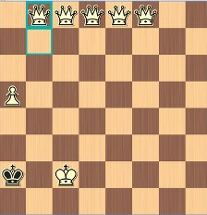
Reducing Active Imitation Learning to I.I.D. Active Learning
Naïve Approach: use an arbitrary distribution
  Often leads to useless/bizarre queries
What the #?&@!
?
Select Best
Action Query
i.i.d. active learner
Teacher
Current Training data
(s, a) pairs

Slide 45




RAIL Algorithm
Iteration t =1
Generate
trajectories
Extract unlabeled
states
Trajectories
correct action to take in is
Unlabeled
states
Teacher
i.i.d. active learning algorithm
Notes:
1. Tell that RAIL stands for Reduction based Active Imitation Learning.

Slide 46

RAIL Algorithm
Iteration t =2
Generate
trajectories
Extract unlabeled
states
Trajectories
correct action to take in is
Unlabeled
states
Teacher
i.i.d. active learning algorithm
Notes:
1. Tell that RAIL stands for Reducition based Active Imitation Learning.

Slide 47


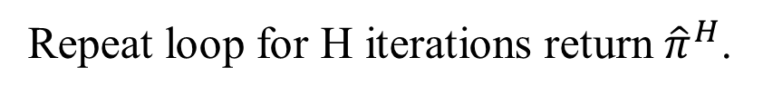
RAIL Algorithm
Iteration t =H
Generate
trajectories
Extract unlabeled
states
Trajectories
correct action to take in is
Unlabeled
states
Teacher
i.i.d. active learning algorithm
Repeat loop for H iterations return ${\hat{π}}^{H}$.
Notes:
1. Tell that RAIL stands for Reducition based Active Imitation Learning.

Slide 48
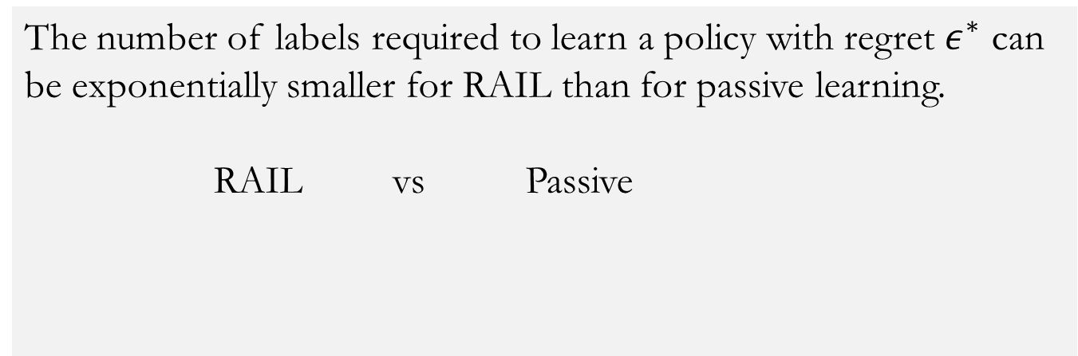


Main Theoretical Result
PAC Learning Framework
In practice we use an incremental version called RAIL-DW

Slide 49
Experiments
We performed experiments in the following domains:
  Bicycle Balancing
  Car Driving
  Wargus
  Cart pole
  Structured prediction
We compared RAIL-DW against following baselines :
  Passive imitation learning (Passive):
    Simulates standard passive imitation learning
  unif-RAND:
    Selects states to query uniformly at random
  unif-QBC:
    Treats all states as i.i.d. and applies standard QBC
  Confidence based autonomy (CBA) [Chernova & Veloso, 2009]:
    Query the teacher if confidence < threshold (automatically computed)
    Performance can be quite sensitive to threshold adjustment
Notes:
1. Explain how each leaner operates as you present each learner to the audience. For example, explain what it means that Passive simulates standard passive imitation learning; same for other baselines!!

Slide 50
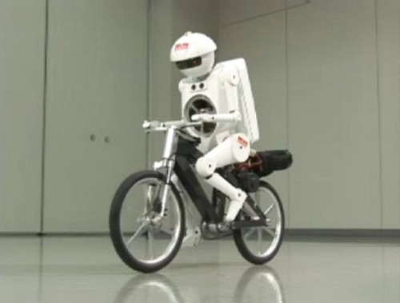
Simulated Bicycle Balancing
  Goal is to balance a moving bike for 1000 time steps
  State is described using variables measuring various angles, angular velocity and position of the bike
  Five actions each specifying a particular handle-bar torque and rider displacement

Slide 51
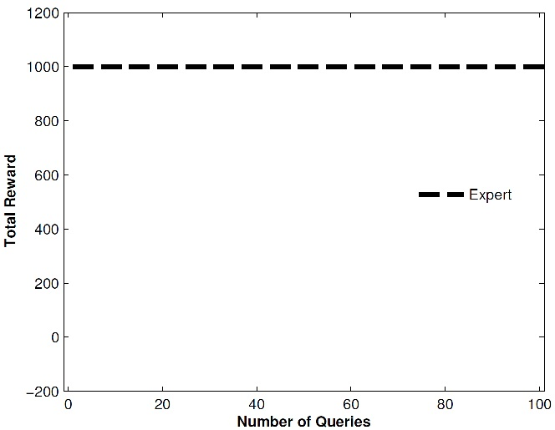
Simulated Bicycle Balancing (simulated teacher)

Slide 52
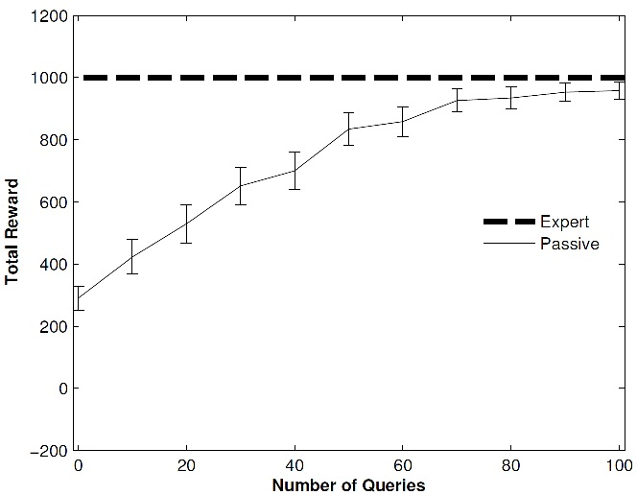
Simulated Bicycle Balancing (simulated teacher)

Slide 53
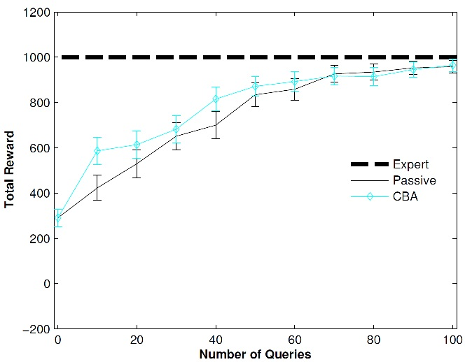
Simulated Bicycle Balancing (simulated teacher)

Slide 54
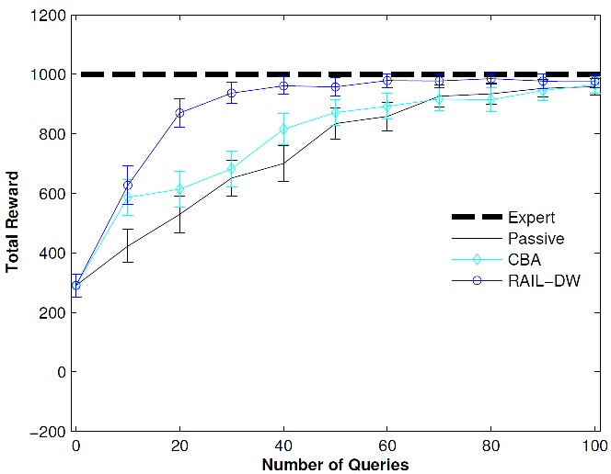
Simulated Bicycle Balancing (simulated teacher)

Slide 55
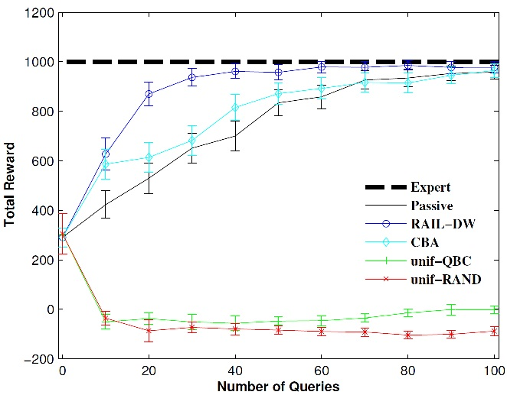
Simulated Bicycle Balancing (simulated teacher)
RAIL-DW
Passive

Slide 56
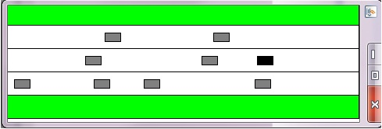
Simulated Car Driving
  Goal is to navigate a car on a 5-lane highway for 1000 time steps
  State is described using various binary features that specify:
    Car’s current lane
    Whether car is colliding, tailgating or trailing another car
    Whether car will collide with another car in near future (gives view of traffic)
  Three actions: Left, Right, Stay

Slide 57
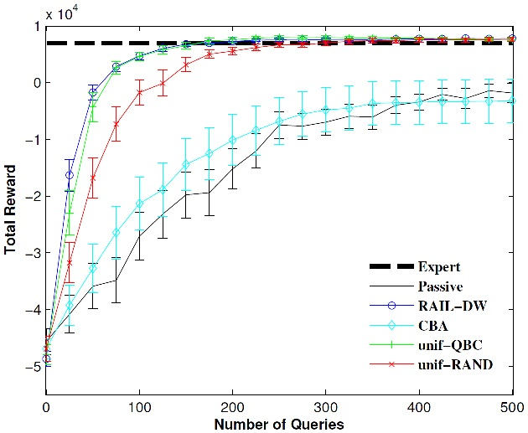
Simulated Car Driving (simulated teacher)
RAIL-DW
unif-QBC
Passive

Slide 58
Future Work
Just scratching the surface
  Allow richer, more natural teacher input (e.g. preference queries)
  Allow more natural and more efficient queries
Move from students based on reactive policies to students based on deliberative planning
  What type of knowledge can be naturally specified and reliably incorporated into a planner
More user studies under realistic conditions
  Will require more sophisticated models of teachers

Slide 59
Thanks!

