Slide 1
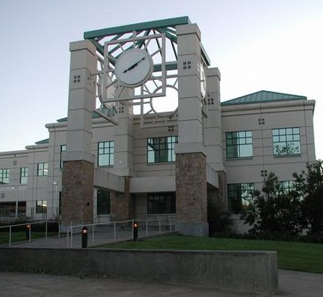
CS 242 Discrete Structures for Computer Science Spring 2014
Bala Ravikumar
Computer Science & Engg Science Dept
Some slides adapted from Marc Pomplin, UMB

Slide 2
Web site and other info
Office: 116 I Darwin Hall
Phone: 664 3335
E-mail: piazza, ravi@cs.sonoma.edu
Course Web site:
https://piazza.com/sonoma/spring2014/cs242/home

Slide 3
Digital revolution
A major revolution in history of science was to assign numbers to physical entities.
Height, weight, area, volume (1000s of years)
Temperature, pressure, … (only 3-400 hundred years)
Another revolution (20th century) was to digitize the quantities (analog devices gradually replacing digital ones)
Dicrete math is gradually replacing calculus as the math tool.

Slide 4
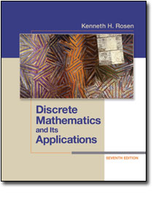
Course Text:
Kenneth H. Rosen,
Discrete Mathematics and its Applications
7th Edition
Best price $ 13.05 + $6.99 (shipping)
international edition
Course Web Site:
https://piazza.com/sonoma/spring2014/cs242

Slide 5
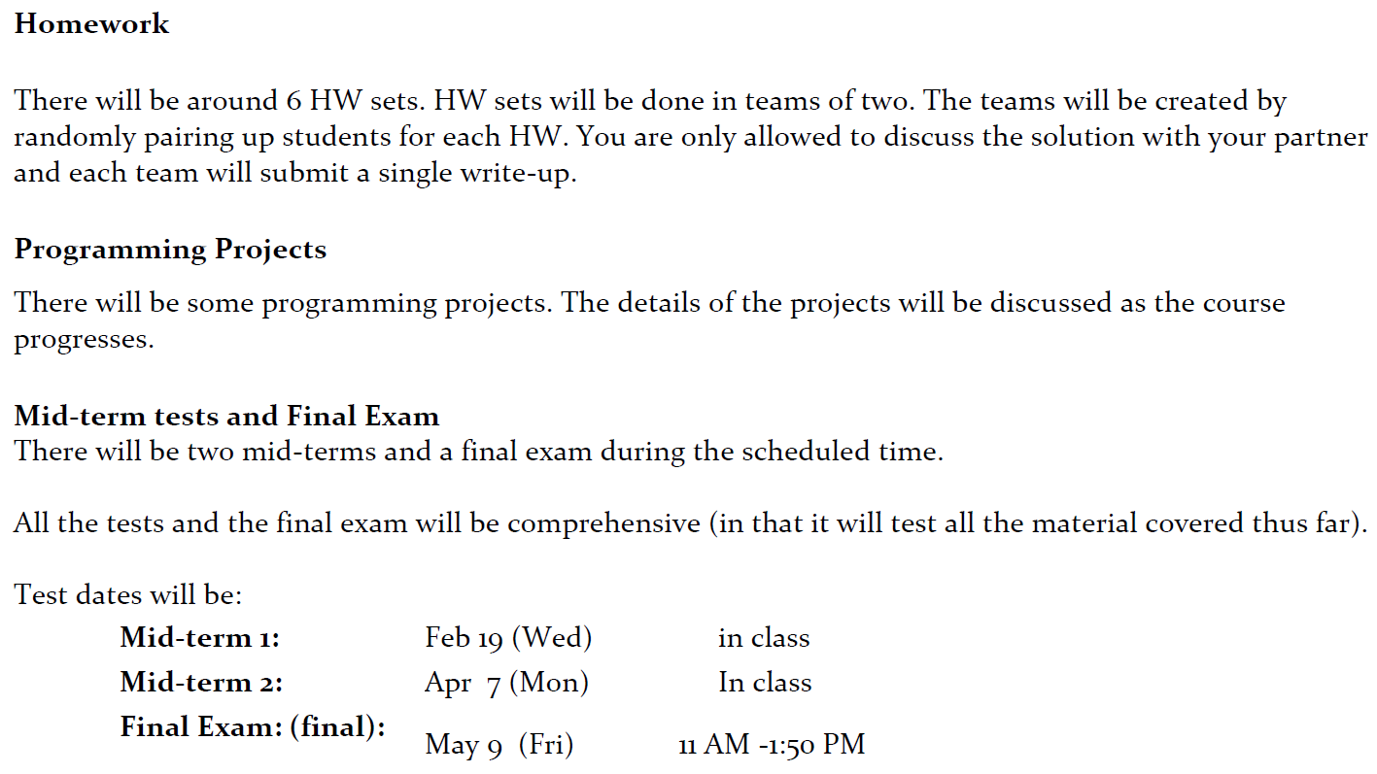
Course Work and Grading

Slide 6
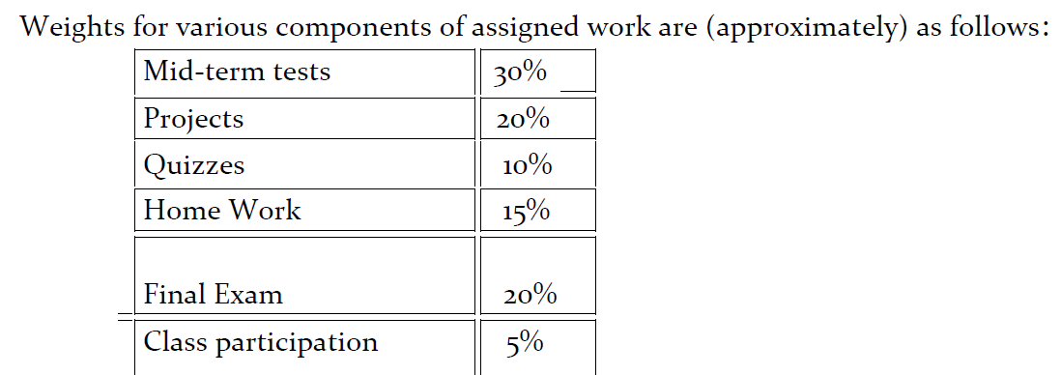
Grading

Slide 7
What are discrete structures?
Sets
Strings, sequences
logical formulas
Graphs
Grammars
Automata
Computer programs
circuits

Slide 8
What are discrete structures?
Sets
Finite sets, infinite sets (infinite sets play an important role in Computer Science just like infinity plays an important role in engineering and physical sciences)
Topics related to sets
Define
Count the number of items
Perform various operations like union, intersection etc.
Count subsets with various conditions

Slide 9
What are discrete structures?
Sequences
Sets in which order is important
Ex: {3, 4} = {4, 3}, but <3, 4> != <4, 3>
What to study about sequences?
define
Count the number of arrangements with various conditions
Strings are special sequences with many applications (text, programs etc.)

Slide 10
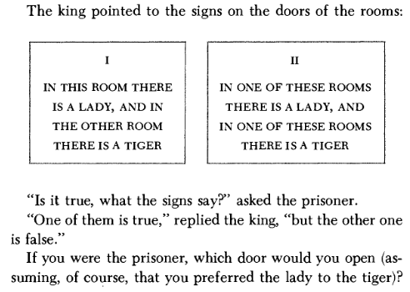
What are discrete structures?
Logic
Role of logic
Formal statement of problem (specification)
Develop proof
Logic gates form
basis for hardware

Slide 11
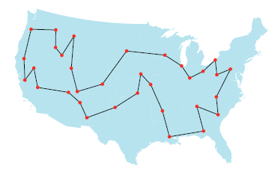
What are discrete structures?
Graphs
Points (vertices) and edges (connections between vertices)
Paths, cycles, connectivity, …
Model for
Electric grid
Road networks
Social networks
Links between web
sites

Slide 12
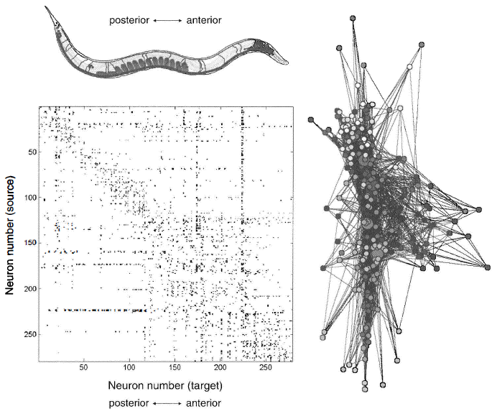
Graph model of neuronal connections: c-elegans

Slide 13
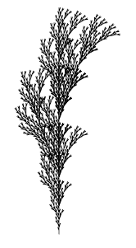
What are discrete structures?
Grammars
Rules
Generate by rewriting
Example:
A -> A B
B -> A A B
A -> 1
B -> 0
A => AB => 1B => 10

Slide 14
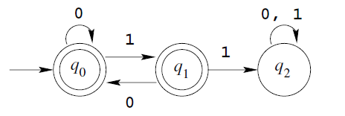
What are discrete structures?
Automata
Model for
Circuits
Protocols
Biological systems
Languages (computer,
natural)

Slide 15
What are discrete structures?
algorithms
form basis for software and programs
Many ways to express them:
High-level languages (c++, python etc.)
Machine languages
Turing machines
Lambda calculus

Slide 16
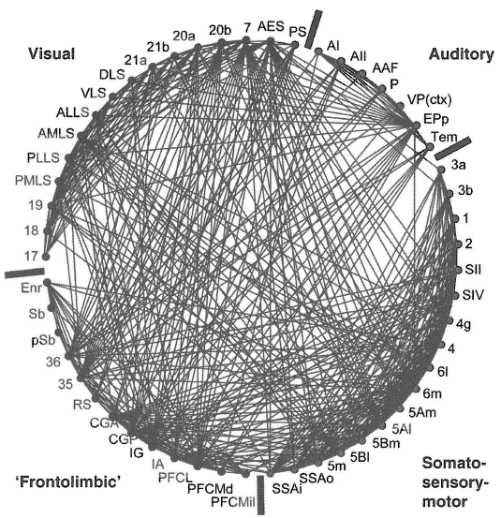
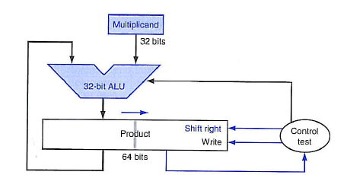
What are discrete structures?
Circuits
Basis for computer design
Model for brain,
other biological pathways
Closely related to graphs and automata
Circuit of cat cortex

Slide 17
Why Care about Discrete Math?
Digital computers are based on discrete “atoms” (bits).
Therefore, both a computer’s
structure (circuits) and
operations (execution of algorithms)
can be described by discrete math.
Modeling various systems (engineering, physical, chemical, biological etc.) require discrete math

Slide 18
Main theme of the course
Problem solving
Proofs
Applications
Implementation

Slide 19
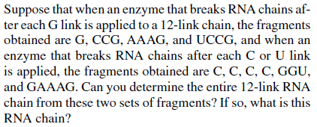
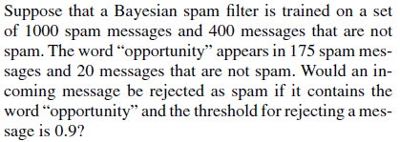
Main theme of the course
Problem solving
Ex 1: (from the text, page 443)
Ex 2: (from the text, page 477)
Ex 3: (from the text, page 293)

Slide 20
Main theme of the course
Proofs
Formal proofs, informal proofs
Constructive proofs
Proof by example, counter-example
Induction proofs
Statement from the text (page 101)

Slide 21
Main theme of the course
Applications
Algorithms
Correctness
Analysis of time complexity
Hardware design
Circuits, memory, interconnection networks, …
Modeling and simulation
statistical models
Analysis of user experience
Analysis of data from social networks
Biological and other networks

Slide 22
Main theme of the course
Implementation
Write programs to implement the algorithms
Other forms of implementation
3d printing
Knitting, weaving, card-board design, …
Arduino, raspberry pi, …

