Slide 1
Subversion Tool Presentation

Slide 2
Agenda
What is Subversion?
Why do we need CM?
Basic concepts
Repositories
  Options
  Setup
Clients
  Options
  Setup
  Operation
Troubleshooting

Slide 3

What is Subversion?
A centralized version control system
Not the newest form of configuration management, but easy to use and popular
  Founded in 2000
  Successor to widely used CVS
Aka SVN
Repository
Notes:
In the centralized system one server holds the repository, and each user maintains their own working copy of the files. The CM system is used to flow changes from the repository into the working copies and vice versa.

Slide 4
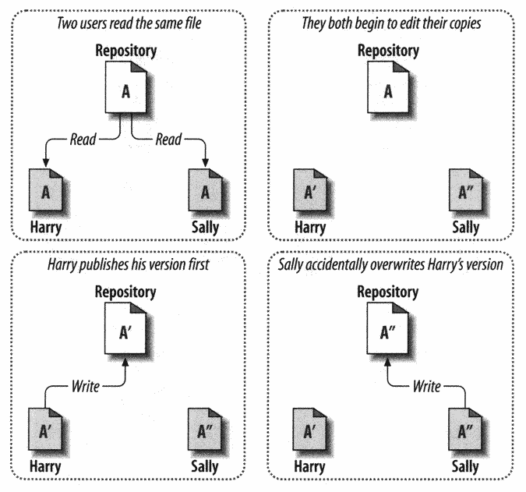
Why do we need CM?
Inconsistent updates
Work is lost!
* Pictures taken from “Version Control with Subversion” Pilato, Collins-Sussman & Fitzpatrick, O’Reilly press
Notes:
The picture is the fundamental reason why having multiple people edit a single shared file on a network drive does not work.

Slide 5
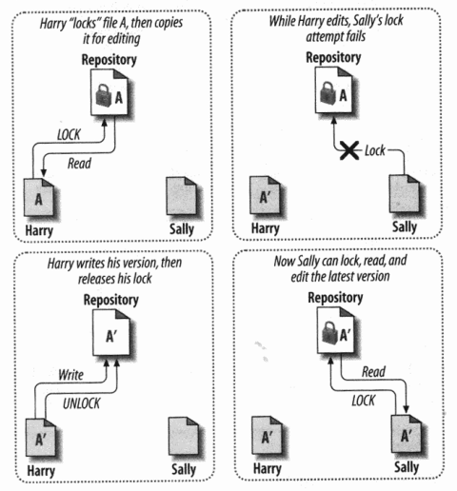
The Locking Model
Prevents concurrent work, slows down development
Subversion can do this, but it’s usually not the best way
Notes:
Note that locking can often slow down development and introduce inefficiencies. One person may hold a lock on a file for a few days while making a large change (or forget to unlock it before going on vacation!!). During this time no one else can change the file, even to make small changes or do refactoring.

Slide 6
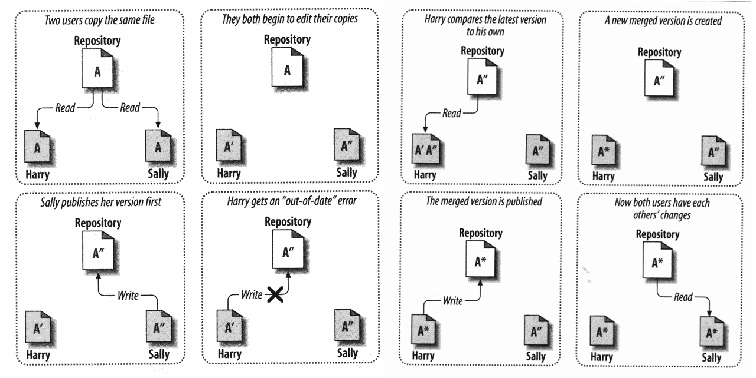
The Merge Model
This is much better, Subversion does it too
1
2
5
7
3
4
6
8
Notes:
Also see slide 10

Slide 7


Revisions
Revision (version) numbers are for the entire repository, not for each file
A
A
D
B
B
B
Rev 0
C
C
E
E
Rev 1
Rev 2
Rev 3
Notes:
Note that not every file needs to change in every revision. Revision number increments every time anything is changed and so the revision numbers will get quite high (hundreds or thousands). “HEAD” may be used as a synonym for the latest checked in revision and “BASE” as a synonym for the version a working copy is based upon.

Slide 8

Working Copies
Each user’s real time editing is on their own working copy
  Normal file stored on in the local file system
Working copy is created by “checking out” the repository
  Subversion remembers the relationship between the working copy and the repository revision it is based upon
  Information stored in “.svn” directories; don’t mess with them!
Each working file in 1 of 4 states
  Unchanged and current
  Locally changed and current
  Unchanged and out of date
  Locally changed and out of date
Repository
Notes:
“svn status” command is an easy way of showing state for each file. Subclipse presents these as different icons

Slide 9
Operations - Normal
Repository
Working Copy
R4
checkout
R4
Another user commits
R5
update
R5
Local Edit
R5 modified
commit
R6
R6
Notes:
Probably 95% of all your interaction with subversion will be these three commands

Slide 10
Operations - Conflict
Repository
Working Copy
R4
checkout
Another user commits
R4
R5
Local Edit
R4 modified
commit
Fail – out of date
update
R5 modified
commit
R6
R6
Notes:
Conflicts like this are usually not a problem. If the changes are in different parts of the file the update will merge them automatically, if they overlap each other (e.g. two users renamed the same variable) then the tool will ask the user for help in resolving the conflict.

Slide 11
Server Side
Many code hosting sites include a subversion server
  Google Code, Assembla, etc
  This is the easy way!!
  Can also view repo through a web interface
Can install subversion on a server which all users can access and create your own repository
  svnadmin is the command line tool
    svnadmin create --fs-type fsfs /srv/svn/test
  Two backend options; Berkeley DB and FSFS
    Use FSFS!!

Slide 12
Server Side (continued)
Any repository has a URL which is necessary to configure the clients
  e.g. https://subversion.assembla.com/svn/cse5306-calendar
By convention, each project in a repository has 3 top level directories:
  trunk Main line development
  branches Allows experimental/developmental work without breaking the trunk
  tags Can be used to name “special” revisions

Slide 13
Client Side
Many, many different subversion clients available
  All follow the same subversion model
    If you understand the model you should understand the tool
  All use the same working file information
Some operations are easier in some tools
  Can be worth using more than one
Notes:
Since all clients are using the standard subversion interface and working with information stored in .svn directories in the working copy, it is very possible and frequently useful to interact with the same working directory using more than one tool. Different things are easier in different tools. E.g. checkout through KDESVN, make changes through Subclipse

Slide 14
Client Side – Example Tools
TortoiseSVN (http://tortoisesvn.net/)
  Windows, integrates with explorer shell
  Very easy to use, powerful
kdesvn (http://kdesvn.alwins-world.de/)
  Linux KDE, standalone application
  Full featured, very powerful
Subclipse (http://subclipse.tigris.org/)
  Eclipse plugin, excellent integration
  Can’t afford to be without this if working in eclipse!
svn – standard command line tool
  Very similar to *nix commands: “svn mv”, “svn rm”, etc
  Useful for maintaining/troubleshooting working copies
  Useful for integration into scripts

Slide 15
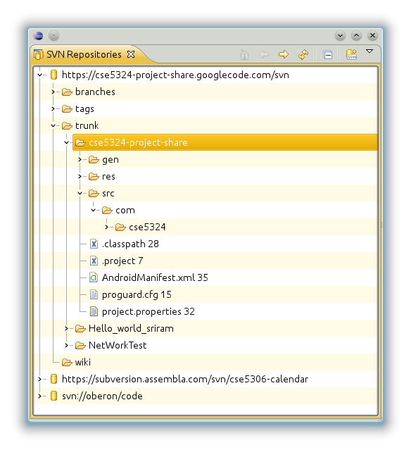
Subclipse – Repo Browser
Use this to view and checkout new repositories
Always important to understand what is in the repository vs local file system
Notes:
Open repository browser as a view; SVN->”SVN Repositories”
Right click, new repository location, enter url from server
To checkout a project, right click then “Checkout…”

Slide 16
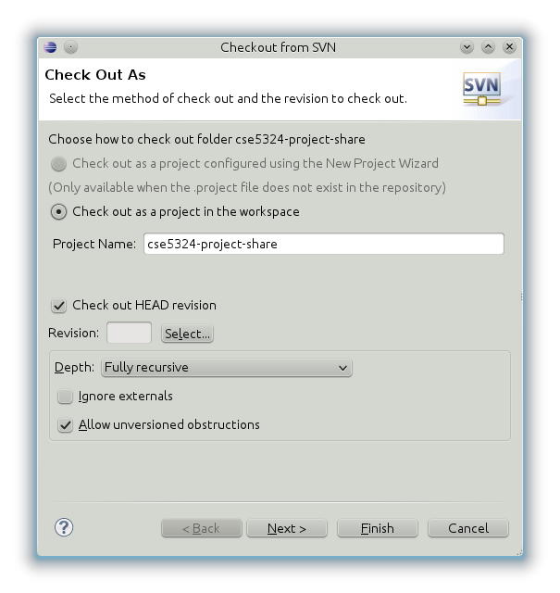
Subclipse – Checkout
Notes:
Can checkout a project directly from the repo browser, and it will automatically add the project into your workspace.

Slide 17
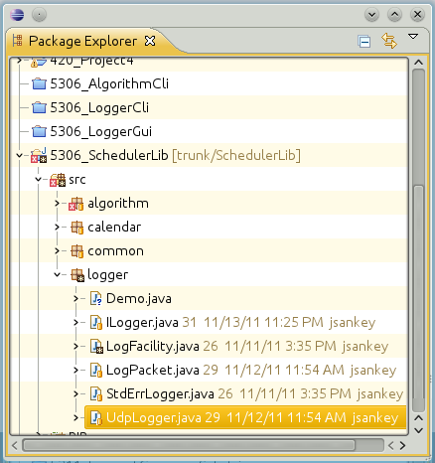
Subclipse – Status Symbology
Symbol on bottom right of icon shows status of local file
In repository and up no local changes made
Not yet added to repository
Local changes not yet committed
Base revision, date, and author

Slide 18
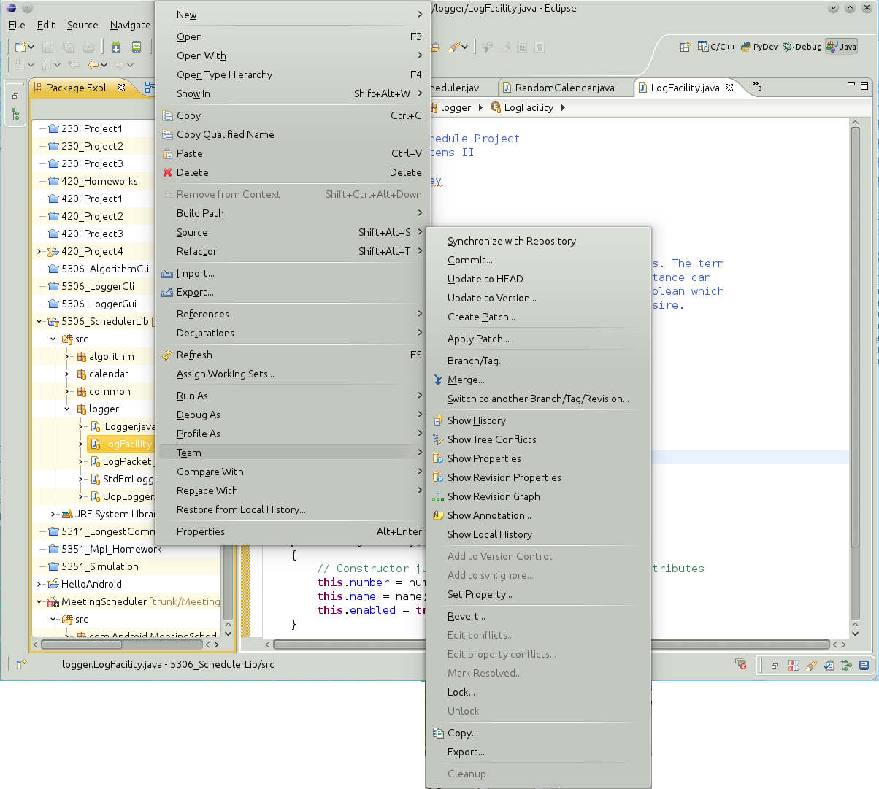
Subclipse Menu
3: Lots of useful commands
1: Right Click File
2: Select Team
Notes:
Commit and Update are essential commands on this menu, can also revert (remove any local changed and go back to version in repository), manage properties, lock/unlock, etc
After creating a new file, need to first select “Add to version control” and then “Commit..”

Slide 19
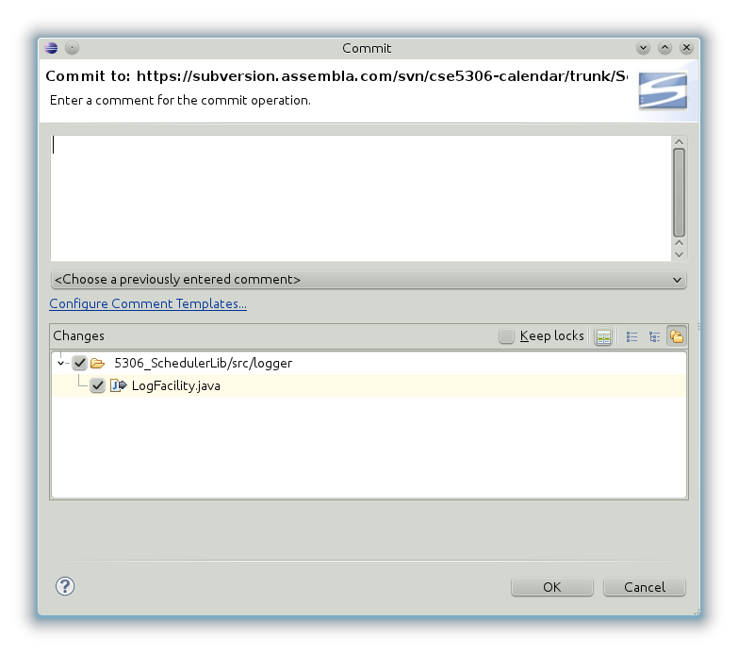
Subclipse – Commit
Adding comments is a good habit to get into
Select which (changed or added) files to commit
Type something here !!
Notes:
Remember each revision is against the entire repository, not a particular file. Can commit multiple files at the same time, and the comment will be against the repository, not particular files.

Slide 20
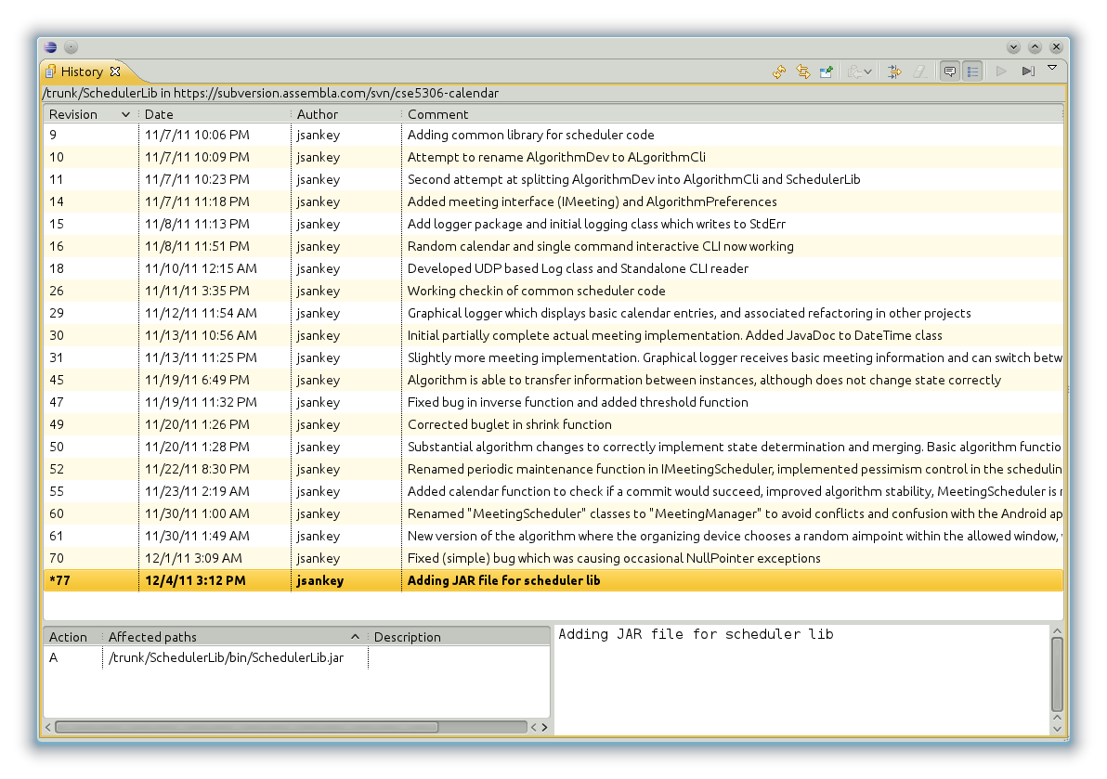
Subclipse - History

Slide 21
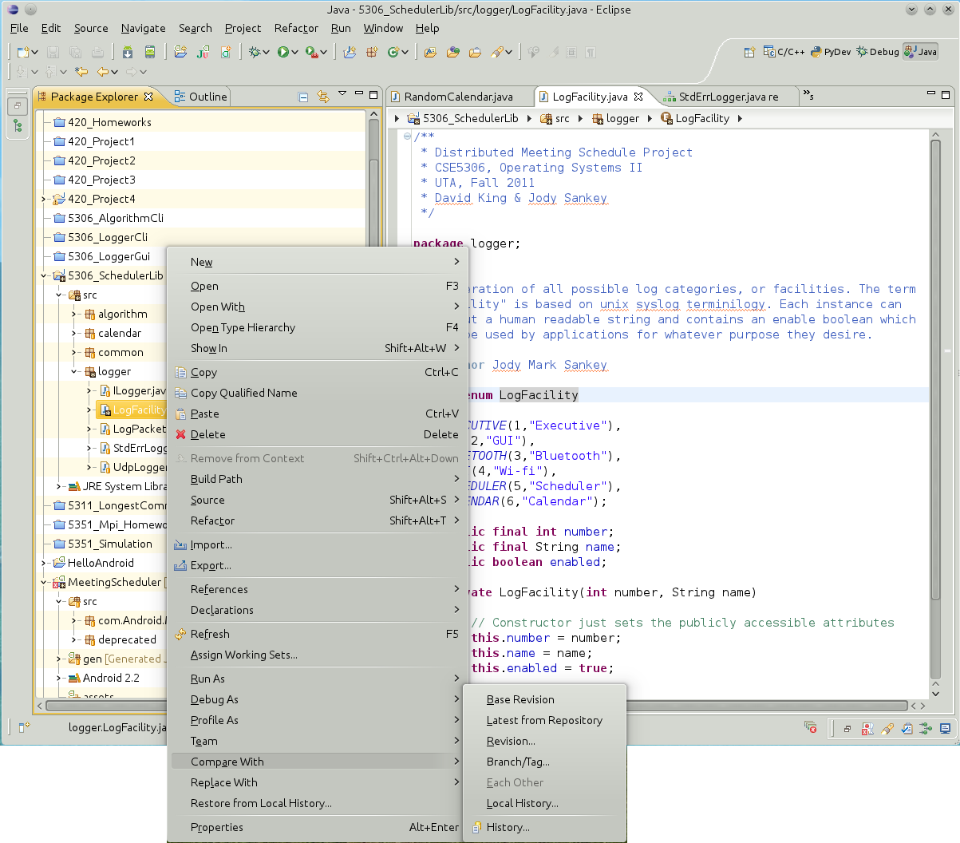
Subclipse – Diff with repository
1: Right Click File
3: Select Base or Latest
2: Select Compare With

Slide 22
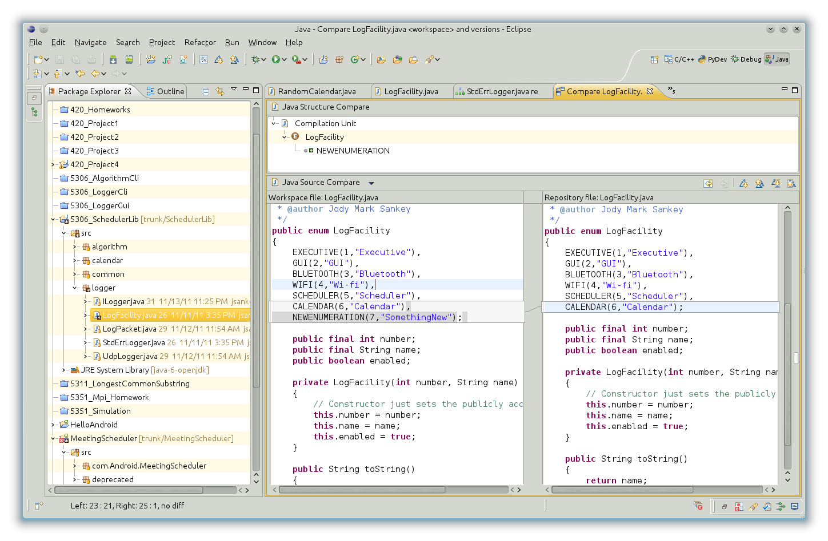
Subclipse – Diff with repository

Slide 23
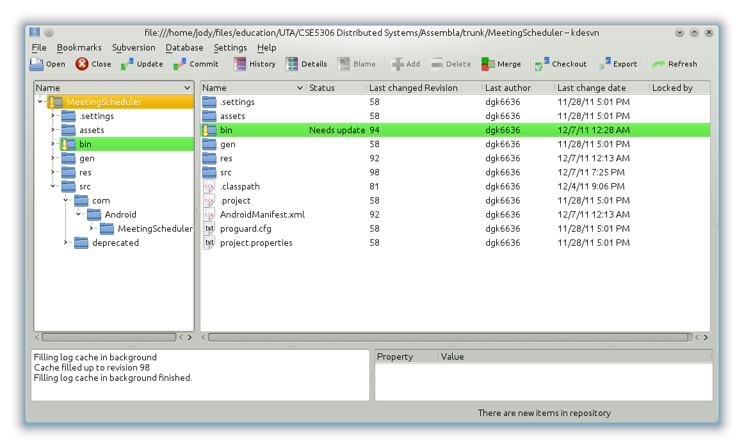
kdesvn – Main Screen

Slide 24
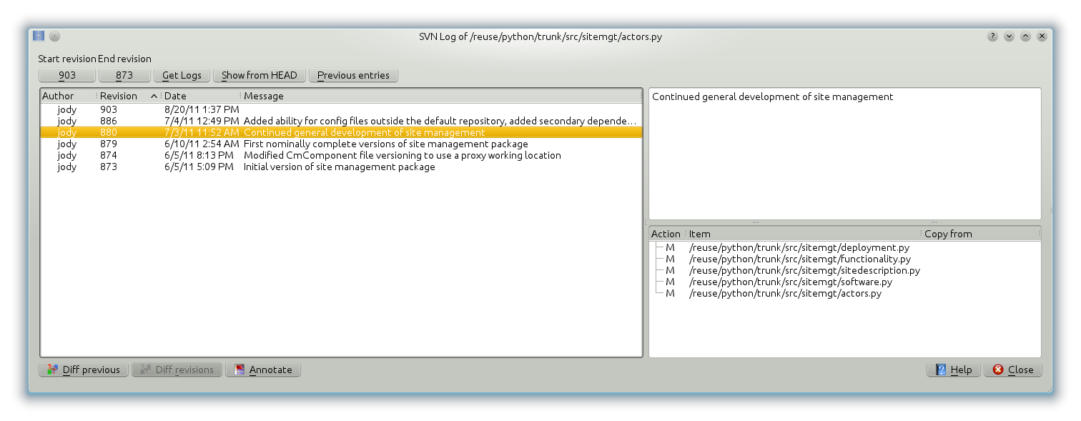
kdesvn – Example file-rev relation
Left shows all revisions at which a particular file changed
For one of these revisions…
  Top right shows comment against the revision
  Bottom right shows all files which changed at that revision

Slide 25
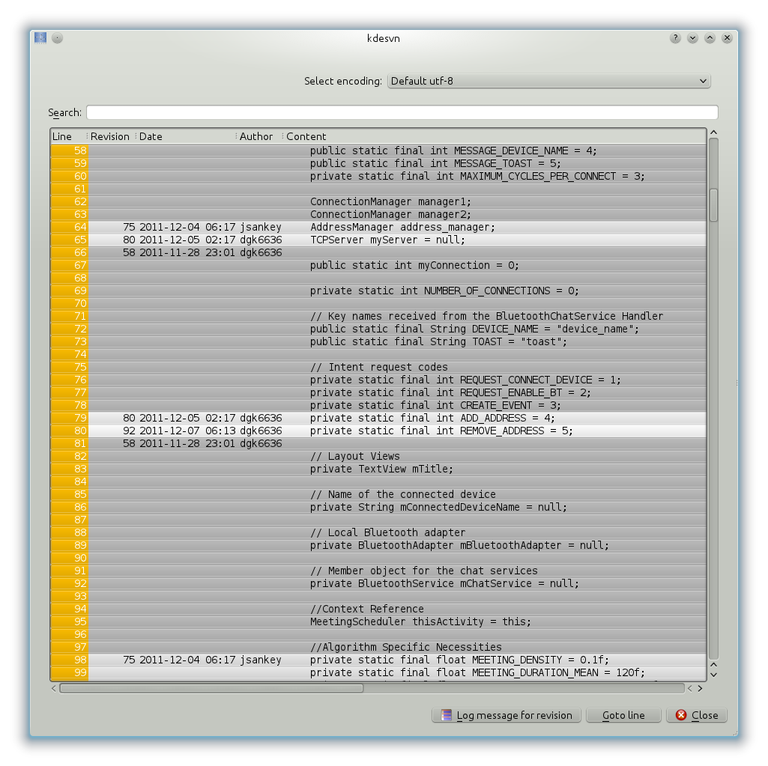
kdesvn - Blame
For every line in a file; shows last date and revision it was changed
Also shows who did it!

Slide 26
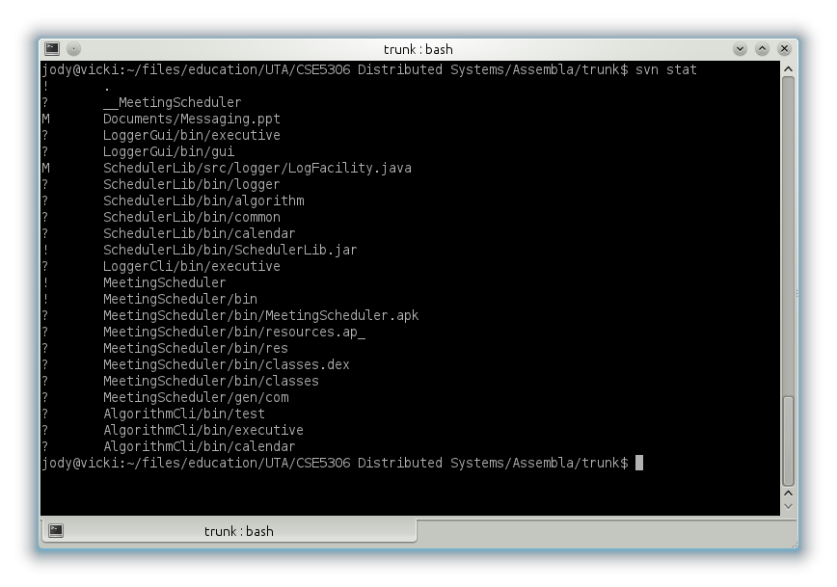
Command line – SVN Status
Shows exactly what state subversion believes each file is in
Very useful first step if you are getting error messages on commit or update

Slide 27
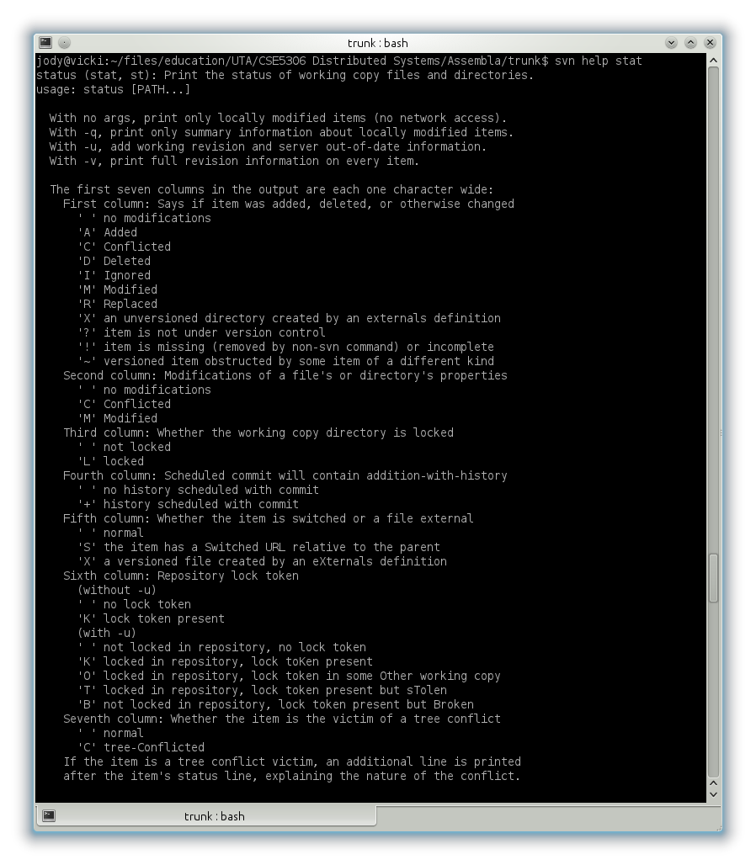
Command line – Stat definitions
Key for understanding the symbols used by svn status command
Help on any command is available with
svn help <command>

Slide 28
Command line - Reference
svn help COMMAND - Show help for specified command
svn import LOCALDIR URL - Add new tree to repository
svn checkout URL [LOCALDIR] - Create new working copy from URL
svn update - Bring remote changes into working copy
svn add FN - Add new file to working copy
svn delete FN - Remove existing file
svn copy FN1 FN2 - Duplicate existing file
svn move FN1 FN2 - Move or rename existing file
svn mkdir DR - Convenient way of making and configuring new directory
svn status - Show status of specified files (very powerful and useful)
svn diff - Diff local copy to last update
svn revert FN - Revert FN to checkout version (or remove pending add/del)
svn commit -m XXX - Commit changes, with log message XXX
svn log - Shows log of all changes to a file
svn diff -r X - Compare working copy to rev X
svn cat -r X - Show version X
svn list -r X - Show all files present at rev X
svn cleanup - Checks directory for outstanding locks or partially completed operations
svn log -r 9238 - Read about everything checked in at rev 9238
svs copy URL/FN@807 FN - Resurrect FN at deleted rev 807
svn lock FN -m XXX - Place a lock on FN
svn unlock FN - Remove lock. Other users can often forcibly remove a lock

Slide 29
Some “DON’T”s
Don’t delete, rename, or mess with .svn directories
Don’t use normal file system operations to delete, rename or move files in a working copy
  Use the svn versions instead
Don’t try and move directories
  Create a new directory, move files, delete old directory
    (problem I had may be tool or version dependant)
Don’t move and edit a file in the same revision
  Do a commit between the two versions
Don’t try and using branching without
understanding what you’re doing

Slide 30
Questions

