Slide 1

Introduction to OOSD
Lecture-1
Prof. Hari Mohan Pandey
Assistant Professor, CSE Department
Amity School of Engineering & Technology
hmpandey@amity.edu

Slide 2
Outline
Introduction to OOSD
What is OO?
What is OOSD?
How to do OOSD?
What is the benefits?

Slide 3
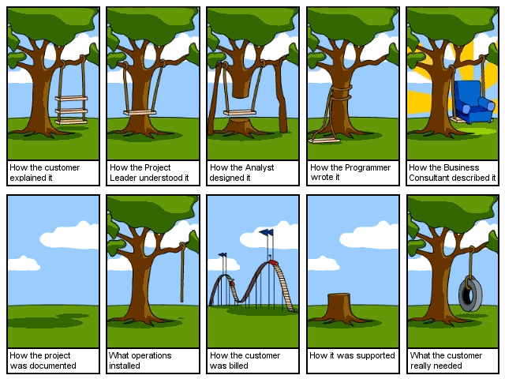

Slide 4
Why Object-Oriented?
“The "software crises" came about when people realized the major problems in software development were … caused by communication difficulties and the management of complexity” [Budd]
The Whorfian Hypothesis:
Human beings … are very much at the mercy of the particular language which has become the medium of expression for their society … the 'real world' is … built upon the language habits … We cut nature up, organize it into concepts, and ascribe significances as we do, largely because we are parties to an agreement to organize it in this way … and is codified in the patterns of our language.


What kind of language can alleviate difficulties with communication & complexity hopefully well?

Slide 5
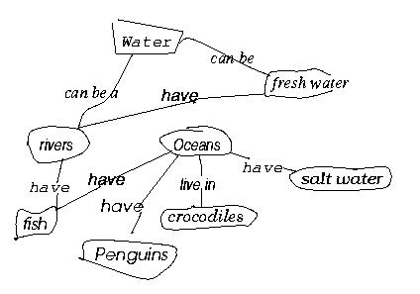
Why Object-Oriented? - concepts and objects
So, concepts are needed to bring order … into
But, What is CONCEPT? [Martin & Odell] [Novak, 1984, Cambridge University Press]
Study of a first grade class
When given a list of concepts (water, salt water, Oceans, Penguins,...),
Harry constructed a concept diagram through which he understands his world and communicates meaning
Does Harry understand the concepts? Do you understand what Harry understands? Agree or Diagree?

Slide 6
Why Object-Oriented? … for Conceptual … Modeling Reasons
What kind of language can be used to create this concept diagram, or Harry’s mental image?
Water
Fresh water
have
Rivers
Oceans
have
have
live in
have
Salt water
Crocodiles
Fish
have
Penguins

Slide 7
Why Object-Oriented -> What is a model and why?
A model is a simplification of reality.
E.g., a miniature bridge for a real bridge to be built
Well...sort of….but not quite
A model is our simplification of our perception of reality
(that is, if it exists, otherwise it could be a mere illusion).
communication is not about reality but about your/my/his/her perception of reality => validation and verification hard but needed
A model is an abstraction of something for the purpose of understanding, be it the problem or a solution.
To understand why a software system is needed, what it should do, and how it should do it.
To communicate our understanding of why, what and how.
To detect commonalities and differences in your perception, my perception, his perception and her perception of reality.
To detect misunderstandings and miscommunications.

Slide 8


What is Object-Orientation? - What is Object?
An "object" is anything to which a concept applies, in our awareness
Things drawn from the problem domain or solution space.
E.g., a living person in the problem domain, a software component in the solution space.
A structure that has identity and properties and behavior
It is an instance of a collective concept, i.e., a class.

Slide 9

What is Object-Orientation
- Abstraction and Encapsulation
Abstraction
Focus on the essential
Omits tremendous amount of details
…Focus on what an object “is and does”
Encapsulation
information hiding
Objects encapsulate:
property
behavior as a collection of methods invoked by messages
…state as a collection of instance variables

Slide 10
What is Object-Orientation
- Another Example of Abstraction and Encapsulation
Class Car
Attributes
Model
Location
#Wheels = 4
Operations
Start
Accelerate
<<instanceOf>>
<<instanceOf>>
<<instanceOf>>
What is generalization?
What is over-generalization??
Forall x [Car(x) -> …]

Slide 11
What is Object-Orientation? - Class
<<instanceOf>>
Class Car
Attributes
Model
Location
#Wheels = 4
Operations
Start
Accelerate
<<instanceOf>>
<<instanceOf>>
What is CLASS?
a collection of objects that share common properties, attributes, behavior and semantics, in general. What are all these???
A collection of objects with the same data structure (attributes, state variables) and behavior (function/code/operations) in the solution space.
Classification
Grouping of common objects into a class
Instantiation.
The act of creating an instance.

Slide 12
What is Object-Orientation
- Subclass vs. Superclass
Specialization: The act of defining one class as a refinement of another.
Subclass: A class defined in terms of a specialization of a superclass using inheritance.
Superclass: A class serving as a base for inheritance in a class hierarchy
Inheritance: Automatic duplication of superclass attribute and behavior definitions in subclass.
Person
name
cont_no
Student
Employee
multiple inheritance?
std-id
emp-id
level
age

Slide 13
What is Object-Orientation - Polymorphism
Objects of different classes respond to the same message differently.
Polymorphism: same method used

Slide 14
What is Object-Oriented Application?
Collection of discrete objects, interacting w. each other
Objects have property and behavior (causing state transition)
Interactions through message passing
(A sender object sends a request (message) to another object (receiver) to invoke a method of the receiver object’s)
M in Fn

Slide 15
What is OOSD?
Analysis — understanding, finding and describing concepts in the problem domain.
Design — understanding and defining software solution/objects that represent the analysis concepts and will eventually be implemented in code.
OOAD — Analysis is object-oriented and design is object-oriented. A software development approach that emphasizes a logical solution based on objects.
Traceability!
Involves both a notation and a process

Slide 16
Harry again …
What do we see here?
Water
Fresh water
have
Rivers
Oceans
have
have
live in
Salt water
have
Crocodiles
Fish
have
Penguins
Things, Relationships, Diagram

Slide 17
How to Do OOAD – Where to Use OO?
Traceability!
Software Lifecycle
Systems Engineering
Requirements Analysis
Quality Assurance
Project Planning
Maintenance
Architectural Design
Detailed Design
Implementation
Something missing?
Release
What’s yours like?

Slide 18
Artificial problem
Accidental design
Traceability!

Slide 19
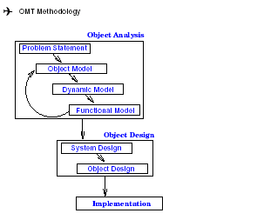
How to Do OOAD – OMT as Object-Oriented Methodology
OMT (Object Modeling Technique) by James Rumbaugh
Object Model: describes the static structure of the objects in the system and their relationships -> Object Diagrams.
Dynamic Model: describes the interactions among objects in the system -> State Diagrams.
Functional Model: describes the data transformation of the system
-> Dataflow Diagrams.
Traceability!

Slide 20
How to Do OOAD
– OMT as Object-Oriented Methodology
OMT (Object Modeling Technique) by James Rumbaugh
Analysis:
i) Model the real world showing its important properties;
ii) Concise model of what the system will do
System Design:
Organize into subsystems based on analysis structure and propose architecture
Object Design: Based on analysis model but with implementation details; Focus on data structures and algorithms to implement each class; Computer and domain objects
Implementation: Translate the object classes and relationships into a programming language
Traceability!

Slide 21
Introduction to OOAD - Summary
Why
Once Software Crisis due to Communication and Complexity
Languages, Concepts, Models
OO for Conceptual Modeling
What
Fundamental OO Concepts
A little taste of UML
How
OO development processes & (Design) Patterns

Slide 22
Why Object-Oriented - Who’s Behind Object-Orientation w. Diff. Concerns
Knowledge Representation (in A.I.)
Psychological Validity
Philosophical Validity
Computational Validity
Databases
Emphasis in Persistent Data (and now ACID properties)
RelationalDB
Network DB
Hierarchical DB
OODB
ERD
CM
SDM
ADT
Programming Languages
Emphasis in Efficiency
Simula, SmallTalk, C++, Protel, Java
ERD: Entity Relationship Diagram
SDM: Semantic Data Model
ADT: Abstract Data Type
CM: Conceptual Model
System/Software
Engineering
Where does Unified Modeling Language come into this?

Slide 23
Why Object-Oriented – A New Paradigm with Evolving Object Orientation
OOP: Object-Oriented Programming
Simula (1967), Smalltalk (70’s), C++ (mid 80’s), Eiffel, Ada95, Turing, …
OOD: Object-Oriented Design
Taxis (1976), Adaplex, …, Grady Booch (1980)
OOA: Object-Oriented Requirements
RML (1981), James Rumbaugh (late 80’s)
OO-Databases (OODBs): 1980-90’s
OLE/DCOM, VisualBasic, CORBA, Java: mid 90’s
.Net, C#, (eb/voice…/-)XML, J2EE: into 2000+
UML: mid 90’s and still evolving

Slide 24
Introduction to OOAD - Points to Ponder
How do you think your mental image is represented?
What kinds of languages are used for what purpose in our daily life?
What are the differences among a concept, a model and a language?
What are the differences between a language and a methodology?
Can we use C# for analysis?
If C++ is a language, does it model anything? If so, what?
What does a concept in C++ refer to (i.e., semantics)?
What does a concept in a (OO) design refer to?
What does a concept in an (OO requirements) analysis refer to?
Is the current OOAD for Functional Analysis and Design, or Non-Functional Analysis and Design?
What is the relationship between OO (Object-Orientation) and GO (Goal-Orientation), between OO and AO (Agent-Orientation), and between GO and AO?
Can you prove you and I communicate with each other perfectly?

