Slide 1
Introduction to OOSD
Lecture-4
Prof. Hari Mohan Pandey
Assistant Professor, CSE Department
Amity School of Engineering & Technology
hmpandey@amity.edu

Slide 2
Session Objective
Upon completing of this session students will be able to define and use the following:
Object Design
Identification of Class
How to discover relationships.
Applications of Object Design and UML

Slide 3
Introduction: Object Design
Object design is concerned with
The detailed design of the objects and their interactions.
The specification of
→ Attribute types
→ How operations function?
→ How objects are linked to other objects?
It produces a detailed specification of the classes and use the UML notation

Slide 4
Attributes
The attributes has a different meaning and would be manipulated differently for each of the data types
It is important to determine during analysis which has appropriate meaning.

Slide 5
Attribute: Syntax
An attribute data type is declared in UML using the following syntax:
Name ‘:’ type-expression ‘=’ initial-value ‘{property-string’}’
Name: attribute name,
type-expression: data type
initial-value: value of the attribute is set when the object is first created.
property-string: property of the attribute such as constant or fixed

Slide 6
Operations: What, Why and How to Use???
Each operation also has to be specified in terms of the parameters that it passes and returns.
The syntax used for an operation is:
Operation name ‘(‘parameter-list ‘)’ ‘:’ return-type-expression
An operation’s signature is determined by:
operation’s name
number and type of its parameters
type of the return value if any

Slide 7
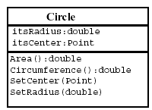
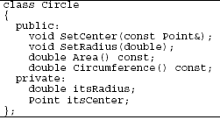
Operations: Example

Slide 8
Identification of Class: Method
For identifying class, there is technique called noun identification technique.
It is a technique which can be used to identify classes.

Slide 9
Identification of Class: How?
Working of Noun Identification Technique
Identify candidate classes by picking up all the nouns and noun phrases out of a requirements specification of the system
Discard candidates which are inappropriate for any reason, renaming the remaining classes if necessary

Slide 10
Identification of Class: Inappropriate Class
Inappropriate classes:
Redundant (the same class given more than one name)
Vague- unclear
An event or an operation (noun refers to something which is done to, by or in the system)
An attribute

Slide 11
Identification of Class: Scenario Based Example
Books and journals: The library contains books and journals. It may have several copies of a given book. Some of the books are for short term loans only. All other books may be borrowed by any library member for three weeks. Members of the library can normally borrow up to six items at a time, but members of staff may borrow up to 12 items at one time. Only members of staff may borrow journals. New books and journals arrive regularly. The current year’s journals are sent away to be bound into volumes at the end of each year.
Borrowing: The system must keep track of when books and journals are borrowed and returned, enforcing the rules described above.

Slide 12
Identification of Class: Using Noun Identification
Books and journals: The library contains books and journals. It may have several copies of a given book. Some of the books are for short term loans only. All other books may be borrowed by any library member for three weeks. Members of the library can normally borrow up to six items at a time, but members of staff may borrow up to 12 items at one time. Only members of staff may borrow journals. New books and journals arrive regularly. The current year’s journals are sent away to be bound into volumes at the end of each year.
Borrowing: The system must keep track of when books and journals are borrowed and returned, enforcing the rules described above.

Slide 13
Nouns in the library system (1)
Discard:
library, because it is outside of the scope of our system
short term loan, because a loan is really an action, the
lending of a book to a user – will reconsider this later
member of the library, which is redundant: same as library member
week, because it’s a measure of time, not a thing
time, because it’s outside the scope of the system
system, because it’s part of the meta-language of requirements description
rule, for the same reason

Slide 14
Nouns in the library system (2)
Left with:
– book
– journal
– copy (of book)
– library member
– member of staff
– volume
Note, library member and member of staff are also users of the system
represented in the system because data on these users will be maintained

Slide 15
Discovering Relationships
Identify and name relationships or associations between classes
Static relationship, independent of time
Clarify understanding of the problem, by describing how objects work together
For this task we can identify verbs in the requirements description as indicators of possible relationships
A library member borrows/returns a copy
A member of staff borrows/returns a copy
A member of staff borrows/returns a journal
A copy is a copy of a book
A journal belongs to a volume

Slide 16
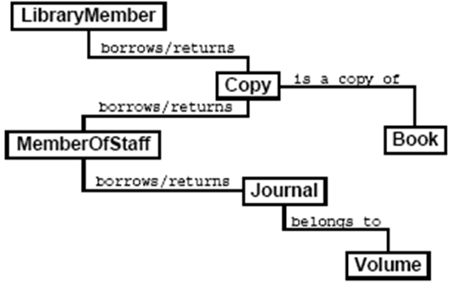
Initial Class Diagram

Slide 17
Lecture Summary/Conclusion
In the of the lecture we mainly discussed about object oriented design and Unified Modeling Language (UML)
Then, we discussed Attributes and Operations.
The main focus of this lecture was for Identification of Classes.
To do this we discussed “noun identification techniques”
For better understanding we implemented the above given technique for a scenario (library System)., where, we identified nouns and relationships.
Finally, we came up with Initial Class Diagram.

Slide 18
Thank You!!!

