Slide 1

Introduction to OOSD
Lecture-3
Prof. Hari Mohan Pandey
Assistant Professor, CSE Department
Amity School of Engineering & Technology
hmpandey@amity.edu

Slide 2
Outline
Introduction to Use Case Model
Notations in Use Case Diagram
Guide lines for drawing Use case diagrams
Use Case Specification
Types of flow of the events.

Slide 3
Introduction: Use Case Modeling
A diagram that shows a set of use cases and actors and their relationships.
Use cases represent system functionality, the requirements of the system from the user's perspective.
Use case diagrams show actor and use case together with their relationships.
The use cases represent functionality of a system or a classifier, like a subsystem or a class, as manifested to external interactors with the system or the classifier.

Slide 4
Notation in Use Case Modeling
Use case:
  A description of a set of sequences of actions, including variants, that system performs that yields an observable value to an actor.
Actor:-
  The people or systems that provide or receive information from the system; they are among the stakeholders of a system.
  Actors that stimulate the system and are the initiators of events are called primary actors (active)Actors that only receive stimuli from the system are called secondary actors (passive)

Slide 5
Applications: Use Case Diagrams
Use case diagrams are helpful in three areas.
  Determining features (requirements). New use cases often generate new requirements as the system is analyzed and the design takes shape.
  Communicating with clients. Their notational simplicity makes use case diagrams a good way for developers to communicate with clients.
  Generating test cases. The collection of scenarios for a use case may suggest a suite of test cases for those scenarios.

Slide 6
Use Case Relationships
There are several kinds of relationships between use cases, such as include, generalization, extend.
Association:
  The participation of an actor in a use case, i.e. instances of an actor and instances of the use communicate with each other.
  This is only relationship between an actor and a use cases.
Undirected Association
Directed Association

Slide 7
Use Case Relationships Cont.
Extend:
  The extend relationship occurs when one use case that is similar to another use case but does a bit more.
  An extend relationship from use case A to use case B indicates that an instance of use case B may be extended (subject to specific conditions specified in the extension) by the behavior specified by A.
  The behavior is inserted at the location defined by the extension point in B which is referenced by the extend relationship

Slide 8
Use Case Relationships Cont.
Generalization:
  A generalization from use case A to use case B indicates that A is a specialization of B.

Slide 9
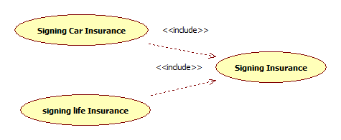
Use Case Relationships Cont.
Include:
  The include relationship occurs when chunk of behavior that is similar across more than one use case then there is no need to keep copying the description of that behavior.
  An include relationship from use case A to use case B indicates that an instance of the use case of A will also include the behavior specified by B. The behavior included at the location which defined A.

Slide 10
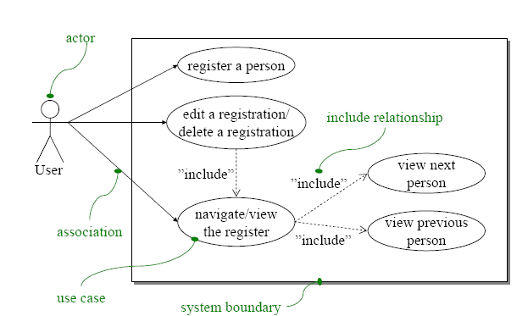
Use Case Relationships Cont.

Slide 11
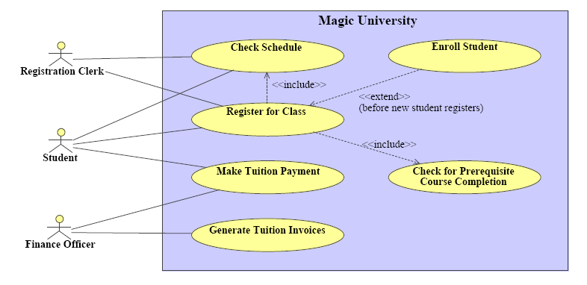
Include Vs. Extend

Slide 12
Guide lines for drawing Use Case Diagrams
Use cases should ideally begin with a verb – i.e. generate report. Use cases should NOT be open ended – i.e. Register (instead should be named as Register New User)
Avoid showing communication between actors.
Actors should be named as singular. i.e. student and NOT students. NO names should be used – i.e. John, Sam, etc.
Do NOT show behavior in a use case diagram; instead only depict only system functionality.
Use case diagram does not show sequence.

Slide 13
Use Case Specification
Use case specification is synonymous to use case description and use case definition and can used interchangeably.
Use case specification defines information that pertains to a particular use case which is important in understanding the purpose behind the use case.
Use case specification is written for every use case.
A use case specification has one or more flow of events or pathways association with it.

Slide 14
Use Case Specification Cont.
A flow of events or pathway is a textual description embodying sequence of events with regards to the use case and is part of the use case specification.
Flow of events is understood by the customer. A detailed description is necessary so that one can better understand the complexity that might be involved in realizing the use cases.
Use case specification serves as a “bridge” between stakeholders of a system and the development team.

Slide 15
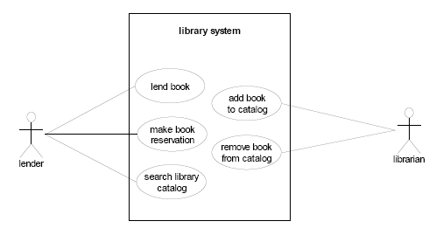
An Example

Slide 16
Thank You!!!

