Slide 1
Chapter 8: More on the Repetition Structure

Slide 2
PA1 Re Do
Input | Processing | Output
Day Of Week Orch Sales Main Sales Balc Sales Orch Costs (NC- 25) Main Floor Costs (NC - 30) Balc Costs (NC - 15) Discount Rate (NC - .1) Continue | Processing Items Total Rev, Orch Rev, Main Rev, Balc Rev Algorithm Initialize Continue, GT Orch Rev, GT Main Rev, GT Balc Rev & GT Rev Repeat while Continue = ‘Y’ Initialize Day of Week, Orch Sales, Main Sales, Balc Sales & Total Rev Input Day of Week Input Orch Sales Input Main Sales Input Balc Sales Orch Rev = Orch Sales * Orch Costs Main Rev = Main Sales * Main Floor Costs Balc Rev = Balc Sales * Balc Costs Total Rev = Orch Rev + Main Rev + Balc Rev If Day of Week = “Monday” or “Tuesday” Orch Rev = Orch Rev * (1-discount rate) Main Rev = Main Rev * (1-Main Rev) Balc Rev = Balc Rev * (1-Balc Rev) Total Rev = Total Rev * (1-discount rate) End If GT Rev = Grand Total Rev + Total Rev GT Orch Rev = GT Orch Rev + Orch Rev GT Main Rev = GT Main Rev + Main Rev GT Balc Rev = GT Balc Rev + Balc Rev Input if user would like to continue End Repeat Output GT Orch Rev | Output GT Main Rev | Output GT Balc Rev | Output GT Rev | GT Orch Rev GT Main Rev GT Balc Rev GT Rev

Slide 3
Upcoming Important Dates
9/26 – Post Test Loops
9/29 – Value Returning Functions
10/1 – Void Functions
10/1 – PA3 Due
10/6 – Exam Review
10/8 – Exam 2: chapters 5 – 10, Testing

Slide 4
Objectives
Include a posttest loop in pseudocode
Include a posttest loop in a flowchart
Code a posttest loop using the C++ do while statement
Nest repetition structures
Raise a number to a power using the pow function

Slide 5
Posttest Loops
Repetition structures can be either pretest or posttest loops
Pretest loop – condition evaluated before instructions are processed
Posttest loop – condition evaluated after instructions are processed
Posttest loop’s instructions are always processed at least once
Pretest loop’s instructions may never be processed

Slide 6
Flowcharting a Posttest Loop
Decision symbol in a flowchart (a diamond) representing a repetition structure contains the loop condition
Decision symbol appears at the top of a pretest loop, but at the bottom of a posttest loop

Slide 7
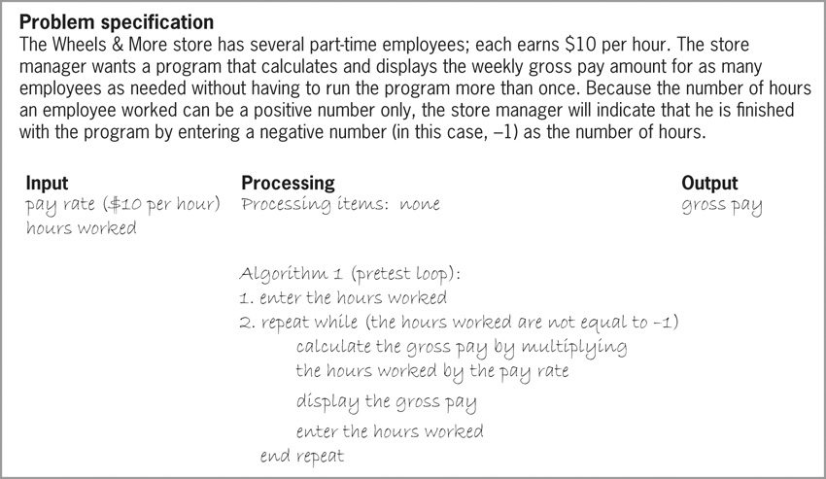
Flowcharting a Posttest Loop (cont’d.)
Figure 8-3 Wheels & More problem specification & algorithms (continues)

Slide 8
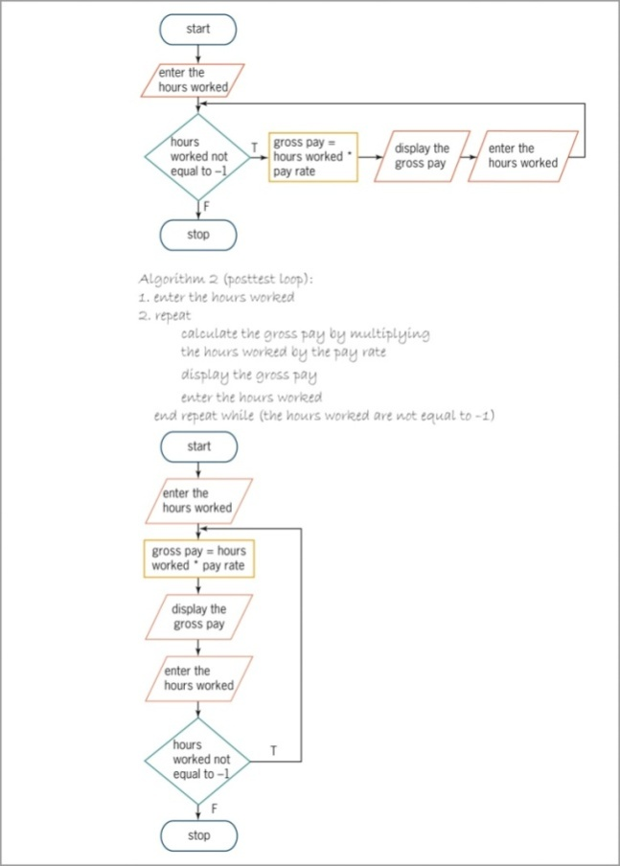
Flowcharting a Posttest Loop (cont’d.)
Figure 8-3 Wheels & More problem
specification & algorithms (continued)

Slide 9
The do while Statement
do while statement is used to code posttest loops in C++
Syntax:
do {
one or more statements to be processed one time,
and thereafter as long as the condition is true
} while (condition);
Some programmers use a comment (such as:
//begin loop) to mark beginning of loop

Slide 10
The do while Statement (cont’d.)
Programmer must provide loop condition
Must evaluate to a Boolean value
May contain variables, constants, functions, arithmetic operators, comparison operators, and logical operators
Programmer must also provide statements to be executed when condition evaluates to true
Braces are required around statements if there are more than one

Slide 11
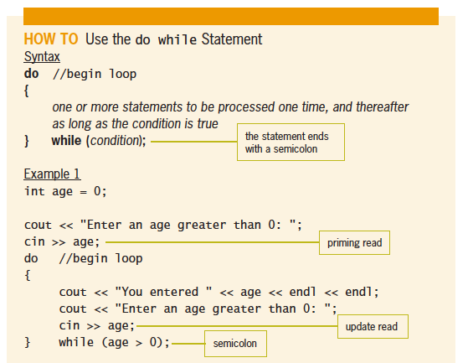
The do while Statement (cont’d.)
Figure 8-9 How to use the do while statement

Slide 12
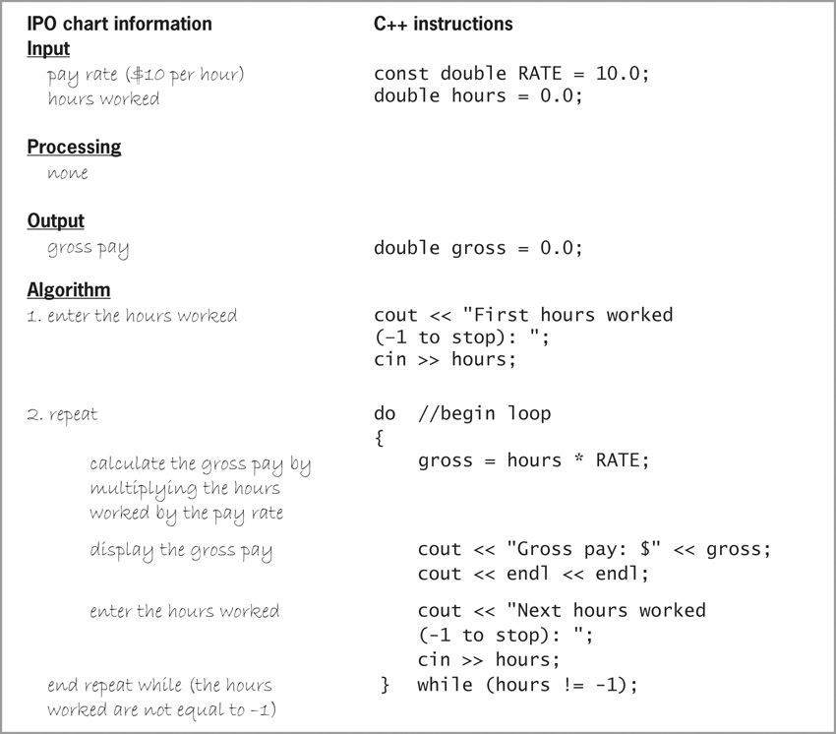
The do while Statement (cont’d.)
Figure 8-10 IPO chart information and C++
instructions for the Wheels & More program

Slide 13
Nested Repetition Structures
Like selection structures, repetition structures can be nested
You can place one loop (the inner, or nested loop) inside another loop (the outer loop)
Both loops can be pretest loops or posttest loops, or the two loops may be different types
Programmer decides whether a problem requires a nested loop by analyzing the problem specification

Slide 14
Nested Repetition Structures (cont’d.)
Figure 8-12 Logic used by a clock’s minute and second hands

Slide 15
The Asterisks Program
Simple program that prints asterisks to the screen in different patterns
First version contains a single loop
Second version contains a nested loop
Prints out three lines of five asterisks each using a nested for loop to print each line

Slide 16
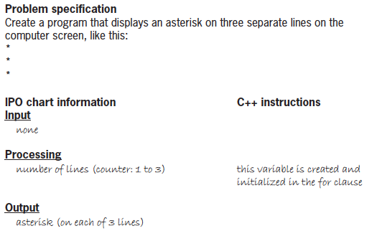
The Asterisks Program (cont’d.)
Figure 8-15 Problem specification IPO chart information
and C++ instructions for the asterisks program

Slide 17
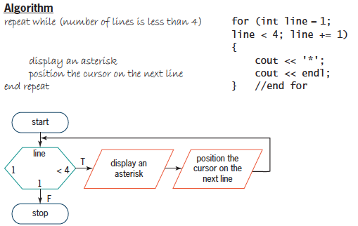
The Asterisks Program (cont’d.)
Figure 8-15 IPO chart information and C++ instructions
for the asterisks program (cont’d.)

Slide 18
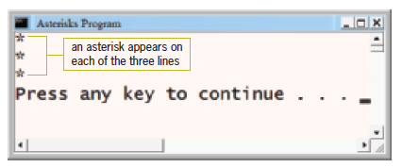
The Asterisks Program (cont’d.)
Figure 8-16 Completed desk-check table for the asterisks program
Figure 8-17 Sample run of the asterisks program

Slide 19
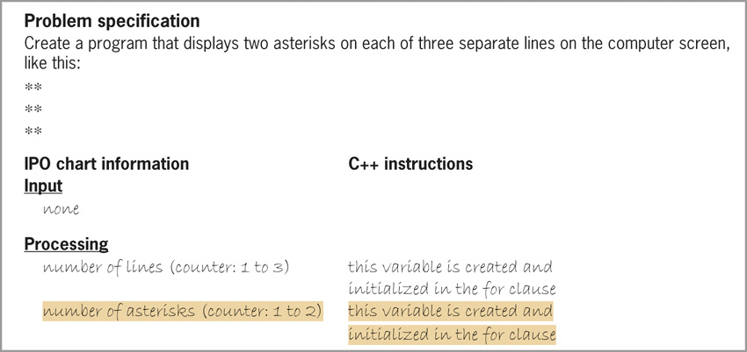
The Asterisks Program (cont’d.)
Figure 8-18 Problem specification, IPO chart information,
and C++ instructions for the modified asterisks program

Slide 20
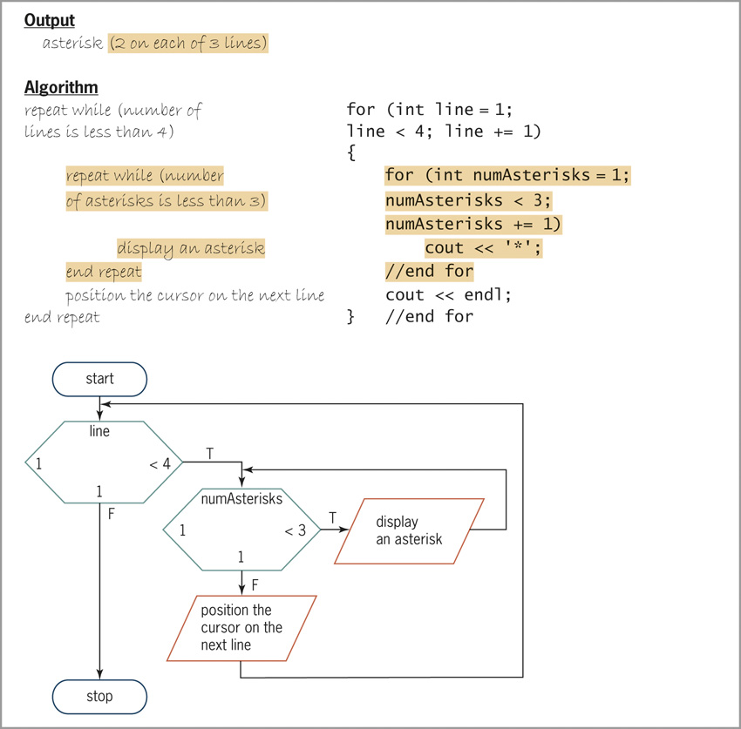
The Asterisks Program (cont’d.)
Figure 8-18 Problem specification, IPO chart information, and
C++ instructions for the modified asterisks program (cont.)

Slide 21
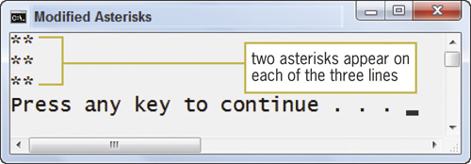
The Asterisks Program (cont’d.)
Figure 8-24 Sample run of the modified asterisks program

Slide 22
The pow Function
The pow function is a convenient tool to raise a number to a power (exponentiation)
The pow function raises a number to a power and returns the result as a double number
Syntax is pow(x, y), in which x is the base and y is the exponent
At least one of the two arguments must be a double
Program must contain the #include <cmath> directive to use the pow function

Slide 23
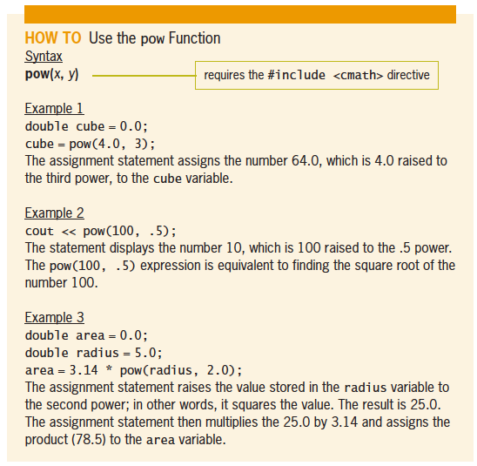
The pow Function (cont’d.)
Figure 8-27 How to use the pow function

Slide 24
Summary
A repetition structure can be either a pretest loop or a posttest loop
In a pretest loop, the loop condition is evaluated before the instructions in the loop are processed
In a posttest loop, the evaluation occurs after the instructions within the loop are processed
Use the do while statement to code a posttest loop in C++
Use either the while statement or the for statement to code a pretest loop in C++

Slide 25
Summary (cont’d.)
Repetition structures can be nested, which means one loop (called the inner or nested loop) can be placed inside another loop (called the outer loop)
For nested repetition structures to work correctly, the entire inner loop must be contained within the outer loop
You can use the built-in C++ pow function to raise a number to a power
The pow function returns the result as a double

