Slide 1
Chapter 10: Void Functions

Slide 2
Objectives
Create a void function
Invoke a void function
Pass information by reference to a function

Slide 3
Functions
Recall that value-returning functions perform a task and then return a single value
Void functions also perform tasks but do not return a value
A void function may be used to do something like display information on the screen
  Doesn’t need to return a value

Slide 4
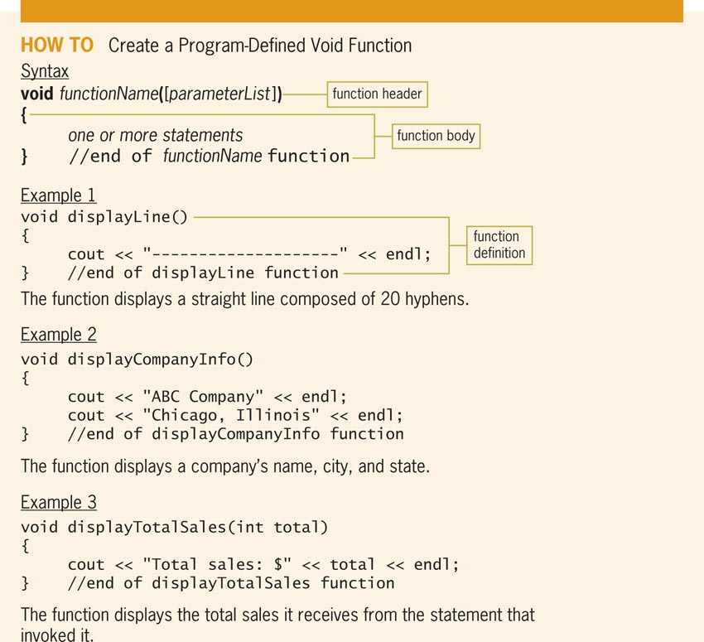
Creating Program-Defined Void Functions
Figure 10-2 How to create a program-defined void function

Slide 5
Creating Program-Defined Void Functions (cont’d.)
Note that header begins with keyword void, instead of a return data type
  Indicates that the function does not return a value
Function body does not contain a return statement
Call a void function by including its name and actual arguments (if any) in a statement
Call to a void function appears as a self-contained statement, not part of another statement
Execution is same as for value-returning functions

Slide 6
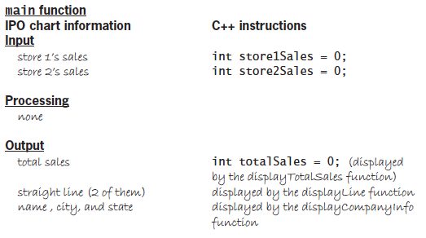
Creating Program-Defined Void Functions (cont’d.)
Figure 10-4 IPO chart information and C++
instructions for the ABC Company program

Slide 7
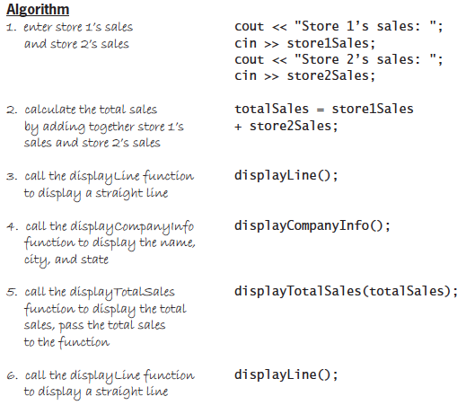
Creating Program-Defined Void Functions (cont’d.)
Figure 10-4 IPO chart information and C++
instructions for the ABC Company program (cont’d.)

Slide 8
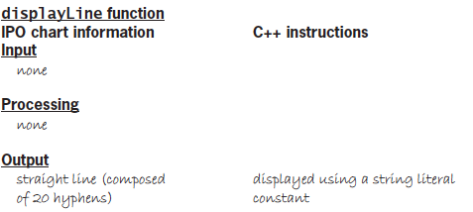

Creating Program-Defined Void Functions (cont’d.)
Figure 10-4 IPO chart information and C++
instructions for the ABC Company program (cont’d.)

Slide 9
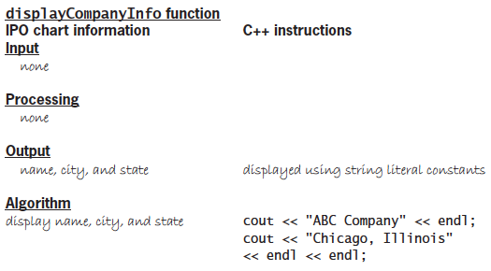
Creating Program-Defined Void Functions (cont’d.)
Figure 10-4 IPO chart information and C++
instructions for the ABC Company program (cont’d.)

Slide 10
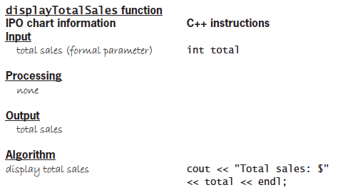
Creating Program-Defined Void Functions (cont’d.)
Figure 10-4 IPO chart information and C++
instructions for the ABC Company program (cont’d.)

Slide 11
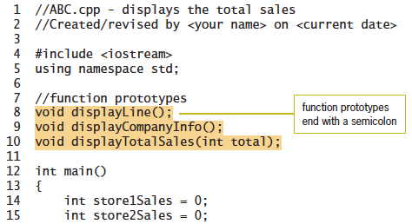
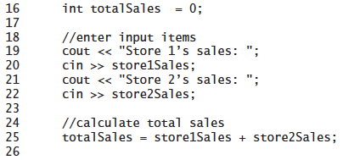
Creating Program-Defined Void Functions (cont’d.)
Figure 10-5 ABC Company program

Slide 12
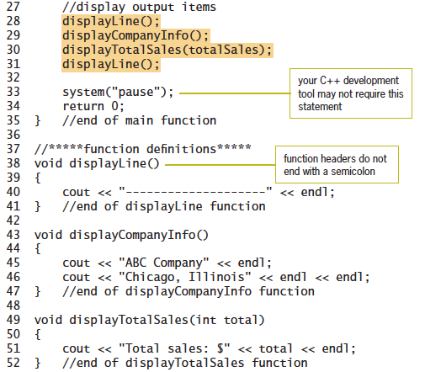
Creating Program-Defined Void Functions (cont’d.)
Figure 10-5 ABC Company program (cont’d.)

Slide 13
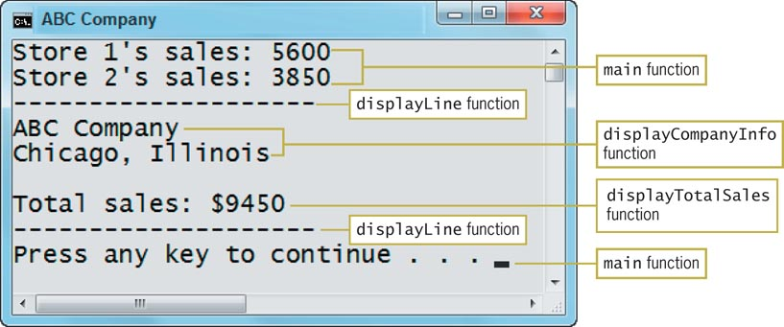
Creating Program-Defined Void Functions (cont’d.)
Figure 10-6 Sample run of the ABC Company program

Slide 14
Passing Variables to a Function
Recall you can pass a variable’s value or its address
Passing a variable’s value is referred to as passing by value, while passing a variable’s address is referred to as passing by reference
Which one you choose depends on whether the receiving function should have access to the variable in memory
Passing by value will not permit the function to change the contents of the variable, but passing by reference will

Slide 15
Reviewing Passing Variables by Value
Passing a variable by value means that only a copy of the variable’s contents is passed, not the address of the variable
This means that the receiving function cannot change the contents of the variable
It is thus appropriate to pass by value when the receiving function needs to know the value of the variable but does not need to change it

Slide 16
Passing Variables by Reference
Passing a variable’s address in internal memory to a function is referred to as passing by reference
You pass by reference when you want the receiving function to change the contents of the variable
To pass by reference in C++, you include an ampersand (&) before the name of the formal parameter in the receiving function’s header
Ampersand (&) is the address-of operator
  Tells the computer to pass the variable’s address rather than a copy of its contents

Slide 17
Passing Variables by Reference (cont’d.)
If receiving function appears below main, you must also include the & in the receiving function’s prototype
You enter the & immediately before the name of the formal parameter in the prototype
  If the prototype does not contain the formal parameter’s name, you enter a space followed by & after the formal parameter’s data type
Void functions use variables passed by reference to send information back to the calling function, instead of a return value

Slide 18
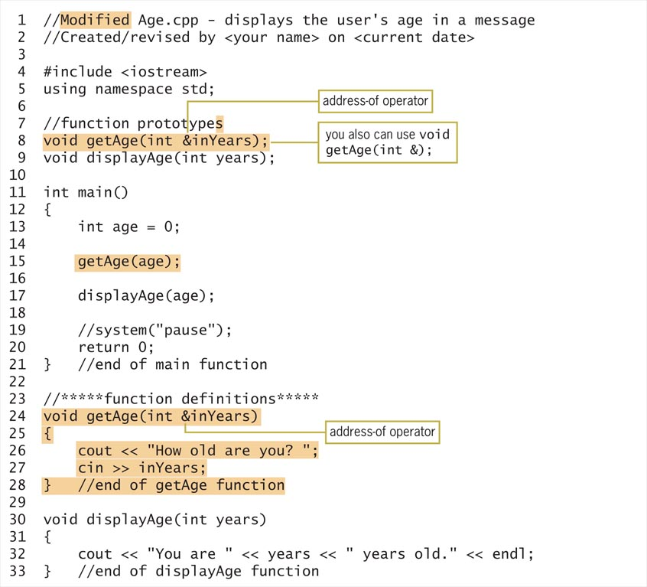
Passing Variables by Reference (cont’d.)
Figure 10-13 Modified age message program

Slide 19
Summary
All functions are either void or value-returning
Value-returning functions return one value
Void functions do not return a value
Function header of a void function begins with the keyword void instead of a return data type
Function body of a void function does not contain a return statement
You call a void function by including its name and actual arguments in a statement

Slide 20
Summary (cont’d.)
A call to a void function appears as a statement by itself rather than as part of another statement
Variables can be passed to functions either by value (the default) or by reference
When a variable is passed by value, only a copy of the variable’s value is passed
  Receiving function is not given access to the variable, so it cannot change the variable’s contents
  Computer uses data type and name of formal parameter to store a copy of the value

Slide 21
Summary (cont’d.)
When a variable is passed by reference, the variable’s address in memory is passed
  Receiving function can change variable’s contents
  Computer assigns name of formal parameter to memory location – variable then has two names
To pass by reference you include the address-of operator (&) before the name of the formal parameter in function header
If function appears below main, you must also include the & in the function’s prototype

