Slide 1
CS450 – Introduction to Networking Lecture 39 – Computer Network Security Overview
Phu Phung
April 24, 2015

Slide 2
SSL: Secure Sockets Layer
widely deployed security protocol
supported by almost all browsers, web servers
https
billions $/year over SSL
mechanisms: [Woo 1994], implementation: Netscape
variation -TLS: transport layer security, RFC 2246
provides
confidentiality
integrity
authentication
original goals:
Web e-commerce transactions
encryption (especially credit-card numbers)
Web-server authentication
optional client authentication
minimum hassle in doing business with new merchant
available to all TCP applications
secure socket interface

Slide 3
SSL and TCP/IP
Application
Application
SSL
TCP
TCP
IP
IP
normal application
application with SSL
SSL provides application programming interface (API) to applications
C and Java SSL libraries/classes readily available

Slide 4
Where SSL Fits
HTTP SMTP POP3
80 25 110
HTTPS SSMTP SPOP3
443 465 995
Secure Sockets Layer
Transport
Network
Link

Slide 5
SSL cipher suite
cipher suite
public-key algorithm
symmetric encryption algorithm
MAC algorithm
SSL supports several cipher suites
negotiation: client, server agree on cipher suite
client offers choice
server picks one
common SSL symmetric ciphers
DES – Data Encryption Standard: block
3DES – Triple strength: block
RC2 – Rivest Cipher 2: block
RC4 – Rivest Cipher 4: stream
SSL Public key encryption
RSA

Slide 6
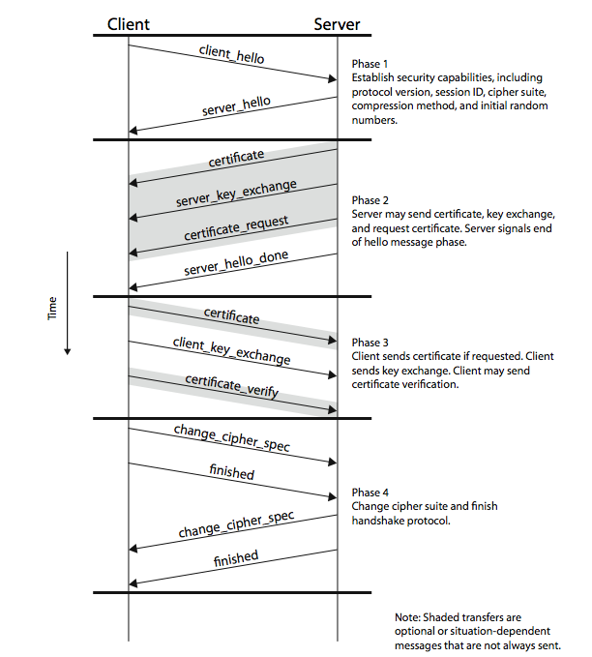
SSL connection

Slide 7
Real SSL: handshake (1)
Purpose
server authentication
negotiation: agree on crypto algorithms
establish keys
client authentication (optional)

Slide 8
Real SSL: handshake (2)
client sends list of algorithms it supports, along with client nonce
server chooses algorithms from list; sends back: choice + certificate + server nonce
client verifies certificate, extracts server’s public key, generates pre_master_secret, encrypts with server’s public key, sends to server
client and server independently compute encryption and MAC keys from pre_master_secret and nonces
client sends a MAC of all the handshake messages
server sends a MAC of all the handshake messages

Slide 9
Real SSL: handshaking (3)
last 2 steps protect handshake from tampering
client typically offers range of algorithms, some strong, some weak
man-in-the middle could delete stronger algorithms from list
last 2 steps prevent this
last two messages are encrypted

Slide 10
Real SSL: handshaking (4)
why two random nonces?
suppose Trudy sniffs all messages between Alice & Bob
next day, Trudy sets up TCP connection with Bob, sends exact same sequence of records
Bob (Amazon) thinks Alice made two separate orders for the same thing
solution: Bob sends different random nonce for each connection. This causes encryption keys to be different on the two days
Trudy’s messages will fail Bob’s integrity check

Slide 11
Key exchange and certificate
Server
Private key
Public key
SSL version number client supported (v2, v3)
Ciphers supported client (DES, 3DES, RC2, RC4)
Client Random Number
SSL version number server picked (v2, v3)
Ciphers server picked (DES, 3DES, RC2, RC4)
Server Random Number
Certificate
Client
Public key

Slide 12
Verify Certificate
Server
Private key
Public key
Certificate is Good and Valid
Server/vendor has been verified and authenticated
Client request
Client has vendor’s public key and can now encrypt pre-master to send to server/vendor
Certificate
Valid
Client
Checking
Public key
Certificate

Slide 13
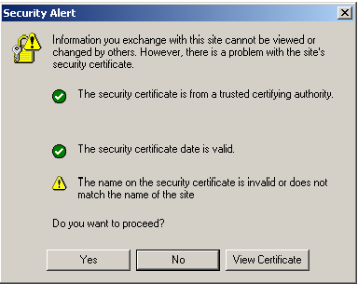
Not-recognizable Certificate

Slide 14
SSL Session Key
Server
Private key
Public key
Pre-Master
Session key
Pre-Master
Client
Public key
Pre-Master
Session key

Slide 15
Secure Data on Network
Server
Private key
Public key
Session key
Data
Session key
Data
Data
Client
Data
Session key
Data

Slide 16
Integrating SSL/TLS with HTTP ⇒ HTTPS
HTTPS
SSL
TCP

Slide 17
HTTP Transaction
Client Browser
Web Server
TCP
Connect
HTTP GET
transaction

Slide 18
HTTPS Transaction
Client Browser
Web Server
TCP
Connect
SSL
Connect
HTTPS GET
transaction

Slide 19
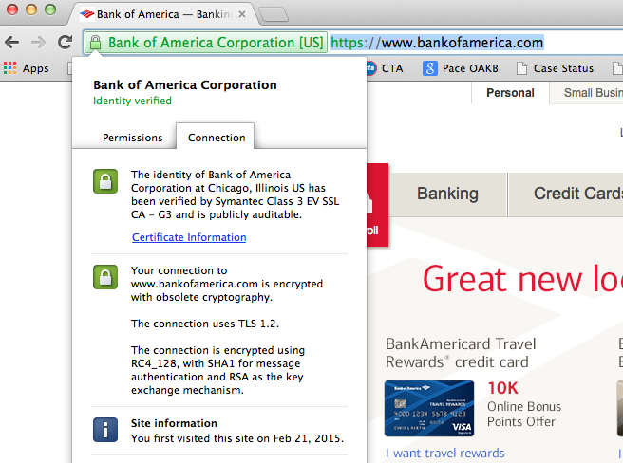
HTTPS example

Slide 20
In HTTPS
Both public key infrastructure and symmetric key mechanism are used
Both HTTP header fields and data are encrypted
Secret keys to encrypt data are exchanged between client and server
A and B
A, B and C

Slide 21
Firewalls
firewall
isolates organization’s internal net from larger Internet, allowing some packets to pass, blocking others
administered
network
public
Internet
trusted “good guys”
untrusted “bad guys”
firewall

Slide 22
Firewalls: why
prevent denial of service attacks:
SYN flooding: attacker establishes many bogus TCP connections, no resources left for “real” connections
prevent illegal modification/access of internal data
e.g., attacker replaces CIA’s homepage with something else
allow only authorized access to inside network
set of authenticated users/hosts
three types of firewalls:
stateless packet filters
stateful packet filters
application gateways

Slide 23
Notes
i-clicker question review
Monday April 27
Final review
Wednesday April 29
Last office hours and assignment 6 demo
Friday May 1, 11-2
Check and do course evaluation
I-clicker scores
Tentative final exam:
Monday May 4, 1-3PM, SES 238 (Will be officially confirmed)

