Slide 1
CS450 – Introduction to Networking Final review
Phu Phung
April 29, 2015

Slide 2
Internet protocol stack
application: supporting network applications
FTP, SMTP, HTTP
transport: process-process data transfer
TCP, UDP
network: routing of datagrams from source to destination
IP, routing protocols
link: data transfer between neighboring network elements
Ethernet, 802.111 (WiFi), PPP
physical: bits “on the wire”
application
transport
network
link
physical

Slide 3
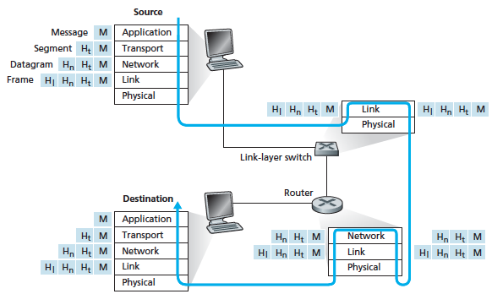
A must remember diagram

Slide 4
HTTP connections
non-persistent HTTP
at most one object sent over TCP connection
connection then closed
downloading multiple objects required multiple connections
persistent HTTP
multiple objects can be sent over single TCP connection between client, server

Slide 5
DNS: services, structure
DNS services
hostname to IP address translation
host aliasing
canonical, alias names
mail server aliasing
load distribution
replicated Web servers: many IP addresses correspond to one name

Slide 6
Internet transport-layer protocols
reliable, in-order delivery (TCP)
congestion control
flow control
connection setup
unreliable, unordered delivery: UDP
no-frills extension of “best-effort” IP
services not available:
delay guarantees
bandwidth guarantees
application
transport
network
data link
physical
network
data link
physical
network
data link
physical
network
data link
physical
logical end-end transport
network
data link
physical
network
data link
physical
network
data link
physical
network
data link
physical
application
transport
network
data link
physical

Slide 7
Addressing processes
identifier includes both IP address and port numbers associated with process on host.
example port numbers:
HTTP server: 80
mail server: 25
to send HTTP message to www.cs.uic.edu web server:
IP address: 131.193.32.29
port number: 80
more shortly…

Slide 8
Network layer
transport segment from sending to receiving host
on sending side encapsulates segments into datagrams
on receiving side, delivers segments to transport layer
network layer protocols in every host, router
router examines header fields in all IP datagrams passing through it
application
transport
network
data link
physical
network
data link
physical
network
data link
physical
network
data link
physical
network
data link
physical
network
data link
physical
network
data link
physical
network
data link
physical
network
data link
physical
network
data link
physical
application
transport
network
data link
physical
network
data link
physical
network
data link
physical

Slide 9
Two key network-layer functions
forwarding: move packets from router’s input to appropriate router output
routing: determine route taken by packets from source to dest.
routing algorithms
analogy:
routing: process of planning trip from source to dest
forwarding: process of getting through single interchange

Slide 10
Router architecture overview
two key router functions:
run routing algorithms/protocol (RIP, OSPF, BGP)
forwarding datagrams from incoming to outgoing link
forwarding tables computed,
pushed to input ports
routing
processor
routing, management
control plane (software)
forwarding data plane (hardware)
high-seed
switching
fabric
router input ports
router output ports

Slide 11
Routing: Comparison of LS and DV algorithms
message complexity
LS: with n nodes, E links, O(nE) msgs sent
DV: exchange between neighbors only
convergence time varies
speed of convergence
LS: O(n²) algorithm requires O(nE) msgs
may have oscillations
DV: convergence time varies
may be routing loops
count-to-infinity problem
robustness: what happens if router malfunctions?
LS:
node can advertise incorrect link cost
each node computes only its own table
DV:
DV node can advertise incorrect path cost
each node’s table used by others
error propagate thru network

Slide 12
Hierarchical routing
our routing study thus far - idealization
all routers identical
network “flat”
… not true in practice
scale: with 600 million destinations:
can’t store all dest’s in routing tables!
routing table exchange would swamp links!
administrative autonomy
internet = network of networks
each network admin may want to control routing in its own network

Slide 13
Hierarchical routing
aggregate routers into regions, “autonomous systems” (AS)
routers in same AS run same routing protocol
“intra-AS” routing protocol
routers in different AS can run different intra-AS routing protocol
gateway router:
at “edge” of its own AS
has link to router in another AS

Slide 14
IP addressing
223.1.1.1
IP address: 32-bit identifier for host, router interface
interface: connection between host/router and physical link
router’s typically have multiple interfaces
host typically has one or two interfaces (e.g., wired Ethernet, wireless 802.11)
IP addresses associated with each interface
223.1.2.1
223.1.1.2
223.1.1.4
223.1.2.9
223.1.1.3
223.1.3.27
223.1.2.2
223.1.3.1
223.1.3.2
223.1.1.1 = 11011111 00000001 00000001 00000001
223
1
1
1

Slide 15
Subnets
IP address:
subnet part - high order bits
host part - low order bits
what’s a subnet ?
device interfaces with same subnet part of IP address
can physically reach each other without intervening router
223.1.1.1
223.1.1.2
223.1.2.1
223.1.1.4
223.1.2.9
223.1.2.2
223.1.1.3
223.1.3.27
subnet
223.1.3.1
223.1.3.2
network consisting of 3 subnets

Slide 16
IP addressing: CIDR
CIDR: Classless InterDomain Routing
subnet portion of address of arbitrary length
address format: a.b.c.d/x, where x is # bits in subnet portion of address
subnet
part
host
part
11001000 00010111 00010000 00000000
200.23.16.0/23

Slide 17
DHCP client-server scenario
DHCP
server
223.1.1.0/24
223.1.1.1
223.1.2.1
223.1.1.2
arriving DHCP
client needs
address in this
network
223.1.1.4
223.1.2.9
223.1.3.27
223.1.2.2
223.1.1.3
223.1.2.0/24
223.1.3.1
223.1.3.2
223.1.3.0/24

Slide 18
NAT: network address translation
rest of
Internet
local network
(e.g., home network)
10.0.0/24
10.0.0.1
10.0.0.4
10.0.0.2
138.76.29.7
10.0.0.3
all datagrams leaving local
network have same single source NAT IP address: 138.76.29.7,different source port numbers
datagrams with source or
destination in this network
have 10.0.0/24 address for
source, destination (as usual)

Slide 19
IPv6
initial motivation: 32-bit address space soon to be completely allocated.
additional motivation:
header format helps speed processing/forwarding
header changes to facilitate QoS
IPv6 datagram format:
fixed-length 40 byte header
no fragmentation allowed

Slide 20
Tunneling
A
B
IPv4 tunnel
connecting IPv6 routers
E
F
logical view:
IPv6
IPv6
IPv6
IPv6
A
B
C
D
E
F
physical view:
IPv6
IPv6
IPv4
IPv4
IPv6
IPv6
flow: X
src: A
dest: F
data
src:B
dest: E
src:B
dest: E
flow: X
src: A
dest: F
data
Flow: X
Src: A
Dest: F
data
Flow: X
Src: A
Dest: F
data
A-to-B:
IPv6
B-to-C:
IPv6 inside
IPv4
B-to-C:
IPv6 inside
IPv4
E-to-F:
IPv6

Slide 21
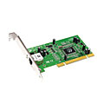
Where is the link layer implemented?
in each and every host
link layer implemented in “adaptor” (aka network interface card NIC) or on a chip
Ethernet card, 802.11 card; Ethernet chipset
implements link, physical layer
attaches into host’s system buses
combination of hardware, software, firmware
application
transport
network
link
cpu
memory
link
physical
host
bus
(e.g., PCI)
controller
physical
transmission
network adapter
card

Slide 22
Multiple access links, protocols
two types of “links”:
point-to-point
PPP for dial-up access
point-to-point link between Ethernet switch, host
broadcast (shared wire or medium)
old-fashioned Ethernet
upstream HFC
802.11 wireless LAN
shared wire (e.g.,
cabled Ethernet)
shared RF
(e.g., 802.11 WiFi)
shared RF
(satellite)
humans at a
cocktail party
(shared air, acoustical)

Slide 23
ARP: address resolution protocol
Question: how to determine
interface’s MAC address, knowing its IP address?
ARP table: each IP node (host, router) on LAN has table
IP/MAC address mappings for some LAN nodes:
< IP address; MAC address; TTL>
TTL (Time To Live): time after which address mapping will be forgotten (typically 20 min)
137.196.7.78
1A-2F-BB-76-09-AD
137.196.7.23
137.196.7.14
LAN
71-65-F7-2B-08-53
58-23-D7-FA-20-B0
0C-C4-11-6F-E3-98
137.196.7.88

Slide 24
Ethernet switch
link-layer device: takes an active role
store, forward Ethernet frames
examine incoming frame’s MAC address, selectively forward frame to one-or-more outgoing links when frame is to be forwarded on segment, uses CSMA/CD to access segment
transparent
hosts are unaware of presence of switches
plug-and-play, self-learning
switches do not need to be configured

Slide 25
Switches vs. routers
application
transport
network
link
physical
both are store-and-forward:
routers: network-layer devices (examine network-layer headers)
switches: link-layer devices (examine link-layer headers)
both have forwarding tables:
routers: compute tables using routing algorithms, IP addresses
switches: learn forwarding table using flooding, learning, MAC addresses
datagram
frame
link
physical
frame
switch
network
link
physical
datagram
frame
application
transport
network
link
physical

Slide 26
VLANs: motivation
consider:
CS user moves office to EE, but wants connect to CS switch?
single broadcast domain:
all layer-2 broadcast traffic (ARP, DHCP, unknown location of destination MAC address) must cross entire LAN
security/privacy, efficiency issues
Computer
Science
Computer
Engineering
Electrical
Engineering

Slide 27
802.11 LAN architecture
wireless host communicates with base station
base station = access point (AP)
Basic Service Set (BSS) (aka “cell”) in infrastructure mode contains:
wireless hosts
access point (AP): base station
ad hoc mode: hosts only
Internet
hub, switch
or router
BSS 1
BSS 2

Slide 28
802.11: Channels, association
802.11b: 2.4GHz-2.485GHz spectrum divided into 11 channels at different frequencies
AP admin chooses frequency for AP
interference possible: channel can be same as that chosen by neighboring AP!
host: must associate with an AP
scans channels, listening for beacon frames containing AP’s name (SSID) and MAC address
selects AP to associate with
may perform authentication [Chapter 8]
will typically run DHCP to get IP address in AP’s subnet

Slide 29
HTTPS Transaction
Client Browser
Web Server
TCP
Connect
SSL
Connect
HTTPS GET
transaction

Slide 30
A day in the life: scenario
browser
DNS server
Comcast network
68.80.0.0/13
school network
68.80.2.0/24
web page
web server
Google’s network
64.233.160.0/19
64.233.169.105

Slide 31
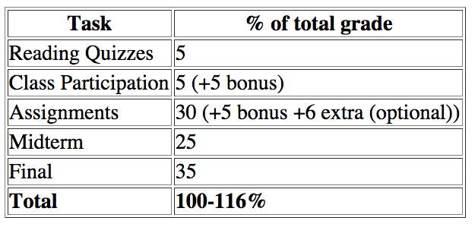
Grade weighting

Slide 32
Final Exam: 1-3PM Monday May 4, 2015 in SES 238
35 points (+ 5 additional bonus points)
One handwriting letter sheet of notes
Content
Everything in the lectures ☺
Grades (A, B, C …) are curved based on an aggregate course score
average score is calculated without bonus points

Slide 33
Final words
Study hard and good luck to the exam
Exam: 1-3PM Monday May 4, 2015 in this room
Thank you for your participation, good luck to your future.
Complete the course evaluation
Email or visit me if you have questions/comments on the course, or job interviews related, or …

