Slide 1
XFLR5 Airfoil, Wing and Plane Analysis
John Sullivan

Slide 2
Description of XFLR5
XFLR5 is an analysis tool for airfoils, wings and planes. It includes:
XFoil's Direct and Inverse analysis capabilities
Wing design and analysis capabilities based on the Lifiting Line Theory, on the Vortex Lattice Method, and on a 3D Panel Method
The airfoil analysis portion is based on the program XFOIL developed by Professor Mark Drela from MIT. XFLR5 has an updated GUI, so the operation of it is somewhat different than that of XFOIL.
The XFLR5 program and Guidelines can be downloaded from the project web site:
http://sourceforge.net/projects/xflr5/
http://www.xflr5.com/xflr5.htm (links to related material)
More information on XFOIL is available at http://web.mit.edu/drela/Public/web/xfoil/ and a simple tutorial can be found on the course website in the file XFOIL_tutorial.pdf.

Slide 3
XFLR5 Examples
NACA 2415
NACA 66(2)215 laminar flow airfoil
Rectangular Wing
Lifting Line Theory
3D Panel method

Slide 4
Example #1 NACA 4 digit Airfoil Analysis
NACA 2412
Reynolds number 1 million to 10 million in steps of 1 million
Angle of attack -5 to 10 degrees in steps of .2 degrees

Slide 5
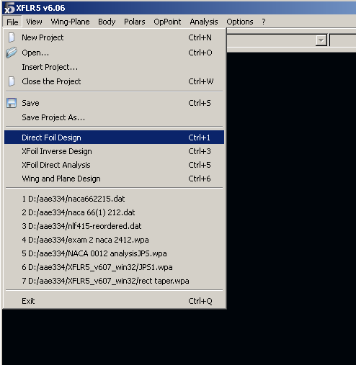
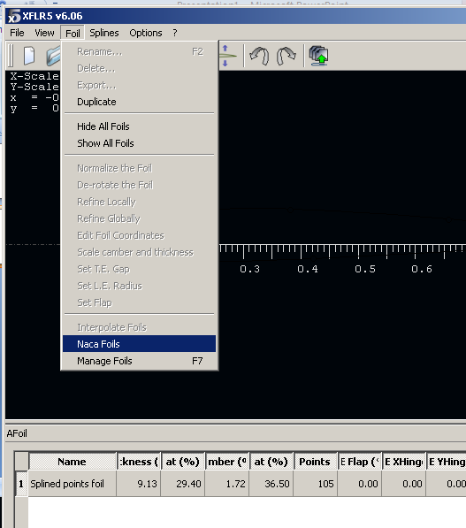
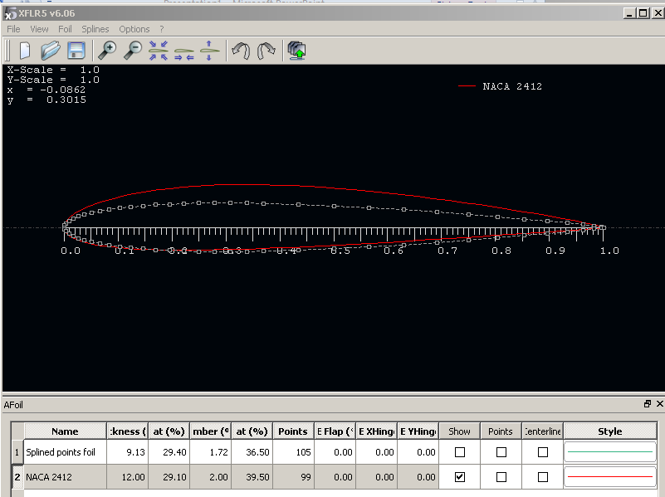
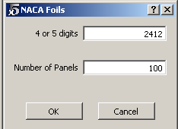
Start XFLR5
Click <File><Direct Foil Design>
Click <Foil Design><Naca Foils>
Enter the 4- or 5-digit name of the airfoil and the number of panels to use

Slide 6
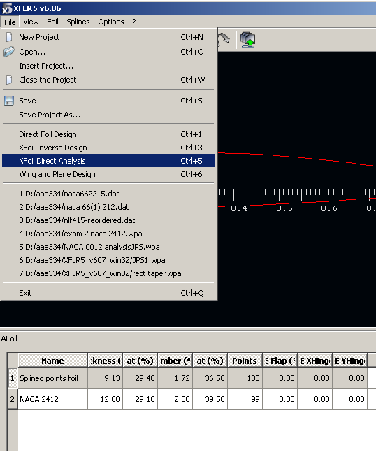
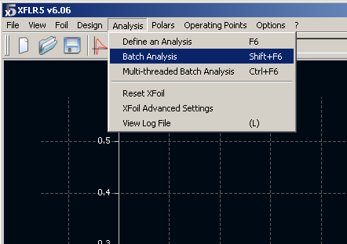
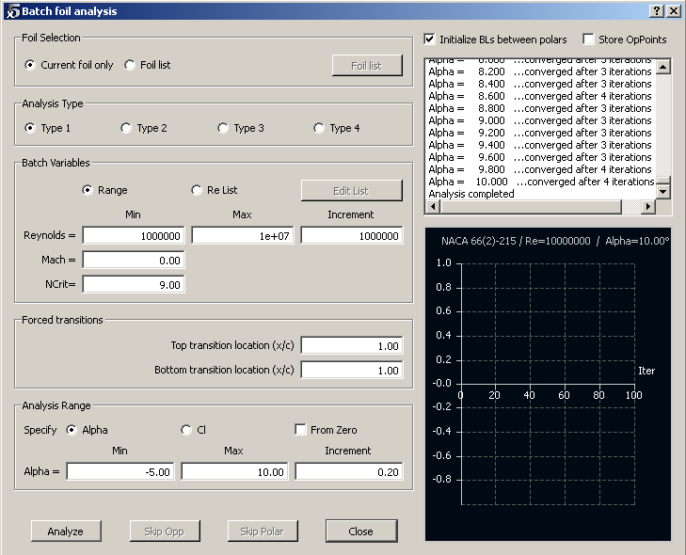
Click <File> <XFOIL <Direct Analysis>
Click <Analysis> <BatchAnalysis>.
Choose Type 1.
Enter Reynolds number, Mach number and transition information.
Enter angles of attack
Click the <Analyze> button.
The program runs through an iterative procedure to solve the problem at each angle of attack Click close when finished

Slide 7
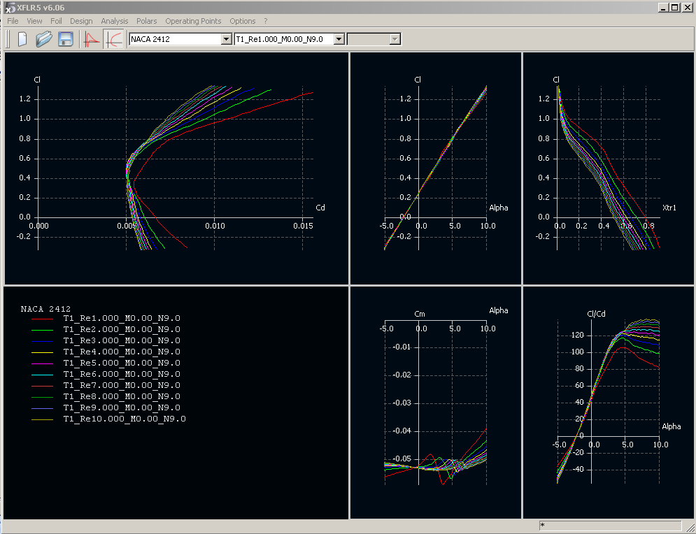
Analysis Results

Slide 8
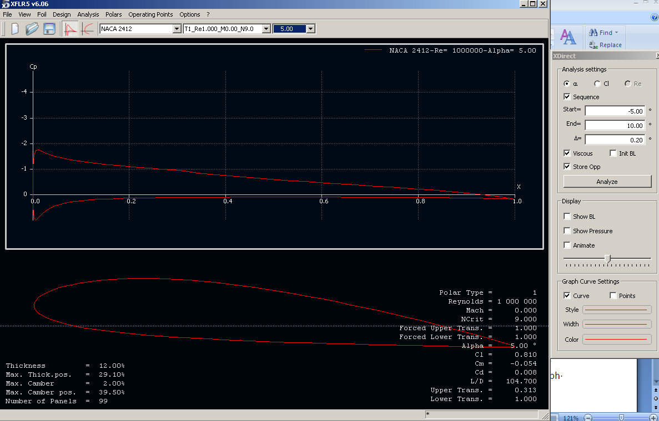
1. Click the pressure
distribution icon
Pressure Distribution
3. Change Angle of Attack
2. Click analyze

Slide 9
The program may not converge for a given angle of attack if the solution is particularly complex or if the change from the initial guess or the previous solution is too large. You can increase the maximum number of iterations in the <Analysis><XFOIL Advanced Settings> menu. If there are a small number of angles of attack for which the solution did not converge, that is OK. Just realize that the results for those angles of attack are more unreliable.
The airfoil is shown in the bottom part of the window at the angle of attack at the end of the sequence you chose. In the upper part of the window is shown the pressure coefficient distribution. To see Cp using an inviscid analysis (panel method), choose <Operating Points><Cp Graph><Show Inviscid Curve> (or <right click> on the Cp graph instead of <Operating Points>). The inviscid Cp distribution shows up as a dashed line, while the solid line shows Cp accounting for viscous boundary layer effects. You can choose a particular angle of attack by clicking on the button on the far right side of the tool bar.
Check the box in the XDirect pane for Show Pressure to see the local pressure distribution on the airfoil shown as force arrows. Check the Show Boundary Layer box to see the boundary layer thickness on the airfoil surface. Check the Animate box to see a sweep through the angles of attack and to watch the results change.
Click <Polars><Polar Graphs><All Polar Graphs> to see the five polar plots. The menu that the choice <All Polar Graphs> is on shows what is plotted as figures (1) through (5). (Note: There is a short cut button in the tool bar at the top to switch between polars and the Cp plot.)
You can use the mouse to zoom in and out and to translate any of the plots.
To save a plot choose <Right Click><Save View to Image File>. Possible file formats are bitmap, jpeg and png.
To plot other variables computed by XFOIL, on the Cp plot choose <Right Click><Cp Graph><Current XFOIL Results> and then the name of the variable you want to plot, e.g. <Skin Friction Coefficient>. (The variables D* and Theta refer to d* = d₁ = boundary layer displacement thickness and q = d₂ = boundary layer momentum thickness.)

Slide 10
Example #2 NACA 66(2)-215 Airfoil Analysis
NACA 66(2)-215 laminar airfoil
Reynolds number 1 million to 10 million in steps of 1 million
Angle of attack -5 to 10 degrees in steps of .2 degrees

Slide 11
Airfoil Coordinates for XFLR5
Example file naca662215.dat
NACA 66(2)-215
1.000000 0.000000
0.993359 0.001014
0.982368 0.002802
0.969897 0.004996
0.955711 0.007707
0.939801 0.011019
0.922598 0.014866
0.904739 0.019047
0.886614 0.023373
0.868296 0.027778
0.849849 0.032225
………………………………….
…………………………………
0.909485 -0.008053
0.926545 -0.005413
0.942539 -0.003293
0.957211 -0.001775
0.970490 -0.000802
0.982471 -0.000252
0.993316 -0.000019
1.000000 0.000000
XFLR5 reads coordinates from a *.dat file
The points must be in (x,y) pairs, starting at the trailing edge (TE), going to the leading edge (LE), and back to the TE. The points may go over the upper surface and back along the lower surface, or vice versa (the code can figure that out).
The first line is the airfoil name
A good source of airfoil data is:
http://www.ae.illinois.edu/m-selig/ads/coord_database.html
Note that some of this data is in the wrong format and must be reordered

Slide 12
Airfoil Analysis
Click <File> < new project>
Click <File> < open> naca662215.dat
Click <File> < direct foil design> to see airfoil
Click <File> < Xfoil direct analysis>
Click <Analysis> <BatchAnalysis>.
Choose Type 1.
Enter Reynolds number, Mach number and transition information.
Enter angles of attack
Click the <Analyze> button.
Same as Example #1

Slide 13
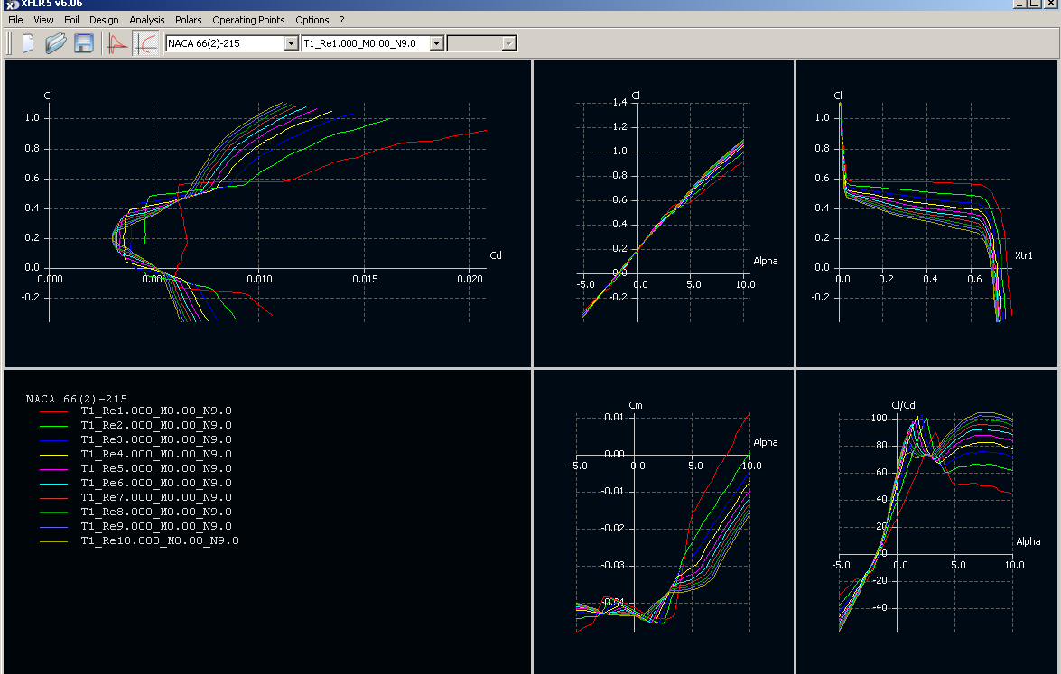
NACA 66(2)-215

Slide 14
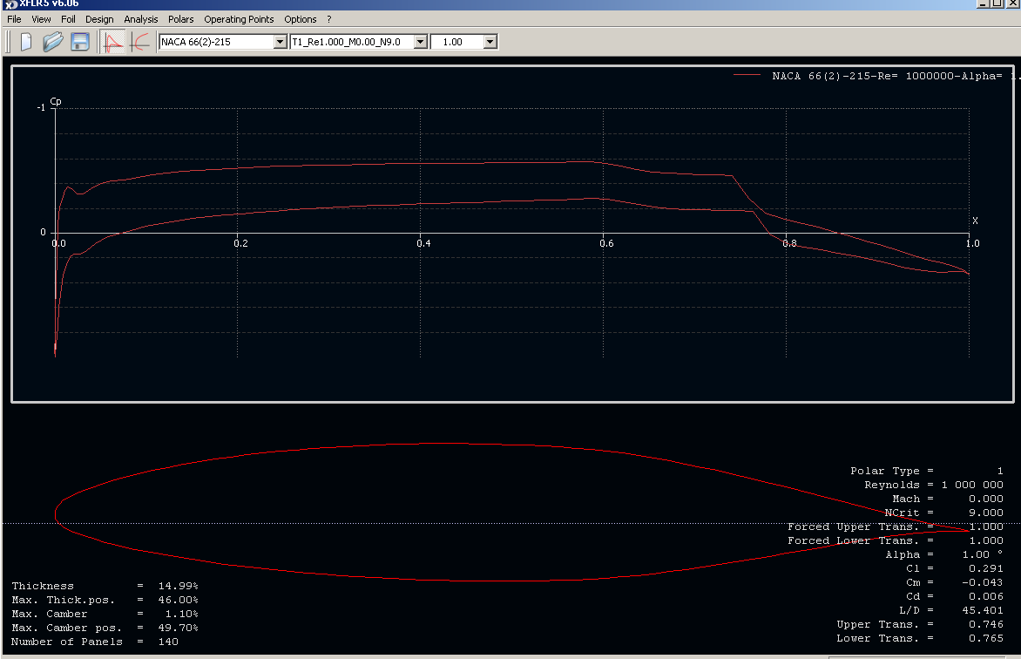

Slide 15
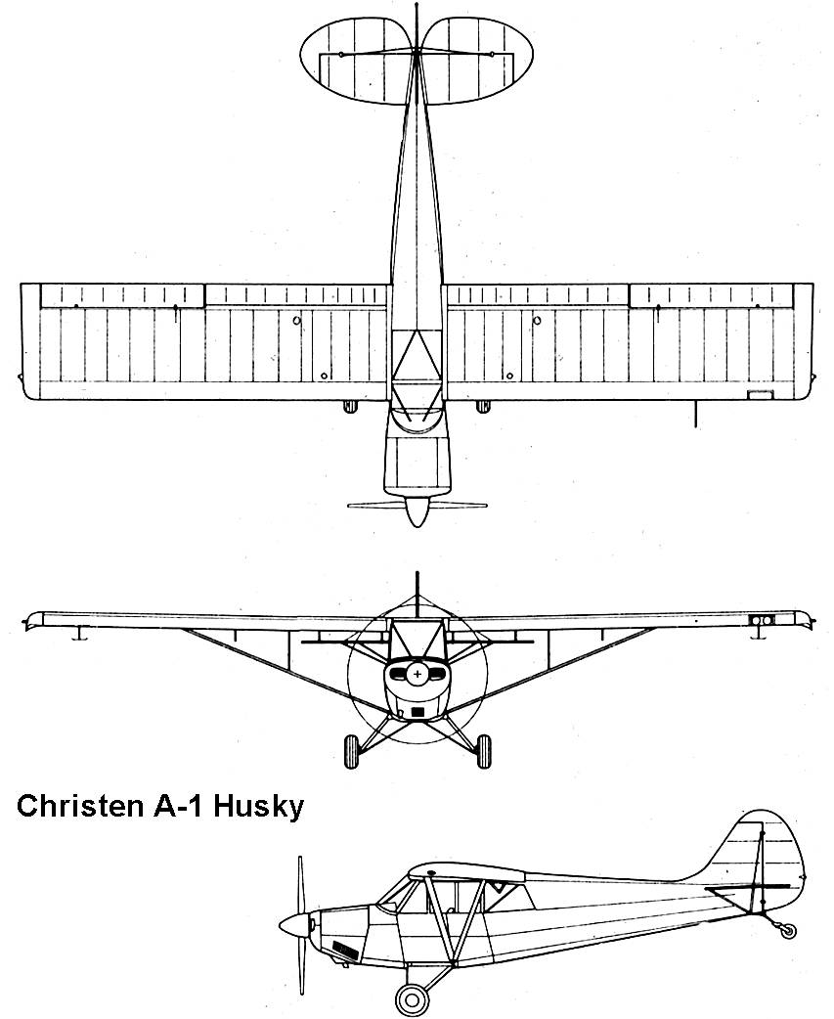
Example #3a NACA 2415 Rectangular Wing Lifting Line Theory
1.725
13.8.0

Slide 16
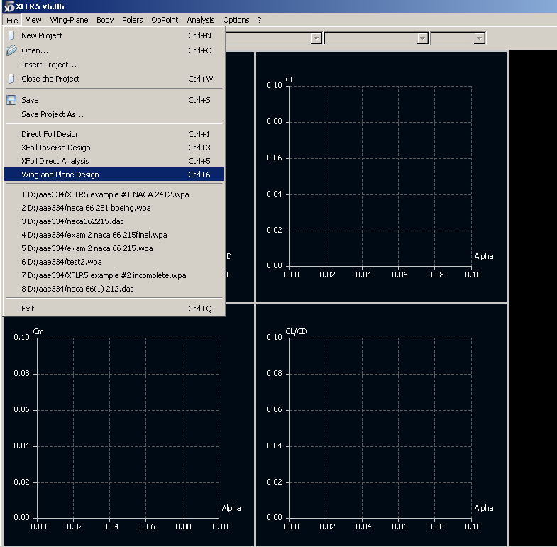
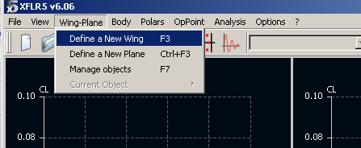
Wing Analysis
Click <File> < new project>
Run Example #1 NACA 2415 airfoil
Click <file> <wing and plane Design
Click <wing and plane<new wing design>
The wing edition window pops up

Slide 17
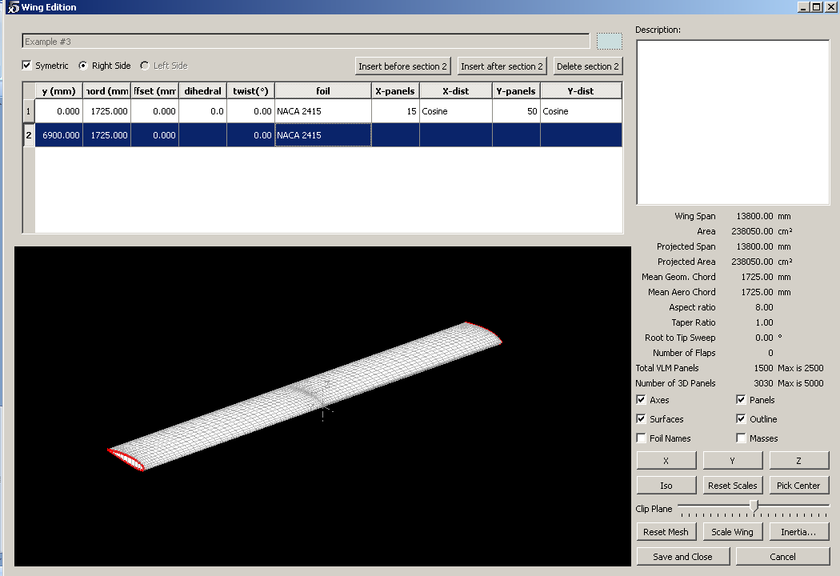
Click Symmetry and right side
Add dimensions for the right half wing
Click <foil> and choose NACA2415
Add the panel numbers and click the distribution and choose cosine
Check calculated quantities on right side
Click ,save and close.

Slide 18
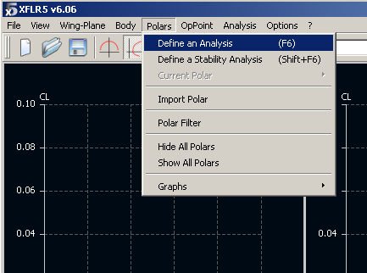
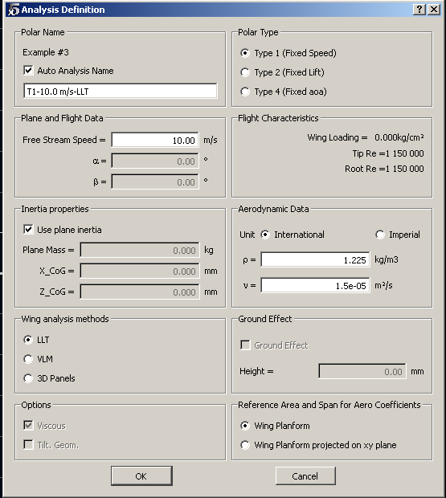
Click <polars><define analysis
In pop-up window
Choose auto name,Type 1
Input Free stream speed
Check calculated Re numbers to be sure they are in the range of the airfoil analysis . You will get an error if they are out of range.
Choose international units
Choose LLT – lifting Line Theory
Clikck OK

Slide 19
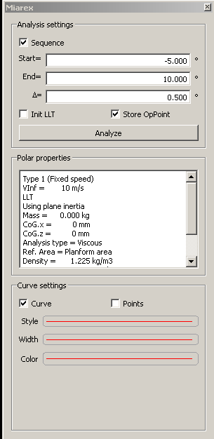
On Pop-up
Set angle of attack range
Click Analyze

Slide 20
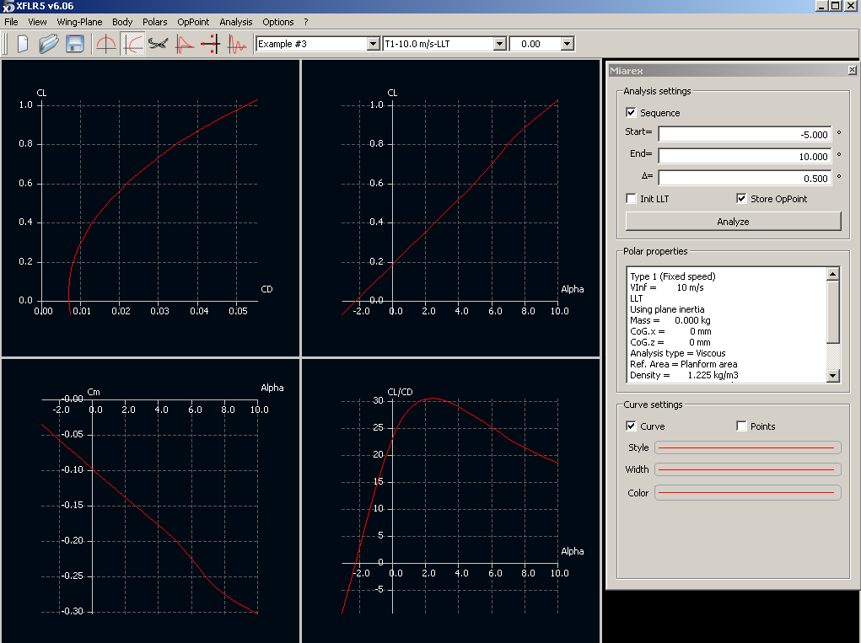
Polars

Slide 21
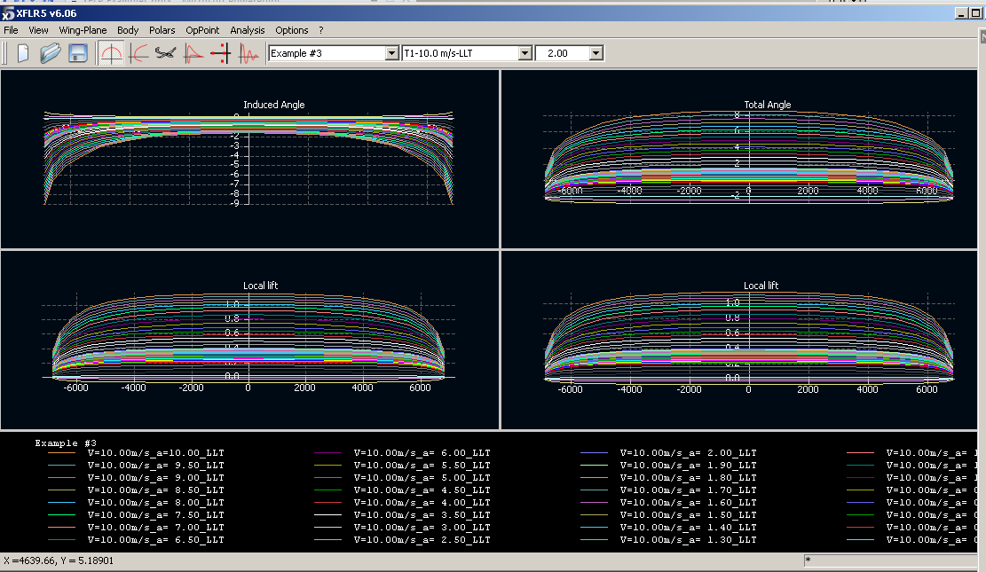

Slide 22
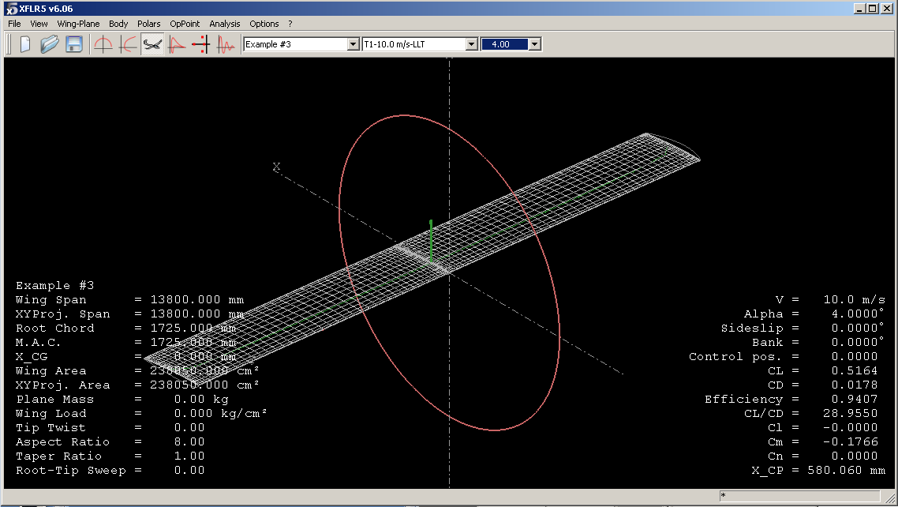
Operating Point

Slide 23
Right Click on graph, choose current op point, export Generates file of data
XFLR5 v6.06
Example #3
T1-10.0 m/s-LLT
QInf = 10.000000 m/s
Alpha = 4.000000
Beta = 0.000°
Phi = 0.000°
Ctrl = 0.000
CL = 0.516417
Cy = 0.000000
Cd = 0.017835 ICd = 0.011280 PCd = 0.006555
Cl = -3.62042e-17
Cm = -0.176573
ICn = 0.000000 PCn = 0.000000
XCP = 0.580060 YCP = 0.000000
XNP = 0.000000
Bend. = 1182.365112
Example #3
y-span Chord Ai Cl PCd ICd CmGeom CmAirf XTrtop XTrBot XCP BM
-6.8150 1.7250 -4.594 0.172674 0.006612 0.013845 -0.094896 -0.051747 0.6109 0.4782 0.5500 0.0000
-6.5623 1.7250 -3.350 0.308041 0.006376 0.018009 -0.127697 -0.050674 0.5468 0.6522 0.4113 0.7787
-6.1479 1.7250 -2.458 0.404226 0.006369 0.017345 -0.150668 -0.049605 0.5049 0.7636 0.3682 6.5532
-5.5822 1.7250 -1.848 0.469725 0.006398 0.015152 -0.166086 -0.048677 0.4806 0.8337 0.3484 26.2776
-4.8790 1.7250 -1.438 0.513307 0.006472 0.012887 -0.176195 -0.047924 0.4645 0.8757 0.3377 72.9358
-4.0557 1.7250 -1.167 0.541930 0.006549 0.011034 -0.182737 -0.047339 0.4537 0.8999 0.3314 161.6461
-3.1325 1.7250 -0.989 0.560369 0.006636 0.009673 -0.186913 -0.046927 0.4451 0.9141 0.3276 307.2766
-2.1322 1.7250 -0.882 0.571906 0.006668 0.008799 -0.189599 -0.046744 0.4414 0.9222 0.3255 522.0347
-1.0794 1.7250 -0.823 0.578211 0.006685 0.008303 -0.191067 -0.046644 0.4394 0.9266 0.3244 813.3718
-0.0000 1.7250 -0.804 0.580211 0.006690 0.008143 -0.191532 -0.046612 0.4388 0.9280 0.3240 1182.3651
1.0794 1.7250 -0.823 0.578211 0.006685 0.008303 -0.191067 -0.046644 0.4394 0.9266 0.3244 813.3718
2.1322 1.7250 -0.882 0.571906 0.006668 0.008799 -0.189599 -0.046744 0.4414 0.9222 0.3255 522.0347
3.1325 1.7250 -0.989 0.560369 0.006636 0.009673 -0.186913 -0.046927 0.4451 0.9141 0.3276 307.2766
4.0557 1.7250 -1.167 0.541930 0.006549 0.011034 -0.182737 -0.047339 0.4537 0.8999 0.3314 161.6461
4.8790 1.7250 -1.438 0.513307 0.006472 0.012887 -0.176195 -0.047924 0.4645 0.8757 0.3377 72.9358
5.5822 1.7250 -1.848 0.469725 0.006398 0.015152 -0.166086 -0.048677 0.4806 0.8337 0.3484 26.2776
6.1479 1.7250 -2.458 0.404226 0.006369 0.017345 -0.150668 -0.049605 0.5049 0.7636 0.3682 6.5532
6.5623 1.7250 -3.350 0.308041 0.006376 0.018009 -0.127697 -0.050674 0.5468 0.6522 0.4113 0.7787
6.8150 1.7250 -4.594 0.172674 0.006612 0.013845 -0.094896 -0.051747 0.6109 0.4782 0.5500 0.0000

Slide 24
Example #3b NACA 2415 Rectangular Wing 3D Panel Method
1.725
13.8.0

Slide 25
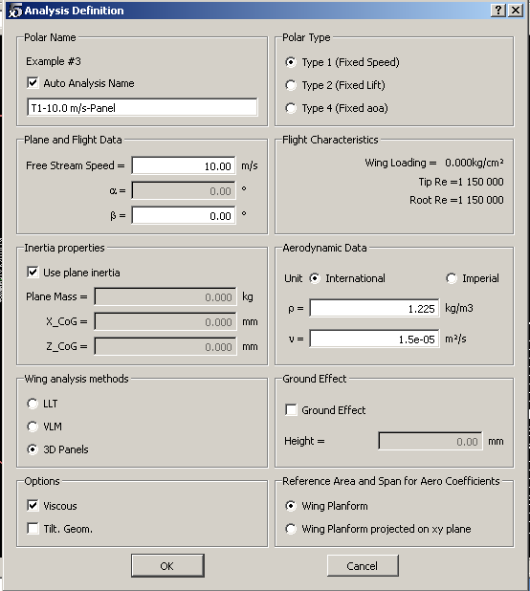
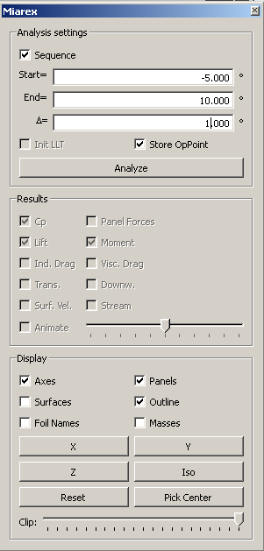
Continuing from the LLT analysis
Click <polars><define an analysis
Choose 3D Panels
Click OK
Set angle attack range
Click Analyze

Slide 26
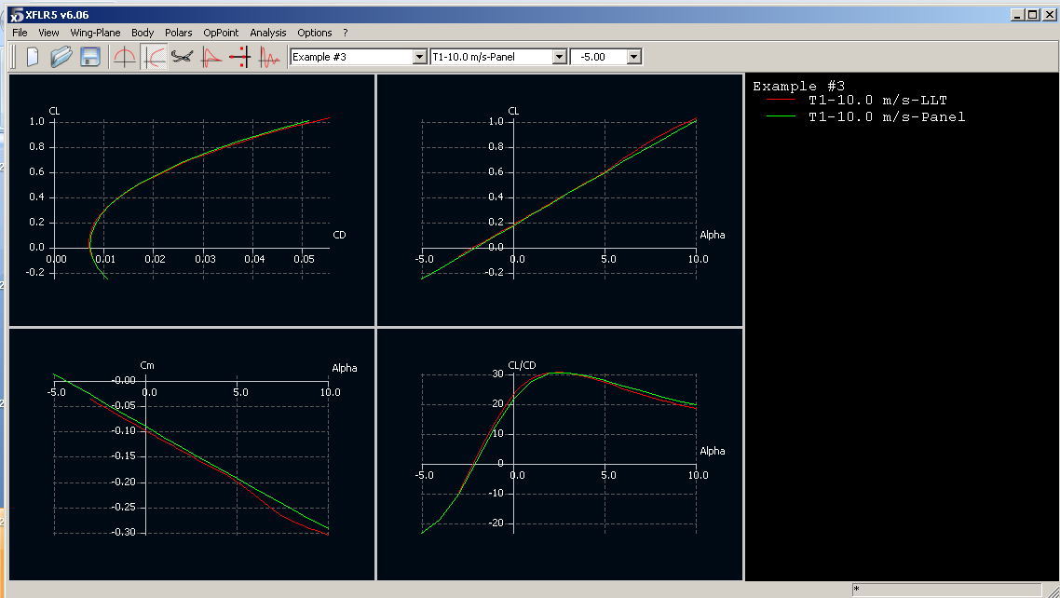

Slide 27
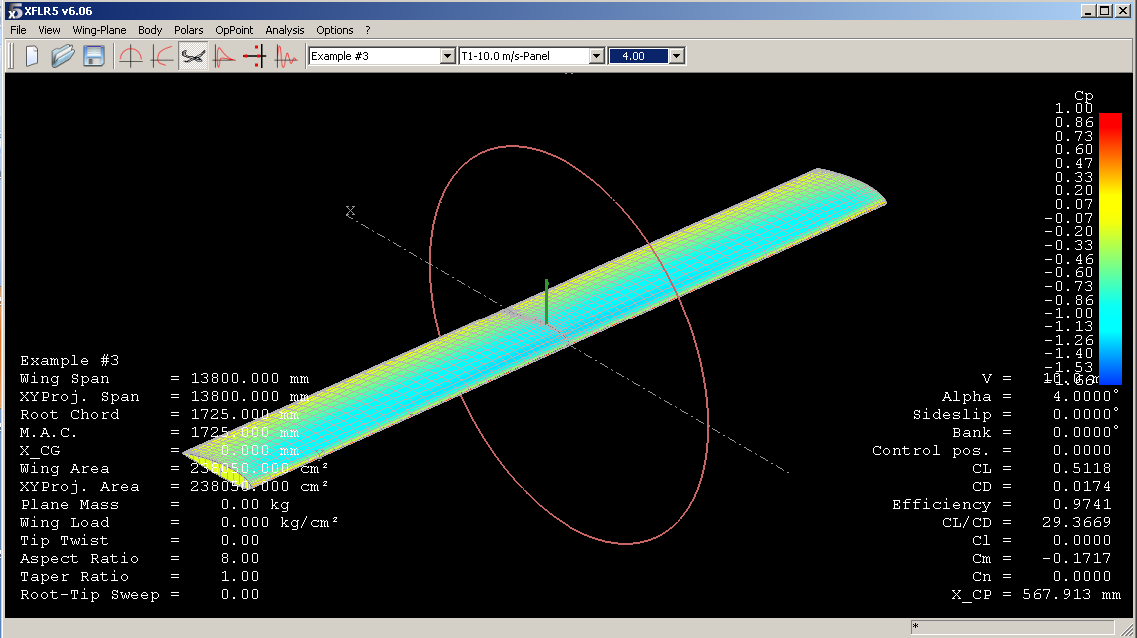
Right Click on graph, choose current op point, export Generates file of data with pressures on all panels

