Slide 1
Database System Architecture and Implementation
Disk Manager – 9.3 of Ramakrishnan/Gehrke
With thanks to Michael Grossniklaus

Slide 2
Orientation
Web Forms
Applications
SQL Interface
SQL Commands
DBMS
Executor
Parser
Operator Evaluator
Optimizer
Files and Index Structures
Recovery Manager
Transaction Manager
Buffer Manager
Lock Manager
Disk Space Manager
We are here!
Index and Data Files Catalog
Database
Figure Credit: Raghu Ramakrishnan and Johannes Gehrke: “Database Management Systems”, McGraw-Hill, 2003.

Slide 3
Disk Space Manager
Abstracts from the gory details of the underlying storage
disk space manager talks to disk controller and initiates I/O operations
DBMS issues allocate/deallocate and read/write commands to disk space manager
Provides the concept of a page
a page is a disk block that has been brought into memory
disk blocks and pages are of the same size (usually)
sequences of pages are mapped onto contiguous sequences of blocks
unit of storage for all system components in higher layers

Slide 4
Disk Space Manager
Upper DBMS Layers
Locality-preserving mapping
track page locations and block usage internally
page number ↔ physical location
Abstract physical location
OS file name and offset within that file
head, sector, and track of a hard disk drive
tape number and offset for data stored in tape library
…
Main Memory (RAM)
Data
Pages
Disk Space
Manager
Disk
Blocks
Magnetic Disk

Slide 5
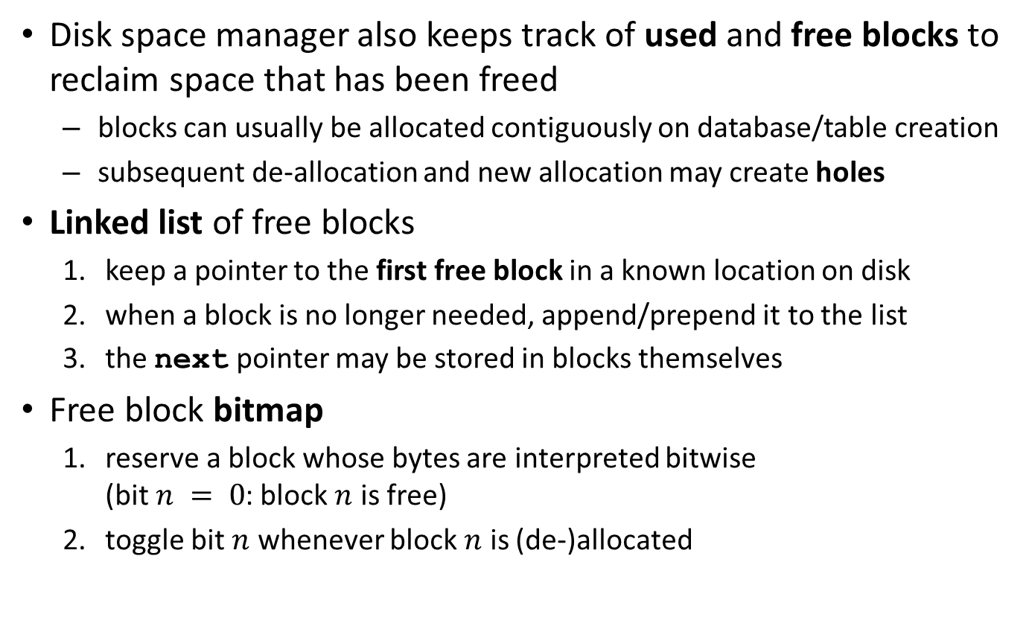
Managing Free Space
Disk space manager also keeps track of used and free blocks to reclaim space that has been freed
blocks can usually be allocated contiguously on database/table creation
subsequent de-allocation and new allocation may create holes
Linked list of free blocks
keep a pointer to the first free block in a known location on disk
when a block is no longer needed, append/prepend it to the list
the next pointer may be stored in blocks themselves
Free block bitmap
reserve a block whose bytes are interpreted bitwise (bit $n = 0$: block $n$ is free)
toggle bit $n$ whenever block $n$ is (de-)allocated

Slide 6
Contiguous Sequences of Pages
! Exercise
To exploit sequential access, it is useful to allocate contiguous sequences of pages
Which technique would you use, a linked list or a bitmap of free blocks?
Slide Credit: Torsten Grust, University of Tübingen, Germany

Slide 7
Contiguous Sequences of Pages
! Exercise
To exploit sequential access, it is useful to allocate contiguous sequences of pages
Which technique would you use, a linked list or a bitmap of free blocks?
Free block bitmaps support fast identification of contiguous sequences of free blocks
Minibase uses a bitmap of free blocks in its disk space manager (DiskManager.java)
Slide Credit: Torsten Grust, University of Tübingen, Germany

Slide 8
Database System Architecture and Implementation
Buffer Manager

Slide 9
Orientation
Web Forms
Applications
SQL Interface
SQL Commands
DBMS
Executor
Parser
Operator Evaluator
Optimizer
Files and Index Structures
Recovery Manager
Transaction Manager
Buffer Manager
We are here!
Lock Manager
Disk Space Manager
Index and Data Files Catalog
Database
Figure Credit: Raghu Ramakrishnan and Johannes Gehrke: “Database Management Systems”, McGraw-Hill, 2003.

Slide 10
Buffer Manager
 Recall
size of database on secondary storage ≫ size of available primary memory to hold user data
To scan the entire pages of a 50 GB table (SELECT * FROM …), the DBMS needs to
bring pages into memory as they are needed for processing
overwrite (replace) pages when they become obsolete and new pages are required
The buffer manager mediates between external storage and main memory

Slide 11
Buffer Pool
Upper DBMS Layers
Buffer pool is a designated main memory area managed by the buffer manager
organized as a collection of frames (empty slots)
pages brought into memory and are loaded into frames as needed
a replacement policy decides, which page to evict when the buffer is full
Page Requests
Main Memory (RAM)
Disk Pages
9
5
6
Buffer Manager
Buffer Pool
4
Free Frames
3
Disk Space
Manager
Disk
Blocks
1
2
3
4
5
6
Magnetic Disk
7
8
9
10
11
…

Slide 12
Buffer Manager Interface
Higher-level code requests (pins) pages from the buffer manager and releases (unpins) pages after use
pin(pageNo)
request page number pageNo from the buffer manager
if necessary, load page into memory
mark page as clean (¬dirty)
return a reference to the frame containing page number pageNo
unpin(pageNo, dirty)
release page number pageNo, making it a candidate for eviction
if page was modified, dirty must be set to true
! Why do we need the dirty bit?
Slide Credit: Torsten Grust, University of Tübingen, Germany

Slide 13
Buffer Manager Interface
Higher-level code requests (pins) pages from the buffer manager and releases (unpins) pages after use
pin(pageNo)
request page number pageNo from the buffer manager
if necessary, load page into memory
mark page as clean (¬dirty)
return a reference to the frame containing page number pageNo
unpin(pageNo, dirty)
release page number pageNo, making it a candidate for eviction
if page was modified, dirty must be set to true
! Why do we need the dirty bit?
Only modified pages need to be written back to disk upon eviction.
Slide Credit: Torsten Grust, University of Tübingen, Germany

Slide 14
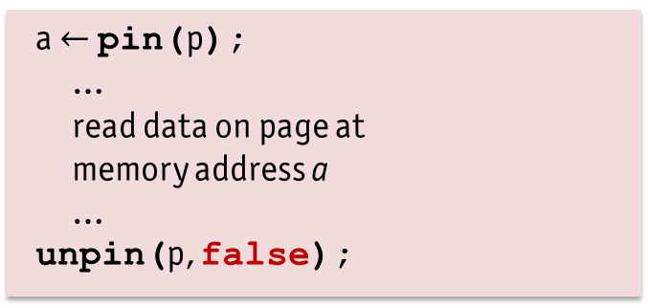
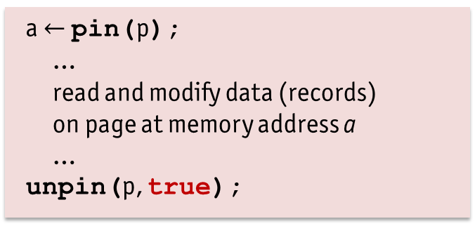
Proper Nesting of pin()and unpin()
 A read-only page operation
 A read/write page operation
a $←$ pin(p);
…
read data on page at memory address a
…
unpin(p, false);
a $←$ pin(p);
…
read and modify data (records) on page at memory address a
…
unpin(p, true);
All database transactions are required to properly “bracket” page operations using pin() and unpin() calls
Proper bracketing enables the system keeps a count of active users (e.g., transactions) accessing a page (pinCount)

Slide 15
Writing Pages Back to Disk
Pages are written back to disk when evicted from buffer pool
“clean” victim pages are not written back to disk
call to unpin() does not trigger any I/O operations, even if the pinCount of the page becomes 0
pages with pinCount = 0 are simply a suitable victim for eviction
 Digression: Transaction Management
Wait! Stop! This makes no sense… If pages are written only when they are evicted from the buffer pool, then how can we ensure proper transaction management, i.e., guarantee durability?
 A buffer manager typically offers at least one or more interface calls (e.g., flushPage(p)) to force a page p (synchronously) back to disk

Slide 16
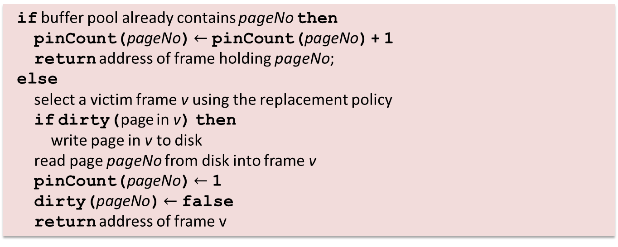
Implementation of pin()
 Function pin(pageNo)
if buffer pool already contains pageNo then
pinCount(pageNo) $←$ pinCount(pageNo) + 1
return address of frame holding pageNo;
else
select a victim frame v using the replacement policy
if dirty(page in v) then
write page in v to disk
read page pageNo from disk into frame v
pinCount(pageNo) $←$ 1
dirty(pageNo) $←$ false
return address of frame v
Slide Credit: Torsten Grust, University of Tübingen, Germany

Slide 17
Implementation of unpin()
 Function unpin(pageNo, dirty)
pinCount(pageNo) $←$ pinCount(pageNo) – 1
dirty(pageNo) $←$ dirty(pageNo) ⋁ dirty
! But… Why don’t we write pages back to disk during unpin()?
Slide Credit: Torsten Grust, University of Tübingen, Germany

Slide 18
Implementation of unpin()
 Function unpin(pageNo, dirty)
pinCount(pageNo) $←$ pinCount(pageNo) – 1
dirty(pageNo) $←$ dirty(pageNo) ⋁ dirty
! But… Why don’t we write pages back to disk during unpin()?
Of course, this is a possibility…
⊕ recovery from failure would be a lot simpler
⊖ higher I/O cost (every page write implies a write to disk)
⊖ bad response time for writing transactions
This discussion is also know as force (or write-through) vs. write-back. Actual database systems typically implement write-back.
Slide Credit: Torsten Grust, University of Tübingen, Germany

Slide 19
Two Strategic Questions
Buffer Allocation Problem: How much precious buffer space should be allocated to each active transaction?
static assignment
dynamic assignment
Page Replacement Problem: Which page will be replaced when a new request arrives and the buffer pool is full?
decide without knowledge of reference pattern
presume knowledge of (expected) reference pattern
Additional complexity is introduced when we take into account that DBMS may manage “segments” of different page sizes
one buffer pool: good space utilization, but fragmentation problem
multiple buffer pools: no fragmentation, but worse utilization, global allocation/replacement strategy may get complicated
A possible solution is to support set-oriented pin({p}) calls

Slide 20
Buffer Allocation Policies
Problem: allocate parts of buffer pool to each transaction (TX) or let replacement policy decide who gets how much space?
Local policies…
allocate buffer frames to a specific TX without taking the reference behavior of concurrent TX into account
have to be supplemented with a mechanism for handling the allocation of buffer frames for shared pages
Global policies…
consider not only the reference pattern of the transaction currently executing, but also the reference behavior of all other transactions
based allocation decision on data obtained from all transactions

Slide 21
Local vs. Global Policies
Properties of a local policy
one TX cannot hurt other transactions
all TX are treated equally
possibly, bad overall utilization of buffer space
some TX may occupy vast amounts of buffer space with “old” pages, while others suffer from too little space (“internal page thrashing”)
Problem with a global policy (assume TX reading a huge relation sequentially)
all page accesses are references to newly loaded pages
hence, almost all other pages are likely to be replaced (following a standard replacement policy)
other TX cannot proceed without loading their pages again (“external page thrashing”)

Slide 22
Buffer Allocation Policies
Global one buffer pool for all transactions
Local use various information (e.g., catalog, index, data, …)
Local each TX gets a certain fraction of the buffer pool
static partitioning assign buffer budget once for each TX
dynamic partitioning adjust buffer budget of TX according to its past reference pattern or some kind of semantic information
It is also possible to apply mixed policies
have different buffer pools with different approaches
mixed policies complicate matters significantly!

Slide 23
Dynamic Buffer Allocation Policies
Local LRU (cf. LRU replacement policy, later)
keep a separate LRU-stack for each active TX
keep a global freelist for pages not pinned by any TX
Strategy
replace a page from the freelist
replace a page from the LRU-stack of the requesting TX
replace a page from the TX with the largest LRU-stack
Working Set Model (cf. virtual memory management of OS)
goal: avoid thrashing by allocating “just enough” buffers to each TX
approach: observe number of different page requests by each TX in a certain interval of time (window size τ)
deduce “optimal” buffer budget from this observation
allocate buffer budgets according to ratio between those optimal sizes

Slide 24
Buffer Replacement Policies
Choice of buffer replacement policy (victim frame selection) can considerably affect DBMS performance
Large number of policies in OS and DBMS

Slide 25
Buffer Replacement Policies
Choice of buffer replacement policy (victim frame selection) can considerably affect DBMS performance
Large number of policies in OS and DBMS
Criteria |  | Age of page in buffer
 |  | no | since last reference | total age
References | none | Random |  | FIFO
 | last |  | LRU CLOCK GCLOCK(V1)
 | all | LFU | GCLOCK(V2) DGCLOCK | LRD(V1)
 |  |  | LRD(V2)
Criteria for victim selection used in some policies

Slide 26
Typical Buffer Replacement Policies
DBMS typically implement more than one replacement policy
FIFO (“first in, first out”)
LRU (“least recently used”): evicts the page whose latest unpin() is longest ago
LRU-k: like LRU, but evicts the k latest unpin() call, not just the latest
MRU (“most recently used”): evicts the page that has been unpinned most recently
LFU (“least frequently used”)
LRD (“least reference density”)
CLOCK (“second chance”): simulates LRU with less overhead (no LRU queue reorganization on every frame reference)
GCLOCK (“generalized clock”)
WS, HS (“working set”, “hot set”)
Random: evicts a random page

Slide 27
Details of LRU and CLOCK Policy
 Example: LRU Buffer Replacement Policy
keep a queue (often described as a stack) of pointers to frames
in unpin(pageNo, dirty), append p to the tail of queue, if pinCount(pageNo) is decremented to 0
to find next victim, search through the queue from its head and find the first page p with pinCount(pageNo) = 0
 Example: CLOCK Buffer Replacement Policy
number the N buffer frames 0 … N-1, initialize current $←$ 0, maintain a bit array referenced[0 … N-1], which is initialized to all 0
in pin(pageNo), do referenced[pageNo] $←$ 1
to find the next victim, consider page current: if pinCount(current) = 0 and referenced[current] = 0, current is the victim; otherwise, referenced[current] $←$0, current $←$ (current + 1) mod N; repeat 3.

Slide 28
Heuristic Policies Can Fail
These buffer replacement policies are heuristics only and can fail miserably in certain scenarios
 Example: A Challenge for LRU
A number of transactions want to scan the same sequence of pages (as for example a repeated SELECT * FROM R). Assume a buffer pool capacity of 10 pages.
Let the size of relation R be 10 or less page. How many I/O operations do you expect?
Let the size of the relation R be 11 pages. What about the number of I/O operations in this case?

Slide 29
Details of LRD
Record the following three parameters
$trc(t)$ total reference count of transaction $t$
$age(p)$ value of $trc(t)$ at the time of loading $p$ into buffer
$rc(p)$ reference count of page $p$
Update these parameters during a transaction’s page references (pin(pageNo) calls)
Compute mean reference density of a page $p$ at time $t$ as
$rd\left(p,t\right)≔\frac{rc\left(p\right)}{trc\left(t\right)−age\left(p\right)}$, where $trc\left(t\right)−rc\left(p\right)≥1$
Strategy for victim selection
chose page with least reference density $rd(p,t)$
many variants exist, e.g., for gradually disregarding old references

Slide 30
Exploiting Semantic Knowledge
Background: query compiler/optimizer already…
selects access plan, e.g., sequential scan vs. index
estimates number of page I/O operations for cost-based optimization
Idea: use this information to determine query-specific, optimal buffer budget, i.e., a Hot Set
Goals of Query Hot Set model
optimize overall system throughput
avoiding thrashing is the most important goal

Slide 31
Hot Set with Disjoint Page Sets
 Mode of Operation
only those queries are activated, whose Hot Set buffer budget can be satisfied immediately
queries with higher demand have to wait until their budget becomes available
within its own buffer budget, each transaction applies a local LRU policy
Properties
no sharing of buffered pages between transactions
risk of internal thrashing when Hot Set estimates are wrong
queries with large Hot Sets block following small queries (or, if bypassing is permitted, many small queries can lead to starvation of large queries)

Slide 32
Hot Set with Non-Disjoint Page Set
 Mode of Operation
queries allocate their budget stepwise, up to the size of their Hot Set
local LRU stacks are used for replacement
request for a page p
if found in own LRU stack: update LRU stack
if found in another transaction’s LRU stack: access page, but do not update the other LRU stack
if found in freelist: push page on own LRU stack
call to unpin(pageNo): push page onto freelist stack
filling empty buffer frames: taken from the bottom of the freelist stack
As long as a page is in a local LRU stack, it cannot be replaced
If a page drops out of a local LRU stack, it is pushed onto freelist stack
A page is replaced only if it reaches the bottom of the freelist stack before some transaction pins it again

Slide 33
Priority Hints
Idea: with unpin(pageNo), a transaction gives one of two possible indications to the buffer manager
preferred page managed in a transaction-local partition
ordinary page managed in a global partition
Strategy: when a page needs to be replaced…
try to replace an ordinary page from the global partition using LRU
replace a preferred page of the requesting transaction using MRU
Advantages
much simpler than Hot Set, but similar performance
easy to deal with “too small” partitions
 Variant: Fixing and Hating Pages
Operator can fix a page if it may be useful in the near future (e.g., nested-loop join) or hate a page it will not access any time soon (e.g., pages in a sequential scan)

Slide 34
Prefetching
Buffer manager can try to anticipate page requests
asynchronously read ahead even if only a single page is requested
improve performance by overlapping CPU and I/O operations
Prefetching techniques
prefetch lists: on-demand, asynchronous read-ahead e.g., when traversing the sequence set of an index, during a sequential scan of a relation
heuristic (speculative) prefetching e.g., sequential n-block look-ahead (cf. drive or controller buffers in hard disks), semantically determined supersets, index prefetch, …

Slide 35
Prefetching
✓ The Real World
IBM DB2
supports both sequential and list prefetch (prefetching a list of pages)
default prefetch size is 32 4 kB pages (user-definable), but for some utilities (e.g., COPY, RUNSTAT) pages up to 64 4 kB are prefetched
for small buffer pools (i.e., < 1000 buffers) prefetch adjusted to 8 or 16 pages
prefetch size can be defined by user (sometimes it makes sense to prefetch 1000 pages)
Oracle 8
uses prefetching for sequential scan, retrieving large objects, and certain index scans
Microsoft SQL Server
supports prefetching for sequential scan and for scans along the leaf-level of a B+ tree index
prefetch size can be adjusted during a scan
extensive use of asynchronous (speculative) prefetching

Slide 36
Database vs. Operating System
Stop! What you are describing is an operating system (OS)!
Well, yes…
disk space management and buffer management very much look like file management and virtual memory (VM) in an operating system
But, no…
DBMS can predict the access patterns of certain operators a lot better than the operating system (prefetching, priority hints, etc.)
concurrency control is based on protocols that prescribe the order in which pages have to be written back to disk
technical reasons can make operating systems tools unsuitable for a database (e.g., file size limitation, platform independence)

Slide 37
Double Buffering
DBMS buffer manager within VM of DBMS server process can interfere with OS VM manager
virtual page fault: page resides in DBMS buffer, but the frame has been swapped out by operating system VM manager  one I/O operation is necessary that is not visible to the DBMS
buffer fault: page does not reside in DBMS buffer, but frame is in physical memory  regular DBMS page replacement requiring one I/O operation
double page fault: pages does not reside in DBMS buffer and frame has been swapped out of physical memory by operating system VM manager  two I/O operations necessary: one to bring in the frame (OS) and another one to replace the page in that frame (DBMS)
DBMS buffer needs to be memory resident in OS

Slide 38
Buffer Management in Practice
✓ The Real World
IBM DB2
buffers can be partitioned into named pools
each database, table, or index can be bound to a pool
each pool uses FIFO, LRU or (variant of) Clock buffer replacement policy
supports “hating” of pages
Oracle 7
maintains a single global buffer pool using LRU
Microsoft SQL Server
uses a single buffer pool with Clock replacement
supports a “reservation” of pages by queries that require large amount of memory (e.g., queries involving sorting of hashing)

