Slide 1
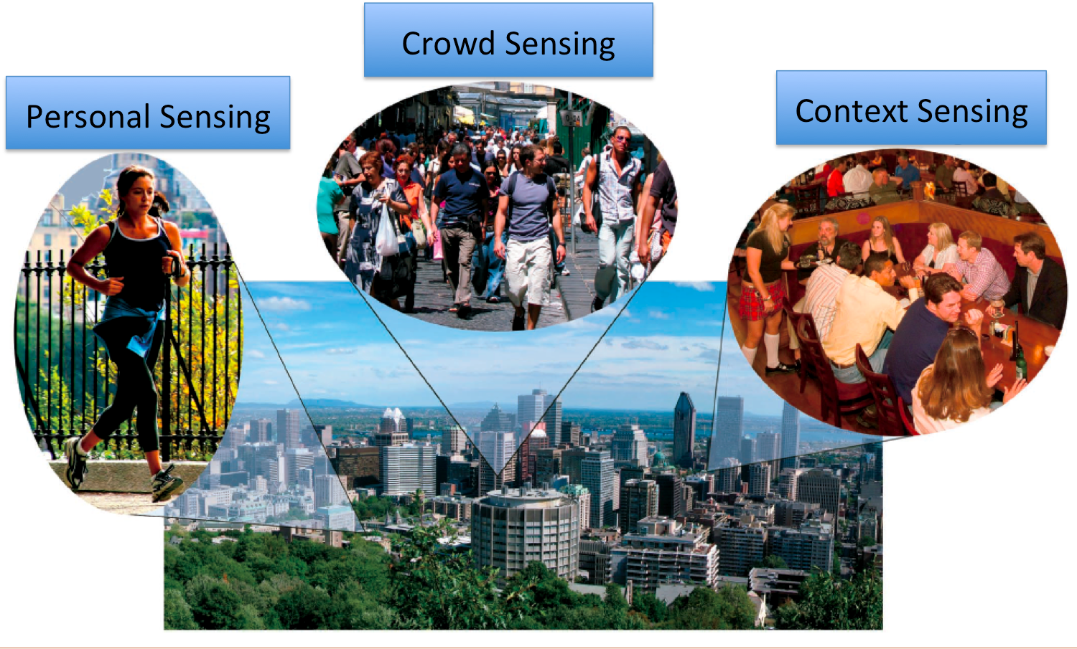

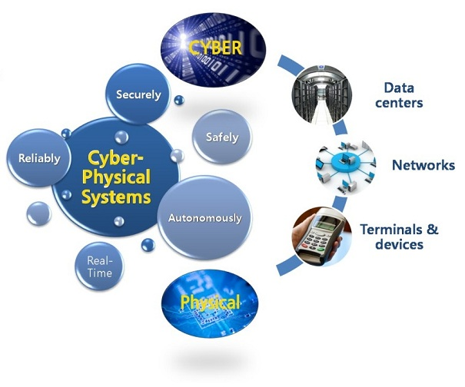
Social Sensing and Cyber-Physical Systems
http://www3.nd.edu/~dwang5/courses/spring15/
CSE 40437/60437-Spring 2015
Prof. Dong Wang

Slide 2
Logistics
Instructor
Dong Wang, Office: 214 B Cushing, Tel: 631-3749
Office Hours: Tue, 3:15-5:15 PM
Email:dwang5@nd.edu
TA
Chao Huang, Office: 254 Fitzpatrick Hall
Office Hours: Mon: 4-6 PM; Thu: 4-6 PM.
Email: chuang7@nd.edu

Slide 3
A Little About Me
Ph.D. in Quantifying the QoI in Social Sensing, Department of Computer Science, University of Illinois at Urbana-Champaign, 2012.
2014-present: Assistant Professor, Department of Computer Science and Engineering, University of Notre Dame
Research Interests: Big Data Analytics, Social Sensing and Cyber-Physical Systems, Trust Analysis in Information and Social Networks
Homepage: http://www3.nd.edu/~dwang5/

Slide 4
Where and When
Lecture Times and Location
Tuesday and Thursday, 2:00 - 3:15pm
DeBartolo Hall 117

Slide 5
Honor Code
The graded work you do in this class must be your own. In the case where you collaborate with other students make sure to fairly attribute their contribution to your project.

Slide 6
Prerequisite
Senior or Graduate Standing
Proficiency in Python Programming
Experiences with Big Data Analytics (e.g., Data Mining) and Processing (e.g., Cloud Computing) will be a PLUS!
Experiences with Real-time, Mobile Sensing, Online Social Media will be a PLUS!

Slide 7
Grading
Participation: 10%
  Assigned for individuals' class participation, and discussion of papers (individual based).
Assignments: 30%
  Three assignments, 10% for each (individual based).
Presentation: 10%
  Assigned for an in-class presentation (group based).
Project: 50%
  Determined by a group course project (group based).

Slide 8
Grading
Project: 50%
  Updates and Discussion: 5%
  Proposal: 5%
  Mid-term presentation: 5%
  Mid-term report: 10%
  Final presentation: 10%
  Final project paper: 15%

Slide 9
Assignments
There will be three assignments, each accounts for 10% of the final grade.
They are centered around building a simplified data crawling and analysis engine based on Twitter.
Most of the coding can be done in Python.
The assignments are individual based. You can discuss the problems with others but you are expected to finish the assignment by yourself.

Slide 10
In-class Paper Presentation
Form a group of up to three people for a in-class presentation of a selected technical paper (the group can be the same as your project group).
Exercise your critical thinking ability, understand how to present and challenge other’s work, and learn how to lead technical discussions.
It contains a presentation part and Q&A part (about 25 min).
It is scheduled in the second half of the semester. Detailed instructions on preparation and sign-up will be announced later.

Slide 11
Collaborative Projects
(up to 3 people per group)
It is a group based collaborative project. You can form your group of up to three people in the first couple of weeks. Feel free to use Piazza to find your partner.
The only restriction is the the project should use the online social media data (e.g., Twitter, Flickr, Foursquare, Facebook, etc.) to solve some interesting problem in social sensing.
Some example ideas are on the course website, and you are always encouraged to come up with your own ideas!
http://www3.nd.edu/~dwang5/courses/spring15/project/project.html
However, if you do have a cool idea that does not meet the above requirement, please schedule a meeting with the instructor to discuss about it.

Slide 12
Collaborative Projects
(Milestones)
Project title, abstract, and member list is due Jan 30th.
Meetings to discuss progress and problems on your project of interest.
2-page project proposal by Feb 20th.
Mid-term project presentation, March 17th-19th.
4-page mid-term project report due: March 20th
Final project presentation, starting from the week of April 21th
Final project paper is due May 4th. The paper follows the standard technical paper format.
Successful projects could result in a conference or journal quality research paper.
All project documents (abstract, proposal, report and final paper) are due at Noon of the due day.

Slide 13
Getting Help
Office Hours – Schedule on the course website
Email - Contact Prof. Wang for questions about grades, course policies, etc.
Piazza Discussion Page - General announcement, lecture notes and Q&A after class
Grades are available in Sakai.

Slide 14
Readings
First week, 2 overview papers
Starting next week
  Papers are posted on the course website (about 4 papers per week)

Slide 15
Schedule
See Course Website:http://www3.nd.edu/~dwang5/teach/spring15/
Lectures, Project Meetings, and Presentations
Lecture notes will be available at:https://piazza.com/nd/spring2015/cse4043760437/resources

Slide 16
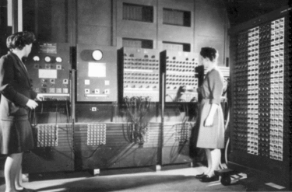

Where is Computer Science Research Going?
The first general purpose computer in the world
ENIAC (Electronic Numerical Integrator And Computer)
Born in Feb. 1946 at University of Pennsylvania

Slide 17
Where is Computer Science Research Going?
1946-1970s:
The beginning:
Centralized
machines
Theory
Languages
Architecture
Core
Operating
Systems

Slide 18
Where is Computer Science Research Going?
1970s-2007:
Towards
Distribution
Parallel machines
Centralized
machines
LANs
Databases
Graphics
Theory
Languages
Architecture
Towards
Applications
Core
Operating
Systems
High-performance
Computing
MANET
Security

Slide 19
Where is Computer Science Research Going?
Infosphere
1970s-2007:
GIS
Towards
Distribution
Parallel machines
Centralized
machines
LANs
Grid Computing
Internet
Brain
Interfaces
Databases
WWW
Graphics
Theory
Languages
Architecture
Interdisciplinary
Application
Research
Core
Operating
Systems
High-performance
Computing
MANET
Quantum
Security
Computing
Bio-info

Slide 20
Where is Computer Science Research Going?
Infosphere
2007-now:
GIS
Parallel machines
Cyber-Physical
Centralized
machines
Computing
LANs
Grid Computing
Internet
Brain
Interfaces
Databases
WWW
Graphics
Theory
Languages
Architecture
Interdisciplinary
Application
Research
Core
Operating
Systems
High-performance
Computing
MANET
Quantum
Security
Computing
Bio-info

Slide 21
Where is Computer Science Research Going?
Infosphere
2007-now:
GIS
Parallel machines
Cyber-Physical
Centralized
machines
(Distributed) Computing
LANs
Grid Computing
Internet
Brain
Interfaces
Databases
WWW
Graphics
Theory
Languages
Architecture
Interdisciplinary
Application
Research
Core
Operating
Systems
High-performance
Computing
MANET
Quantum
Security
Computing
Bio-info

Slide 22
Where is Computer Science Research Going?
2007-now:
Cyber-Physical
Systems
For example:
In the US, in 2007, the Presidential Counsel of Advisors in Science and Technology named systems that interact with the physical world the
#1 Research Priority in the US

Slide 23
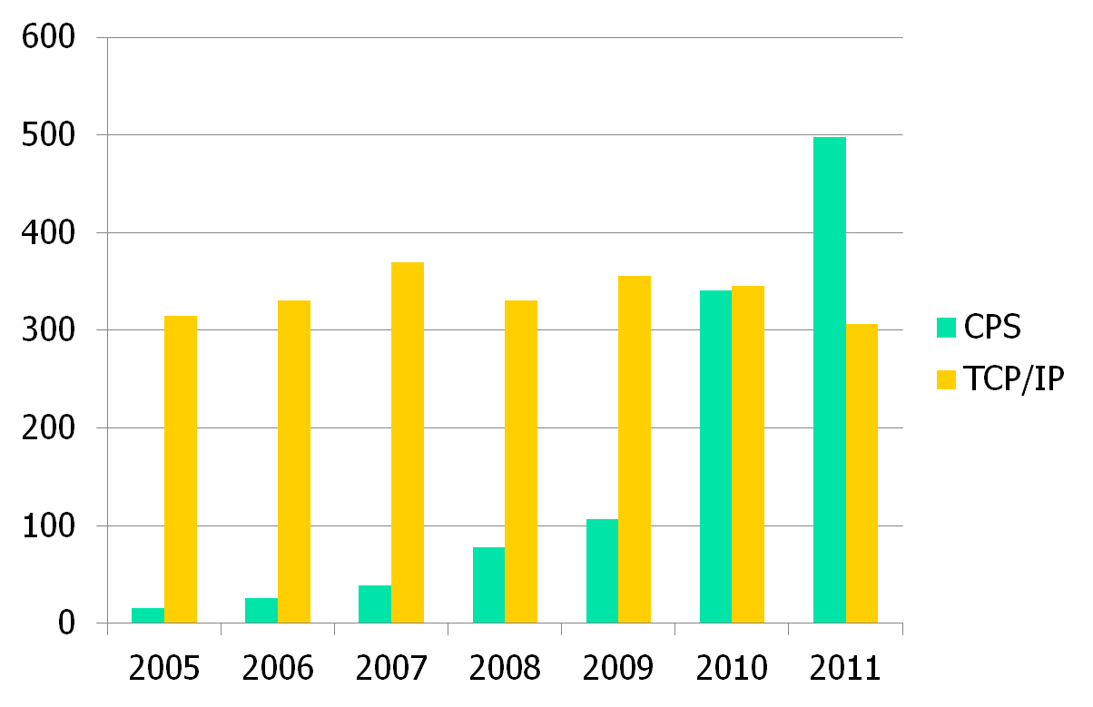
Keyword Trends (on INSPEC) in Computers/Control Eng.

Slide 24
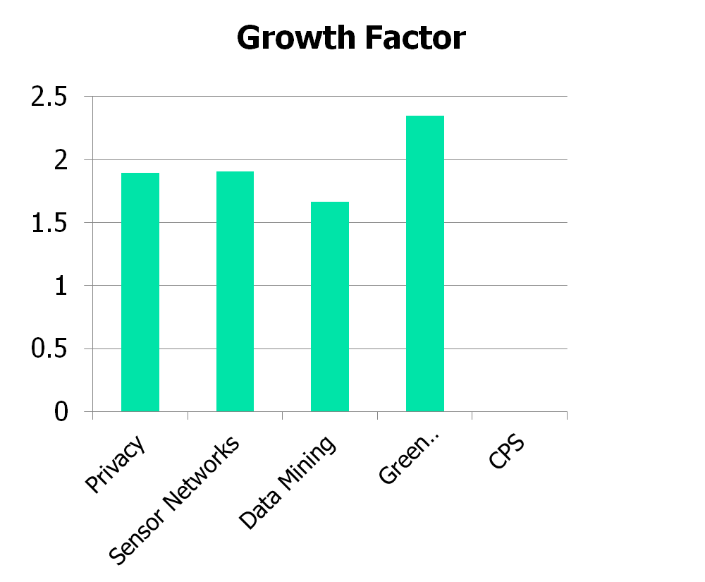
Keyword Trends (Continued):
2011/2006 Multiplicative Factor

Slide 25
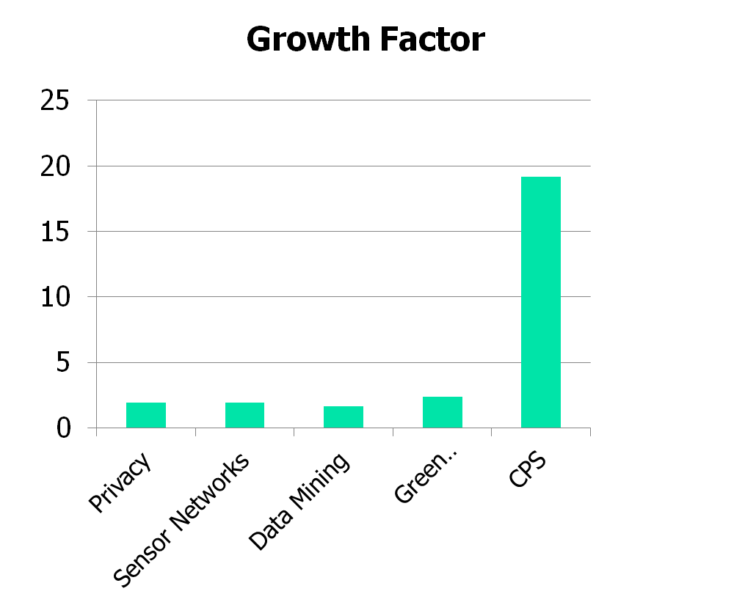
Keyword Trends (Continued):
2011/2006 Multiplicative Factor

Slide 26






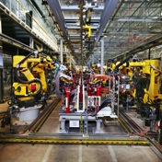
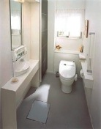

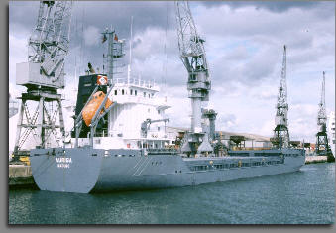

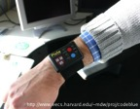
Force #1: Moore’s Law
(Device proliferation)
Cyber
Physical
Networks
Industrial
Single-hop: monitor
cargo, machinery
factory floor, …
Send to base.
Applications
“Classical”
Unattended multihop
ad hoc wireless
Medical
Ubiquitous Computing

Slide 27

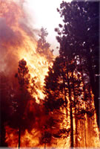

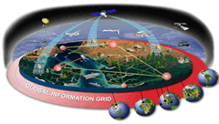
Force #2: Integration at Scale
(Isolation has cost!)
Low end: ubiquitous embedded devices
  Large-scale networked embedded systems
  Seamless integration with a physical environment
High end: complex systems with global integration
  Examples: Global Information Grid, Total Ship Computing Environment
  Picture courtesy of
  Patrick Lardieri
Global Information Grid
Total Ship Computing Environment (TSCE)
Integration
and Scaling
Challenges
World Wide Sensor Web
(Feng Zhao)
Future Combat System
(Rob Gold)
Low End
High End

Slide 28
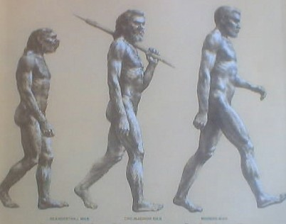
Force #3: Biological Evolution

Slide 29
Force #3: Biological Evolution
It’s too slow!
  The exponential proliferation of data sources (afforded by Moore’s Law)
  is not matched by
  a corresponding increase in human ability to consume information!
  → Increasing focus on information distillation to support decision making

Slide 30
Confluence of Trends
The Overarching Challenge
Trend2: Integration at Scale
(Isolation has cost)
Trend1: Device/Data Proliferation
(by Moore’s Law)
Trend3: Autonomy
(Humans are not getting faster)

Slide 31
Confluence of Trends
The Overarching Challenge
Trend2: Integration at Scale
(Isolation has cost)
Core Challenges:
Distributed CPS
Information Distillation
Trend1: Device/Data Proliferation
(by Moore’s Law)
Trend3: Relative autonomy
(Humans are not getting faster)

Slide 32
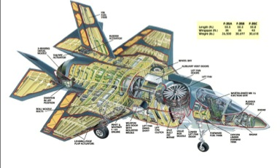
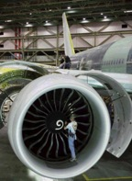
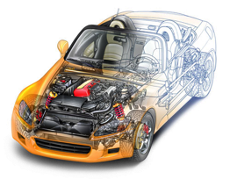
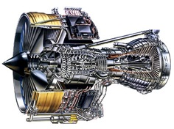
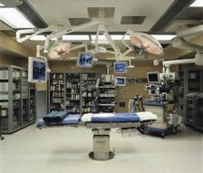
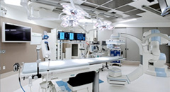
Traditional Embedded Computing (Cyber+Physical)
Embedded Computing Systems

Slide 33


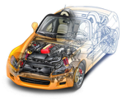



Emerging Directions
Distribution,
Humans in the Loop,
“Big” Data from the Physical World

Slide 34
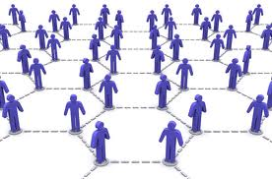

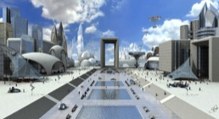




Emergence of Social Sensing
Information Services for a Smarter World
People
Analytics
fantasyartdesign.com
Sensors
Future Applications
Data

Slide 35

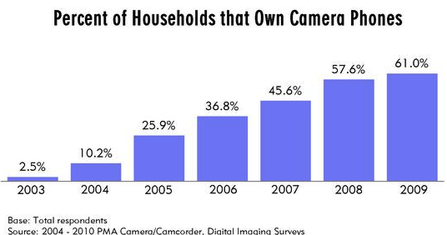
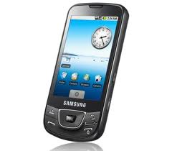
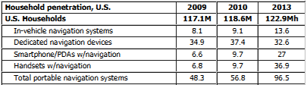
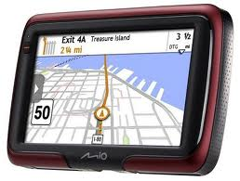
Growth Statistics of Mobile “Sensors”
The number perhaps already is much higher now

Slide 36
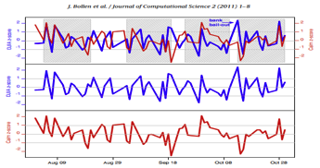
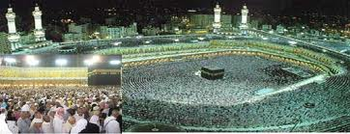
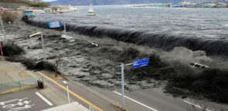
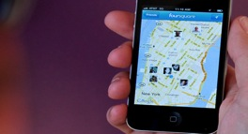

Social Sensing
A set of applications where data are collected from human sources or devices on their behalf.
Human + Cyber + Physical
Twitter Mood Predicts Stock Market, 2011
Help Pilgrims utilize schedule in Hajj , 2012
FourSquare helps blind people navigate , 2012
Japan Tsunami and Nuclear Event, 2011

Slide 37


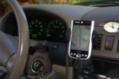





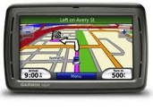
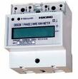

Why Social Sensing?
A Confluence of Three Trends
Mass Dissemination Media
Sensors
Connectivity
Smart Phone
Cars on Internet
Smart Meter
GPS
Cell-phones

Slide 38
The Rise of Social Media
Platforms for Information Dissemination
Significant growth in social networks over the last decade
Millions of Users
Year
http://dstevenwhite.com

Slide 39
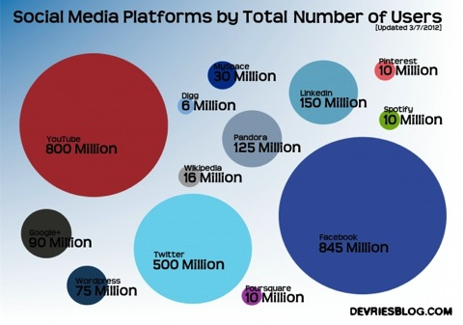
The Rise of Social Media
Platforms for Information Dissemination
100s of millions of users on Facebook, YouTube, Twitter, LinkedIn, and Pandora
Growth Chart: 2006-2011
Millions of Users
Total Users in 2011
http://devriesblog.com/category/social-networking/
http://dstevenwhite.com

Slide 40






A Wealth of Social Sensing Content
Every Minute:
More than 350,000 tweets made on Twitter http://www.internetlivestats.com/twitter-statistics/
Almost 700,000 status updates made on Facebook http://www.themarketingbit.com/infographics/online-for-one-minute/
More than 3,500 images uploaded to Flickr http://www.pcmag.com
More than 2000 check-ins on FourSquare http://articles.businessinsider.com
More than 100 hours of video uploaded to YouTube http://www.youtube.com/t/press_statistics

Slide 41
Significant Information on Ongoing Events
Thousands of tweets per second during key events
http://yearinreview.twitter.com
Tweets per second, 2011

Slide 42

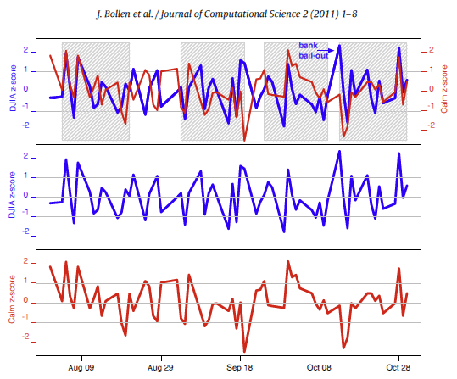
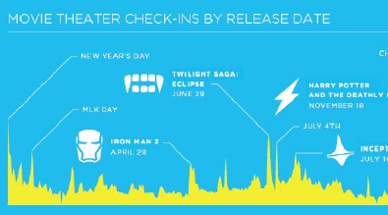
Examples of Real-time Content Analytics
Twitter mood predicts stock market trends
Uses Twitter to analyze and predict global events
FourSquare: Keeps track of human spatio-temporal data

Slide 43

A Deluge of Information!!!

Slide 44

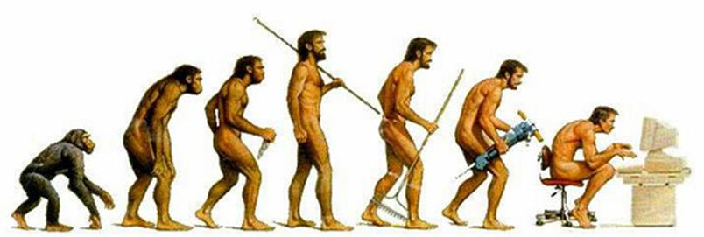

Huge amount of data grows much faster than our cognitive ability to consume it
BIG DATA
Fast data growth!
Social Sensing
Information Distillation Services
Slow Evolution!

Slide 45
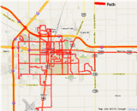


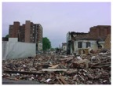
Towards Information Distillation Services
Much like Google organizes (relatively static) world content, we need an engine for organizing real-time/streaming data feeds and:
Reconstructing the
“State of the World”,
Physical and Social!
Clean structured representation, high quality of information
Information distillation
A firehose of text, images, video, sound, and time-series data

Slide 46
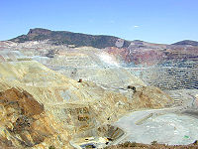
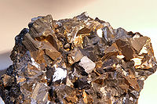

Towards Information Distillation
An information refining pipeline
First stage - rough cut: reduce vast amounts of crude input to a much smaller amount of higher value material
Subsequent stages - refinement: Employ specialized techniques to extract final value for end user

Slide 47
Towards Information Distillation
An information refining pipeline
Our focus:
First stage - rough cut: reduce vast amounts of crude input to a much smaller amount of higher value material
Add-ons:
Subsequent stages - refinement: Employ specialized techniques to extract final value for end user

Slide 48
Transportation
EPA Statistics
200 million light vehicles on the streets
Each driven 12000 miles annually on average
Average MPG is 20.3 miles/gallon
118 Billion Gallons of Fuel per year!
Savings of 1% = One Billion Gallons

Slide 49
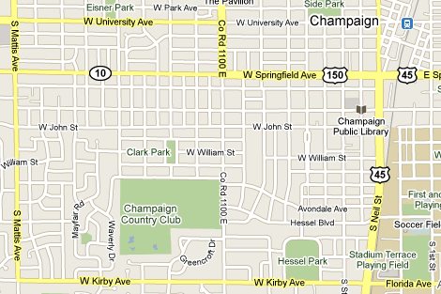
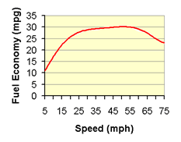
Fuel Efficient Routing
Fuel efficient routes may differ from shortest or fastest routes
  Congestion => shortest may not be fuel efficient
  MPG vs. speed is non-linear => fastest may not be fuel efficient
Source: US EPA

Slide 50
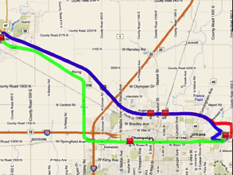
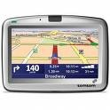
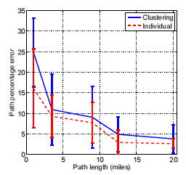

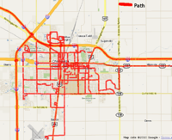

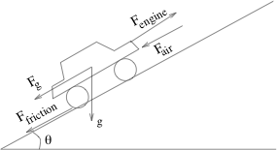


Green GPS
Saves 6% over shortest path and 13% over fastest path
Shortest and fastest
Green GPS
Most fuel-efficient
Fuel Error (%)
vs. Trip Length
Subscribers
Subscribers: Premium service
High savings
Open access: Standard service
Average savings
+
Fuel Data
Physical Models
+
OBDII-WiFi
Adaptor ($50)
GPS Phone
Server

Slide 51
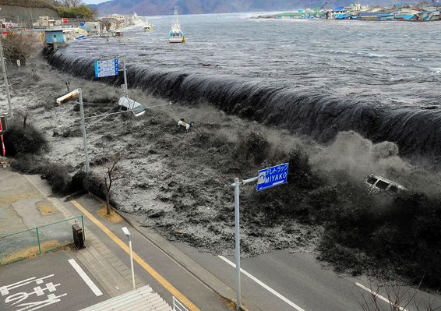
Japan’s tsunami 2011
Japan’s Tsunami and Nuclear Event (2011)
51

Slide 52
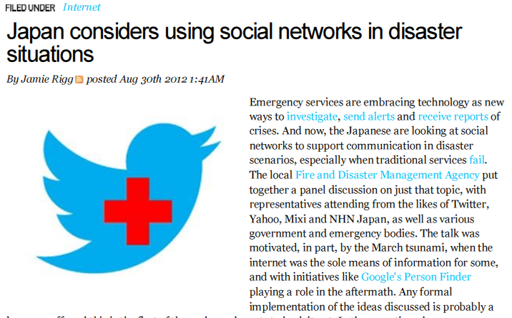
Japan’s tsunami 2011
Japan’s Tsunami and Nuclear Event (2011)
52

Slide 53





Zero Energy Buildings
How can sensing and computing help?
Environmental Technology Center at Sonoma State University
Science House at the Science Museum of Minnesota
Aldo Leopold Legacy Center
Oberlin College Lewis Center
Hawaii Gateway Energy Center

Slide 54



Smart Grid
Connecting millions of intermittent sources?

Slide 55
Project Ideas
Trust and Credibility Analysis
Disaster Tracking and Report System
Social Media Command Center for Business
Personalize Information Subscription Service
Real-Time Data Analytics
Multi-genre Network Analysis
Big Data Processing
Detect and Reduce Redundant Information
Geo-location and Spatial Distribution Problem
Assembling information for heterogeneous data types
Your own idea ☺

Slide 56


Trust and Credibility Analysis
Project Ideas
Dow Jones lost 150 points on a rumor of two explosions in the White House on April 23rd, 2013
200 Billion Lost!

Slide 57
Trust and Credibility Analysis
Project Ideas
Example tweets in the aftermath of Boston Bombing, April 2013
@USATODAY Boston police commissioner says he believes 3rd blast at JFK Library is related to marathon explosions. Next briefing at 7 p.m.
@_BostonMarathon. Posing as the organizers of the race, whoever is behind the account tweeted: "For every retweet we receive we will donate $1 to the #BostonMarathon victims #PrayForBoston.”
on Monday that police in Boston had shut down cellular networks to prevent an attacker from using a cell phone to detonate another explosive.
False!
False!
False!

Slide 58


Disaster Report and Event Tracking
Project Ideas
U.S. Geological Survey is using Twitter to detect earthquake and report sever weather conditions

Slide 59




Disaster Report and Event Tracking
Project Ideas
In many unrest/riot events, both authority and common citizens use social media to obtain real-time information
Egypt Unrest Feb. 2011
Occupy Wall Street Sept. 2011
Stockholm Riots, May. 2013
Crimea Unrest, Feb. 2014

Slide 60

Social Media Command Center
Project Ideas
Large companies start to build their Social Media Command Center (SMCC) to create novel ways of marketing and interacting with customers
Twitter mood predicts stock market trends

Slide 61


Social Media Command Center
Project Ideas
Delta built its own social media lab

Slide 62


Project Idea
New Information Subscription Service

Slide 63





Project Idea
New Information Subscription Service
Heterogeneous, real-time and potentially unreliable sources
Explore the Collective Wisdoms of Common Individuals !

Slide 64


Project Idea
Multi-genre Network Analysis
Physical World Anomaly
Social Network Anomaly
Cross-genre network analysis is essential !

Slide 65


Real-time Data Analytics
Project Ideas
Google Analytics has started to develop a built-in Real-time Insights function to analyze social media

Slide 66


Big Data Processing
Project Ideas
The data generated by online social media is increasing exponentially in last five years

Slide 67




Big Data Processing
Project Ideas
The data generated by online social media is increasing exponentially in last five years

Slide 68

Detect and Reduce Redundant Information
Project Ideas
Many messages from on-line social media are forwarded, duplicate, and redundant
t1: Huge New Toyota Recall Includes 245,000 Lexus GS, IS Sedans - http://newzfor.me/?cuye
t3: Huge New Toyota Recall Includes 245,000 Lexus GS,
IS Sedans - http://bit.ly/ibUoJs
Nearly Exact Copy
t8: Federal Judge rules Obamacare is unconsitutional...
t9: Our man of the hour: Judge Vinson gave Obamacare its second unconstitutional ruling. http://fb.me/zQsChak9
Low Overlap

Slide 69
Detect and Reduce Redundant Information
Project Ideas
Many messages from on-line social media are forwarded, duplicate, and redundant
1. Detect and reduce redundancy
2. Increase the diversity of search results.

Slide 70


Geo-location and Spatial Distribution Problem
Project Ideas
Due to the privacy concern, a very small fraction of social media sensing data contains accurate geo-location data
"coordinates":
{
"coordinates":
[
-75.14310264,
40.05701649
],
"type":"Point"
}

Slide 71

Geo-location and Spatial Distribution Problem
Project Ideas
Due to the privacy concern, a very small fraction of social media sensing data contains accurate geo-location data

Slide 72




Structured vs Unstructured Data
Project Ideas
Exploring correlation between different data modalities could help enhance information fusion in social sensing

Slide 73

Come Up with Your Own Idea!
Project Ideas
It is always fun to come up with your own idea and make it work!

Slide 74

Project Ideas
If you have any questions, please feel free to come to my office hour or schedule a meeting.

