Slide 1
Trends in Cyber Physical Systems: A Historical Perspective
Systems that Interact with the Physical World
CSE 40437/60437-Spring 2015
Prof. Dong Wang

Slide 2
Last Lecture
Infosphere
2007-now:
GIS
Parallel machines
Cyber-Physical
Centralized
machines
Systems
LANs
Grid Computing
Internet
Brain
Interfaces
Databases
WWW
Graphics
Theory
Languages
Architecture
Interdisciplinary
Application
Research
Core
Operating
Systems
High-performance
Computing
MANET
Quantum
Security
Computing
Bio-info

Slide 3
This Lecture
History and Origin of CPS
Two Fundamental Challenges of Traditional CPS
Real-world Examples

Slide 4
History: The Beginnings
NSF Workshop on Cyber-Physical Systems, October 16-17, 2006, Austin, TX.
National Meeting on Beyond SCADA: Networked Embedded Control for Cyber Physical Systems, November 8-9, 2006, Pittsburgh, PA.
National Workshop on High-Confidence Software Platforms for Cyber-Physical Systems (HCSP-CPS), November 30 - December 1, 2006, Alexandria, VA.
NSF Industry Round-Table on Cyber-Physical Systems, May 17, 2007, Arlington, VA.
Joint Workshop On High-Confidence Medical Devices, Software, and Systems (HCMDSS) and Medical Device Plug-and-Play (MD PnP) Interoperability, June 25-27, 2007, Boston, MA.
National Workshop on Composable Systems Technologies for High-Confidence Cyber-Physical Systems, July 9-10, 2007, Arlington, VA.
National Workshop on High-Confidence Automotive Cyber-Physical Systems, April 3-4, 2008, Troy, MI.
CPSWeek, April 21-24, 2008, St. Louis, MO.
CPS Summit, April 25, 2008, St. Louis, MO: NSF Announces new CPS Initiative
The First International Workshop on Cyber-Physical Systems, International Conference on Distributed Computing Systems (ICDCS), June 20, 2008, Beijing, CHINA.
Workshop on CPS Applications in Smart Power Systems, Raleigh, NC, 2011

Slide 5
History: The Beginnings
NSF Workshop on Cyber-Physical Systems, October 16-17, 2006, Austin, TX.
National Meeting on Beyond SCADA: Networked Embedded Control for Cyber Physical Systems, November 8-9, 2006, Pittsburgh, PA.
National Workshop on High-Confidence Software Platforms for Cyber-Physical Systems (HCSP-CPS), November 30 - December 1, 2006, Alexandria, VA.
NSF Industry Round-Table on Cyber-Physical Systems, May 17, 2007, Arlington, VA.
Joint Workshop On High-Confidence Medical Devices, Software, and Systems (HCMDSS) and Medical Device Plug-and-Play (MD PnP) Interoperability, June 25-27, 2007, Boston, MA.
National Workshop on Composable Systems Technologies for High-Confidence Cyber-Physical Systems, July 9-10, 2007, Arlington, VA.
National Workshop on High-Confidence Automotive Cyber-Physical Systems, April 3-4, 2008, Troy, MI.
CPSWeek, April 21-24, 2008, St. Louis, MO.
CPS Summit, April 25, 2008, St. Louis, MO: NSF Announces new CPS Initiative
The First International Workshop on Cyber-Physical Systems, International Conference on Distributed Computing Systems (ICDCS), June 20, 2008, Beijing, CHINA.
Workshop on CPS Applications in Smart Power Systems, Raleigh, NC, 2011
Technologies

Slide 6
History: The Beginnings
NSF Workshop on Cyber-Physical Systems, October 16-17, 2006, Austin, TX.
National Meeting on Beyond SCADA: Networked Embedded Control for Cyber Physical Systems, November 8-9, 2006, Pittsburgh, PA.
National Workshop on High-Confidence Software Platforms for Cyber-Physical Systems (HCSP-CPS), November 30 - December 1, 2006, Alexandria, VA.
NSF Industry Round-Table on Cyber-Physical Systems, May 17, 2007, Arlington, VA.
Joint Workshop On High-Confidence Medical Devices, Software, and Systems (HCMDSS) and Medical Device Plug-and-Play (MD PnP) Interoperability, June 25-27, 2007, Boston, MA.
National Workshop on Composable Systems Technologies for High-Confidence Cyber-Physical Systems, July 9-10, 2007, Arlington, VA.
National Workshop on High-Confidence Automotive Cyber-Physical Systems, April 3-4, 2008, Troy, MI.
CPSWeek, April 21-24, 2008, St. Louis, MO.
CPS Summit, April 25, 2008, St. Louis, MO: NSF Announces new CPS Initiative
The First International Workshop on Cyber-Physical Systems, International Conference on Distributed Computing Systems (ICDCS), June 20, 2008, Beijing, CHINA.
Workshop on CPS Applications in Smart Power Systems, Raleigh, NC, 2011
Applications

Slide 7
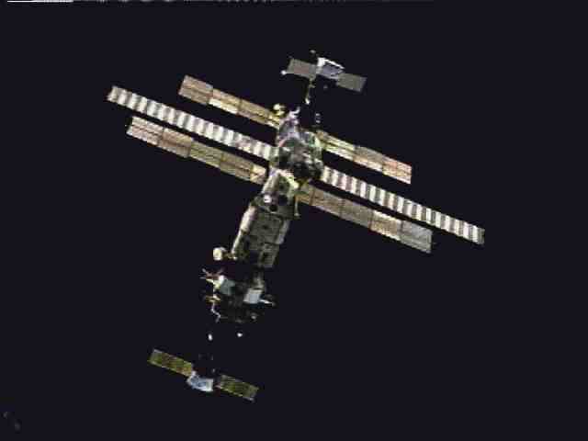
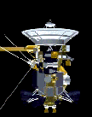

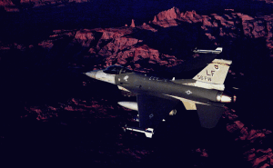

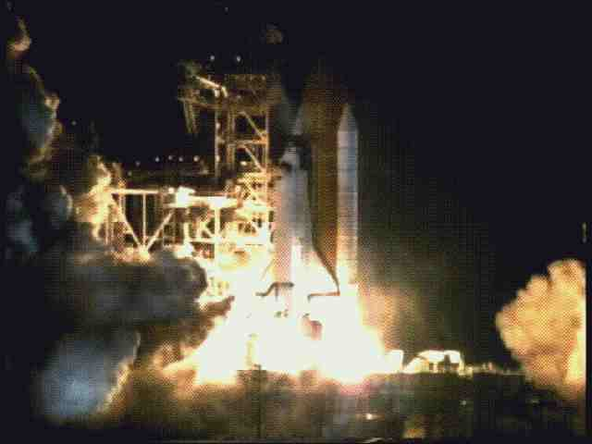
Original Focus: Mission-critical Systems
Building Timely, Predictable, Reliable Systems

Slide 8
Two Classical Challenges
Establish Functional Correctness: How to build functionally correct systems from possibly flawed components?
Establish Temporal Correctness: What are the analytic foundation for robust timing guarantees in highly dynamic, time-critical software systems?

Slide 9
Two Classical Challenges
Establish Functional Correctness: How to build functionally correct systems from possibly flawed components?
Establish Temporal Correctness: What are the analytic foundation for robust timing guarantees in highly dynamic, time-critical software systems?

Slide 10
Rate of Innovation and Development Time Issues
Near the turn of the 20th century products had a 20-30 year life-span before new “versions” were developed
At present, a product is obsolete in 2-3 years
  No time to discover and “debug” all possible problems
  New problems introduced in new versions
  Component reuse generates additional problems

Slide 11
Software: Increasingly the Primary Cause of System Failure
Arbitrary component interactions unconstrained by physical laws of nature (algorithms can do anything)
Fast error propagation (at computing device speed)
Software that interacts with the physical world is buggy!

Slide 12
Typical Isolation Techniques
Abstraction
Separation of concerns

Slide 13
Typical Isolation Techniques
Abstraction
Separation of concerns
Separate virtual machines or protection domains
Transport
Abstraction
Network
Kernel
Link
Physical
Virtualization

Slide 14
Abstraction → Solution?
Complexity
→ More levels of abstraction
→ Narrower specialization
→ More details are “abstracted away”
→ Myopic view. Less knowledge of
possible adverse interactions
→ More potential for interaction
or incompatibility errors

Slide 15

The Curse of Component Re-use
The Ariane 5 Explosion
On June 4, 1996, the maiden flight of the European Ariane 5 launcher crashed about 40 seconds after takeoff (0.5 Billion Dollars)

Slide 16
The Curse of Component Re-use
The Ariane 5 Explosion
On June 4, 1996, the maiden flight of the European Ariane 5 launcher crashed about 40 seconds after takeoff (0.5 Billion Dollars)
Cause of problem?
  An inertial reference software component.
    Not needed during flight. Should be stopped before takeoff but is allowed to operate for up to 50 additional seconds to avoid expensive restarts should countdown be interrupted
    Component was designed for Ariane 4. Ariane 5 was a faster system. Velocity variable overflowed.
    Overflow causes an exception that is not caught and crashes the software

Slide 17
Example 1: Interactive Complexity in Distributed Protocols
Interactive complexity means:
  Simple individually insignificant failures interact to compound into system failures, or even…
  Sets of correctly operating components interact to produce a system failure
    Example:
      Shortest hop routing
      Adaptive rate control

Slide 18
Example 1:
Shortest hop routing
  Find shorter path (fewer hops that are longer)
Long wireless hops → poor channel quality
Adaptive rate control
  Reduce transmission rate to improve quality
Reduced transmission rate
→ Has longer transmission range

Slide 19
Example 2:
Correlated failure modes between “independent components”
Localization (determining a node’s location) fails in a correlated manner with failure to synchronize clocks. Why?
  Note: None of the two components uses the other
Tracking
Localization
Clock synchronization

Slide 20
Example 2:
Correlated failure modes between “independent components”
Localization (determining a node’s location) fails in a correlated manner with failure to synchronize clocks. Why?
  Note: None of the two components uses the other
Answer: communication problems. Both subsystems rely on distributed protocols
Tracking
Poor performance is
Compounded by two
Correlated failures
Localization
Clock synchronization

Slide 21
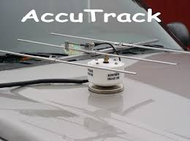
Example 3:
More on hidden interactions
Magnetic tracking system operates perfectly in calm weather but fails under strong wind conditions. Why?
  Wind should not change magnetic sensor reading

Slide 22
Example 3:
More on hidden interactions
Magnetic tracking system operates perfectly in calm weather but fails under strong wind conditions. Why?
  Wind should not change magnetic sensor reading
Explanation
  Wind caused node antenna to vibrate
  Moving (metal) antenna caused a lot of noise on the magnetic sensor
  Noise filter adapted noise threshold to remove background noise (and in this case the signal too)

Slide 23

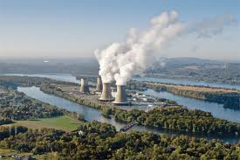
Example 4: Three Mile Island Nuclear Reactor Failure
March 28, 1979

Slide 24
Example 4: Three Mile Island Nuclear Reactor Failure
Core temperature and pressure
continue to build up
Coolant pressure relief valve opens to reduce pressure
Core overheating triggers emergency shutdown
Pressure drops. Valve is stuck open. Coolant boils off. Core temperature rises. Reaction resumes.
Valve failure indicator light turns on but is occluded by repair tag on another device
Core is flooded with water
Failure to open valves
Open emergency feed-water pumps from emergency tank to cool coolant
Water at very high temperature oxidizes metal fuel rod coating (rusting)
Heat exchange stops between primary and secondary cooling
Systems. Primary overheats.
Hydrogen is released and eventually leads to explosion
Stop secondary coolant flow and turbine
False alarm of minor secondary system coolant leakage through seal

Slide 25
Ensuring Software Correctness
The physical world has no “reset” button
  When failures occur, they can be costly!
Must reduce:
  Interactive complexity
    Unexpected interactions between seemingly correct components
  Coupling
    Fast propagation of effects of failure to other system components

Slide 26
Designing Complex Systems
(Example: Air-traffic control)
Reduce interactive complexity
  Air traffic is restricted to non-intersecting “corridors” that separate flight paths in the sky
Reduce coupling
  Separate aircraft by a substantial distance to reduce cascaded failure effects (think: multiple-car pile-ups in freeway accidents)

Slide 27
Interaction Examples
Function calls
Resource sharing
  One module crashes → overwrites memory of another → second “unrelated” module crashes (analogy to physical proximity and correlated damage)
  One module is overloaded → another starves
Timing and synchronization constraints
  Precedence constraints (one module must execute before another)
  Exclusion constraints (cannot operate at the same time)
Assumptions
  I thought you submitted our paper?
  No, I thought you did?

Slide 28
Question: How to Build Reliable Software?
Common approaches:
  Tracing, source level debugging
  Simulation/emulation
  Log and replay

Slide 29
Candidate Approach:
Formal Methods
Express safety properties (e.g., task A will never miss its deadline)
Prove that safety properties hold
  If proof fails, counter example is presented (a sequence of events that leads to failure)
Problem:
  Proofs require axioms. Axioms may make incorrect assumptions (e.g., circular sensing range)
  Interactions must be explicitly modeled. Failure to model interactions (e.g., between wind and magnetic sensor) may overlook some failure modes.

Slide 30
Living with Buggy Systems
If errors cannot be avoided (even using formal methods), we must design systems to tolerate them
  Architectures for “living with bugs”
  Fast diagnosis and recovery
  Issues
    Problem must be observable (or else cannot diagnose)
    Observation must be in time so that recovery is possible (observing that you forgot your parachute after you jump will not help you)

Slide 31
Simplicity to Conquer Complexity
Prof. Lui Sha UIUC
Elements of a good design
  Simple safety core
  Complex enhanced mission functionality
  Formal proof of core correctness
  Well formed dependency (core may use but will not depend on any other components)
Sha, Lui. "Using simplicity to control complexity." IEEE Software 18.4 (2001): 20-28.

Slide 32
Diagnosis:
A Development-Time Data Mining Example
Run system multiple times
Log all observable interactions (messages exchanged, resources allocated, etc)
Label execution as “correct” (no observable problems) or “incorrect” (problems observed)
Separate logs into “good” data set and “bad” data set
Look for sequences of events in the “good” pile but not the “bad” pile and vice versa

Slide 33
Two Classical Challenges
Establish Functional Correctness: How to build functionally correct systems from possibly flawed components?
Establish Temporal Correctness: What are the analytic foundation for robust timing guarantees in highly dynamic, time-critical software systems?

Slide 34
Real-Time
Overview
Real-time Tasks
Periodic Tasks
Aperiodic Tasks
Fixed-Priority
Dynamic-Priority
Deferrable
Polling
Sporadic
DPE
EDL
Slack Steal.
Priority Ex.
Sporadic
IPE
Total B.
TBS+
CBS
Deadline=Period
Deadline<Period
Rate Monotonic
EDF
Deadline Monotonic
EDF
Bounds
Optimality
Result
Bound
Optimality
Result
Bound
(Poor)
Per Task
Tests
Processor
Demand
Classical
Hyperbolic
Simple
Recursive

Slide 35
Real-Time Workload
Job (unit of work)
  a computation, a file read, a message transmission, etc
Attributes
  Resources required to make progress
  Timing parameters
Absolute deadline
Released
Execution time
Relative deadline

Slide 36
Real-Time Task
Task : a sequence of similar jobs
  Periodic task (p,e)
    Its jobs repeat regularly
    Period p = inter-release time (0 < p)
    Execution time e = maximum execution time (0 < e < p)
    Utilization U = e/p
0
5
10
15

Slide 37
Deadlines: Hard vs. Soft
Hard deadline
  Disastrous or very serious consequences may occur if the deadline is missed
  Validation is essential : can all the deadlines be met, even under worst-case scenario?
  Deterministic guarantees
Soft deadline
  Ideally, the deadline should be met for maximum performance. The performance degrades in case of deadline misses.
  Best effort approaches / statistical guarantees

Slide 38
Schedulability
Property indicating whether a real-time system (a set of real-time tasks) can meet their deadlines
(4,1)
(5,2)
(7,2)

Slide 39
Real-Time Scheduling
Determines the order of real-time task executions
Static-priority scheduling
Dynamic-priority scheduling
(4,1)
(5,2)
5
10
15
(7,2)
5
10
15

Slide 40
RM (Rate Monotonic)
Optimal static-priority scheduling
It assigns priority according to period
A task with a shorter period has a higher priority
Executes a job with the shortest period
T₁
(4,1)
T₂
(5,2)
5
10
15
T₃
(7,2)
5
10
15

Slide 41
RM (Rate Monotonic)
Executes a job with the shortest period
T₁
(4,1)
T₂
(5,2)
5
10
15
T₃
(7,2)
5
10
15

Slide 42
RM (Rate Monotonic)
Executes a job with the shortest period
Deadline Miss !
T₁
(4,1)
T₂
(5,2)
5
10
15
T₃
(7,2)
5
10
15

Slide 43
Response Time
Response time
  Duration from released time to finish time
T₁
(4,1)
T₂
(5,2)
5
10
15
T₃
(10,2)
5
10
15

Slide 44
Response Time
Response time
  Duration from released time to finish time
Response Time
T₁
(4,1)
T₂
(5,2)
5
10
15
T₃
(10,2)
5
10
15

Slide 45
Response Time
Response Time (r_{i}) [Audsley et al., 1993]
HP(T_{i}) : a set of higher-priority tasks than T_{i}
T₁
(4,1)
T₂
(5,2)
5
10
T₃
(10,2)
5
10

Slide 46
RM - Schedulability Analysis
Real-time system is schedulable under RM
if and only if r_{i} ≤ p_{i} for all task T_{i}(p_{i},e_{i})
Joseph & Pandya,
“Finding response times in a real-time system”,
The Computer Journal, 1986.

Slide 47
RM – Utilization Bound
Real-time system is schedulable under RM if
∑U_{i} ≤ n (2^{1/n}-1)
Liu & Layland,
“Scheduling algorithms for multi-programming in a hard-real-time environment”, Journal of ACM, 1973.

Slide 48
RM – Utilization Bound
Real-time system is schedulable under RM if
∑U_{i} ≤ n (2^{1/n}-1)
Example: T₁(4,1), T₂(5,1), T₃(10,1),
∑U_{i} = 1/4 + 1/5 + 1/10
= 0.55
3 (2^{1/3}-1) ≈ 0.78
Thus, {T₁, T₂, T₃} is schedulable under RM.

Slide 49
RM – Utilization Bound
Real-time system is schedulable under RM if ∑U_{i} ≤ n (2^{1/n}-1)
Example: T₁(4,1), T₂(5,2), T₃(7,2),
∑U_{i} = 1/4 + 2/5 + 2/7
≈ 0.94
3 (2^{1/3}-1) ≈ 0.78
Thus, {T₁, T₂, T₃} is NOT schedulable under RM.

Slide 50
RM – Utilization Bound
Real-time system is schedulable under RM if
∑U_{i} ≤ n (2^{1/n}-1)
Example: T₁(4,1), T₂(5,2), T₃(10,2),
∑U_{i} = 1/4 + 2/5 + 2/10
= 0.85
3 (2^{1/3}-1) ≈ 0.78
However, {T₁, T₂, T₃} is still schedulable under RM (as we just showed) even their total utilization is higher than the bound!

Slide 51
RM – Utilization Bound
Real-time system is schedulable under RM if (but not only if) ∑U_{i} ≤ n (2^{1/n}-1)
The above condition is only a sufficient but not necessary condition!
  We only know tasks with utilization lower than the bound is guaranteed to be schedulable under RM.
  We know nothing about tasks with higher utilization!

Slide 52
RM – Utilization Bound
Real-time system is schedulable under RM if
∑U_{i} ≤ n (2^{1/n}-1)

Slide 53
EDF (Earliest Deadline First)
Optimal dynamic priority scheduling
A task with a shorter deadline has a higher priority
Executes a job with the earliest deadline
T₁
(4,1)
T₂
(5,2)
5
10
15
T₃
(7,2)
5
10
15

Slide 54
EDF (Earliest Deadline First)
Executes a job with the earliest deadline
T₁
(4,1)
T₂
(5,2)
5
10
15
T₃
(7,2)
5
10
15

Slide 55
EDF (Earliest Deadline First)
Executes a job with the earliest deadline
T₁
(4,1)
T₂
(5,2)
5
10
15
T₃
(7,2)
5
10
15

Slide 56
EDF (Earliest Deadline First)
Executes a job with the earliest deadline
T₁
(4,1)
T₂
(5,2)
5
10
15
T₃
(7,2)
5
10
15

Slide 57
EDF (Earliest Deadline First)
Optimal scheduling algorithm
  if there is a schedule for a set of real-time tasks,
  EDF can schedule it.
T₁
(4,1)
T₂
(5,2)
5
10
15
T₃
(7,2)
5
10
15

Slide 58
EDF – Utilization Bound
Real-time system is schedulable under EDF if and only if
∑U_{i} ≤ 1
Liu & Layland,
“Scheduling algorithms for multi-programming in a hard-real-time environment”, Journal of ACM, 1973.

Slide 59
EDF – Overload Conditions
Domino effect during overload conditions
  Example: T₁(4,3), T₂(5,3), T₃(6,3), T₄(7,3)
Deadline Miss !
T₁
T₂
T₃
T₄
0
3
5
6
7
Better schedules :
T₁
T₃
T₁
T₄
0
3
5
6
7
0
3
5
6
7

Slide 60
RM vs. EDF
Rate Monotonic
  Simpler implementation, even in systems without explicit support for timing constraints (periods, deadlines)
  Predictability for the highest priority tasks
EDF
  Full processor utilization
  Misbehavior during overload conditions
For more details: Buttazzo, “Rate monotonic vs. EDF: Judgement Day”, EMSOFT 2003.

Slide 61
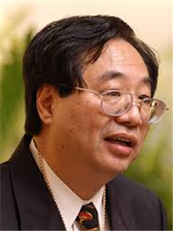
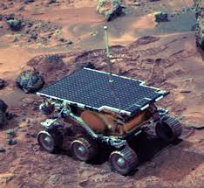
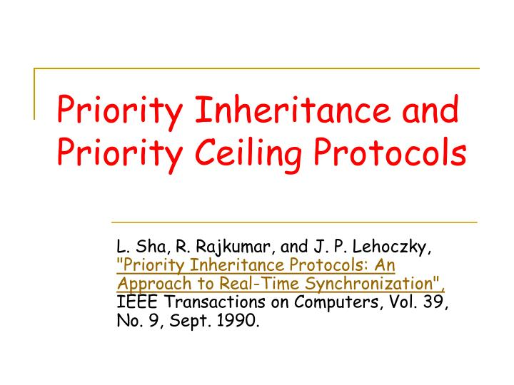
Real-world Example: What Happens on Mars?
Prof. Lui Sha, CS, UIUC
http://research.microsoft.com/en-us/um/people/mbj/Mars_Pathfinder/Mars_Pathfinder.html

Slide 62
The Problem
Tasks have synchronization constraints
  Semaphores protect critical sections
Blocking can cause a higher-priority task to wait on an lower-priority one to unlock the resource
  Problem: In all previous scheduling examples, we assumed that a task can only wait for higher priority tasks not lower-priority tasks

Slide 63
Mutual Exclusion Constraints
Tasks that lock/unlock the same semaphore are said to have a mutual exclusion constraint
Lock S
Unlock S
Task 1
Critical Sections (Mutually exclusive)
Task 2
Lock S
Unlock S

Slide 64
Priority Inversion
Locks and priorities may be at odds. Locking results in priority inversion.
High-priority Task
Lock S
Preempt
Low-priority Task

Slide 65
Priority Inversion
Locks and priorities may be at odds. Locking results in priority inversion.
Attempt to Lock S but results in blocking
High-priority Task
Lock S
Preempt
Priority Inversion
Low-priority Task

Slide 66
Priority Inversion
How to account for priority inversion?
Attempt to Lock S but results in blocking
High-priority Task
Lock S
Unlock S
Lock S
Preempt
Priority Inversion
Low-priority Task
Unlock S

Slide 67
Priority Inversion
What is the problem of this scheme? Can the high-priority task gets delayed unboundedly?
Attempt to Lock S but results in blocking
High-priority Task
Lock S
Unlock S
Lock S
Preempt
Priority Inversion
Low-priority Task
Unlock S

Slide 68
Unbounded Priority Inversion
Consider the following: a series of intermediate priority tasks is delaying a higher-priority one
Attempt to Lock S but results in blocking
High-priority Task
Unbounded priority inversion
Preempt
…..
Intermediate-priority Task
Lock S
Preempt
Low-priority Task
Unlock S

Slide 69
Unbounded Priority Inversion
Consider the following: a series of intermediate priority tasks is delaying a higher-priority one
Attempt to Lock S but results in blocking
The root cause of the Mars Pathfinder restarting problem!
High-priority Task
Unbounded priority inversion
Preempt
…..
Intermediate-priority Task
Lock S
Preempt
Low-priority Task
Unlock S

Slide 70
Unbounded Priority Inversion
How to prevent unbounded priority inversion?
Attempt to Lock S but results in blocking
High-priority Task
Unbounded priority inversion
Preempt
…..
Intermediate-priority Task
Lock S
Preempt
Low-priority Task
Unlock S

Slide 71
Priority Inheritance Protocol
Let a task inherit the priority of any higher priority task it is blocking
Attempt to Lock S but results in blocking
High-priority Task
Preempt
Intermediate-priority Task
Lock S
Priority Inherit
Low-priority Task
Unlock S

Slide 72
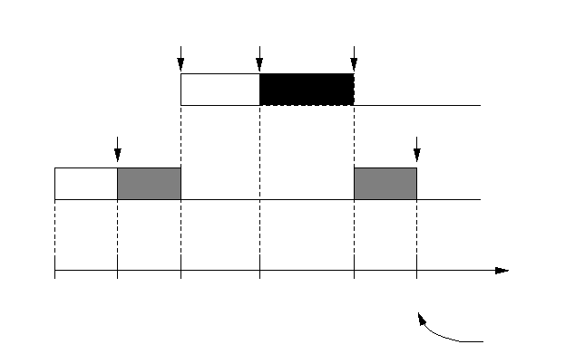
Deadlocks in PIP
J₁ = {..., P(S₂) ..., P(S₁),...,V(S₁) ...,V(S₂),...}
J₂ = {..., P(S₁) ..., P(S₂),...,V(S₂) ...,V(S₁),...}
crossing nested semaphores
(try to lock S1)
blocked by J2
preempt J2
lock S2
lock S1
(try to lock S2)
blocked by J1
deadlock!
time

Slide 73
Blocking Chains in PIP
J₁ = {..., P(S₁), ..., V(S₁), ..., P(S₂), ..., V(S₂), ...}
J₂ = {..., P(S₂) , ..., V(S₂), ...}
J₃ = {..., P(S₁) , ..., V(S₁), ...}
(attempt to lock S2)
blocked by J2
(attempt to lock S1)
blocked by J3
unlock
S1
unlock S2
complete
lock
S1
lock
S2
preempt J3
complete
lock
S2
unlock
S2
complete
lock
S1
unlock
S1
time
t0
t1
t2
t3
t4
t5
t6
t7
t8
t9
t10
t11
t12
t13

Slide 74
Priority Ceiling Protocol (PCP)
Goals:
  Solve problems of PIP.
    Prevent deadlocks and blocking chains
Basic idea:
  Priority ceiling of a semaphore:
    The priority of the highest priority task that may use the semaphore
  Additional condition for allowing a job J to start a new critical section
    only if J’s priority is higher than all priority ceilings of all the semaphores locked by jobs other than J .
Notes:
The key thing of priority ceiling is to make sure nobody is using the thing you will use in your job execution. In other words, make sure the job has every semaphore it needs (not used by anyone) to finish its execution.

Slide 75
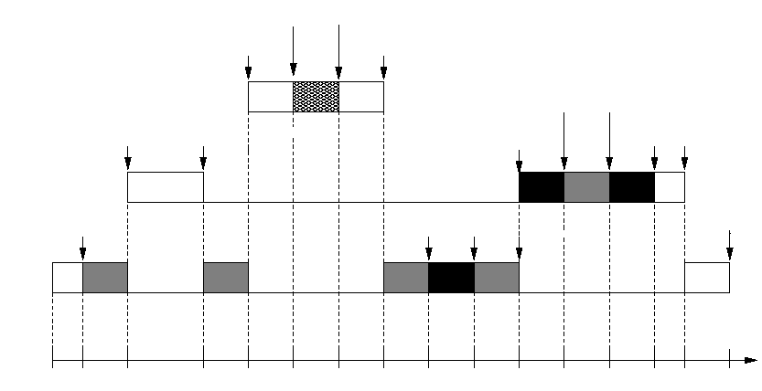
Examples for PCP (1/2)
Prevent deadlocks
J₁ = {..., P(S₀) ..., V(S₀),...}
J₂ = {..., P(S₁) ..., P(S₂),...,V(S₂) ...,V(S₁),...}
J₃ = {..., P(S₂) ..., P(S₁),...,V(S₁) ...,V(S₂),...}
Ceiling(S0)= H
Ceiling(S1)= M
Ceiling(S2)= M
nested crossing semaphores
lock S0
unlock S0
preempt J3
complete
lock S2
unlock S2
preempt J3
(attempt to lock S1)
blocked by J3
lock S1
unlock S1
complete
lock S2
unlock S1
lock S1
unlock S2
complete
time

Slide 76
Real-Time
Overview
Real-time Tasks
Periodic Tasks
Aperiodic Tasks
Fixed-Priority
Dynamic-Priority
Deferrable
Polling
Sporadic
DPE
EDL
Slack Steal.
Priority Ex.
Sporadic
IPE
Total B.
TBS+
CBS
Deadline=Period
Deadline<Period
Rate Monotonic
EDF
Deadline Monotonic
EDF
Bounds
Optimality
Result
Bound
Optimality
Result
Bound
(Poor)
Per Task
Tests
Processor
Demand
Classical
Hyperbolic
Simple
Recursive

Slide 77
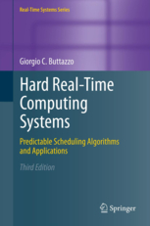
Further Reading
Buttazzo, Giorgio C. Hard real-time computing systems: predictable scheduling algorithms and applications. Vol. 24. Springer, 2011.

Slide 78
Open Cyber-Physical Systems
Safety-critical
Non Real-time
Hard Real-time
Non-critical

Slide 79
Open Cyber-Physical Systems
Most
Embedded
Systems
Research
Safety-critical
Model checking
Formal verification
Worst-case analysis
Certification
Non Real-time
Hard Real-time
Non-critical

Slide 80
Open Cyber-Physical Systems
Most
Embedded
Systems
Research
Safety-critical
A Proliferation
of Networked Open
Cyber-physical Systems
Model checking
Formal verification
Worst-case analysis
Certification
Non Real-time
Hard Real-time
Non-critical

Slide 81
Open Cyber-Physical Systems
Most
Embedded
Systems
Research
Safety-critical
Challenges?
A Proliferation
of Networked Open
Cyber-physical Systems
Non Real-time
Hard Real-time
Non-critical

Slide 82
Open Cyber-Physical Systems
Most
Embedded
Systems
Research
Safety-critical
Challenges?
A Proliferation
of Networked Open
Cyber-physical Systems
- Data reliability
- Large scale
- Distributed ownership
- Imprecise/Incomplete models
Non Real-time
Hard Real-time
Non-critical

Slide 83
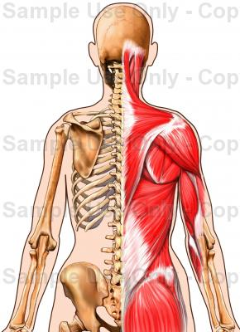
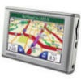

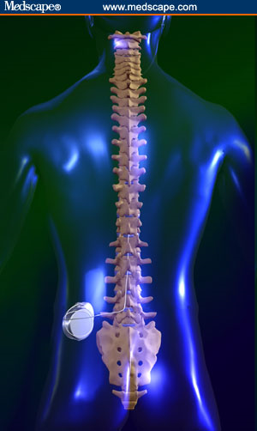





Personalized Healthcare
Medical care
services
Sanitized
Community
Data
Community/Social
Network
Care Providers,
Physicians
Social
Factors
Comparative
Analysis
Context Factors,
Bio-feedback
Personal Data
Services
Logging
Logging
Direct
Control
Smart Tattoos
Bio-loops
Biometric
Sensing
Implantable
Medical Devices, Biosensors
Biological
System
Wearable and Ambient Sensors: Opportunistic Context Measurement
Context and
Activity Sensing,
NEAT-factor, etc.

Slide 84

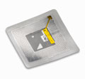
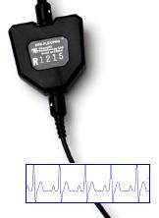
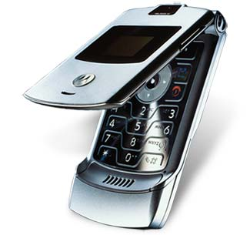
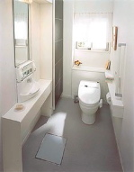
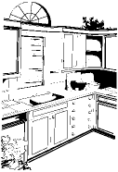


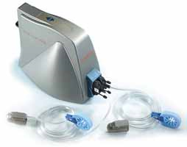
Body-Area Networks
Point of Care
Devices
Micro- and Nano-sensors, Biochips
Bio-feedback Sensors
Implanted Sensors
Insulin pumps, pacemakers, glucose monitors, …
Wearable Activity
and Biometric Monitoring
Transparent
Testing
Smart Spaces

Slide 85
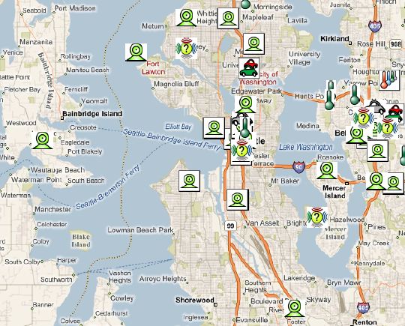
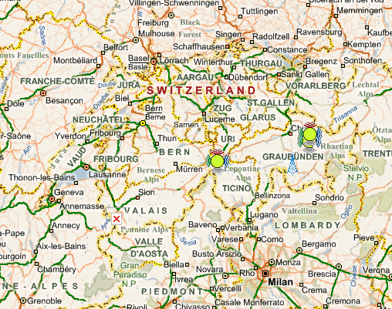
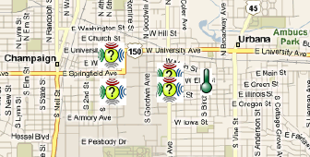
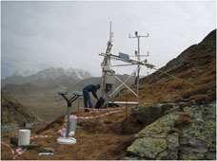
Crowd-sensing
Browsing the Physical World
Feng Zhao http://research.microsoft.com/en-us/projects/senseweb/

Slide 86



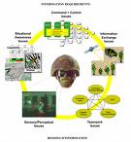

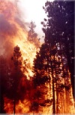





Military Situation Awareness Applications
Prioritized
Situation-awareness
Information Network
Information
High QoI,
Quantifiable uncertainty
Optimize resource allocation
Extract objects and linkages
Extract objects and linkages
Signal data
Social networks
Human data
Feedback
to sensor and communication networks
Visual data
Sensors, witnesses, sources, …
Notes:
86
86
86

Slide 87
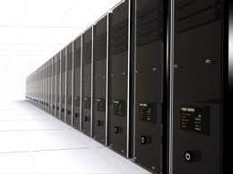
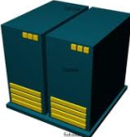
An Architecture for Open CPS
Critical Services

Slide 88
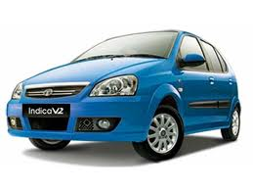
An Architecture for Open CPS
Mobiles
Critical Services

Slide 89
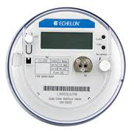



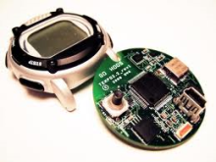
An Architecture for Open CPS
Mobiles
Critical Services
Sensors

Slide 90
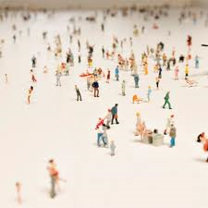
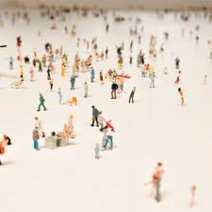
An Architecture for Open CPS
Mobiles
Critical Services
People
Sensors

Slide 91
Publication Venues
Cyber-physical systems
  International conference on cyber-physical systems (ICCPS)
  CPSWeek (http://www.cpsweek.org)
Real-time systems
  IEEE Real-time systems symposium (IEEE RTSS)
  IEEE Real-time applications symposium (IEEE RTAS)
  Springer Journal on Real-time Systems
Embedded systems
  International conference on embedded software (EmSoft)
  ACM Transactions on Embedded Computing Systems (ACM TECS)
Networked sensing
  ACM Sensys (http://sensys.acm.org/2014/index.html)
  ACM/IEEE IPSN (http://ipsn.acm.org/2015/)
  ACM Transactions on Sensor Networks (ACM ToSN)

Slide 92
Publication Venues (Cont.)
Data Analytics, Mining and Processing
  ACM KDD Conference on Knowledge Discovery and Data Mining (http://www.kdd.org/kdd2015/)
  IEEE International Conference on Data Mining (ICDE) (http://icdm2014.sfu.ca/home.html)
  ACM International Conference on Web Search and Data Mining (http://www.wsdm-conference.org/2015/)
  International World Wide Web Conference (WWW) (http://www.www2015.it/ )
  IEEE Transactions on Knowledge and Data Engineering (TKDE) (http://www.computer.org/portal/web/tkde)

Slide 93
Education Venues
Nano-Tera/Artist Summer School on Embedded System Design
  http://artist-summer-school.epfl.ch/
Georgia Tech Summer School on Cyber Physical Systems
  http://users.ece.gatech.edu/~magnus/CPSschool.html

Slide 94
The CPS Research Landscape
(An Incomplete List, Alphabetic)
Berkeley (architecture, control, automotive, sensor networks, …):
  http://chess.eecs.berkeley.edu/
CMU (real-time, automotive, …):
  http://users.ece.cmu.edu/~raj/
Notre Dame (social sensing, CPS in social space)
  http://www3.nd.edu/~dwang5/
UIUC (avionics, human-centric, medical, …)
  http://publish.illinois.edu/cpsintegrationlab/
U. of Pennsylvania (composability, medical, …)
  http://precise.seas.upenn.edu/
University of Virginia (sensor networks, real-time, …)
  http://www.cs.virginia.edu/~stankovic/rts.html
Vanderbilt (composition, control, …)
  http://www.isis.vanderbilt.edu/research/NES

Slide 95
Pointers and Readings
"Opportunities and Obligations for Physical Computing Systems", Computer, Volume 38, Issue 11, November 2005, pages 23-31. (Report produced by a Workshop at the IEEE Real-Time Systems Symposium, December 2003).
http://repository.upenn.edu/cis_papers/222/
"High Confidence Medical Device Software and Systems (HCMDSS)" Workshop, June 2 - 3, 2005, Philadelphia, PA.
http://rtg.cis.upenn.edu/hcmdss/index.php3
National Workshop on "Aviation Software Systems: Design for Certifiably Dependable Systems", October 5-6, 2006, Alexandria, TX
http://chess.eecs.berkeley.edu/hcssas/index.html
NSF Workshop on "Cyber-Physical Systems", October 16-17, 2006, Austin, TX.
http://varma.ece.cmu.edu/CPS
National Workshop on "High-Confidence Software Platforms for Cyber-Physical Systems (HCSP-CPS)", November 30 - December 1, 2006, Alexandria, VA.
http://www.isis.vanderbilt.edu/HCSP-CPS/

Slide 96
Pointers and Readings
"Joint Workshop On High-Confidence Medical Devices, Software, and Systems (HCMDSS) and Medical Device Plug-and-Play (MD PnP) Interoperability", June 25-27, 2007, Boston, MA.
http://rtg.cis.upenn.edu/hcmdss07/index.php3
National Workshop on "Composable and Systems Technologies for High-Confidence Cyber-Physical Systems", July 9-10, 2007, Arlington, VA.
http://www.isis.vanderbilt.edu/CST-HCCPS/
National Workshop on "High-Confidence Automotive Cyber-Physical Systems", Apr 3-4, 2008, Troy, MI.
http://varma.ece.cmu.edu/Auto-CPS/
CPSWeek, 2008-present
http://www.cpsweek.org/
CPS Summit, April 25, 2008, St. Louis, MO, USA.
http://varma.ece.cmu.edu/Summit
National Workshop on "Research on Transportation Cyber-Physical Systems: Automotive, Aviation, and Rail", November 18-20, 2008, Washington, DC (USA).
http://www.ee.washington.edu/research/nsl/aar-cps

