Slide 1
Data Reliability II:
A Fundamental Challenge in Social Sensing
With Humans as Sensors
CSE 40437/60437-Spring 2015
Prof. Dong Wang

Slide 2


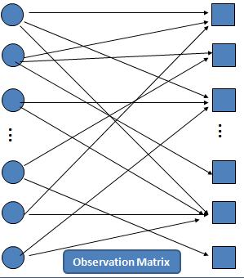


Last Lecture: Humans as Sensors
Expectation Maximization
Z={z₁, z₂, …z_{N}} where z_{j} =1 when claim C_{j} is true and 0 otherwise
Observation Matrix
Estimation parameter
Observed data
Hidden Variable
X
- Expectation Step (E-step)
- Maximization Step (M-step)
Find MLE of estimation parameter and values of hidden variables

Slide 3
Related Work on Data Reliability in Social Sensing
SECON 12, JSAC 13
Conflicting Variables ⁵
ACM ToSN 13
IPSN 14
ICDCS 13
IPSN 12
RTSS 13
Accuracy
Bounds ^{2,3}
Humans Sensors⁷
Streaming
Data ⁴
Basic Model ¹
Variable Constraints ⁶
1. Dong Wang, Lance Kaplan, Hieu Le, and Tarek Abdelzaher. "On Truth Discovery in Social Sensing: A Maximum Likelihood Estimation Approach." The 11th ACM/IEEE Conference on Information Processing in Sensor Networks (IPSN 12). Beijing, China April 2012.
2. Dong Wang , Lance Kaplan, Tarek Abdelzaher and Charu C. Aggarwal. "On Scalability and Robustness Limitations of Real and Asymptotic Confidence Bounds in Social Sensing." The 9th Annual IEEE Communications Society Conference on Sensor, Mesh and Ad Hoc Communications and Networks (SECON 12), Seoul, Korea, June, 2012.
3. Dong Wang, Lance Kaplan, Tarek Abdelzaher and Charu C. Aggarwal. "On Credibility Tradeoffs in Assured Social Sensing." IEEE JSAC special issue on Network Science, June, Vol. 31, No. 6, 2013.
4. Dong Wang, Tarek Abdelzaher, Lance Kaplan and Charu C. Aggarwal. "Recursive Fact-finding: A Streaming Approach to Truth Estimation in Crowdsourcing Applications.", 33rd International Conference on Distributed Computing Systems (ICDCS 13) Philadelphia, PA, July 2013.
5. Dong Wang, Lance Kaplan and Tarek Abdelzaher. "On Truth Discovery in Social Sensing with Conflicting Observations: A Maximum Likelihood Estimation Approach.” ACM Transaction on Sensor Network s (TOSN), in press, 2013
6. Dong Wang, Tarek Abdelzaher, Lance Kaplan and Raghu Ganti. "Exploitation of Physical Constraints for Reliable Social Sensing," IEEE 34th Real-Time Systems Symposium (RTSS'13) Vancouver, Canada, December, 2013.
7. Dong Wang , Tanvir Amin, Shen Li, Tarek Abdelzaher, Lance Kaplan, Siyu Gu, Chenji Pan, Hengchang Liu, Charu Aggrawal, Raghu Ganti, XinLei Wang, Prasant Mohapatra, Boleslaw Szymanski, Hieu Le, "Humans as Sensors: An Estimation Theoretic Perspective," The 13th ACM/IEEE International Conference on Information Processing in Sensor Networks (IPSN 14), Berlin, Germany, April, 2014.
Notes:
If you are interested in working reliable sensing problem, here are some related work on this problem for your reference.

Slide 4
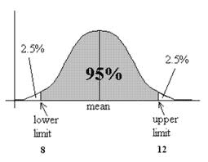
Estimation Accuracy of MLE from EM?
Expectation Maximization
S₁
C₁
Maximum Likelihood Estimation
S₂
C₂
Participant Reliability
Claim Correctness
S₃
C₃
Error Bound?
…
…
S_{i}
C_{j}
S_{i+1}
C_{j+1}
S_{M}
Observation Matrix
C_{N}

Slide 5
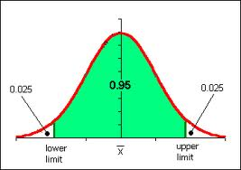
Establishing Estimation Confidence
Goal: Identify Confidence Interval of Source Reliability Estimation from MLE

Slide 6
Establishing Estimation Confidence
Fisher Information
Cramer-Rao Lower Bound

Slide 7
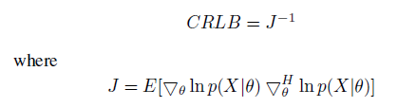
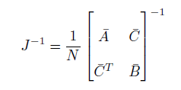
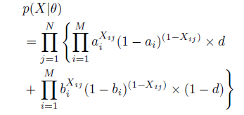
Establishing Estimation Confidence
Deriving the Cramer-Rao Lower Bound
Cramer-Rao Lower Bound (CRLB)

Slide 8

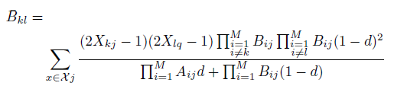

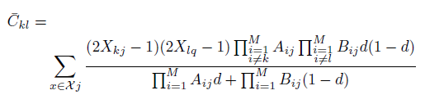
Real Cramer-Rao Lower Bound Derivation
Confidence Interval of Participant Reliability
Can be computed numerically and computation is exponential w.r.t to number of participants

Slide 9
Asymptotic Cramer-Rao Lower Bound Derivation
Confidence Interval of Participant Reliability
Assume truthfulness of each variable is estimated correctly from EM.
Confidence bound remains to be asymptotic

Slide 10
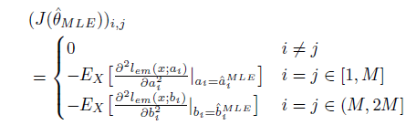
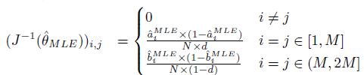
Asymptotic Cramer-Rao Lower Bound Derivation
Confidence Interval of Participant Reliability

Slide 11
Establishing Estimation Confidence
Maximum Likelihood Property
Asymptotic Normality
CRLB
Confidence Interval of Source S_{i}
c_{p} is the standard score of confidence level p

Slide 12
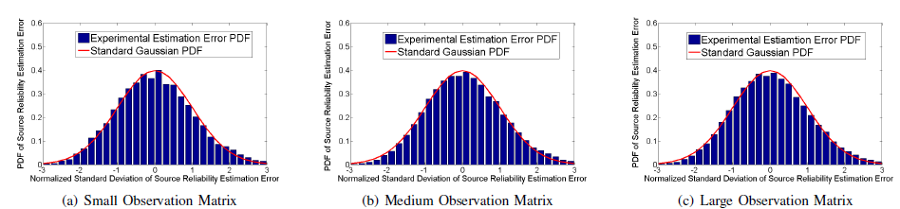
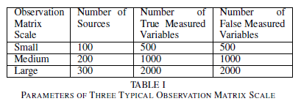
Asymptotic Normality Evaluation
Confidence Interval of Participant Reliability
PDF of Participant Reliability Estimation Error
PDF of experiment matched the Standard Gaussian Distribution well

Slide 13
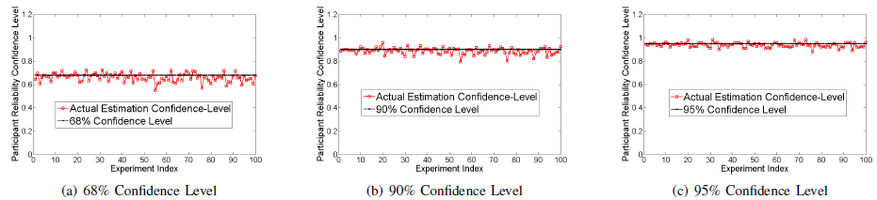
Estimation Confidence Evaluation
Confidence Interval of Participant Reliability
Estimation Confidence on Participant Reliability on small observation matrix scale
95%
90%
68%
Estimation confidence stays around the correct confidence level-small scale
Parameters:
Number of Participants: 100
Number of True Assertions: 500
Number of False Assertions: 500
Average Number of Claims per Participant: 100

Slide 14
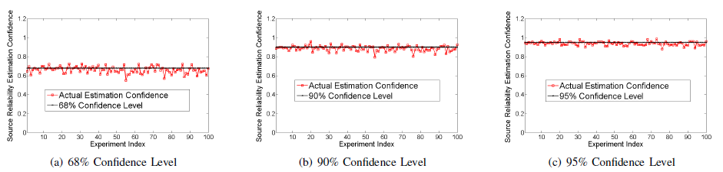
Estimation Confidence Evaluation
Confidence Interval of Participant Reliability
Estimation Confidence on Participant Reliability on medium observation matrix scale
Estimation confidence stays around the correct confidence level-medium scale
Parameters:
Number of Participants: 200
Number of True Assertions: 1000
Number of False Assertions: 1000
Average Number of Claims per Participant: 100

Slide 15
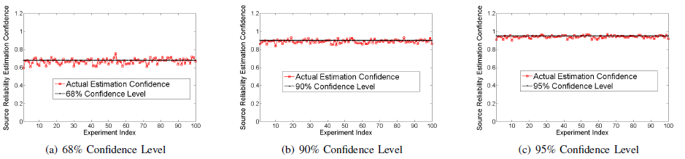
Estimation Confidence Evaluation
Confidence Interval of Participant Reliability
Estimation Confidence on Participant Reliability on large observation matrix scale
Estimation confidence stays around the correct confidence level-large scale
Parameters:
Number of Participants: 300
Number of True Assertions: 2000
Number of False Assertions: 2000
Average Number of Claims per Participant: 100

Slide 16
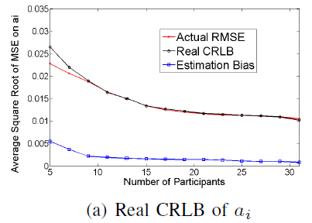
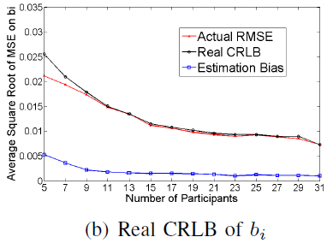
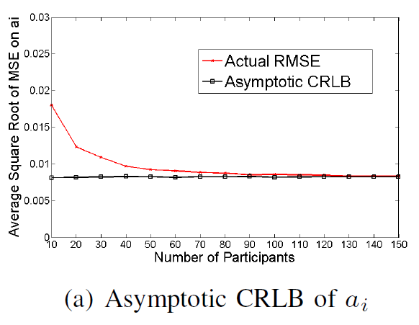
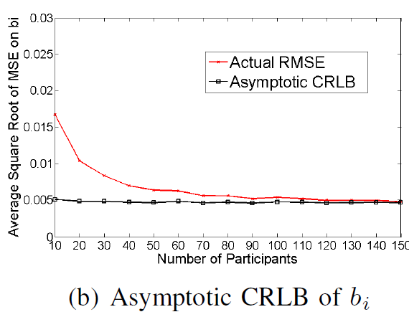
Scalability of CRLB
CRLB on Estimation Parameters versus Varying Number of Participants

Slide 17
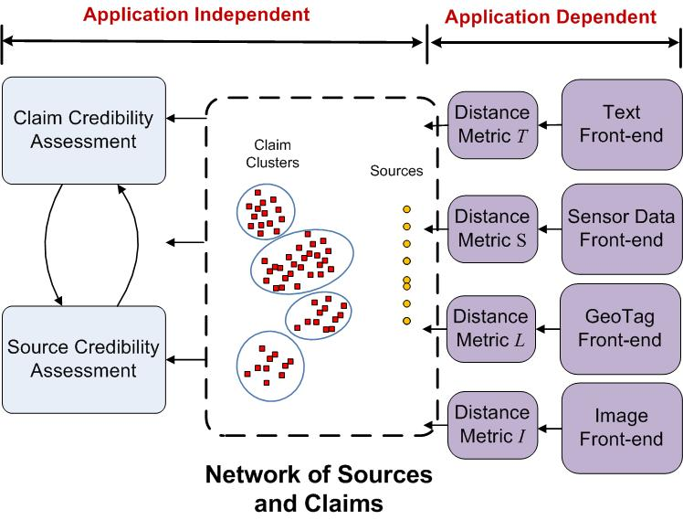
The Apollo Fact-finder
Evaluation using Crowdsensing
What to believe?
Assured Information Distillation
Who to believe?
Application:
Crowdsensing from GPS Data

Slide 18
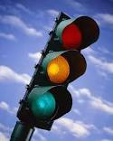
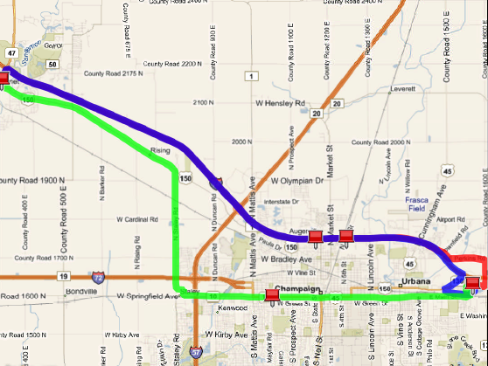
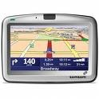

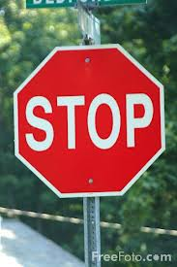
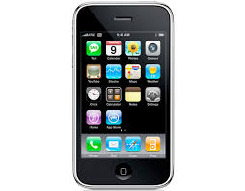
Crowdsensing Application Case Study: Traffic Regulator Mapping from GPS Data

Slide 19
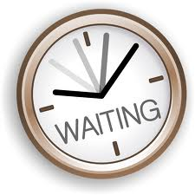
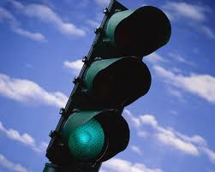
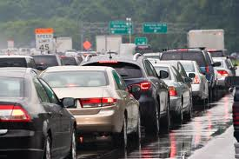
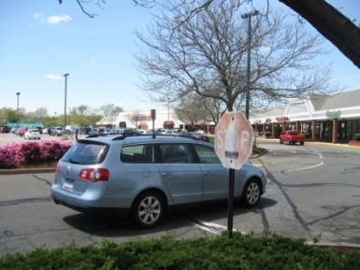
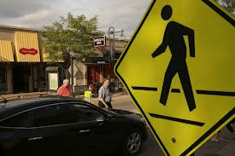
Method: Intentionally Simple “Sensors”
Claim Traffic Light
15-90 s Stop
2-10 s Stop
Claim Stop Sign
Unreliable “Sensors”!

Slide 20
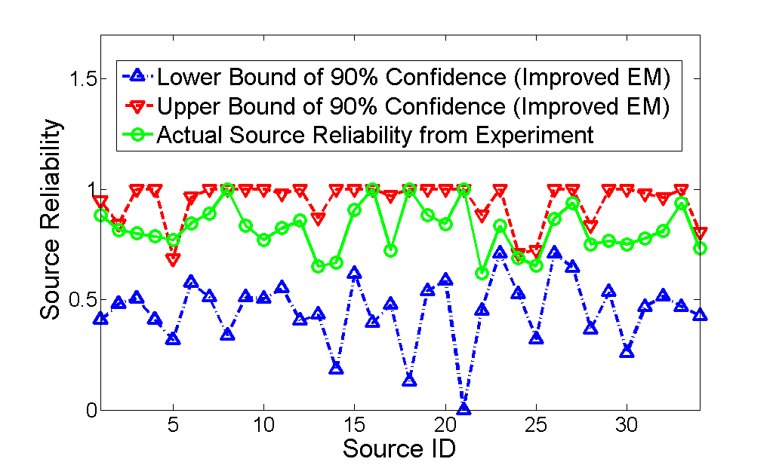
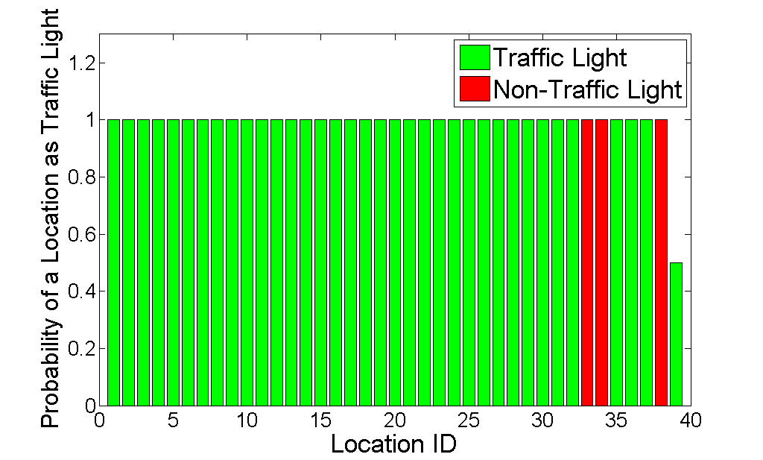
Traffic Regulator Mapping From
GPS Data
1 outlier out of 34
Source Reliability Estimation
Traffic Light Location Detection
Experiment setup:
34 drivers, 300 hours of driving in Urbana-Champaign
1,048,572 GPS readings, 4865 claims generated by phone (3033 for stop signs, 1562 for traffic lights)

Slide 21
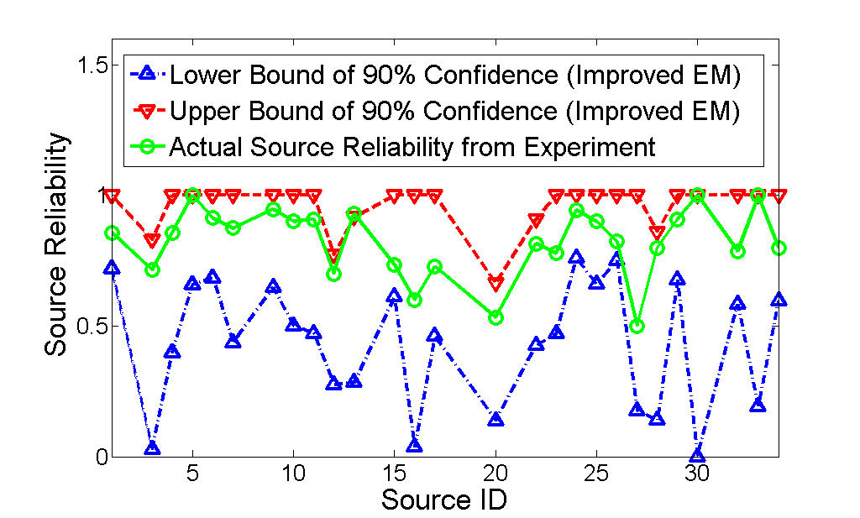
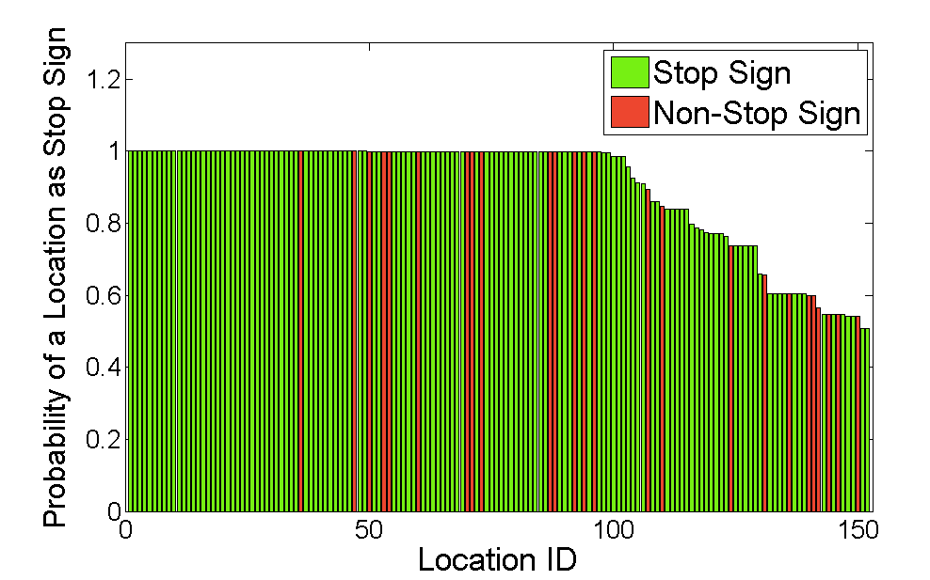
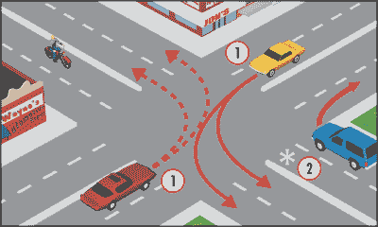
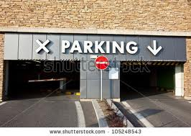

Traffic Regulator Mapping From
GPS Data
Source Reliability Estimation
Stop Sign Location Detection

Slide 22
Surrogate Sensing
Can we use simple sensors (e.g., on our phones) to sense much more complex concepts?
Examples:
  Detect free parking spots
  Find popular places in a city
  Predict bus arrival time
  Monitor noise and urban environments

Slide 23
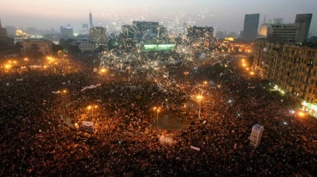
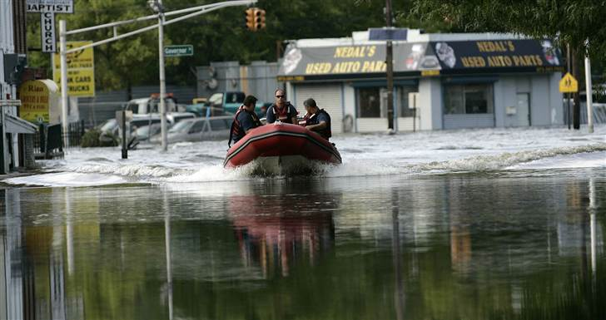


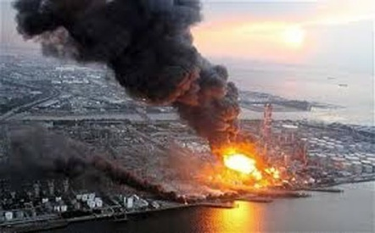
Incorporate Prior Knowledge
Opportunity to Observe
Some sources may not have the opportunity to observe some variables
Measured Variables
Sources
Events
Egypt Unrest
…
OR
Hurricane Irene
Attribute:
Credibility
Attribute:
True/False
Fukushima

Slide 24

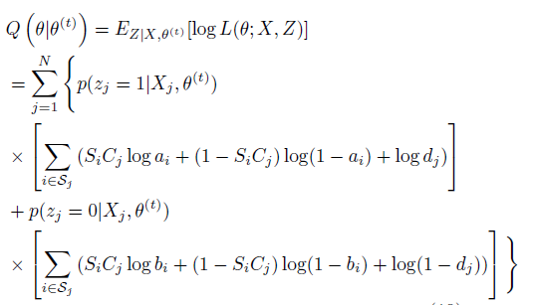



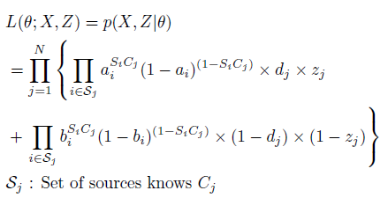
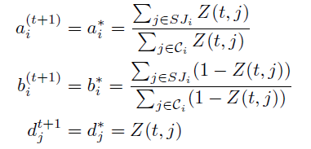
Impact of the Opportunity to Observe
Basic Definitions
Expectation Step (E-Step)
Rebuilt Likelihood Function
Maximization Step (M-Step)

Slide 25
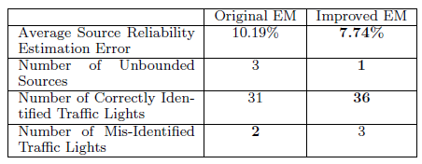
Traffic Regulator Detection
(Enhanced)

Slide 26
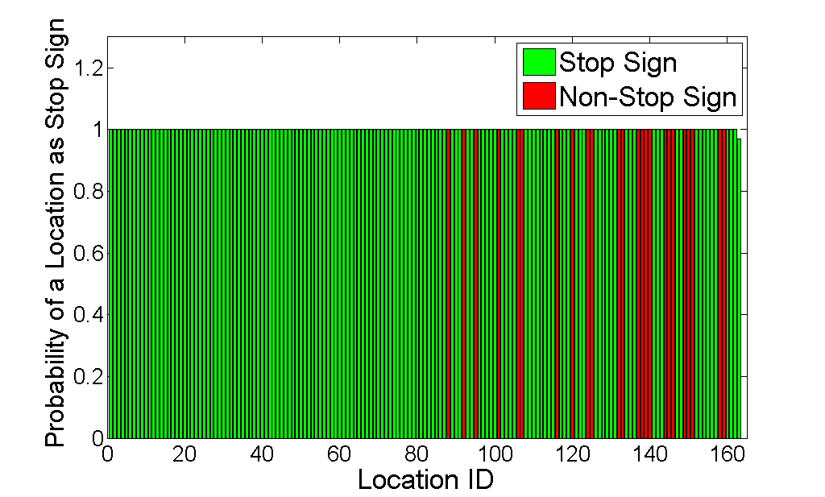
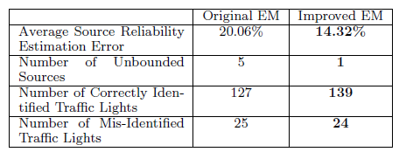
Traffic Regulator Detection
(Enhanced)

Slide 27


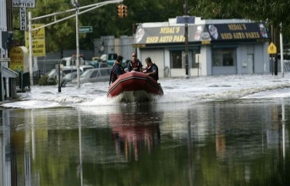
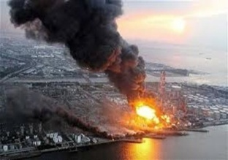
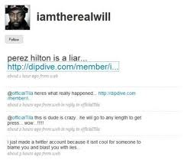
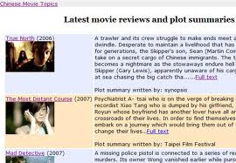
Relations between Variables
Measured Variables
Variables are not independent !
Some variables are contradictory and cannot be true at the same time
Sources
Events
Conflicting Product Reviews
Egypt Unrest
…
Conflicting Tweets
Conflicting Movie Comments
Hurricane Irene
Attribute:
Reliability
Fukushima
Attribute:
True/False
D. Wang, etc, ACM ToSN 14

Slide 28
MLE with Conflicting Variables
Y
Positive Observations
N
Expectation Maximization
Negative Observations
Maximum Likelihood Estimation
…
Source Reliability
Measured Variable Correctness
…
Hypothesis that is mostly
consistent with observations

Slide 29
MLE with Conflicting Variables
Basic Definition
True Measured Variables
Y
Y_{i}
N
Reliability of Participant i
N
Y_{i}
Y_{i}
False Measured Variables
Y
Y: Positive Observation
Y
N_{i}
Y
N_{i}
N_{i}
N: Negative Observation
N
N
Y
N
Y
Y

Slide 30

MLE with Conflicting Variables
Basic Definition
Y
True Measured Variables
Y_{i}
Y_{i}
N
Positive Speak Rate of Participant i
N
All
All
False Measured Variables
Y
Y
Y: Positive Observation
Y
N: Negative Observation
N
Negative Speak Rate of Participant i
N_{i}
N_{i}
N
Y
All
All
N
Y
Y

Slide 31
MLE with Conflicting Variables
Basic Definition
True Measured Variables
False Measured Variables
Y: Positive Observation
Y
N: Negative Observation
a_{i}^{T}
a_{i}^{F}
N

Slide 32
MLE with Conflicting Variables
Basic Definition
True Measured Variables
False Measured Variables
Y
Y: Positive Observation
b_{i}^{T}
N: Negative Observation
b_{i}^{F}
N

Slide 33
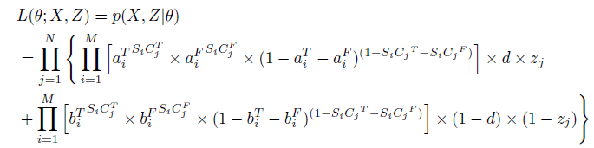



Approach: EM with Conflicting Variables
Likelihood function of Extended EM
Expectation Step (E-Step)
Maximization Step (M-Step)
Iterate

Slide 34

Free Parking Lot Identification from GeoTag Data
Goal: Find Free Parking Lots on UIUC Campus
Y: Free Parking lot : no charge after 5pm
N: Not free parking lot
Y
N

Slide 35


Free Parking Lot Identification from GeoTag Data
Results of Extended EM vs Baselines
Experiment setup:
106 parking lots of interests, 46 indeed free
30 participants, 901 marks collected

Slide 36





Address Variable Constraints
Events
Measured Variables
Sources
Claims constraints can be general!
Hurricane Sandy
…
Road Speed Map
Boston Marathon
Explosion
Fukushima
Attribute:
Reliability
Hurricane Risk Map
Egypt President
Arrest
Attribute:
True/False
D. Wang, et al., RTSS, 2013

Slide 37



Approach: EM with General Correlated Claims and Opportunity to Observe
Likelihood function of Extended EM
General Claim Correlations
Expectation Step (E-Step)
Maximization Step (M-Step)
Iterate

Slide 38



Traffic Regulator Mapping From
GPS Data

Slide 39






Address Source Dependency
Measured Variables
Sources are not independent !
Consider the social network and source forwarding behaviors
Sources
Events
Egypt Unrest
…
Hurricane Irene
Attribute:
Reliability
Attribute:
True/False
Fukushima

Slide 40



Examples
Examples of Twitter Observations
Crash blocking lanes on I-5S @ McBean Pkwy in Santa Clarita
BREAKING NEWS: Shots fired in Watertown; source says Boston Marathon terror bomb suspect has been pinned down
The police chief of Afghanistan’s southern Kandahar province has died in a suicide attack on his headquarters.
Yonkers mayor has lifted his gas rationing order. Fill it up!
Egypt Unrest, 2011
Hurricane Sandy, 2012
Boston Marathon Explosion,2013
Chile Earthquake, 2014

Slide 41
Humans as Sensors Challenges
How to Model Networked Humans as Participatory Sensors?
How to Filter Out “Bad Data” from Human Sensors?
How Good is the Necessarily Simplified Model?

Slide 42
A Binary Human Sensor Model
1: Model Humans as Sensors of
  Unknown Reliability
  Binary Observations
  Uncertain Data Provenance
2: Build An Estimation-theoretic Framework to
  Solve the Reliable Sensing Problem
  Validate through Real-world Twitter Traces

Slide 43

Formulate the Likelihood Function
Events
Measured Variable
Sources
SC: Source Variable Graph
SD: Social Dissemination Graph
Hurricane Sandy
…
Boston Marathon
Explosion
Attribute:
Reliability
Fukushima
Attribute:
True/False
Egypt President
Arrest
D. Wang, et al., IPSN 2014

Slide 44


Social Expectation Maximization (1/2)
Likelihood Function Incorporating Source Dependency
g
Variable
j
Dependent Sources

Slide 45



Social Expectation Maximization (2/2)
E-Step
DAG
M-Step

Slide 46
Simple Illustrative Examples
C
True Claim
S₂
1-p₂₁
SD Links
S₂
1-a₂
SC Links
a₁
C₁
1-a₁
C₁
S₁
SD Links that are ignored
S₁
S₃
p₃₁
S₃
a₃
p₄₁
a₄
Missing SC Links
S₄
S₄
S
Example 1
Example 2
Source that made claim
Notes:
Example 1: : Parent S₁ makes claim C₁. Each descendant, i, repeats it with probability p_{i1} or not to with probability 1-p_{i1}
Example 2: Parent S₁ does not make claim C₁. Its descendants are modeled as independent nodes. They make claim C₁ with probability a_{i} or chose not to with probability 1-a_{i} .

Slide 47
Evaluation
Integrated Social EM with Apollo
  Apollo is an Information Distillation Tool for Reliable Social Sensing
Evaluated Through Real-world Twitter Based Case Studies
  Hurricane Sandy, Hurricane Irene, Egypt Unrest
Compared with State-of-the-art Baselines
  Regular EM in IPSN 12, EM with AD, Voting, etc.

Slide 48
Evaluation using Real Twitter Traces
Trace | Hurricane Sandy | Hurricane Irene | Egypt Unrest
Time duration | 14 days (Nov.2-15, 2012) | 8 days (Aug.26-Sept.2, 2011) | 18 days (Feb.2-Feb.19,2011)
Locations | 16 cities in East Coasts | New York | Cairo, Egypt
# of users tweeted | 7,583 | 207,562 | 13,836
# of tweets | 12,931 | 387,827 | 93,208
# of users crawled in social network | 704,941 | 2,510,316 | 5,285,160
# of follower-followee links | 37,597 | 3,902,713 | 10,490,098

Slide 49


Estimate Latent Social Dissemination (SD) Network
i
j
Estimate Latent Social Dissemination Network
j
FF SD
i
i
j
RT SD
Epidemic Cascade*
i
j
* P. Netrapalli and S. Sanghavi. Learning the graph of epidemic cascades. SIGMETRICS ’12, pages 211–222, New York, NY, USA,
2012. ACM.
EC SD

Slide 50

Evaluation on Sandy Trace
18%
32%
RT: Retweet
FF: Follower-Followee
EC: Epidemic Cascade
Understanding Source Dependency Helps !

Slide 51

Evaluation on Irene Trace
15%
36%
RT: Retweet
FF: Follower-Followee
EC: Epidemic Cascade
Understanding Source Dependency Helps !

Slide 52

Evaluation on Egypt Trace
10%
42%
RT: Retweet
FF: Follower-Followee
EC: Epidemic Cascade
Understanding Source Dependency Helps !

Slide 53

Ground Truth Events Found by Social EM vs Regular EM

Slide 54



One Interesting Example
Shark in the street!
FAKE!
Suppressed by Social EM
http://www.washingtonpost.com/blogs/blogpost/post/hurricane-irene-photo-of-shark-swimming-in-street-is-fake/2011/08/26/gIQABHAvfJ_blog.html

Slide 55
Design for Streaming Data
Update Estimation On the Fly !
Events
Claims
Sources
Claims
Sources
Hurricane Sandy
Updated Claim
?
…
…
Boston Marathon
Explosion
Attribute:
Reliability
Attribute:
Reliability
Egypt President Arrest
D. Wang, et al., ICDCS, 2013
Time

Slide 56



Design for Streaming Data
Recursive Formula of EM
Previous Estimate
Updated Observations
CRLB
Plugging the CRLB derived before

Slide 57


Design for Streaming Data
Runs much faster!
Converges to the Batch Algorithm
Improved Algorithm Efficiency
Converge to the Optimal Estimation
Synthetic Dataset
Parking Lot Dataset

Slide 58
Human Sensor vs Physical Sensor
Human Sensor | Physical Sensor
Broad spectrum of observations | Narrow spectrum but accurate measurements
Good at reporting binary observations | Good at measuring continuous variables
Unreliable and unknown failure model | Reliable and know failure model
Uncertain data provenance | Certain data provenance
Human specific energy limitation | Battery limitation and other resource constraints
Mostly unstructured data (e.g., text, images) | Mostly structured data
Unvetted sources and often unknown to applications | Verified sensors and often known to applications

Slide 59
What is next ?
Q: What are the problems remaining to be solved?
Events
Claims
Sources
Maximum Likelihood Estimation
Hurricane Sandy
Reliability of sources
Correctness of claims
…
Q: What are the new perspectives to look at the reliability of CPS with humans-in-the-loop?
Boston Marathon
Explosion
Attribute:
Reliability
Attribute:
True/False
Egypt President
Arrest

Slide 60
Future Work
Time dimension is an interesting direction to follow up
  Accommodate dynamic states and dependencies of observed variables
Measured Variables are not always equal
  Generalize the model to handle “hardness” of variables
Uncertainty and Bias of Sources
  Model the bias and uncertainty of data sources
Expertise of Sources
  Model the reliability of sources in different expertise dimensions
Apply the Model beyond Twitter-based Applications
  Apply to a much broader set of crowdsourcing and mobile sensing applications

