Slide 1
Data Reliability I:
A Fundamental Challenge in Social Sensing
With Humans as Sensors
CSE 40437/60437-Spring 2015
Prof. Dong Wang

Slide 2
Cyber-Physical System Challenges
Functional Correctness Guarantees
Temporal Correctness Guarantees
Data Correctness Guarantees

Slide 3
Cyber-Physical System Challenges
Functional Correctness Guarantees
Temporal Correctness Guarantees
Data Correctness Guarantees

Slide 4
Outline
Introduction:
  Using Humans as Sensors
Analytical Foundation:
  Maximum Likelihood Estimation
Performance:
  Simulation and Emulation
  Real world case studies based on Twitter

Slide 5
Outline
Introduction:
  Using Humans as Sensors
Analytical Foundation:
  Maximum Likelihood Estimation
Performance:
  Simulation and Emulation
  Real world case studies based on Twitter

Slide 6
Role of Humans in the Loop?
The CPS “Control Loop”
The loop represents a causality chain
Disturbance
Controller
(Policy)
Actuator
(Mechanism)
Process
Output
Desired
Behavior
-
Sensor
Measured Output

Slide 7
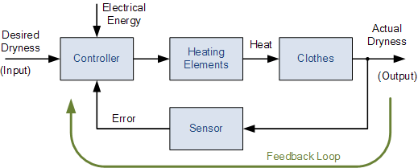
Role of Humans in the Loop?
The CPS “Control Loop”
A Drying Machine Example

Slide 8
Role of Humans in the Loop?
The CPS “Control Loop”
The loop represents a causality chain
Disturbance
Controller
(Policy)
Actuator
(Mechanism)
Process
Output
Desired
Behavior
-
Sensor
Humans as Sensors
Measured Output

Slide 9
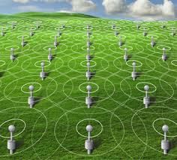

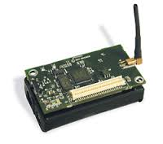
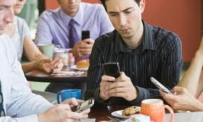
Humans as Sensors
Social Networks
Sensor Networks
Human
Sensor

Slide 10
Overview
Following problems are not well addressed/defined in traditional sensor network application:
  Q1: What would happen if “sensors” are not known to the application a priori?
  Q2: How to model a person as a “sensor”
  Q3: How to assess the quality of the results without independent ways of verifying the reliability of sources and correctness of their measurements?
The work discussed in this lecture made efforts to address the above problems emerging in social sensing !

Slide 11
Related Work on Data Reliability in Social Sensing
SECON 12, JSAC 13
Conflicting Claims ⁵
ACM ToSN 13
IPSN 14
ICDCS 13
IPSN 12
RTSS 13, 14
Accuracy
Bounds ^{2,3}
Humans Sensors⁷
Streaming
Data ⁴
Basic Model ¹
Claim Constraints ⁶
1. Dong Wang, Lance Kaplan, Hieu Le, and Tarek Abdelzaher. "On Truth Discovery in Social Sensing: A Maximum Likelihood Estimation Approach." The 11th ACM/IEEE Conference on Information Processing in Sensor Networks (IPSN 12). Beijing, China April 2012.
2. Dong Wang , Lance Kaplan, Tarek Abdelzaher and Charu C. Aggarwal. "On Scalability and Robustness Limitations of Real and Asymptotic Confidence Bounds in Social Sensing." The 9th Annual IEEE Communications Society Conference on Sensor, Mesh and Ad Hoc Communications and Networks (SECON 12), Seoul, Korea, June, 2012.
3. Dong Wang, Lance Kaplan, Tarek Abdelzaher and Charu C. Aggarwal. "On Credibility Tradeoffs in Assured Social Sensing." IEEE JSAC special issue on Network Science, June, Vol. 31, No. 6, 2013.
4. Dong Wang, Tarek Abdelzaher, Lance Kaplan and Charu C. Aggarwal. "Recursive Fact-finding: A Streaming Approach to Truth Estimation in Crowdsourcing Applications.", 33rd International Conference on Distributed Computing Systems (ICDCS 13) Philadelphia, PA, July 2013.
5. Dong Wang, Lance Kaplan and Tarek Abdelzaher. "On Truth Discovery in Social Sensing with Conflicting Observations: A Maximum Likelihood Estimation Approach.” ACM Transaction on Sensor Network s (TOSN), in press, 2013
6. Dong Wang, Tarek Abdelzaher, Lance Kaplan and Raghu Ganti. "Exploitation of Physical Constraints for Reliable Social Sensing," IEEE 34th Real-Time Systems Symposium (RTSS'13) Vancouver, Canada, December, 2013.
7. Dong Wang , Tanvir Amin, Shen Li, Tarek Abdelzaher, Lance Kaplan, Siyu Gu, Chenji Pan, Hengchang Liu, Charu Aggrawal, Raghu Ganti, XinLei Wang, Prasant Mohapatra, Boleslaw Szymanski, Hieu Le, "Humans as Sensors: An Estimation Theoretic Perspective," The 13th ACM/IEEE International Conference on Information Processing in Sensor Networks (IPSN 14), Berlin, Germany, April, 2014.

Slide 12
Related Work on Data Reliability in Social Sensing
SECON 12, JSAC 13
Conflicting Claims ⁵
ACM ToSN 13
IPSN 14
ICDCS 13
IPSN 12
RTSS 13, 14
Accuracy
Bounds ^{2,3}
Humans Sensors⁷
Streaming
Data ⁴
Basic Model ¹
Claim Constraints ⁶
1. Dong Wang, Lance Kaplan, Hieu Le, and Tarek Abdelzaher. "On Truth Discovery in Social Sensing: A Maximum Likelihood Estimation Approach." The 11th ACM/IEEE Conference on Information Processing in Sensor Networks (IPSN 12). Beijing, China April 2012.
2. Dong Wang , Lance Kaplan, Tarek Abdelzaher and Charu C. Aggarwal. "On Scalability and Robustness Limitations of Real and Asymptotic Confidence Bounds in Social Sensing." The 9th Annual IEEE Communications Society Conference on Sensor, Mesh and Ad Hoc Communications and Networks (SECON 12), Seoul, Korea, June, 2012.
3. Dong Wang, Lance Kaplan, Tarek Abdelzaher and Charu C. Aggarwal. "On Credibility Tradeoffs in Assured Social Sensing." IEEE JSAC special issue on Network Science, June, Vol. 31, No. 6, 2013.
4. Dong Wang, Tarek Abdelzaher, Lance Kaplan and Charu C. Aggarwal. "Recursive Fact-finding: A Streaming Approach to Truth Estimation in Crowdsourcing Applications.", 33rd International Conference on Distributed Computing Systems (ICDCS 13) Philadelphia, PA, July 2013.
5. Dong Wang, Lance Kaplan and Tarek Abdelzaher. "On Truth Discovery in Social Sensing with Conflicting Observations: A Maximum Likelihood Estimation Approach.” ACM Transaction on Sensor Network s (TOSN), in press, 2013
6. Dong Wang, Tarek Abdelzaher, Lance Kaplan and Raghu Ganti. "Exploitation of Physical Constraints for Reliable Social Sensing," IEEE 34th Real-Time Systems Symposium (RTSS'13) Vancouver, Canada, December, 2013.
7. Dong Wang , Tanvir Amin, Shen Li, Tarek Abdelzaher, Lance Kaplan, Siyu Gu, Chenji Pan, Hengchang Liu, Charu Aggrawal, Raghu Ganti, XinLei Wang, Prasant Mohapatra, Boleslaw Szymanski, Hieu Le, "Humans as Sensors: An Estimation Theoretic Perspective," The 13th ACM/IEEE International Conference on Information Processing in Sensor Networks (IPSN 14), Berlin, Germany, April, 2014.

Slide 13
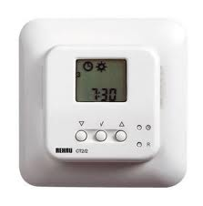
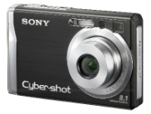
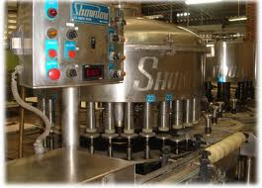
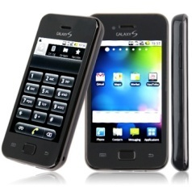
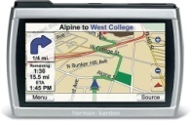
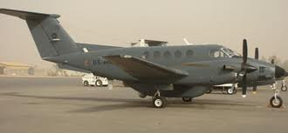
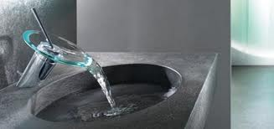

Sensing is Evolving
Platform
Sensors are increasingly used by everyday people
Smart Phone

Slide 14
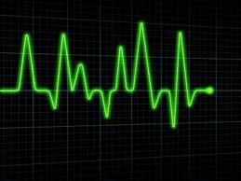
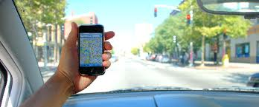
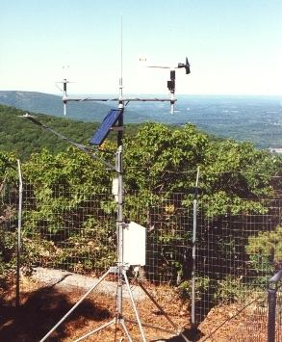
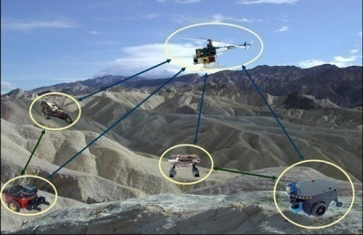
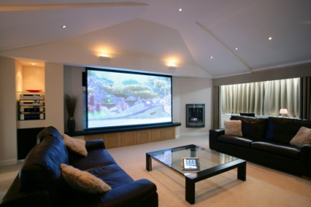

Sensing is Evolving
Platform
Sensors are increasingly used by everyday people
Smart Phone
Social (Human-Centric) Sensing is Emerging!
Application
Humans are getting into the Loop of Sensing.
Health Monitoring
Geotagging
Target Tracking
Environment
Monitoring
Smart House
Social Sensing

Slide 15
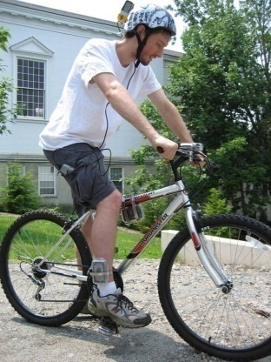

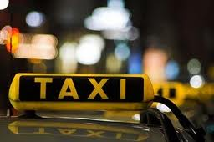
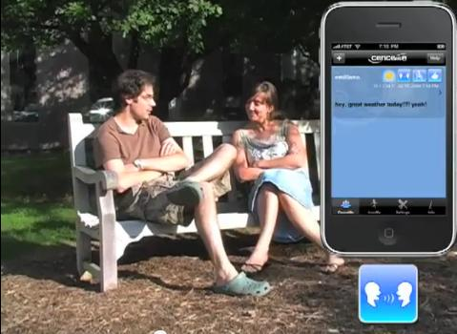
Examples of Social Sensing
Participatory Sensing
Geotagging
BikeNet
Opportunistic Sensing
CabSense
CenceMe

Slide 16
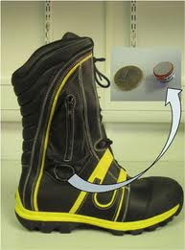
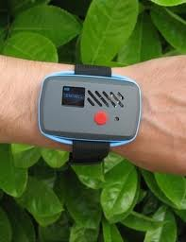
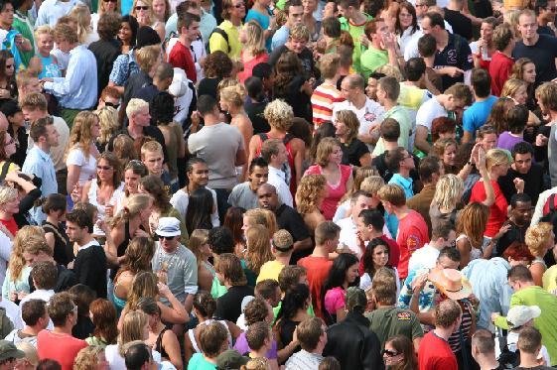
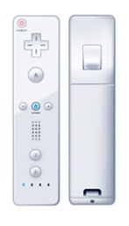



Human’s Role in Social Sensing
Human are sensor carriers
Human are sensor operators
Human are sensors themselves!

Slide 17
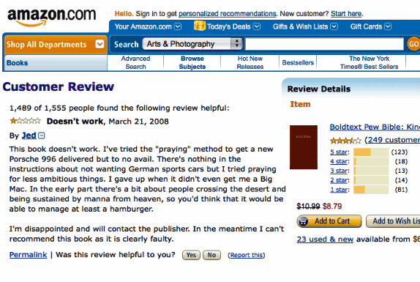
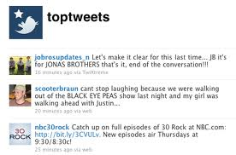


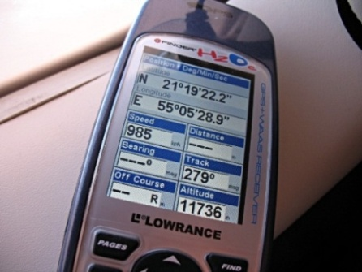
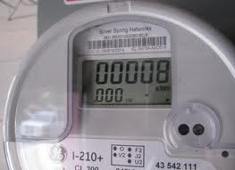
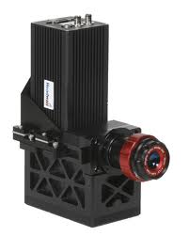
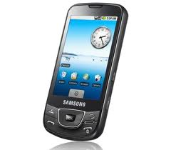
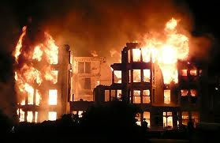
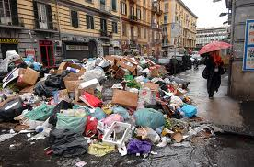
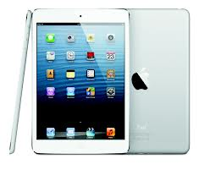

Data Reliability Problem in Social Sensing
Who to believe?
What to believe?
Text
Guaranteed Data Correctness!
1. How to Answer the above two questions?
People
Numeric data
2. How to Assess the Quality of our answers ?
Smart Devices
Images
Sources
Measurements

Slide 18

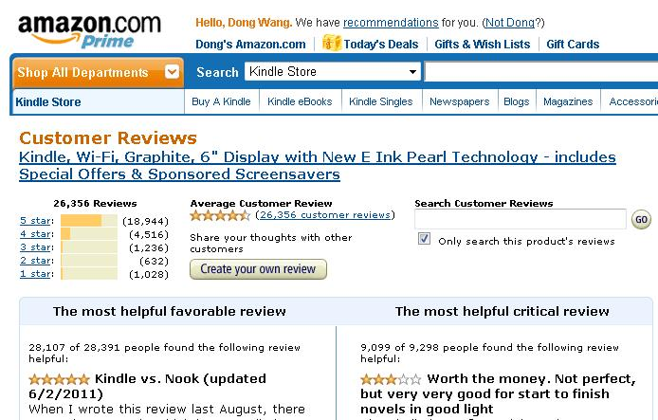

Challenges in Reliable Social Sensing
Lack of Human attention!
Different Opinions!
Lack of Sensor Calibration!
Reliability of Sources is Unknown a priori
Poor Sensor Quality!
Intent to Deceive!

Slide 19
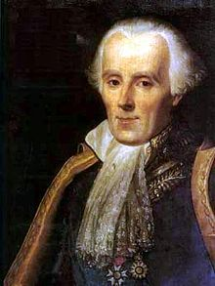
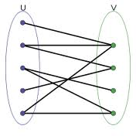


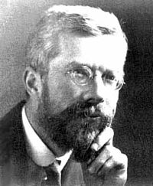
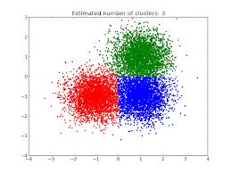
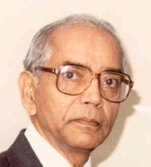
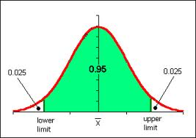
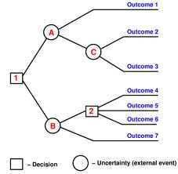
Bridging Data Mining and Estimation Theory
Estimation Theory
Knowledge Gap
Data Mining
1. What does a source rank # 3 really mean?
Fact-finding
Source Rank | Ranking Score
1 | 128
2 | 110
3 | 20
Maximum Likelihood Estimation (MLE)
Assured Information Distillation
Ranking
2. What is the Confidence?
Clustering
Fisher Information
Source Rank | Ranking Confidence
1 | 50%
2 | 90%
3 | 100%
Source Rank | Ranking Confidence
1 | ?
2 | ?
3 | ?
Classification
Cramer-Rao lower Bound (CRLB)

Slide 20
Outline
Introduction:
  Using Humans as Sensors
Analytical Foundation:
  Maximum Likelihood Estimation
Performance :
  Simulation and Emulation
  Real world case studies based on Twitter

Slide 21
State of the Art
Fact-finders
  Rank both sources and assertions
  Heuristic based approach
Data Cleaning and Outlier Analysis
  Data Mining: Binning, Regression, Clustering, Statistical-based, etc.
  Statistics: Kalman Filter, Particle Filter, etc.
Reputation Systems
  Simple counting: eBay
  Complex heuristic: similar as PageRank

Slide 22
Basic Fact-finding
Participant (or Source)
S₃
C₁₉
Claim [Binary: True or False]
S₁₈
C₂
Fact-Finding
S₁
C₁
…
…
S₆
C₈
S₂
C₂
Source Reliability
Claim Correctness
S₃
C₃
…
…
# of True claims /Total # of claims from a participant
Probability a claim is true
S_{i}C_{j}=1
S_{i}
C_{j}
S_{i}C_{j+1}=0
S_{i+1}
C_{j+1}
S_{M}
Observation Matrix
C_{N}

Slide 23
Basic Fact-finding
Participant (or Source)
S₃
C₁₉
Claim [Binary: True or False]
S₁₈
C₂
Fact-Finding
S₁
C₁
…
…
S₆
C₈
S₂
C₂
Source Reliability
Claim Correctness
S₃
C₃
…
…
Voting
S_{i}C_{j}=1
S_{i}
C_{j}
S_{i}C_{j+1}=0
What is the problem with Voting?
S_{i+1}
C_{j+1}
S_{M}
Observation Matrix
C_{N}

Slide 24
Basic Fact-finding
Participant (or Source)
Claim [Binary: True or False]
Voting
Fact-Finding
S₁
C₁
Claim ID | Votes
C1 | 4
C2 | 3
C4 | 3
C3 | 2
C5 | 2
S₂
C₂
True
S₃
C₃
False
S₄
C₄
C₅
Prior: 3 true claims and 2 false claims

Slide 25
Basic Fact-finding
Participant (or Source)
Claim [Binary: True or False]
Voting
Fact-Finding
0.66
S₁
C₁
False
Claim ID | Votes
C1 | 4
C2 | 3
C4 | 3
C3 | 2
C5 | 2
0.33
S₂
C₂
False
0.5
S₃
C₃
True
0.5
S₄
C₄
True
Not all sources are equally reliable!
C₅
True
Prior: 3 true claims and 2 false claims

Slide 26
Examples: Some Fact-Finding Algorithms
Difference:
The specific way to compute source or assertion credibility in iterations.
Similarity:
Only output ranking, not posterior probability desired .

Slide 27
Basics of Maximum Likelihood Estimation
A Simple Example:
A random number generator G(T):
  It can generate a random integer in [1,T] with a uniform probability distribution
Question:
  If T only has two possible values: 10 and 20, we run G(T) once, the generate number is 5. What is the most likely value of T?

Slide 28
Basics of Maximum Likelihood Estimation
A Simple Example:
A random number generator G(T):
  It can generate a random integer in [1,T] with a uniform probability distribution
Question:
  If T can be any integer value, we run G(T) once, the generate number is still 5. What is the most likely value of T?
MLE: Make the guess of the estimated parameters for which the observed data is least surprising!

Slide 29
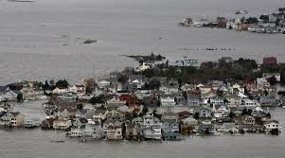
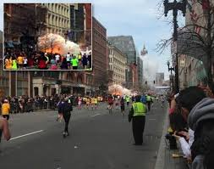
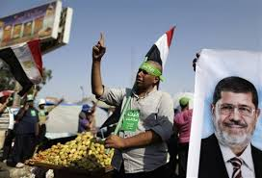
Maximum Likelihood Estimation
Measured Variables
# of True variables /Total # of variables a source reports
Events
Sources
Maximum Likelihood Estimation
Hurricane Sandy
Reliability of sources
Correctness of variables
Unknown a priori!
…
Boston Marathon
Explosion
Probability a measured variable is true
Attribute:
Reliability
Attribute:
True/False
Egypt President
Arrest
D. Wang, et al., IPSN, 2012

Slide 30
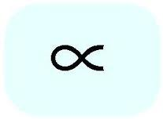
Maximum Likelihood Estimation
Basic Definition
True Measured Variable
Reliability of Participant i
i
i
i
False Measured Variable
i
i
Speak Rate of Participant i
All
All

Slide 31
Maximum Likelihood Estimation
Basic Definition
True Measured Variable
False Measured Variable
a_{i}
b_{i}

Slide 32


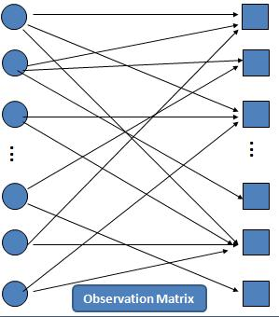



Expectation Maximization
Background and Problem Formulation
Expectation Maximization
Z={z₁, z₂, …z_{N}} where z_{j} =1 when assertion C_{j} is true and 0 otherwise
Observation Matrix
Estimation parameter
Observed data
Hidden Variable
X
Apply EM
Expectation Step (E-step)
Maximization Step (M-step)
Find MLE of estimation parameter and values of hidden variables

Slide 33
Maximum Likelihood Estimation
Source Reliability
Measured Variable Correctness
S₁
C₁
Find the “unknown” values of variables, θ, that maximize the probability of observations
S₂
C₂
S₃
C₃
…
…
S_{i}C_{j}=1
S_{i}
C_{j}
S_{i}C_{j+1}=0
S_{i+1}
C_{j+1}
S_{M}
C_{N}
Observation Matrix, SC

Slide 34

Maximum Likelihood Estimation
Source Reliability
Measured Variable Correctness
S₁
C₁
Find the “unknown” values of variables, θ, that maximize the probability of observations
S₂
C₂
S₃
C₃
…
…
S_{i}C_{j}=1
Maximize:
S_{i}
C_{j}
S_{i}C_{j+1}=0
S_{i+1}
C_{j+1}
S_{M}
C_{N}
Observation Matrix, SC

Slide 35
Maximum Likelihood Estimation
Source Reliability
Measured Variable Correctness
S₁
C₁
Find the “unknown” values of variables, θ, that maximize the probability of observations
S₂
C₂
S₃
C₃
…
…
S_{i}C_{j}=1
Maximize:
S_{i}
C_{j}
S_{i}C_{j+1}=0
S_{i+1}
C_{j+1}
Continuous unknowns that depend on discrete unknowns, z?
S_{M}
C_{N}
Observation Matrix, SC

Slide 36
Maximum Likelihood Estimation
Source Reliability
Measured Variable Correctness
S₁
C₁
Find the “unknown” values of variables, θ, that maximize the probability of observations
S₂
C₂
S₃
C₃
…
…
S_{i}C_{j}=1
Maximize:
S_{i}
C_{j}
S_{i}C_{j+1}=0
S_{i+1}
C_{j+1}
Continuous unknowns that depend on discrete unknowns, z?
S_{M}
C_{N}
Observation Matrix, SC

Slide 37
Maximum Likelihood Estimation
Source Reliability
Measured Variable Correctness
S₁
C₁
Find the “unknown” values of variables, θ, that maximize the probability of observations
S₂
C₂
S₃
C₃
…
…
Source reliability
Variable correctness
S_{i}C_{j}=1
Maximize:
S_{i}
C_{j}
S_{i}C_{j+1}=0
S_{i+1}
C_{j+1}
Continuous unknowns that depend on discrete unknowns, z?
S_{M}
C_{N}
Observation Matrix, SC

Slide 38
Maximum Likelihood Estimation
Source Reliability
Measured Variable Correctness
Source reliability
Variable correctness
S₁
C₁
Maximize:
S₂
C₂
S₃
C₃
Take log of both sides
Observe that log of sum is higher than sum of log
Maximize sum of log
…
…
S_{i}C_{j}=1
S_{i}
C_{j}
S_{i}C_{j+1}=0
S_{i+1}
C_{j+1}
S_{M}
C_{N}
Observation Matrix, SC

Slide 39

Maximum Likelihood Estimation
Source Reliability
Measured Variable Correctness
Source reliability
Variable correctness
S₁
C₁
Maximize:
S₂
C₂
S₃
C₃
Take log of both sides
Observe that log of sum is higher than sum of log
Maximize sum of log
…
…
S_{i}C_{j}=1
S_{i}
C_{j}
S_{i}C_{j+1}=0
S_{i+1}
C_{j+1}
S_{M}
C_{N}
Observation Matrix, SC

Slide 40


Maximum Likelihood Estimation
Source Reliability
Measured Variable Correctness
S₁
C₁
S₂
C₂
And since variables are independent:
Hence:
S₃
C₃
…
…
S_{i}C_{j}=1
S_{i}
C_{j}
S_{i}C_{j+1}=0
S_{i+1}
C_{j+1}
S_{M}
C_{N}
Observation Matrix, SC

Slide 41
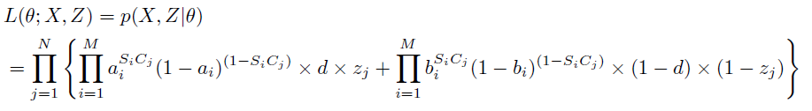
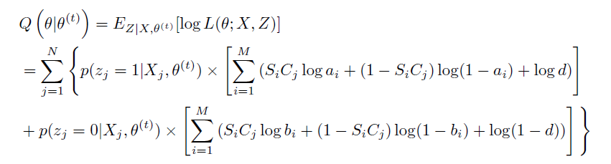
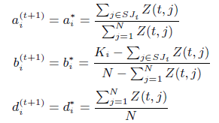
Expectation Maximization
Solution
Likelihood function of EM
Expectation Step (E-Step)
Maximization Step (M-Step)
Iterate

Slide 42
Expectation Maximization
Solution-Optimal Iteration
EM’s Iteration
Fact-finder’s Iteration
E-Step
Optimal Non-linear
Approximate Linear
M-Step
Iterate

Slide 43
Outline
Introduction:
  Using Humans as Sensors
Analytical Foundation:
  Maximum Likelihood Estimation
Performance :
  Simulation and Emulation
  Real world case studies based on Twitter

Slide 44
Expectation Maximization
Evaluation
Simulations:
  Source Reliability Estimation Error
  Measured Variable Classification:
    False Positives: False variables misclassified as true/False variables
    False Negatives: True variables misclassified as false/True variables
Evaluate EM through emulated and real social sensing applications

Slide 45
Evaluation
Simulation: Sensing Topology Generation
True Measured Variables
t_{i}
t_{i}
1-t_{i}
Observations
…
False Measured Variables
Notes:
Think more to describe the topology.
Q: What are the parameters we could change in this simulation step? Number of sources, number of observations per source, the ratio of true/false variables, the initial estimate of d.

Slide 46
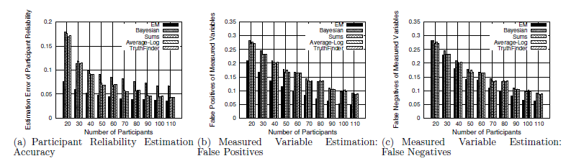
Expectation Maximization
Simulation
Estimation Accuracy of EM vs Baselines with Varying # of Participants
EM outperforms state-of-art heuristics
Parameters:
Number of Participants: 20-110
Number of True Measured Variables: 1000
Number of False Measured Variables: 1000
Average Number of Observations per Participant: 100

Slide 47
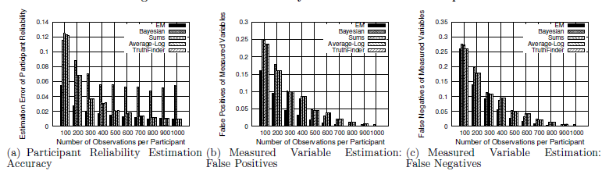
Expectation Maximization
Simulation
Estimation Accuracy of EM vs Baselines with Varying # of Observations per Participants
EM outperforms state-of-art heuristics
Parameters:
Number of Participants: 30
Number of True Measured Variables: 1000
Number of False Measured Variables: 1000
Average Number of Claims per Participant: 100-1000

Slide 48

Expectation Maximization
Simulation
Estimation Accuracy of EM vs Baselines with Varying Ratio of True Measured Variables
EM outperforms state-of-art heuristics
Parameters:
Number of Participants: 30
Number of Total Measured Variables: 2000
Average Number of Observations per Participant: 150
Ratio of true Measured Variables: 0.1-0.6

Slide 49

Expectation Maximization
Simulation
Estimation Accuracy of EM vs Baselines with Initial Estimation offset on Claim Prior (d)
EM outperforms state-of-art heuristics
Parameters:
Number of Participants: 30
Number of True Measured Variables: 1000
Number of False Measured Variables: 1000
Average Number of Observations per Participant: 150
Initial Estimation Offset on Prior d: 0.1-0.45

Slide 50

Evaluation
Estimation Convergence of EM
EM Converges Quickly
Parameters:
Number of Participants: 50
Number of Measured Variables: 1000
Number of False Measured Variables: 1000
Average Number of Observations per Participant: 250
Initial Estimation offset on d: 0.3

Slide 51



Expectation Maximization
Emulated Geotagging Application
Entrance
False Negatives:
Missed Litter Locations/Total Litter
P_{c}: probability to continue
False Positives:
Incorrectly labeled Locations/Total Locations
Reported Litter
Litter
Trail

Slide 52


Expectation Maximization
Emulated Geotagging Application
Litter Geotagging Accuracy versus Number of People
EM is better at detecting correct litter locations than baselines

Slide 53


Expectation Maximization
Emulated Geotagging Application
Litter Geotagging Accuracy versus Park Pollution Ratio
EM is better at detecting correct litter locations than baselines

Slide 54

The Apollo Fact-finder
http://apollo.cse.nd.edu/

Slide 55

The Apollo Fact-finder
http://apollo.cse.nd.edu/
What to believe?
Data Reliability
Who to believe?
The Architecture of Apollo

Slide 56

Github: Apollo Source Code
https://github.com/ApolloFactFinder/Apollo

Slide 57
The Apollo Fact-finder
Evaluation of EM using Twitter Data
What to believe?
Assured Information Distillation
Application:
Real world event tracking from Twitter Data
Who to believe?

Slide 58


EM is Integrated with Apollo
A Real World Application
Keywords/Location
EM is integrated as an option for data analysis
Data Collection Frontend
Information Analysis Frontend

Slide 59







Real World Event Tracking from Twitter Data
Difficult to verify truthfulness of tweets
Difficult to find out trustworthiness of sources
Datasets collected:
Egypt Unrest
Hurricane Sandy
Japan Tsunami and Nuclear Event
Boston Bombing

Slide 60


Egypt Unrest
(1.5M Tweets, Feb. 2011)
Media Report | Tweet found by EM
Bursts of heavy gunfire early aimed at antigovernment demonstrators in Tahrir leave at least five people dead and several wounded. | Heavy gunfire rings out in Cairo protest square
Media Report | Tweet found by EM
The leadership of Egypt’s ruling National Democratic Party resign, including Gamal Mubarack, the son of Hosni Mubarak. Hossam Badrawi, a member of the liberal wing of the party, became the new secretary-general. | Leadership of Egypt’s ruling party resigns http://bit.ly/hebSGm.
2 hours before
2011-2-3 1:02 (CNN)
2011-2-2 22:03 (Tweets)
Top correct tweets found by EM matches well with Media Reports

Slide 61


Hurricane Sandy
(2 M Tweets, Nov. 2012)
Media Report | Tweet found by EM
New Jersey and New York, struggling to recover from the wreckage of Sandy, were staggered today by a gas shortage | Live gas chat: Hurricane Sandy causes massive lines at N.J. gas stations http://t.co/9IAbN0l2
Media Report | Tweet found by EM
New York Governor Andrew Cuomo says New York City subway, bus and train service will be suspended starting at 7pm ET ahead of Hurricane Sandy. | Governor Cuomo Announces Public Transportation Shutdown At 7 PM Tonight http://t.co/PcKzTUSW
Top correct tweets found by EM matches well with Media Reports

Slide 62
Japan Nuclear Disaster
(1.0M Tweets, March 2011)
Media Articles | Top Tweets Returned by Triage Tool
The first earthquake hits Japan | RT @Hu.PostWorld: BREAKING: Massive 7.9 earthquake reportedly rocks Japan, 19-foot tsunamis feared http://hu..to/ezzmQb
The government warns the possibility of radiation leak | RT @Reuters: Japan warns of radiation leak from quake-hit plants http://t.co/iAFcDZg
Large number of dead and missing were reported | RT @BreakingNews: Latest Japan quake toll: 398 dead, 805 missing - Kyodo
Prediction of high probability of nuclear meltdown at Fukushima | RT @Reuters: FLASH: #Japan nuclear authorities say high possibility of meltdown at Fukushima Daiichi No. 1 reactor - Jiji
Cooling system at Fukushima nuclear plant failed | RT @komonews: RT @Reuters: Japan’s nuclear safety agency says Fukushima Daiichi Nuclear Plant No. 3 reactor’s emergency cooling system not functioning

Slide 63
Japan Nuclear Disaster
(1.0M Tweets, March 2011)
Media Articles | Top Tweets Returned by Triage Tool
The first earthquake hits Japan | RT @Hu.PostWorld: BREAKING: Massive 7.9 earthquake reportedly rocks Japan, 19-foot tsunamis feared http://hu..to/ezzmQb
The government warns the possibility of radiation leak | RT @Reuters: Japan warns of radiation leak from quake-hit plants http://t.co/iAFcDZg
Large number of dead and missing were reported | RT @BreakingNews: Latest Japan quake toll: 398 dead, 805 missing - Kyodo
Prediction of high probability of nuclear meltdown at Fukushima | RT @Reuters: FLASH: #Japan nuclear authorities say high possibility of meltdown at Fukushima Daiichi No. 1 reactor - Jiji
Cooling system at Fukushima nuclear plant failed | RT @komonews: RT @Reuters: Japan’s nuclear safety agency says Fukushima Daiichi Nuclear Plant No. 3 reactor’s emergency cooling system not functioning

Slide 64

Example: Early Warning
Syrian WMD Attack, August 21st, 2013

Slide 65
Example:
Syrian WMD Attack
Triage Result: Recommended for Viewing
Medecins Sans Frontieres says it treated about 3,600 patients with 'neurotoxic symptoms' in Syria, of whom 355 died http://t.co/eHWY77jdS0
Weapons expert says #Syria footage of alleged chemical attack "difficult to fake" http://t.co/zfDMujaCTV
U.N. experts in Syria to visit site of poison gas attack http://t.co/jol8OlFxnf via @reuters #PJNET
Syria Gas Attack: 'My Eyes Were On Fire' http://t.co/z76MiHj0Em
Long-term nerve damage feared after Syria chemical attack http://t.co/8vw7BiOxQR
Syrian official blames rebels for deadly attack http://t.co/76ncmy4eqb
Assad regime responsible for Syrian chemical attack, says UK government http://t.co/pMZ5z7CsNZ
US forces move closer to Syria as options weighed: WASHINGTON (AP) — U.S. naval forces are moving closer to Sy... http://t.co/F6UAAXLa2M
400 tonnes of arms sent into #Syria through Turkey to boost Syria rebels after CW attack in Damascus --&gt; http://t.co/KLwESYChCc
UN Syria team departs hotel as Assad denies attack http://t.co/O3SqPoiq0x
Vehicle of @UN #Syria #ChemicalWeapons team hit by sniper fire. Team replacing vehicle &amp; then returning to area.
International weapons experts leave Syria, U.S. prepares attack. More @ http://t.co/4Z62RhQKOE
Military strike on Syria would cause retaliatory attack on Israel, Iran declares http://t.co/M950o5VcgW
Asia markets fall on Syria concerns: Asian stocks fall, extending a global market sell-off sparked by growing ... http://t.co/06A9h2xCnJ

Slide 66
Example:
Syrian WMD Attack
Triage Result: Recommended for Viewing
Medecins Sans Frontieres says it treated about 3,600 patients with 'neurotoxic symptoms' in Syria, of whom 355 died http://t.co/eHWY77jdS0
Weapons expert says #Syria footage of alleged chemical attack "difficult to fake" http://t.co/zfDMujaCTV
U.N. experts in Syria to visit site of poison gas attack http://t.co/jol8OlFxnf via @reuters #PJNET
Syria Gas Attack: 'My Eyes Were On Fire' http://t.co/z76MiHj0Em
Long-term nerve damage feared after Syria chemical attack http://t.co/8vw7BiOxQR
Syrian official blames rebels for deadly attack http://t.co/76ncmy4eqb
Assad regime responsible for Syrian chemical attack, says UK government http://t.co/pMZ5z7CsNZ
US forces move closer to Syria as options weighed: WASHINGTON (AP) — U.S. naval forces are moving closer to Sy... http://t.co/F6UAAXLa2M
400 tonnes of arms sent into #Syria through Turkey to boost Syria rebels after CW attack in Damascus --&gt; http://t.co/KLwESYChCc
UN Syria team departs hotel as Assad denies attack http://t.co/O3SqPoiq0x
Vehicle of @UN #Syria #ChemicalWeapons team hit by sniper fire. Team replacing vehicle &amp; then returning to area.
International weapons experts leave Syria, U.S. prepares attack. More @ http://t.co/4Z62RhQKOE
Military strike on Syria would cause retaliatory attack on Israel, Iran declares http://t.co/M950o5VcgW
Asia markets fall on Syria concerns: Asian stocks fall, extending a global market sell-off sparked by growing ... http://t.co/06A9h2xCnJ

Slide 67


An Example Timeline (Abbreviated)
Charlie Hebdo Shooting at Paris (Jan. 07-11, 2015)
Distilling hundreds of thousands of raw tweets into a summary of the event (told in tweets selected by Apollo)

Slide 68
Example: The Paris Shooting in Tweets (Apollo Summary)
Jan 7: Massacre at French magazine office: Gunmen have attacked the Paris office of the French satirical magazine... http://t.co/6DXhg5taXI
Jan 7: French officials identify 3 suspects in Paris terror attack that left 12 dead: http://t.co/gpkbQNoACy #Fox #News #AN247

Slide 69
Example: The Paris Shooting in Tweets (Apollo Summary)
Jan 8: Paris terror attack suspect surrenders to police: One of three suspects in the Charlie Hedbo attack in Paris W... http://t.co/jHtEJR5HLL
Jan 8: Tensions running high as two people injured in separate Paris shooting http://t.co/UzkQCtIR9J

Slide 70
Example: The Paris Shooting in Tweets (Apollo Summary)
Jan 8: Paris terror suspects reportedly spotted in northern France, police flood scene | Fox News http://t.co/cDpNEtrsnm
Jan 8: French police swarm forest 'larger than Paris' in hunt for Charlie Hebdo jihadist assassins http://t.co/5mxovSzp54

Slide 71
Example: The Paris Shooting in Tweets (Apollo Summary)
Jan 9: Police surround Paris attack suspects, at least one hostage reported taken | http://t.co/fs1opaqDF8
Jan 9: French police kill Paris massacre suspects, hostage-taking ally in separate raids | http://t.co/gI5EjMpYO9

Slide 72
Example: The Paris Shooting in Tweets (Apollo Summary)
Jan 10: THE AL QAEDA CONNECTION Yemen terror group claims it directed Paris massacre as cops kill http://t.co/trPDUXLFIK
Jan 11: #BREAKING Prosecutor: Man who killed kosher market hostages, policewoman, now linked to third shooting in #Paris. http://t.co/Hhi2WtX02u

Slide 73
Demo
http://apollo.cse.nd.edu/now/
http://apollo.cse.nd.edu/analysis/browse3.html

