Slide 1
Online Social Media Sensing 1:
Sensing the Physical and Social World
CSE 40437/60437-Spring 2015
Prof. Dong Wang

Slide 2

Online Social Media: A New Information Age
Empower the analysts and decision makers to quickly understand ongoing events!
Source: http://www.signagesolutionsmag.com/article/unleashing-new-media-the-rise-of-the-social-media-command-center-15501

Slide 3
The Decade of Social Media
Platforms for Information Dissemination
Game changing trend of the decade: The rise of social media
Millions of Users
Year
http://dstevenwhite.com

Slide 4
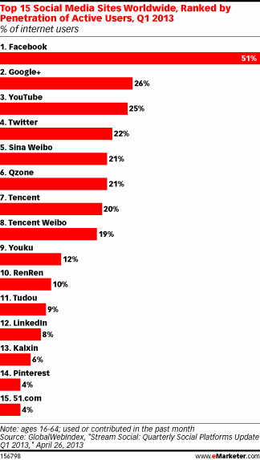
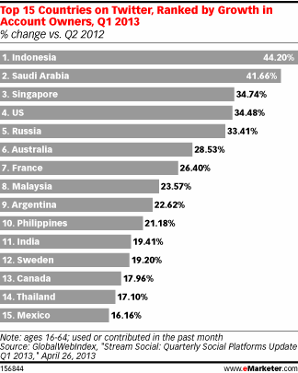
Social Media Statistics
Social media growth charts

Slide 5






A Wealth of Social Sensing Content
Every Minute:
More than 350,000 tweets made on Twitter http://www.internetlivestats.com/twitter-statistics/
Almost 700,000 status updates made on Facebook http://www.themarketingbit.com/infographics/online-for-one-minute/
More than 3,500 images uploaded to Flickr http://www.pcmag.com
More than 2000 check-ins on FourSquare http://articles.businessinsider.com
More than 100 hours of video uploaded to YouTube http://www.youtube.com/t/press_statistics

Slide 6
Significant Information on Ongoing Events
Thousands of tweets per second during key events
http://yearinreview.twitter.com
Event Day
Normal Day
Tweets per second, 2011

Slide 7
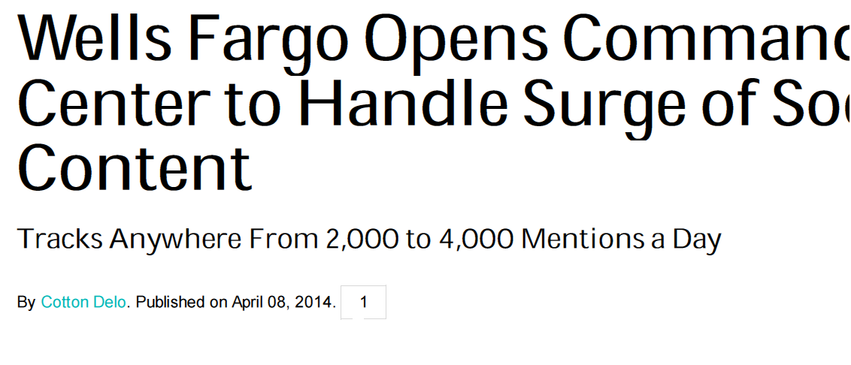
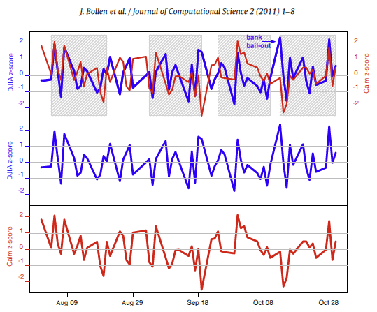
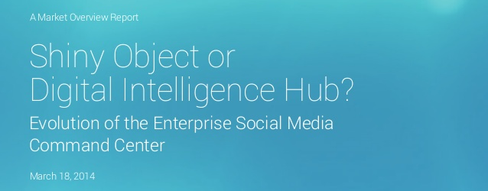
Examples of Real-time Content Analytics
Twitter mood predicts stock market trends

Slide 8
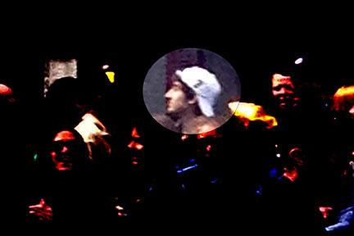

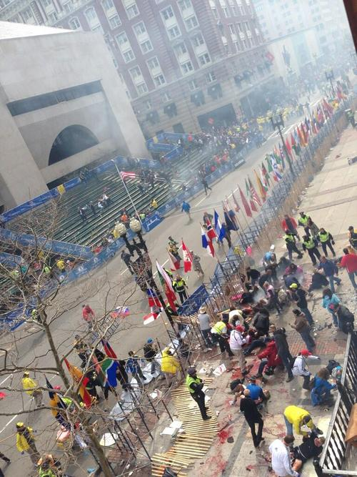
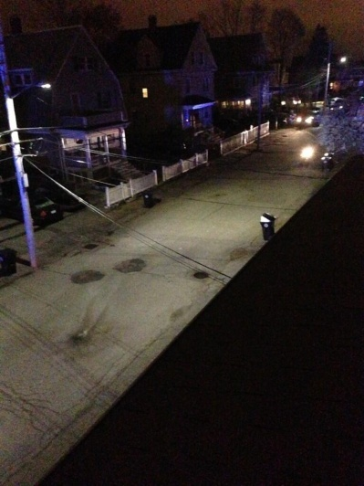
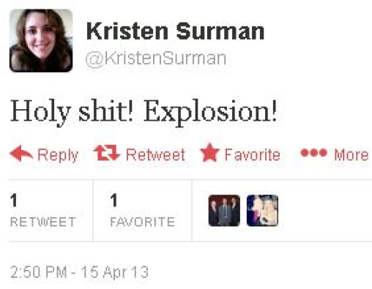
Reconstructing Event Timelines
A Twitter Example
RT @Boston_Police: Do you know these individuals? Contact boston@ic.fbi.gov or 1-800-CALL-FBI (1-800-225-5324), prompt #3 http://t.co/QJias1Kywe
RT @TomlinM: Unreal. Officer down in Cambridge. Scene centered around a MIT building. Does NOT appear related to #bostonmarathon. http://t.co/DQuXQuP7wK
@AKitz: Site of the bomb explosion on laurel st. bomb detectors are out #mitshooting #boston #mit http://t.co/lhOjCiBgY5
2:50 PM- 15 April 13
RT @MassStatePolice: Photos taken from State Police Air Wing on Watertown manhunt.Media, please credit MSP for pics. http://t.co/Qzafbp4MBE

Slide 9
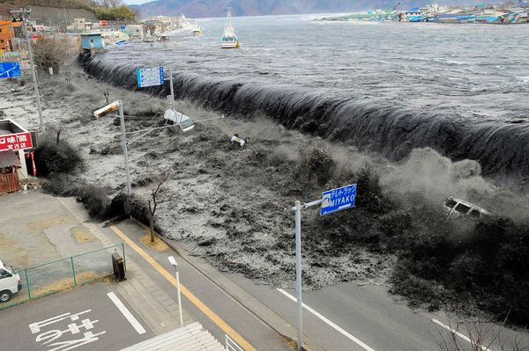
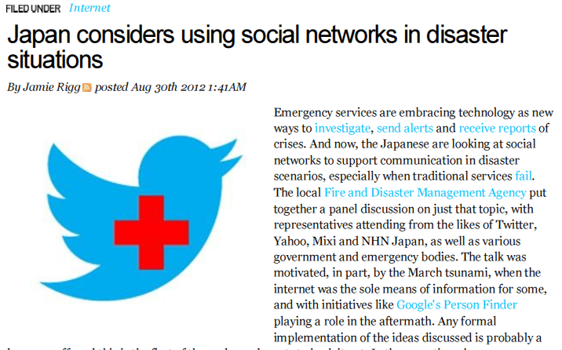
Japan’s tsunami 2011
Japan’s Tsunami and Nuclear Event
9

Slide 10
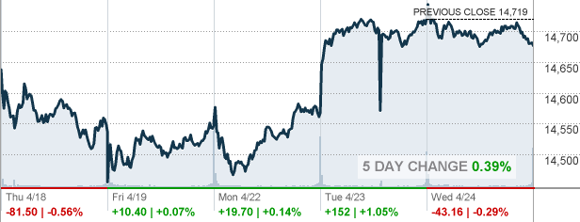
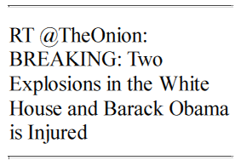
Dow Jones Hickup
Dow Jones lost 150 points on a rumor of two explosions in the White House on April 23rd, 2013

Slide 11
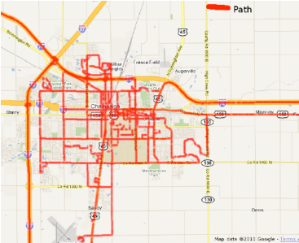


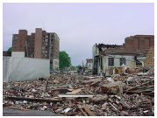
Challenge:
Data Cleaning and Summarization
Much like Google organizes (relatively static) world content, we need an engine for organizing real-time/streaming data feeds and:
Reconstructing the
“State of the World”,
Physical and Social!
Clean structured representation, high quality of information
Information distillation
A firehose of text, images, video, sound, and time-series data

Slide 12
Paper 1: "Earthquake shakes Twitter users: real-time event detection by social sensors." Sakaki, Takeshi, Makoto Okazaki, and Yutaka Matsuo. Proceedings of the 19th international conference on World wide web. ACM, 2010.
Paper2: "From tweets to polls: Linking text sentiment to public opinion time series.” O'Connor, Brendan, et al. ICWSM 11 (2010): 122-129.
Papers discuss today

Slide 13

Paper 1: "Earthquake shakes Twitter users: real-time event detection by social sensors." Sakaki, Takeshi, Makoto Okazaki, and Yutaka Matsuo. Proceedings of the 19th international conference on World wide web. ACM, 2010.
Physical Events

Slide 14
Outline
Introduction
Event Detection
Model
Experiments And Evaluation
Application
Conclusions

Slide 15
What’s happening?
Twitter
  is one of the most popular microblogging services
  has received much attention recently
Microblogging
  is a form of blogging
    that allows users to send brief text updates
  is a form of micromedia
    that allows users to send photographs or audio clips
In this research, they focus on an important characteristic
real-time nature

Slide 16
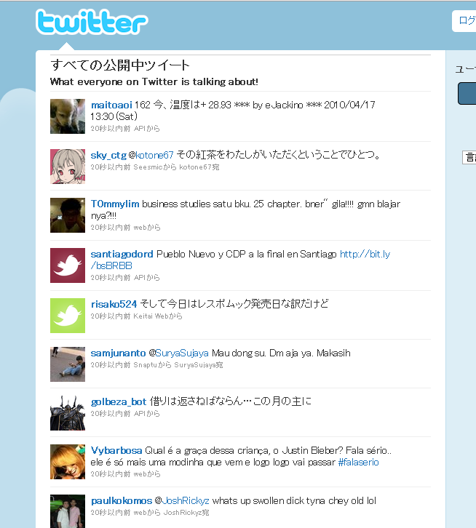
Real-time Nature of Microblogging
disastrous events
storms
fires
traffic jams
riots
heavy rain-falls
earthquakes
social events
parties
baseball games
presidential campaign
  Twitter users write tweets several times in a single day.
  There is a large number of tweets, which results in many reports related to events
  We can know how other users are doing in real-time
  We can know what happens around other users in real-time.

Slide 17
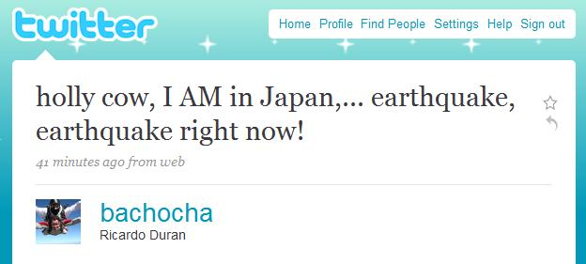
The Motivation
Adam Ostrow, an Editor in Chief at Mashable wrote the possibility to detect earthquakes from tweets in his blog
Japan Earthquake Shakes Twitter Users ... And Beyonce:
Earthquakes are one thing you can bet on being covered on Twitter first, because, quite frankly, if the ground is shaking, you’re going to tweet about it before it even registers with the USGS* and long before it gets reported by the media.
That seems to be the case again today, as the third earthquake in a week has hit Japan and its surrounding islands, about an hour ago.
The first user we can find that tweeted about it was Ricardo Duran of Scottsdale, AZ, who, judging from his Twitter feed, has been traveling the world, arriving in Japan yesterday.
We can know earthquake occurrences from tweets
-> The motivation of this research
*USGS : United States Geological Survey

Slide 18
The Goals
Propose an algorithm to detect a target event
  do semantic analysis on Tweet
    to obtain tweets on the target event precisely
  regard Twitter user as a sensor
    to detect the target event
    to estimate location of the target
Produce a probabilistic spatio-temporal model for
  event detection
  location estimation
Propose Earthquake Reporting System using Japanese tweets

Slide 19
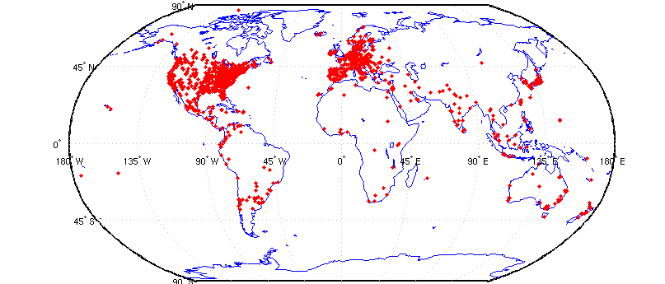
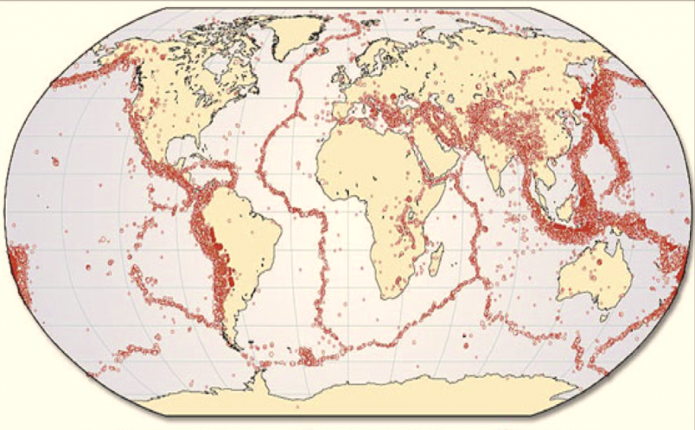
Twitter and Earthquakes in Japan
a map of Twitter user
world wide
a map of earthquake occurrences world wide
The intersection is regions with many earthquakes and large twitter users.

Slide 20
Twitter and Earthquakes in Japan
Other regions:
Indonesia, Turkey, Iran, Italy, and Pacific coastal US cities

Slide 21
Event detection algorithms
Do semantic analysis on Tweet
  to obtain tweets on the target event precisely
Consider a Twitter user as a sensor
  to detect the target event
  to estimate location of the target

Slide 22
Semantic Analysis on Tweet
Search tweets including keywords related to a target event
  Example: In the case of earthquakes
    “shaking”, “earthquake”
Classify tweets into a positive class or a negative class
  Example:
    “Earthquake right now!!” ---positive
    “Someone is shaking hands with my boss” --- negative
  Create a classifier
How would you build such a classifier?
What kinds of features would you use?

Slide 23
Semantic Analysis on Tweet
Create classifier for tweets
  use Support Vector Machine (SVM)
Features (Example: I am in Japan, earthquake right now!)
  Statistical features (7 words, the 5th word)
  the number of words in a tweet message and the position of the query within a tweet
  Keyword features ( I, am, in, Japan, earthquake, right, now)
  the words in a tweet
  Word context features (Japan, right)
  the words before and after the query word

Slide 24






Tweet as a Sensory Value
Event detection from twitter
Object detection in
ubiquitous environment
Probabilistic model
Probabilistic model
Classifier
values
tweets
・・・
・・・
・・・
・・・
・・・
observation by twitter users
observation by sensors
target event
target object
the correspondence between tweets processing and
sensory data detection

Slide 25
Tweet as a Sensory Value
Event detection from twitter
Object detection in
ubiquitous environment
detect an earthquake
detect an earthquake
search and classify them into positive class
some earthquake sensors responses positive value
Probabilistic model
Probabilistic model
Classifier
values
tweets
・・・
・・・
・・・
・・・
・・・
some users posts
“earthquake right now!!”
observation by twitter users
observation by sensors
earthquake occurrence
target event
target object
We can apply methods for sensory data detection to tweets processing

Slide 26
Tweet as a Sensory Value
Assumption 1: Each Twitter user is regarded as a sensor
  a tweet →a sensor reading
  a sensor detects a target event and makes a report probabilistically
  Example:
    make a tweet about an earthquake occurrence
    “earthquake sensor” return a positive value
Assumption 2: Each tweet is associated with a time and location
  a time : post time
  location : GPS data or location information in user’s profile
The location assumption may not always hold:
Very few tweets may have geo-locations embedded.
The user’s profile location may not match the exact location of the user.
Processing the time and location information of the positive tweets, we can detect target events and estimate location of target events

Slide 27
Probabilistic Model
Why we need probabilistic models?
  Sensor values are noisy and sometimes sensors work incorrectly (e.g., unreliable human sources and non-perfect classifier)
  We cannot judge whether a target event occurred or not from a single tweet
  We have to calculate the probability of an event occurrence from a series of data
Propose a probabilistic model for
  event detection from time-series data
  location estimation from a series of spatial information

Slide 28
Temporal Model
Calculate the probability of an event occurrence from multiple sensor values
Examine the actual time-series data to create a temporal model

Slide 29
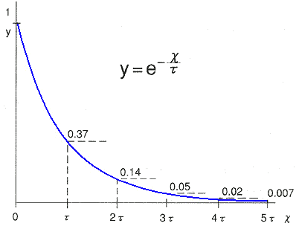
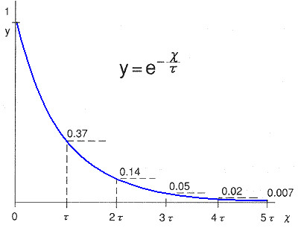
Temporal Model

Slide 30
Temporal Model
The data fits very well to an exponential function
Design the alarm of the target event probabilistically, which was based on an exponential distribution

Slide 31
Temporal Model
The probability of an event occurrence at time t
  the false positive ratio of a sensor
  the probability of all n sensors returning a false alarm
  the probability of event occurrence
  sensors at time 0 → sensors at time t
  the number of sensors until t
Expected wait time to deliver notification for 1% false positives
  parameter
Less than 0.4 s

Slide 32
Spatial Model
We must calculate the probability distribution of location of a target
We apply Bayes filters to this problem which are often used in location estimation by sensors
  Kalman Filers
  Particle Filters

Slide 33
Bayesian Filters for Location Estimation
Kalman Filters
  are the most widely used variant of Bayes filters
  approximate the probability distribution which is virtually identical to a uni-modal Gaussian representation
  advantages: the computational efficiency
  disadvantages: being limited to accurate sensors or sensors with high update rates

Slide 34
Bayesian Filters for Location Estimation
Particle Filters
  represent the probability distribution by sets of samples, or particles
  advantages: the ability to represent arbitrary probability densities
    particle filters can converge to the true posterior even in non-Gaussian, nonlinear dynamic systems.
  disadvantages: the difficulty in applying to
  high-dimensional estimation problems

Slide 35

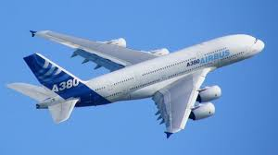
A Short Intro on Particle Filter
A short tutorial: http://www.it.uu.se/katalog/andsv164

Slide 36
Information Diffusion Related to Real-time Events
Proposed spatiotemporal models need to meet one condition that
  Sensors are assumed to be independent
We check if information diffusions about target events happen because
  if an information diffusion happened among users, Twitter user sensors are not independent. They affect each other

Slide 37
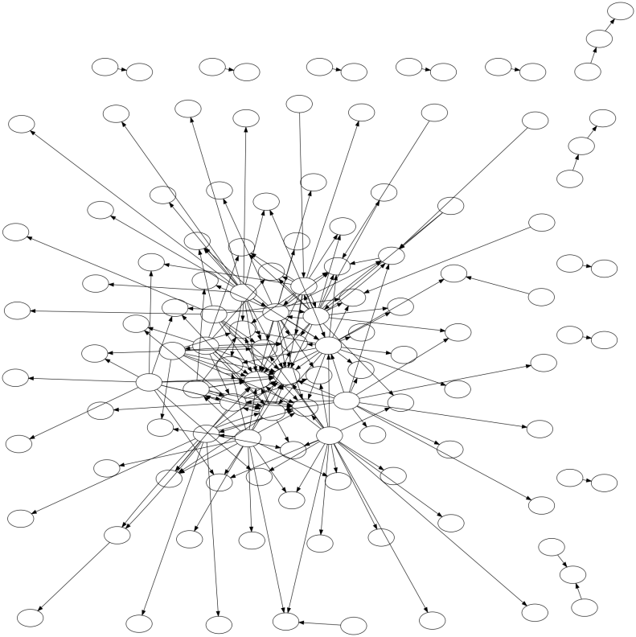
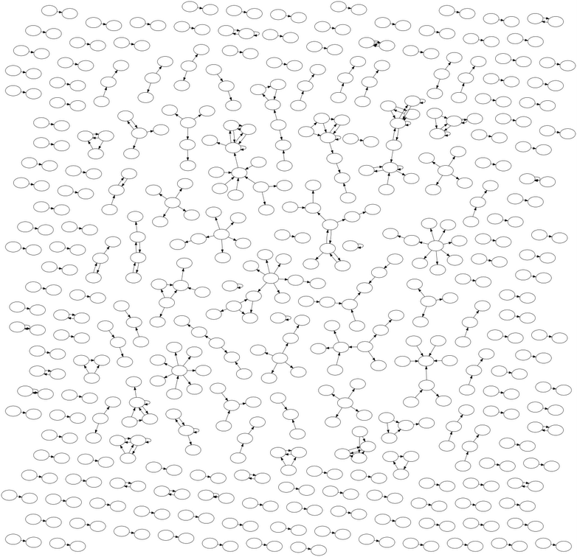

Information Diffusion Related to Real-time Events
Information Flow Networks on Twitter
Nintendo DS Game
an earthquake
a typhoon
In the case of an earthquakes and a typhoons, very little information diffusion takes place on Twitter, compared to Nintendo DS Game
→ We assume that Twitter user sensors are independent about earthquakes and typhoons
Source independency may not always hold for twitter case studies, even for disaster scenarios!

Slide 38
Experiments And Evaluation
Demonstrate performances of
  tweet classification
  event detection from time-series data
  → show this results in “application”
  location estimation from a series of spatial information

Slide 39
Evaluation of Semantic Analysis
Queries
  Earthquake query: “shaking” and “earthquake”
  Typhoon query: ”typhoon”
Examples to create classifier
  597 positive examples

Slide 40
Evaluation of Semantic Analysis
“earthquake” query
“shaking” query
Features | Recall | Precision | F-Value
Statistical | 87.50% | 63.64% | 73.69%
Keywords | 87.50% | 38.89% | 53.85%
Context | 50.00% | 66.67% | 57.14%
All | 87.50% | 63.64% | 73.69%
“Is this an earthquake or a truck passing?”
Features | Recall | Precision | F-Value
Statistical | 66.67% | 68.57% | 67.61%
Keywords | 86.11% | 57.41% | 68.89%
Context | 52.78% | 86.36% | 68.20%
All | 80.56% | 65.91% | 72.50%

Slide 41
Discussions of Semantic Analysis
Features | Recall | Precision | F-Value
Statistical | 87.50% | 63.64% | 73.69%
Keywords | 87.50% | 38.89% | 53.85%
Context | 50.00% | 66.67% | 57.14%
All | 87.50% | 63.64% | 73.69%
It obtains highest F-value when we use Statistical features and all features.
Keyword features and Word Context features don’t contribute much to the classification performance
A user becomes surprised and might produce a very short tweet
It’s apparent that the precision is not so high as the recall

Slide 42
Experiments And Evaluation
Demonstrate performances of
  tweet classification
  event detection from time-series data
  → show this results in “application”
  location estimation from a series of spatial information

Slide 43
Evaluation of Spatial Estimation
Target events
  earthquakes
    25 earthquakes from August.2009 to October 2009
  typhoons
    name: Melor
Baseline methods
  weighed average
    simply takes the average of latitudes and longitudes
  the median
    simply takes the median of latitudes and longitudes
Evaluate methods by distances from actual centers
  a distance from an actual center is smaller, a method works better

Slide 44
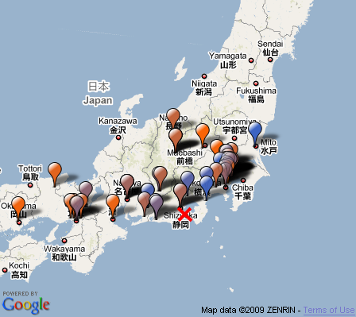
Evaluation of Spatial Estimation
balloon: each tweets
color : post time
Kyoto
Tokyo
estimation
by median
estimation
by particle filter
Osaka
actual earthquake center

Slide 45
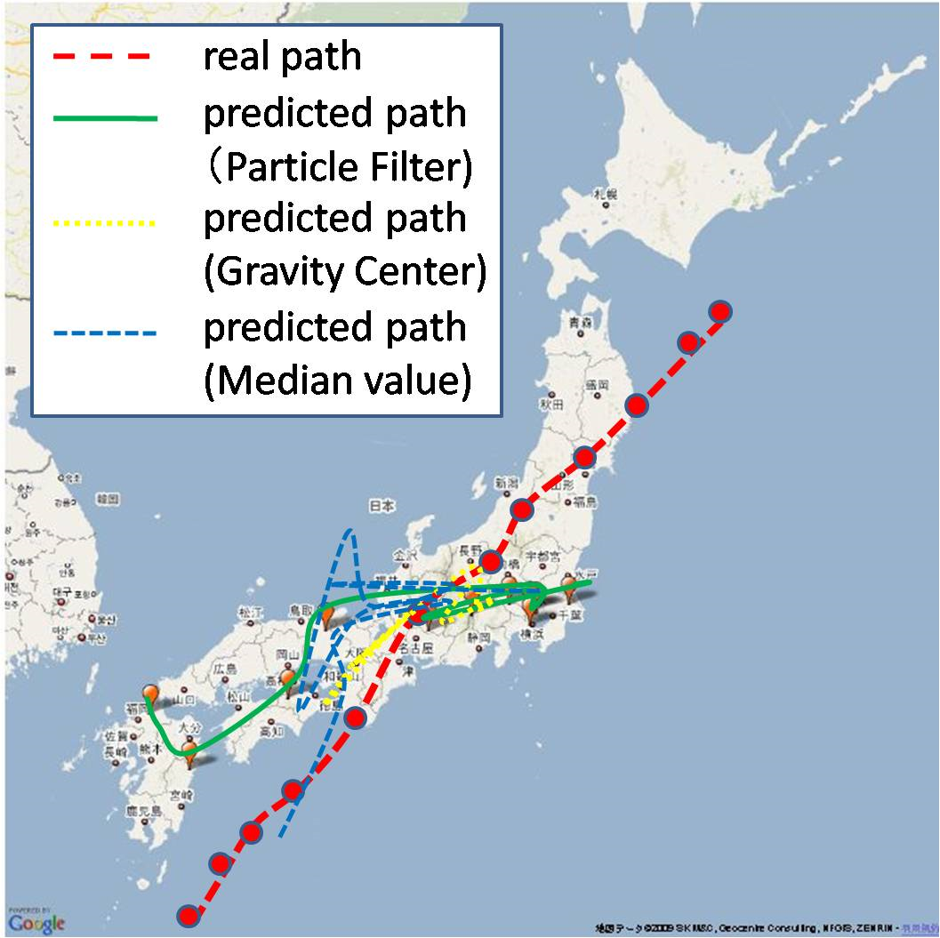
Evaluation of Spatial Estimation

Slide 46
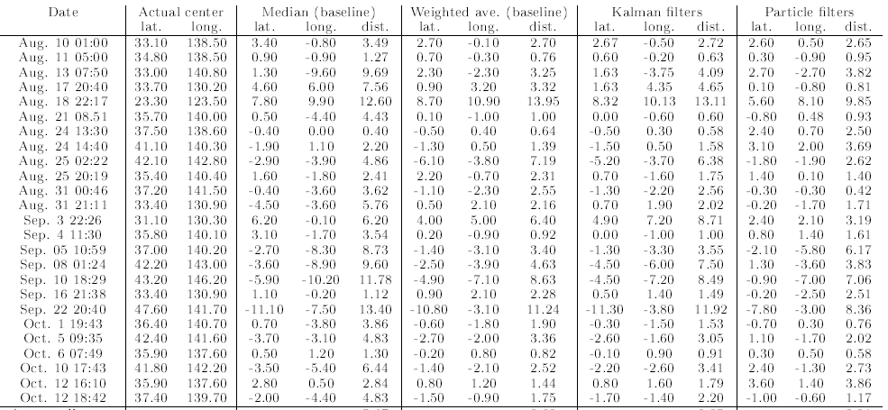
Evaluation of Spatial Estimation
Earthquakes
Date | Actual Center | Median | Weighed Average | Kalman Filter | Particle Filter
mean square errors of latitudes and longitude
Average | － | 5.47 | 3.62 | 3.85 | 3.01
Particle filters works better than other methods

Slide 47
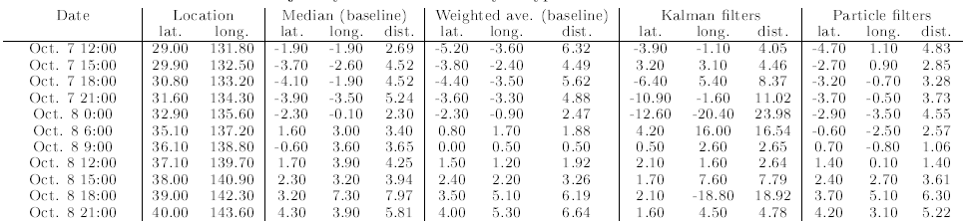
Evaluation of Spatial Estimation
A typhoon
Date | Actual Center | Median | Weighed Average | Kalman Filter | Particle Filter
mean square errors of latitudes and longitude
Average | － | 4.39 | 4.02 | 9.56 | 3.58
Particle Filters works better than other methods

Slide 48
Discussions of Experiments
Particle filters performs better than other methods
If the center of a target event is in an oceanic area, it’s more difficult to locate it precisely from tweets
It becomes more difficult to make good estimation in less populated areas

Slide 49
Earthquake Reporting System
Toretter ( http://toretter.com)
  Earthquake reporting system using the event detection algorithm
  All users can see the detection of past earthquakes
  Registered users can receive e-mails of earthquake detection reports
Dear Alice,
We have just detected an earthquake
around Chiba. Please take care.
Toretter Alert System

Slide 50
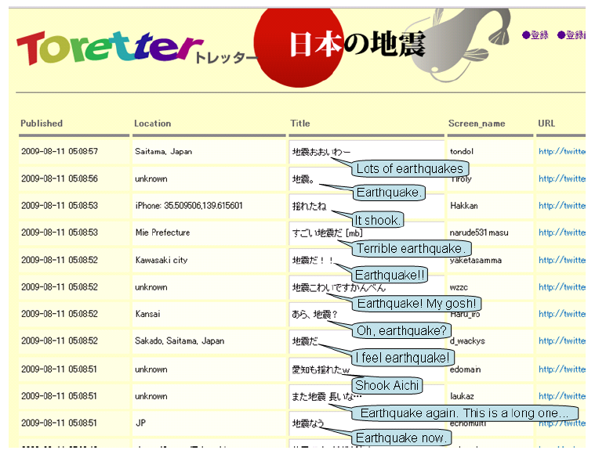
Screenshot of Toretter.com
Q: What would be a key feature of this system?

Slide 51
Earthquake Reporting System
Effectiveness of alerts of this system
  Alert E-mails urges users to prepare for the earthquake if they are received by a user shortly before the earthquake actually arrives.
Is it possible to receive the e-mail before the earthquake actually arrives?
  An earthquake is transmitted through the earth's crust at about 3~7 km/s.
  a person has about 20~30 sec before its arrival at a point that is 100 km distant from an actual center

Slide 52
Results of Earthquake Detection
Date | Magnitude | Location | Time | E-mail sent time | time gap [sec] | # tweets within 10 minutes | Announce of JMA
Aug. 18 | 4.5 | Tochigi | 6:58:55 | 7:00:30 | 95 | 35 | 7:08
Aug. 18 | 3.1 | Suruga-wan | 19:22:48 | 19:23:14 | 26 | 17 | 19:28
Aug. 21 | 4.1 | Chiba | 8:51:16 | 8:51:35 | 19 | 52 | 8:56
Aug. 25 | 4.3 | Uraga-oki | 2:22:49 | 2:23:21 | 31 | 23 | 2:27
Aug.25 | 3.5 | Fukushima | 2:21:15 | 22:22:29 | 73 | 13 | 22:26
Aug. 27 | 3.9 | Wakayama | 17:47:30 | 17:48:11 | 41 | 16 | 1:7:53
Aug. 27 | 2.8 | Suruga-wan | 20:26:23 | 20:26:45 | 22 | 14 | 20:31
Ag. 31 | 4.5 | Fukushima | 00:45:54 | 00:46:24 | 30 | 32 | 00:51
Sep. 2 | 3.3 | Suruga-wan | 13:04:45 | 13:05:04 | 19 | 18 | 13:10
Sep. 2 | 3.6 | Bungo-suido | 17:37:53 | 17:38:27 | 34 | 3 | 17:43
In all cases, we sent E-mails before announces of JMA (Japan Meteorological Agency)
In the earliest cases, it can sent E-mails in 19 sec.
On average, JMA announces 6 min after the earthquake

Slide 53
Experiments And Evaluation
We demonstrate performances of
  tweet classification
  event detection from time-series data
  → show this results in “application”
  location estimation from a series of spatial information

Slide 54
Results of Earthquake Detection
JMA intensity scale | 2 or more | 3 or more | 4 or more
Num of earthquakes | 78 | 25 | 3
Detected | 70(89.7%) | 24(96.0%) | 3(100.0%)
Promptly detected* | 53(67.9%) | 20(80.0%) | 3(100.0%)
JMA intensity scale: the original scale of earthquakes by Japan Meteorology Agency
Promptly detected: detected in a minute
Period: Aug.2009 – Sep. 2009
Tweets analyzed : 49,314 tweets
Positive tweets : 6291 tweets by 4218 users
It detected 96% of earthquakes that were stronger than scale 3 or more during the period.

Slide 55
Conclusions
It investigated the real-time nature of Twitter for event detection
Semantic analysis was applied to tweets classification
It considers each Twitter user as a sensor and set a problem to detect an event based on sensory observations
Location estimation methods such as Kaman filters and particle filters are used to estimate locations of events
It developed an earthquake reporting system, which is a novel approach to notify people promptly of an earthquake event
Authors plan to expand their system to detect events of various kinds such as rainbows, traffic jam etc.

Slide 56
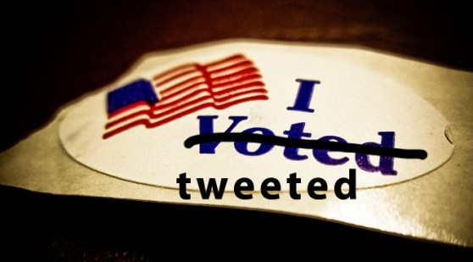
Paper2: "From tweets to polls: Linking text sentiment to public opinion time series.” O'Connor, Brendan, et al. ICWSM 11 (2010): 122-129.
Social Events

Slide 57

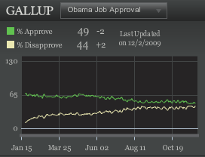
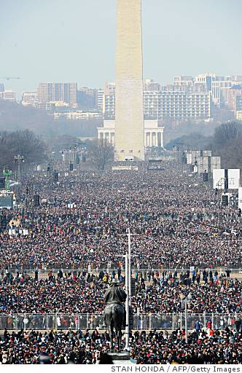

Measuring public opinion through social media?
People in U.S.
Query
Think about three possible benefits of using social media to measure public opinion
I like Obama
Can we derive a
similar measurement?
I do not
Aggregate
Text Sentiment Measure
Query
Write

Slide 58
Contributions
Correlations between
  Very simple text sentiment analysis
  Telephone public opinion polls
    Consumer confidence and Presidential job approval
Negative results as well!
Also
  Time-series smoothing is a critical issue
  Topic selection, topic volumes, text leads polls, stemming, election polling

Slide 59
Text Data: Twitter
A large and public social media service
  People volunteer their thoughts on various topics at a large scale
Sources
  Archiving the Twitter Streaming API
    “Gardenhose”/”Sample”: ~10-15% of public tweets
  Scrape of earlier messages
~2 billion messages before topic selection,
Jan 2008 – May 2010
It did not justify tweet users are good representations of the general population.

Slide 60
Message data
{
"text": "Time for the States to fight back !!! Tenth Amendment Movement: Taking On the Feds http://bit.ly/14t1RV #tcot #teaparty”,
"created_at": "Tue Nov 17 21:08:39 +0000 2009",
"geo": null,
"id": 5806348114,
"in_reply_to_screen_name": null,
"in_reply_to_status_id": null,
"user": {
"screen_name": "TPO_News",
"created_at": "Fri May 15 04:16:38 +0000 2009",
"description": "Child of God - Married - Gun carrying NRA Conservative - Right Winger hard Core Anti Obama (Pro America), Parrothead - www.ABoldStepBack.com #tcot #nra #iPhone",
"followers_count": 10470,
"friends_count": 11328,
"name": "Tom O'Halloran",
"profile_background_color": "f2f5f5",
"profile_image_url": "http://a3.twimg.com/profile_images/295981637/TPO_Balcony_normal.jpg",
"protected": false,
"statuses_count": 21147,
"location": "Las Vegas, Baby!!",
"time_zone": "Pacific Time (US & Canada)",
"url": "http://www.tpo.net/1dollar",
"utc_offset": -28800,
}
}

Slide 61
Message data used
{
"text": "Time for the States to fight back !!! Tenth Amendment Movement: Taking On the Feds http://bit.ly/14t1RV #tcot #teaparty”,
"created_at": "Tue Nov 17 21:08:39 +0000 2009”
}
Text
Timestamp
Message data not used:
  Locations from GPS
  Locations from IP addresses – not public
  User information (name, description, self-described location)
  Conversation structure: retweets, replies
  Social structure: follower network

Slide 62
Poll Data
Consumer confidence, 2008-2009
  Index of Consumer Sentiment (Reuters/Michigan)
  Gallup Daily (free version from gallup.com)
2008 Presidential Elections
  Aggregation, Pollster.com
2009 Presidential Job Approval
  Gallup Daily

Slide 63
Poll Data: Sample Questions
“We are interested in how people are getting along financially these days. Would you say that you (and your family living there) are better off or worse off financially than you were a year ago?”
“Now turning to business conditions in the country as a whole—do you think that during the next twelve months we’ll have good times financially, or bad times?”
Ask human sensors what they are good at: Binary Observations!

Slide 64
Text sentiment analysis method
Two-stage process
  1. Topic Selection: select topical tweets, via hand-selected keywords
  2. Sentiment Analysis: For one topic’s messages, count “sentiment polarity” words, from pre-existing lexicon
  (More sophisticated methods are possible, for both stages)

Slide 65
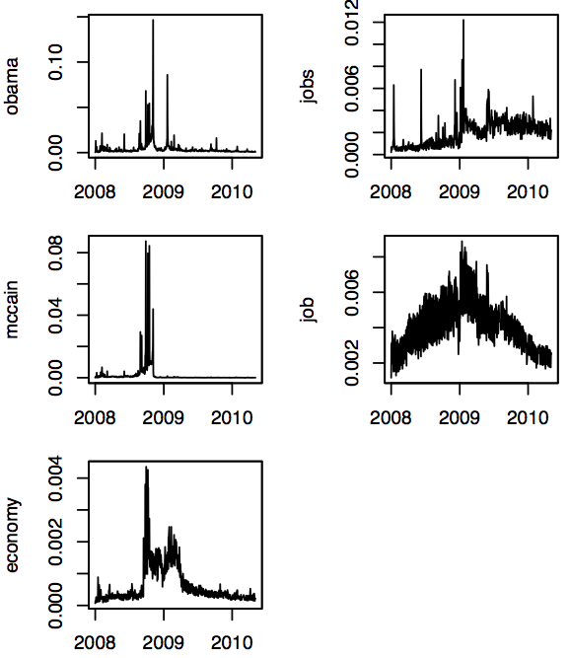
Message selection via topic keywords
Analyzed subsets of messages that contained manually selected topic keyword
  “economy”, “jobs”, “job” -> consumer confidence
  “obama”-> presidential approval
  “obama”, “mccain” -> elections
High day-to-day dynamics
  Fraction of messages containing keyword
  Nov 5 2008: 15% of tweets contain “obama”
Few messages
High dynamics

Slide 66
Opinion Estimation: Word Counting
Subjectivity Clues lexicon from OpinionFinder (Univ. of Pittsburgh)http://mpqa.cs.pitt.edu/opinionfinder/
  Wilson et al 2005
  1600 positive, 1200 negative words
Procedure
  Within topical messages,
  Count messages containing these positive and negative words
Sentiment Analysis Tool

Slide 67
A note on the sentiment list
This list is not well suited for social media English.
  “sucks”, “ :) ”, “ :( ”, “lol”
Examples for one day.
False Negatives
(Top examples)
word valence count
will positive 3934
bad negative 3402
good positive 2655
help positive 1971
(Random examples)
word valence count
funny positive 114
fantastic positive 37
cornerstone positive 2
slump negative 85
bearish negative 17
crackdown negative 5
False Positives

Slide 68
Sentiment Ratio over Messages
For one day t and a particular topic word, compute score
SentimentRatio( topic_word, t ) =

Slide 69
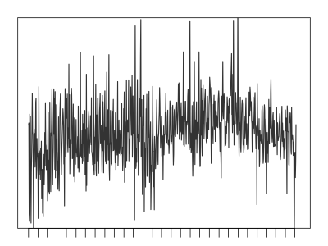
Sentiment Ratio Moving Average
High day-to-day dynamics.
Average last k days.
SentRatio (“jobs”),
k = 1
(Gallup tracking polls: 3 or 7-day smoothing)
Q: How to observe consistent behaviors over a longer period of time?

Slide 70
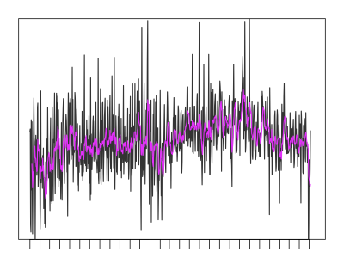
Sentiment Ratio Moving Average
High day-to-day volatility.
Average last k days.
SentRatio(“jobs”),
k = 1, 7
(Gallup tracking polls: 3 or 7-day smoothing)

Slide 71
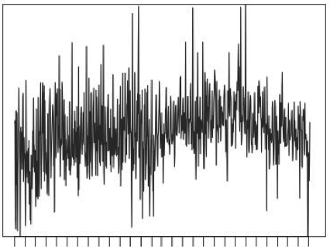
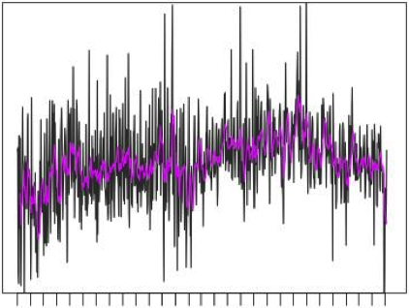

Sentiment Ratio Moving Average
High day-to-day volatility.
Average last k days
SentRatio(“jobs”),
k = 1, 7, 30
(Gallup tracking polls: 3 or 7-day smoothing)

Slide 72
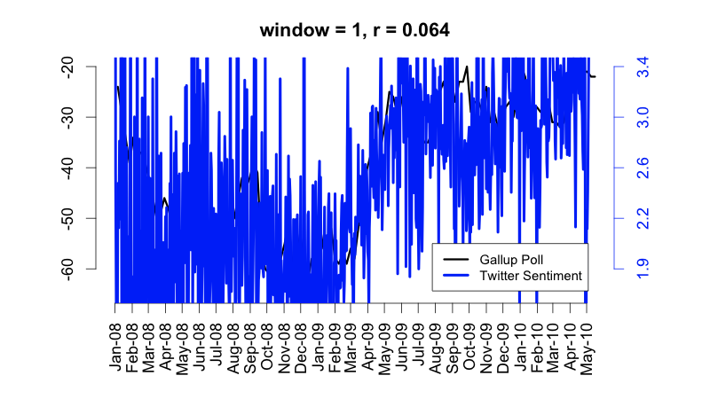
Smoothed comparisons
SentimentRatio(”jobs”)

Slide 73
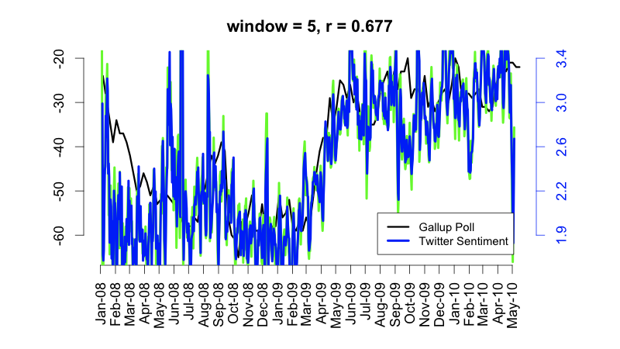
Smoothed comparisons
SentimentRatio(”jobs”)

Slide 74
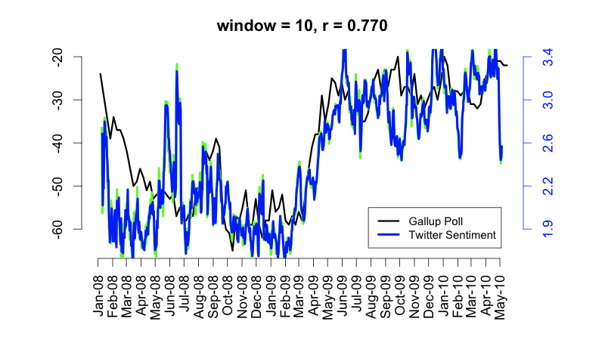
Smoothed comparisons
SentimentRatio(”jobs”)

Slide 75
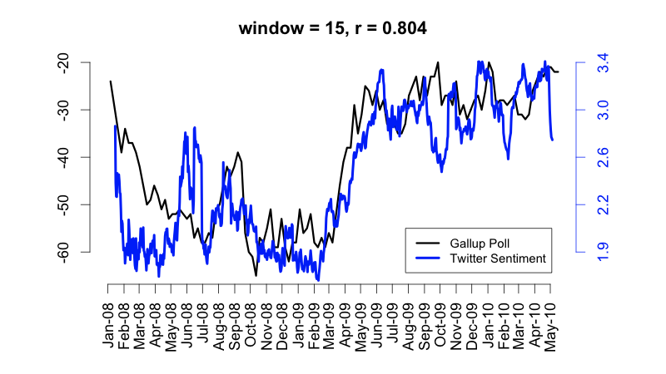
Smoothed comparisons
SentimentRatio(”jobs”)

Slide 76
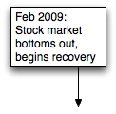
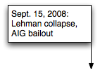
Smoothed comparisons
SentimentRatio(”jobs”)

Slide 77
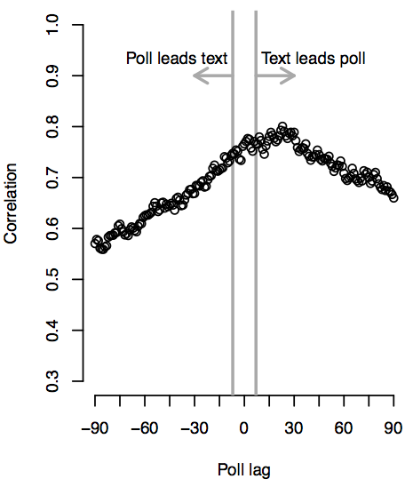
Which leads, poll or Twitter?
Cross-correlation analysis: between
  SentimentRatio(“jobs”) on day t
  Poll for day t+L
Twitter text is a leading indicator for polls
L= 20 days

Slide 78
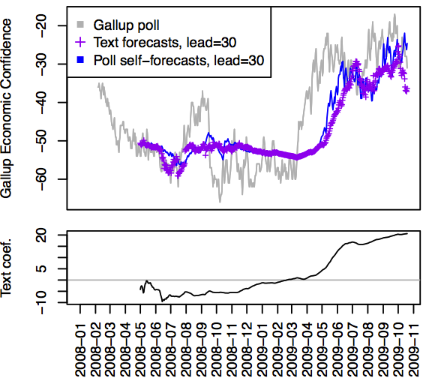
Predicting polls
Using text (tweets) is almost as good as using polling data itself at prediction

Slide 79
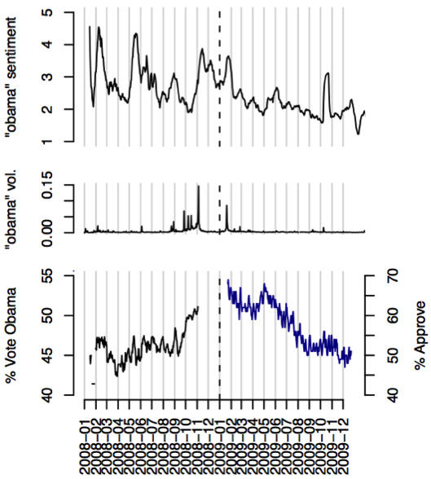
Presidential elections and job approval
Sentiment ratio has negative correlate to the election r = -8%
Looks easy : simple decline
r=72.5% k= 15
We should probably not strongly rely on Twitter to predict our president!

Slide 80
Remained Challenges
  Who is using Twitter?
    Massive changes over time (2009 Twitter != 2015 Twitter)
  Is Polling the Gold Standard?
    Other more reliable sources (e.g., face-to-face interviews)
  Better text analysis
    How to handle retweets and duplicated information (next lecture)
    Word sense ambiguity: “steve jobs”
  Less biased data
    Use demographic information on Twitter to reduce bias

