Slide 1
Online Social Media Sensing 2:
Geo-location and Redundant Content
CSE 40437/60437-Spring 2015
Prof. Dong Wang

Slide 2
Paper 3: "You are where you tweet: a content-based approach to geo-locating twitter users." Cheng, Zhiyuan, et. al. Proceedings of the 19th ACM international conference on Information and knowledge management. ACM, 2010.
Paper 4: "From tweets to polls: Linking text sentiment to public opinion time series.” O'Connor, Brendan, et al. ICWSM 11 (2010): 122-129.
Papers discuss today

Slide 3

Paper 3: "You are where you tweet: a content-based approach to geo-locating twitter users." Cheng, Zhiyuan, et. al. Proceedings of the 19th ACM international conference on Information and knowledge management. ACM, 2010.
Geo-locations of Tweets

Slide 4
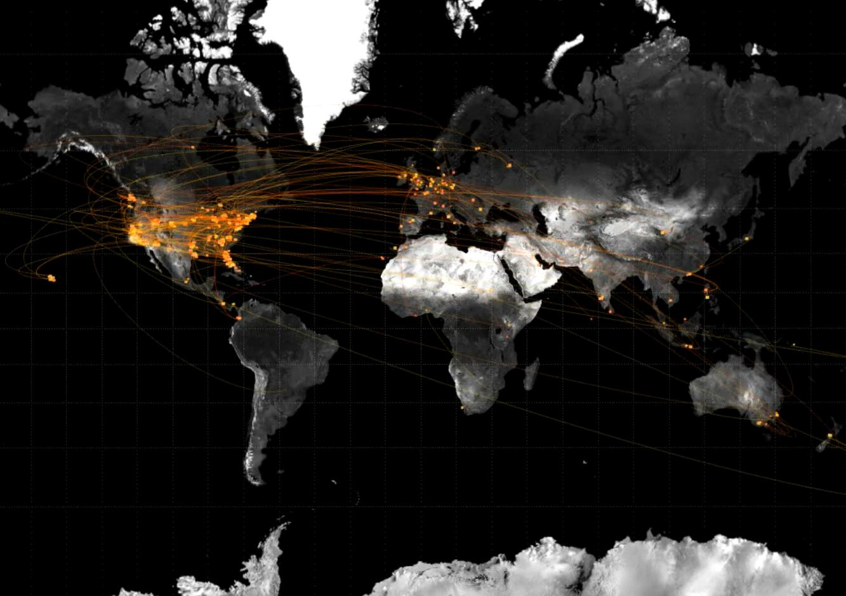
The Promise: Twitter as “human” sensing
500 million tweets per day

Slide 5
Question to think
How would you use the geo-location information of the twitter users or tweets if they are available?
What are the pros and cons of using such geo-information?

Slide 6
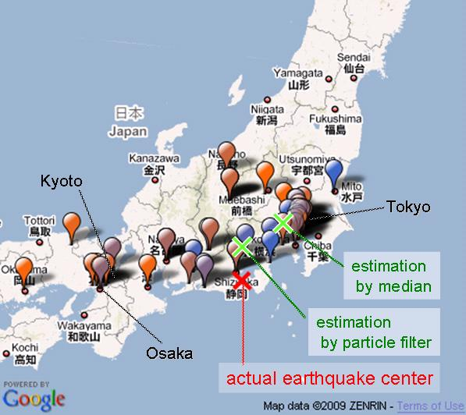
Example: Earthquake Detection
Earthquake shakes Twitter users, Sakaki et al, WWW 2010

Slide 7
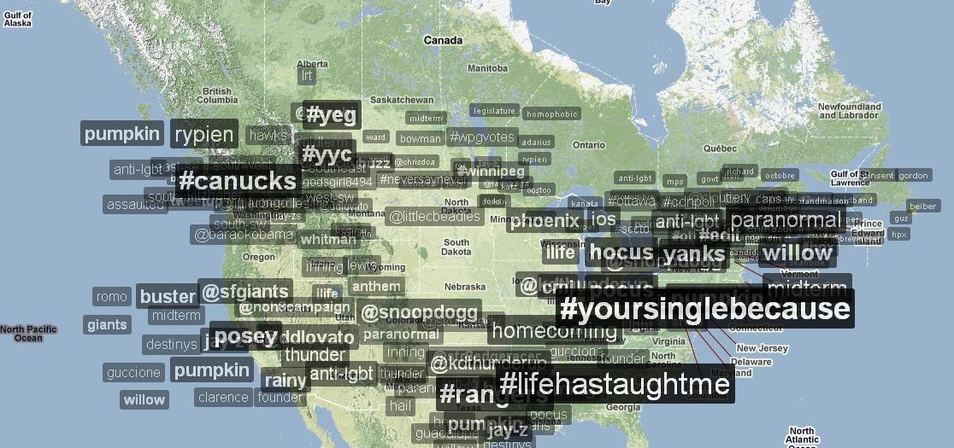
Example: Buzz Tracking
http://trendsmap.com/

Slide 8
And on and on …
New personalized location-based information services
  Local news service based on Twitter
  Targeting Ads based on user’s geo-location
Emergency management:
  Project EPIC at UC-Boulder: (http://epic.cs.colorado.edu/)
  Earthquake and fires detection
Tracking the diffusion of infectious diseases
  Google Flue-Trend like service based on Twitter

Slide 9

But … Location Sparsity is a Severe Problem
Dataset:
  Random sampling from public timeline.
  BFS sampling from 20 random seeds.
  ➔ 1M user profiles and 30M tweets
Only 21% of users list a location as granular as a city name
Only 5% of users list a location as granular as latitude/longitude coordinates
Rest are overly general, missing, or nonsensical
  “California”, “worldwide”, “Wonderland” …

Slide 10
But … Location Sparsity is a Severe Problem
{
"text": "Time for the States to fight back !!! Tenth Amendment Movement: Taking On the Feds http://bit.ly/14t1RV #tcot #teaparty”,
"created_at": "Tue Nov 17 21:08:39 +0000 2009",
"geo": null,
"id": 5806348114,
"in_reply_to_screen_name": null,
"in_reply_to_status_id": null,
"user": {
"screen_name": "TPO_News",
"created_at": "Fri May 15 04:16:38 +0000 2009",
"description": "Child of God - Married - Gun carrying NRA Conservative - Right Winger hard Core Anti Obama (Pro America), Parrothead - www.ABoldStepBack.com #tcot #nra #iPhone",
"followers_count": 10470,
"friends_count": 11328,
"name": "Tom O'Halloran",
"profile_background_color": "f2f5f5",
"profile_image_url": "http://a3.twimg.com/profile_images/295981637/TPO_Balcony_normal.jpg",
"protected": false,
"statuses_count": 21147,
"location": "Las Vegas, Baby!!",
"time_zone": "Pacific Time (US & Canada)",
"url": "http://www.tpo.net/1dollar",
"utc_offset": -28800,
}
}
Only 0.42% of tweets contain geocodes (i.e., geo/coordinate field of a tweet)

Slide 11
Goal: Predict Twitter User Location at a City Level
Requirements:
  Generalizable across social media sites and future human-centric sensing systems
  Provide accurate and reliable location estimation
  No need for proprietary data from system operators (e.g., backend database) or privacy-sensitive data from users (e.g., IP or user/pass)
Approach:
  Based purely on public content posted by user

Slide 12
Challenges
What are the challenges of doing content-based location estimation for Twitter data?

Slide 13
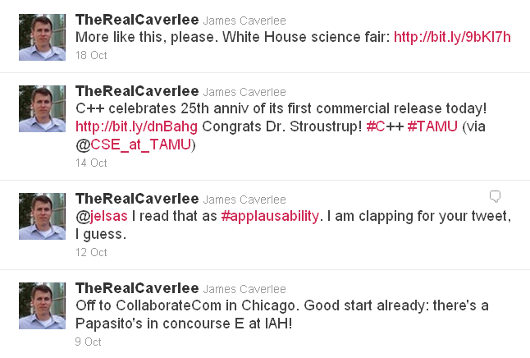
Content-Based Location Estimation: Challenges
Tweets are noisy, mixing a variety of daily interests.
Science Activity
C++
Conversation
Travel

Slide 14
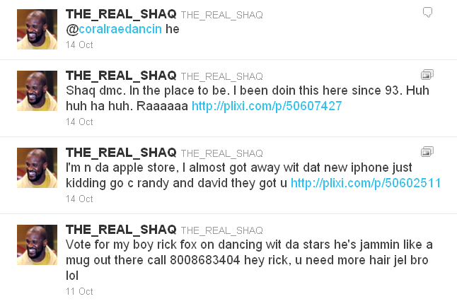
Content-Based Location Estimation: Challenges
Prevalence of shorthand and non standard vocabulary for informal communication
What?
dmc? Huh huh ha huh?
Raaaaaa?
n da? wit dat?
c? u?
jel? bro? lol?

Slide 15
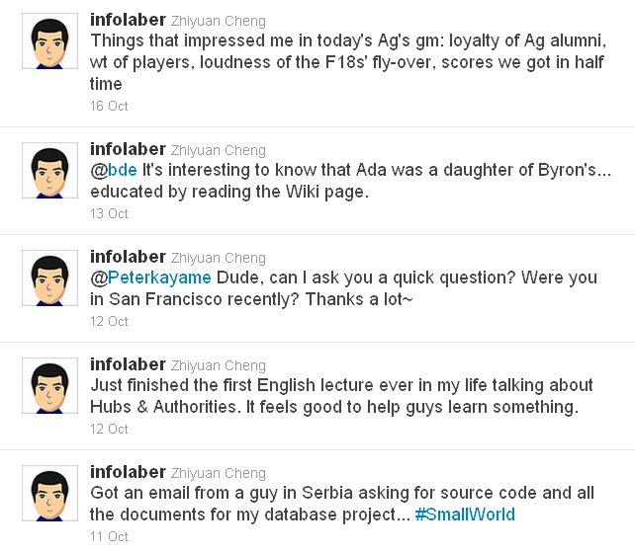
Content-Based Location Estimation: Challenges
A user may have interests that span multiple locations beyond their immediate home location
Texas A&M?
San Francisco??
Serbia???

Slide 16

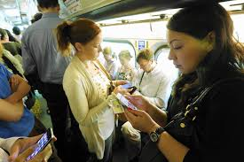
Content-Based Location Estimation: Challenges
A user may have more than one natural location, e.g., travel, commute, etc.

Slide 17
Training Datasets
Focus on users within the continental U.S.
Using city names in Census 2000 U.S. Gazetter to filter user profile with valid city names
For ambiguous city names, only consider “Cityname, StateName” or “Cityname, StateAbbreviation”
  E.g., 3 city named “Anderson”, 6 named “Madison”
12% of all sampled users (130,689) have valid and unambiguous city names

Slide 18
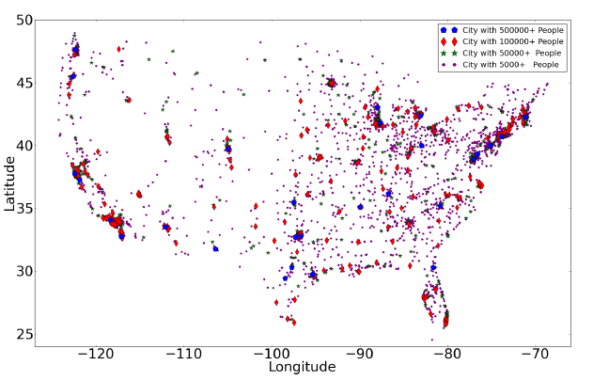
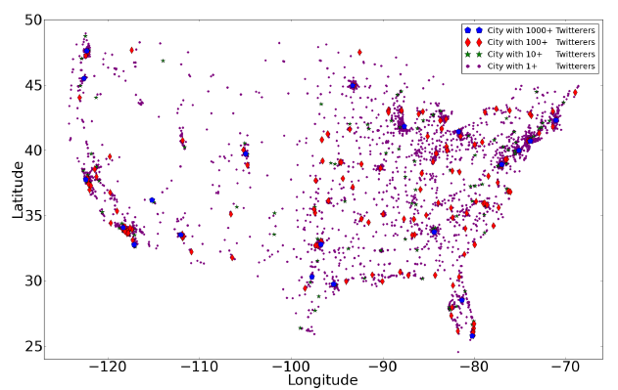
Comparison of US Population and Sample Twitter User Population
US Population
Sample Twitter User Population
Match Well!
The authors at least consider the sampling bias problem on Twitter.

Slide 19
Experimental Setup
Location Estimation Problem: Given a set of tweets S_{tweets}(u) posted by a Twitter user u, estimate a user’s probability of being located in city i: p(i|S_{tweets}(u)), such that the city with maximum probability l_{est}(u) is the user’s actual location l_{act}(u).
[Training Set]: 130K Twitter users with self-labeled city-level location within United States, and 4M tweets sampled from them.
[Test Set]: 5K Twitter users with 1K tweets each + lat/long (separate from the training set)
[Metrics]:
  Average Error Distance: distance in miles between the actual location of the user and the estimated location
  Accuracy (ACC): percentage of users with an error distance between 0-100 miles.

Slide 20
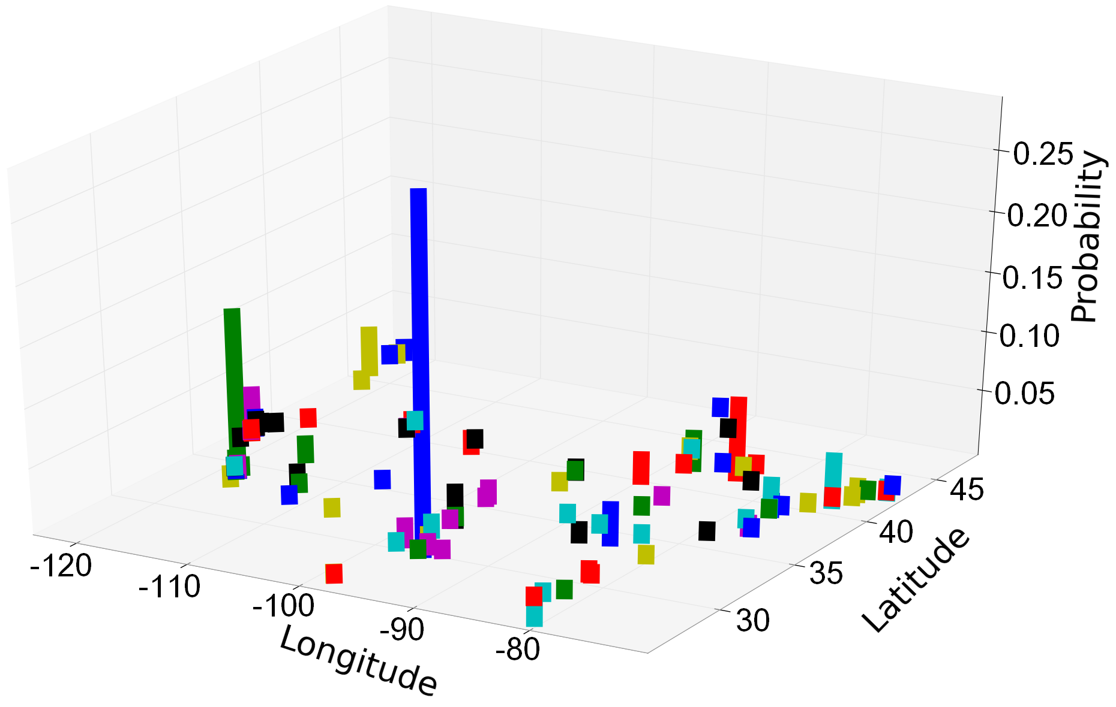
Probability of a Location Given a Word
Distribution of the word “Rockets”
Huston:
- Home of NASA
- NBA team Rockets

Slide 21
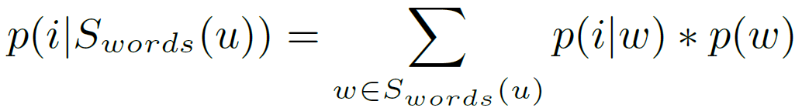
Baseline Estimator: Aggregate Over All Words
[Method]: Given the set of words extracted from user u’s tweets, aggregating the probability of city i given individual word w, will give us the probability of the user to be located in city i.

Slide 22

Baseline Location Estimation
[Results]:
  Average Error Distance: 1,773 miles
  Accuracy: 10.12% of users in the test data set are geo-located within 100 miles to the real locations

Slide 23
Two Key Observations
Observation #1:
  Most words provide very little power at distinguishing the location of a user. (e.g., August, peace, world)
  ➔Need a method to isolate “local words” (e.g., “howdy” is a typical greeting word used in Texas)
Observation #2:
  Per-city word distributions for small cities are under-specified leading to large estimation errors.
  ➔Need a method to overcome this sparsity

Slide 24
How to identify the local words?

Slide 25
Identifying Local Words in Tweets
Local Words: A high local focus and fast dispersion
Non-local Words: many multiple central points with no clear dispersion
Q: How do we assess spatial focus and dispersion?

Slide 26
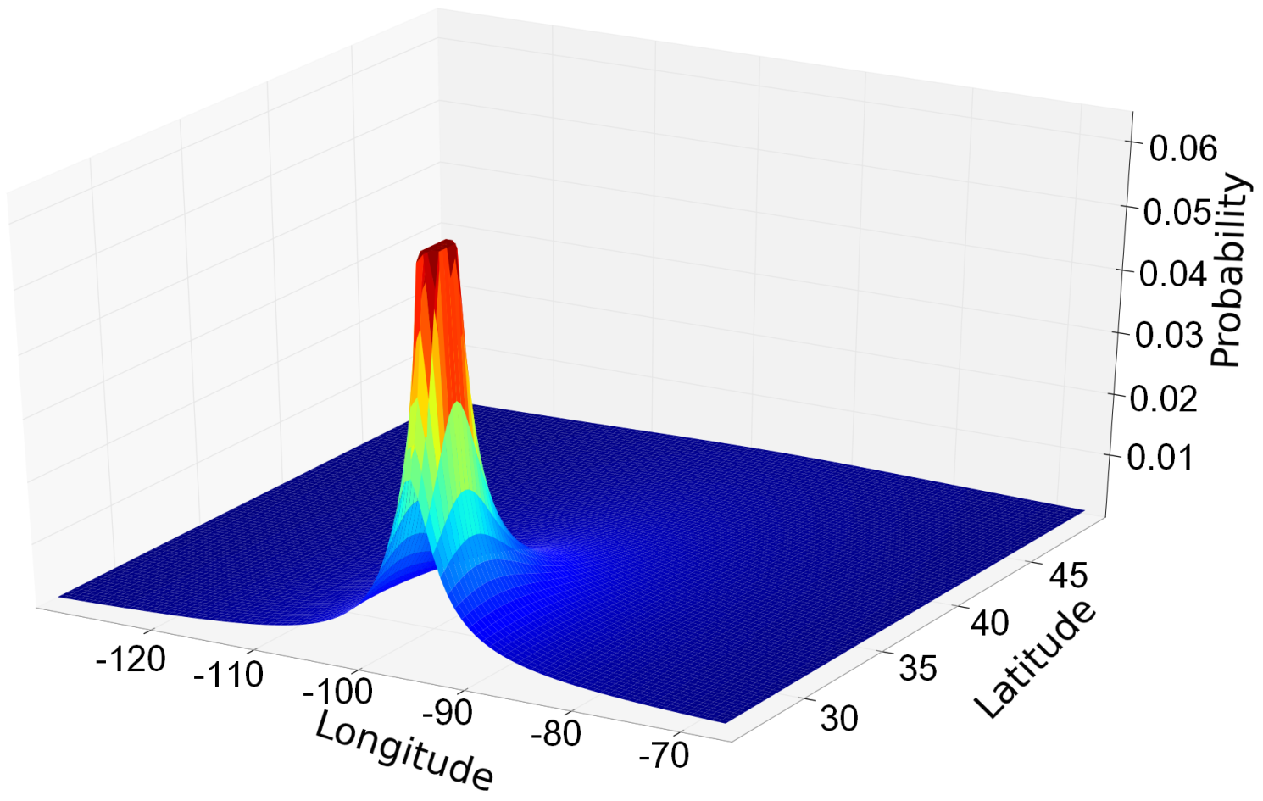
Identifying Local Words in Tweets
Enlightened by Backstrom’s model [Backstrom et al. WWW 08], generate a model for each word according to the observed probabilistic distribution, in the form of:
C: central frequency
a: how fast the frequency falls
Model of word “Rockets”

Slide 27
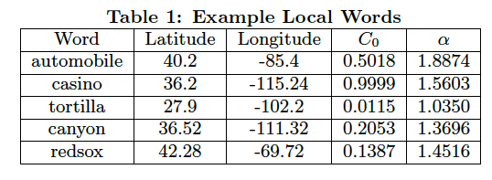
Identifying Local Words in Tweets
Manual classified some models as local words, and train classifiers with the labeled set to categorize other models. Finally, 3,615 words are classified as local words.
Detroit
Las Vegas
Border of Texas and Mexico
Grand Canyon
Boston

Slide 28
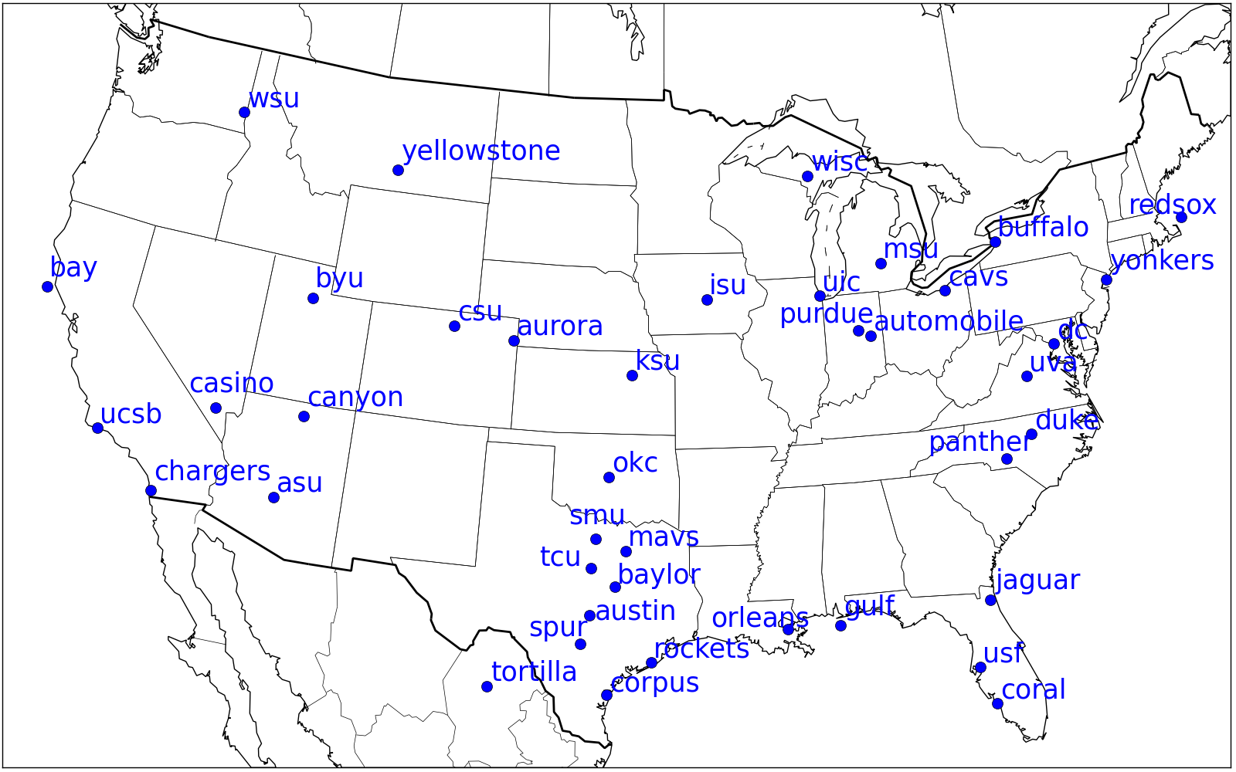
Identifying Local Words in Tweets
Manual classified some models as local words, and train classifiers with the labeled set to categorize other models. Finally, 3,615 words are classified as local words.

Slide 29
How to overcome tweet sparsity?

Slide 30



Overcoming Tweet Sparsity
Laplace Smoothing:
State-Level Smoothing:
Lattice-Based Neighborhood Smoothing:
Ignore geographic information
Coarse grained: State
Fine grained: Lattice

Slide 31
Impact of Refinements
Method | ACC | AvgErrDist (Miles)
Baseline | 0.101 | 1773.146
+ Local Filtering (LF) | 0.498 | 539.191
+ LF + Laplace | 0.480 | 587.551
+ LF + State-Level | 0.502 | 551.436
+ LF + Neighborhood | 0.510 | 535.564
+ LF + Model-based | 0.250 | 719.238
Key: Local Filtering.
#1 Smoothing Technique: Neighborhood-based smoothing.

Slide 32
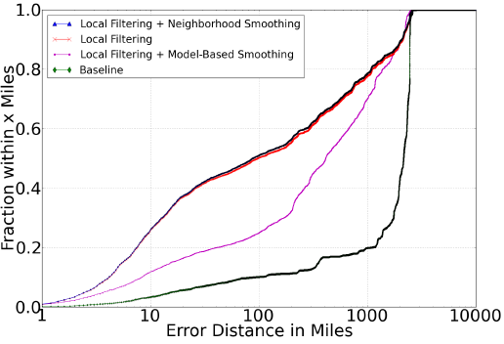
Comparison Across Estimators
51%
30%

Slide 33
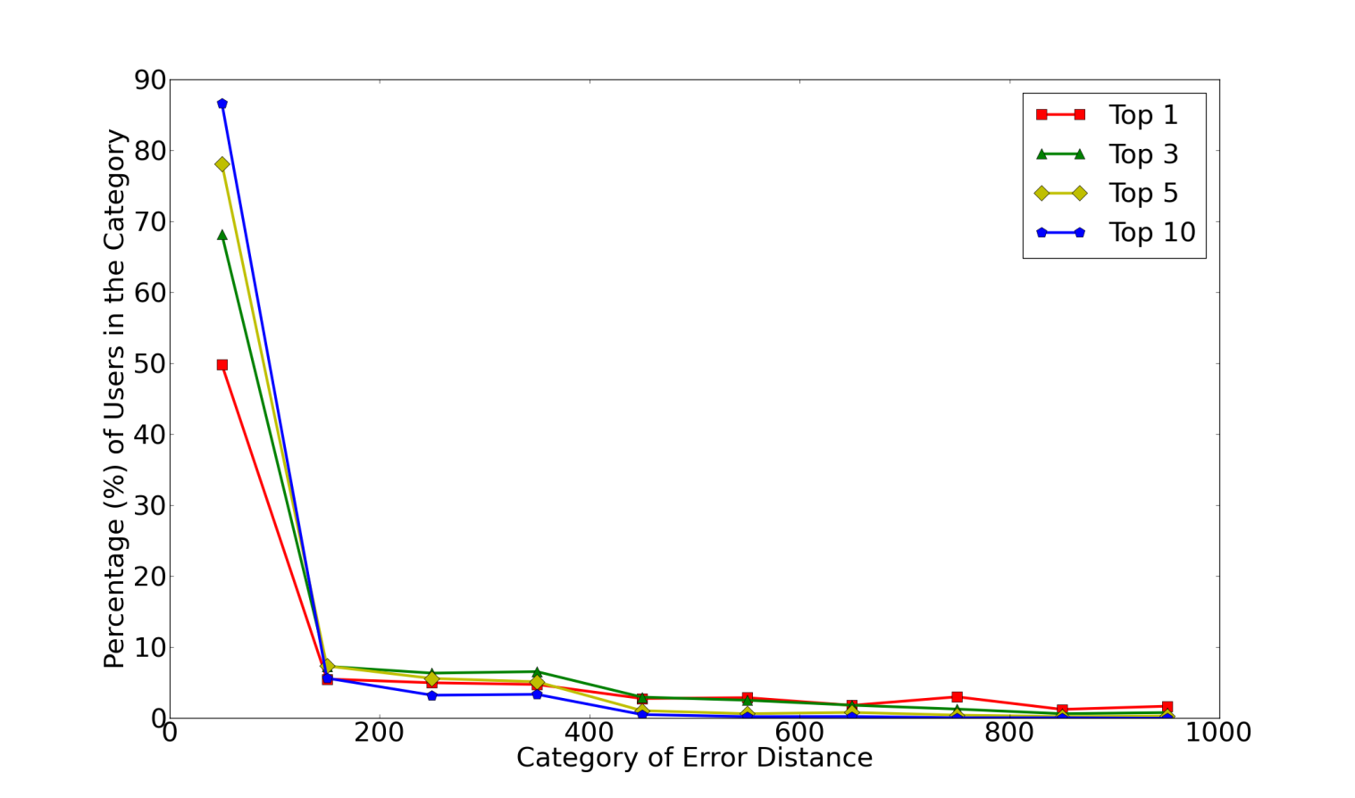
Capacity of the Location Estimator
40% improvement by increasing k from 1 to 10
There are still rooms to improve the accuracy for the top 1 prediction!
Accuracy is dramatically improved as they increase k, and almost 90% of users are located within 100 miles of their actual locations in the top 10.

Slide 34
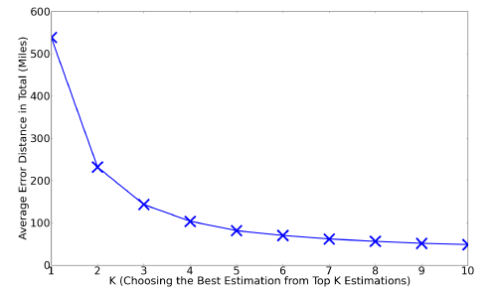
Average Error Distance vs k
More than 400 miles error reduced by increasing k from 1 to 10

Slide 35
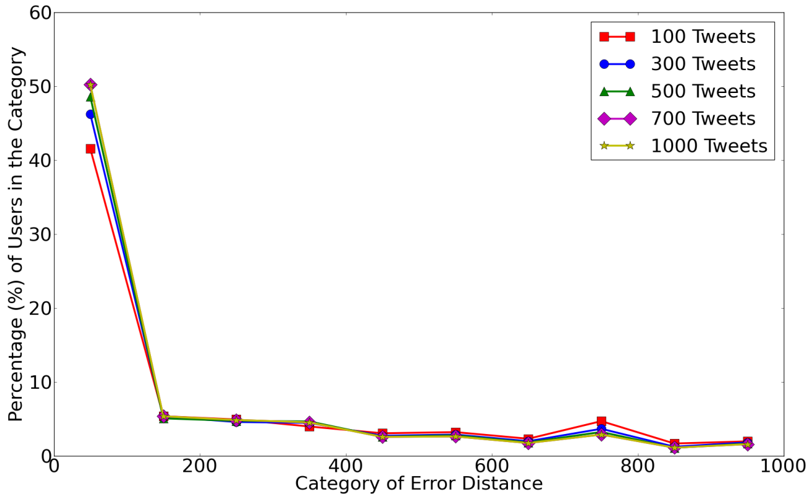
Estimation Quality: Number of Tweets
Examine whether they can achieve equally good estimation results using only 100 tweet or a few 100s.
10% drop by reducing the # of tweets per user from 1k to 100
Even with only 100 tweets, 40%+ users are located within 100 miles.

Slide 36
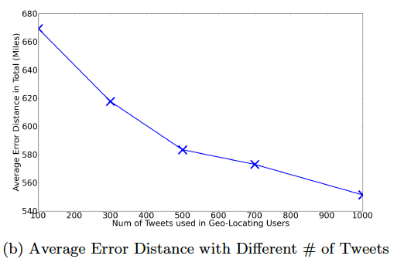
Estimation Quality: Number of Tweets
Examine whether they can achieve equally good estimation results using only 100 tweet or a few 100s.
100 miles more in error by reducing the # of tweets per user from 1k to 100
Even with only 100 tweets, 40%+ users are located witin 100 miles.

Slide 37
Conclusions and Next Steps
Proposed and evaluated a probabilistic framework for estimating a Twitter user's city-level location based purely on the content of the user's tweets.
Can place 51% of Twitter users within 100 miles of their actual location.
What next?
  More data = better location estimation
  Incorporate social ties into the estimator
  Explore temporal aspect of location estimation

Slide 38
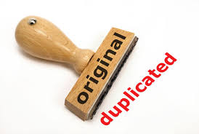
Paper 4: "Groundhog day: near-duplicate detection on twitter." Tao, Ke, et al. Proceedings of the 22nd international conference on World Wide Web. International World Wide Web Conferences Steering Committee, 2013.
Duplicate Detection on Twitter

Slide 39

Groundhog Day
Film released on Feb. 12 1993.
Story: A weather man finds himself in a time loop, repeating the same day again and again.

Slide 40
Outline
Search & Retrieval on Twitter
Duplicate Content on Twitter
Near-duplicates in Twitter Search
Solution to Twitter Search: the Twinder Framework
Analysis & Evaluation
Conclusion

Slide 41
Search & Retrieval on Twitter
How do people use Twitter as a source of information?
Twitter is more like a news media.
How do people search on Twitter? [Teevan et al.]
  Repeated queries & monitoring for new content
Problems:
  Short tweets ➔ lots of similar information
  Few people produce contents ➔ many retweets, copied content
J. Teevan, D. Ramage, and M. R. Morris. #TwitterSearch: A Comparison of Microblog Search and Web Search. In Proceedings of the 4th International Conference on Web Search and Web Data Mining (WSDM), 2011.

Slide 42
Duplicate Content on Twitter (1/3)
Classification of near-duplicates in 5 levels
Exact copy
  Completely identical in terms of characters.
Nearly exact copy
  Completely identical except for #hashtags, URLs or @mentions
t1: Huge New Toyota Recall Includes 245,000 Lexus GS, IS Sedans - http://newzfor.me/?cuye
t2: Huge New Toyota Recall Includes 245,000 Lexus GS, IS Sedans - http://newzfor.me/?cuye
t3: Huge New Toyota Recall Includes 245,000 Lexus GS,
IS Sedans - http://bit.ly/ibUoJs

Slide 43
Duplicate Content on Twitter (2/3)
Classification of near-duplicates in 5 levels
Strong near-duplicate
  Same core message, one tweet contains more information.
Weak near-duplicate
  Same core message, one tweet contains personal views.
  Convey semantically the same message with differing information nuggets.
t4: Toyota recalls 1.7 million vehicles for fuel leaks: Toyota’s latest recalls are mostly in Japan, but they also... http://bit.ly/dH0Pmw
t5: Toyota Recalls 1.7 Million Vehicles For Fuel Leaks http://bit.ly/flWFWU
t6: The White Stripes broke up. Oh well.
t7: The White Stripes broke up. That’s a bummer for me.

Slide 44
Duplicate Content on Twitter (3/3)
Classification of near-duplicates in 5 levels
Low overlap
  Semantically contain the same core message, but only have a few words in common
t8: Federal Judge rules Obamacare is unconsitutional...
t9: Our man of the hour: Judge Vinson gave Obamacare its second unconstitutional ruling. http://fb.me/zQsChak9

Slide 45
Near-Duplicates in Twitter Search (1/2)
Analysis of the Tweets2011 corpus
For the 49 topics (queries), 2,825 topic-tweet pairs are relevant, 57 tweets/topic
They manually labeled 55,362 tweet pairs
They found 2,745 pairs of duplicates in different levels.
People like to tweet their personal opinions.

Slide 46
Near-Duplicates in Twitter Search (2/2)
Motivation
For each of the 49 topics, rank the tweets according to their relevance to the topic (using previous work)
On average, they found around 20% duplicates in the search results.
Range | Top 10 | Top 20 | Top 50 | All
Duplicate % | 19.4% | 22.2% | 22.5% | 22.3%

Slide 47
Twinder Framework
Search Infrastructure

Slide 48
Building a Classifier … (1/5)
Overview of the syntactic features
Features | Description
Levenshtein distance | Number of characters required to change (substitution, insertion, deletion) one tweet to the other
Overlap in terms | Jaccard similarity between two sets of words in tweets.
Overlap in #hashtags | Jaccard similarity between two sets of #hashtags in tweets.
Overlap in URL | Jaccard similarity between two sets of URLs in tweets.
Overlap in expanded URL | Recomputed “Overlap in URL” after expanding shortened URLs in both tweets.
Length difference | The difference in length between two tweets.

Slide 49
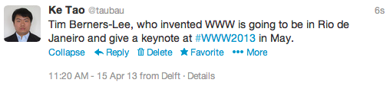
Building a Classifier … (2/5)
Extract semantics from tweets (using information extraction tool to extract entities)
dbp:Tim_Berners-Lee
dbp:World_Wide_Web
Dbpedia Spotlight (dbp): locate and classify elements in text into pre-defined categories such as the names of persons, organizations, locations,, etc.
dbp:Rio_de_Janeiro
dbp:International_World_Wide_Web_Conference
Topic:Internet_Technology

Slide 50
Building a Classifier … (3/5)
Overview of the semantic features
WordNet: a large lexical database of English. Nouns, verbs, adjectives and adverbs are grouped into sets of cognitive synonyms (synsets), each expressing a distinct concept.
http://wordnet.princeton.edu/
Examples:
-Fire, flame, blaze
-Explosion, blast, blow up

Slide 51
Building a Classifier … (3/5)
Overview of the semantic features
Features | Description
Overlap in Entities | Jaccard similarity between two sets of entities extracted from two tweets
Overlap in Entities Types | Jaccard similarity between two sets of types of entities from two tweets
Overlap in Topics | Jaccard similarity between two sets of detected topics in two tweets
Overlap in WordNet Concepts | Jaccard similarity between two sets of WordNet Nouns in tweets
Overlap in WordNet Synset Concepts | Recomputed Overlap in WordNet Concepts after Combining interlinked Concepts in Synsets
WordNet similarity | The similarity calculated based on semantic relatedness* between concepts from two tweets

Slide 52

Building a Classifier … (4/5)
Enriched semantic features
Integrate content from external resources and construct the same set of semantic features
t3: Huge New Toyota Recall Includes 245,000 Lexus GS,
IS Sedans - http://bit.ly/ibUoJs

Slide 53
Building a Classifier … (5/5)
Overview of contextual features
Features | Description
Temporal difference | The difference of posting time of two tweets
Difference in #followees | The difference in number of followees of the author of the tweets
Difference in #followers | The difference in number of followers of the author of the tweets
Same client | Indicator of whether the two tweets are posted from the same client application

Slide 54
Summary of Features
What feature categories do they have?
  Syntactical features (6)
  Semantic features (6)
  Enriched semantic features (6)
  Contextual features (4)
Classification strategies ➔ different feature combinations
  Dependent on available resources and time constraints

Slide 55
Classification Strategies
Using different sets of features for near-duplicate detection on Twitter
Strategy | Description
Baseline | Based on Levenshstein distance
Sy | Only Syntactical features
SySe | Add semantics from tweets
SyCo | Without Semantics
SySeCo | Without Enriched Semantics
SySeEn | Without Contextual features
SySeEnCo | All Feature included

Slide 56
Analysis and Evaluation
Research Questions:
  R1: How accurately can the different duplicate detection strategies identify duplicates?
  R2: What kind of features are of particular importance for duplicate detection?
  R3: How does the accuracy vary for the different levels of duplicates?
  R4: How do the duplicate detection strategies impact search effectiveness on Twitter?

Slide 57
Data set: Tweets2011
TREC 2011 Microblog Track
Twitter corpus
  16 million tweets (Jan. 24th, 2011 – Feb. 8th)
  4,766,901 tweets classified as English
  6.2 million entity-extractions (140k distinct entities)
Relevance judgments
  49 topics
  40,855 (topic, tweet) pairs, 2,825 judged as relevant
  57.65 relevant tweets per topic (on average)
Duplicate level labeling
  55,362 tweet pairs labeled
  2,745 labeled as duplicates (in 5 levels)
  Publicly available at http://wis.ewi.tudelft.nl/duptweet/

Slide 58
Classification Accuracy
Duplicate or not? → RQ1
Features | Precision | Recall | F-measure
Baseline | 0.5068 | 0.1913 | 0.2777
Sy | 0.5982 | 0.2918 | 0.3923
SyCo | 0.5127 | 0.3370 | 0.4067
SySe | 0.5333 | 0.3679 | 0.4354
SySeEn | 0.5297 | 0.3767 | 0.4403
SySeCo | 0.4816 | 0.4200 | 0.4487
SySeEnCo | 0.4868 | 0.4299 | 0.4566
Overall, they can achieve a precision and recall of about 49% and 43% respectively by applying all possible features.

Slide 59
Feature Weights (1/2)
Which features matter the most? → RQ2

Slide 60
Feature Weights (2/2)
Which features matter the most? → RQ2

Slide 61
Results for Predicting Duplicate Levels (1/2)
Exact copy, weak near-duplicate, … or low overlap? → RQ3
Features | Precision | Recall | F-measure
Baseline | 0.5553 | 0.5208 | 0.5375
Sy | 0.6599 | 0.5809 | 0.6179
SyCo | 0.6747 | 0.5889 | 0.6289
SySe | 0.6708 | 0.6151 | 0.6417
SySeEn | 0.6694 | 0.6241 | 0.6460
SySeCo | 0.6852 | 0.6198 | 0.6508
SySeEnCo | 0.6739 | 0.6308 | 0.6516
Overall, they achieve a precision and recall of about 67% and 63% respectively by applying all features.

Slide 62
Results for Predicting Duplicate Levels (2/2)
Exact copy, weak near-duplicate, … or low overlap? → RQ3
F -Measure
Q: What information can you extract from this figure?

Slide 63
Search Result Diversification
How much redundancy can they detect and remove? → RQ4
A core application of near-duplicate detection strategies is the diversification of search results. They simply remove the duplicates that are identified by our method.
Near-duplicates after filtering:
Range | Top10 | Top20 | Top50 | All
Baseline | 19.4% | 22.2% | 22.5% | 22.3%
After Filtering | 9.1% | 10.5% | 12.0% | 12.1%
Improvement | +53.1% | +52.0% | +46.7% | +45.7%

Slide 64
Revisit Twinder Framework
Less redundant and more diversified results!

Slide 65
Conclusions
Conduct an analysis of duplicate content in Twitter search results and infer a model for categorizing different levels of duplicity.
Develop a near-duplicate detection framework for microposts that provides functionality for analyzing 4 categories of features.
Given duplicate detection framework, the paper performs extensive evaluations and analysis of different duplicate detection strategies on a large, standardized Twitter corpus to investigate the quality of (i) detecting duplicates and (ii) categorizing the duplicity level of two tweets.
The proposed approach enables search result diversification and analyzes the impact of the diversification on the search quality.
The progress on Twinder on be found at:
http://wis.ewi.tudelft.nl/twinder/

