Slide 1

Big Data Processing
CSE 40437/60437-Spring 2015
Prof. Dong Wang

Slide 2
Key Questions to Answer
Why Hadoop?
What is Hadoop?
How to Hadoop?
Examples of Hadoop

Slide 3
Why is Hadoop ?

Slide 4
What is Big Data
A bunch of data?
A technical term?
An industry?
A trend?
A set of skills?
…
What is your interpretation of BIG DATA?

Slide 5
What is Big Data
Wikipedia big data
  An all-encompassing term for any collection of data sets so large and complex that it becomes difficult to process using on-hand data management tools or traditional data processing applications.

Slide 6
How big is big?
2008: Google processes 20 PB a day
2009: Facebook has 2.5 PB user data + 15 TB /day
2011: Yahoo! has 180-200 PB of data
2012: Facebook ingests 500 TB/day
2013: YouTube 1000 PB video storage; 4 billion views/day
1 PB=10^3 TB=10^6 GB=10^15 B
1 Exabyte = 1000 PB
Zettabyte, Yottabyte …
Notes:
alphabets

Slide 7
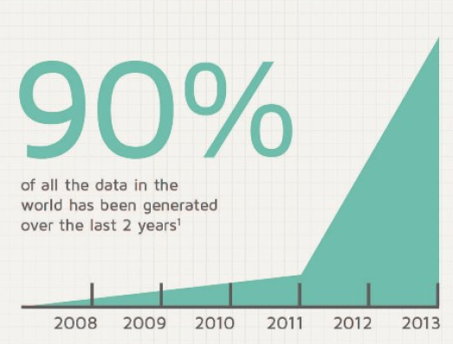
The percentage of all data in the word that has been generated in last 2 years?

Slide 8
Who is generating Big Data?

Slide 9











Who is generating Big Data?
Social
User Tracking & Engagement
Homeland Security
eCommerce
Financial Services
Real Time Search

Slide 10

That is a lot of data …

Slide 11
What are Key Features of Big Data?
Volume
Velocity
Petabyte scale
Social Media
Sensor
Throughput
Big Data
Variety
4 Vs
Veracity
Structured
Semi-structured
Unstructured
Unclean
Imprecise
Unclear

Slide 12
Philosophy to Scale for Big Data?

Slide 13
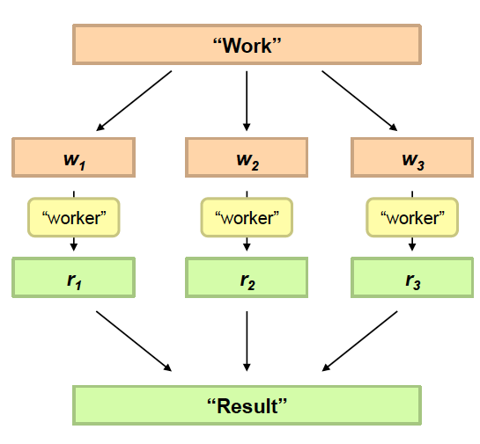
Divide and Conquer
Divide Work
Combine Results

Slide 14

Distributed processing is non-trivial
How to assign tasks to different workers in an efficient way?
What happens if tasks fail?
How do workers exchange results?
How to synchronize distributed tasks allocated to different workers?

Slide 15

Big data storage is challenging
Data Volumes are massive
Reliability of Storing PBs of data is challenging
All kinds of failures: Disk/Hardware/Network Failures
Probability of failures simply increase with the number of machines …
Notes:
A single machine fails with a probability of 1%, what is the probability to have a server failure in a machine room with 10 machines: 10%. What is the probability to have a server failure in a machine room with 100 machines: 100%. We need to face the failure.

Slide 16
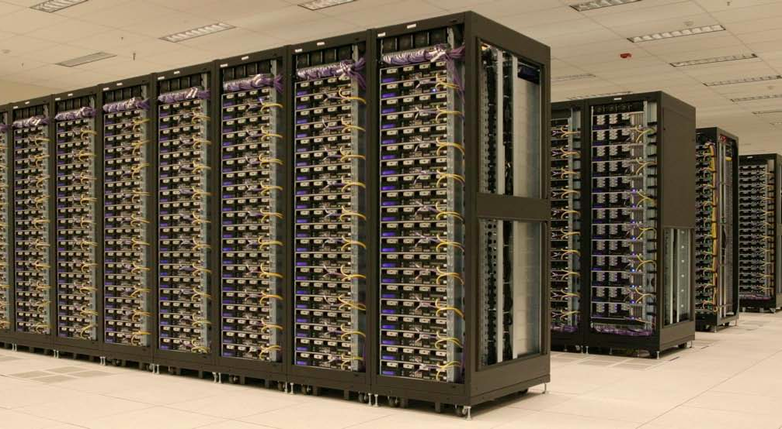
One popular solution: Hadoop
Hadoop Cluster at Yahoo! (Credit: Yahoo)

Slide 17

Hadoop offers
Redundant, Fault-tolerant data storage
Parallel computation framework
Job coordination

Slide 18


Hadoop offers
Redundant, Fault-tolerant data storage
Parallel computation framework
Job coordination
Q: Where file is located?
No longer need to worry about
Q: How to handle failures & data lost?
Q: How to divide computation?
Programmers
Q: How to program for scaling?

Slide 19



A real world example of New York Times
Goal: Make entire archive of articles available online: 11 million, from 1851
Task: Translate 4 TB TIFF images to PDF files
Solution: Used Amazon Elastic Compute Cloud (EC2) and Simple Storage System (S3)
Time: ?
Costs: ?
Notes:
New York Times Faced Challenge in 2007:
Challenging and Complicated Computing Chore
http://www.greenm3.com/gdcblog/2008/11/5/nytimes-aws-cloud-computing-mistake-cost-240.html

Slide 20
A real world example of New York Times
Goal: Make entire archive of articles available online: 11 million, from 1851
Task: Translate 4 TB TIFF images to PDF files
Solution: Used Amazon Elastic Compute Cloud (EC2) and Simple Storage System (S3)
Time: < 24 hours
Costs: $240
Notes:
New York Times Faced Challenge in 2007:
Challenging and Complicated Computing Chore
http://www.greenm3.com/gdcblog/2008/11/5/nytimes-aws-cloud-computing-mistake-cost-240.html

Slide 21

So we are

Slide 22

A little history on Hadoop
Hadoop is an open-source implementation based on Google File System (GFS) and MapReduce from Google
Hadoop was created by Doug Cutting and Mike Cafarella in 2005
Hadoop was donated to Apache in 2006

Slide 23
Who are using Hadoop?
Social
User Tracking & Engagement
Homeland Security
“By 2015, 50% of Enterprise data will be processed by Hadoop” –Yahoo!
eCommerce
Financial Services
Real Time Search

Slide 24
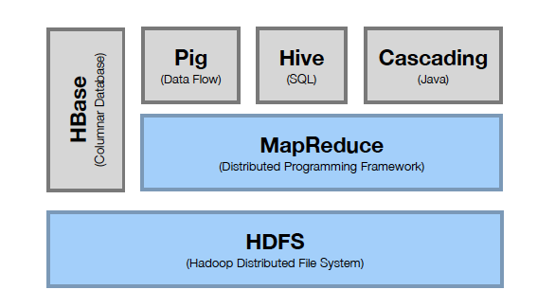
Hadoop Stack
Computation
Storage

Slide 25
Hadoop Resources
Hadoop at ND:
http://ccl.cse.nd.edu/operations/hadoop/
Apache Hadoop Documentation:
http://hadoop.apache.org/docs/current/
Data Intensive Text Processing with Map-Reduce
http://lintool.github.io/MapReduceAlgorithms/
Hadoop Definitive Guide:
http://www.amazon.com/Hadoop-Definitive-Guide-Tom-White/dp/1449311520

Slide 26
HDFS
Hadoop Distributed File System

Slide 27
HDFS Outline
Motivation
Architecture and Concepts
Inside
User Interface

Slide 28
Motivation Questions
Problem 1: Data is too big to store on one machine.
HDFS: Store the data on multiple machines!

Slide 29
Motivation Questions
Problem 2: Very high end machines are too expensive
HDFS: Run on commodity hardware!

Slide 30
Motivation Questions
Problem 3: Commodity hardware will fail!
HDFS: Software is intelligent enough to handle hardware failure!
Notes:
1%-10%-100%

Slide 31
Motivation Questions
Problem 4: What happens to the data if the machine stores the data fails?
HDFS: Replicate the data!

Slide 32
Motivation Questions
Problem 5: How can distributed machines organize the data in a coordinated way?
HDFS: Master-Slave Architecture!

Slide 33
HDFS Architecture: Master-Slave
Master
Name Node: Controller
  File System Name Space Management
  Block Mappings
Data Node: Work Horses
  Block Operations
  Replication
Secondary Name Node:
  Checkpoint node
Name Node (NN)
Secondary Name Node (SNN)
Data Node (DN)
Slaves
Single Rack Cluster

Slide 34
HDFS Architecture: Master-Slave
Multiple-Rack Cluster
Switch
Switch
Name Node (NN)
Secondary Name Node (SNN)
Data Node (DN)
Data Node (DN)
Data Node (DN)
Rack 1
Rack 2
. . .
Rack N

Slide 35
HDFS Architecture: Master-Slave
Multiple-Rack Cluster
Reliable Storage
Switch
Switch
I know all blocks and replicas!
NN will replicate lost blocks in another node ☺
Name Node (NN)
Secondary Name Node (SNN)
Data Node (DN)
Data Node (DN)
Data Node (DN)
Rack 1
Rack 2
. . .
Rack N

Slide 36
HDFS Architecture: Master-Slave
Multiple-Rack Cluster
Rack Awareness
Switch
Switch
I know the topology of the cluster!
NN will replicate lost blocks across racks ☺
Name Node (NN)
Secondary Name Node (SNN)
Data Node (DN)
Data Node (DN)
Data Node (DN)
Rack 1
Rack 2
. . .
Rack N

Slide 37
HDFS Architecture: Master-Slave
Multiple-Rack Cluster
Switch
Switch
Do not ask me, I am down ☹
Single Point of Failure
Name Node (NN)
Secondary Name Node (SNN)
Data Node (DN)
Data Node (DN)
Data Node (DN)
Rack 1
Rack 2
. . .
Rack N

Slide 38
HDFS Architecture: Master-Slave
Multiple-Rack Cluster
How about network performance?
Switch
Switch
Keep bulky communication within a rack!
Name Node (NN)
Secondary Name Node (SNN)
Data Node (DN)
Data Node (DN)
Data Node (DN)
Rack 1
Rack 2
. . .
Rack N

Slide 39
HDFS Inside: Name Node
Name Node
Snapshot of FS
Edit log: record changes to FS
Filename | Replication factor | Block ID
File 1 | 3 | [1, 2, 3]
File 2 | 2 | [4, 5, 6]
File 3 | 1 | [7,8]
Data Nodes
1, 2, 5, 7,
4, 3
1, 5, 3,
2, 8, 6
1, 4, 3,
2, 6

Slide 40

HDFS Inside: Name Node
Name Node
Periodically
Secondary Name Node
FS image
FS image
Edit log
Edit log
House Keeping
Backup NN Meta Data
Reply
(Control Info.
Embedded)
Data Nodes
Notes:
Heart beating every 3 seconds. If NN does not hear from DN in 10 mins, it starts to replicate the blocks

Slide 41
HDFS Inside: Blocks
Q: Why do we need the abstraction “Blocks” in addition to “Files”?
Reasons:
  File can be larger than a single disk
  Block is of fixed size, easy to manage and manipulate
  Easy to replicate and do more fine grained load balancing

Slide 42
HDFS Inside: Blocks
HDFS Block size is by default 64 MB, why it is much larger than regular file system block?
Reasons:
  Minimize overhead: disk seek time is almost constant
  Example: seek time: 10 ms, file transfer rate: 100MB/s, overhead (seek time/a block transfer time) is 1%, what is the block size?
  100 MB (HDFS-> 128 MB)
Notes:
HDFS block is 32K times larger than regular file system

Slide 43
HDFS Inside: Read
1
Name Node
Client
2
3
4
DN1
DN2
DN3
. . .
DNn
Client connects to NN to read data
NN tells client where to find the data blocks
Client reads blocks directly from data nodes (without going through NN)
In case of node failures, client connects to another node that serves the missing block
Notes:
Analogy: Name Node is like the Index cards in library. When you borrow a book, go to find its index in the central place and then go to book shelves and find those books

Slide 44
HDFS Inside: Read
Q: Why does HDFS choose such a design for read? Why not ask client to read blocks through NN?
Reasons:
  Prevent NN from being the bottleneck of the cluster
  Allow HDFS to scale to large number of concurrent clients
  Spread the data traffic across the cluster

Slide 45
HDFS Inside: Read
Q: Given multiple replicas of the same block, how does NN decide which replica the client should read?
HDFS Solution:
  Rack awareness based on network topology

Slide 46
HDFS Inside: Network Topology
The critical resource in HDFS is bandwidth, distance is defined based on that
Measuring bandwidths between any pair of nodes is too complex and does not scale
Basic Idea:
  Processes on the same node
  Different nodes on the same rack
  Nodes on different racks in the same
  data center (cluster)
  Nodes in different data centers
Bandwidth becomes less
Notes:
scarece

Slide 47
HDFS Inside: Network Topology
HDFS takes a simple approach:
  See the network as a tree
  Distance between two nodes is the sum of their distances to their closest common ancestor
Rack 1
Rack 2
Rack 3
Rack 4
n1
n3
n5
n7
n2
n4
n6
n8
Data center 1
Data center 2
Notes:
Do a short excise

Slide 48
HDFS Inside: Network Topology
What are the distance of the following pairs:
Dist (d1/r1/n1, d1/r1/n1)=
Dist(d1/r1/n1, d1/r1/n2)=
Dist(d1/r1/n1, d1/r2/n3)=
Dist(d1/r1/n1, d2/r3/n6)=
0
2
4
6
Rack 1
Rack 2
Rack 3
Rack 4
n1
n3
n5
n7
n2
n4
n6
n8
Data center 1
Data center 2
Notes:
Do a short excise

Slide 49
HDFS Inside: Write
1
Name Node
Client
2
4
3
DN1
DN2
DN3
. . .
DNn
Client connects to NN to write data
NN tells client write these data nodes
Client writes blocks directly to data nodes with desired replication factor
In case of node failures, NN will figure it out and replicate the missing blocks
Notes:
Q: what happens if a node fails during write?

Slide 50
HDFS Inside: Write
Q: Where should HDFS put the three replicas of a block? What tradeoffs we need to consider?
Tradeoffs:
  Reliability
  Write Cost
  Read Cost
Q: What are some possible strategies?
Notes:
Currently HDFS provides a configurable block placement policy interface so that the users and researchers can experiment and test alternate policies that are optimal for their applications.

Slide 51


HDFS Inside: Write
Replication Strategy vs Tradeoffs
 | Reliability | Write Cost | Read Cost
Put all replicas on one node
Put all replicas on different racks

Slide 52

HDFS Inside: Write
Replication Strategy vs Tradeoffs
 | Reliability | Write Cost | Read Cost
Put all replicas on one node
Put all replicas on different racks
HDFS: 1-> same node as client 2-> a node on different rack 3-> a different node on the same rack as 2
Notes:
The rest are placed on random nodes with restrictions that no more than one replica is placed at any one node and no more than two replicas are placed in the same rack, if possible.
Because the chance of a rack failure is far less than that of a node failure, this policy does not impact data reliability and availability guarantees. In the usual case of three replicas, it can reduce the aggregate network bandwidth used when reading data since a block is placed in only two unique racks rather than three.

Slide 53
HDFS Interface
Web Based Interface
  http://ccl.cse.nd.edu/operations/hadoop/
Command Line: Hadoop FS Shell
  https://hadoop.apache.org/docs/r2.4.1/hadoop-project-dist/hadoop-common/FileSystemShell.html

Slide 54
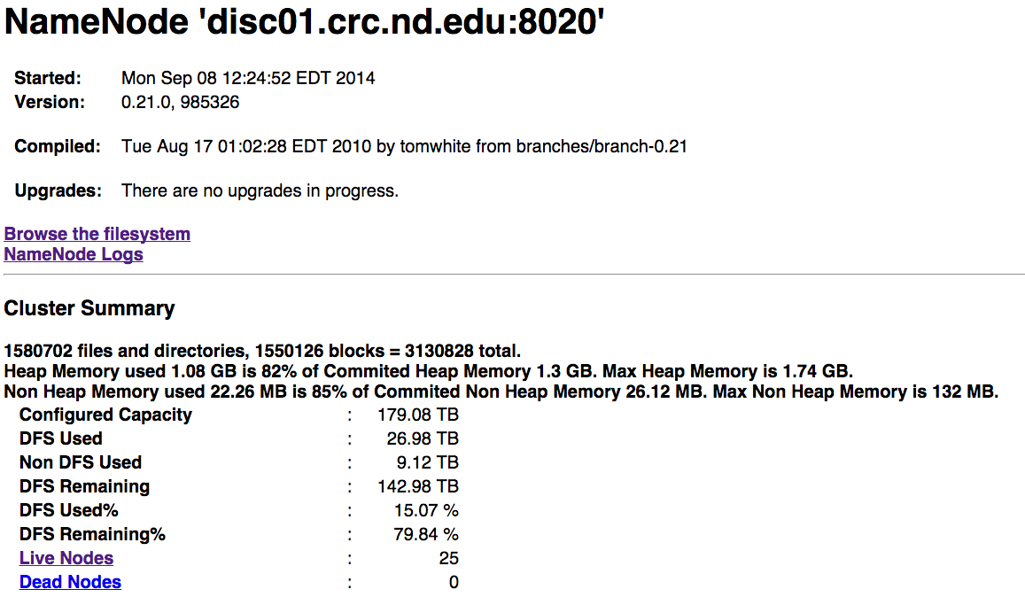
HDFS-Web UI

Slide 55
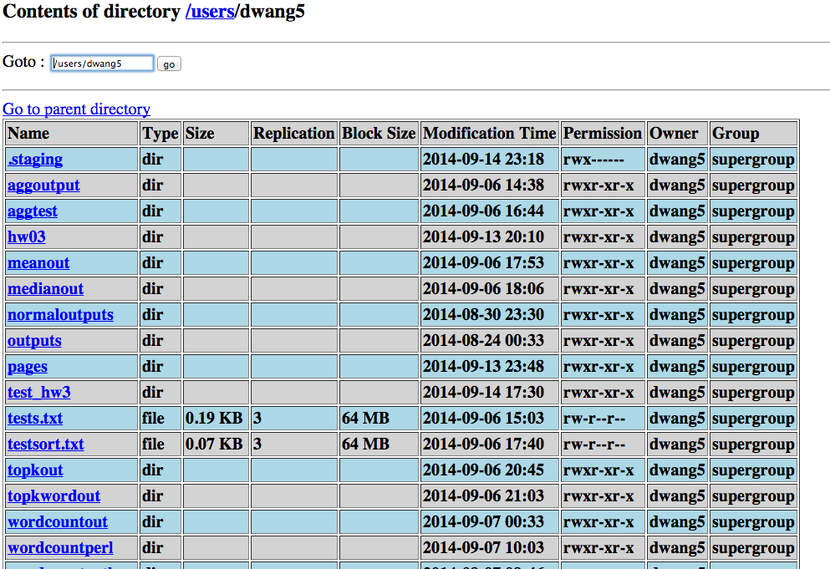
HDFS-Web UI

Slide 56
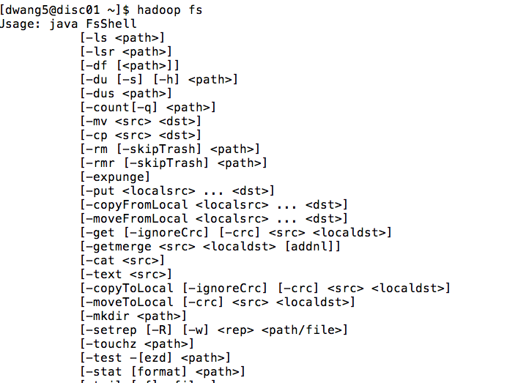
HDFS Command Line
Hadoop Shell

Slide 57
Big Data Processing 1 Summary
Big Data and Hadoop background
  What and Why about Hadoop
  4 V challenge of Big Data
Hadoop Distributed File System (HDFS)
  Motivation: guide Hadoop design
  Architecture: Single rack vs Multi-rack clusters
  Reliable storage, Rack-awareness, Throughput
  Inside: Name Node file system, Read, Write
  Interface: Web and Command line

Slide 58
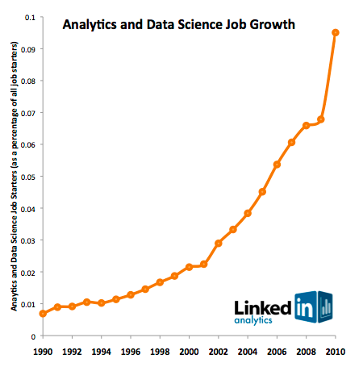
Job Market Demand in Big Data Science in Last Two Decades
Courtesy Linked Corp.

Slide 59
MapReduce

Slide 60
MapReduce Outline
MapReduce Architecture
MapReduce Internals
MapReduce Examples
JobTracker Interface

Slide 61


MapReduce: A Real World Analogy
Coins Deposit
?

Slide 62
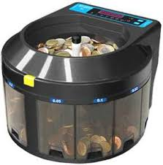
MapReduce: A Real World Analogy
Coins Deposit
Coins Counting Machine

Slide 63
MapReduce: A Real World Analogy
Coins Deposit
Mapper: Categorize coins by their face values
Reducer: Count the coins in each face value in parallel

Slide 64
MapReduce Architecture: Master-Slaves
Job Client
Task Trackers
Job Tracker
Idea: Bring Computation to Data!
Map
Reduce
Name Node
Inputs
Outputs
HDFS
Job Client: Submit Jobs
Task Tracker: Execute Jobs
Job Tracker: Coordinate Jobs
(Scheduling, Phase Coordination, etc.)
Job: MapReduce Function+ Config

Slide 65
MapReduce Architecture: Workflow
1
Job Client
Task Trackers
1
6
3
Job Tracker
2
4
Map
Reduce
Name Node
Inputs
Outputs
5
HDFS
Client submits job to Job Tracker and copy code to HDFS
Job Tracker talks to NN to find data it needs
Job Tracker creates execution plan and submits work to Task Trackers
4. Task trackers do the job and report progress/status to Job Tracker
5. Job Tracker manages task phases
6. Job Tracker finishes the job and updates status

Slide 66
MapReduce Paradigm
Implement two functions:
  Map (k1,v1) -> list (k2, v2)
  Reduce(k2, list(v2)) -> list (v3)
Framework handles everything else
Value with the same key go to the same reducer

Slide 67
MapReduce Internal
Input
Data Node 1
Input
Data Node 1
Split
Split
Split
Split
Split
Split
Map
Map
Map
Map
Map
Map
Shuffle
Shuffle
Sort
Sort
Reduce
Reduce
HDFS
Output
Output

Slide 68
MapReduce Example: Word Count
Input
Split
Map
Shuttle/Sort
Reduce
Output
Deer, 1
Beer, 1
River, 1
Beer, 1
Beer, 1
Beer, 2
Dear Beer River
Beer, 2
Car, 3
Deer, 2
River, 2
Deer Beer River
Car Car River
Deer Car Beer
Car Car River
Car, 1
Car, 1
River, 1
Car, 1
Car, 1
Car, 1
Car, 3
Deer Car Beer
Deer, 1
Car, 1
Beer, 1
Deer, 1
Deer, 1
Deer, 2
River, 1
River, 1
River, 2
Similar Flavor of Coins Deposit ? ☺

Slide 69
MapReduce Example: Word Count
Input
Split
Map
Shuttle/Sort
Reduce
Output
Deer, 1
Beer, 1
River, 1
Beer, 1
Beer, 1
Beer, 2
Dear Beer River
Beer, 2
Car, 3
Deer, 2
River, 2
Deer Beer River
Car Car River
Deer Car Beer
Car Car River
Car, 1
Car, 1
River, 1
Car, 1
Car, 1
Car, 1
Car, 3
Deer Car Beer
Deer, 1
Car, 1
Beer, 1
Deer, 1
Deer, 1
Deer, 2
River, 1
River, 1
River, 2
Q: What are the Key and Value Pairs of Map and Reduce?
Map: Key=word, Value=1
Reduce: Key=word, Value=aggregated count

Slide 70
Mapper and Reducer of Word Count
Map(key, value){
// key: line number
// value: words in a line
for each word w in value:
Emit(w, "1");}
Reduce(key, list of values){
  // key: a word
// list of values: a list of counts
int result = 0;
for each v in values:
result += ParseInt(v);
Emit(key, result);}

Slide 71
MapReduce Example: Word Count
Input
Split
Map
Shuttle/Sort
Reduce
Output
Deer, 1
Beer, 1
River, 1
Beer, 1
Beer, 1
Beer, 2
Dear Beer River
Beer, 2
Car, 3
Deer, 2
River, 2
Deer Beer River
Car Car River
Deer Car Beer
Car Car River
Car, 1
Car, 1
River, 1
Car, 1
Car, 1
Car, 1
Car, 3
Deer Car Beer
Deer, 1
Car, 1
Beer, 1
Deer, 1
Deer, 1
Deer, 2
River, 1
River, 1
River, 2
Q: Do you see any place we can improve the efficiency?
Local aggregation at mapper will be able to improve MapReduce efficiency.

Slide 72
MapReduce: Combiner
Combiner: do local aggregation/combine task at mapper
Q: What are the benefits of using combiner:
  Reduce memory/disk requirement of Map tasks
  Reduce network traffic
Q: Can we remove the reduce function?
  No, reducer still needs to process records with same key but from different mappers
Q: How would you implement combiner?
  It is the same as Reducer!
Car, 1
Car, 1
River, 1
Car, 2
River, 1
Car, 2
Car, 1
Car, 3

Slide 73
MapReduce WordCount 2
New Goal: output all words sorted by their frequencies (total counts) in a document.
Question: How would you adopt the basic word count program to solve it?
Solution:
  Sort words by their counts in the reducer
  Problem: what happens if we have more than one reducer?

Slide 74
MapReduce WordCount 2
New Goal: output all words sorted by their frequencies (total counts) in a document.
Question: How would you adopt the basic word count program to solve it?
Solution:
  Do two rounds of MapReduce
  In the 2nd round, take the output of WordCount as input but switch key and value pair!
  Leverage the sorting capability of shuffle/sort to do the global sorting!

Slide 75
MapReduce WordCount 3
New Goal: output the top K words sorted by their frequencies (total counts) in a document.
Question: How would you adopt the basic word count program to solve it?
Solution:
  Use the solution of previous problem and only grab the top K in the final output
  Problem: is there a more efficient way to do it?

Slide 76
MapReduce WordCount 3
New Goal: output the top K words sorted by their frequencies (total counts) in a document.
Question: How would you adopt the basic word count program to solve it?
Solution:
  Add a sort function to the reducer in the first round and only output the top K words
  Intuition: the global top K must be a local top K in any reducer!

Slide 77
MapReduce In-class Exercise
Problem: Find the maximum monthly temperature for each year from weather reports
Input: A set of records with format as:
  <Year/Month, Average Temperature of that month>
  - (200707,100), (200706,90)
  - (200508, 90), (200607,100)
  - (200708, 80), (200606,80)
Question: write down the Map and Reduce function to solve this problem
  Assume we split the input by line

Slide 78
Mapper and Reducer of Max Temperature
Map(key, value){
// key: line number
// value: tuples in a line
for each tuple t in value:
Emit(t->year, t->temperature);}
Reduce(key, list of values){
  // key: year
//list of values: a list of monthly temperature
int max_temp = -100;
for each v in values:
max_temp= max(v, max_temp);
Emit(key, max_temp);}
Combiner is the same as Reducer

Slide 79
MapReduce Example: Max Temperature
(200707,100), (200706,90)
(200508, 90), (200607,100)
(200708, 80), (200606,80)
Input
Map
(2007,100), (2007,90)
(2005, 90), (2006,100)
(2007, 80), (2006, 80)
Combine
(2007,100)
(2005, 90), (2006,100)
(2007, 80), (2006, 80)
Shuttle/Sort
(2005,[90])
(2006,[100, 80])
(2007,[100, 80])
Reduce
(2005,90)
(2006,100)
(2007,100)

Slide 80
MapReduce In-class Exercise
Key-Value Pair of Map and Reduce:
  Map: (year, temperature)
  Reduce: (year, maximum temperature of the year)
Question: How to use the above Map Reduce program (that contains the combiner) with slight changes to find the average monthly temperature of the year?

Slide 81
Mapper and Reducer of Average Temperature
Map(key, value){
// key: line number
// value: tuples in a line
for each tuple t in value:
Emit(t->year, t->temperature);}
Reduce(key, list of values){
  // key: year
// list of values: a list of monthly temperatures
int total_temp = 0;
for each v in values:
total_temp= total_temp+v;
Emit(key, total_temp/size_of(values));}
Combiner is the same as Reducer

Slide 82
MapReduce Example: Average Temperature
(200707,100), (200706,90)
(200508, 90), (200607,100)
(200708, 80), (200606,80)
Input
Real average of 2007: 90
Map
(2007,100), (2007,90)
(2005, 90), (2006,100)
(2007, 80), (2006,80)
Combine
(2007,95)
(2005, 90), (2006,100)
(2007, 80), (2006,80)
Shuttle/Sort
(2005,[90])
(2006,[100, 80])
(2007,[95, 80])
Reduce
(2005,90)
(2006,90)
(2007,87.5)

Slide 83
MapReduce In-class Exercise
The problem is with the combiner!
Here is a simple counterexample:
  (2007, 100), (2007,90) -> (2007, 95)
  (2007,80)->(2007,80)
  Average of the above is: (2007,87.5)
  However, the real average is: (2007,90)
However, we can do a small trick to get around this
  Mapper: (2007, 100), (2007,90) -> (2007, <190,2>)
  (2007,80)->(2007,<80,1>)
  Reducer: (2007,<270,3>)->(2007,90)

Slide 84
MapReduce Example: Average Temperature
(200707,100), (200706,90)
(200508, 90), (200607,100)
(200708, 80), (200606,80)
Input
Map
(2007,100), (2007,90)
(2005, 90), (2006,100)
(2007, 80), (2006,80)
Combine
(2007,<190,2>)
(2005, <90,1>),
(2006, <100,1>)
(2007, <80,1>), (2006,<80,1>)
Shuttle/Sort
(2005,[<90,1>])
(2006,[<100,1>, <80,1>])
(2007,[<190,2>, <80,1>])
Reduce
(2005,90)
(2006,90)
(2007,90)

Slide 85
Mapper and Reducer of Average Temperature
Map(key, value){
// key: line number
// value: tuples in a line
for each tuple t in value:
Emit(t->year, t->temperature);}
Combine(key, list of values){
  // key: year
// list of values: a list of monthly temperature
int total_temp = 0;
for each v in values:
total_temp= total_temp+v;
Emit(key,<total_temp,size_of(list of values)>);}
Reduce (key, list of values){
  // key: year
// list of values: a list of <temperature sums, counts> tuples
int total_temp = 0;
int total_count=0;
for each v in values:
total_temp= total_temp+v->sum;
total_count=total_count+v->count;
Emit(key,total_temp/total_count);}
Combiner is different from Reducer!

Slide 86

MapReduce In-class Exercise
Functions that can use combiner are called distributive:
  Distributive: Min/Max(), Sum(), Count(), TopK()
  Non-distributive: Mean(), Median(), Rank()
Gray, Jim*, et al. "Data cube: A relational aggregation operator generalizing group-by, cross-tab, and sub-totals." Data Mining and Knowledge Discovery 1.1 (1997): 29-53.
*Jim Gray received Turing Award in 1998

Slide 87
Map Reduce Problems Discussion
Problem 1: Find Word Length Distribution
Statement: Given a set of documents, use Map-Reduce to find the length distribution of all words contained in the documents
Question:
  What are the Mapper and Reducer Functions?
12: 1
7: 1
6: 1
4: 4
3: 2
2: 1
1: 1
This is a test data for
the word length distribution problem
MapReduce

Slide 88
Map Reduce Problems Discussion
Problem 1: Find Word Length Distribution
Mapper and Reducer:
  Mapper(document)
    { Emit (Length(word), word) }
  Reducer(output of map)
    { Emit (Length(word), Size of (List of words at a particular length))}

Slide 89
Mapper and Reducer of Word Length Distribution
Map(key, value){
// key: document name
// value: words in a document
for each word w in value:
Emit(length(w), w);}
Reduce(key, list of values){
  // key: length of a word
// list of values: a list of words with the same length
Emit(key, size_of(list of values));}

Slide 90
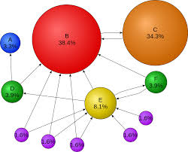
Map Reduce Problems Discussion
Problem 2: Indexing & Page Rank
Statement: Given a set of web pages, each page has a page rank associated with it, use Map-Reduce to find, for each word, a list of pages (sorted by rank) that contains that word
Question:
  What are the Mapper and Reducer Functions?
MapReduce
Word 1: [page x1, page x2, ..]
Word 2: [page y1, page y2, …]
…

Slide 91
Map Reduce Problems Discussion
Problem 2: Indexing and Page Rank
Mapper and Reducer:
  Mapper(page_id, <page_text, page_rank>)
    { Emit (word, <page_id, page_rank>) }
  Reducer(output of map)
    { Emit (word, List of pages contains the word sorted by their page_ranks)}

Slide 92
Mapper and Reducer of Indexing and PageRank
Map(key, value){
// key: a page
// value: words in a page, page_rank
for each word w in value:
Emit(w, <page_id, page_rank>);}
Reduce(key, list of values){
  // key: a word
// list of values: a list of pages containing that word
sorted_pages=sort(list of values, page_rank)
Emit(key, sorted_pages);}

Slide 93
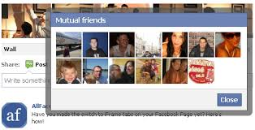
Map Reduce Problems Discussion
Problem 3: Find Common Friends
Statement: Given a group of people on online social media (e.g., Facebook), each has a list of friends, use Map-Reduce to find common friends of any two persons who are friends
Question:
  What are the Mapper and Reducer Functions?

Slide 94
Map Reduce Problems Discussion
Problem 3: Find Common Friends
Simple example:
Input:
A -> B,C,D
B-> A,C,D
C-> A,B
D->A,B
A
C
MapReduce
Output:
(A ,B) -> C,D
(A,C) -> B
(A,D) -> ..
….
B
D

Slide 95
Map Reduce Problems Discussion
Problem 3: Find Common Friends
Mapper and Reducer:
  Mapper(friend list of a person)
    { for each person in the friend list:
    Emit (<friend pair>, <list of friends>) }
  Reducer(output of map)
    { Emit (<friend pair>, Intersection of two (i.e, the one in friend pair) friend lists)}

Slide 96
Map Reduce Problems Discussion
Problem 3: Find Common Friends
Mapper and Reducer:
Input:
A -> B,C,D
B-> A,C,D
C-> A,B
D->A,B
Map:
(A,B) -> B,C,D
(A,C) -> B,C,D
(A,D) -> B,C,D
(A,B) -> A,C,D
(B,C) -> A,C,D
(B,D) -> A,C,D
(A,C) -> A,B
(B,C) -> A,B
(A,D) -> A,B
(B,D) -> A,B
Reduce:
(A,B) -> C,D
(A,C) -> B
(A,D) -> B
(B,C) -> A
(B,D) -> A
Suggest Fiends ☺

Slide 97
Mapper and Reducer of Common Friends
Map(key, value){
// key: person_id
// value: the list of friends of the person
for each friend f_id in value:
Emit(<person_id, f_id>, value);}
Reduce(key, list of values){
  // key: <friend pair>
// list of values: a set of friend lists related with the friend pair
for v1, v2 in values:
common_friends = v1 intersects v2;
Emit(key, common_friends);}

Slide 98

Map Reduce Problems Discussion
Problem 4: Unique User Count
Statement: You have a set of documents containing the web browsing records for a company in the form of:
  Record x [User_id, Visit_Date, Url]
  Use Map-Reduce to count the number of unique user visits of the company web pages per day.
Question:
  What are the Mapper and Reducer Functions?

Slide 99
Map Reduce Problems Discussion
Problem 4: Unique User Count
Mapper and Reducer:
  Mapper(records)
    { for each record in records:
    Emit (day, user_id) }
  Reducer(output of map)
    { Emit (day, count of unique user_id appearing on this particular day)}

Slide 100
Mapper and Reducer of Unique User Count
Map(key, value){
// key: name of a browsing record document
// value: the list of browsing records in the document
for each record r in value:
Emit(r->date, r->user_id);}
Reduce(key, list of values){
  // key: date
// list of values: a list of users who visit on the day specified by the key
unique_list = unique (values)
Emit(key, size_of(uniuqe_list));}

Slide 101
Map Reduce Problems Discussion
Problem 4: Unique User Count
Q: How to solve this problem by just using the word count program (i.e., do not use the unique function in the reducer)?

Slide 102
Map Reduce Problems Discussion
Problem 4: Unique User Count
Two rounds of Map Reduce:
  Round 1:
    Mapper(record)
    { for each record in records:
    Emit (<day, user_id>, 1) }
    Reducer: same as word count
  Round 2:
    Mapper (output of round 1)
    {for each item in list of (<day, user_id>, count)
    Emit (day, 1)}
    Reducer: same as word count

Slide 103
Mapper and Reducer of Unique User Count
Map1(key, value){
// key: name of a browsing record document
// value: the list of browsing records in the document
for each record r in value:
Emit(<r->date, r->user_id>, 1);}
Reduce1: same as word count reducer
Map2(key, list of values){
  // key: <date, user_id>
// list of values: a list of counts related with the key
Emit(key->date, 1);}
Reduce2: same as word count reducer

Slide 104
Map Reduce Problems Discussion
Problem 4: Unique User Count
What if we have records from multiple companies mixed together, we want to find the unique user count per day per company?
Similar solutions, just change the <key, value> pair.

Slide 105
Mapper and Reducer of Unique User Count
Map_p1(key, value){
// key: name of a browsing record document
// value: the list of browsing records in the document
for each record r in value:
Emit(<r->company_url, r->date, r->user_id>, 1);}
Reduce_p1: same as word count reducer
Map_p2(key, list of values){
  // key: <company_url, day, user_id>
// list of values: a list of counts related with the key
Emit(<key->company_url, key->date>, 1>);}
Reduce_p2: same as word count reducer

Slide 106
Big Data Processing 2 Summary
Map-Reduce:
  Map-Reduce Paradigm: Mapper and Reducer
  What is the key and what is the value and list of values?
  Combiner and Distributive Functions
  Practice makes perfect☺

Slide 107

Enjoy MR and Hadoop☺

