Slide 1
Crowd and Mobile Sensing
Using Mobile Phones as Sensors
CSE 40437/60437-Spring 2015
Prof. Dong Wang

Slide 2
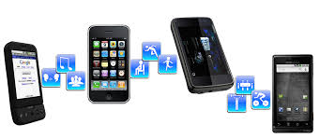
Papers
Paper 1: "A survey of mobile phone sensing." Lane, Nicholas D., et al. Communications Magazine, IEEE 48.9 (2010): 140-150.

Slide 3
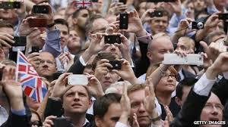
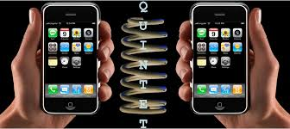
From Mobile (Smart)phones to CrowdSensing
What makes this happen?

Slide 4
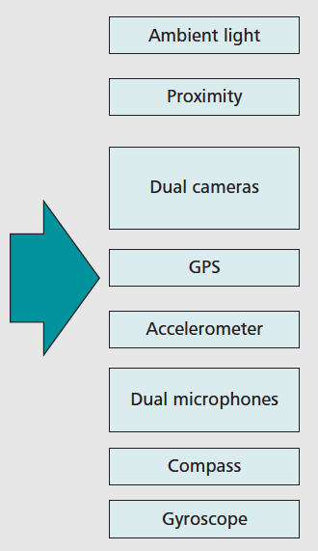
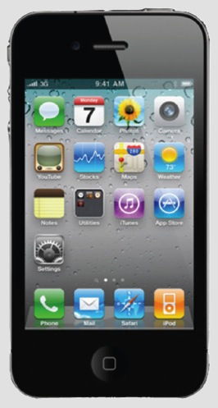
Technical Enabler 1: Powerful Embedded Sensors in Smartphones
Sensors

Slide 5

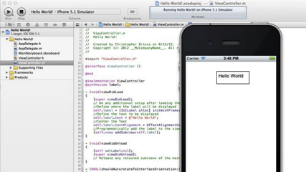
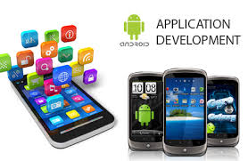
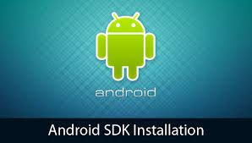
Technical Enabler 2: Smartphones are open and programmable

Slide 6


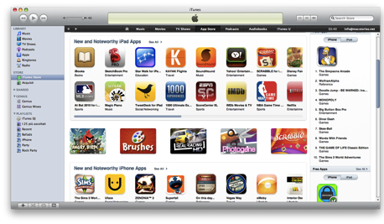
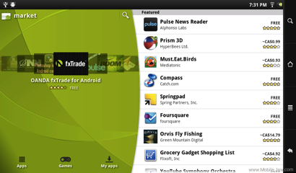
Technical Enabler 3: Phone vendors now offer app store to delivery new apps

Slide 7
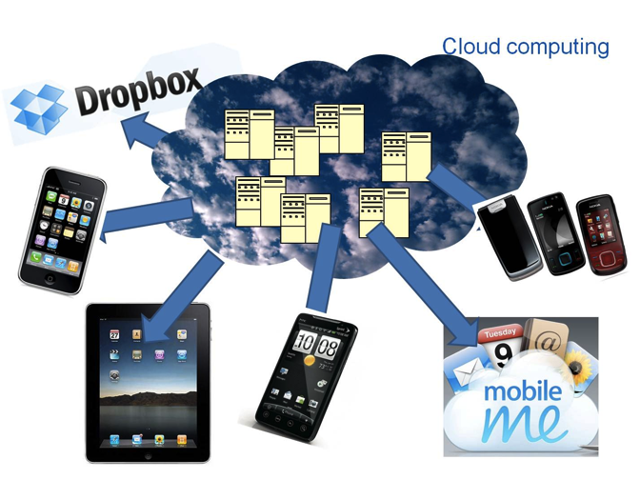
Technical Enabler 4: Mobile Computing Cloud-> offload services to back-end

Slide 8
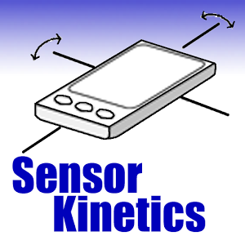
Demo: Sensors on Android Phones
https://play.google.com/store/apps/details?id=com.innoventions.sensorkinetics&hl=en

Slide 9

Demo: Sensors on Android Phones
https://play.google.com/store/apps/details?id=imoblife.androidsensorbox&hl=en

Slide 10
What can phone sensors do?
Proximity sensors:
  Detect when the user holds her phone close to face -> disable touchscreen
Lightness sensors:
  Adjust the brightness of screen to save power
GPS: identify phone location:
  Local search, mobile social network, navigation
Compass and gyroscope:
  provide direction and orientation in location-based apps

Slide 11
What can phone sensors do?
Accelerometers:
  Characterize physical movements of users; Activity recognition (e.g., running, walking, standing).
Camera and Microphone:
  Record personal digital trace. Context Sensing (e.g., where is the user and what she is doing now)
Combination of accelerometer and GPS/Celluar signal:
  Recognize the mode of transportation (e.g., bus vs subway)
WiFi and Bluetooth:
  Indoor localization and detecting social contact

Slide 12
Applications
What are the interesting applications you can think of using one or a set of sensors available on the smartphones?

Slide 13
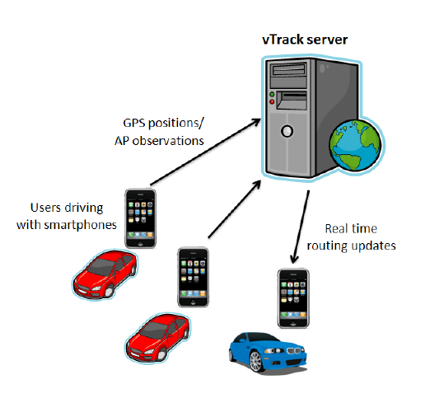
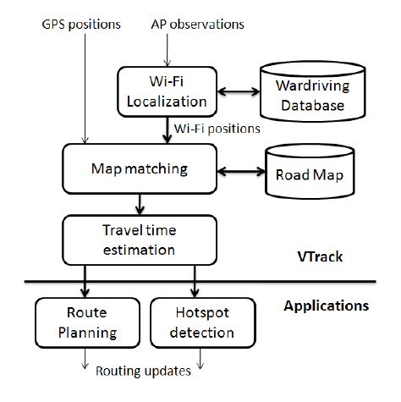
Applications: Transportation
MIT VTrack: Use GPS and WiFi signals on driver’s smartphones to estimate delay prone segments on city streets.

Slide 14
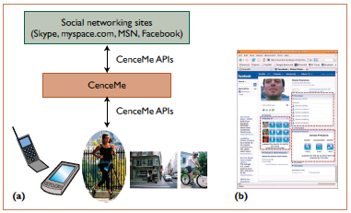
Applications: Social Networking
Dartmouth CenceMe: Use sensors on smartphones to automatically classify events in people’s lives (“where are u and what are u doing?”) and selectively share it on online social networks (e.g, Twitter, Facebook, etc.)

Slide 15
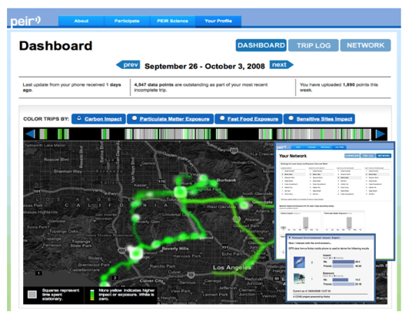
Applications: Environment Monitoring
UCLA Peir: A personal environment impact report that uses sensors on phones to track how the actions of individuals affect their exposure and contribution to environmental problems (e.g., carbon emissions)

Slide 16
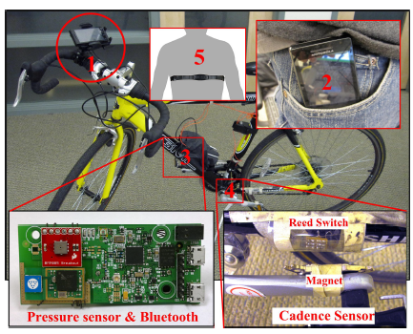
Applications: Health and Wellbeing
Johns Hopkins Pocket Sensing: Use sensors on the smartphone in the bicyclist’s pocket to accurately estimate measure her cadence and caloric expenditure.

Slide 17
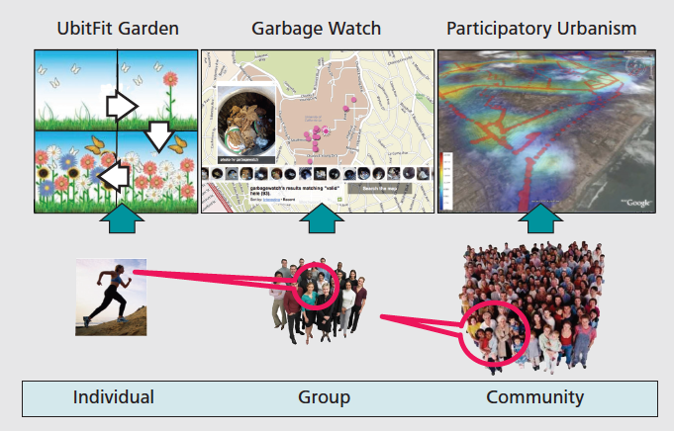
Sensing Scales
Crowdsensing

Slide 18
Sensing Paradigms
Participatory Sensing
  Users actively engage in the “sensing process”
  Human intelligence can be leveraged for complex tasks
  More costs or incentives are needed to keep humans involved
  Privacy Issues
Opportunistic Sensing
  Fully automated and no user involvement
  Less burden and costs on the user
  Detect the phone context
  Humans are underutilized
  Privacy and Energy Issues

Slide 19
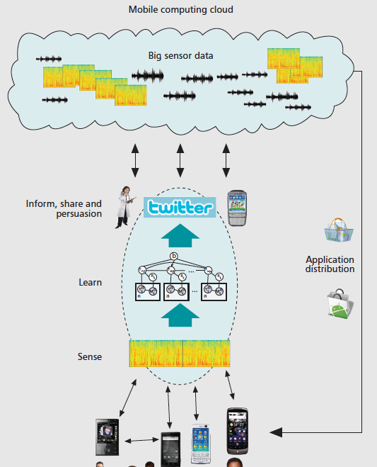
Sensing Architecture
Close the Loop
Learn
Sense

Slide 20
Sense
Programmability:
  Lack of low level sensor control
  Different vendors offer different APIs
Continuous sensing:
  Need to support multitasking and background processing
  Limited battery power on mobile phones
Phone Context:
  Phones are used on the go and in different contexts (e.g., in vs out of pocket)
  Anticipating all possible different phone usage scenarios is very difficult

Slide 21
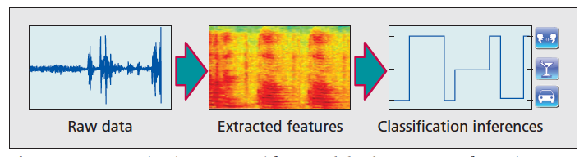
Learn
Human Behavior and Context Modeling
  Supervised learning (small scale)
  Semi-supervised/Unsupervised (medium to large scale)
  Learn every data activities (e.g., brushing teeth, driving, running)
  Learn places (e.g., work, home, coffee shop )

Slide 22
Close the loop
Sharing
  Standardized method: Visualization using a web portal (e.g., display sensor data and inferences)
  Leverage social media outlets (e.g., Twitter, Facebook, Flickr) to build a community around a sensing application (e.g., Nike+)
Personalized Sensing
  Monitor individual’s daily activities and profile their preferences (e.g., voice search on Google)
  Make personalized recommendations (e.g., book, clothes, food, etc.)

Slide 23
Close the loop
Persuasion
  Peer pressure, sharing the sensed data or information within a community or social network
  Design interesting interface that targets user’s individual goal (e.g., UbiFit)
Privacy
  Key concern for people to participate and share their data ( which can reveal a LOT of information)
  Local data processing and aggregation
  Adding controlled random noise that does not affect aggregated results (e.g., GreenGPS)

Slide 24
Open Questions
How much intelligence we shall push to the phone without jeopardizing the phone experience?
How do we scale the sensing application from individual to a large community?
How to efficiently process and storage the big data from the mobile and crowdsensing apps?
How to efficiently filter noises from the collected data, especially when humans are in the loop?

Slide 25
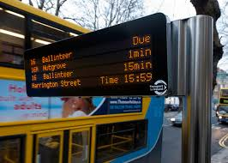
Papers
Paper 2: How Long to Wait? Predicting Bus Arrival Time with Mobile Phone based Participatory Sensing. Zhou, Pengfei, Yuanqing Zheng, and Mo Li. Proceedings of the 10th international conference on Mobile systems, applications, and services (Mobysis 12). ACM, 2012.

Slide 26
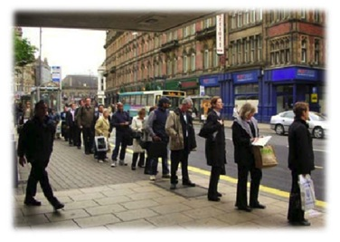
Goal
Goal: Predict bus arrival time accurately using collaborative efforts from crowds
How long to wait ?
  Alternative transit choices
  Better travel plans
Q: What is current solutions to predict bus arrival time?

Slide 27
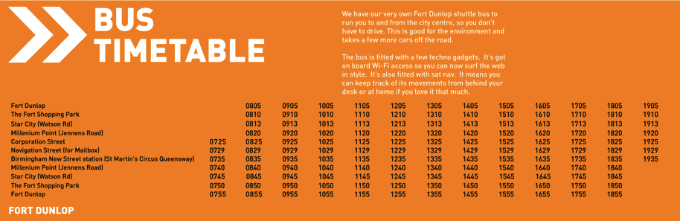
Exist Solutions
  Timetable ( operating hours, time intervals, etc.)
  Cons: Static and Not timely updated

Slide 28
Current Solutions
  Complex information system with special in-vehicle GPS devices
  Cons: Substantial costs; Collaborative bus operators; Local availability; “1 min” != 1 min

Slide 29
Design Goals
Crowdsensing approach
Independent of transit operators
No in-vehicle GPS devices (GPS signals are not always good in big cities)
Energy Efficient
Fully automatic

Slide 30
Share your thoughts …
How would you solve the problem by designing a crowd-sensing application?
What are the design challenges you have in mind?

Slide 31
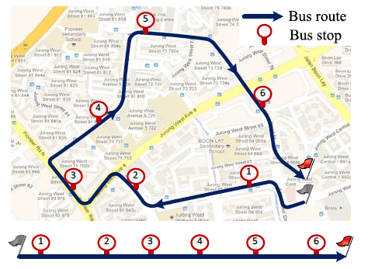
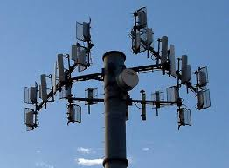
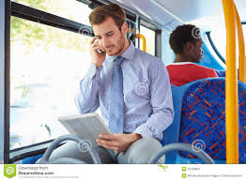
Their Solution
Use the cellular signals of passenger’s mobile phones to predict bus arrival time.

Slide 32
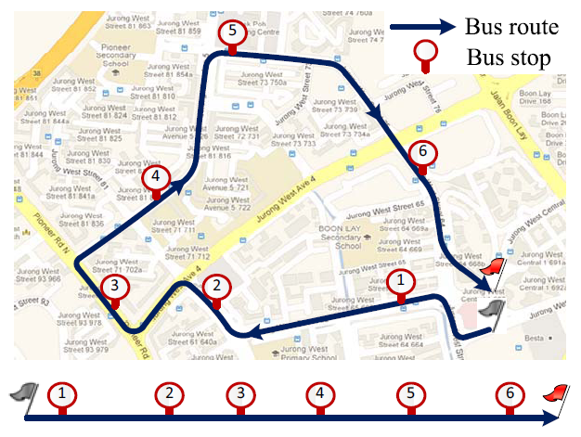
Key Question: How could we track bus location in real-time in a 2D space?

Slide 33
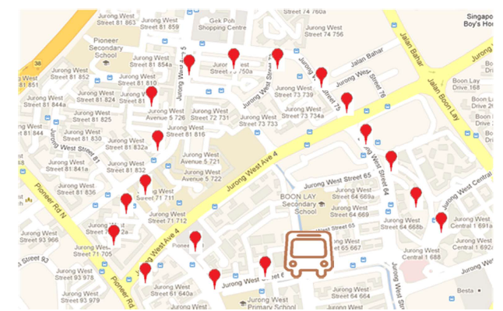
Basic Q: 2D vs 1D
City map is a 2D (dimension) space

Slide 34
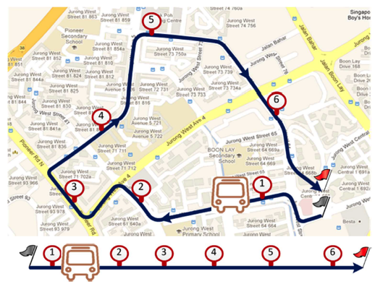
Basic Q: 2D vs 1D
Bus route is simply 1 D space

Slide 35
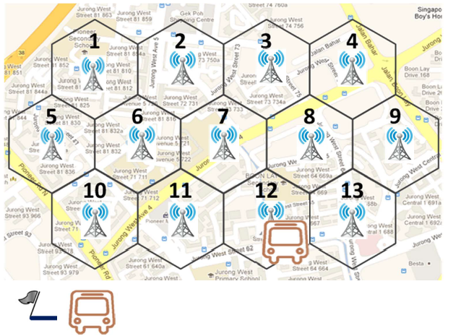
In cellular space
The bus route can be characterized by a sequence of cells the bus goes by

Slide 36
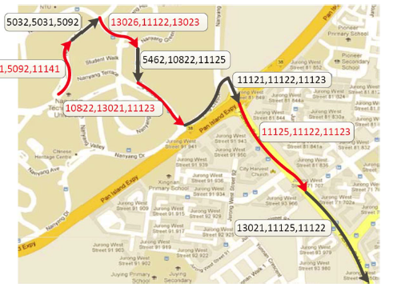
Mapping bus route to cell tower ID
Cell tower IDs can be used to characterize the route of the bus

Slide 37
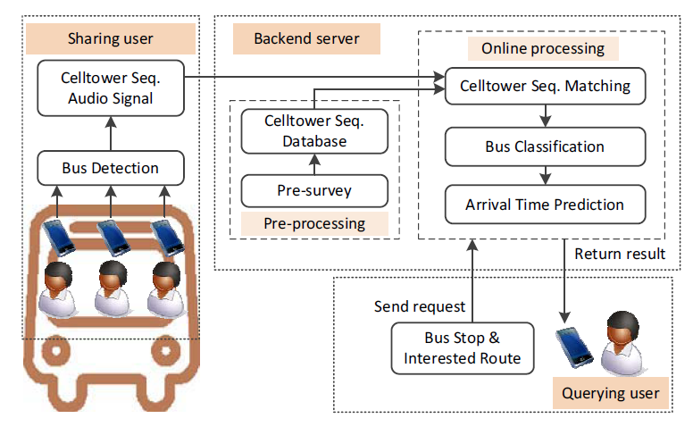
System Design Challenges
Which Route of the Bus I am on?
Am I on the Bus now?
Cellular Towers->Bus Location?
System Architecture

Slide 38
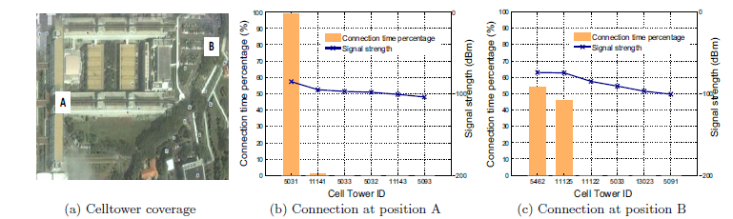
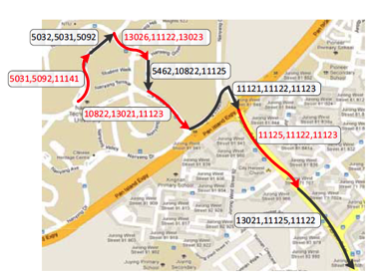
Mapping Bus Route to Celltower IDs
300 m
Top-3 Strongest Celltower ->Signature for bus route segments
Celltower sequence along a bus route

Slide 39
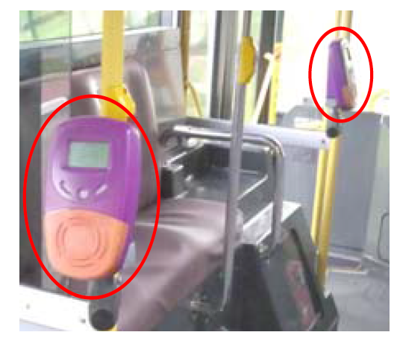
Bus Detection
Q: How to detect whether a user is on the bus or not?

Slide 40
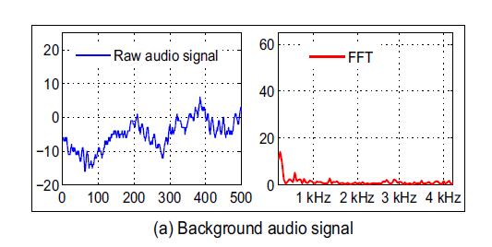
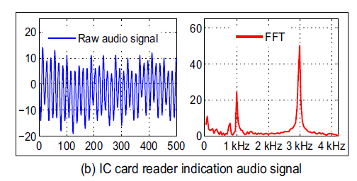
Bus Detection
Audio Detection: Short Beep Response from IC Card Reader
Dual-tone Signals

Slide 41
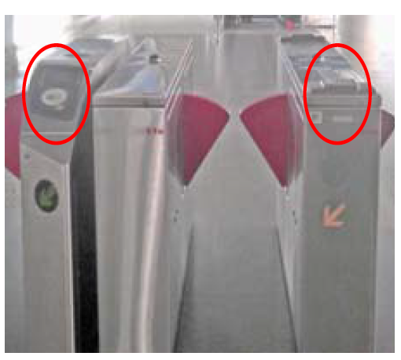
Rapid train uses the same IC card system
Q: How to decide if a user gets on a bus or a rapid train?

Slide 42
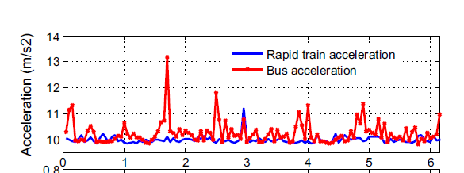
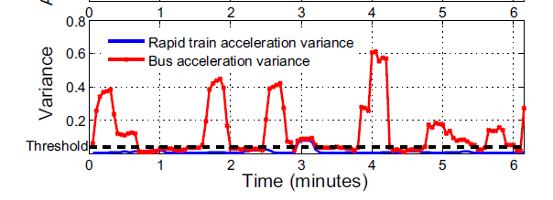
Bus Detection
Accelerometer detection: Bus vs Rapid Train
A rapid train moves at a more table speed than a bus.

Slide 43
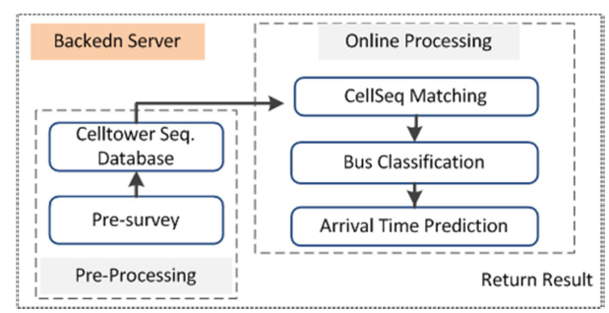
Backend Server
Pre-survey: Cell tower sequence database
Online processing:
  Cell tower sequence matching
  Bus classification
  Arrival time prediction

Slide 44
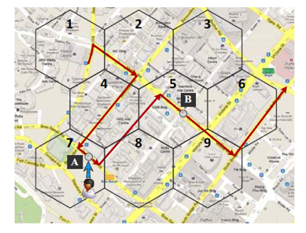

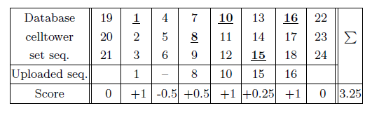
Bus Classification
Modified Smith-Waterman Algorithm
w: rank of signal strength
Find the Route with the highest matching score!

Slide 45
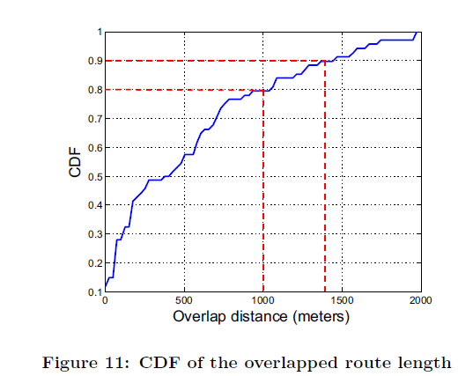
Overlapped route
Survey 50 bus route
Range of cell tower:
300-900 meters
threshold of celltower sequence length : 7

Slide 46
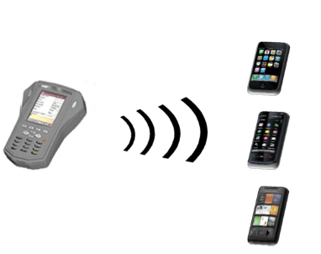
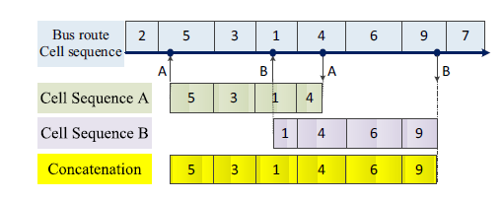
Celltower Sequence Concatenation
What if sequence lengths from users are too short?
Signals of 3 users on the same bus

Slide 47
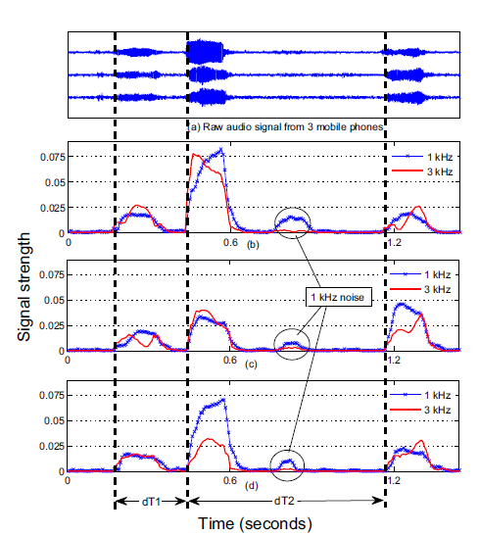
Celltower Sequence Concatenation
Time intervals between consecutive beep signals can fingerprint each bus in time domain
Signals of 3 users on the same bus

Slide 48
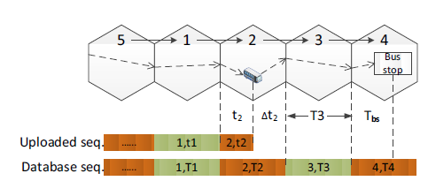


Arrival Time Prediction

Slide 49
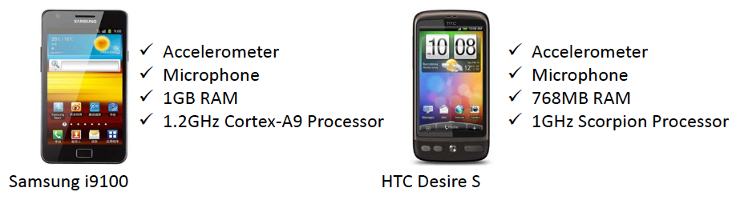
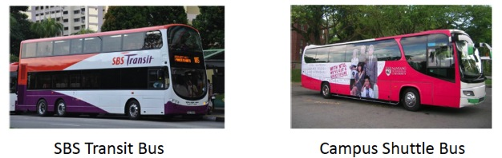
Evaluation : Experimental Methodology
Mobile phones
Buses

Slide 50



Evaluation : Experimental Methodology
Experiment environment
  4 campus shuttle bus routes
  2 SBS transit bus route 179 and 241
Opposite Direction!

Slide 51

Evaluation: Bus Detection Performance
Normal Distance on Bus: 0.5 m

Slide 52

Evaluation: Bus vs. MRT Train
False detection: Driving along straight routes late during night time

Slide 53


Evaluation: Bus Classification Performance
Overlapped routes are in the same direction!

Slide 54

Evaluation: Arrival Time Prediction
Campus Bus: median errors: 40-60 s

Slide 55

Evaluation: Arrival Time Prediction
Public Bus: median errors: 80s (this paper) vs 150s (LTA)

Slide 56

Evaluation: System Overhead
Energy Consumption (Battery Life)

Slide 57
What are the limitations you see?

Slide 58
Limitations the authors claimed
Number of passengers
  if no sharing users on a bus, the backend server may miss the bus
First few bus stops
  short celltower sequence, arrival time may not be timely updated
Overlapped routes
  classifying bus routes sharing substantial portion of overlapped routes remain challenging
  use bus speed to differentiate
Notes:
Number of passengers: equip the bus driver with the phones so at least one sharing user is on bus all the time; this is a common issue of crowd-sourcing applications, which is the penetration ratio.
First few bus stops: these stops are less affected by the traffic conditions and more predictable based on historical data; The backend server may bias the arrival time prediction for
those bus stops towards the official bus schedules and realtime traffic conditions on the bus routes.
Overlapped routes: use bus speed to differentiate: The buses with more frequent stops tend to drive at lower speed than buses with fewer stops.

Slide 59
Future Extensions
Preprocessing phase with crowdsourcing:
  Querying user -> Sharing user
Alternative reference points:
  Roadside WiFi
Trip planning:
  From “how long to wait” to “where to go”

Slide 60

Q&A

