Slide 1
Crowd and Mobile Sensing 2
Using Mobile Phones as Sensors
CSE 40437/60437-Spring 2015
Prof. Dong Wang

Slide 2
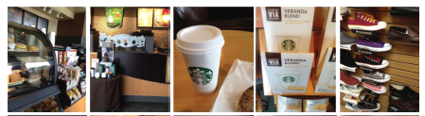
Papers
Paper 3: Automatically Characterizing Places
with Opportunistic CrowdSensing using Smartphones. Chon, Yohan, et al. Proceedings of the 2012 ACM Conference on Ubiquitous Computing (Ubicom 12). ACM, 2012. (Best Paper Award)

Slide 3
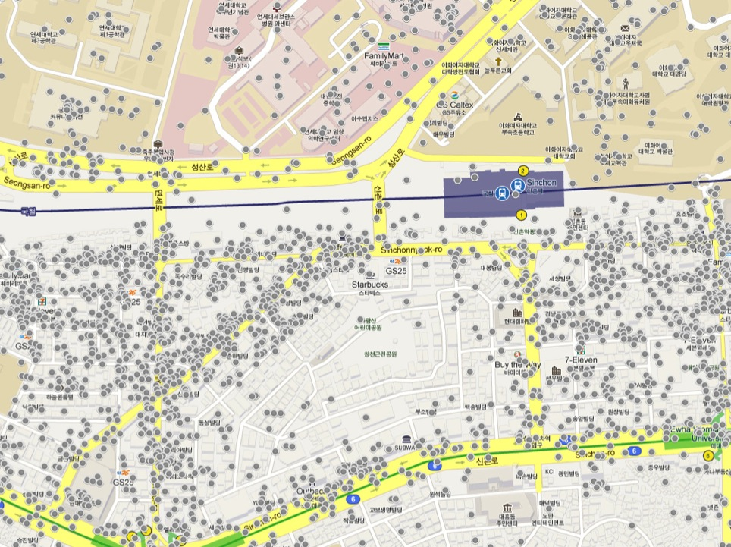
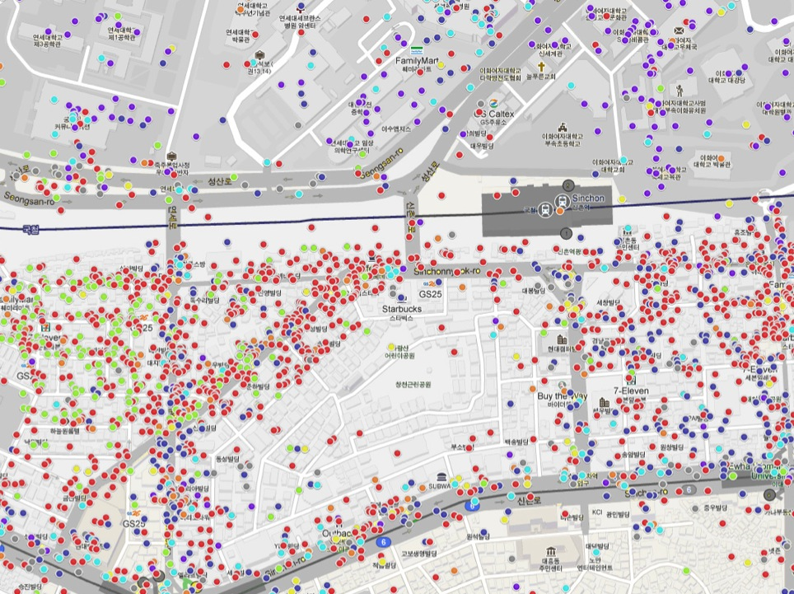
Characterizing Places = Semantic Annotation of Places
1
Yonsei
University
Ewha
University
Shopping
Nightlife
Food
Shopping
College & University
Nightlife
Workplace
Arts & Entertainment
Outdoors & Sports
Travel & Transport
Residences
Understanding City-Scale Behavior Patterns
Enhanced Local Search & Recommendations
Location-based Reminder & Content Delivery
Rich CrowdSourced Point-of-Interest Category Maps
1km by 800m, near Yonsei University, Seoul, Korea

Slide 4
Share your thoughts
Q: How would you design an app that can automatically characterize places using smartphone sensing data?
Q: What are the possible challenges of your design?
Location (low level sensor data) --> Place (high level logical concepts)

Slide 5
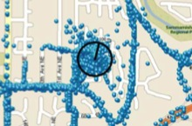
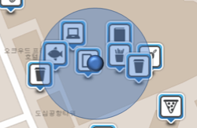
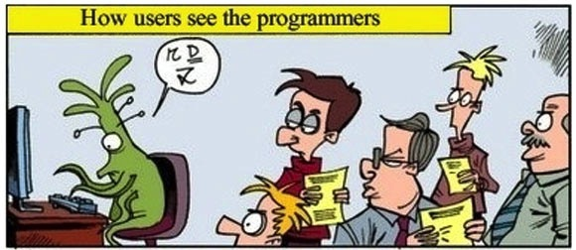
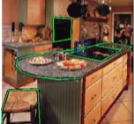
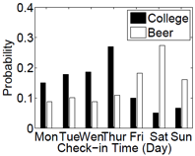
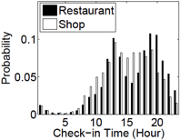
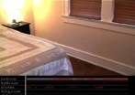
Existing Approaches
Tell me latitude
and longitude.
Show me wallpaper.
Tell me visit time.
Location (Latitude, Longitude)
  Category: Home, workplace
  GPS-based localization
Location-based Lookups
  Wide number of categories
  Yelp, Bing, Google, etc.
  Subject to
  localization
  error
What is the category of this place ?
We will guess!
Engineering approach
How about something else?
J. Krumm et al., Pervasive’11, D. Lian et al., GIS’11
Image-based Processing
  Category: Bathroom, bedroom, kitchen, living room, dining room
  Object counts in places
  Patterns at walls
Check-in Service Analysis
  Category: Food, shopping, nightlife
  Stay duration, visit time
J. Wu et al., IRS’09, P. Viswanathan et al., CRV’11
M. Ye et al., KDD’11
2

Slide 6
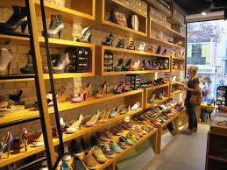
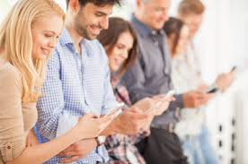

CrowdSense@place (csp)
Images
Places
Smartphone App
Audio Clips

Slide 7
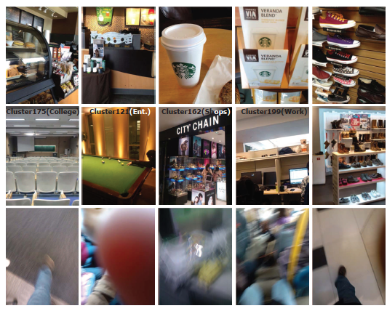
Examples of captured images
Hints
CrowdSense@Place: it depends on crowdsensing to collect enough clean data.
Noise

Slide 8
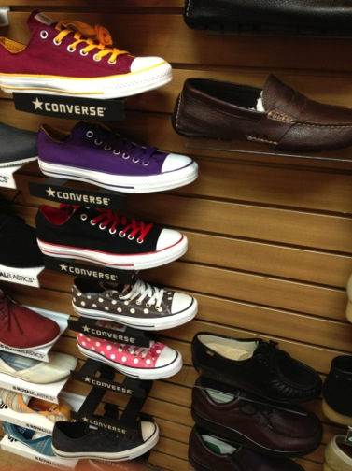
Main Idea
CSP exploits sensor-based hints to recognize place categories.
The category of this place is
.
① Theater
② Shoe Store
① Theater
② Shoe Store
Hints
Shoes
Converse
3

Slide 9
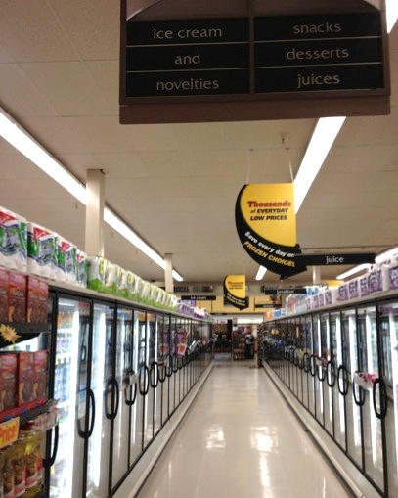
Main Idea
CSP exploits sensor-based hints to recognize place categories.
The category of this place is
.
① Museum
② Supermarket
① Museum
② Supermarket
Hints
Display stands
Ice cream
Snacks
Desserts
Everyday low prices
4

Slide 10

Main Idea
CSP exploits sensor-based hints to recognize place categories.
The category of this place is
.
① Apple Store
② Fast Food Restaurant
① Apple Store
② Fast Food Restaurant
Hints
Super hot spicy cheese burger
Here to go
5

Slide 11
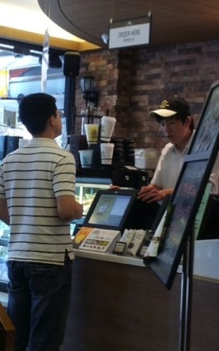
Conceptual Scenario
CSP considers a place as a document and
build a document with sensor-based hints.
ID: WiFi Fingerprint
order(.78) here(.78)
cup(.62) discount(.38)
coffee(.38)
Image
one waffle(.43)
and(.43) two(.43)
Americanos(.43)
please(.43)
Audio
bottle(.53) cash(.75)
almond(.17) bee(.74)
chocolate(.53) lotte(.7)
Americano(.83)
dessert(.44)
Caveat: CSP assumes users will leave the WiFi and GPS sensors on (they are power hungry!)
Place
Document

Slide 12
CrowdSense@Place (CSP)
Framework

Slide 13
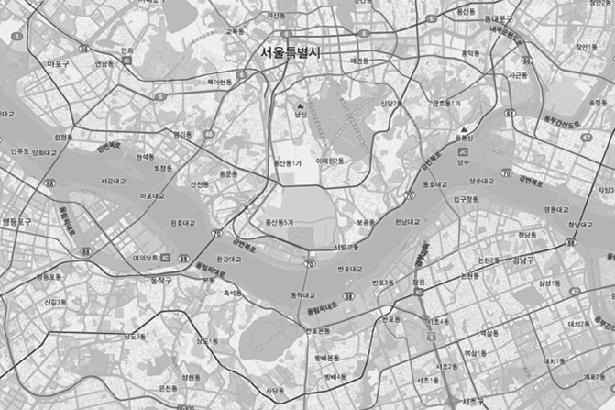
Conceptual Scenario
Documents are built by extracting place hints
from data collected by CrowdSensing.
A few places are labeled with a category by users.
Trained place models are used to
infer the category of other places.
she is beautiful I’d like to meet tiffany yuhan chen again
she is beautiful I’d like to meet tiffany yuhan chen again
arts entertainment class
arts entertainment class
arts entertainment class
arts entertainment class
arts entertainment class
arts entertainment class
oppa gangnam style psy big hit in america
arts entertainment class
oppa gangnam style psy big hit in america
arts entertainment class
beep car can snack do you think crowd sensing is feasible
beep car can snack do you think crowd sensing is feasible
windows chair ubicomp best paper
windows chair
windows chair ubicomp best paper
windows chair ubicomp best paper
mobile computing is best in the world do you
chair book man
mobile computing is best in the world do you
chair book man bottle lamb
chair book man bottle lamb
chair book man bottle lamb
arts entertainment class
time must goes by
arts entertainment class
time must goes by
arts entertainment class
arts entertainment class
arts entertainment class
arts entertainment class
tv newspaper I like ahn
tv newspaper
tv newspaper I like ahn
infocom percom mobisys ubicomp acm ieee
tv newspaper I like ahn
coffee chattering juice
infocom percom mobisys ubicomp acm ieee
coffee chattering juice sofa here
coffee chattering juice sofa here
hey nic let’s burning paper be the best
coffee chattering juice sofa here
hey nic let’s burning paper be the best
yaeri lee is similar to meal lim I agree but she should change her
yaeri lee is similar to meal lim I agree but she should change her
arts entertainment class
arts entertainment class
arts entertainment class
I love microsoft research I will join this amazing research
arts entertainment class
I love microsoft research I will join this amazing research
arts entertainment class
arts entertainment class
arts entertainment class
arts entertainment class
book sitting music dokdo
book sitting music
book sitting music dokdo
book sitting music dokdo
this is amazing events so great bridge
arts entertainment class
this is amazing events so great bridge
arts entertainment class
arts entertainment class
arts entertainment class
americano ice
americano ice yohan loves girls
americano ice yohan loves girls
americano ice yohan loves girls
cool beer I’d like to come again sexy lady
cool beer I’d like to come again sexy lady
Caveat: CSP assumes all place categories have been labeled in the training phase before any inference happens.
desk human stands do your best
desk human stands
desk human stands do your best
desk human stands do your best
bags
bags last night tv show mrs lee
bags last night tv show mrs lee
I want to work with her I love her smile and face
bags last night tv show mrs lee
mobisys 2013 will be held in taiwan I should go there for
mobisys 2013 will be held in taiwan I should go there for
I want to work with her I love her smile and face
arts entertainment class
arts entertainment class
arts entertainment class
arts entertainment class
7

Slide 14


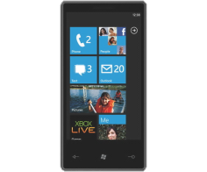
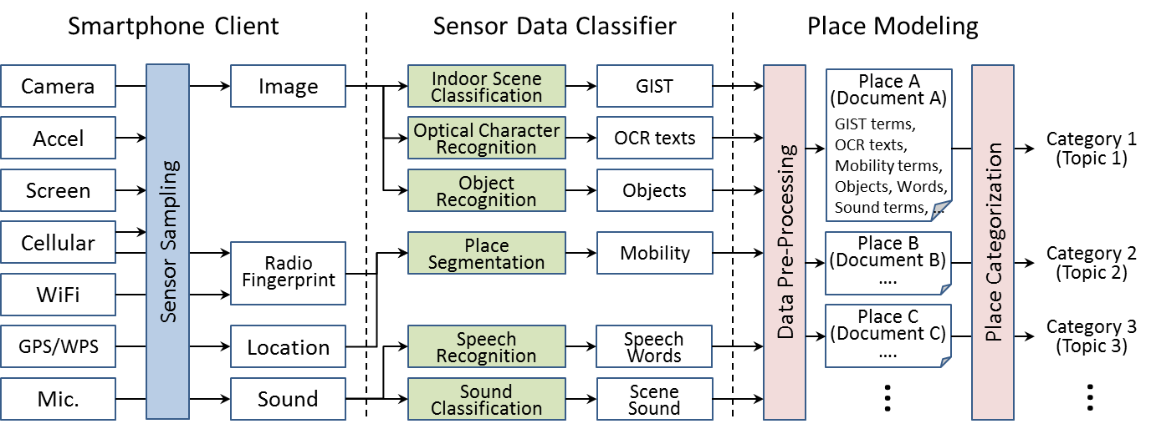
CrowdSense@Place Framework
Opportunistic Sensing
from
Smartphone
Opportunistic Sensing
from
Smartphone
Multi-Modal Classifiers
for
Extracting
Sensor Place Hints
Topic Modeling
for
Place Categorization
9

Slide 15
When to collect data?
Q: When do you think the sensors should start sensing?
When people use the phones
Q: How to ensure user’s privacy (image and audio clips can be sensitive)?
Give the users full control of data collection & the ability to delete data before upload

Slide 16
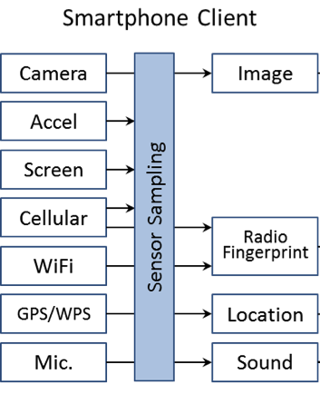


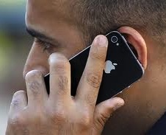
Opportunistic Sensing from Smartphone
Q. When should CSP turn on sensors for collecting high-quality data?
CSP opportunistically collects data based on user context.
Opportunistic collection driven by context
Application usage
e.g., phone calls, browsing, etc.,
Screen state and light sensor
Piggy-back on user actions
Accelerometer (orientation,movement)
to improve image quality
Privacy
User controlled
Review collected data
Buffered before transmission
Purge data with single click based on time or location
10

Slide 17
CrowdSense@Place Framework
Opportunistic Sensing
from
Smartphone
Multi-Modal Classifiers
for
Extracting
Sensor Place Hints
Topic Modeling
for
Place Categorization

Slide 18
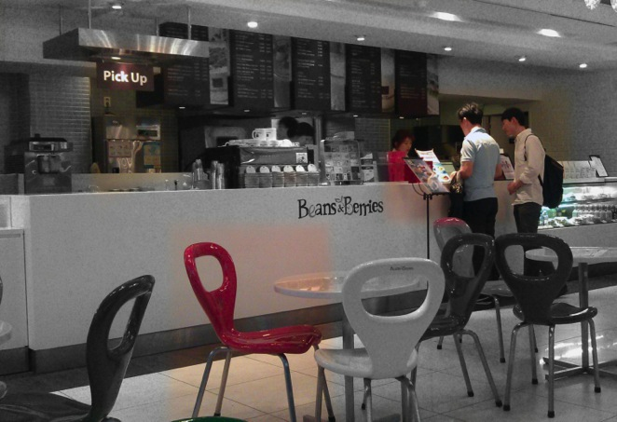


Multi-Modal Classifiers
Q. How can we extract meaningful features?
CSP utilized a wide set of classifiers.
Optical Character Recognition
pick (88%)
up (90%)
Speech Recognition
two (74%)
Americanos
please (85%)
coffee
machine
(56%)
Sound Classification
Object Detection
chair (72%)

Slide 19
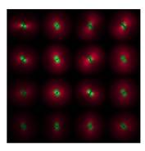
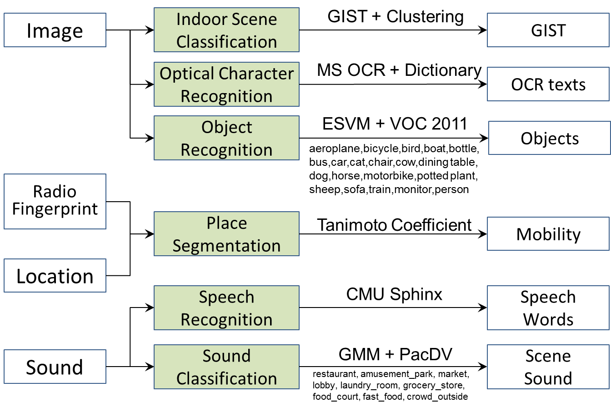
Multi-Modal Classifiers
Q. How can we extract meaningful features?
CSP utilized a wide set of classifiers.
¹
²
³
⁵
Stay duration
Time-of-day
⁴
⁶
13
1. A Oliva, IJCV, 42(3), 2. J. Du, ICDAR’11, 3. T. Malisiewicz, ICCV’11, 4. cmusphinx.sourceforge.net, 5. M. Everingham, VOC’07, 6. pacdv.com

Slide 20
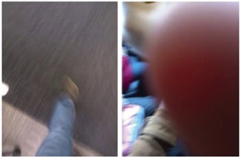
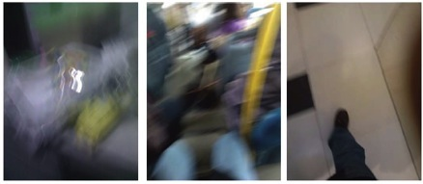
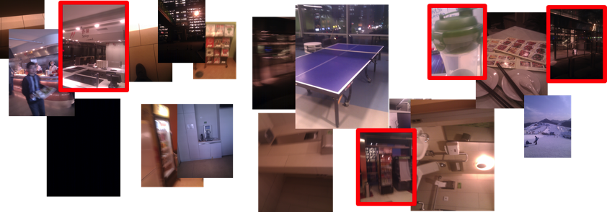
Multi-Modal Classifiers
Q. How can we extract meaningful features?
Challenge of Low Quality Sensor Data.
Overcome by quantity of samples from CrowdSensing
Filter out the noisy data when the phone is faced down/up/shaky
Sensor hints accumulate as user repeatedly visit the same place
Conventional classifiers viable and confidence scores are used to filter results
14

Slide 21
CrowdSense@Place Framework
Opportunistic Sensing
from
Smartphone
Multi-Modal Classifiers
for
Extracting
Sensor Place Hints
Topic Modeling
for
Place Categorization

Slide 22
Topic modeling
A topic model: statistical model for discovering the abstract "topics" that occur in a collection of documents.
Example:
"dog" and "bone" will appear more often in documents about dogs
"cat" and "meow" will appear in documents about cats
"the" and "is" will appear equally in both.
A topic model allows examining a set of documents and discovering, based on the statistics of the words in each, what the topics might be and what each document's balance of topics is.

Slide 23
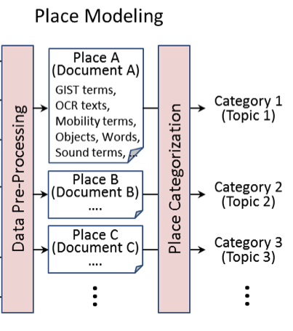
Topic Modeling for Place Categorization
Q. How can we automatically categorize places?
A place (document) is comprised of place hints (terms)
corresponds to multiple place categories (topics).
Place | = | Document
Place Hints | = | Terms
Categories | = | Topics
Pre-Processing
- Confidence of features
- Term frequency-inverse
document frequency (TF-IDF)¹
Category assignment
- Adopt supervised topic model (LDA) ²
16
1. B.C. Salton, IPM 24(5), 2. D. Ramage, EMNLP’09

Slide 24
CrowdSense@Place (CSP)
Evaluation

Slide 25
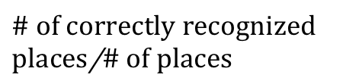
Evaluation Setup
Experiment Questions
  How accuracy does CSP classify places?
  Which features types are most discriminative for place categorization?
  How well do certain feature types operate in noisy environments?
Metrics
  Accuracy of place categorization: # of correctly recognized places/# of places
Baselines
 | Feature | Method | Cons.
GPS | Latitude Longitude | Closest place using Foursquare API | Noise in indoor Dense POIs in urban
Mobility | Stay duration Visit count & time | Place modeling using residence-time distribution | Confused by similar residence pattern
18

Slide 26

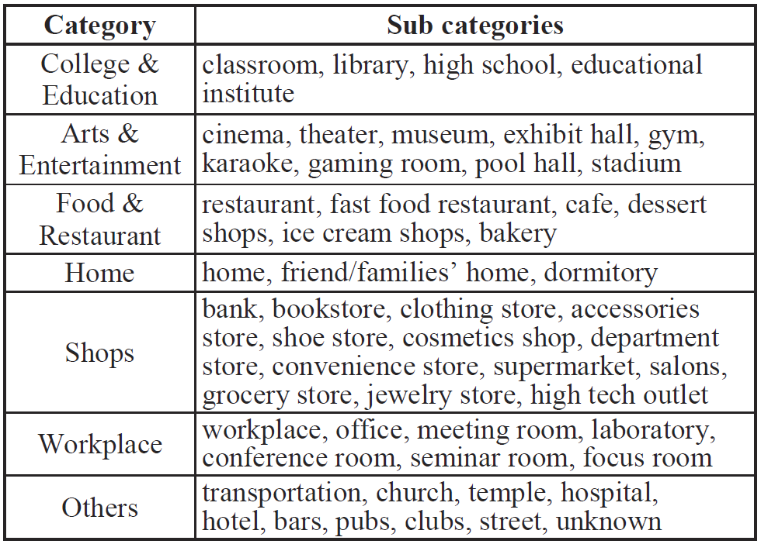































Evaluation – Category Definition
CSP follows category definition of Foursquare. .
19

Slide 27
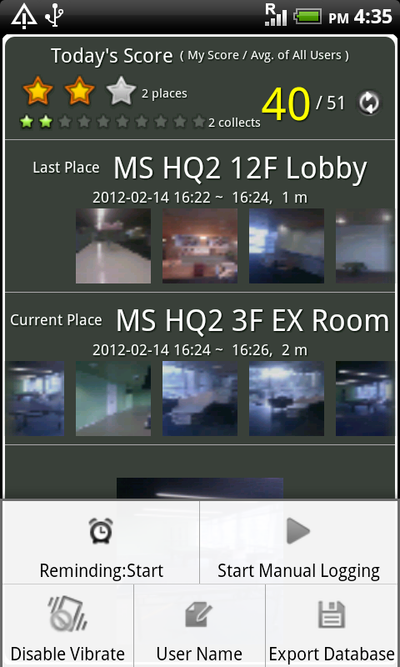
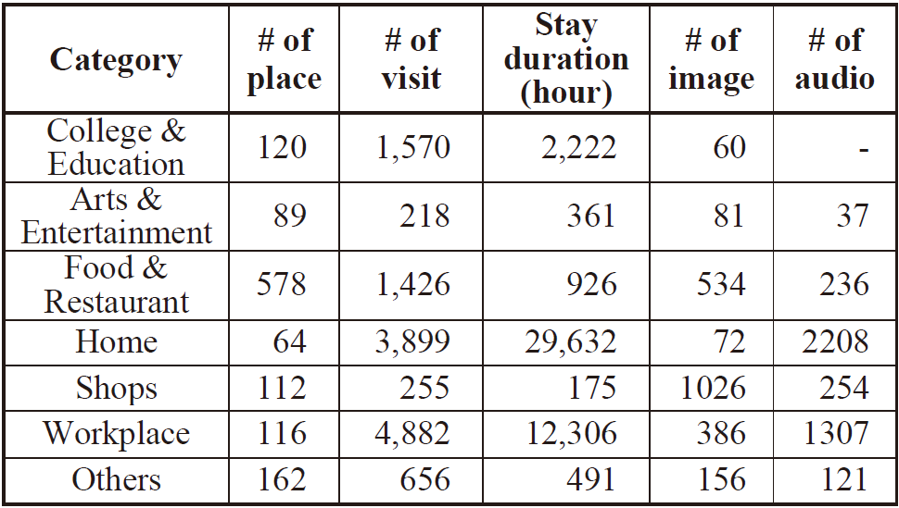
Evaluation - Data Collection
36 participants in Korea, China, and USA
Run collection app. in Android SDK 1.5 smartphone
  1,300 places for 46,000 hours
  2,300 images and 4,200 audios
  22% of images are either blurred or
  completely black
20

Slide 28
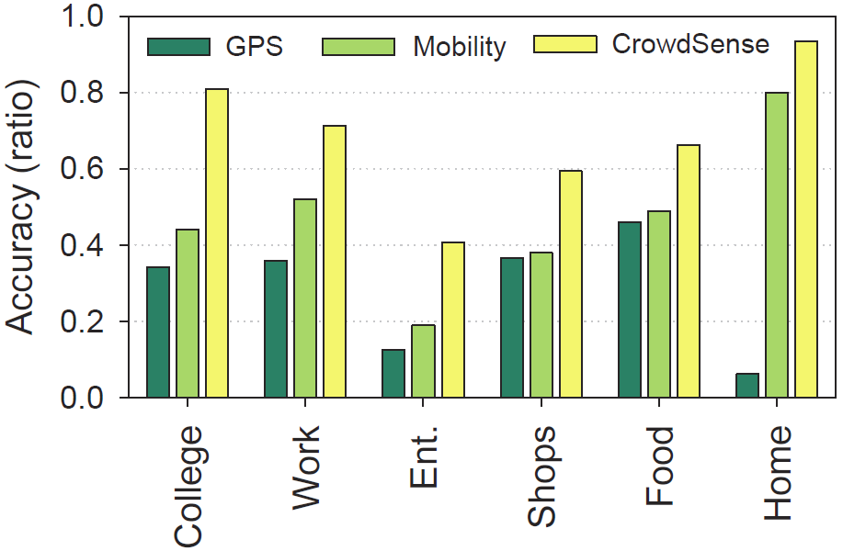
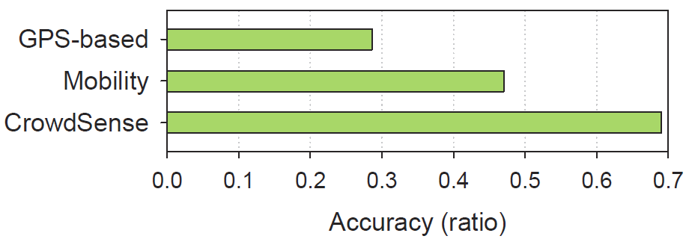
Evaluation - Overall
CrowdSense outperforms existing techniques
with 69% overall accuracy.
Home, college, workplace shows relatively higher accuracy and
entertainment shows worst accuracy.

Slide 29
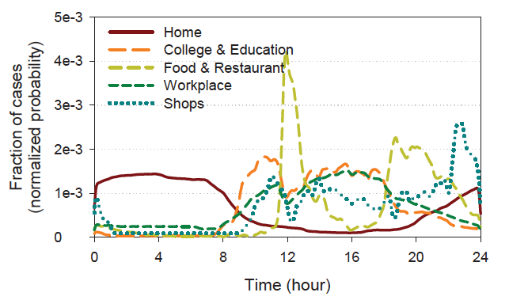
Mobility Patterns

Slide 30
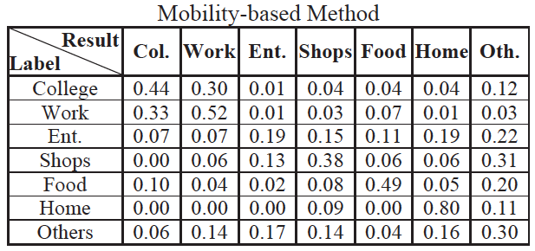
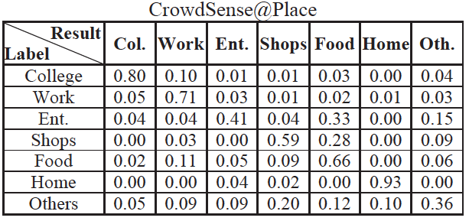
CSP vs Mobility: Confusion Matrix
User Mobility Only
User Mobility + Images + Audio

Slide 31
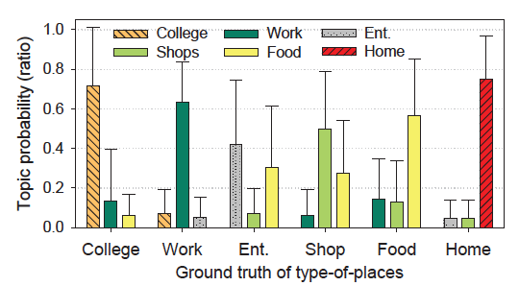
Some Places Belong to More Than One Category
Top-three highest-probability topics for each category

Slide 32
Evaluation - Classifiers
Mobility is the most powerful feature.
Strong discriminative power
Weak discriminative power
Texts by OCR
Scene features by GIST
Object detection in indoor
Speech words and sounds
22

Slide 33
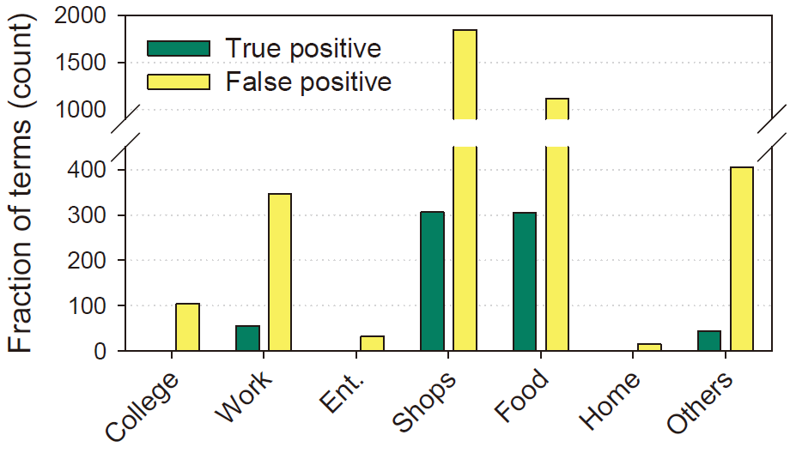
Evaluation - Classifiers
Texts are mainly observed
in shopping and food-related places.
Frequency of recognized words from different place categories
24

Slide 34
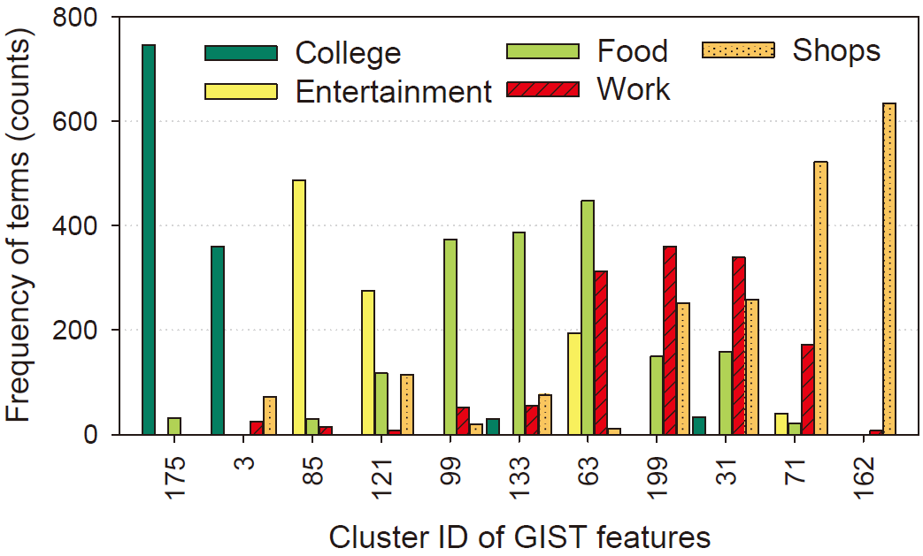
Evaluation - Classifiers
Scene features are distributed differently
for different place categories.
Distribution of indoor scene features (GIST) at different place categories

Slide 35
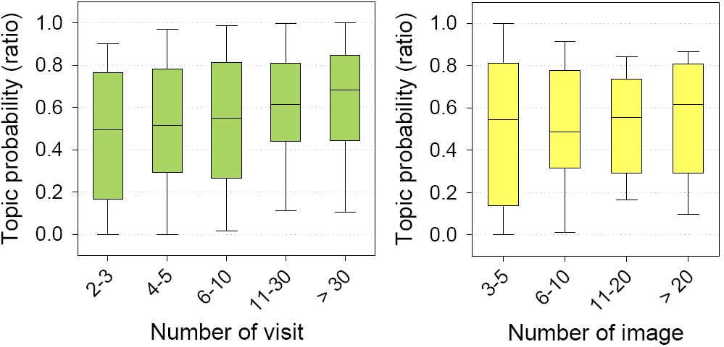
Evaluation - Classifiers
CSP becomes more certain about place categories
as users visit places multiple times.
Box plot of correctly allocated topic probability
26

Slide 36
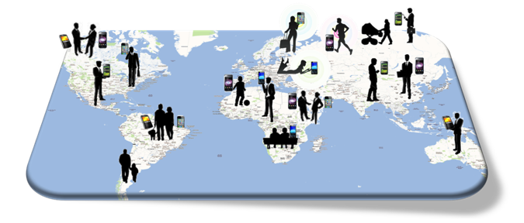
Discussion (1)
Good Example of CrowdSensing Framework
Privacy Concern
Local processing & Anonymization
Induce User Participation
Incentive for data collection
Accurate & Efficient Classifier
Extract high-level context from real data
Advanced Applications
Use crowd context

Slide 37
Discussion (2)
Smartphone Client
Sensor Data Classifier
Application
Camera
Image
Indoor Scene
GIST
Accel
OCR
OCR texts
Automatic Place
Characterizing
Screen
Object Detec.
Objects
Cellular
Radio
Fingerprint
WiFi
Place Segmen.
Mobility
GPS/WPS
Location
Sensor Sampling
Speech Recog.
SpeechWords
?
Mic.
Sound
Sound Classifi.
SceneSound
CPU
?
App.
?
?
?
Gyro
Light
?
?
?
?
Battery
Photo
Social Netw.
Text
?
?

Slide 38
Application Scenarios
Enhanced Local Search and Recommendation
It provides a richer awareness of the types of places a user frequently visits -> additional user profile attribute.
Places can be compared using more refined place hints (e.g., lighting conditions and background music)
Rich Crowdsourced Point-of-Interests Category Map
It can be used to build “maps” that relate places to place categories
A targeted advertising app can determine the user’s current place category based on a WiFi scan performed by his or her smpartphone

Slide 39
Limitations of csp
It has limited place categorization accuracy (< 70%)
Some features (e.g., speech, object recognition) contribute little to the ability to classify places
In future, they plan to train the classifier using a small amount of specific place hints (e.g., discriminative words)
Data collection is completely opportunistic
High-quality hints accumulate slowly
It is better suited to incrementally learning static information over long time scales

Slide 40
Limitations of csp
It did not consider energy issues in their solution
WiFi and GPS are power hungry
Taking many pictures and audio clips will certainly shorten phone’s usage time
Privacy concern is still a BIG problem
It relies on users to decide what images/audio clips to upload, which might not be reliable
In future, it can choose to process sensor data on the phone and then upload features instead of raw data to the backend

Slide 41
Conclusion
Use Hints as Human Does
Recognize a diversity of categories
Integrate Topic Models
with Leveraging Conventional Classifiers
Large-Scale Evaluation
36 users visiting 1300 places in 5 cities
Providing Insights to CrowdSensing Systems

Slide 42

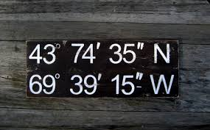

The Author’s Follow up work
Crowdsensing data
GPS Coordinates (with noises)
Actual Name of the Place
Social Network Services
Chon, Yohan, et al. "Autonomous place naming system using opportunistic crowdsensing and knowledge from crowdsourcing." Information Processing in Sensor Networks (IPSN), 2013 ACM/IEEE International Conference on. IEEE, 2013.

Slide 43
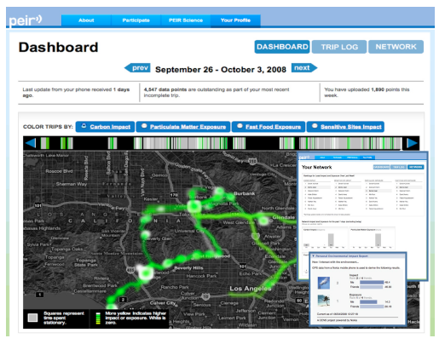
Papers
Paper 4:"PEIR, the personal environmental impact report, as a platform for participatory sensing systems research." Mun, Min, et al. Proceedings of the 7th international conference on Mobile systems, applications, and services. ACM, 2009.

Slide 44
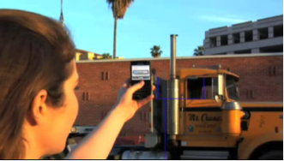
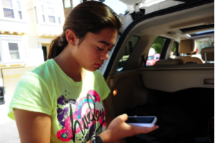
Participatory Sensing
Distributed data collection and analysis at the personal, urban, and global scale
Individuals and communities make decisions about when and how to
Capture -> Store -> Access -> Analyze -> Share
What, where and when to sense?
Participants use mobile phones to gather data and web services to aggregate and interpret the assembled information.

Slide 45
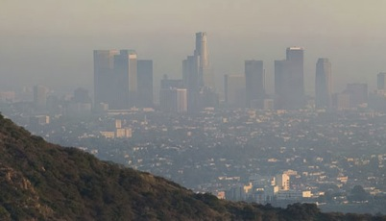
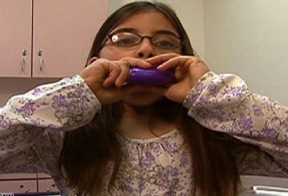
Health and Wellness : PM 2.5
" Los Angeles recently claimed the title of the metropolitan area most polluted by year-round particle pollution."
- America Lung Association
" We know that environmental pollutants have a very significant impact on children with asthma."
- Dr. Avril Beckford,
a pediatrician in Austell, Georgia

Slide 46
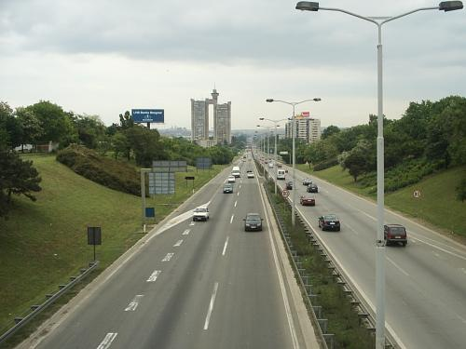
Health and Wellness : CO2
" Transportation sector makes up 1/3 of CO2 emissions."
" Increases in transportation and account for 41% of the growth of CO2 emissions between 1990 and 2005."

Slide 47
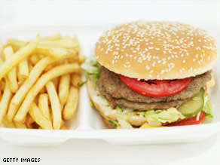
Health and Wellness : Fast Food
" The risk of stroke in a neighborhood increased by 1% for every fast food restaurant"
- CNN
"Proximity to fast food correlates with increased obesity"
- National Bureau of Economic Research

Slide 48
Share your thoughts
What are the environmental and health related application you could think of by using participatory sensing paradigm?
What are the challenges to design and implement the system you proposed?

Slide 49
Personal Environmental Impact Report
  Carbon Impact: a measure of transportation-related carbon footprint (e.g., CO2, etc.)
  Sensitive Site Impact: a user’s transportation related airborne particulate matter emissions (e.g., PM 2.5) near sites with populations sensitive to it (e.g., hospitals and schools)
  Smog Exposure: a user’s transportation-related exposure to particulate matter emissions (e.g., PM 2.5) from other vehicles
  Fast Food Exposure: the time integral of proximity to fast-food eating establishment

Slide 50



What We Expect from PEIR
Ultimately we want people to take notice of impact and exposure and be able to start conversations. The absolute numbers are not what’s key, but instead, trends over time. How can one reduce impact and minimize exposure?
Goal: Draw people’s attention to the environment and health problems by getting them involved!

Slide 51
PEIR is different from other existing carbon footprint calculators
Existing web-based and mobile carbon footprint calculators such as Ecorio, Carbon Hero, UbiGreen
  require users to manually input data each time they travel
  focus only on computing carbon emission values
PEIR senses pollution by using existing infrastructure without much user intervention and emphasizes how individual transportation choices simultaneously influence both environmental impact and exposure

Slide 52
PEIR as a Participatory Sensing System
"Sensing Pollution without Pollution-Sensors”
Existing
Infrastructure
Annotation
/Inferences
Scientific
Models
GPS and Cellular Networks
Users Labe the Data to Train Activity Classifiers
Estimate the Environmental Impact and Exposure

Slide 53
Activity Classification
  Determines whether a user is staying in one location, walking or driving.
  What is the most important activity for PEIR:
  Driving!
  How to detect the driving behavior?
  GPS readings are noisy to compute speed (especially for indoor scenarios)!
  Uses freeway annotation information in addition to speed values in order to identify driving activities better.

Slide 54

Activity Classification: Map Matching
Determines which road a user is on.
Mississippi Ave
Naive approach: find the nearest road as a correct match
What is the problem of this approach?
Both GPS readings and map may not be accurate: nearest road may not be the correct road.
Highway 405

Slide 55
Activity Classification: Map Matching
Determines which road a user is on.
Naive approach: find the nearest road as a correct match
-> often fails in practice
Is there a way to get around this problem?
A better approach: Finds pairs of intersection roads that a user passes by and extracts the common road among subsequent intersections
Sepulveda and National Blvd
National Blvd
Sawtelle and National Blvd

Slide 56


Activity Classification: Map Matching
Problem 1: The captured GPS data points are not always near intersections
Problem 2: The erroneous identification of pre-intersections can lead to error propogation
Two enhancements:
  - A close enough road can be considered as a possible intersection point.
  - It replaces both pre- and post- intersections when there is no common road among subsequent intersections

Slide 57

Activity Classification: Problems and Improvement by Leveraging GSM Data
Classification based on GPS data alone is difficult if GPS performance is compromised by limited satellite visibility. E.g. when users are indoors
Q: What can we do to mitigate this limitation without adding additional hardware/sensors?

Slide 58
Activity Classification: Problems and Improvement by Leveraging GSM Data
Classification based on GPS data alone is difficult if GPS performance is compromised by limited satellite visibility. E.g. when users are indoors
GSM (Global Systems for Mobile Communication), i.e., Cellular Network data is already available and can compensate for the speed values from GPS devices.
Unique cell ID: Country Code + Network Code + Area Code + Cell ID
Rough indication of a user’s location

Slide 59

Activity Classification: Problems and Improvement by Leveraging GSM Data
Classification based on GPS data alone is difficult if GPS performance is compromised by limited satellite visibility. E.g. when users are indoors
GSM (Global Systems for Mobile Communication), i.e., Cellular Network data is already available and can compensate for the speed values from GPS devices.
Indicate the user’s travel mode

Slide 60

Activity Classification: Problems and Improvement by Leveraging GSM Data
Annotate
PEIR Users
Stationary Indoors
Walking Indoors
Stationary Outdoors
Walking Outdoors
Driving
Accuracy: percentage of the number of the correctly predicted data points

Slide 61


Activity Classification: Problems and Improvement by Leveraging GSM Data
User 2 and 3: Staying-in-place activities involve a lot more movements than other users

Slide 62

Modeling of Impact and Exposure
Dataflow Diagram

Slide 63



Shall We Explore PEIR
Backend status
To visualize location traces color-coded by level of impact or exposure.
Bar graph
Interactive Map
Impact and exposure in a day-by-day break down

Slide 64
Shall We Explore PEIR
Q: Can you design some novel incentive mechanisms to encourage users to reduce their impact and exposure in daily lives?

Slide 65


Share and Compare: Peer Pressure -> Incentive to Reduce Impact and Exposure
Location data is sensitive, hence not shared on PEIR unless users enable it!
Ranking list of the user and her/his friends based on impact and exposure
Facebook App: Compare the impact/exposure of the user with the average of friends

Slide 66


Deployment
  The PEIR system has been running since June 8, 2008
  As of November 28, 2008, over four million individual GPS points grouped into over 20,000 separate trips.
  50-60 high school students have been using PEIR in the Northern California area as part of a sustainability challenges.

Slide 67

Lessons
User’s feedback:
"It's hard to step away from the car. But even though it takes an extra step to walk or bike, we see it can make a difference."
"Instead of driving, I'm biking more because I'm subconsciously connecting this phone in my pocket with how much energy I'm using,"

Slide 68






Lessons
More choices about the types of transportation
The point-based computations or annotations of location traces and GIS data are expensive.

Slide 69
PEIR produces all the valuable information for individuals while individuals give up their privacy (since they upload their time-location trace to the system).

Slide 70

Participatory Privacy Regulation
Location traces quantify habits, routines, associations
Individual control of time/space accountability
Potential consequences:
  Location-based discrimination
  Safety & security threats
  Inference of personal activities

Slide 71




Legibility of PEIR Data and Selective Sharing
  PEIR allows users to break down the trip and select what and with whom they feel comfortable to share
  By default, they system will delete all location information after six months unless users specify otherwise.
Trip Breakdown
Selective Sharing

Slide 72
Selective Hiding
People want to hide a trip to a particular significant destination (e.g., hospital, a certain store, or a particular restaurant, etc.)
However, simply removing the trip is suspicious: the lack of data may raise attention to the space/time to be protected.
Q: What is your solution to address the above problem (i.e., hide a trip to a particular destination without introducing extra suspicion?)

Slide 73
Selective Hiding
Proposed solution: replace a particular route with a trace which satisfying the following:
(a) Privacy enhancement:
Increase the user's sense of privacy when sharing a substituted-trace.
(b) Application output equivalency:
The substitute trace results in minimal changes to the PEIR metrics.
(c) Believability:
The substitute trace should be credible to the people with whom the user shares his/her data.

Slide 74

Selective Hiding: Hide Location C
The Original Trace
Adding Noise
Spatial Rounding
Selective Hiding
Original Route: A->B->A->C->A
Selective Hiding: A->B->D->A

Slide 75

Selective Hiding
  The high degree of data corruption is required to preserve privacy using prior art counter measures
  Selective hiding with substitute path segments produces nearly the same PEIR model output met
Almost the same as the original route!

Slide 76
Conclusion and Future Directions
  Exemplified an emerging class of adaptive, human in-the-loop sensing systems
  Detailed PEIR’s architecture, implementation and enhancements are presented
Where do we go from here?
  Focus on scalability, stability, performance and usability
  Extend activity classification to accommodate other modalities such as cycling, bus, train, and subway
  Enhance sustained usability of the system through the introduction of goal setting and feedback

