Slide 1
Automobile Sensing and Intelligent Transportation Systems 1
CSE 40437/60437-Spring 2015
Prof. Dong Wang

Slide 2


Papers
Paper1: Raghu K. Ganti, Nam Pham, Hossein Ahmadi, Saurabh Nangia, and Tarek F. Abdelzaher, "GreenGPS: a Participatory Sensing Fuel-efficient Maps Application," In Proceedings of the 8th international conference on Mobile systems, applications, and services (MobiSys), 2010

Slide 3
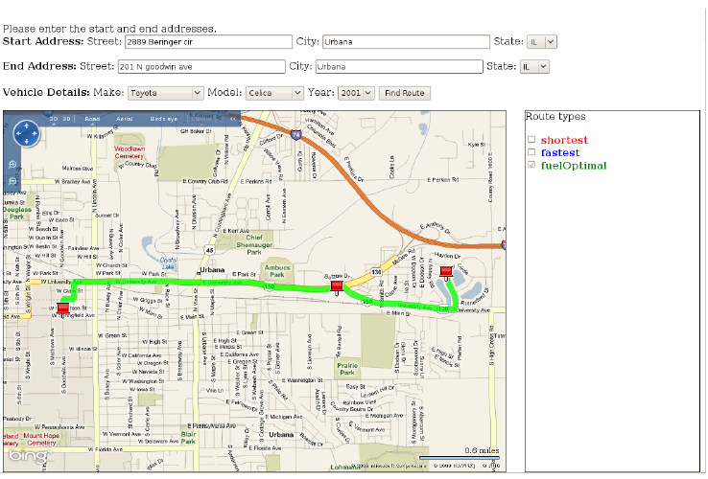
Green GPS Map Interface

Slide 4
Key Points
GreenGPS uses participatory sensors to determine a fuel-efficient route between two arbitrary end-points.
Utilizes the OBD-II interface to retrieve data from sensing automobiles
The most fuel-efficient route is not always the shortest or fastest

Slide 5
Green GPS Goals
Long term Goal:
  Develop a fuel efficient navigation service using participatory sensing to influence routing decisions of individuals
Short term Goal:
  Accurate fuel consumption prediction model
  Experimental deployment to analyze fuel savings, average savings of 10%

Slide 6
Why Green GPS?
200 million light vehicles on the streets
Each driven 12000 miles annually on average
Average MPG (Miles Per Gallon) is 20.3 miles/gallon
118 Billion Gallons of Fuel per year!
Savings of 1% = One Billion Gallons (2~3 Billion $)
* The above data are from Environment Protection Agency (EPA) Statistics

Slide 7
Share your thoughts
How would you design such an green navigation service using participatory sensing paradigm?
  Assume you have a group of participants (drivers). Each of them has a smartphone with GPS, WiFi and Bluetooth, etc.)
  You can get the parameters of their vehicles (e.g., current speed, total fuel consumption, fuel consumption rate, time, etc.) through a special on board device (OBD-II)
What are the key challenges of designing this service?

Slide 8
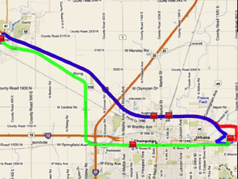
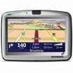
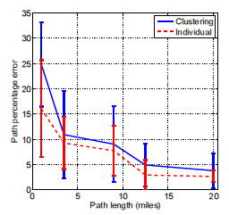

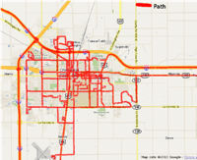

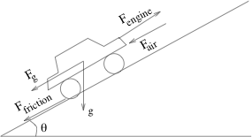


Green GPS
System Architecture
Shortest and fastest
Green GPS
Most fuel-efficient
Fuel Error (%)
vs. Trip Length
Subscribers
Subscribers: Premium service
High savings
Open access: Standard service
Average savings
+
Fuel Data
Physical Models
+
OBDII-WiFi
Adaptor ($50)
GPS Phone
Server

Slide 9
Small Scale Feasibility Study
Three different cars and drivers between Urbana-Champaign landmarks
  Shopping Center, author’s office and football stadium
  Shortest and fastest routes calculated using MapQuest (http://www.mapquest.com/ )

Slide 10
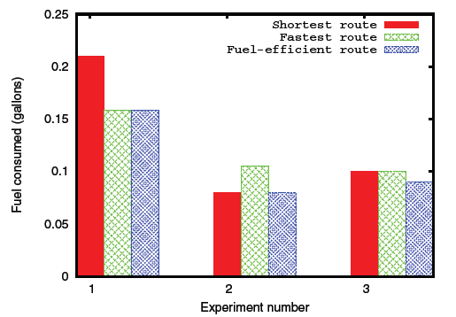
Small Scale Results
Average of 11% overhead for always taking the “fastest” route
Average of 11.5% overhead for “shortest”
Simply choosing the shortest or the fastest route will not always be fuel-optimal.

Slide 11
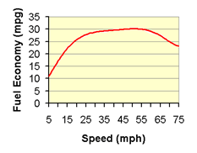
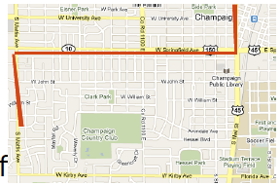
GreenGPS: Fuel Efficient Routing
Fuel efficient route different from shortest or fastest route ->Why?
  Congestion, number of traffic regulators -> shortest may not be fuel efficient
  MPG vs. speed is non-linear OR fastest route might be longer -> fastest may not be fuel efficient
Individuals record fuel-related sensor data from their daily commutes
Share the sensor data in a community to build fuel map of a given area
Source: US EPA

Slide 12
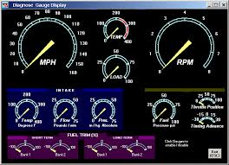

On Board Diagnostic (OBD-II) System
Cars manufactured after 1996 equipped with On Board Diagnostic (OBD-II) System
OBD measures engine parameters (e.g., fuel consumption, RPM, speed, etc.)
Commercial OBD scanners available
An estimated 200 millions cars and light trucks are on the roads in U.S

Slide 13
GreenGPS Users
Members (Subscribers):
  Have OBD-II Equipment
  Upload their data to the service
  Get accurate estimation of the fuel consumption
Non-members
  Just query fuel efficient routes from GreenGPS
  Does not share their measurements
  Approximate answers based on the average estimation based on car’s make, model, year
Why members can normally get better estimation on their fuel consumptions?

Slide 14
Fuel Consumption Modeling
Ideal scenario: all cars collect data on a LOT of streets
Current situation: few individuals with OBD scanners
Challenge: sparse deployment and data to model complex phenomena
Question: Can we generalize a few measurements on a few cars to predict fuel consumption of an arbitrary car on an arbitrary street?

Slide 15
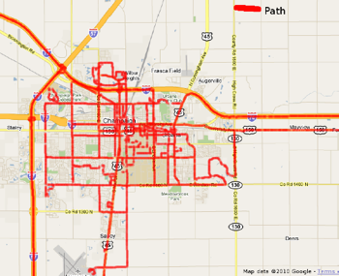
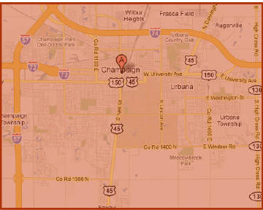
Sampling Regression Modeling Framework
Fuel consumptions of few cars on a few streets to predict fuel consumption of any car on any street?
Use data from existing cars and streets to build generalized models (data cube) to predict fuel consumption of other cars on other streets.

Slide 16
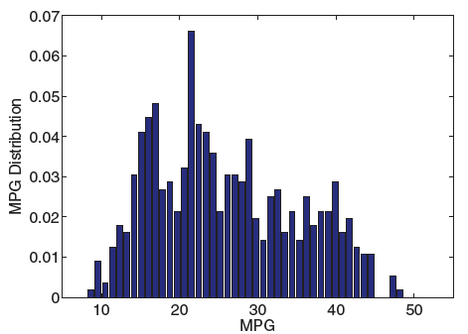
Simple Prediction: Average MPG
Uniform distribution of mpg and high standard deviation (standard deviation= 9.12 mpg)
Nearly Uniform
Deviation is too high

Slide 17
Model Structure Deviation
Simple model for fuel consumption derived from physics principles
What kind of features/parameters should we consider in order to predict the fuel consumption of a trip for a given car?

Slide 18
Model Structure Deviation
Simple model for fuel consumption derived from physics principles
Approximate based on easily measurable parameters (e.g., stop signs, speed limits)
# of stop signs
# of traffic lights
Distance traveled
Average speed
Weight of the car
Car front area
Slope

Slide 19
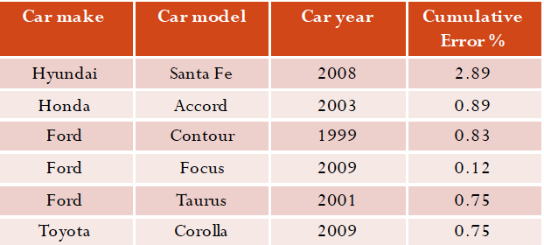
Individual Car Models
Split data into 1 mile segments (segment length determined empirically)
Individual models: how can we predict a car’s fuel consumption on a different path?

Slide 20
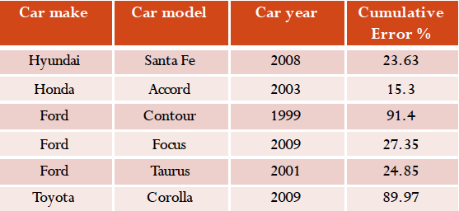
One Size Fits All?
Generalize: Use model computed from all data to predict fuel consumption of a car that lacks previously measured values
Fuel consumption of different cars is different: one size did not fit all!

Slide 21
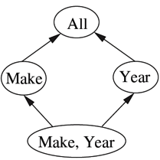
Generalization Hierarchy
Derive a hierarchy for prediction using the sampling regression framework when data for a specific car is missing
Q: What if a car is encountered for which we do not have data on its (make, year)?
Q: What if there are no models corresponding to either make or year for the car?
Example: 2001 compact Ford is modeled differently from a 2001 mid-size Ford, a 2002 compact Ford or a 2001 compact Toyota.

Slide 22
Generalization Hierarchy Evaluation Results
Evaluate model performance using this framework
Car make | Car model | Car year | Mean error %
Hyundai | Santa Fe | 2008 | 0.73
Honda | Accord | 2003 | 1.01
Ford | Contour | 1999 | 1.42
Ford | Focus | 2009 | 2.7
Ford | Taurus | 2001 | 3.38
Toyota | Corolla | 2009 | 1.28
Hierarchical generalization addressed the sparse data and modeling challenge!

Slide 23
Green GPS System Implementation
Open Street Map (OSM) database
Routing: think of it as weighted Dijkstra’s algorithm with weights as fuel consumption on road segments
Microsoft Bing maps based interface for input and output route display
Preliminary system:
http://green-way.cs.illinois.edu/GreenGPS.html

Slide 24
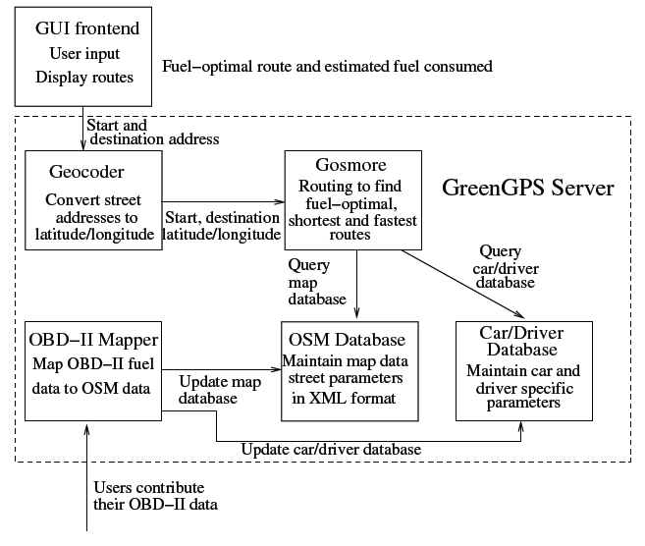
GreenGPS Modules

Slide 25
Evaluation
Performed in two stages
  Stage 1 – Use to predict end-to-end fuel consumption for long routes
  Stage 2 – Evaluate potential fuel savings of an individual using GreenGPS

Slide 26
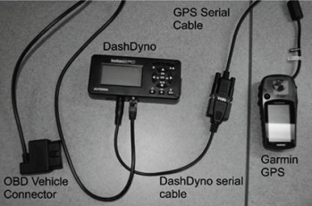
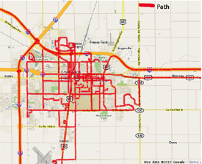
Preliminary Deployment
DashDyno – OBD scanner with GPS to collect location tagged car sensor data
16 different compact and mid-sized sedans, e.g., Ford, Toyota, Honda
Over 1000 miles of data collected
Users record sensor data and GPS on SD card and upload to the backend server
DashDyno
Coverage map

Slide 27
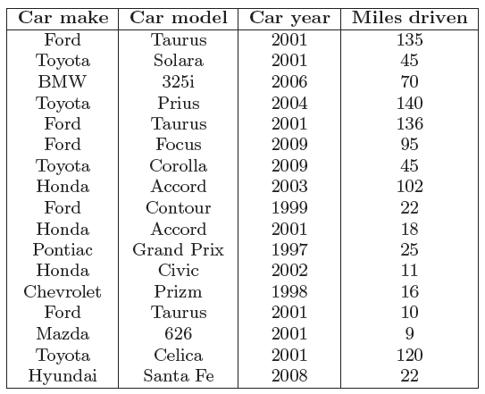
Cars Used in Experiments

Slide 28
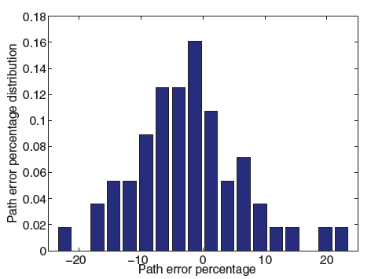
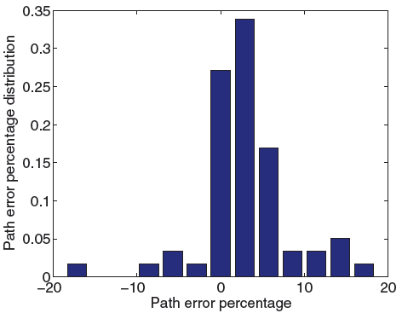
Model Accuracy
Unbiased Model
Left: Remove the path but calculating prediction from the same car on different paths
Right: Remove all data from that car and use hierarchical method to find an appropriate model
Both version have normal distribution with a near zero mean (long term savings)
Path error is reduced with the length of the travel

Slide 29
Fuel Savings Evaluation
Experiments on five cars, each does four round-trips between 2 landmarks in Urbana-Champaign on fastest and shortest routes
GreenGPS predicts fuel efficient route between fastest and shortest always correctly
Car Details | Landmarks | GreenGPS Route | Savings %
Honda Accord 2001 | H1 to Mall | Shortest | 31.4
 | H1 to Gym | Shortest | 19.7
Ford Taurus 2001 | H2 to Restaurant | Shortest | 26
Toyota Celica 2001 | H2 to Work | Fastest | 10.1
Nissan Sentra 2009 | H3 to CUPHD | Fastest | 8.4
Honda Civic 2002 | Grad to Work | Fastest | 18.7
Average fuel savings across 5 cars

Slide 30
Lessons Learnt
Experience with GreenGPS
  Data cleaning is important
    Sometimes GPS would not provide/record data to DashDyno
    Some cars used metric while others used imperial systems
    Need to filter complete datasets
  Privacy
    User activity is traced via GPS
    User can turns this off but this affects data
  What incentives should be provided to the user?
    Need to mitigate sparse data
    Free gas or mutual benefits or more? (e.g., 1 mile -> 1 dollar)

Slide 31
Limitations
What important limitations do you observe about GreenGPS service?

Slide 32
Limitations
GreenGPS should eventually be a real-time service since traffic condition changes quickly over time. This paper does not explore time dimension!
Fuel consumption is also a function of driver’s behavior (e.g., abrupt break and acceleration), which is totally ignored in the paper due to the small sample size of the users

Slide 33
Limitations
Cars used in the experiments are mostly compact and mid-sized sedans. A broader range of vehicles (e.g., SUVs, minivans, light trucks) should also be considered.
Experiments have been done in a quiet college town. Hence it is not clear if the model will be accurate for large cities (where traffic and road conditions can be quite different)

Slide 34
Conclusions
Demonstrate the use of participatory sensing system to predict fuel consumption of an arbitrary car on an arbitrary street
Show a 6% on average savings vs shortest route and 13% savings over fastest route
Demonstrate how to generalize sparse samples of high dimensional spaces to develop models of complex non-linear phenomena-> one size does not fit all!

Slide 35
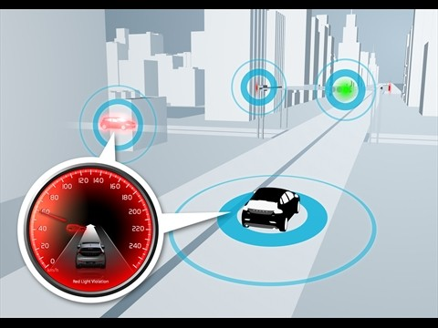
Papers
Paper2: Koukoumidis, Emmanouil, Li-Shiuan Peh, and Margaret Rose Martonosi. "Signalguru: leveraging mobile phones for collaborative traffic signal schedule advisory." Proceedings of the 9th international conference on Mobile systems, applications, and services. ACM, 2011 (Best Paper Award).

Slide 36
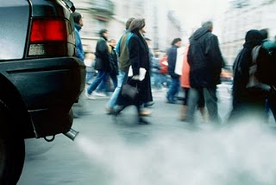
Vehicles: The polluting energy hogs
Cars are big polluters & energy hogs
Produce 32% of total C0₂.
Consume 28% of USA’s total energy.
10 times the energy for computing infrastructure.
* Source: US Environmental Protection Agency (http://www.epa.gov/)

Slide 37




Traffic Signals - GLOSA
Traffic signals:
  (+) Provide safety.
  (.-.) Enforce a stop-and-go movement pattern.
    Increases fuel consumption by 17%*.
    Increases CO₂ emissions by 15%*.
Solution: Green Light Optimal Speed Advisory (GLOSA).
* Source: Audi Travolution Project
w/o
GLOSA:
Need to know the schedule of traffic signals.
with
GLOSA:

Slide 38


Signal Schedule Advisory Systems
 | Infrastructure Cost | Predictability | Continuous Advisory | Advance Advisory
Pedestrian countdown timers
Vehicular countdown timers
Road-side speed message signs
Audi Travolution
SignalGuru
$
$$
$$$
None

Slide 39
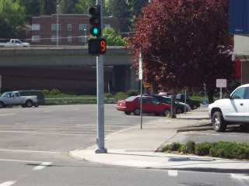

Slide 40
Signal Schedule Advisory Systems
 | Infrastructure Cost | Predictability | Continuous Advisory | Advance Advisory
Pedestrian countdown timers
Vehicular countdown timers
Road-side speed message signs
Audi Travolution
SignalGuru
$
$
$$
$$$
None

Slide 41
Signal Schedule Advisory Systems
 | Infrastructure Cost | Predictability | Continuous Advisory | Advance Advisory
Pedestrian countdown timers
Vehicular countdown timers
Road-side speed message signs
Audi Travolution
SignalGuru
$
$$
$$$
None

Slide 42
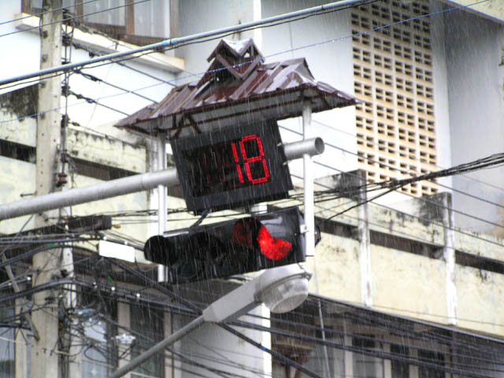
Thailand

Slide 43

Design: Damjan Stankovich

Slide 44

Design: Thanva Tivawong

Slide 45
Signal Schedule Advisory Systems
 | Infrastructure Cost | Predictability | Continuous Advisory | Advance Advisory
Pedestrian countdown timers
Vehicular countdown timers
Road-side speed message signs
Audi Travolution
SignalGuru
$
$
$$
$$$
None

Slide 46
Signal Schedule Advisory Systems
 | Infrastructure Cost | Predictability | Continuous Advisory | Advance Advisory
Pedestrian countdown timers
Vehicular countdown timers
Road-side speed message signs
Audi Travolution
SignalGuru
$
$
$$
$$$
None

Slide 47
Signal Schedule Advisory Systems
 | Infrastructure Cost | Predictability | Continuous Advisory | Advance Advisory
Pedestrian countdown timers
Vehicular countdown timers
Road-side speed message signs
Audi Travolution
SignalGuru
$
$
$$
None

Slide 48
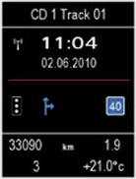
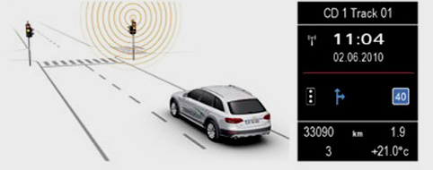
Audi Travolution

Slide 49
Signal Schedule Advisory Systems
 | Infrastructure Cost | Predictability | Continuous Advisory | Advance Advisory
Pedestrian countdown timers
Vehicular countdown timers
Road-side speed message signs
Audi Travolution
SignalGuru
$
$
$$
$$$
None

Slide 50
Signal Schedule Advisory Systems
 | Infrastructure Cost | Predictability | Continuous Advisory | Advance Advisory
Pedestrian countdown timers
Vehicular countdown timers
Road-side speed message signs
Audi Travolution
SignalGuru
$
$
$$
$$$
None

Slide 51
Share your thoughts
How would you design such a speed advisory system using smartphones in cars?
What are the key challenges you can envision?

Slide 52
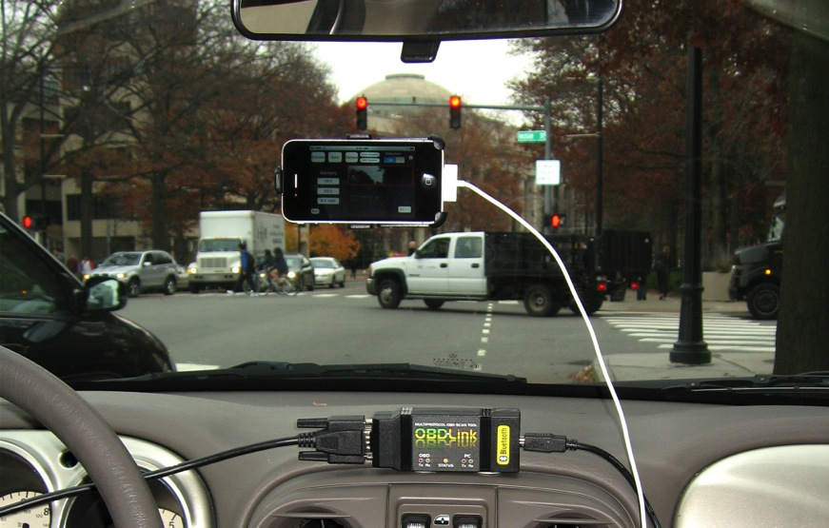
SignalGuru Approach

Slide 53
Challenges
Commodity cameras. Low video resolution:
  iPhone 4: 1280 × 720 pixels.
  iPhone 3GS: 640 × 480 pixels
Limited processing power.
  But need high video processing frequency.
Uncontrolled environment.
Traffic-adaptive traffic signals.
  Singapore traffic signal system using inductive loop detectors
Non-challenge: Energy.

Slide 54
SignalGuru Architecture
Q: Why detect R->G transitions (instead of G->Y, Y->R)?
A: Cars stop at red lights and have a higher chance to capture R->G transition

Slide 55
Detection Module
Detects signal current status (Red/Yellow/Green) from video.
Activated based on its GPS location (<50m) to the intersection
Process a new frame every 2sec.
Main features:
  Bright color.
  Shape (e.g., round, arrow).
  Within black housing.
  Location in frame (detection window).

Slide 56
IMU-based Detection Window
φ: field of view
ω: roll angle
θ: detection angle
Top half
Gyro and Accelerometer
GPS
Roll angle ω is calculated by gyro and accelerometer (inertial measurement unit-IMU) data.
Process only area within detection window.
Cuts off half of the image:
  Processing time reduced by 41%.
  Misdetection rate reduced by 49%.

Slide 57
Transition Filtering Module
The raw detection of traffic signals and their color transitions (R->G) given by the detection module is fairly noisy.
  Many things can be misclassified as traffic signals (e.g., signs on bus, cars, etc.)
Q: How could we filter out noise (i.e., avoid false positives) in the transition detection?
  False positives pollute the prediction scheme (e.g., R->R->G->R->R)

Slide 58
Transition Filtering Module
Filters out false positives.
Low Pass Filter:
…→R→R→R→G→R→R→…
…→G→G→G→R→G→G→…
Colocation filter.
  Red and Green bulbs should be colocated.
frame i
frame i+1
Filters compensate for lightweight but noisy detection module.

Slide 59
Collaboration Module
Why?
  A node is limited in its vision
  A node needs information ahead of time before it “sees” the signal
No central server.
Real-time adhoc exchange of time-stamped R→G transitions (last 5 cycles)
Collaboration:
  Improves mutual information.
  Enables advance advisory.

Slide 60
Prediction Module
Add to timestamp of phase A’s detected R→G transition (t_{A, R→G}) the predicted Phase Length of A (PL_{A}) to predict R→G transition for B (t_{B, R→G}).
B
A
B
A
PL_{A}
t_{A, R→G}
t_{B, R→G}
Phase Length prediction:
  Pre-timed signals: Look-up in database.
  Traffic-adaptive traffic signals: Predict based on history of settings using machine learning (SVR).
A
B

Slide 61
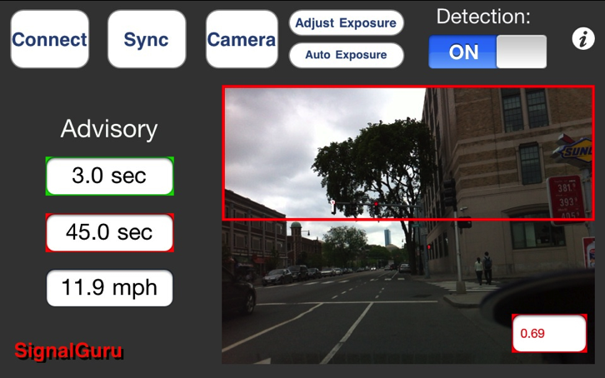
SignalGuru/GLOSA iPhone Application
Residual amount of time in sec until the traffic signal turns green.
Residual amount of time in sec until the traffic signal turns red again.
Recommended GLOSA speed.

Slide 62
SignalGuru
Evaluation

Slide 63
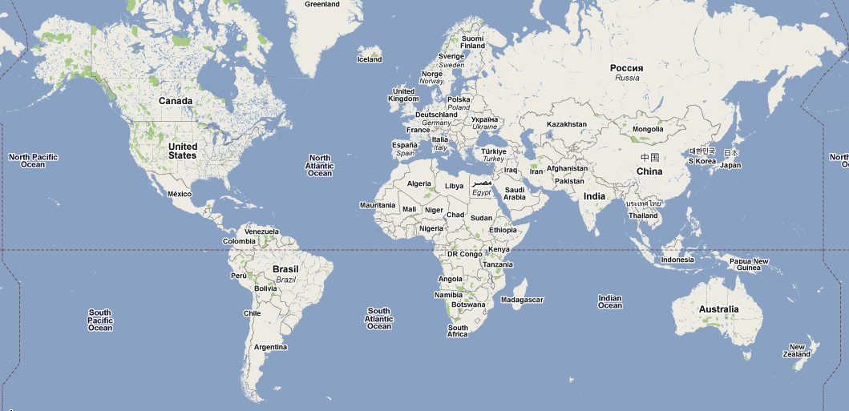
SignalGuru Evaluation
Cambridge (MA, USA)
Singapore

Slide 64
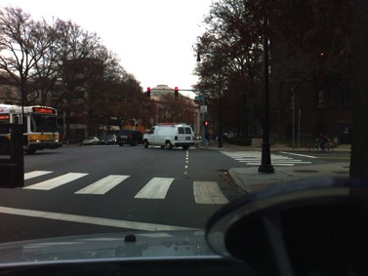
Cambridge: Prediction Accuracy Evaluation
Cambridge (MA, USA)
Pre-fixed traffic signals
Experiment on Massachusetts Ave:
  5 cars over 3 hours.
  1 pedestrian node serves as the relay nodes
Pre-timed traffic signals.
Experiment:
  5 cars over 3 hours.
  3 signals, >200 transitions.
Error_{Average} = 0.66sec (2%).
The error was solely caused by the detection phase of SignalGuru

Slide 65
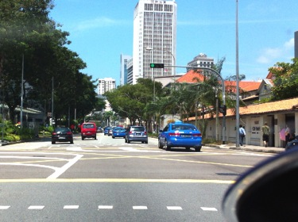
Singapore: Prediction Accuracy Evaluation
Singapore
SignalGuru accurately predicts both pre-timed and traffic adaptive traffic signals.
Traffic-adaptive traffic signals
Experiment in downtown:
  8 cars over 30 min.
  2 signals, 26 transitions.
Error_{Average} = 2.45sec (3.8%).
  Error_{Transition Detection} = 0.60sec (0.9%).
  Error_{Phase Length Prediction} = 1.85sec (2.9%).

Slide 66
Evaluation: GLOSA Fuel Savings
Trip: P₁ to P₂ through 3 signalized intersections.
20 trips to measure fuel consumption.

Slide 67
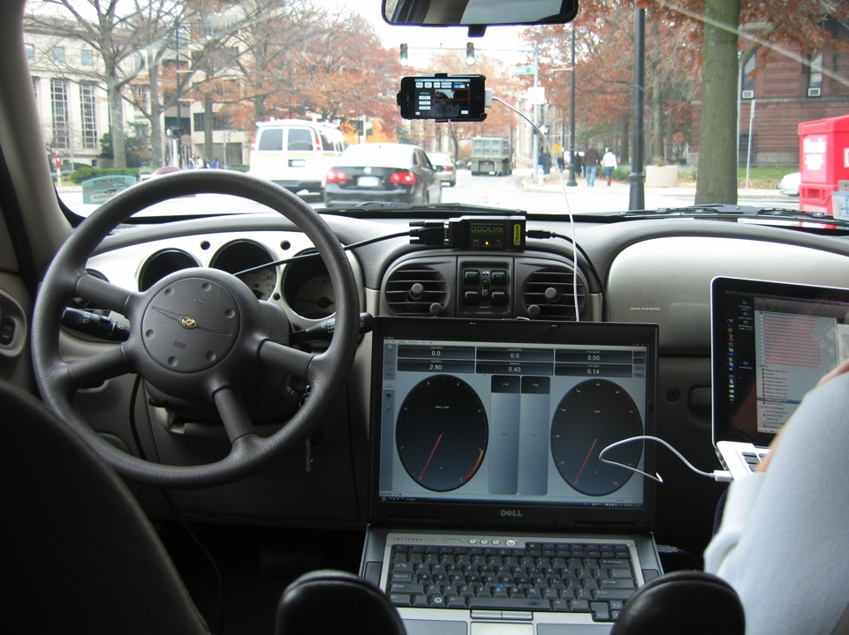
2.4L Chrysler
PT Cruiser ’01
SignalGuru/GLOSA-enabled iPhone
Scan Tool
OBD-LINK device
20%
OBDWiz software (IMAP)

Slide 68
Evaluation: GLOSA Fuel Savings
20%
Without GLOSA driver made on average 1.7/3 stops.
Average fuel consumption reduced by 20.3%.
Mpg improved by 24.5% (16.1->20.1 mpg).

Slide 69
Limitations
What limitations do you observe about Signal Guru?

Slide 70
Limitations
The paper did not discuss the issue of user’s adaptability to this technology.
  It might change user’s driving behavior
  It might affect the car that is behind you
It does need sufficient cars with the SignalGuru app to participate and share their detected signal transition traces

Slide 71
Limitations
The prototype has only been tested on limited number of roads in two cities
  Large city and busy roads may introduce more noise
The privacy issue has not been discussed
  People are sharing their GPS traces with each other

Slide 72
Other related applications
Traffic Signal-Adaptive Navigation
  Suggest better route to avoid long-waiting traffic signals
Red Light Duration Advisory
  Driver can switch off engine to save fuel and decrease environment impact during long wait red lights
Imminent Red Light Advisory
  Let the driver know the residual amount of time before the signal turns red to avoid unnecessary speeding
Red Light Violation Advisory
  Warns the driver when they are about to violet red lights using the signals detected and accelerometers on the phone

Slide 73
Conclusions
With selective accelerometer- and gyro-based image detection and filtering near real-time, the accurate image processing can be supported.
SignalGuru predicts accurately both pre-timed and traffic-adaptive traffic signals.
SignalGuru-based GLOSA helps save 20% on gas.

