Slide 1
Automobile Sensing and Intelligent Transportation Systems 2
CSE 40437/60437-Spring 2015
Prof. Dong Wang

Slide 2
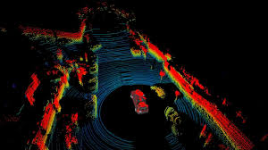
Papers
Paper 3: Kumar, Swarun, et al. "Carspeak: a content-centric network for autonomous driving." ACM SIGCOMM Computer Communication Review 42.4 (2012): 259-270.

Slide 3
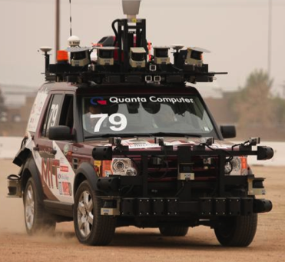
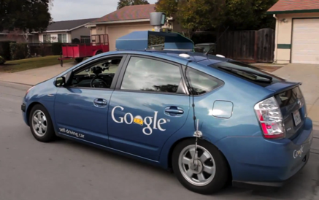
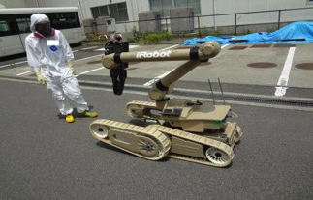
Much Interest in Autonomous Vehicles
Google’s Autonomous Car
  Benefits include lower traffic congestion, higher fuel efficiency, improved productivity
DARPA Urban Challenge (Team MIT)
Projected to save $100B/yr in US alone [WPI’07]
Robots for Disaster Areas (Fukushima)
Notes:
Recently, there has a been a lot of interest in autonomous vehicles
Perhaps the most well known initiative is the DARPA Urban challenge, in which, universities designed autonomous cars that can navigate on urban roads.
Another recent example is that of Google’s autonomous car which has traveled thousands of miles on public roads.
In fact, autonomous vehicles are not just restricted to cars on the road, but were also used to detect radiation during the recent Fukushima nuclear disaster.
These autonomous vehicles provide multiple benefits including:
Fewer traffic congestions,
much higher fuel efficiency and
improved productivity
Estimates show that these benefits are projected to save billions of dollars in the US alone.

Slide 4
“Expect them on the road by 2020”
- General Motors
Nevada and California legalized testing autonomous vehicles. Florida expected to follow.
Autonomous Vehicles tested on Europe’s roads
Notes:
In fact, major companies are already building autonomous cars. And General Motors expects them on the road by 2020.
There is support from governments as well. In the US, Nevada has legalized testing autonomous vehicles on the road. Many other states, including California and Florida are expected to follow.
Similarly, multiple countries in Europe are encouraging testing autonomous cars on the road.
All this is great, but there is still one huge technical challenge that we have to address.

Slide 5



Challenge: Safely Detecting Hidden Objects
Sensors on a car see only line of sight objects
Notes:
Autonomous vehicles still can’t safely detect hidden objects.
In particular, sensors on any one autonomous car can only view objects in its direct line of sight.
This is a significant safety challenge, because today, an autonomous car may fail to detect a kid running around the corner
or a car pulling out of an occluded driveway.

Slide 6
Challenge: Safely Detecting Hidden Objects
Sensors on a car see only line of sight objects
Hidden objects affect autonomous cars
  “Google’s autonomous car requires occasional human intervention to prevent accident”
  “Future of autonomous driving depends on detecting hidden objects & blind spots” - DARPA Challenge [JFR08]
Notes:
In fact hidden objects do affect today’s autonomous cars.
For example, Google’s autonomous car requires occasional human intervention to prevent accidents.
Similarly, according to the DARPA urban challenge, the future of commercial autonomous driving critically depends on how well cars can deal with blind spots and hidden objects.

Slide 7

How can autonomous vehicles detect hidden objects?
Communication
Notes:
Q: the real question is how can autonomous vehicles detect hidden objects?
Of course, The natural answer is communication!
In principle, these vehicles can communicate with static infrastructure, like a sensor on the road as shown here [pause]
Or even with other vehicles in the vicinity, to gather information about hidden objects beyond line of sight.

Slide 8
How can autonomous vehicles detect hidden objects?
Communication
Expand field of view beyond line of sight
Also valuable for human drivers – can react faster to objects they couldn’t see
Notes:
So, the real question is how can autonomous vehicles detect hidden objects?
Of course, The natural answer is communication!
In principle, these vehicles can communicate with static infrastructure, like a sensor on the road as shown here [pause]
Or even with other vehicles in the vicinity, to gather information about hidden objects.
Hence, communication expands the field of view of a car beyond line of sight.
Note that having access to a wider field of view beyond line of sight is also valuable for human drivers. Because now they have more time to react to objects that they couldn’t see before.

Slide 9
Simply use past work on VANETs?
VANETs(Vehicular Ad-hoc networks) typically oblivious to application
  Efficient routing
  Reliable message delivery
  … (etc)
But, not integrated with specific applications
Notes:
In fact, people have looked at communication between vehicles using Vehicular Ad-hoc networks. So can we simply use this past work?
VANET protocols are typically oblivious to the application. Instead they focus on improving communication through
efficient routing,
reliable message delivery,
etc.
Such protocols are generic and not directly integrated with specific applications.

Slide 10
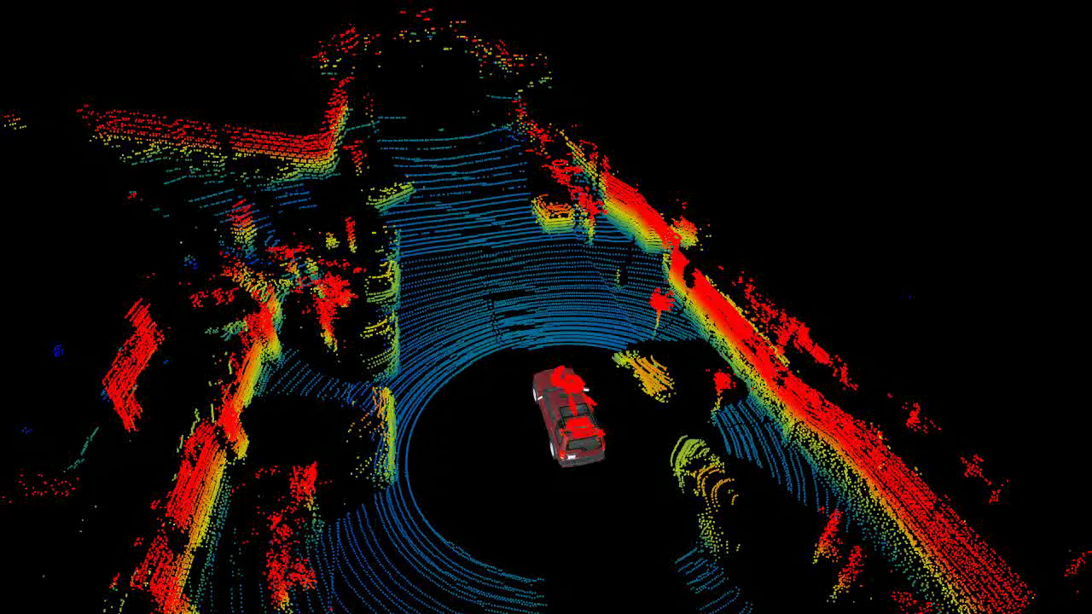
Autonomous Driving needs Tight Integration with Communication
Data is huge (Gb/s) and time critical
  Communication should focus on information
  most critical to the application
Notes:
However, autonomous driving needs tight integration with the communication system.
There are two reasons for this.
First, the sensors on these autonomous vehicles generate Gb/s of data. In fact sensor data is like a 3D video stream of all objects in the environment.[stop video]
This generates a huge amount of time-critical data far beyond what wireless networks can support.
Thus, we should design communication systems that only sends information most critical to the application.

Slide 11
Autonomous Driving needs Tight Integration with Communication
Data is huge (Gb/s) and time critical
  Communication should focus on information
  most critical to the application
Don’t know who has the desired content
  In typical networks, you know your destination
  Instead, autonomous car seeks sensor data from part of the road, e.g. an intersection
  It doesn’t know which car has this information
  Focus on content as opposed to accessing a particular destination
Notes:
The second issue is that autonomous vehicles don’t know who has the content they desire.
In today’s networks, you know which destination has the content you seek. Say, for CNN.com, you access CNN’s server.
But, in autonomous driving, a car wants sensor data from some part of the road, e.g., an intersection.
And it doesn’t even know which car has that information. Maybe it’s the red BMW or maybe it’s nobody!
So the whole communication system should focus on accessing content as opposed to accessing a particular destination.

Slide 12
CarSpeak
A communication system integrated with path planning and navigation in autonomous vehicles
Has a content centric design
  content, i.e. parts of road, is a first class citizen
New MAC design where content, not senders, contend for the medium
Implemented & evaluated on real autonomous vehicles
Notes:
In the rest of this talk, I will present CarSpeak. [pause]
CarSpeak is a communication system for autonomous driving that is integrated with path planning and navigation.
CarSpeak has a content centric design where content, describing parts of the road, is a first class citizen
We designed a new MAC protocol where content, instead of senders contend for the wireless medium.
We implemented and evaluated CarSpeak on real autonomous vehicles.

Slide 13
What is “content” and how do we represent it?
2. How do we disseminate this content?
Notes:
For this, we need to answer two main questions.
First, what is the content that autonomous vehicles care about and how do we represent it?
Second, how can senders go about disseminating this content?

Slide 14
What is “content” and how do we represent it?
2. How do we disseminate this content?
Notes:
Let me start with the first question.
That is, What is content and how do we represent it.

Slide 15



What is “content” and how do we represent it?
Content is sensor data from cubes in the environment
z
How do we represent these cubes in environment?
Notes:
The first answer is very simple.
For autonomous vehicles, content is any sensor information that describes a cube of the environment.
For example, the autonomous car might be interested in information from the gray cube as shown.
So the real question is, how do we represent these cubes in the environment.

Slide 16
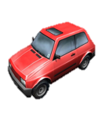


Ideally…
Obtain low resolution view of environment
Zoom in for higher resolution view of a smaller part of environment
z
Notes:
Ideally, we need a representation where cars can obtain a low resolution view of their environment.
Based on this low resolution view, the cars can then zoom in to obtain a higher resolution view of a smaller part of the environment.
For example, in our case, the car should ideally obtain a low resolution view of a big cubical region that surrounds it.
And based on this information, it can decide to zoom in for a high resolution view of the smaller cube containing what looks like a pedestrian.
So effectively, we need to have a recursive representation of the environment that makes best use of available bandwidth by zooming in only on required content.

Slide 17
Ideally…
Obtain low resolution view of environment
Zoom in for higher resolution view of a smaller part of environment
z
Notes:
Ideally, we need a representation where cars can obtain a low resolution view of their environment.
Based on this low resolution view, the cars can then zoom in to obtain a higher resolution view of a smaller part of the environment.
For example, in our case, the car should ideally obtain a low resolution view of a big cubical region that surrounds it.
And based on this information, it can decide to zoom in for a high resolution view of the smaller cube containing what looks like a pedestrian.
So effectively, we need to have a recursive representation of the environment that makes best use of available bandwidth by zooming in only on required content.

Slide 18
Ideally…
Obtain low resolution view of environment
Zoom in for higher resolution view of a smaller part of environment
z
Notes:
Ideally, we need a representation where cars can obtain a low resolution view of their environment.
Based on this low resolution view, the cars can then zoom in to obtain a higher resolution view of a smaller part of the environment.
For example, in our case, the car should ideally obtain a low resolution view of a big cubical region that surrounds it.
And based on this information, it can decide to zoom in for a high resolution view of the smaller cube containing what looks like a pedestrian.
So effectively, we need to have a recursive representation of the environment that makes best use of available bandwidth by zooming in only on required content.

Slide 19
Ideally…
Obtain low resolution view of environment
Zoom in for higher resolution view of a smaller part of environment
z
Need recursive representation that makes best use of available wireless bandwidth
Notes:
Ideally, we need a representation where cars can obtain a low resolution view of their environment.
Based on this low resolution view, the cars can then zoom in to obtain a higher resolution view of a smaller part of the environment.
For example, in our case, the car should ideally obtain a low resolution view of a big cubical region that surrounds it.
And based on this information, it can decide to zoom in for a high resolution view of the smaller cube containing what looks like a pedestrian.
So effectively, we need to have a recursive representation of the environment that makes best use of available bandwidth by zooming in only on required content.

Slide 20
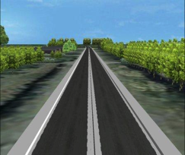
Representing Content in CarSpeak
Consider large cube encompassing environment
Notes:
So let me now tell you how CarSpeak achieves this recursive representation of content.
To achieve this, let us first consider a large cube which encompasses the environment.
We now divide this cube into 8 smaller cubes.
We repeat this process recursively, and divide each one of these cubes into smaller and smaller cubes.
We stop when the smallest cubes are nearly point objects smaller than 1 mm.
Just like any other recursive structure, we can represent this recursion by a tree.
Each vertex in the tree represents a cube in the environment.
We label them by a unique ID depending on their position in the tree.
Now, suppose a car wants information about some cube at a particular resolution.
To identify the cube, it specifies the unique ID of the corresponding vertex in the tree.
And for the resolution, it provides the depth of the sub-tree needed from below this vertex
So we now understand how to represent content in terms of recursive cubes.

Slide 21
Representing Content in CarSpeak
Consider large cube encompassing environment
Recursively divide into 8 smaller cubes
Notes:
So let me now tell you how CarSpeak achieves this recursive representation of content.
To achieve this, let us first consider a large cube which encompasses the environment.
We now divide this cube into 8 smaller cubes.
We repeat this process recursively, and divide each one of these cubes into smaller and smaller cubes.
We stop when the smallest cubes are nearly point objects smaller than 1 mm.
Just like any other recursive structure, we can represent this recursion by a tree.
Each vertex in the tree represents a cube in the environment.
We label them by a unique ID depending on their position in the tree.
Now, suppose a car wants information about some cube at a particular resolution.
To identify the cube, it specifies the unique ID of the corresponding vertex in the tree.
And for the resolution, it provides the depth of the sub-tree needed from below this vertex
So we now understand how to represent content in terms of recursive cubes.

Slide 22
Representing Content in CarSpeak
Consider large cube encompassing environment
Recursively divide into 8 smaller cubes
Notes:
So let me now tell you how CarSpeak achieves this recursive representation of content.
To achieve this, let us first consider a large cube which encompasses the environment.
We now divide this cube into 8 smaller cubes.
We repeat this process recursively, and divide each one of these cubes into smaller and smaller cubes.
We stop when the smallest cubes are nearly point objects smaller than 1 mm.
Just like any other recursive structure, we can represent this recursion by a tree.
Each vertex in the tree represents a cube in the environment.
We label them by a unique ID depending on their position in the tree.
Now, suppose a car wants information about some cube at a particular resolution.
To identify the cube, it specifies the unique ID of the corresponding vertex in the tree.
And for the resolution, it provides the depth of the sub-tree needed from below this vertex
So we now understand how to represent content in terms of recursive cubes.

Slide 23
Representing Content in CarSpeak
Consider large cube encompassing environment
Recursively divide into 8 smaller cubes
Notes:
So let me now tell you how CarSpeak achieves this recursive representation of content.
To achieve this, let us first consider a large cube which encompasses the environment.
We now divide this cube into 8 smaller cubes.
We repeat this process recursively, and divide each one of these cubes into smaller and smaller cubes.
We stop when the smallest cubes are nearly point objects smaller than 1 mm.
Just like any other recursive structure, we can represent this recursion by a tree.
Each vertex in the tree represents a cube in the environment.
We label them by a unique ID depending on their position in the tree.
Now, suppose a car wants information about some cube at a particular resolution.
To identify the cube, it specifies the unique ID of the corresponding vertex in the tree.
And for the resolution, it provides the depth of the sub-tree needed from below this vertex
So we now understand how to represent content in terms of recursive cubes.

Slide 24
Representing Content in CarSpeak
Consider large cube encompassing environment
Recursively divide into 8 smaller cubes
Notes:
So let me now tell you how CarSpeak achieves this recursive representation of content.
To achieve this, let us first consider a large cube which encompasses the environment.
We now divide this cube into 8 smaller cubes.
We repeat this process recursively, and divide each one of these cubes into smaller and smaller cubes.
We stop when the smallest cubes are nearly point objects smaller than 1 mm.
Just like any other recursive structure, we can represent this recursion by a tree.
Each vertex in the tree represents a cube in the environment.
We label them by a unique ID depending on their position in the tree.
Now, suppose a car wants information about some cube at a particular resolution.
To identify the cube, it specifies the unique ID of the corresponding vertex in the tree.
And for the resolution, it provides the depth of the sub-tree needed from below this vertex
So we now understand how to represent content in terms of recursive cubes.

Slide 25
Representing Content in CarSpeak
Consider large cube encompassing environment
Recursively divide into 8 smaller cubes
Notes:
So let me now tell you how CarSpeak achieves this recursive representation of content.
To achieve this, let us first consider a large cube which encompasses the environment.
We now divide this cube into 8 smaller cubes.
We repeat this process recursively, and divide each one of these cubes into smaller and smaller cubes.
We stop when the smallest cubes are nearly point objects smaller than 1 mm.
Just like any other recursive structure, we can represent this recursion by a tree.
Each vertex in the tree represents a cube in the environment.
We label them by a unique ID depending on their position in the tree.
Now, suppose a car wants information about some cube at a particular resolution.
To identify the cube, it specifies the unique ID of the corresponding vertex in the tree.
And for the resolution, it provides the depth of the sub-tree needed from below this vertex
So we now understand how to represent content in terms of recursive cubes.

Slide 26
Representing Content in CarSpeak
Consider large cube encompassing environment
Recursively divide into 8 smaller cubes
Cubes
Tree Representation
Notes:
So let me now tell you how CarSpeak achieves this recursive representation of content.
To achieve this, let us first consider a large cube which encompasses the environment.
We now divide this cube into 8 smaller cubes.
We repeat this process recursively, and divide each one of these cubes into smaller and smaller cubes.
We stop when the smallest cubes are nearly point objects smaller than 1 mm.
Just like any other recursive structure, we can represent this recursion by a tree.
Each vertex in the tree represents a cube in the environment.
We label them by a unique ID depending on their position in the tree.
Now, suppose a car wants information about some cube at a particular resolution.
To identify the cube, it specifies the unique ID of the corresponding vertex in the tree.
And for the resolution, it provides the depth of the sub-tree needed from below this vertex
So we now understand how to represent content in terms of recursive cubes.

Slide 27
Representing Content in CarSpeak
Consider large cube encompassing environment
Recursively divide into 8 smaller cubes
Vertex ID
Cubes
Tree Representation
Notes:
So let me now tell you how CarSpeak achieves this recursive representation of content.
To achieve this, let us first consider a large cube which encompasses the environment.
We now divide this cube into 8 smaller cubes.
We repeat this process recursively, and divide each one of these cubes into smaller and smaller cubes.
We stop when the smallest cubes are nearly point objects smaller than 1 mm.
Just like any other recursive structure, we can represent this recursion by a tree.
Each vertex in the tree represents a cube in the environment.
We label them by a unique ID depending on their position in the tree.
Now, suppose a car wants information about some cube at a particular resolution.
To identify the cube, it specifies the unique ID of the corresponding vertex in the tree.
And for the resolution, it provides the depth of the sub-tree needed from below this vertex
So we now understand how to represent content in terms of recursive cubes.

Slide 28
Representing Content in CarSpeak
Consider large cube encompassing environment
Recursively divide into 8 smaller cubes
Car needs cube at resolution
(vertex ID
, depth)
Vertex ID
Depth
Cubes
Tree Representation
Notes:
So let me now tell you how CarSpeak achieves this recursive representation of content.
To achieve this, let us first consider a large cube which encompasses the environment.
We now divide this cube into 8 smaller cubes.
We repeat this process recursively, and divide each one of these cubes into smaller and smaller cubes.
We stop when the smallest cubes are nearly point objects smaller than 1 mm.
Just like any other recursive structure, we can represent this recursion by a tree.
Each vertex in the tree represents a cube in the environment.
We label them by a unique ID depending on their position in the tree.
Now, suppose a car wants information about some cube at a particular resolution.
To identify the cube, it specifies the unique ID of the corresponding vertex in the tree.
And for the resolution, it provides the depth of the sub-tree needed from below this vertex
So we now understand how to represent content in terms of recursive cubes.

Slide 29

What Info does Autonomous Car Need?
Looks for obstacle free paths to destination
Needs to know which parts of environment:
  Are empty and safe to pass through
  Are occupied and unsafe to pass through
z
X
Notes:
But what kind of information does an autonomous car need from these cubes?
Basically, an autonomous car is just looking for obstacle free paths to safely get to its destination.
So it needs to know which parts of its environment….
… are empty and therefore safe to pass through.
.. And are occupied and therefore unsafe to pass through

Slide 30
What Info does Autonomous Car Need?
Each cube has one bit: Empty (0) or Occupied (1)
If cube is empty
  all cubes inside are empty
0
0
0
0
0
→
0
0
0
Notes:
So all that we need to say about a cube is one bit – 0 if it’s empty or 1 if it’s occupied.
Of course if a cube is empty, everything cube inside it is also empty.
In contrast, if a cube is occupied, it doesn’t mean everything inside it is occupied. It just means that at least one cube inside it is occupied.

Slide 31
What Info does Autonomous Car Need?
Each cube has one bit: Empty (0) or Occupied (1)
If cube is empty
  → all cubes inside are empty
If cube is occupied
  → at least one cube inside is occupied
1
0
0
→
0
1
Notes:
So all that we need to say about a cube is one bit – 0 if it’s empty or 1 if it’s occupied.
Of course if a cube is empty, everything cube inside it is also empty.
In contrast, if a cube is occupied, it doesn’t mean everything inside it is occupied. It just means that at least one cube inside it is occupied.

Slide 32
Compactly Representing Data
Level 1 has 8 bits where 0-empty, 1-occupied
1
0
0
0
1
0
0
0
0
Notes:
So let’s see how we can use this method to compactly represent this data.
Let’s say that this is our cube of interest, and again, green refers to empty and red refers to occupied.
As before, we can represent this using a tree.
The first level of the tree has 8 bits, where 0 refers to empty and 1 refers to occupied.
Now every empty cube is completely empty, none of these 0’s need to be expanded to the 2nd level of the tree.
Only the 1 is expanded, if we want to see inside this cube at more resolution.
Now as we zoom further into this cube, only 1’s need to be expanded and all 0’s will terminate.
Thus, we can use this method to compress information about the cube efficiently. [pause]
So we now have the tools to both represent content and compress information that cars need.

Slide 33
Compactly Representing Data
Level 1 has 8 bits where 0-empty, 1-occupied
None of 0 nodes need to be expanded
1
0
0
0
1
0
0
0
0
Notes:
So let’s see how we can use this method to compactly represent this data.
Let’s say that this is our cube of interest, and again, green refers to empty and red refers to occupied.
As before, we can represent this using a tree.
The first level of the tree has 8 bits, where 0 refers to empty and 1 refers to occupied.
Now every empty cube is completely empty, none of these 0’s need to be expanded to the 2nd level of the tree.
Only the 1 is expanded, if we want to see inside this cube at more resolution.
Now as we zoom further into this cube, only 1’s need to be expanded and all 0’s will terminate.
Thus, we can use this method to compress information about the cube efficiently. [pause]
So we now have the tools to both represent content and compress information that cars need.

Slide 34
Compactly Representing Data
Level 1 has 8 bits where 0-empty, 1-occupied
None of 0 nodes need to be expanded
Expand 1 node to see inside at more resolution
1
0
0
0
1
0
0
0
0
0
0
1
0
0
0
0
0
Notes:
So let’s see how we can use this method to compactly represent this data.
Let’s say that this is our cube of interest, and again, green refers to empty and red refers to occupied.
As before, we can represent this using a tree.
The first level of the tree has 8 bits, where 0 refers to empty and 1 refers to occupied.
Now every empty cube is completely empty, none of these 0’s need to be expanded to the 2nd level of the tree.
Only the 1 is expanded, if we want to see inside this cube at more resolution.
Now as we zoom further into this cube, only 1’s need to be expanded and all 0’s will terminate.
Thus, we can use this method to compress information about the cube efficiently. [pause]
So we now have the tools to both represent content and compress information that cars need.

Slide 35
Compactly Representing Data
Level 1 has 8 bits where 0-empty, 1-occupied
None of 0 nodes need to be expanded
Expand 1 node to see inside at more resolution
1
0
0
0
1
0
0
0
0
0
0
1
0
0
0
0
0
Tree representation compresses data efficiently
0
0
1
0
0
0
0
1
Notes:
So let’s see how we can use this method to compactly represent this data.
Let’s say that this is our cube of interest, and again, green refers to empty and red refers to occupied.
As before, we can represent this using a tree.
The first level of the tree has 8 bits, where 0 refers to empty and 1 refers to occupied.
Now every empty cube is completely empty, none of these 0’s need to be expanded to the 2nd level of the tree.
Only the 1 is expanded, if we want to see inside this cube at more resolution.
Now as we zoom further into this cube, only 1’s need to be expanded and all 0’s will terminate.
Thus, we can use this method to compress information about the cube efficiently. [pause]
So we now have the tools to both represent content and compress information that cars need.

Slide 36
What is “content” and how do we represent it?
2. How do we disseminate this content?
Notes:
So let’s move on to our next question.
How do we disseminate this content?

Slide 37
How do we disseminate this content?
Q: Can we ask each car to broadcast the data it has been collected?
Autonomous cars collect huge amount of data
  → Cannot flood medium with all their data
Notes:
As we said earlier, autonomous cars collect a huge amount of sensor information.
So, they cannot simply flood the medium with all their data.

Slide 38
A Request-Response Approach
Notes:
That’s why, CarSpeak adopts a request response approach.

Slide 39


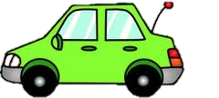
A Request-Response Approach
Car requests only data of interest
  E.g. at blind spots, intersections, etc.
Cars which sense the data, may respond
z
Request
for R
Response for R
Cube R
Notes:
A car requests a cube that it is interested in, for e.g. its blind spot, the next intersection, etc.
Vehicles which possess this information can respond with sensor data in that cube.
In this example, [animate], the red car wants to know about the area around the intersection in its blind spot –that is cube R.
So, [animate] the red car sends a request for R.
[animate] And the green Car can send a response for R.

Slide 40
Challenge 1: Who Should Respond?
Notes:
To make this request-response approach work we need to address multiple challenges.
The first challenge is: [animate] who should respond to a particular request? [pause]
This challenge is better described with an example.

Slide 41
Challenge 1: Who Should Respond?
Naïve solution 1: Simply let all cars respond
Q: What is the problem of doing this?
  A lot of redundant data
  Congested wireless medium
  Q: What are other possible solutions?
Cube R
Notes:
Say someone sends a request for the cube in the picture. Which of the four cars should answer?
One naïve solution is to make all cars respond.
Q: What is the problem of this approach?
This of course will cause a lot of overlap and wasted bandwidth.

Slide 42
Challenge 1: Who Should Respond?
Naïve solution 2: One car respond; others who hear it suppress their response
Q: What is the problem of this solution?
Responder leaves before sending all packets
  Different cars have different perspectives
Need to balance data diversity with data overlap
Cube R
Notes:
What if we instead make just one car respond? [pause]
This too is problematic.
First, [animate] the responder may leave the network before it has sending all packets in the cube.
More importantly, [animate] different cars offer different perspectives; for example some may see the intersection from the left while others from the right; some may see a pedestrian, others may have the pedestrian occluded.
[Pause]
What we need is a solution that balance data diversity with data overlap. [pause]

Slide 43
Solution: Random Walks
Content of the cube (i.e., its subtree) is divided into packets
Each car uses a different random walk to transmit packets
If one car transmits → Eventually finishes walk
If multiple cars transmit → Overlap is minimum
Notes:
Our solution is to make the cars use random walks as they disseminate the information about a particular cube.
Specifically, the content of the cube (that is its subtree) is divided into packets.
Each vehicle that has information about the requested cube, uses a different random walk to for sending packets in cube.
For example, one car may walk the packets in the cube along the blue line, while another does so along the red line.
If only one car has data about the cube, then it eventually finishes its random walk and sends all the data it has about the cube.
However, if multiple cars have data about the cube, they will transmit different packets at any time. This will minimize the overlap. [pause]

Slide 44
Challenge 2: Ensure medium is shared fairly by requested content
Request for Cube 2
Request for Cube 1
Cube 2
Cube 1
Notes:
The second challenge is to ensure that medium is shared equally by all content of interest.
Consider for example two cubes 1 and 2.
Let us say that cube 1 has requested by some car.
And cube 2 gets requested by some other car.
Cube 1 has 5 vehicles observing it, while cube 2 just has one.
Traditional wireless protocols like 802.11, provide an equal share of the medium to all contending senders. As a consequence, Cube 1 gets 5 times the share of the medium that Cube 2 does.
Ideally, we need a medium access protocol which ensures
that cube 1 and cube 2’s share are equal regardless of the number of vehicles viewing these cubes.
So how can we achieve this?

Slide 45




Challenge 2: Ensure medium is shared fairly by requested content
5 cars see Cube 1
One car sees Cube 2
Request for Cube 2
Request for Cube 1
Cube 2
Cube 1
Notes:
The second challenge is to ensure that medium is shared equally by all content of interest.
Consider for example two cubes 1 and 2.
Let us say that cube 1 has requested by some car.
And cube 2 gets requested by some other car.
Cube 1 has 5 vehicles observing it, while cube 2 just has one.
Traditional wireless protocols like 802.11, provide an equal share of the medium to all contending senders. As a consequence, Cube 1 gets 5 times the share of the medium that Cube 2 does.
Ideally, we need a medium access protocol which ensures
that cube 1 and cube 2’s share are equal regardless of the number of vehicles viewing these cubes.
So how can we achieve this?

Slide 46
Challenge 2: Ensure medium is shared fairly by requested content
802.11 shares medium between senders
→ Cube 1’s share = 5 x Cube 2’s share
Ideally, we want a MAC where
→ Cube 1 share = Cube 2’s share
Cube 2
Cube 1
Notes:
The second challenge is to ensure that medium is shared equally by all content of interest.
Consider for example two cubes 1 and 2.
Let us say that cube 1 has requested by some car.
And cube 2 gets requested by some other car.
Cube 1 has 5 vehicles observing it, while cube 2 just has one.
Traditional wireless protocols like 802.11, provide an equal share of the medium to all contending senders. As a consequence, Cube 1 gets 5 times the share of the medium that Cube 2 does.
Ideally, we need a medium access protocol which ensures
that cube 1 and cube 2’s share are equal regardless of the number of vehicles viewing these cubes.
So how can we achieve this?

Slide 47
Solution: Replace sender-contention by content-contention
Ideally, we want a MAC where
Cube 1 share = Cube 2’s share
Q: How would you design a MAC protocol that ensures the equal medium share between cubes (instead of cars)?
Cube 2
Cube 1
Notes:
The solution is to replace contention between senders by contention between content.
In other words, instead of senders, cubes must contend for the medium. This would ensure that all requested cubes get an equal share of the medium.
But of course, cubes are just virtual entities that we created. Therefore, we must design a MAC protocol where all cars that view a cube contend on its behalf.

Slide 48
Solution 2: Replace sender-contention by content-contention
Instead of senders, cubes contend for the medium
→ Requested cubes get equal share of medium
But cubes are virtual entities
→ Cars viewing a cube contend on its behalf
Q: How would let car content medium on behalf of the cubes?
Cube 2
Cube 1
Notes:
The solution is to replace contention between senders by contention between content.
In other words, instead of senders, cubes must contend for the medium. This would ensure that all requested cubes get an equal share of the medium.
But of course, cubes are just virtual entities that we created. Therefore, we must design a MAC protocol where all cars that view a cube contend on its behalf.

Slide 49

Content-Based Contention
C 1
C 2
Each cube should get a share of 1/2
Green car share of the medium 3/4
red car share of the medium 1/4
Q: But how can a car compute its medium share?
Notes:
So let’s see how we can implement content-based contention.
To understand this, let’s first look at a toy example.
Say we have two requested cubes.
The green car here sees both cubes while the red car sees only the second cube.
Ideally we want the two cubes to share the medium equally, which means each of them gets a half share.
This means that the green car’s share of the medium is 3/4;
And the red car’s share is 1/4.
The problem is that these cars do not know who has information about these cubes; so how can they compute their shares?

Slide 50
Content-Based Contention
C 1
C 2
Car listens to how many cars respond for a particular cube
Share-per-cube = 1 / # cars responding
Car’s total share = (Σ share-per-cube) / # requested cubes
Set contention window using car’s share on off-the-shelf cards
Notes:
The answer to this question is easy.
Each car listens on the medium and counts how many other cars are responding to a particular request.
For each cube it can sense, it computes its medium share as 1 over the number of nodes currently responding about that cube.
The car then computes its total share of the medium as the sum of these shares normalized by the number requested cubes. This tells the car the fraction of the medium it should use.
In this example: share per cube: C1: 1/1=1, C2: ½=1/2. Green car: (1+1/2)/2=3/4; Red car: (1/2)/2=1/4. This is to make C1 and C2 has equal media share: C1: ¾*1/(1+1/2)=1/2, C2=1/4+3/4*1/2/(1+1/2)=1/2.
In the paper, we show how to set the contention window using a car’s share to implement CarSpeak’s MAC on off the shelf wireless cards.

Slide 51
Content-Based Contention
C 1
C 2
Cube 1: Share-per-cube = 1; Cube 2: Share-per-cube=1/2
Green Car’s total share = (1+1/2) / 2=3/4
Red Car’s total share = 1/2/2=1/4
Notes:
The answer to this question is easy.
Each car listens on the medium and counts how many other cars are responding to a particular request.
For each cube it can sense, it computes its medium share as 1 over the number of nodes currently responding about that cube.
The car then computes its total share of the medium as the sum of these shares normalized by the number requested cubes. This tells the car the fraction of the medium it should use.
In this example: share per cube: C1: 1/1=1, C2: ½=1/2. Green car: (1+1/2)/2=3/4; Red car: (1/2)/2=1/4. This is to make C1 and C2 has equal media share: C1: ¾*1/(1+1/2)=1/2, C2=1/4+3/4*1/2/(1+1/2)=1/2.
In the paper, we show how to set the contention window using a car’s share to implement CarSpeak’s MAC on off the shelf wireless cards.

Slide 52
Empirical Results
Notes:
So, now let us see how CarSpeak performs in practice

Slide 53
CarSpeak Implementation
Implemented in Robot OS (ROS)
Integrated with MIT’s Path Planner from DARPA challenge
MAC implemented in the ath9k driver for Atheros WiFi cards
Notes:
We implemented CarSpeak in ROS – the Robot Operating system. This enables CarSpeak to be easily integrated with various autonomous vehicle and robotic systems.
We integrated CarSpeak with MIT’s Path Planner from the DARPA Urban challenge.
We also implemented CarSpeak’s content-based MAC protocol by modifying the ath9k driver for commodity Atheros WiFi cards.

Slide 54
Compared Schemes
CarSpeak
802.11 – Request & Response
Experiments
Indoor Testbed with Robots
Outdoor Testbed with Autonomous Car
Notes:
We compared CarSpeak with a baseline that uses 802.11 Since flooding all information can be extremely inefficient, we allow the baseline to send requests and responses for certain cube along the road, like in CarSpeak. The baseline however does not express cubes recursively, nor does it use CarSpeak’s MAC.
We perform our experiments in two settings: An indoor testbed of robots, and an outdoor testbed that has a real autonomous car.

Slide 55
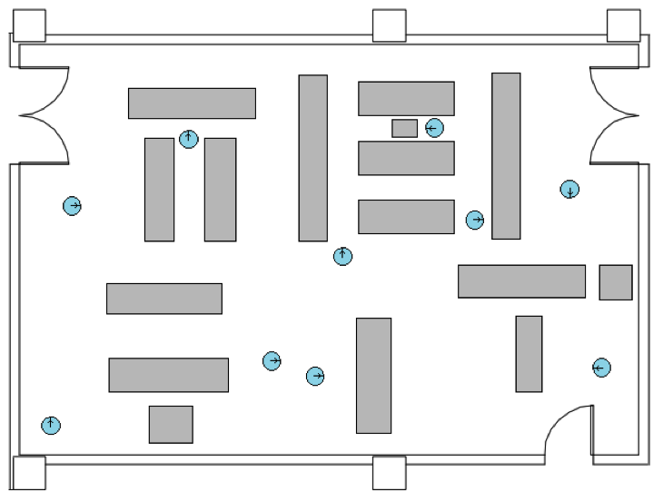
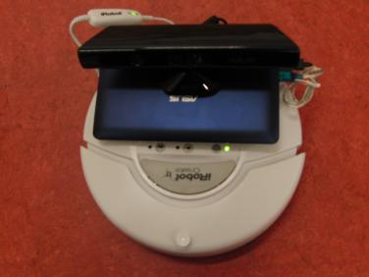
Indoor Testbed
10 Roomba robots with Kinect
Navigate environment with obstacles
Notes:
Let’s start with the indoor experiments.
Here we have 10 roomba robots fitted with Kinect sensors.
They navigate in an environment with obstacles as shown in the figure.

Slide 56
Can CarSpeak’s MAC assign fair share to content?
2 requested cubes, 10 moving robots
Ideal System
CDF
Ratio of data transmitted from Cube 1 to Cube 2
Notes:
We first check whether CarSpeak’s MAC can assign a fair share of the medium to different requested content.
We have 10 moving robots responding to a requests for 2 cubes.
In each experiment we measure the ratio of the number of packets transmitted from Cube 1 to that from Cube 2.
We repeat the experiment multiple times and plot the CDF. [pause]
Ideally, the two cubes should have more or less the same number of transmitted packets. That is the CDF should be a step function at “1” [pause]
Let’s see the actual results.

Slide 57
Can CarSpeak’s MAC assign fair share to content?
2 requested cubes, 10 moving robots
802.11 – Req&Res
CDF
Ratio of data transmitted from Cube 1 to Cube 2
Notes:
Here is the 802.11 baseline. [Pause]
As you can see The ratio varies a lot across the runs and can be as large as three times.
Q: Why is that?
This is because in 802.11, a cube gets transmitted more if it is sensed by more cars. [Pause]

Slide 58
Can CarSpeak’s MAC assign fair share to content?
2 requested cubes, 10 moving robots
CarSpeak
802.11 – Req&Res
CDF
CarSpeak’s content-centric MAC divides the medium fairly between requested content
Ratio of data transmitted from Cube 1 to Cube 2
Notes:
Here are the results for CarSpeak [Pause]
As you can see, the two Cubes get the same share of the medium.
In contrast to 802.11, CarSpeak’s content centric MAC divides the medium fairly between requested content. [Pause]

Slide 59
Does CarSpeak Improve Reaction to Objects in Blind Spots?
A drives on road while B pulls out of occluded driveway
Timely communication can help avoid collisions
B
A
Notes:
Next, we evaluate whether CarSpeak can improve reaction to hidden objects in blind spots.
Here, robot A is driving on the road while B pulls out from a completely occluded driveway.
This could lead to a collision. [pause]
But, if the robots can communicate they can learn about each other’s presence and avoid the collision.
Of course, “A” and “B” have to share the medium with other transmitters. Thus they can exchange enough data to avoid the collision, only if they have sufficient access to the medium. [pause]
We run this experiment with Carspeak and the baseline.

Slide 60
Reaction to Objects in Blind Spots
Percentage of runs
robot stops on time
Number of independent transmitters
Notes:
We plot the percentage of runs in which robots B discovers robot A and stops before it exists the driveway [Pause]
We plot this percentage as a function of how many independent transmitters are sharing the medium with the two robots.

Slide 61
Reaction to Objects in Blind Spots
Percentage of runs
robot stops on time
No Communication (percentage= 0)
Number of independent transmitters
Notes:
Before showing the results, let me show you the probability of stopping if we did not have communication at all.
Since the experiment is set up so that the drive way is completely hidden from the car on the road, in the absence of communication, there is no reason to stop and hence the probability is 0.
Q: what curve trend would expect for this result? Increasing or decreasing?

Slide 62
Reaction to Objects in Blind Spots
Percentage of runs
robot stops on time
Robot unlikely to stop!
802.11–Req&Res.
Number of independent transmitters
Notes:
Now let’s see how the 802.11 baseline performs. [pause]
As you can see, [animate] as the number of contending transmitters increases, the information does not arrive on time, and robot B drives into robot A without stopping. [pause]

Slide 63
Reaction to Objects in Blind Spots
CarSpeak
Percentage of runs
robot stops on time
802.11–Req&Res.
Number of independent transmitters
Notes:
Here are the results for CarSpeak [pause]
As you can see, the probability of robot B stopping on time increases significantly

Slide 64
Reaction to Objects in Blind Spots
CarSpeak
Percentage of runs
robot stops on time
14x
802.11–Req&Res.
CarSpeak enables vehicles to better deal with hidden objects in blind spots
Number of independent transmitters
Notes:
Thus we see that CarSpeak improves the probability of stopping safely by up to 14 times.
Thus, [animate] CarSpeak can enable vehicles to better deal with hidden objects in their blind spots.

Slide 65
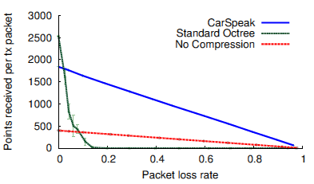
Robustness to Packet Loss
Degrades gracefully with packet loss

Slide 66
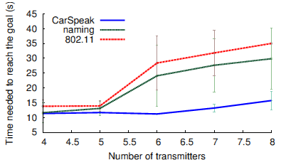
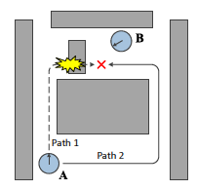
Planning Efficiency
Better planning due to reduced losses

Slide 67
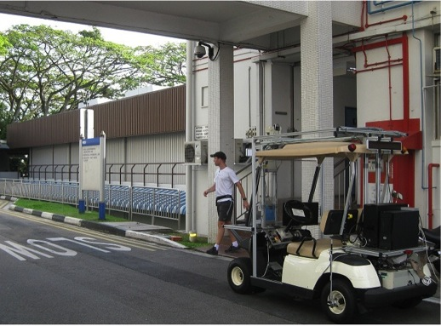
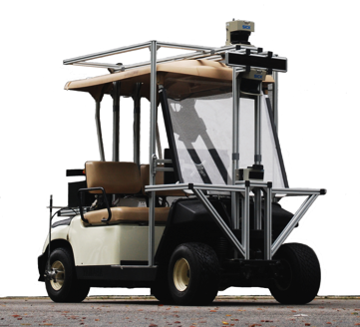
Outdoor Testbed
Instrumented Yamaha car with laser sensors
Pedestrian crosswalk in campus-like environment
Notes:
Next, let us see how CarSpeak performs in an outdoor environment.
For our outdoor experiments, we integrated CarSpeak with an instrumented Yamaha car that was equipped with SICK and Hokuyo laser sensors.
We evaluated CarSpeak in a campus like environment where the car needs to detect pedestrians and other vehicles. In this setup, we consider a segment of the road where with a hidden pedestrian crosswalk.

Slide 68
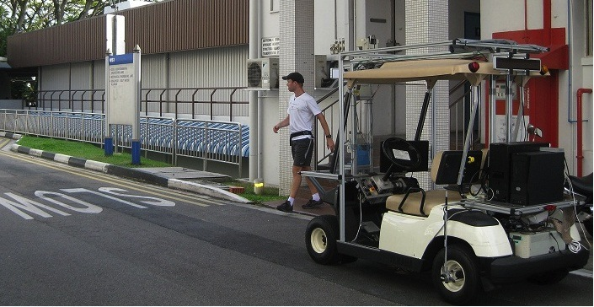
Detecting a Pedestrian in Blind Spot
Pedestrians emerge from lobby
Lobby is a blind spot
Infrastructure sensors, some can send view of lobby
Notes:
Pedestrians often walk down the stairs from a lobby adjacent to the crosswalk, to cross the road.
The lobby, however, is a blind spot for the vehicle.
To mitigate this, we have infrastructure sensors some of which can send a view of the lobby over the wireless medium. [pause]
We evaluate whether CarSpeak can enable early detection of the pedestrian safely stopping the car before he steps in to the crosswalk.

Slide 69
Outdoor Results
How far from cross walk
Car stops (m)
1-2 m
2-4 m
4-6 m
6-8 m
Distance from crosswalk when pedestrian appears (m)
Notes:
So here are the results.[pause]
On the x-axis we plot how far the car was from the crosswalk when the pedestrian appeared on the stairs. [pause]
On the y-axis we plot how far the car was from the crosswalk when it stopped.
In particular negative values on the y-axis mean that car drove into the crosswalk as the pedestrian was trying to cross. [pause]

Slide 70
Outdoor Results
Car overshoots crosswalk
If it’s < 4m away when
pedestrian appeared
802.11
How far from cross walk
Car stops (m)
1-2 m
2-4 m
4-6 m
6-8 m
Distance from crosswalk when pedestrian appears (m)
Notes:
First, here are the results for the 802.11 baseline.
Clearly, with 802.11, the car overshoots the crosswalk if it were less than 4m away when the pedestrian appeared in the stairs. This is the circled area.
As you might imagine, having the car run into the crosswalk while the pedestrian is crossing can be quite dangerous. [pause]
Of course, in our experiments, we ensured that the pedestrian stops short of actually obstructing the car.

Slide 71
Outdoor Results
CarSpeak
802.11
How far from cross walk
Car stops (m)
1-2 m
2-4 m
4-6 m
6-8 m
Distance from crosswalk when pedestrian appears (m)
Notes:
Here are the results for CarSpeak.
The results show that CarSpeak allows the vehicle to safely stop before the crosswalk. The car stops even if it were only 1 to 2m away from the crosswalk when the pedestrian appeared on the stairs.

Slide 72
Conclusion
A communication system fully integrated with autonomous driving
Content-Centric approach to data access & MAC
Generally applies to collaborative robotics, virtual reality and virtual games
Notes:
To conclude,
I presented CarSpeak, a communication system fully integrated with autonomous driving.
CarSpeak adopts a content-centric approach to data access and medium access control.
Many of CarSpeak’s core concepts apply to collaborative robotics, virtual reality, and virtual games which involve collaboration of distributed sensors over the wireless medium.
Thank you and I will take questions.

Slide 73
Papers
Paper 4: Wagh, Aditya, et al. "Human centric data fusion in vehicular cyber-physical systems." Computer Communications Workshops (INFOCOM WKSHPS), 2011 IEEE Conference on. IEEE, 2011.

Slide 74
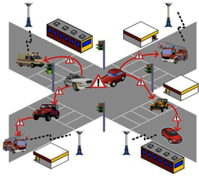
Introduction
Vehicular Cyber-Physical Systems (VCPS), also known as Vehicular Ad Hoc Networks (VANET)
Human Factors (HF) are critical
  Final control unit of all fused information
  Too many messages can overwhelm the driver
  Need efficient and effective data fusion scheme

Slide 75
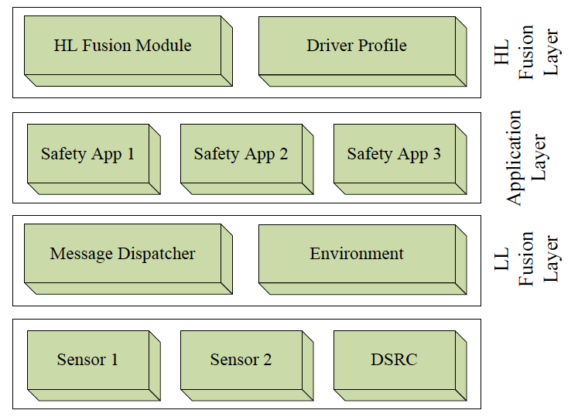
Overall Architecture
Notes:
existing safety applications (such as Forward Collision Detection,
Speeding Warning, Intersection Violation Detection,
etc) we introduce a multi-layered architecture that houses the
algorithm in a separate fusion layer. This allows the safety
applications to be developed and implemented independently
of the fusion process.
The main goal of the LL Fusion layer is to reduce the congestion
in the wireless medium. This is crucial from the safety
application perspective since most vehicles are constantly in
motion, and the range of the on-board radio is only a few
hundred feet, thereby giving us a very small time-window for communication.
HL fusion forms the basis for our work and is placed between the applications and the driver. It is directly responsible for applying HF considerations to the application layer output,
rendering it more useful to the driver. It queries and uses information from the Driver Profile module to customize the Warning Messages to the driver. The Driver Profile module supplies the fusion algorithm with the necessary data via lookup functions. This includes the driver’s preferences as well as the quality of the driver’s responses to warning messages. For example, an elderly driver might prefer to hear a message using the audio system in addition to a tactile stimulus. They might also wish to have messages repeated if no response is detected within a certain time.

Slide 76
High-level Data Fusion
Implication of warning message repetition
  If a driver has responded to a particular warning (e.g., specific hazard) multiple times in the past, it is more strongly linked in the memory
  If the required evasive actions are the same for two warning messages, notify the driver with the warning he/she is more familiar with
  The response to repeated events is better when different kinds of events are alternated
Notes:
For a particular message in the queue, we denote its utility based on three factors, N , the total number of messages in the queue, n , the number of messages of its own
type that follow it and f ; 0 < f 1 , the driver’s familiarity
with this type of message: equation 1
We note that there are limits on the usefulness of repetitions
and that increasing the frequency beyond a certain limit,
depending on the message, does not improve the response from
an individual [10].
Hence, once f reaches a certain threshold, we simply denote
the utilty as: f=1

Slide 77
High-level Data Fusion
Evasive Actions:
  Three key parameters:
  (Lance Choice, Direction, Speed)
Goal: pick a small subset of evasive actions to avoid all hazards

Slide 78
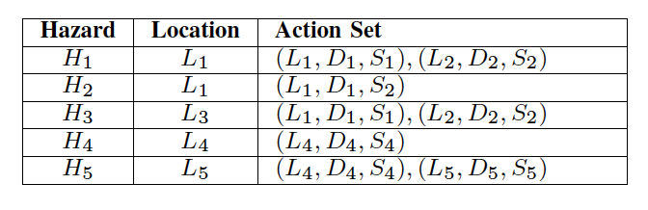
High-level Data Fusion
High-level Fusion Algorithm
Q: How to remove redundant actions while still avoiding all hazards?
Original: H1-H5
Notes:
If we just take a union of all actions needed:
The set of actions needed are: (L1,D1,S1) (L2,D2,S2) (L1,D1,S2) (L4,D4,S4) (L5,D5,S5)

Slide 79
High-level Data Fusion
High-level Fusion Algorithm
  STEP 1: Location-based
Original: H1-H5
Reduced: H1, H3-H5
Notes:
Step 1. Location-based: H1 and H2 appear to be originating
at the same location. We find the utility Utype of the corresponding
warnings W1 and W2 and choose the one (say H1)
that offers higher benefit.

Slide 80
High-level Data Fusion
High-level Fusion Algorithm
  STEP 2: Matching Actions
Original: H1-H5
Reduced: H3-H5
Notes:
Step 2. Matching Actions: From the remaining hazards, we
look for those pairs that require the same actions from the
driver. We identify H1 and H3 and find the value of Utype for
each. Let us assume

Slide 81
High-level Data Fusion
High-level Fusion Algorithm
  STEP 3: Action Subsets
Original: H1-H5
Reduced: H3, H4
Notes:
Finally, we identify hazards whose
corresponding action sets form subsets of other hazards. This
leads us to H4 and H5 . In such a case, we choose the one with
the smaller action set since any evasive maneuver chosen from
it is an equally valid response for the other hazard; here we
choose H4 .

Slide 82
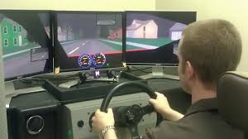
Experiment Setup
Environment: STISIM driving simulator with real drivers
Three compared schemes:
  No warning system
  A warning system without data fusion
  A warning system with data fusion

Slide 83
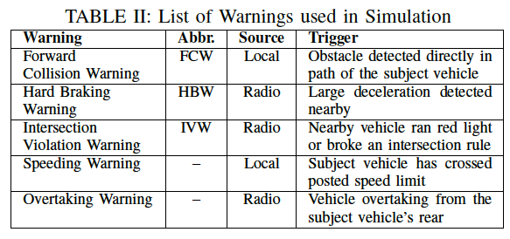
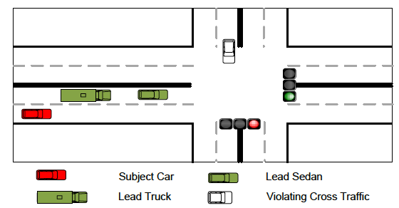
Experiment Setup
No Fusion: the notification system attempts to deliver as many warnings as possible
High-level Fusion: Only warn the subject car about the FCW warning (its evasive action also handles other warnings)!
Notes:
Without Fusion, the notification system attempted to deliver
as many warnings as it could on a first-come first-served basis.
Using the high level fusion algorithm, we needed to warn the subject only about the FCW since the actions induced by it also cover the HBW and IVW warnings. Thus, in this case, the system repeated the FCW at regular intervals near the intersection.
The key point: the more repetition of the same message, the better response the driver will have
High-level Fusion: Only warn the subject car about the FCW warning since actions induced by it also cover HBW and IVW warning.

Slide 84
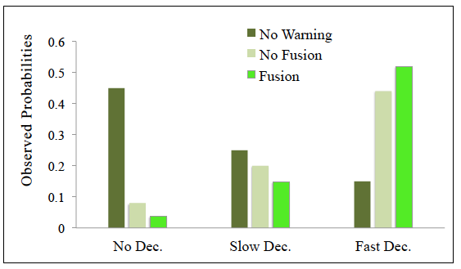
Performance Analysis
Notes:
These were classified as No Deceleration, if the driver failed to
decelerate through the entire intersection, Slow Deceleration,
if the driver decelerated but could not have stopped behind
the lead vehicles and Fast Deceleration, if the driver had
slowed sufficiently to be able to stop behind the lead vehicles.
Comparing the reactions at intersections where the notification
system was disabled, with the intersections where the
warnings were delivered, we saw that most drivers in the
former case failed to apply the brakes in time. Here, the
dominant reaction was to swerve across obstacles without
decelerating. This can be seen by the sharp increase in the
No Deceleration response
When presented with only a single warning (FCW), most drivers chose to slow
down immediately. Although a few drivers chose to ignore the warnings completely, it was rare for most to continue at full speed given the warnings. There were improvements across all the parameters in the presence of data fusion.
Comparing the fusion and non-fused warnings systems, the chances that
the driver would not decelerate at all were cut down by 50%.
Instances of delayed decelerations were reduced by 20%, while
fast decelerations went up by 27%.

Slide 85
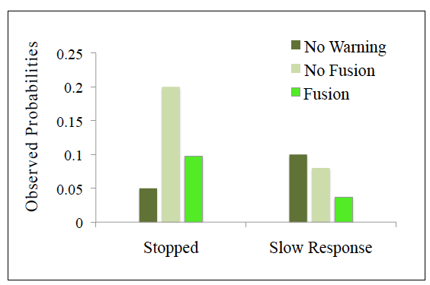
Performance Analysis
Notes:
We also included two other events: Stopped, when the driver
stopped behind the lead vehicles and Slow reaction, when the
driver took at least 2 seconds to respond after the first audiovisual
warning notification, either though braking or changing
their direction.
Here, it is important to note that coming to a complete
stop is not necessarily the best course of action. Most drivers
decelerated rapidly when provided with the fused warnings
and thus were able to choose between stopping and driving
around the lead vehicles if it was safe to do so. In the non fused
scenario, we saw the the drivers had applied brakes
slower and this caused some of them to attempt to bring the
vehicle to a stop rather than going around the lead vehicles. As
expected, drivers with no warnings performed poorly across
all the observed parameters.

Slide 86
Conclusion
A fusion system to reduce the amount of non-beneficial information delivered to drivers
People react better to fewer and more relevant warnings rather than a deluge of correlated warnings
This idea can also be applied in other related areas, e.g., notification system for soldiers, aviation and naval system

