Slide 1
Energy in Social Sensing and CPS-I
Sensor nodes and Smartphones
CSE 40437/60437-Spring 2015
Prof. Dong Wang

Slide 2
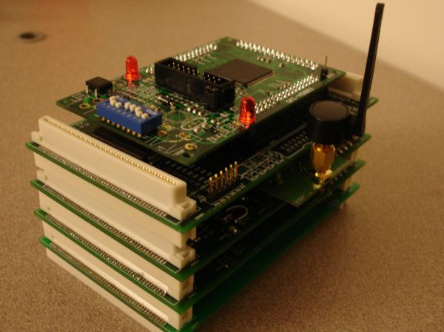
Papers
Paper 1: "Energy-optimal Batching periods for asynchronous multistage data processing on sensor nodes: foundations and an mPlatform case study." Wang, Dong, et al. Real-Time Systems 48.2 (2012): 135-165.

Slide 3
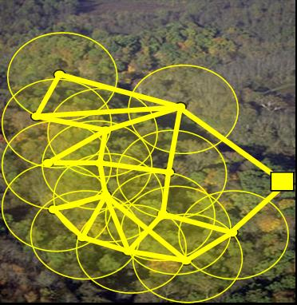
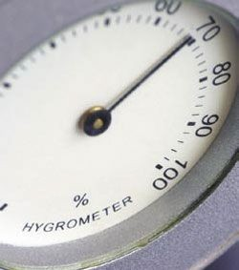
Background
Energy
  primary concern in sensor network
  much energy consumed in idle state
  build more energy economic processor
Time:
  critical to real time and control related tasks
  specified as end to end deadline

Slide 4
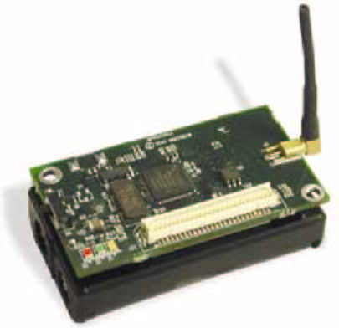
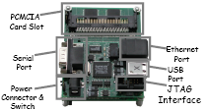
Background
Microserver
  Fast speed
  Large storage
  High CPU power
Mote
  Slow CPU speed
  Low power consumption
  Low cost
Can the high-end processor be used to Save Energy
rather than increasing computation speed?
mPlatform
  Heterogeneous platform
  Multi-processor boards, multiple radios
High-end Processor Board
Low-end Processor Board
Notes:
Recently people start to look at the heterogeneous platform, for example, mPlatform is one from Microsoft and equipped with both high and low end processor.
One the explicit purpose of using this heterogeneous platform is to explore the heterogeneity to save energy as compared to using the low end processor alone.
Use one platform’s advantage to offset the other platform’s disadvantage
It Can often lead to performance/energy improvements

Slide 5
Background
 | High-end Processor | Low-end Processor
Active Power | High | Low
Speed | Fast | Slow
Wakeup Cost | High | Low
Q: Do you have some intuition how high-end processor can be used to save energy when it is used to process a batch of data?
Notes:
Computation may have multi-stages that are running asynchronously to process the data sequentially, each of the stage may have different periods, so meeting the time requirement is not trivial

Slide 6
Background
 | High-end Processor | Low-end Processor
Active Power | High | Low
Speed | Disproportionately Faster | Slow
Energy/Unit | Low | High
Wakeup Cost | High | Low
Process data in batches to save energy!
Key Challenge: Batching Period should be carefully designed to
Exploit heterogeneity to minimize energy consumption
Meet time requirement of the data processing
Notes:
Computation may have multi-stages that are running asynchronously to process the data sequentially, each of the stage may have different periods, so meeting the time requirement is not trivial

Slide 7
Model
Task 1
Task 2
Sensor
Fixed Rate
P₁
P₂
2
4
6
1
3
5
4
3
2
1
Path
Task 1
Multistage
Task 2
P₁
Asynchronous
P₂
End to end deadline
Data-centric Model
Tasks run on batching period to process data
Asynchronous
Multistage
Notes:
We assume utilization is really slow, non-preemptive scheduling. The fundamental assumption is these things operate at very low cycles, they are long lived applications, long delayed. We don’t worry about Schedulability constraints as everything is run at very low cycles, and the utilization is under the bound. It is not the traditional multi-processor application, where we are pushing the performance bound. We are really underloading the system, because we what are really shooting for is the long life time.
The data rate is constant, I can run at longer period and have to process more data and I can run at shorter period and process less data, the question is what is the right period ?
Synchronous: it creates dependence (one has to wait another to be finished) among tasks, we assume that those tasks start with different piece of code already have been written by different people
Asyn: Explore the cost of simplicity
Asynchronous multistage data processing
No synchronization needed
Separation of complex computations
Simplicity, fewer bugs
The computation time is not fixed, depends on the period. The more you batch, the more you process.
Data-centric Model:
Data generated at sensors
Tasks are filters on data flows: R_{i,in} to R_{i,out}

Slide 8
A Task Set Example
End-to-end deadline for each data path
Task 1
Sensor 1
Fixed Rate
High-end Processor
P₁?
Task 4
Asynchronous
P₄?
Task 3
Task 2
Sensor 2
Fixed Rate
P₃?
P₂?
Low-end Processor
End-to-end deadline for each data path
A Sensor Node
End to End Deadline: Associated with a Path
Notes:
Tasks operate on data in batches
Batching Period: the period of each task
Paths: an ordered set of tasks processing data sequentially
End-End Deadline: deadline of a path

Slide 9
Problem Statement
Energy to execute a task on processor k:
: data independent cost (wakeup, state storage)
: data dependent cost (computation, data transfer)
Average power to execute a task:
: Batching period of task i on processor k
: End-end deadline on path p
2*Pi
Pi
Notes:
The average power optimization is the same as energy since average_power*time = energy

Slide 10
Problem Statement
Goal: to find optimal batching period P_{i}* for each task to minimize
Subject to the constraint

Slide 11
Optimal Batching Period
Method: Lagrange function
Solution:
Solutions can be computed numerically
For particular task allocation: Ignore task index for notation simplicity

Slide 12
Chain Task Topology
Chain topology:
  n tasks T₁…T_{n} form a single path p
T1
T2
…
Tn
Optimal Batching Period:
Theorem1: Chain Period Allocation:
P1 : P2 : … : Pn
(E_{wakeup_1})^{1/2} : (E_{wakeup_2})^{1/2} : … : (E_{wakeup_n})^{1/2}
T1
T2
Tn
Dp/2

Slide 13
Chain Task Topology
Theorem 2: Chain Reduction
P1 : P2 : … : Pn
E_{wakeup_eq}={ Συμ (E_{wakeup_i})^{1/2}}²
(E_{wakeup_1})^{1/2} : (E_{wakeup_2})^{1/2} : : (E_{wakeup_n})^{1/2}
T_{eq}
T1
T2
Tn
Dp/2
P_{eq}=D_{p}/2
P₁=?
P₁=1 s
P₂=?
P₂=2 s
P₃=?
P₃=3 s
P_{eq}=6 s
Task 1
Task 2
Task 3
Task 123
E_{wakeup_123}=36
E_{wakeup_1}=1
E_{wakeup_2}=4
E_{wakeup_3}=9
P₁=6*(1/(1+2+3))= 1s;
P₂=2 s; P₃=3 s;
E_{wakeup_123}=36; P_{eq}=6 s
Dp=12 s

Slide 14
Star Task Topology
Star Topology
  Outputs of n tasks T₁…T_{n} (leaf tasks) are inputs to a single task T₀ (aggregator task)
  Assume: all paths have same D_{p}
T2
…
T1
T0
Tn
Optimal Batching Period:
Theorem 3:
Star Period Allocation:
Dp/2
T1
T2
T0
…
Tn
Pi : P0
(Συμ (E_{wakeup_j})^{1/2}): (E_{wakeup_0})^{1/2}
Notes:
Important assumption for start topology: fuse data collected at same time, thus assume same deadline for all paths

Slide 15
Star Task Topology
Dp/2
Dp/2
Theorem 4
Star Reduction
T1
T2
T_{eq}
T0
T0
…
Tn
E_{wakeup_eq}=Συμ E_{wakeup_i} ,
Pi : P0
P_{eq}=Pi : P0
P₁=?
P₁=3 s
P₃=?
P₃=3 s
Task 1
Task 3
E_{wakeup_1}=1
E_{wakeup_3}=4
Task 123
Task 0
P₀=?
P₀=4 s
Task 0
E_{wakeup_0}=16
E_{wakeup_123}=9
E_{wakeup_0}=16
P₁=P₂=P₃=7*(9^{1/2}/(9^{1/2} +16^{1/2}))=3 s;
P₀=7-P₃=4 s
E_{wakeup_123}=9;
P₂=?
P₂=3 s
Dp=14 s
Task 2
E_{wakeup_2}=4
Notes:
For Star topology Peq of leaf tasks=Pi*, Peq of aggregator task = P0*, both != Dp/2 here!

Slide 16
Period Allocation in Aggregation Tree
P₁=7.5 s P₂=7.5 s
P₁=? P₂=?
P₁₂=15 s
P₁₂=?
Task 1
Task 2
Task 12
P₅= ?
P₅= 9s
P₅= ?
E_{wakeup_1}=4
E_{wakeup_2}=4
E_{wakeup_12} =(2+2)²=16
P₅= 9s
Task 5
Task 5
P₃=5 s P₄=10 s
P₃=? P₄=?
P₃₄=15 s
P₃₄=?
Task 3
Task 4
Task 34
E_{wakeup_5}=9
E_{wakeup_5}=9
E_{wakeup_3}=1
E_{wakeup_4}=4
E_{wakeup_34}=(1+2)²=9
Deadline = 48 s
Deadline = 48 s
P₁₂₃₄=(5/8)*24=15 s
P₁₂₃₄=?
P₅= (3/8)*24=9 s
P₅= ?
Task 1234
Task 5
E_{wakeup_1234}=16+9=25;
E_{wakeup_5}=9
Deadline = 48 s

Slide 17
Heterogeneous Task to Processor Assignment
Parameters E_{wakeup_i,} W_{datarate_i} are processor dependent
Period allocation: not entirely separable from task-processor assignment
In general, number of tasks on sensor nodes are quite limited (e.g. 5-10)
Run optimal period allocation for each possible task-processor allocation, find optimal solution
Simple Heuristics can be derived to find optimal solution with high probability

Slide 18
Task to Processor Assignment Heuristics
Run optimal batching period allocation assuming all tasks are allocated to higher-end processor (ARM)
Test resulting optimal batching periods for satisfying inequality (*). If a task Ti fails the test, move to lower-end processor (MSP)
Repeat optimal batching period allocation based on new task-processor assignment, check to see if it is different from the one got before step 2: different-go back to step2; same: reach (locally) optimal solution
Note: the allocation found by heuristics is locally optimal, but it has a high probability to find global optimal

Slide 19
Evaluation
Evaluation platform: mPlatform
  Heterogeneous sensor platform: multiple processor boards, multi radios
  MSP Board: MSP430F2618 processor
  ARM Board: LPC2138 processor
Notes:
Prepare a backup slides to show how the energy/power is measured for mPlatform

Slide 20
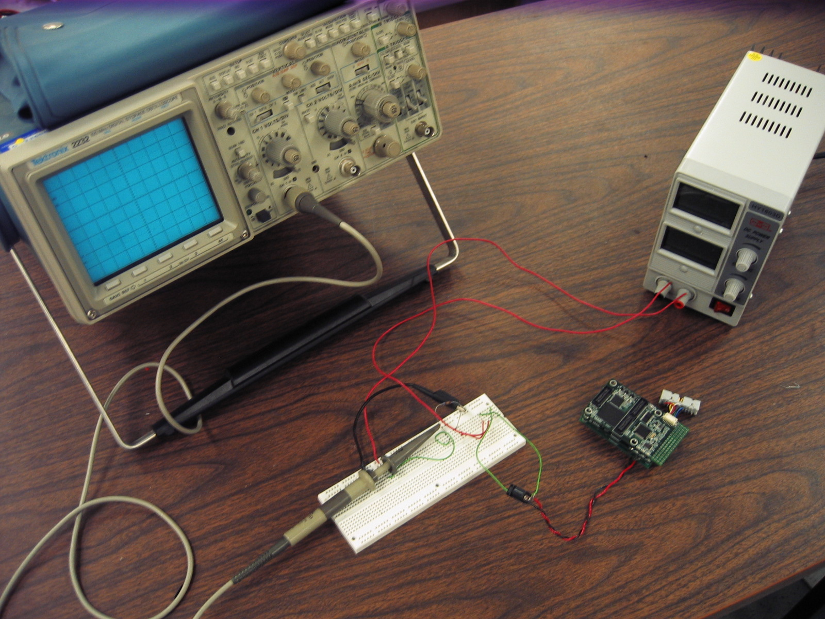
Experiment Setup
Oscilloscope
Power Source
Resistor
mPlatform

Slide 21
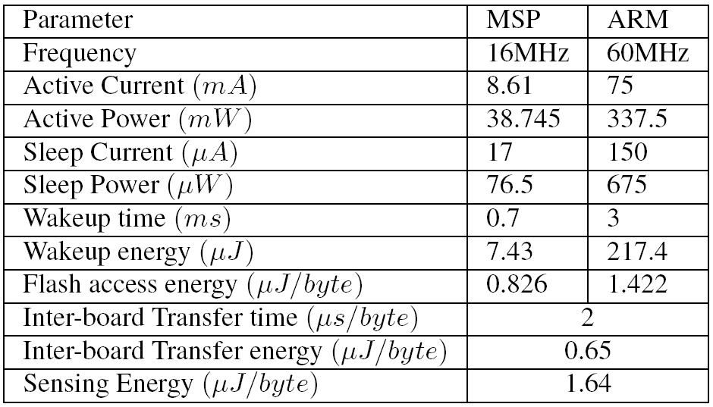
Energy Profile
Energy Profiling Comparison of MSP Board and ARM Board. Board Supply Voltage is 4.5V.
Notes:
Get a backup slides for table 2 to show details of energy/instruction/data_type

Slide 22
Comparison of Basic Operation on Two Processor Boards

Slide 23
Task Set Generation
Representative routines in sensor network and digital signal processing are selected:
  e.g: Digital Filter, Fast Fourier Transform (FFT), Statistic, CRC, Checksum, Encryption/Decryption
Several task template that represent typical data processing and aggregation:
Filter
Statistics
Filter
FFT
CRC
Encryption

Slide 24
Flash Access
Flash Access Overhead for MSP
Flash Access Overhead for ARM
Notes:
Flash access is part of the wakeup cost that is independent of data rate. The ARM processor is much more expensive than MSP.

Slide 25
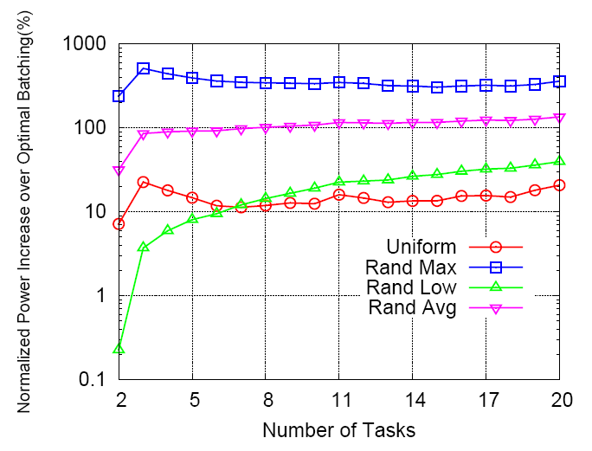
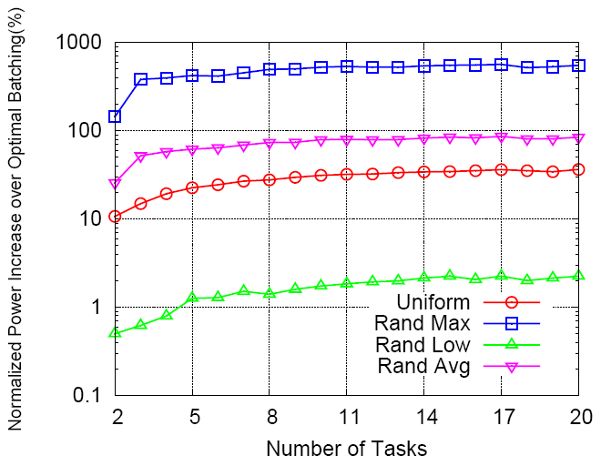
Experiment with Batching Period-1
Comparison for Chain Topology on MSP
Comparison for Star Topology on MSP
Notes:
Run tasks on MSP processor, compare optimal batch period with uniform and random period allocation
This two figures show result of both chain and star topology.
Generate 20 workflows, each of them is selected from the task template in last slides.
We adopt the end-end deadline as 48 s, all assignments satisfy the constraints that the sum of batch period add up to half deadline. We run each experiment 100 times and report average result.
The x axis is the number of tasks in system, the y axis is the average power consumption increase of random and uniform scheme as compared to optimal batch period.
Those curve show the corresponding period allocation scheme, for example red one is the uniform scheme. The results show that the optimal batch period can has lower power consumption as compared to other allocation scheme.

Slide 26
Experiment with Batching Period-2
Comparison for Chain Topology on ARM
Comparison for Star Topology on ARM

Slide 27
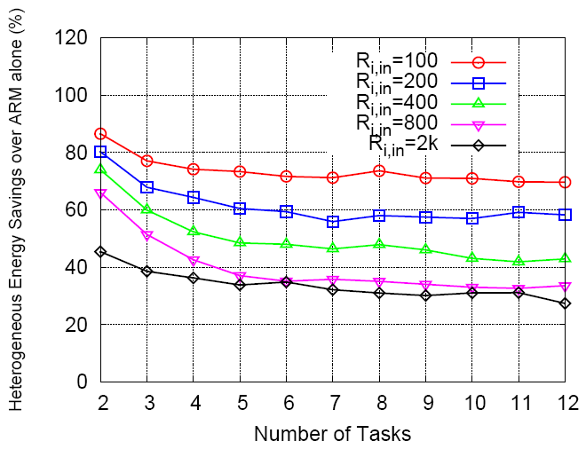
Experiment with
Optimal Task Assignment
Heterogeneous Assignment vs MSP
Heterogeneous Assignment vs ARM
Up to 25% energy is saved over MSP and upto 80% energy is saved over ARM
Notes:
We compare the performance of assigning tasking to only one processor boards vs the optimal heterogeneous processor board assignment.
The left figure compares the energy consumed by heterogeneous assignment to assignment of MSP only. The x axis is number of tasks, the y axis is the energy consumption savings. The different curves represent the saving under different data rate. It is shown up to 25% saving is achieved by using heterogeneous processor boards. The right figure is the result on ARM board, it is shown we can achieve upto 80% energy savings by using heterogeneous processor rather than use ARM alone. This validate our claim that we can achieve better energy efficiency by exploring the processor heterogeneity with optimal batching period allocation.

Slide 28
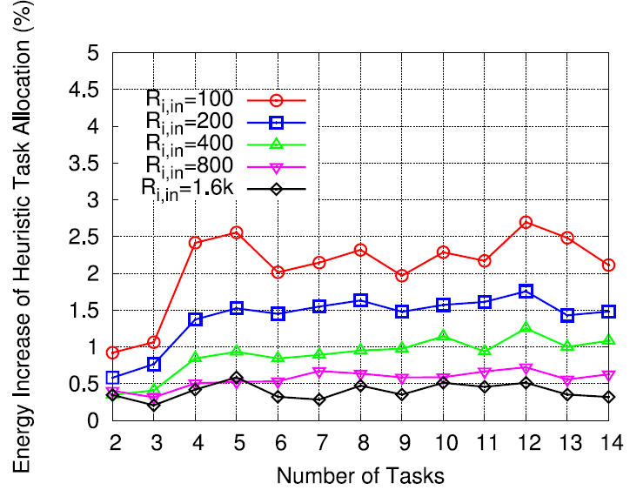
Task-Processor Heuristic Performance
Energy Increase of Heuristic with varying Input Rate
Energy Increase of Heuristic with varying Deadline
The energy increase of using heuristics is very small ☺

Slide 29
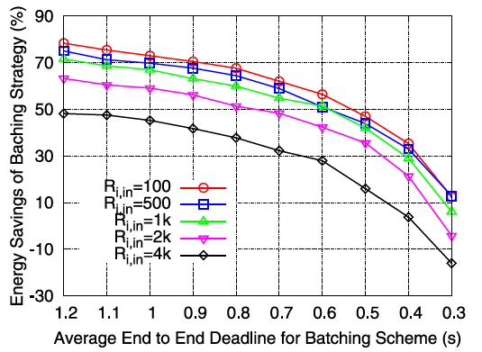
Tradeoffs between Energy Savings and Responsiveness
Energy savings of using batching periods decrease as end-end deadline decreases (sleep time of processors decrease)
Notes:
Observe that the energy savings of the optimal batching scheme drops
as the average deadline of data processing decreases. This is intuitive: the batching
period decreases when the average deadline of data processing decreases, which directly
shortens the time that processors stay in the sleep mode. After the deadline of
data processing falls below certain values, the proposed batching scheme stops gaining
energy savings. The reason is that the batching period is so small under those
conditions that the processor wakeup cost overweights the energy savings obtained
during the sleeping period. Also note that the energy savings is high when the input
data rate is low. This is because lower data rate results in shorter task computation
time, which allows the processor to sleep longer within a batching period.

Slide 30
Energy Cost of Asynchrony

Slide 31
Conclusion
Minimize energy of asynchronous multi-stage data processing with time constraints
Optimal batching period allocation for data aggregation in sensor network
Task to processor assignment is coupled with period allocation
Evaluation on heterogeneous sensor platform-mPlatform

Slide 32

Papers
Paper 2: ”ACE: exploiting correlation for energy-efficient and continuous context sensing." Nath, Suman. Proceedings of the 10th international conference on Mobile systems, applications, and services. ACM, 2012. (Best Paper)

Slide 33




















Continuous Context-Aware Apps
How much do I jog?
Mute phone in meeting
Alert when at grocery shop
Monitor indoor location
Custom message on driving
Jog Tracker
Phone Buddy
Geo-Reminder
Batphone
Phone Buddy
Continuous sensing of user’s context
Notes:
A big overhead of running context-aware application is the high energy consumption. Many of the applications need to monitor the user’s context continuously. The reason is: without continuously or frequently monitoring, some application may not work, for example, it may not be able to quickly infer whether the user is in a meeting or not when a call comes.
If not designed carefully, the cost of continuous sensing may be very high, especially when applications require expensive attributes such as location and multiple such applications run simultaneously.
GeoReminder. Like GeoNote for Android, it continuously monitors a user's current location and displays custom messages when he is at a pre-defined location. The location is computed based on GPS data and WiFi access point signature (using similar techniques as [15]).
JogTracker. Like JogALot for iPhone, it monitors a user’s transportation mode (e.g., IsWalking, IsRunning, IsDriving) and keeps track of how much calories he burns in a day from walking and running.
PhoneBuddy. Like RingWise on Android, it monitors whether a user is in a meeting (InMeeting) or is driving (IsDriving); it mutes the phone if he is in a meeting and
plays a custom greeting message if he is driving.

Slide 34
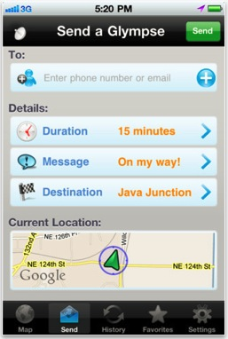

Sensing Context is Expensive
Three orders of magnitude difference
  Some apps limit how long to sense
Our goal: push the limit

Slide 35
Sensing Context is Expensive
Context | Sensors | Sensing Energy (mJ)
IsWalking, IsDriving, IsJogging, IsSitting
AtHome, AtOffice
IsIndoor
IsAlone
InMeeting, IsWorking
Q: What kind of sensors can be used to detect the above context?
Notes:
Contexter: a collection of modules that determines the current value of a context attribute (e.g., is Walking) by acquiring data from necessary sensors by using necessary algorithm.
At home, at office: match the current WiFi signature with a pre-learned dictionary;
IsIndoor: if GPS is not available or current WiFi signature matches with a pre-learned one;
IsAlone: Use Mic to detect;
The key observation here is: energy consumption of various contexters vary by an order of magnitude. This alludes to potential savings in ACE if expensive attributes can be inferred from cheap ones.

Slide 36
Sensing Context is Expensive
Context | Sensors | Sensing Energy (mJ)
IsWalking, IsDriving, IsJogging, IsSitting | Accelerometer (10 sec)
AtHome, AtOffice | WiFi
IsIndoor | GPS + WiFi
IsAlone | Mic (10 sec)
InMeeting, IsWorking | WiFi + Mic (10 sec)
259
605
1985
2995
3505
Three orders of magnitude difference
Q: How would you make the context-sensing more energy-efficient?
Potential Energy Savings by Inferring the Expensive Attributes from Cheaper ones
Notes:
Contexter: a collection of modules that determines the current value of a context attribute (e.g., is Walking) by acquiring data from necessary sensors by using necessary algorithm.
At home, at office: match the current WiFi signature with a pre-learned dictionary;
IsIndoor: if GPS is not available or current WiFi signature matches with a pre-learned one;
IsAlone: Use Mic to detect;
The key observation here is: energy consumption of various contexters vary by an order of magnitude. This alludes to potential savings in ACE if expensive attributes can be inferred from cheap ones.

Slide 37
Sensing Context is Expensive
Context | Sensors | Sensing Energy (mJ)
IsWalking, IsDriving, IsJogging, IsSitting | Accelerometer (10 sec)
AtHome, AtOffice | WiFi
IsIndoor | GPS + WiFi
IsAlone | Mic (10 sec)
InMeeting, IsWorking | WiFi + Mic (10 sec)
259
605
1985
2995
3505
Three orders of magnitude difference
Q: How would you use cheap attributes to infer more expensive ones?
Notes:
Contexter: a collection of modules that determines the current value of a context attribute (e.g., is Walking) by acquiring data from necessary sensors by using necessary algorithm.
At home, at office: match the current WiFi signature with a pre-learned dictionary;
IsIndoor: if GPS is not available or current WiFi signature matches with a pre-learned one;
IsAlone: Use Mic to detect;
The key observation here is: energy consumption of various contexters vary by an order of magnitude. This alludes to potential savings in ACE if expensive attributes can be inferred from cheap ones.

Slide 38
ACE: Acquisitional Context Engine
Low-energy continuous sensing middleware
Goal: Reduce the Cost (Energy) of Context Sensing
Approach: Opportunistically infer expensive attributes from cheap attributes
Conjecture: Relationship of expensive and cheap attributes can be learnt automatically
Intuition: Human activities constrained by physical constraints
  Behavior invariants: Driving implies Not At Home
Notes:
When we consider humans mobility, there is an important concept we may want to introduce: Context;
The context describes the situation or environment a person is currently involved, it can be driving, staying at home, being in a meeting, or is walking.
How to sense those context using the sensors we have in smartphone in an energy efficient way becomes an interesting question.
The main idea of their approach is to opportunistically infer expensive attributes from cheap ones; and found the relationship between expensive and cheap attributes can be automatically learnt;

Slide 39
ACE Big Picture
App1
App2
App3
App4
ACE
Get(attribute)
Raw Sensor Data

Slide 40
ACE Big Picture
Get(Driving)
=True
App1
App2
App3
App4
Sensing
Get(attribute)
Running
Contexters
Inference Cache
Driving
AtHome
InMeeting
Driving
Running
Correlation Miner
Driving -> Not AtHome
Running -> Not InMeeting
Raw Sensor Data

Slide 41
ACE Big Picture
Get(Driving)
=True
Get(Driving)
=True
Get(AtHome)
=False
App1
App2
App3
App4
Sensing
Hit
Inference Hit
Get(attribute)
Running
Contexters
Inference Cache
Driving
AtHome
InMeeting
Driving
Running
Correlation Miner
Driving -> Not AtHome
Running -> Not InMeeting
Raw Sensor Data
Notes:
Contexters. This is a collection of modules, each of
which determines the current value of a context attribute
(e.g., IsWalking) by acquiring data from necessary sensors
and by using the necessary inference algorithm.
Rule Miner. This module maintains user's context
history and automatically learns context rules|relationships
among various context attributes|from the history.
Inference Cache. This implements the intelligent
caching behavior mentioned before. It provides the same
Get/Put interface as a traditional cache. However, on Get(X),
it returns the value of X not only if the value of X is in the
cache, but also if it can be inferred by using context rules
and cached values of other attributes.
Sensing Planner. On a cache miss, this nds the
sequence of proxy attributes to speculatively sense to deter-
mine the value of the target attribute in the cheapest way.

Slide 42
ACE Big Picture
Get(Driving)
=True
Get(Driving)
=True
Get(AtHome)
=False
Get(InMeeting)
=False
App1
App2
App3
App4
Sensing
Hit
Inference Hit
Proxy sensing
Get(attribute)
Running
Contexters
Inference Cache
Running
Speculative Sensing
miss
AtHome
InMeeting
Driving
Running
Correlation Miner
Driving -> Not AtHome
Running -> Not InMeeting
Raw Sensor Data
Notes:
Sensing running is cheaper than inMeeting as we saw earlier in the Table: sense running only needs IsWalking while sense InMeeting needs WiFi and Micropscope
Importance of Rule/Correlation Miner:
One might argue that
relationships among various context attributes can be hard
coded within applications. Rule Miner automates this pro-
cess. Moreover, it can learn additional rules that are not-
so-obvious to developers, can change over time, are specic
to individual users, and involve attributes from different ap-
plications (and hence developer of one application may not
nd them). Our experiments show that the energy savings
of ACE would have reduced by more than half had it used a
set of static rules for all users, instead of dynamically learn-
ing personalized rules for each user.

Slide 43
ACE Big Picture
Get(Driving)
=True
Get(Driving)
=True
Get(AtHome)
=False
Get(InMeeting)
=False
App1
App2
App3
App4
Sensing
Hit
Inference Hit
Proxy sensing
Get(attribute)
Running
Contexters
Inference Cache
Running
Speculative Sensing
miss
AtHome
InMeeting
Driving
Running
Automatic process
No semantic meaning needed
Easy to extend with new Contexters
Rule Miner
Driving ⇒ ¬AtHome
Running ⇒ ¬InMeeting
Raw Sensor Data

Slide 44
Disclaimers
Not for apps requiring 100% accurate contexts
  Experiments show ~4% inaccuracy
Current prototype
  Boolean attributes (categorical attributes)
  Uses correlations at the same time
    E.g., Driving -> Not at home
    Ignores temporal aspects of rules
Notes:
For simplicity, we assume Boolean context attributes. Even
though our techniques can be generalized to real-valued at-
tributes, we believe that Boolean attributes are sucffient for
a large collection of context-aware applications as they re-
act based on Boolean states of arbitrarily complex context
attributes (e.g., mute the phone when in a meeting or in a
movie theater).
Ignore temporal aspects means we do not explicitly consider the rule such as if I am driving and I will be at home in no more than 20 mins.

Slide 45
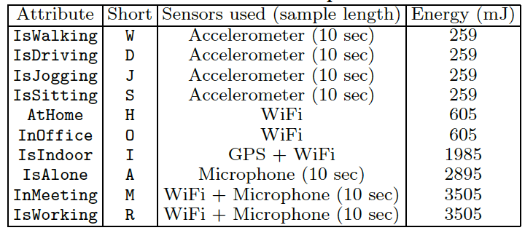
Contexters
Interface:
Attribute Name
Energy Cost
Notes:
Table 1 also shows the sensors various contexters use. The
contexters for attributes W, D, J, and S collect accelerome-
ter data over a 10-second window and derive values of the
attributes based on a decision tree learned from training
data [13]. The values of AtHome and InOffice are deter-
mined by matching the current WiFi signature with a pre-
learned dictionary. The contexter for IsIndoor uses GPS
location and WiFi signature; i.e., the user is assumed to be
indoor if GPS signal is not available or current WiFi ac-
cess points are in a pre-learned dictionary. The value of
IsAlone is determined by collecting an audio sample of 10
seconds and comparing the average signal strength with a
pre-learned threshold [16]. Finally, the values of InMeeting
and IsWorking are determined by using signal strength of
surrounding sound and fine-grained location based on WiFi
signature and acoustic background signature [25].

Slide 46
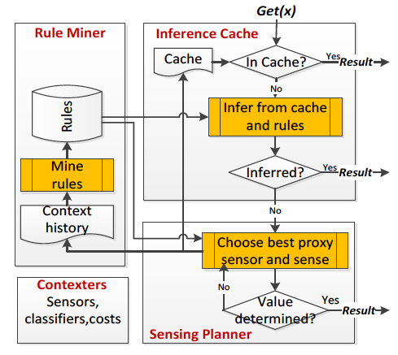
ACE Workflow

Slide 47
Key Questions
Feasibility: Do useful correlations exist and can they be efficiently learnt?
System design: How to systematically exploit the correlations?
Effectiveness: How much energy savings?

Slide 48
Feasibility: Datasets
MIT Reality Mining Dataset
MSR Dataset
95 students and staffs at MIT
Nokia 6600 phones, 2004-2005
min/avg/max: 14/122/269 days
10 interns and researchers
Android phones
min/avg/max: 5/14/30 days
Context Attributes
Location: AtHome, InOffice, IsIndoor,
Task: InMeeting, IsWorking, IsUsingApp, IsCalling,
Transportation mode: IsWalking, IsBiking, IsDriving, IsSitting,
Group: IsAlone
….
10:23:34 am AtHome
10:23:35 am Walking,Outdoor
10:23:36 am Driving,Outdoor
10:23:55 am Walking
10:23:59 am InOffice
….
Notes:
Using real traces is important because effectiveness of ACE depends on its
ability to infer context rules from a user's context history.
Each dataset contains continuous context trace of a number of users, where each trace contains a sequence of lines of the following format: timestamp; attrib1 = value1; attrib2 =value2;. There is a line in the trace every time any attribute changes its value. Thus, a user is assumed to be in the same state between two consecutive timestamps in the trace.

Slide 49
Apriori Algorithm to Find the Rules
Example: 1000 transactions, 200 include both A and B, and 80 of the 200 also includes C.
Association rule: (A,B) => C
  Support: 80/1000=8%
  Confidence: 80/200=40%
Parameters
  minSup (4% works well for ACE)
  minConf (99% works well for ACE)
Notes:
The Apriori algorithm takes as input a collection of transactions, where each transaction is a collection of co-occurring tuples. Each association rule has a support and a confidence.
For example, if a context history has 1000 transactions, out
of which 200 include both items A and B and 80 of these
include item C, the association rule (A;B) -> C (read as “
If A and B are true then C is true") has a support of 8%(=
80=1000) and a confidence of 40%(= 80=200). The algorithm takes two input parameters: minSup and minConf.
It then produces all the rules with support minSup and confidence minConf

Slide 50
Mining Behavior Invariants
….
10:23:34 am AtHome
10:23:35 am Walking
10:23:36 am Driving
10:23:50 am Driving
10:23:55 am Walking
10:23:59 am InOffice
….
…
Driving -> Not AtHome
{Indoor, Alone, Not AtHome} -> InOffice
…
Rules = Patterns that almost always hold
Rules may be person-specific
We use association rule mining algorithms
Challenges
Streaming data
(Decide the right batch size )
Capture rare rules
(Several hours on phone)
Redundant rules
(~700 per person)
Bootstrapping
See the paper for details
Notes:
Use classic data mining algorithms (Apriori) to quickly discover association rules from the database; Some of the rules are always hold, like driving -> not at home; some are more personal specific, like indoor + alone+ not at home -> implies in office.

Slide 51
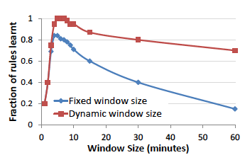
Addressing Rule Mining Challenges
Choose the right window size to batch context attributes to form transactions
A user can change her context any time within a window, hence dynamic windowing is necessary
5 min window is optimal (from data)
Notes:
Then, for a given window size W, we batch all tuples within W as a single transaction. Note that a batch may contain the same tuple multiple
times, in which case we keep only one. Moreover, a batch
may also contain conflicting tuples, in which case we drop
all tuples involving the corresponding attribute.
Figure 3 shows the effect of various window sizes. The y-axis in the graph shows the fraction of rules learned, normalized to the maximum number of manually-verified “good” rules we could learn for various parameters and averaged over all users in ACE Dataset.
Since a user can change his context any time within
a window, such conflicting tuples occur very often. To avoid
this, we use dynamic windowing, where we use a default window size (say 5 minutes), but trim a window into a shorter one whenever the value of any context attribute changes
(e.g., when the user's AtHome context is changed from True
to False). After such a trimmed window, we restore the
default window size. Thus, a window never contains conflicting tuples.
Figure 3 shows that dynamic windowing with 5-minute default window size produces 18% more “good” rules than static windowing with 5-minute window.
Increasing default window size can reduce the number of rules produced, as shown in Figure 3. This is because increasing window size can reduce relative frequencies of popular tuples since multiple occurrences of a popular tuple are treated as a single occurrence within a transaction.

Slide 52
Addressing Rule Mining Challenges
Deal with low support
  Offload rule mining to a powerful backend server
Deal with inaccuracies
  Do cross validation using ground truth results from occasional user annotations
Suppress redundant rules
  Use data mining algorithm to reduce the redundancy
Bootstrapping
  Start with universal rules and update them with personalized rules

Slide 53
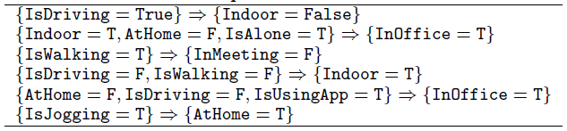
Correlation Miner on Two Traces
Useful correlations exist in our traces
  Avg. ~44 non-redundant rules per person
Errors can be kept reasonably low (~ 4%)
  Take only rules with high confidence (~ 99%)
  Frequent cross-validation (1 in 20)
Some rules can be specific to a single user and may not apply to all users
Notes:
Example Rules. Table 2 shows a few example rules
automatically learned by ACE for a single user in the ACE
Dataset. Some rules are not so obvious; e.g., consider the
fth rule in Table 2: if the user is not at home and not riding
a bus but is using phone apps, he is in the office. Apparently,
this particular user uses apps only at home, in bus, and in
office. Some rules can be specific to a single user and may
not generally apply to all users. For example, the last rule
in Table 2 applies to a user who jogs in a treadmill at home,
and it may not apply to someone who runs outside.
Cross validation
Mine rules may become invalid due the change of user’s behavior.
For example, he may buy a treadmill
and start running at home instead of outside. Then, the
rule fIsRunning = Trueg ) fAtHome = Falseg needs to
be replaced with a new rule. To achieve this, ACE cross
validates its inferred results with ground truths (collected
by occasionally running contexters or getting feedback from
users/applications, as mentioned in Section 2). ACE conser-
vatively drops a rule if its support and confidence go below
minSup and minConf due to the ground truths. New rules
emerged due to change in habits are eventually learned by
the Rule Miner as their itemsets become frequent.

Slide 54
Key Questions
Feasibility: Are there useful rules? Can we learn them?
System design: Systematically exploiting correlation
  Inference Cache
  Speculative Sensing
Effectiveness: How much energy savings?

Slide 55
Inference Caching
Get(Indoor)
AND-OR Expression Tree
Indoor
Ινφερ
Cache
Driving
Walking
OR
Jogging
Alone
Ινφερ
Indoor
InMeeting
AtHome
InOffice
AND
Indoor -> Indoor
InMeeting -> Indoor
InOffice -> Indoor
AtHome -> Indoor
Ινφερ
Χαχηε
Sitting
^{Not} Alone
AND
Sitting AND ^{Not} Alone -> InMeeting
Χαχηε
Χαχηε
Χαχηε
Capture the transitive relationship among rules.
^{Not} Driving
^{Not} Walking
^{Not} Jogging
^{Not} Driving AND ^{Not} Walking
AND ^{Not} Jogging -> Sitting
Notes:
Expression Tree for a tuple a=v: A Boolean AND OR tree representation of the expression that implies the value of the attribute a.
Inference cache: on a get request on attribute X, the cache evaluates two expression trees- one for X=T and one for X=F, and see if any of these trees satisfied. If X=T satisfied returns true, if X=F satisfied returns false; Otherwise invokes Sensing Planner to invoke contexters.

Slide 56
Speculative Sensing
Goal: speculatively sense a cheap attribute to determine value of an expensive attribute
  Infer InMeeting from IsRunning (e.g., 5pm)
Challenge:
  Choose the next attribute to sense
    If infers target attributes, save energy
    If not, waste energy
  Goal: minimize expected cost
    Choose attributes with low c and high p
Cost c
Prob p
Notes:
When the inference cache fails to determine the value of an attribute, we need to call necessary contexters to determine the value. The straightforward way is to directly call the contexter that produce the value. But that can be at a high cost. The authors show that probably the ACE may be able to find the value of an attribute in an indirect and cheaper way.
For example, if current time is 5:30pm and the user is likely to be jogging between 5-6pm, then ACE can just speculative sense jogging to infer InMeeting attribute, which is much costly to get.
An optimal ordering of selecting the right attributes to sense depends on both the cost of getting the attribute and the likelihood of this attribute being true. (This is related because only a true/false value of attribute can infer target attribute, e.g., only isRunning is true, you can infer Inmeeting is False, but if isRunning is false, we cannnot infer Inmeeting). Cost is learnt from configuration file while p is learnt on historical data.
So the goal is to chose the right set of attributes to sense in order to infer the target attribute while keeping the expected cost of sensing minimal.

Slide 57
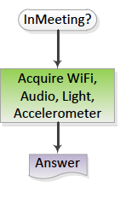
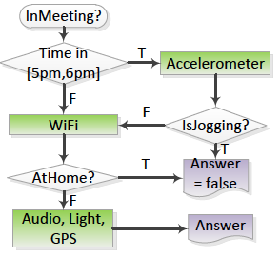
Example: InMeeting?
1
2
3
Traditional plan
ACE plan
Notes:
Suppose an application wants to see if the user is InMeeting.
A traditional system will determine the value of the at-
tribute by acquiring necessary sensor data, e.g., audio, GPS,
and WiFi signature and by using necessary classifiers. How-
ever, ACE's conditional planning exploits context rules to
opportunistically infer the value of InMeeting by acquir-
ing attributes that are cheaper (in terms of sensing cost)
and are likely to conclude a value of InMeeting. For ex-
ample, if the current time is 5.30pm and the user is likely
to be jogging between 5pm and 6 pm, ACE can specula-
tively acquire the value of IsJogging, and if it is found to
be True, ACE can infer InMeeting = False according to the
rule IsJogging = True => InMeeting = False. Similarly, if
checking AtHome is cheaper (by sensing WiFi only) and the
user is likely to be at home, ACE can check if the user is ac-
tually at home and if so, can conclude InMeeting = False.

Slide 58
Speculative Sensing
Problem: Select next attributes to sense that minimizes the expected total sensing cost
NP Hard in general
  Probabilistic And-Or Tree Resolution (PAOTOR)
ACE provides: (see paper for details)
  Dynamic programming : usable for <10 attributes
  Heuristic: Fast, close to optimal
Notes:
In general the number of valid plans to sensing attributes can be exponential. In the previous example, we can also check if both isDriving and is Walking are False. If not check other attributes.
How can we evaluate a Boolean expression with minimum cost? The optimal algorithm would evaluate variables with small cost but high likelihood to determine the value of the whole expression before other variables.
The problem here is an instance of the probabilistic And-Or tree resolution (PAORT) problem, which is shown to be NP hard.
However, when the number of attributes is relatively small (fewer than 10), it may be feasible to exhaustively search for all possible ordering of the attributes and then to choose the one that minimizes the expected cost.
The authors use dynamical programming to prune the search space and reduce computational overhead.
When the number of attributes becomes large, designs a fast and efficient heuristic algorithm that perform close to optimal.

Slide 59
Key Questions
Feasibility: Are there useful rules? Can we learn them?
System design: Systematically exploiting correlation
  Inference Cache
  Speculative Sensing
Effectiveness: How much energy savings?

Slide 60

Evaluation Setup
  Prototype on Windows Phone
1G CPU
512MB RAM
Li-Ion 1500 mAh Battery
How much do I jog?
Mute phone in meeting
Alert when at grocery shop
Three apps
Jog Tracker
Phone Buddy
Geo-Reminder
IsWalking, isJogging, and IsBiking
IsDriving,InMeeting, IsAlone, and InOffice.
AtHome, InOffice, Indoor
  Effectiveness with MSR and Reality Mining traces
  Performance on Samsung Focus Win 7 phone
Notes:
Experiments are done on Samsung Focus phone running Win 7.5 OS. 1G CPU, 512MB RAM and Li-Ion 1500 mAh battery;
Trace-driven experiments: run ACE on a laptop and replace its contexters with fake ones that return a user’s current context from a given trace, instead of acquiring sensory data. The energy cost are modeled by the numbers measured from real experiments.
JogTracker needs: IsWalking; IsJogging, IsBiking;
PhoneBuddy: IsDriving, IsMeeting, IsAlone and InOffice
Geo-Reminder: AtHome, InOffice, Indoor

Slide 61
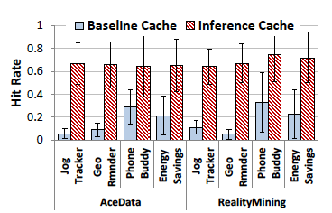
Hit Rate of Inference Cache
Inference Cache has a much higher hit rate: return an attribute even if it is not in cache!
Notes:
Compared to the baseline cache, Inference Cache consistently provides significantly higher hit rates (65 - 75%), for all applications and datasets. The additional benefit comes from its ability to return the value of an attribute even if it is not in cache,
Figure 8 shows the average and 95% confidence interval of hit rates of various applications under two datasets. The applications have some overlap in terms of required sensor data and context attributes, and hence the baseline cache
gives nonzero hit rates (5 - 30%). The hit rate is the highest for PhoneBuddy because it has the maximum overlap with other applications.

Slide 62
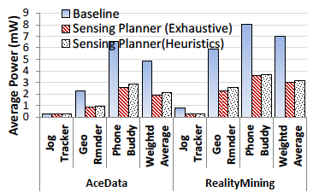
Energy Savings by Sensing Planner
Sensing Planner saves 5%-60% power compared to baseline (Heuristics are as good as Exhaustive Algorithm)
Notes:
Figure 10 shows that, compared to the baseline planner,
the heuristics-based Sensing Planner reduces energy con-
sumption by 5 - 60% for various applications and datasets.
The savings is more significant in applications requiring ex-
pensive attributes (e.g., PhoneBuddy), because often those
expensive attributes are computed by executing cheaper con-
texters. Since Jog Tracker already uses cheap attributes, the
Planner does not provide significant savings beyond the sav-
ings due to Inference Cache.) Overall, the savings is around
55% on average for both datasets.

Slide 63
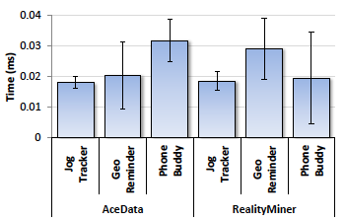
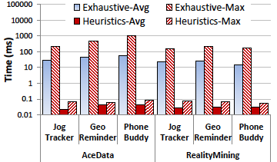
Overhead of ACE
Time on Inference Cache (Cache Hit)
Time on Speculative Sensing (Cache Miss)
Time < 0.1 ms; Memory < 15 MB. Affordable on phones!
Notes:
Figure 12 shows the average latency of a Get() request
when it is answered by the Inference Cache (i.e., a cache hit).
The latency depends on complexity of expression trees, and
we report both average and 95% confidence interval of the
latency on the Samsung phone. The latency is negligible.
Figure 13 shows the time spent by Sensing Planner on such a
miss. (The latency does not include the sensing latency.)
We show both the average and maximum latency for the
exhaustive algorithm and the heuristic algorithm. The ex-
haustive algorithm can be slow and take up to a second.
Planning time of exhaustive algorithm depends on the num-
ber of attributes. In contrast, the heuris-
tic algorithm, which is the default in ACE, runs very fast
(< 0:1 ms) and remains comparable across various datasets
and applications.

Slide 64
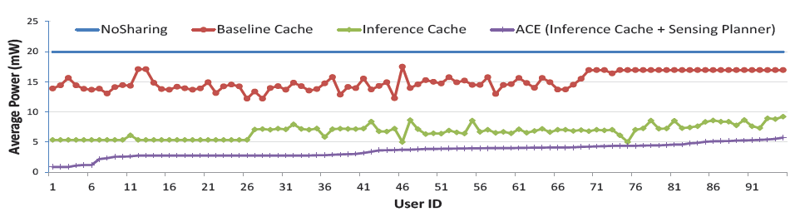
End-to-End Energy Savings
4x
Notes:
No sharing: a scheme where applications do not share any sensor data or context attributes with each other;
Standard cache: Just cached the things in FIFO order; It will only returned the attributes directly found in cache.
Inference cache: Standard cache, but apply inference rules, if an attribute is not directly found, but it can be inferred from attributes in cache, it will do the inference and return the inferred one. But if it cannot infer, it will directly sense the attribute.
ACE: Inference cache+speculative sensing: when the attribute is not found and cannot be inferred from the cache, invoke speculative sensing that tries to sense the cheap attribute to infer the more expensive one
ACE can save more than 4 times energy compared to the standard cache algorithm.

Slide 65
End-to-end Latency
End-to-end latency is < 0.1 ms, which is acceptable to all 3 apps!
Notes:
The latency is controlled within 0.1 ms, which is quite acceptable for all 3 applications.

Slide 66
What are the limitations you see?

Slide 67
Limitations claimed by author
Fundamental: Occasionally inaccuracy in context inference
  Rule mining parameters (support and confidence)
  Cache expiration time
  Cross validation frequency
Non-fundamental
  Boolean attributes only (E.g., cannot capture the user’s moving speed, etc.)
  Not exploit the temporal correlations between attributes (E.g., InOffice => Not at home for next 10 mins)
  Inference cache only returns the value of an attribute not the confidence
Notes:
Not for apps need 100% accuracy: PhoneBuddy, probably you don’t want you phone to ring during some important meeting, just because you are unlucky in the 4% at that time
Boolean attributes: makes implementation of ACE simple, but can be extended to handle more complex rules in the form of decision based inference algorithms.
ACE does not explore temporal correlation across attributes, for example, if a user is inOffice now, he cannot be cat home for the next 10 minutes.

Slide 68
Conclusion
Useful correlations exist across context attributes
ACE uses two key ideas to exploit correlation
  Inference caching
  Speculative sensing
Automatically avoids sensing as much as possible, without requiring semantic information
Significant sensing energy savings (4.2x) at the cost of small inaccuracies (~4%)

