Slide 1
Body Area Sensor Networks I
CSE 40437/60437-Spring 2015
Prof. Dong Wang

Slide 2
Outline
Introduction to Body Area Sensor Network
  "Body area sensor networks: Challenges and opportunities." Hanson, Mark A., et al. Computer 42.1 (2009): 58.
Paper 1: Accurate caloric expenditure of bicyclists using cellphones.” Zhan, Andong, et al. Proceedings of the 10th ACM Conference on Embedded Network Sensor Systems. ACM, 2012.

Slide 3
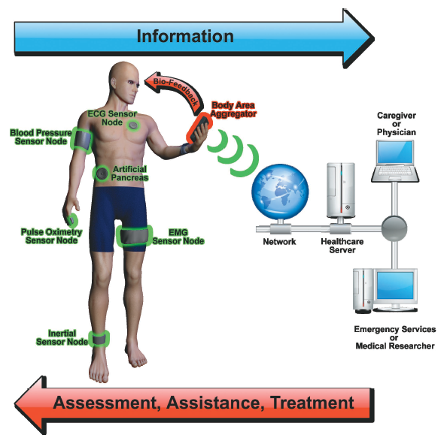
Body Area Sensor Network (BASN)
Notes:
Body area sensor networks (BASNs), for example, promise novel uses
in healthcare, fitness, and entertainment. Each BASN consists of multiple interconnected nodes on, near, or within a human body, which together provide sensing, processing, and communication capabilities.
Figure 1. A body area sensor network and its environment. A BASN can interact with existing systems, such as networks in hospitals and retirement
communities. Body sensors in BASN nodes provide data to the body aggregator, which is central to managing body events. Body aggregators
perform a multitude of functions, including sensing, fusing data from sensors across the body, serving as a user interface, and bridging BASNs to higher-level infrastructures and thus to other stakeholders.

Slide 4
What are the key components of BASN?
Sensing, Data Processing and Fusion, Communication, User Interface
Notes:
Body area sensor networks (BASNs), for example, promise novel uses
in healthcare, fitness, and entertainment. Each BASN consists of multiple interconnected nodes on, near, or
within a human body, which together provide sensing, processing, and communication capabilities.
Figure 1. A body area sensor network and its environment. A BASN can interact with existing systems, such as networks in hospitals and retirement
communities. Body sensors in BASN nodes provide data to the body aggregator, which is central to managing body events. Body aggregators
perform a multitude of functions, including sensing, fusing data from sensors across the body, serving as a user interface, and bridging BASNs to higher-level infrastructures and thus to other stakeholders.

Slide 5
What are the key features of BASN?
Notes:
Body area sensor networks (BASNs), for example, promise novel uses
in healthcare, fitness, and entertainment. Each BASN consists of multiple interconnected nodes on, near, or
within a human body, which together provide sensing, processing, and communication capabilities.
Figure 1. A body area sensor network and its environment. A BASN can interact with existing systems, such as networks in hospitals and retirement
communities. Body sensors in BASN nodes provide data to the body aggregator, which is central to managing body events. Body aggregators
perform a multitude of functions, including sensing, fusing data from sensors across the body, serving as a user interface, and bridging BASNs to higher-level infrastructures and thus to other stakeholders.

Slide 6
BASN Features
Extremely Noninvasive
  Social acceptance
Tiny in Size
  Smaller battery, Constraint resource, Tradeoffs between energy and fidelity
Packaging and placement
  Neither prominent nor uncomfortable
Amortize nonrecurring costs
  Either significant volume in a single app or aggregate volume across apps
Emphasis on “value to user”
  Useful apps that deliver valuable information to users
Notes:
Finally, value to the user will ultimately determine the
technology’s success. BASNs must effectively transmit
and transform sensed phenomena into valuable information
and do so while meeting other system requirements,
such as energy efficiency. A BASN’s value therefore rests
in large part on its ability to selectively process and deliver
information at fidelity levels and rates appropriate to
the data’s destination, whether that is to a runner curious
about her heart rate or a physician needing a patient’s electrocardiogram.

Slide 7
What could be potential applications of BASN?
Notes:
Body area sensor networks (BASNs), for example, promise novel uses
in healthcare, fitness, and entertainment. Each BASN consists of multiple interconnected nodes on, near, or
within a human body, which together provide sensing, processing, and communication capabilities.
Figure 1. A body area sensor network and its environment. A BASN can interact with existing systems, such as networks in hospitals and retirement
communities. Body sensors in BASN nodes provide data to the body aggregator, which is central to managing body events. Body aggregators
perform a multitude of functions, including sensing, fusing data from sensors across the body, serving as a user interface, and bridging BASNs to higher-level infrastructures and thus to other stakeholders.

Slide 8
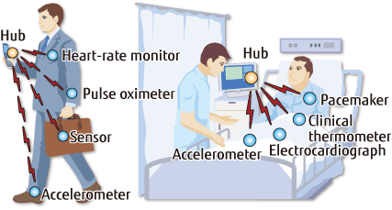
BASN Application Areas
Healthcare Applications
Notes:
BASNs will enable telehealth applications—medicine
beyond the confines of hospitals and clinics1—and, because
of their human-centricity, will facilitate highly personalized
and individual care.
BASNs that can offer real-time
sensing, processing, and control will augment and preserve
body functions and human life. BASN researchers
are already working to improve deep brain stimulation,
heart regulation, drug delivery, and prosthetic actuation.

Slide 9
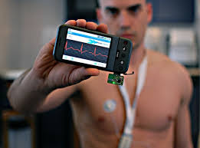
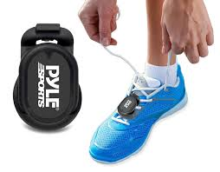
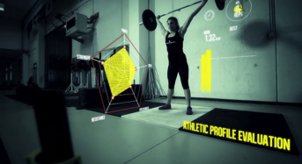
BASN Application Areas
Fitness Applications

Slide 10
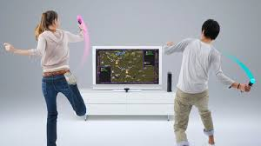
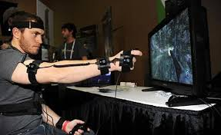
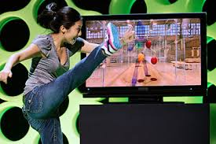
BASN Application Areas
Entertainment Applications
Notes:
gaming systems are
pushing their envelope by integrating
more sophisticated interfaces based on
human movement

Slide 11
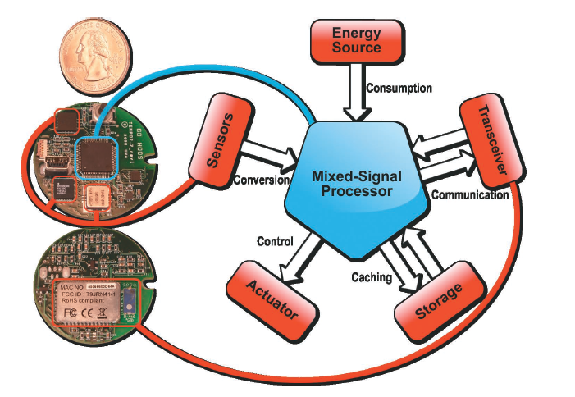
BASN Components: Sensors
TEMPO inertial sensor node (UVA)
Notes:
As Figure 2 shows, BASN nodes create an interface to humans, typically encapsulating
an energy source, one or more sensors, a mixed-signal processor, and a
communication transceiver. Some nodes also support data storage or feedback
control to body-based actuators, such as an insulin pump or robotic prosthetic.
Although BASN and WSN nodes have similar functional architecture, differences in
their operational characteristics—sensing, signal processing, communication,
caching, feedback control, and energy harvesting—present unique challenges and opportunities for BASN nodes.
Figure 2. BASN node architecture. Although the architectural components
are similar to those of a typical wireless sensor network node, a BASN
node presents unique challenges and opportunities—from sensing to
communication. The sensor node (left) is the TEMPO inertial sensor node
developed at the University of Virginia.

Slide 12
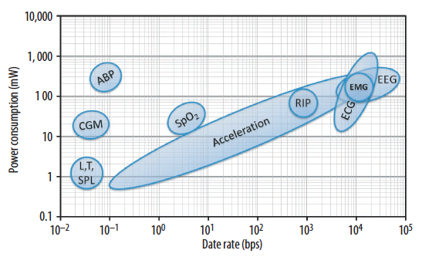
BASN Components: Sensors
High speed, High Power
Low speed, Low Power
ABP: ambulatory blood pressure; CGM: continuous glucose monitoring;
L, T, SPL: light, temperature, sound pressure level;
SpO2: pulse oximetry; RIP: respiratory inductive plethysmography;
ECG: electrocardiography; EMG: electromyography;
EEG: electroencephalography.
Notes:
Figure 3. Average power consumption of continuous
ambulatory monitoring applications. These differences
suggest the need to support multiple applications in a
narrow range of data rates (such as combining ECG, EEG,
and EMG on a single node) or to support a single application
across a wide range of data rates, such as acceleration.
ABP: ambulatory blood pressure; CGM: continuous glucose
monitoring; L, T, SPL: light, temperature, sound pressure
level; SpO2: pulse oximetry; RIP: respiratory inductive
plethysmography; ECG: electrocardiography; EMG:
electromyography; EEG: electroencephalography.

Slide 13
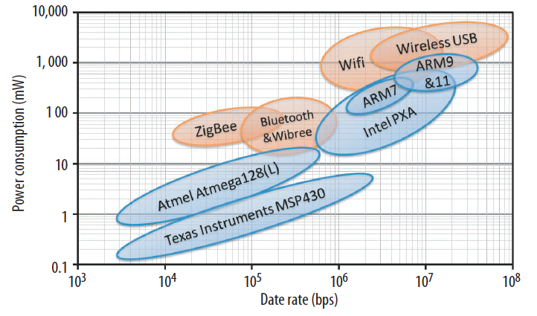
BASN Components: Signal Processing
Orange: Wireless Transceiver;
Blue: Microprocessors
Q: What interesting observations can you get from this figure?
Notes:
Figure 4 shows the power consumption of wireless
transceivers and microprocessors in popular BASN and
WSN platforms. It underlines two characteristics of existing
embedded technology: Processing data at a given rate
consumes less power on average than transmitting the data
wirelessly, and reducing the data rate will reduce power
consumption for both wireless transceivers and microprocessors.
These characteristics create a tradeoff between
processing and communication: On-node signal processing
will consume power to extract information, but it will also
reduce in-network data rate and power consumption.
Figure 4. Average power consumption of wireless
transceivers (orange) and microprocessors (blue) in
typical BASN and WSN platforms. For a given data rate,
wireless transceivers consume more power on average
than processors. Reducing an application’s data rate by
extracting only the essential information will reduce power
consumption.

Slide 14
BASN Components: Signal Processing
Processing data at given rate consumes less power on average than transmitting the data
Notes:
Figure 4 shows the power consumption of wireless
transceivers and microprocessors in popular BASN and
WSN platforms. It underlines two characteristics of existing
embedded technology: Processing data at a given rate
consumes less power on average than transmitting the data
wirelessly, and reducing the data rate will reduce power
consumption for both wireless transceivers and microprocessors.
These characteristics create a tradeoff between
processing and communication: On-node signal processing
will consume power to extract information, but it will also
reduce in-network data rate and power consumption.
Figure 4. Average power consumption of wireless
transceivers (orange) and microprocessors (blue) in
typical BASN and WSN platforms. For a given data rate,
wireless transceivers consume more power on average
than processors. Reducing an application’s data rate by
extracting only the essential information will reduce power
consumption.

Slide 15
BASN Components: Signal Processing
Energy savings: Reduce the application’s communication data rate by extracting only the essential information
Tradeoff: On-node Data Processing vs Wireless Communication
Notes:
Figure 4 shows the power consumption of wireless
transceivers and microprocessors in popular BASN and
WSN platforms. It underlines two characteristics of existing
embedded technology: Processing data at a given rate
consumes less power on average than transmitting the data
wirelessly, and reducing the data rate will reduce power
consumption for both wireless transceivers and microprocessors.
These characteristics create a tradeoff between
processing and communication: On-node signal processing
will consume power to extract information, but it will also
reduce in-network data rate and power consumption.
Figure 4. Average power consumption of wireless
transceivers (orange) and microprocessors (blue) in
typical BASN and WSN platforms. For a given data rate,
wireless transceivers consume more power on average
than processors. Reducing an application’s data rate by
extracting only the essential information will reduce power
consumption.

Slide 16
BASN Components: Communication
Essential for Node Coordination
Restrict the communication radius to the body’s periphery (Why?)
RF Channel: 850 MHz-2.4 GHz
What is the key challenge of node communication in BASN?
Big problem of “Body Shadowing”
  Body’s line of sight absorption of RF energy
  Movements cause highly variable path

Slide 17
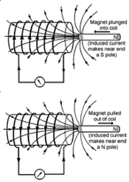
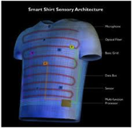
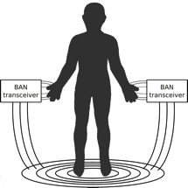
BASN Components: Communication
New/Future communication methods:
Smart textiles
  Embed wires in clothing
Magnetic Induction
  Use near field effect to communicate
Body-coupled communication
  Use human body as a channel
  Highly stable, low energy
  Safety is critical
Notes:
In smart textiles, wires are embedded in clothing, thereby reducing communication power overhead and simplifying networking schemes. Cost, ease of
cleaning, and manufacturer standardization could limit market uptake.
Magnetic induction uses magnetic near-field effects to
communicate between two coils of wire. Near-field communication
typically suffers less path loss than radiative
communication, but coil dimensions complicate packaging.
Despite this complication, implantable and swallowed sensors
have exploited this communication technology.
Body-coupled communication uses the human body as a
channel. BASN transceivers of this nature are either in contact
with, or capacitively coupled to, the skin. Body-coupled
communication is appealing because little radiated energy
is detectable beyond the human body, channels are highly
stable, and energy requirements are low. However, additional
research will need to determine the safety of this approach.

Slide 18
BASN Components: Storage
On-node Storage:
  Low power nonvolatile storage (e.g., MRAM, RRAM)
Cache data and wait for good channel conditions:
  Prolong battery life, decrease transmitting error
Archive data for signal classification:
  Detect longitudinal trends (e.g. recover from surgery)
  Detect instantaneous events (e.g., falls)
Notes:
Cache data for good channel: it can reduce the amount of times to retransmit data, hence reduce energy

Slide 19
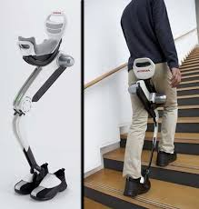
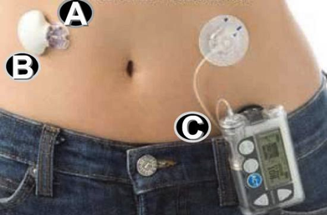
BASN Components: Feedback Control
Prosthetics Devices
Diabetes Monitoring
EMG signals from the eyelid or jaw might be used to control prosthetics devices
Use blood glucose measurements from biosensors to control insulin delivery
Notes:
The deployment and control of prosthetics or remote robotic assistive devices is another possible application. EMG signals from the eyelid or jaw might be used to control a device that assists or replaces a limb or to activate a robotic device that opens doors or controls simple household appliances. Other forms of feedback control include drug delivery and blood glucose regulation facilitated by
implantable biochemical sensors.
The future technology that will permit adjustment of insulin dosage and with automatic control is closed loop control. This approach, also known as the artificial pancreas, is currently being developed. An artificial pancreas will link continuous blood glucose measurement with automatically controlled insulin delivery, using non-living components made of silicon, plastic, and metal.

Slide 20
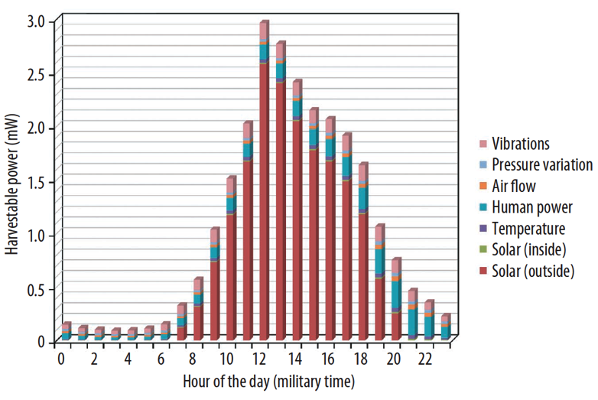
Energy Harvesting
Q: What can you observe from this figure?
Nightly Blackouts
Notes:
Energy harvesting—taking energy from ambient
sources, such as sunlight or vibration—is an attractive solution
to energy woes. Recharging batteries with harvested
energy could not only extend battery life, but also simplify
BASN use. Research challenges are formidable because
of node placement variability and uncertainty about the
user’s exposure to ambient energy. These realities severely
constrain opportunities.
Figure 5. Results of correlating seven energy-harvesting
sources with each source’s availability over an average workday.
Each segment represents the average amount of power
that an individual could expect to harvest at any given time
when all sources are being deployed. Nightly blackouts are a
particular challenge and will require efficient energy storage
mechanisms.

Slide 21
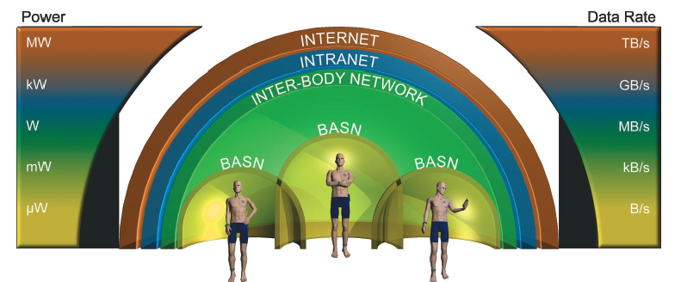
Body Area Networking
BASN is operating at low power and low data rate domain
Notes:
Figure 6. Hierarchy of networks and resources. Data processing starts with the
individual BASN and progresses through communication with existing wireless
technologies via the Internet. Because power consumption and data rate increase
with each processing level, hardware and software will need to interoperate
through multiple levels of infrastructure to share information.
Figure 6 shows the levels and their respective requirements
for data processing, archiving, and management.
During data fusion, systems can detect or react to notable
occurrences from dynamic data, explicit queries, and so
on. Specific reactions might include heightening the state
of awareness, collecting data at a higher fidelity for closer
inspection, forwarding events to higher levels, or even
immediate response.

Slide 22
Open Questions
What are the factors that will affect the widespread BASN adoption and diffusion (e.g., value, safety, privacy, compatibility, ease of use)?
Who will be the stakeholders of BASN (e.g., users, emergency services, caregivers, researchers, etc.)?
Who will pay for the BASN? Who will own the BASN data? How will access to data and information be granted? Who is liable for damages involving BASN?
Notes:
Value. Perceived value of the BASN must improve its user’s quality of life.
Safety. Wearable and implanted sensors will need to be biocompatible
and unobtrusive to prevent harm to the user. Safety-critical applications must have fault-tolerant operation.
Security. Unauthorized access or manipulation of system function could have severe consequences. Security measures such as user authentication will prevent such consequences.
Privacy. BASNs will be entrusted with potentially sensitive information about people. Protecting user privacy will require both technical and nontechnical solutions. Encryption will be necessary to protect sensitive data, and encryption mechanisms will need to be resource-aware.
Compatibility. BASN nodes need to interoperate with other BASN nodes, existing inter-BASN networks, and even with electronic health record systems. This will require standardization of communication protocols and data storage formats.
Ease of use. Wearable BASN nodes will need to be small, unobtrusive, ergonomic, easy to put on, few in number, and even stylish. On-body and off-body user interfaces will need intuitive controls and presentation of information.

Slide 23


From Science Fiction to Reality
The book described a vision where wearable technologies that will “silently monitor” heart rhythm, detect irregularities, and alert emergency personnel in the
event of a heart attack ..
How Science Will Revolutionize the 21st Century and Beyond-Futurist Michio Kaku (Oxford University Press, 1999)
Notes:
In his bestselling book, Visions: How Science Will Revolutionize
the 21st Century and Beyond (Oxford University
Press, 1999), futurist Michio Kaku described wearable
technologies that will “silently monitor” heart rhythm,
detect irregularities, and alert emergency personnel in the
event of a heart attack. This vision, not far removed from
current research efforts, illustrates the promise of BASNs
in this important area.

Slide 24
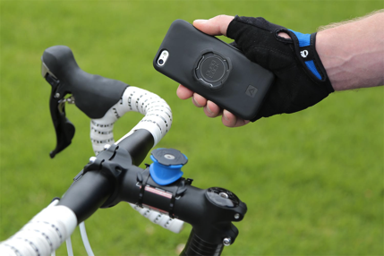
Paper Discussion
Paper 1: "Accurate caloric expenditure of bicyclists using cellphones.” Zhan, Andong, et al. Proceedings of the 10th ACM Conference on Embedded Network Sensor Systems. ACM, 2012.

Slide 25
Biking Renaissance
A biking renaissance has been underway over the past two decades in North America
Pucher et al., Bicycling renaissance in North America? An update and re-appraisal of cycling trends and policies, Transportation Research Part A 45 (2011) 451-475
Introduction
Notes:
A biking renaissance has been underway over the past two decades in North America
As shown in Pucher et al.’s research, annual bike trips increase from 1272 millions in 1977 to 4081 millions in 2009.
meanwhile, daily bike commuters increase from 468 thousands in 1980 to 766 thousands in 2009.

Slide 26
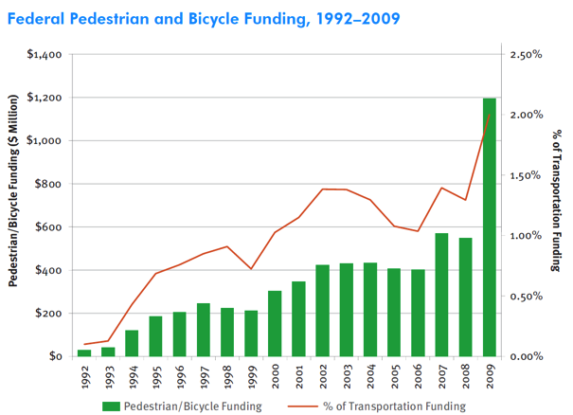
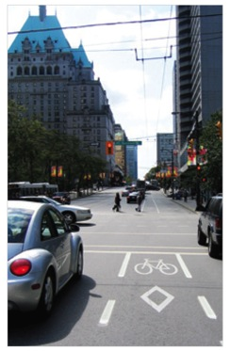
Biking Renaissance (Cont’d)
The National Bicycling and Walking Study: 15-Year Status Report, May 2010
Pedestrain and Bicycle Information Center, U.S. Department of Transportation
Introduction
Notes:
At the same time, there has been a large increase in funding for cycling and in the range and magnitude of pro-bike policies to promote cycling. Like the left figure shown, current federal pedestrian and bicycle funding is reach to $ 1,200 millions.
Bikers receive more support from the government nowadays to ensure safe and enjoyable biking experience.

Slide 27

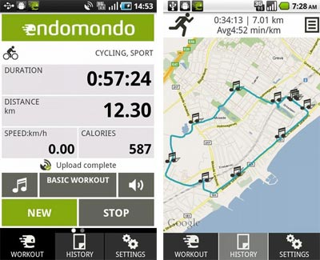
Go with Mobile
Bikers’ cellphones become smarter
Bikers start to use mobile apps to track their trips
  E.g., iMapMyRIDE, endomondo
  Trace route, mange workouts, share experience with friends
A important feature is to estimate caloric expenditure
Quantify their exercises and keep fit.
Introduction
Notes:
Along with this bicycling renaissance, more and more bikers are willing to travel with their mobile phones and use mobile apps to track their trips, e.g., iMapMyRIDE and endomondo. These trips can help bikers to trace their route, manage their workouts, and share their experience with friends.
A important feature is to estimate caloric expenditure. It is also a key feedback to help bikers to quantify their exercises and keep fit.

Slide 28
Estimate Caloric Expenditure
Q 1: Is there some simple approach we can use to quickly estimate caloric expenditure of a bike trip without using smartphones and special sensors?
Q 2: What are the inputs you might need to estimate the caloric expenditure?
Introduction

Slide 29

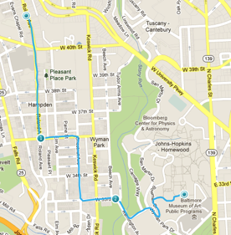
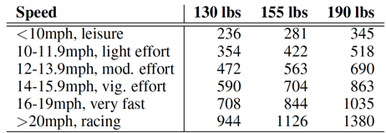

Estimate Caloric Expenditure
Current approach – search table
101m
120Cal
50Cal
State of Wisconsin Department of Health and Family Services: Calories Burned Per Hour
20Cal
70m
What could be the problems of using the search table?
Introduction
Notes:
However, current approach, we called “search table”, is not accurate.
Left table is an example from state of Wisconsin Department of Health and Family Services. With a input of your biking speed, weight and time, you can calculate how many calorie burned based on this table.
But the problem is this table only shows the average caloric expenditure from statistical results. It will generate large errors especially the path is not flat.
For example, we test it on a route between an author’s home and our department hall. The elevation difference is 31 meters. Because both the trip from home to school and the one from school to home takes around 10 minutes. Search table approach shows two trips burn similar calories, around 50 Cal. In fact, the biker feel exhausted after the trip from school to his home, while he during other trip, half of the trip he did not need to push the pedals. The caloric expenditure estimated by heart rate monitor shows the uphill route burns 120 Cal and the downhill only burns 20 Cal. Obviously, “search table” is not an ideal way.

Slide 30
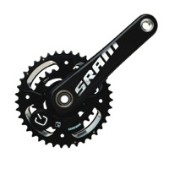
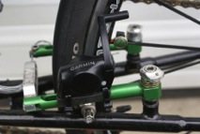
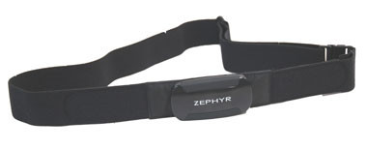
Estimate Caloric Expenditure (Cont’d)
How to track caloric expenditure accurately?
  Integrate more sensors!
  Pay more! money, battery, …, burden
It seems the only way to get accurate caloric expenditure is to buy more hardware sensors.
Is it really the only way to do it?
Power meter
crankset
Heart rate monitor
Cadence sensor
Used by professionals, cost more than 1,000 each
Bikers need to wear strap on their chest
It senses revolution per minute, but it ignores elevation change
Introduction
Notes:
So how to track caloric expenditure accurately?
A straightforward approach is to integrate more sensors. But of course you need to pay more, including money, battery, … and other burden.
For example, you have several choices in the market:
One is power meter crankset, usually used by professionals, which can sense the work you have done on the pedal and send data back to your phone via bluetooth. However, one of this costs more than 1,000 dollars.
The middle one is a heart rate monitor, which estimate your caloric expenditure based on your heart beat per minute. This technology has been widely used in indoor exercises and proved as an accurate approach for caloric expenditure estimation. While for outdoor exercise, e.g., biking, bikers need to wear the strap on their chest which is not comfortable and convenience.
The last one shows a cadence sensor to sense the rpm, revolution per minute, which also can reflect the exercise intensity.
In conclusion, it seems that the only way for bikers to get accurate caloric expenditure is to buy more hardware sensors. While, we don’t believe it! So we are thinking that:
can we use just one smartphone without any accessories to accurately track caloric expenditure?
Our answer is YES!!!

Slide 31

Estimate Caloric Expenditure (Cont’d)
Can we use just one smartphone without any accessories to accurately track caloric expenditure?
How to track caloric expenditure accurately?
  Integrate more sensors!
  Pay more! money, battery, …, burden
Power meter
crankset
Heart rate monitor
Cadence sensor
The answer is YES!!!
Introduction
Notes:
So how to track caloric expenditure accurately?
A straightforward approach is to integrate more sensors. But of course you need to pay more, including money, battery, … and other burden.
For example, you have several choices in the market:
One is power meter crankset, usually used by professionals, which can sense the work you have done on the pedal and send data back to your phone via bluetooth. However, one of this costs more than 1,000 dollars.
The middle one is a heart rate monitor, which estimate your caloric expenditure based on your heart beat per minute. This technology has been widely used in indoor exercises and proved as an accurate approach for caloric expenditure estimation. While for outdoor exercise, e.g., biking, bikers need to wear the strap on their chest which is not comfortable and convenience.
The last one shows a cadence sensor to sense the rpm, revolution per minute, which also can reflect the exercise intensity.
In conclusion, it seems that the only way for bikers to get accurate caloric expenditure is to buy more hardware sensors. While, we don’t believe it! So we are thinking that:
can we use just one smartphone without any accessories to accurately track caloric expenditure?
Our answer is YES!!!

Slide 32
Share your thoughts
How would you design a smartphone based system to accurately estimate the calorie expenditure of bikers?
What are the technical challenges that need to be addressed to design such system?

Slide 33
Related Work
BikeNet
  Use T-mote Sensors + Nokia Smartphones
  Collect samples from a broad range of sensors
  Primarily used for data collection and route tracking
Jigsaw Sensing Engine
  Continuously monitor and classify user activity (walking, cycling, running, etc.)
  Do not quantify the physical aspects of these activities
Biketastic
  Use accelerometers and microphones to gauge the “roughness” of a road and comfort of a ride
  Do not compute calorie consumptions of bikers

Slide 34
Contribution
Design and implement a modular mobile sensing system to enable four major calorie estimators
Introduce a “software method” on smartphone to replace external “hardware sensors”
  Cadence:
    Cadence sensor ➔ software method 1
  Elevation:
    Pressure sensor ➔ software method 2
Accurately estimate caloric expenditure with just one smartphone: achieve the goal ☺
Introduction
Notes:
During the rest of this talk, I’m going to talk about how we find the final solution step by step and evaluate it with current approaches.

Slide 35
Caloric Estimators
Search Table
  Cal = f(speed, time, weight)
Heart Rate Monitor
  Cal = f(bpm, weight, age, time)
Cadence Sensing [AI-Haboubi et. al.]
  Cal = f(rpm, speed, weight)
bpm: beat per minute; rpm: revolution per minute;
Al-Haboubi et al., Modeling energy expenditure during cycling, Ergonomics, 42:3:416-427, 1999
System Design
Notes:
First of all, let me introduce the four caloric estimators for bikers:
You may already know the first two estimators
As we mentioned in the introduction, the calorie expenditure is a function of biking speed, duration, and the biker’s weight. It can be easily implemented by using phone held GPS.
The second one heart rate monitor is widely used in exercise to provide high accurate caloric expenditure estimation. The key input is the heart rate, i.e., beat per minute.
The third one is to use cadence, i.e., pedal speed in revolution per minute, to estimate caloric expenditure.

Slide 36

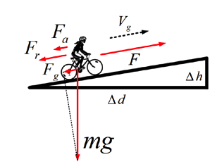

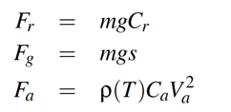
Caloric Estimators (Cont’d)
  Power measurement [Martin et al.]
  Calorie is linear with the total amount of work to move the combined mass of the bike and the biker
Fr: rolling resistance;
Fg: gravity component
on the moving direction;
Fa: Aerodynamic drag
Martin et al., Validation of a Mathematical Model for Road Cycling Power. Journal of Applied Physiology, 82:345, 2000.
System Design
Notes:
The fourth one – power measurement – is a little bit different. The idea is that the calorie burned is linearly related to the total amount of work necessary to move the combined mass of the bike and biker from start to finish.
So calorie burned can be indirectly calculated from power. Based on the law of Mechanics, power is equal to force times ground speed. To maintain a stable speed, the biker needs to generate a force equal to the total resistance which has following three components:
Rolling resistance, gravity component on the moving direction, and aerodynamic drag.
Based on Martin’s model, we need to know Cr, Ca, s (slope), T temperature, and wind velocity. Here Cr can be calibrated by rolling test and Ca we use the recommended value from UK’s cyclists organization. Temperature and wind velocity can be accessed from the web service of local weather station. The last key input we need to know is slope, which can get from elevation difference.

Slide 37
Caloric Estimators (Cont’d)
  Power measurement [Martin et al.]
  Calorie is linear with the total amount of work to move the combined mass of the bike and the biker
Cr: rolling test;
Slope: obtained from elevation difference
Ca: recommended value from UK’s cyclists organization
Va, T: web service and local weather station
coefficient of rolling resistance
slope
coefficient of aerodynamic drag
Wind velocity
Martin et al., Validation of a Mathematical Model for Road Cycling Power. Journal of Applied Physiology, 82:345, 2000.
System Design
Notes:
The fourth one – power measurement – is a little bit different. The idea is that the calorie burned is linearly related to the total amount of work necessary to move the combined mass of the bike and biker from start to finish.
So calorie burned can be indirectly calculated from power. Based on the law of Mechanics, power is equal to force times ground speed. To maintain a stable speed, the biker needs to generate a force equal to the total resistance which has following three components:
Rolling resistance, gravity component on the moving direction, and aerodynamic drag.
Based on Martin’s model, we need to know Cr, Ca, s (slope), T temperature, and wind velocity. Here Cr can be calibrated by rolling test and Ca we use the recommended value from UK’s cyclists organization. Temperature and wind velocity can be accessed from the web service of local weather station. The last key input we need to know is slope, which can get from elevation difference.

Slide 38
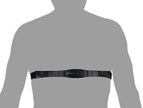
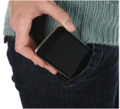
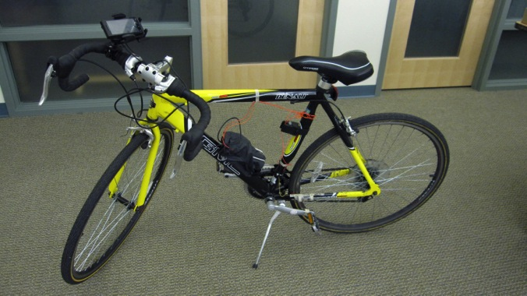
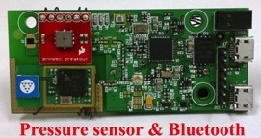
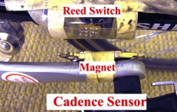
System overview
System Design
Notes:
Now let’s see how our system can enable these four calorie estimators
(Animation 1)
For search table, a phone held GPS is enough.
(Animation 2) For heart rate monitor, we need the biker to wear the strap on his chest. And the bpm will send back to his smartphone via bluetooth.
(Animation 3-4) For cadence sensing, we need to know rpm. Rpm comes from our own built cadence sensor. It has two components: reed switch and magnet. Everytime when the magnet is close to the reed switch, the switch turns on, otherwise it is off. Based on this signal, we can count the revolutions and get rpm.
(Animation 5-6) For power measurement, we use pressure sensor to get the elevation. The pressure sensor is connected with a mote via I2C. And the mote has a bluetooth module to send results to a paired phone.
(Animation 7) a smartphone can mount on the bike or put in the pocket.
Next, we will show we can replace the cadence sensor by the phone in the pocket as well as replace the pressure sensor by using USGS and Google Elevation service. So the cadence sensing and power measurement can be done by only using one smartphone.

Slide 39
System overview
Key Q: How to replace cadence sensor and pressure sensor by using a smartphone and some additional services?
System Design
Notes:
Now let’s see how our system can enable these four calorie estimators
(Animation 1)
For search table, a phone held GPS is enough.
(Animation 2) For heart rate monitor, we need the biker to wear the strap on his chest. And the bpm will send back to his smartphone via bluetooth.
(Animation 3-4) For cadence sensing, we need to know rpm. Rpm comes from our own built cadence sensor. It has two components: reed switch and magnet. Everytime when the magnet is close to the reed switch, the switch turns on, otherwise it is off. Based on this signal, we can count the revolutions and get rpm.
(Animation 5-6) For power measurement, we use pressure sensor to get the elevation. The pressure sensor is connected with a mote via I2C. And the mote has a bluetooth module to send results to a paired phone.
(Animation 7) a smartphone can mount on the bike or put in the pocket.
Next, we will show we can replace the cadence sensor by the phone in the pocket as well as replace the pressure sensor by using USGS and Google Elevation service. So the cadence sensing and power measurement can be done by only using one smartphone.

Slide 40
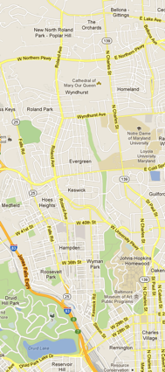
Data collection
15 bike routes around JHU campus
Each can be completed within 20 min
Stable weather condition
sample GPS, heart rate, and pressure sensor once per second
Accelerometer sample rate at 50 Hz
Route | Dist. (km) | Road Conditions
R1 | 1.5 | Neighborhood, uphill
R2 | 2.1 | Neighborhood, uphill
R3 | 0.8 | Neighborhood, downhill
R4 | 0.8 | Neighborhood, uphill
R5 | 2.1 | Neighborhood, downhill
R6 | 1.1 | Neighborhood, downhill
SMDN&SMDS | 1.5 | Woods, river valley, ups and downs, winding path
SMDC | 2.4 | Woods, river valley, ups and downs, winding path
DL | 2.5 | Lakeside, flat, open field
WW | 1.7 | Bridges, ups and downs
WE | 1.7 | Bridges, ups and downs
HJ | 2.9 | Neighborhood, bridge, downhill
JH | 2.9 | Neighborhood, bridge, uphill
C | 3.9 | Flat, circle, open field
JHU
Routes: Uphill, Downhill, Up and Downs
System Design
Notes:
Our data are collected from 15 bike routes around our campus …
There are uphill, downhill, up and downs

Slide 41
Software Method 1
Q: How to use smartphone sensor data to figure out the rpm (revolution per minute) of the bikers? (We do not want to use a cadence sensor)

Slide 42
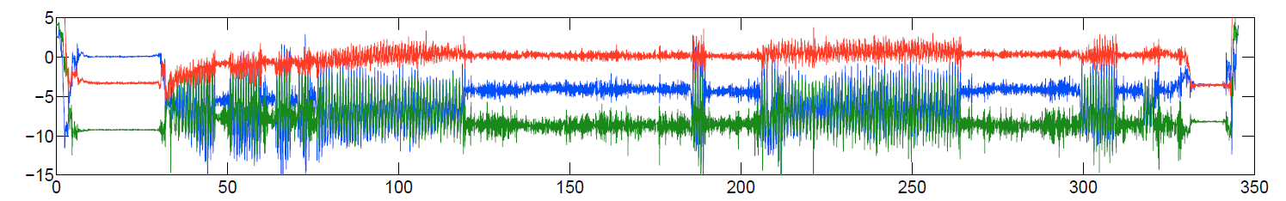
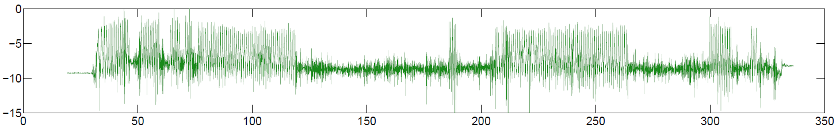
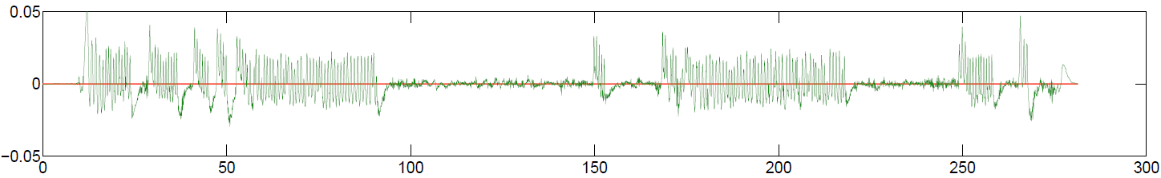
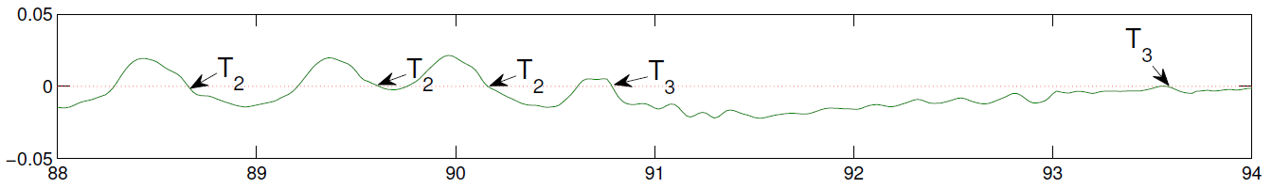
Cadence Sensing in the Pocket
Get rpm from raw accelerometer data
T1
T2
T3
Step 3. utilize k-means to cluster two types based on the amplitude of the immediately previous peak
Step 1. remove T1 vibrations and get the axis with the largest variance
Step 2. apply a low-pass filter and get the derivative of the data
T1: Move phone in/out of pocket; T2: Pedaling; T3: Non-pedaling vibration, e.g., turn, cross a bump, etc.
System Design
Notes:
Q: How to remove T1 and T3 from T2?
Let’s first see how we generate rpm from the phone in the pocket
This figure shows how the raw accelerometer data looks like. We analyze it based on three types of vibrations:
(Animation 1) it shows the type 1 vibration. It is generated when the biker is moving the phone in or out of the pocket.
(Animation 2) T2 are the vibrations when the biker is pedaling.
(Animation 3) while T3 is the vibrations even if the biker is not pedaling. T3 is generated from the vibration from the biker, e.g., turning, or the road, e.g., cross a bump.
To get rpm, we need to remove t1 and t3. we show our approach step by step here:
(Animation 4) step 1. remove T1 is easy. E.g., we can delete the data from first and the last 5 second. Or we can use the speed from GPS, i.e., delete data when the gps speed is 0. and to simplify the process, we only use the data from the axis with the largest variance.
(Animation 5) since every revolution will generate a local maximum and minimum. So we calculate the first derivative of the acceleration signal after applying a low pass filter and detect the revolution by finding the zero crossing (from positive to negative)
(Animation 6) zoom in to part of the data. To remove t3, we find that t2’s amplitude of the immediately previous peak is much larger than t3’s. so we apply k-means to cluster these two types by using the amplitude of the immediately previous peak as the only feature. T2 has large immediate peaks while T3 has small immediate peaks
Finally the number of t2 can be used as the number of revolutions.

Slide 43
Software Method 2
Q: How to use smartphone sensor data and some external database knowledge to figure out the elevation of the bikers? (We do not want to use a pressure sensor)

Slide 44

Elevation measurement
Where to get elevation?
  Pressure sensor (< 2m): most accurate method
  GPS (unknown accuracy)
  U.S. Geological Survey (USGS) (3-10 m)
    Provides an HTTP interface to National Elevation Dataset (NED)
    10-meter resolution in general, 3-meter resolution in dense areas
  Google Maps (~ 20 m)
1 hPa ~= 8.43 m;
Pressure sensor accuracy: 0.2 hPa -> 2 m error
System Design
Notes:
Pressure: error within 2 m
GPS: ?
USGS: 3 m resolution
Google: 20 m resolution
Pressure sensor: we use the international barometric formula to calculate elevation from barometric pressure. The error is within 2 meters. We attempt to use USGS or Google elevation service to replace the pressure sensor.
Meanwhile, GPS also can provide elevation information but with much lower accuracy than USGS and Google.
USGS: provide a http interface to request elevation. Its datasets cover all the United States with 10-meter resolution and 3-meter resolution for most of the densely populated areas. For example, USGS provides 3-meter resolution in the Baltimore metropolitan area.
Google Elevation: only provides a 20-meter resolution for the same area.
So we try all these elevation providers in a sample path, as shown in the left figure, it is evident that the elevation estimates from the pressure sensor, USGS, and Google are close to each other, while the directly measured GPS estimates are both and order of magnitude less accurate and precise.
The most interesting part of this path is around the middle of the trip when the biker crossed a 10-meter long bridge. Let’s zoom in to see it.
Obviously these there elevation estimates do not match. Why? Here, the elevation from the pressure sensor shows the real elevation. But USGS and Google provides the elevation of the terrain – i.e., the riverbed under the bridge -- not the road on the bridge. In addition, the elevation from Google are particularly inaccurate in this location due to the averaging effect generated by the database’s low resolution.
The example shows if we want to get the same quality of elevation as pressure sensor, we have to do some post-processing on USGS or Google elevation, especially to fix bridge error

Slide 45
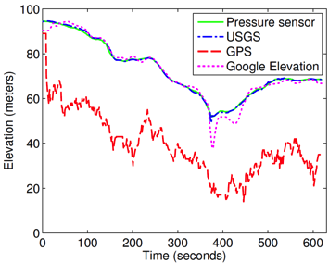

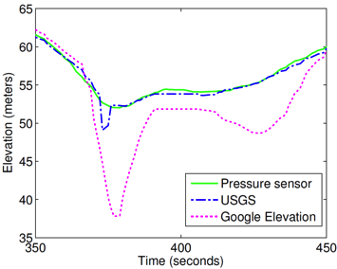
Elevation measurement
Where to get elevation?
  Pressure sensor (< 2m)
  GPS (unknown accuracy)
  U.S. Geological Survey (USGS) (3-10 m)
  Google (~ 20 m)
“bridge error”
Q: Why USGS and Google estimations deviate on bridge ?
A: Their data provides the elevation of the terrain (i.e., river bed under the bridge)
System Design
Notes:
Pressure: error within 2 m
GPS: ?
USGS: 3 m resolution
Google: 20 m resolution
Pressure sensor: we use the international barometric formula to calculate elevation from barometric pressure. The error is within 2 meters. We attempt to use USGS or Google elevation service to replace the pressure sensor.
Meanwhile, GPS also can provide elevation information but with much lower accuracy than USGS and Google.
USGS: provide a http interface to request elevation. Its datasets cover all the United States with 10-meter resolution and 3-meter resolution for most of the densely populated areas. For example, USGS provides 3-meter resolution in the Baltimore metropolitan area.
Google Elevation: only provides a 20-meter resolution for the same area.
So we try all these elevation providers in a sample path, as shown in the left figure, it is evident that the elevation estimates from the pressure sensor, USGS, and Google are close to each other, while the directly measured GPS estimates are both and order of magnitude less accurate and precise.
The most interesting part of this path is around the middle of the trip when the biker crossed a 10-meter long bridge. Let’s zoom in to see it.
Obviously these there elevation estimates do not match. Why? Here, the elevation from the pressure sensor shows the real elevation. But USGS and Google provides the elevation of the terrain – i.e., the riverbed under the bridge -- not the road on the bridge. In addition, the elevation from Google are particularly inaccurate in this location due to the averaging effect generated by the database’s low resolution.
The example shows if we want to get the same quality of elevation as pressure sensor, we have to do some post-processing on USGS or Google elevation, especially to fix bridge error

Slide 46
Elevation measurement
Where to get elevation?
  Pressure sensor (< 2m)
  GPS (unknown accuracy)
  U.S. Geological Survey (USGS) (3-10 m)
  Google (~ 20 m)
Q: How to address the “bridge error”?
“bridge error”
Q: Why USGS and Google estimations deviate on bridge ?
A: Their data provides the elevation of the terrain (i.e., river bed under the bridge)
System Design
Notes:
Pressure: error within 2 m
GPS: ?
USGS: 3 m resolution
Google: 20 m resolution
Pressure sensor: we use the international barometric formula to calculate elevation from barometric pressure. The error is within 2 meters. We attempt to use USGS or Google elevation service to replace the pressure sensor.
Meanwhile, GPS also can provide elevation information but with much lower accuracy than USGS and Google.
USGS: provide a http interface to request elevation. Its datasets cover all the United States with 10-meter resolution and 3-meter resolution for most of the densely populated areas. For example, USGS provides 3-meter resolution in the Baltimore metropolitan area.
Google Elevation: only provides a 20-meter resolution for the same area.
So we try all these elevation providers in a sample path, as shown in the left figure, it is evident that the elevation estimates from the pressure sensor, USGS, and Google are close to each other, while the directly measured GPS estimates are both and order of magnitude less accurate and precise.
The most interesting part of this path is around the middle of the trip when the biker crossed a 10-meter long bridge. Let’s zoom in to see it.
Obviously these there elevation estimates do not match. Why? Here, the elevation from the pressure sensor shows the real elevation. But USGS and Google provides the elevation of the terrain – i.e., the riverbed under the bridge -- not the road on the bridge. In addition, the elevation from Google are particularly inaccurate in this location due to the averaging effect generated by the database’s low resolution.
The example shows if we want to get the same quality of elevation as pressure sensor, we have to do some post-processing on USGS or Google elevation, especially to fix bridge error

Slide 47
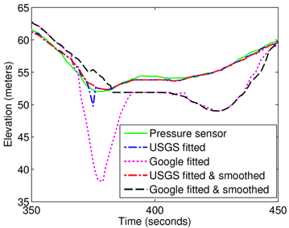

Elevation measurement (Cont’d)
Fitting
  Assume all bike trips take place on either marked paths or roads
  Fit (x, y) to the most likely road in OpenStreetMap
Smoothing
  Treat data from USGS and Google over the bridge section as “outliers”
  Use a robust local regression method: fit to a quadratic polynomial model with robust weights:
Bridge error is corrected by smoothing
Set weights of outliers to be 0
System Design
Notes:
The figure shows after fitting and smoothing, usgs can match the elevation from pressure sensor. But due to the low quality of google elevation, the fitted and smoothed results for google is not that good.
To minimize the elevation error. We introduce two processes:
To minimize the GPS error, <longitude, latitude>, we first fit gps coordinates to the most likely road in openStreetMap.
To fix bridge error, we use a robust local regression method to smooth the elevation traces. By using the method, the weight is not influenced by outliers, i.e., the weight of outliers will be 0.

Slide 48

Calibration: Estimation of Coefficients of Rolling Resistance
A simple experiment:
  Find a flat path that is at least 50 meters long
  Activate GPS Tracking
  Bikers Follow the following 3 steps:
    Accelerate the bike before the start of the 50-m path
    Stop pedaling and keep the bike straight on the path without breaking
    Stop the bike at the end of the path
  Calculate the rolling resistance coefficient Cr:
Measured coefficient: 0.07-1.15
Computed from GPS Tracking Trace;

Slide 49
Evaluation
Hardware sensors vs. software approaches
  Cadence sensor vs. Accelerometer sensing in the pocket
  Pressure sensor vs. Elevation services
Caloric expenditure estimation for multiple bikers
Evaluation

Slide 50
Cadence sensing
Use hardware cadence sensor as ground truth
29 traces collected by two volunteers
  Public roads with real traffic situations, the trip includes uphill, downhill and sharp turns
  Total length is 30.3 km, total 5,377 revolutions
The relative error is less than 2%
The error per km is less than 4 revolutions
Relative error per trip (%) | 0.19 ± 1.59
Error per kilometer | -0.09 ± 3.40
The error introduced by replacing hardware sensors with software sensors (smartphones) is negligible
Evaluation

Slide 51
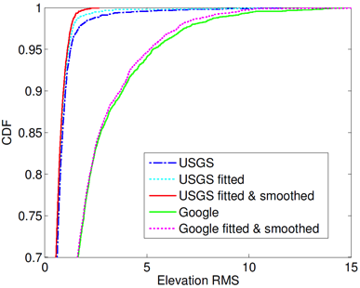
Elevation services
15 traces on 12 routes from Mar. to Apr. 2012
Total of 4,780 GPS and pressure sample pairs
95% of USGS’s RMS are less than 1.2 m
95% of Google’s RMS are less than 5.4 m
Elevation Service | R | RMS (m)
USGS | 0.9993 | 0.9
USGS fitted | 0.9995 | 0.7
USGS fitted & smoothed | 0.9997 | 0.6
Google | 0.9957 | 2.4
Google fitted | 0.9958 | 2.4
Google fitted & smoothed | 0.9960 | 2.3
GPS | 0.9540 | 39
Evaluation
Notes:
(explain RMS here: root mean square error)
After fitting and smoothing, 95% of USGS’s RMS are less than 1.2 m, while 95% of Google Elevation’s RMS are less than 5.4 m.

Slide 52
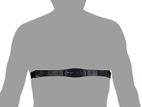
Caloric Expenditure Estimation for Multiple Bikers
Use Heart Rate Monitor as ground truth
Compare calories estimated from Search table (TAB), Cadence sensing (CAD), and power measurement (USGS+FSW)
Recruited 20 volunteers from JHU
  Wear a heart rate strap + a smartphone in the pocket
  17 male and 3 female
  Age from 24 to 32, weight from 110 to 175 lbs.
Calibrated 8 bikes
  3 road, 4 cruiser, and 1 mountain bikes
  Cr = 0.07 ~ 0.21, Ca = 0.26
Collect 70 trips during one week
  At least 3 trips for each volunteer
Evaluation
Notes:
Median
Upper Quartile

Slide 53
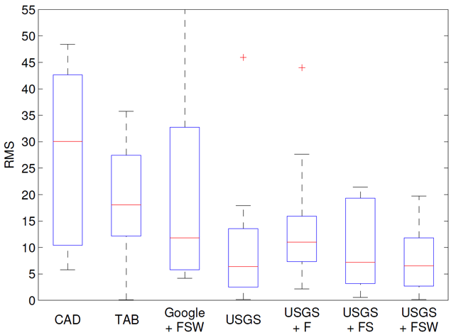
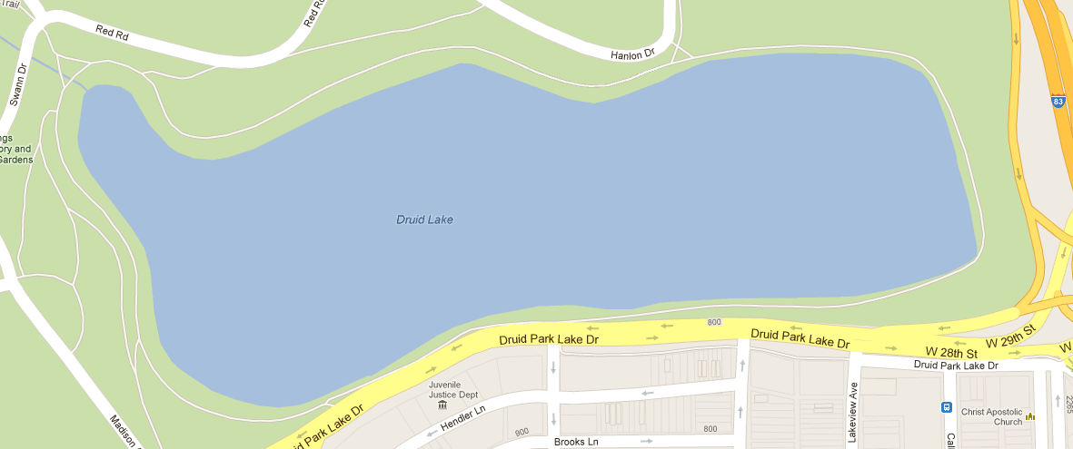
Flat route: Druid Lake
CAD: cadence sensing
TAB: search table
+F: fitting
+S: smoothing
+W: weather information, temperature and wind velocity
2.5 km flat circular bike lane
Collected 10 trips from 7 bikers
Evaluation
Notes:
When the figure comes out, explain:
CAD: cadence sensing
TAB: search table
+F: fitting
+S: smoothing
+W: weather information, temperature and wind velocity
Animation 2: Even on a flat route like this one, the errors from CAD and TAB are more than three times higher than USGS+FSW
Animation 3: Google does not perform well because of the low elevation resolution, causing the elevation to be averaged with the lake.
Animation 4: fitting and smoothing processes recover the outliers; and even the wind is not strong during all the trips, the wind correction decreases the variance compared to USGS+FS
----- Meeting Notes (11/5/12 11:38) -----
falt = flat
RMS: error is in calories (30 = 30 calorie difference from ground truth, not 30% error)
-> TODO: from andong, get absolute number

Slide 54
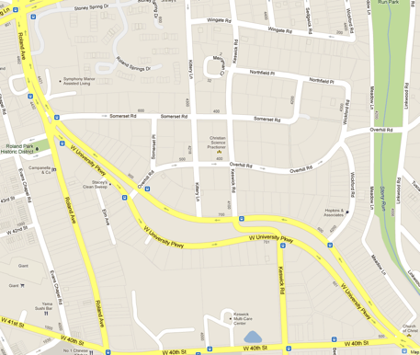
Route: Roland 1 & 6
106m
1.8 km, cross neighborhood
Uphill and downhill path
70m
Evaluation
Notes:
Median
Upper Quartile

Slide 55
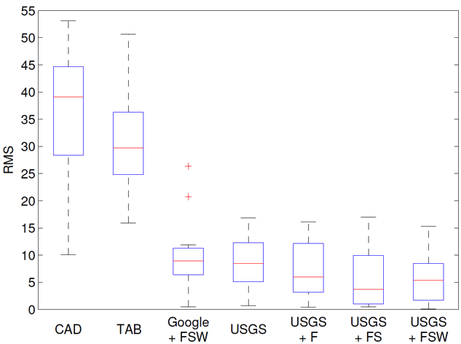
Route: Roland 1, uphill
Why is that?
Both CAD and TAB fail to provide an accurate caloric expenditure estimation for uphill trips
Evaluation
Notes:
This figure shows both CAD and TAB fail to provide an accurate caloric expenditure estimation for uphill trips, especially CAD.

Slide 56
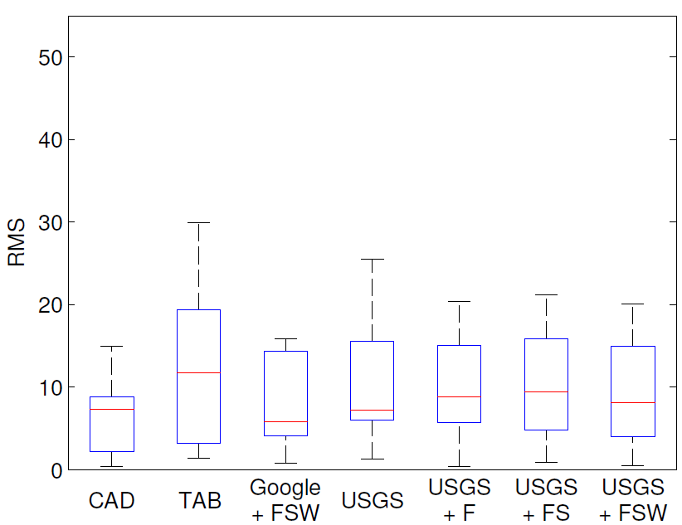
Route: Roland 6, downhill
TAB overestimates calorie in downhill trips
USGS+FSW adapt to both uphill and downhill trips
Evaluation
Notes:
TAB: overestimate calories in downhill trips
CAD: by sensing pedal speed, CAD avoids to overestimate calorie.
USGS+FSW: still control the errors within a low range. So adapt to both uphill and downhill trips
We see that although CAD performs best, the power measurement methods
are only slightly worse, illustrating their ability to adapt to both uphill and downhill stretches.

Slide 57
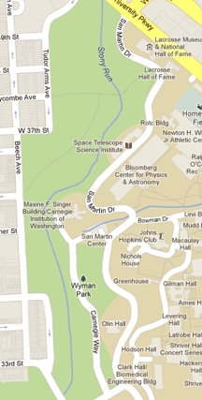
Route: St. Martin Dr.
A winding road along with a river valley
The elevation difference between two sides of the road can be 10 meters
11 trips across 8 bikers
Evaluation
Notes:
Median
Upper Quartile

Slide 58

Route: St. Martin Dr.
The surrounding terrain of the route is complicated and
always changing
Bikers ride both uphill and downhill on this route
Fitting method eliminates most of the errors in this situation
Evaluation
Notes:
Since the surrounding terrain of the route is complicated and
always changing, we see that direct use of the USGS data results
in large errors. However, our fitting method eliminates
most of the errors in this situation.
On the other hand, Google elevation still does not perform well on this route.
TAB performs surprisingly well because bikers ride both uphill and
downhill on this route resulting in any over- and underestimation
errors canceling each other out.

Slide 59


Route: Wyman Park
Cross two bridges: 140, and 67 meters long
Evaluation
Notes:
Median
Upper Quartile

Slide 60

Route: Wyman Park
Smoothing corrects “bridge errors” without adding new errors
Evaluation
Notes:
This 1.7 km route passes two bridges, one is 67 meters long and the other
is 140 meters long, with a height difference of 15 meters between
the road and the bottom of the bridge.
For this route we have 10 trips driven by 8 bikers. Obviously, without
smoothing, the USGS does not perform well as the figure
shows. Fortunately, our smoothing method corrects most of
the elevation errors without adding additional ones.

Slide 61

Overall – 70 Trips
USGS+FSW achieves the lowest error with lowest variance
Evaluation
Notes:
Median decreases from 15 to 5
Upper Quartile decreases form 50 to 20

Slide 62

Reducing GPS Power Consumption
Duty-cycling the GPS receiver (do not sample GPS signal that often)
*
*Fang et. al., EnAcq: energy-efficient GPS trajectory data acquisition based on improved map matching. In Proc. of GIS ‘11, 2011
Evaluation
Notes:
in order to increase the usefulness of our caloric expenditure estimation approach, we investigate the impact of duty-cycling the GPS receiver on caloric expenditure accuracy.
While duty-cycling the GPS means route features lose. To reconstruct the missing bike route points, we consider two cases:
one is interpolation, i.e., generate missing points by interpolating between known points
one is EnAcq algorithm, which is the state-of-the-art map matching and route reconstruction algorithm
Our simulation shows by using simple interpolation, sampling interval can decrease to 15 seconds. While adopting EnAcq, sampling interval can decrease to 30 seconds without largely increase RMS.

Slide 63
Pocket Sensing Approach
GPS
Accelerometer
USGS
Weather
Cadence
Calories

Slide 64
Limitations and Future Work
Current system is designed for offline data analysis
  Implement a real-time bicycling calorie calculation application
A calibration phase is needed to learn those coefficients used in the model
  Develop an auto-calibration module to estimate model coefficients based on user’s height, weight, bike model, etc.
Limited discussions on energy and privacy issues
  Design a more energy-efficient and privacy-aware system, which enables longer battery life and more privacy protection

Slide 65
Conclusion
Just using a smartphone provides comparable accuracy to the best methods that uses external sensors
This work immediately gives millions of bikers a zero-cost solution towards significantly improved biking experiences
The shift from physical to virtual or software sensors will find other applications in quantifying daily lives and activities

Slide 66

Q&A

