Slide 1
Body Area Sensor Networks II
CSE 40437/60437-Spring 2015
Prof. Dong Wang

Slide 2
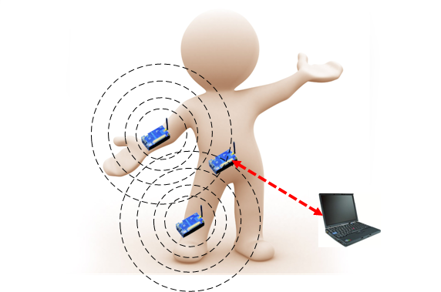
Paper
Paper 3: Qi, Xin, et al. "RadioSense: Exploiting Wireless Communication Patterns for Body Sensor Network Activity Recognition." RTSS. 2012.

Slide 3
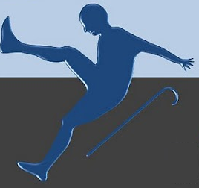
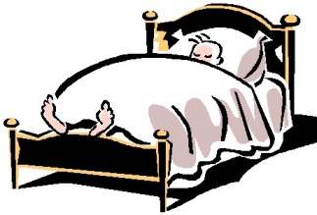
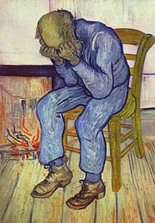
Background - Activity Recognition
Activity Recognition aims to automatically recognize user actions from the patterns (or information) observed on user actions with the aid of computational devices.
Fall Detection
Sleeping Assessment
Depression Detection
Notes:
In computer science, activity recognition aims to …

Slide 4
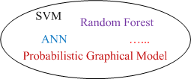
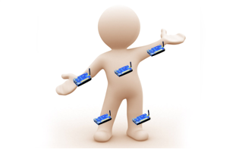
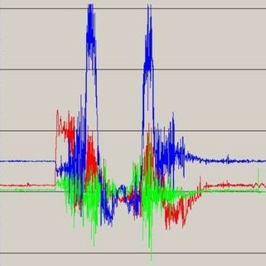
Sensing-based Activity Recognition
Problem setting
Accelerometer
Gyroscope
Temperature
Light
etc.
Running, Walking, Sitting, …
Sensing Data
Notes:
Traditionally, activity recognition is done with sensing technology.
In its problem setting, user wears a group of on-body sensor nodes and each node contains a set of sensors such as … and …
In runtime the sensor nodes collect sensing data and send these data to an aggregator
At the aggregator, received data is used as input to pattern recognition algorithm. The pattern recognition algorithm finally outputs the prediction for user activities.

Slide 5
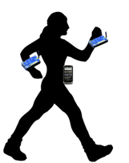

A Dilemma – On One Hand
Sensing data transmission suffers body fading
Accuracy decreased
√
Incomplete data
Notes:
There is a dilemma for the problem setting.
On one hand, sensing data transmission suffers body fading
In this figure, a user wears two sensors nodes on her left and right wrists.
When she is walking, the two sensor nodes send data packets to the aggregator for activity recognition.
It is possible that the transmission of left node fails because of body fading, but the transmission of right node succeeds.
Then the aggregator has to use the incomplete data as the input to the ml algorithm. Of course, the incomplete data will results in reduced accuracy

Slide 6
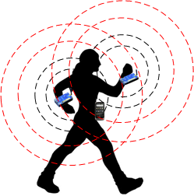
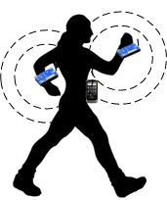



A Dilemma – On the Other Hand
To increase data availability
  Increase transmission power
Consequences:
Increase energy overheads
Increase privacy risks
Transmission Range
Notes:
To increase the data availability at the aggregator, we can increase TX power.
However, one consequence is increasing energy overheads
Moreover, increasing TX power enlarges TX range. In consequence, private data may be overheard by other entities.
If the entity is malicious, privacy is compromised. Therefore, increasing TX power also increases privacy risks.

Slide 7
A Dilemma – On the Other Hand
To increase data availability
  Using complicated MAC protocols
Consequence:
Increase energy overheads
for retransmissions
√
Many existing works propose new MAC protocols to improve packet delivery performance in body sensor network.
However, the impermeability of human body is a large obstacle for transmission efficiency.

Slide 8
The Idea and Research Question
Idea
  As it is difficult to overcome the impermeability of human body, can we utilize it? If so, how?
  It is reasonable to imagine diff. activities have diff. patterns of packet loss and fading, which we call communication patterns.
  We use communication pattern for recognizing activities.
Notes:
Such as energy and privacy we just talk about

Slide 9
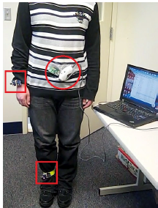
Proof of Concept Experiment
Base Station
RadioSense Nodes
Notes:
Wrist and ankle
are critical places for deploying onbody
sensor nodes for activity recognition
[5]. The third, which is used as a
base station, is highlighted with a cycle. Each of the two
on-body sensor nodes sends 4 packets per second at the TX
power level 2 (-28.7 dBm).
The base station
receives packets from the two on-body sensor nodes, extracts
the node ids, and sends messages containing the ids to a
laptop through the USB interface. A software module on
the laptop receives messages from the base station and logs
the timestamp of each arrival message. Each run of this
software module lasts for one minute, during which the user
is required to perform one activity. There are three activities
(sitting, standing, walking) to perform in total. Sitting is
performed with legs under a table.

Slide 10
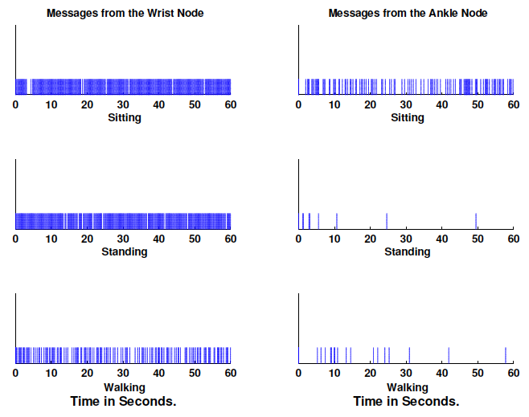
Proof of Concept Experiment
Notes:
Q: Using the results from wrists and ankle, can you differentiate these three activities? If so, show me how can you do that?
Use wrist reading to dif. Walking from sitting and standing. Use Ankle to diff. sitting from standing.
From Figure 2, we observe that the message arrival pattern
of the wrist node is enough for distinguishing walking from
the other two activities. In contrast, sitting and standing
have very similar message arrival patterns of the wrist node.
However, they can be distinguished from each other by the
message arrival patterns of the ankle node. Thus, intuitively,
these three activities are able to be separated from each other
with the message arrival patterns of both the wrist and ankle
nodes.
With only three activities being considered, we demonstrate
the potential of exploiting communication patterns of
the right wrist and ankle nodes for recognizing activities.
However, it is just a concept proof. In the rest of this paper,
we consider more complex activities.

Slide 11
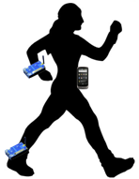
Communication Pattern
PDR = Packet Delivery Ratio
Radio as sensor
RSSI = Received Signal Strength Indicator
Node 1
Aggregator
more nodes
PDR 1
RSSI Feature Set 1
PDR 2
RSSI Feature Set 2
…
Node 2
Communication Pattern
Notes:
Here, I give a definition for communication pattern. To collect communication pattern, we use radio as sensors.
In runtime, each on-body node sends data packets to the aggregator. With received data packets from node 1 during a time window, the aggregator extracts PDR of node 1 and rssi features. RSSI stands for …
In the same way, the aggregator extracts the PDR and RSSI features for node 2 during the same time window and concatenate node2’s node1’s features. If there are more nodes, theirs features will be extracted and concatenated in the same way.
The whole feature vector we call it communication pattern.
In runtime, we use communication pattern as the signature of that time window to recognize activities.

Slide 12
Factors Influencing the Discriminative Capacity of Communication Patterns
Communication patterns
  PDR
    Influencing factor: transmitting power
  RSSI features
    Influencing factors: transmitting power, packet sending rate
  A common influencing factor:
    smoothing window size – length of time window for extracting features
How to optimize the above system parameters:
  Through benchmarking
Notes:
To endow CP with enough discriminative capacity, we first analyze the influencing factors of CP.
According to our definition in our previous slide, CP includes.
Influencing factor of PDR is TX power, high power results in … low power results in
Influencing factor of RSSI related

Slide 13
RadioSense – a Prototype System
Two on-body sensor nodes
Send simple packets to
base station
Packet::NodeId
Base station
Aggregator logs communication
pattern during both training and
runtime phases

Slide 14
Data Collection
Aim to find insightful relationship between recognition accuracy and system parameters – one subject’s data
  Mixing multi-subjects’ data may blur the relationship
7 activities: running, sitting, standing, walking, lying down, cycling and cleaning
  4-activity set: running, sitting, standing, walking
  6-activity set: 4-activity set + lying down and cycling
  7-activity set: 6-activity set + cleaning
Transmission (TX) power level: 1~5 (maximum: 31)
Packet sending rate: 1-4 pkts/s
Each activity is performed for 30 minutes in diff. places (lab, classroom, living room, gym, kitchen, and outdoor)

Slide 15
N-fold Cross Validation
Divide the datasets into N subsets
N-1 subsets are used for training
1 subset is used for testing
Repeat the above process for N times so that each of the N subsets is used exactly once for the testing data

Slide 16
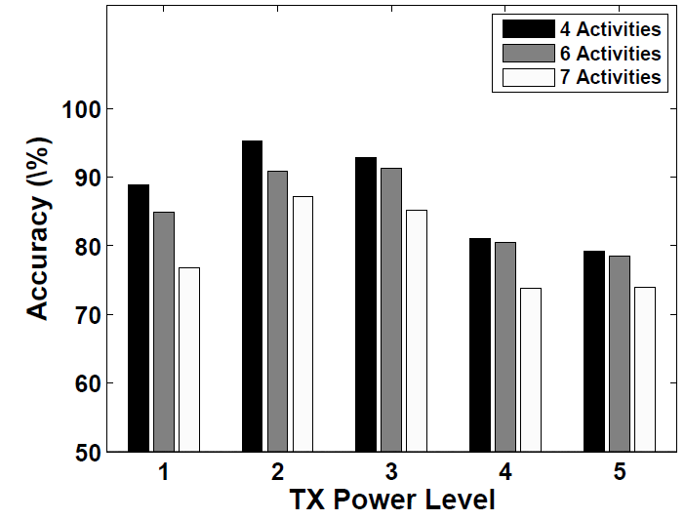
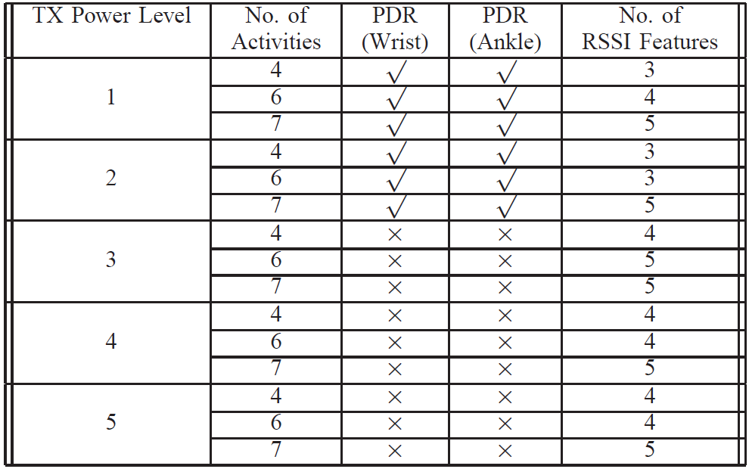
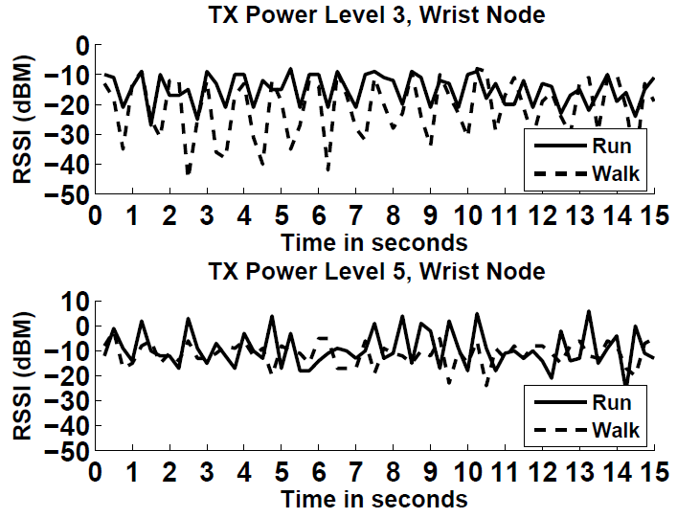
TX Power Level
Accuracy
first increases, then decreases
Q: Why is that?
Packet Sending Rate = 4pkts/s,
Smooth Window= 9 seconds
TX power
PDR’s discriminative capacity
RSSI features
discriminative capacity
Notes:
Q: Why accuracy first increases and then decrease?
First increase because level 1 is too low, almost everyone gets lot, then decrease because the level 3 and more is too high, every packet arrives. Both cases are not discriminative.
This figure illustrates how accuracy varies as the TX power level increases
From table I, we observe that the PDRs of two on-body sensor nodes are selected for activity recognition when the TX power level is low (e.g., 1 or 2).
As the TX power level becomes higher, the PDRs are no longer selected. It is
because a human body’s height is limited and a higher TX
power level results in higher PDRs for different activities,
but the PDRs are less discriminative when they are high for
all activities.
From table I, we also observe that when the TX power
level is higher than 2, the feature selection algorithm only
selects RSSI related features. As illustrated by Figure 4,
accuracy decreases from TX power level 3. It can be inferred
that the discriminative capacity of RSSI features is decreasing
as the TX power level increases. Figure 6 supports this inference.

Slide 17
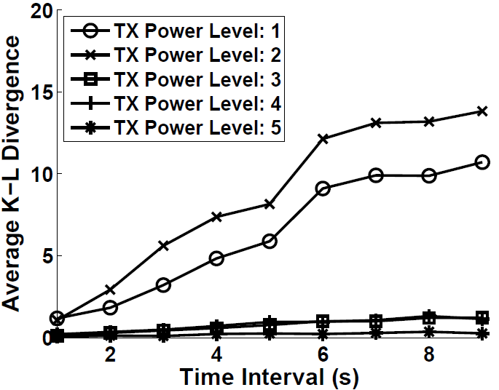
TX Power Level
Quantify PDR’s discriminative capacity
Metric – Average Kullback–Leibler Divergence (KLD) over all activity pairs
KLD: small value = similar; large value = different
most discriminative
highest accuracy
Q: What do you observe from this graph?
Notes:
Since accuracy is highest when PDR is selected, we plan to use KLD to quantify the PDR’s discriminative capacity and see how it varies.
KL divergence is a metric that measures how different two distributions are . A higher KL divergence value means the two distributions being
compared are more different and vice versa. The x-axis in
the figure is the time interval during which the PDR of
each activity is calculated.
From this figure, we observe that TX power level 2 has the largest
average KL divergence, which means that the PDRs are most
discriminative at this TX power level. In contrast, average
KL divergences are much smaller at higher TX power levels.
Thus, the PDRs are less discriminative at these power levels.

Slide 18
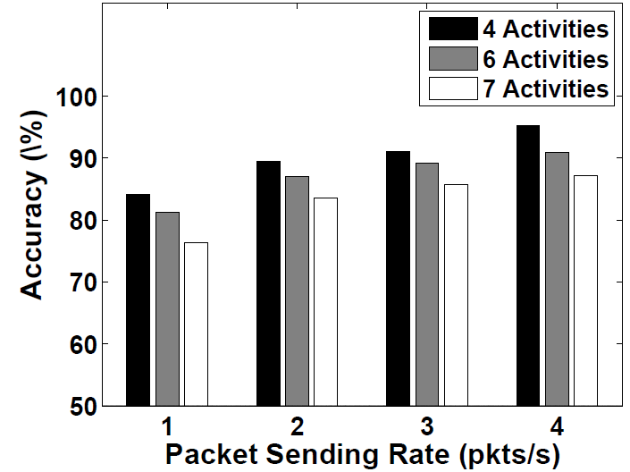
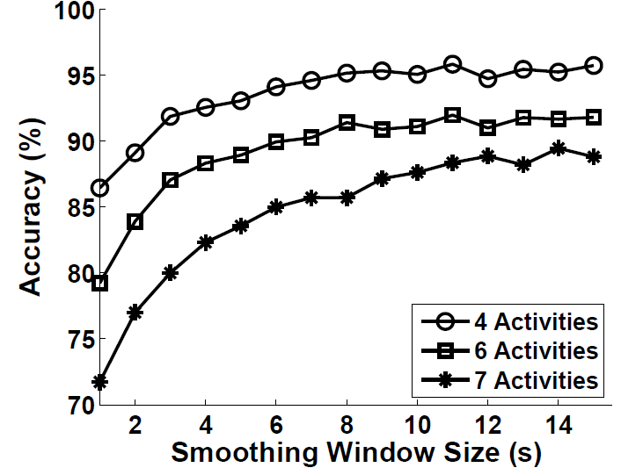
Packet Sending Rate
& Smoothing Window Size
Accuracy increases with higher packet sending rate
Higher packet sending rate captures
more information for RSSI variations
(packet sending -> sensing the BSN channel)
Accuracy increases with larger smoothing
window size
TX Power Level = 2, Smooth Window= 9 seconds
Features extracted from larger smoothing window
are more robust to noise
Any tradeoff you observe?
TX Power Level = 2, packet sending rate = 4 pkts/s
Notes:
Q: Why accuracy increases as the packet sending rate increases? More packets and more information about RSSI. Packet rate should balance accuracy and energy. The packet sending process is like a sampling process of the BASN channel. The higher the packet sending rate, the higher the sampling rate is, the better results.
Q: Why Accuracy increases as the smoothing windows increases? Data from a longer smoothing window is simply more robust to noise. Smoothing window should balance delay and accuracy.
From Figure 7, we observe that the accuracy increases
as the packet sending rate increases. It is because a higher
packet sending rate captures more information of the RSSI
variation during each activity. All activity sets share this
observation. However, a higher packet sending rate means
increased energy overheads. Thus, to balance accuracy and
energy overheads, the optimal packet sending rate should
be the rate above which there is no obvious accuracy
improvement. In Figure 7, compared to the accuracy (for the
seven-activity set) achieved at 3 pkts/s, we observe that the
accuracy increasing rate becomes slow as the packet sending
rate is increased to 4 pkts/s.
Figure 8 depicts how accuracy changes as the smoothing
window size varies. To get this figure, we use 10-minute
data of each activity and set the TX power level and packet
sending rate to be 2 and 4 pkts/s, which are the optimal
parameters for the subject. The accuracies are computed
following the 10-fold cross validation routine. From Figure
8, we observe that at the beginning the accuracy increases as
the smoothing window size increases. It is because features
extracted from a longer smoothing window are more robust
to noise. The increasing rate becomes slow or near zero after
the smoothing window size passes a threshold. It is because
there is not much information gain by using a size which
is larger than the threshold.

Slide 19
Optimize Packet Sending Rate
& Smoothing Window Size
Packet sending rate balances energy overhead and accuracy
Smoothing window size balances latency and accuracy
Rules for packet sending rate optimization:
  At optimal TX power level, from 1 pkts/s, RadioSense selects i pkts/s if:
    i achieves 90% accuracy OR
    i>4, accuracy improvement of i+1<2%
Rules for smoothing window size optimization:
  At optimal TX power level and packet sending rate, RadioSense selects i seconds if:
    i achieves 90% accuracy OR
    i>10 seconds, accuracy improvement of i+1<2%
Notes:
However, we cannot unlimited increasing packet sending rate and smoothing window size, because large packet sending rate consumes large energy overheads and large smoothing window size introduces large latency. To balance energy overhead and accuracy, we design the following heuristic rules for packet sending rate optimization

Slide 20
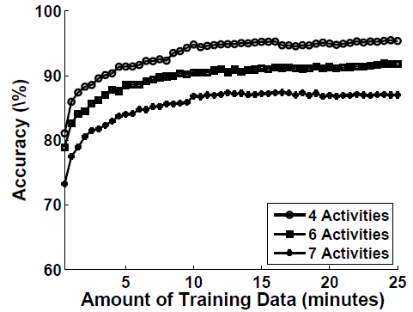
Amount of Training Data
Average accuracy of three subject with different amount of training data
10-minute data is enough for stable accuracy
Notes:
Q: What will be the minimal amount of training data? Since labeling data is tedious.
Besides the 3 system parameters, we also want to identify the minimal amount of training data for stable accuracy
From Figure 9, we observe that the accuracy increases quickly in the first 10 minutes. After 10 minutes, the accuracy increases slowly. Thus, in the deign, the Training Module collects 10-minute data of each activity for training.
With the smoothing window size of 8 seconds (the optimal smoothing window size for 6 activities of subject 1), there are about 75 instances of each activity during 10 minutes.

Slide 21
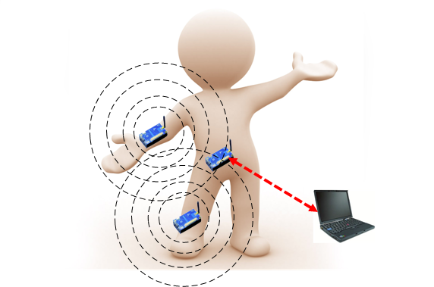
RadioSense Recap
In training phase, we design RadioSense to bootstrap the system following the steps below:
Optimize TX Power Level
10-minute training data for each activity
Optimize Packet Sending Rate
Optimize Smoothing Window Size
Trained Classifier

Slide 22
Up to Now
We have answered …
  How to endow the communication pattern with enough discriminative capacity for recognizing diff. activities?
In the evaluation, we will answer…
  What are the impacts of using communication pattern for AR on other system performance issues, such as energy and privacy?

Slide 23
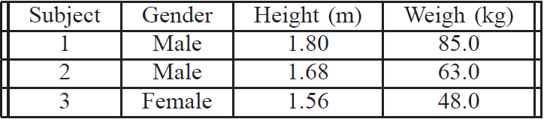
Evaluation – Data Collection
3 subjects
7 activities - running, sitting, standing, walking, lying, riding and cleaning
Different places - lab, classroom, living room, gym, kitchen, and outdoor
During training phase
  Each subject performs activities for system parameter optimization
  With the optimal parameters, for each activity, each subject collects 10-minute data for training and 30-minute data for testing
Lasts for two weeks
One classifier for each subject

Slide 24
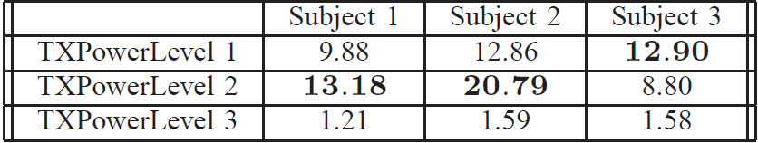
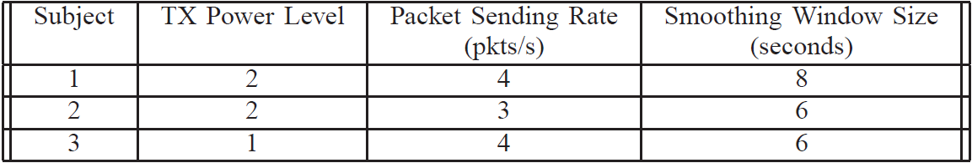
Evaluation – System Parameter Optimization
Average KLD Table
Parameter optimization results
Subject 3 is smaller than the other two
Notes:
This is the average KLD table, each entry in the table is the KLD value for the corresponding subject at the corresponding TX power level.
Smaller TX power level can already result in enough discriminative capacity for subject 3.

Slide 25
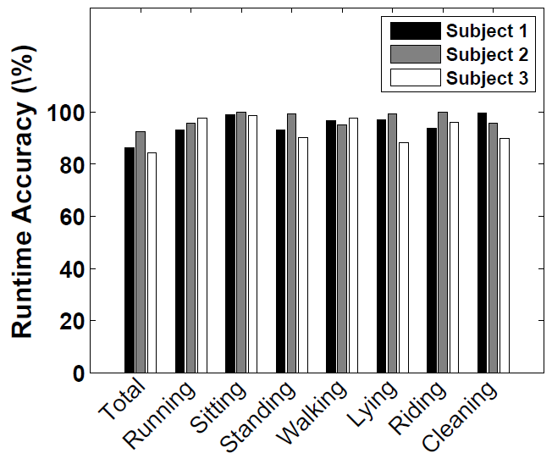
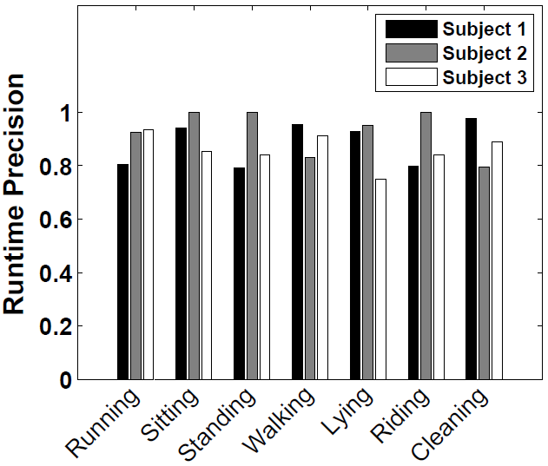
Evaluation – Accuracy and Precision
Most single activity achieves
90% accuracy
86.2%, 92.5%, 84.2%
Ave. KLD: 13.18, 20.79, 12.90
Ave. KLD is a validated metric
Accuracy = (TP+TN)/(TP+TN+FP+FN)
Precision = TP/(TP+FP)
Most single activity achieves
0.8 precision
Notes:
With the data collected under optimal system parameters
Introduce definition of accuracy, precision and recall
In Figure 10, we present the total runtime accuracy of classifying seven
activities for all three subjects. In addition to the total
runtime accuracy, for each activity, we also plot its runtime
accuracy ((true positive + true negative)/(true positive +
false positive+ true negative + false negative)) in Figure
10, runtime precision (true positive/(true positive + false
positive)) in Figure 11, and runtime recall (true positive/(true
positive + false negative)) in Figure 12.
In Figure 10, Subject 1, 2, and 3 have the total runtime
accuracies of 86.3% , 92.5% , and 84.2% , respectively. Interestingly,
subject 2 performs much better than the other two
subjects. Moreover, from Table III, we observe that subject 2
has the largest average KL divergence of PDR distributions
among all subjects at their optimal TX power levels. Thus,
it can be inferred that the average KL divergence of PDR
distributions is a validated metric for indicating accuracy
during the TX power level selection. The reason why subject
2 performs much better may be because that subject 2
performs each activity more cleanly.

Slide 26
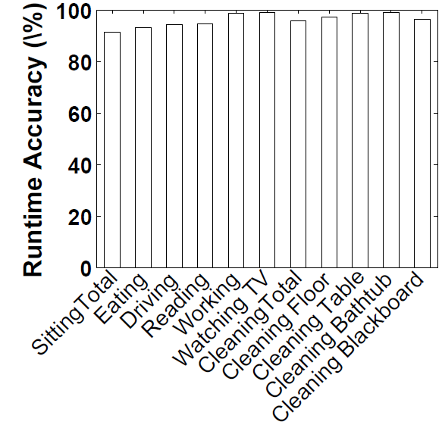
Potentials – More Fine-Grained Activities
One subject
Sitting set - driving, working, reading, eating, and watching TV
Cleaning set - cleaning table, cleaning floor, cleaning bathtub, and cleaning blackboard
10-minute data of each activity for training,
30-minute data of each activity for testing
Sitting - 91.5%
Cleaning - 95.8%

Slide 27
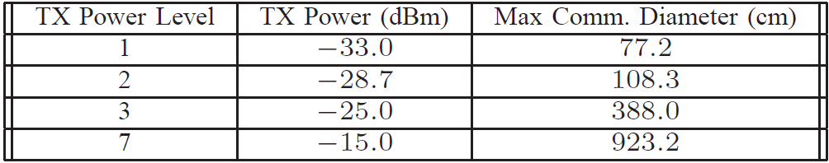
Evaluation – Battery Lifetime and Privacy
Battery lifetime – for each subject’s optimal system parameters
  3 Tmotes with new batteries (AA, Alkaline, LR6, 1.5V)
  Run RadioSense until batteries die
  159.3 hours, 168.7 hours, 175.3 hours
Privacy
Packet::NodeId
Lower TX power and smaller communication range: around 1 m
Privacy risks are reduced!
Commonly used TX power level in BSN, [Mobicom ’09]
Notes:
In this part of evaluation, we use 3 groups of Tmotes, each group of nodes is configured with the optimal system parameters of the 3 subjects. We run the Tmotes with new batteries until the batteries die.
In addition to battery lifetime, we also consider privacy issues in our system.
We measure the communication range of the diff. TX power level , TX power level 7 is …
From the result table, we see that at the TX power levels selected by our system, the communication rage is less that or around 1 meter. In such a small communication range, our system only sends simple packets containing only node id. Compared to the usually methods that use TX power 7, the privacy risks are reduced in our system.

Slide 28
Evaluation - Potential of Coexistence with Other On-body Sensor Nodes
RadioSense - two dedicated on-body sensor nodes, right wrist and ankle, with optimal parameters
Two general purpose on-body sensor nodes, left wrist and ankle, TX power level 7, packet sending rate 4 pkts/s
One subject, for each activity, 10-minute training data, 30-minute testing data
For general purpose nodes:
  PDR: 98.0%, 95.6%
  In good condition [Sensys ’08], since interference from RadioSense nodes is low
For RadioSense nodes:
  Accuracy: 90.8% (with other nodes), 86.3% (without other nodes)
  Communication contention with other on-body nodes may amplify the discriminative capacity of communication pattern
RadioSense does not affect general purpose nodes
RadioSense leverages interference rather than suffers from it!
Notes:
First, the total runtime
accuracy is 90.8% . Compared to the total runtime accuracy
(86.3% ) without the the general purpose nodes, the accuracy
is higher. The reason may be that the general purpose nodes
contend with the RadioSense nodes for the communication
channel. The contention increases the discriminative capacity
of the communication pattern utilized by RadioSense.
Second, the average PDRs of the general purpose nodes are
98.0% and 95.6% , which indicate very good link quality
[28]. Since the RadioSense nodes work at a low TX power,
they have limited effects on the general purpose nodes’
communication.

Slide 29
Limitations
Strong background noises
    Sensing-based approaches will also fail in such case because of high packet loss.
Not scalable for new activities
    It is a common problem for AR system using supervised learning method
Current system is a little bit clunky
  In future, the authors may replace the aggregator with smartphone;

Slide 30
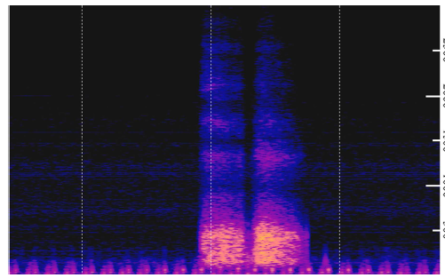
Paper
Paper 4: Yatani, Koji, and Khai N. Truong. "Bodyscope: a wearable acoustic sensor for activity recognition." Proceedings of the 2012 ACM Conference on Ubiquitous Computing. ACM, 2012.

Slide 31
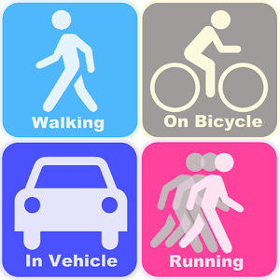
User Activity Recognition
GPS
Camera
Accelerometers
Microphone
RFID
Bluetooth
Cellular
WiFi
Q: Can we use a single type of sensor to detect a rich set of user’s activity?

Slide 32

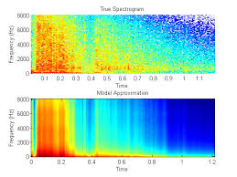
Main Idea
Sound produced in user’s throat area -> User Activities (e.g., drinking, eating, laughing, speaking, etc.)
Drinking
Eating
Speaking
Laughing
.
.
.
Coughing

Slide 33
Share Your Thoughts
Q1: How would you design a system to leverage user’s sound to detect different activities (e.g., drinking, eating, speaking, laughing, coughing, sighing, etc.)?
Q2: What are the equipment(s) you might need to implement your system?

Slide 34
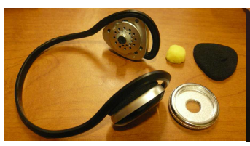
BodyScope
Uni-directional Microphone
Bluetooth headset
Chestpiece of a stethoscope
Notes:
Q: What do you find in this graph?
Bluetooth headset to embed a microphone into one of its earpiece and then covered it with the chestpiece of a stethoscope. Because the uni-directional microphone points towards the user, this eliminates external noises.
The chestpiece then amplifies the sounds produced inside the
throat, enhancing features that differentiate the recorded
audio for one user activity from another.

Slide 35
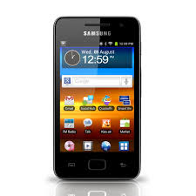
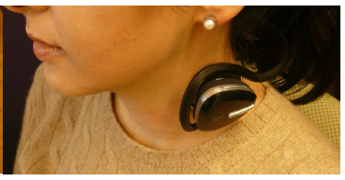
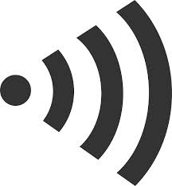
BodyScope
12 Sound-related User Activities
Notes:
The chestpiece is designed to be positioned on the side of
the neck to amplify the sounds produced inside the throat
and minimize audio from external sources.
Q: Why not place it near the larynx?
Not comfortable and interfere with user’s speaking and drinking activities.
Through pilot studies, we observed that placement of the chestpiece at or
near the larynx interfered with some activities, such as
speaking and drinking. Thus, we designed the BodyScope
device to be worn on the side of the neck, near the carotid
artery. The device sends the sound to a computer or mobile
phone via Bluetooth.

Slide 36
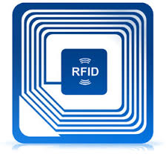
State-of-the-arts
GPS sensors: infer activities related to locations (e.g., working, shopping, driving, etc.)
Accelerometers: recognize user’s posture and movement activities (e.g., sitting, standing, walking, running, etc.)
Cameras + Microphone data: CrowdSense@Place (CSP) to categorize places and infer user activities
A combination of the above+ WiFi: ACE to sense the context of a user and infer the activities
RFID (Radio Frequency Identification): Embed RFID readers to smart gloves and install RFID tags to objects. Infer user activities from interactions (e.g., washing hands, preparing food or a drink, etc.)
Use Microphone Sensor Alone to Detect a Rich Set of User Activities!

Slide 37
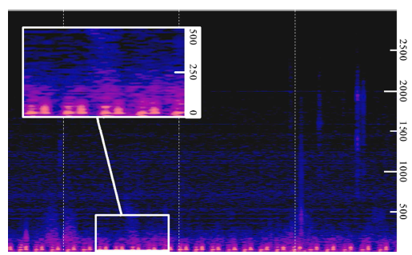
User Activities Detected Through Sound
Sound Spectrogram
Blood Pumping (Opening and Closing of Atrioventricular Valves)
Infer health condition (isolation of vascular sound is challenging)
Sitting
Notes:
Introduction of the graph:
What can be this signal be used for:
Infer health condition, but separating signal from noise might be very challenging!

Slide 38
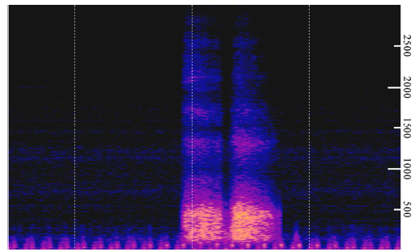
User Activities Detected Through Sound
Inhaling and Exhaling Air
Infer whether a user is engaging in a physical activity
Deep Breath
Notes:
What can this signal be used for?
Infer whether a user is engaging a physical activity or not

Slide 39
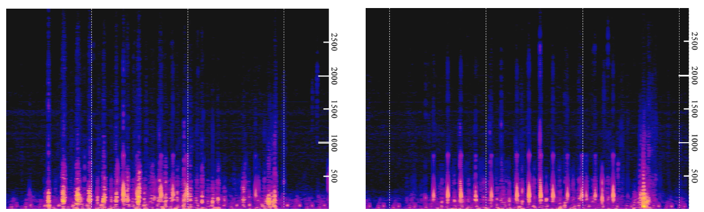
User Activities Detected Through Sound
Infer user’s dietary behavior and calorie intake
Cookie
Bread
Swallowing Sound
Eating (Bread vs Cookie)
Notes:
Q: What can this signal detection be used for?

Slide 40
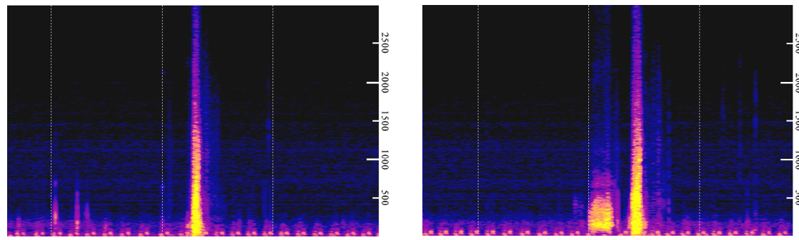
User Activities Detected Through Sound
Infer user’s fluid intake and health-related activity
Cold Water
Hot Tea
Gulping
Sipping
Drinking (Cold Walter vs Hot Tea)
Notes:
Cold Water and Hot Tea, which one belongs to which?
However, the user also could sip when drinking cold beverages or when
drinking out of a different container. Thus, we focused only on examining whether drinking with and without a sip are
distinguishable rather than detecting whether the user is drinking cold or warm beverages.

Slide 41
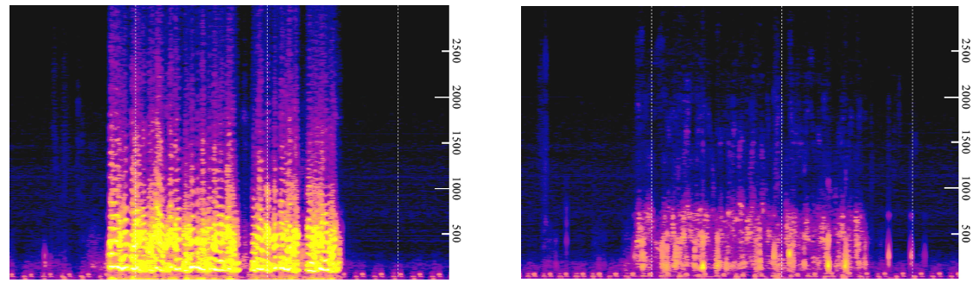
User Activities Detected Through Sound
Speaking
Whispering
Speaking (Speaking vs Whispering)
Notes:
Code Water and Hot Tea, which one belongs to which?

Slide 42
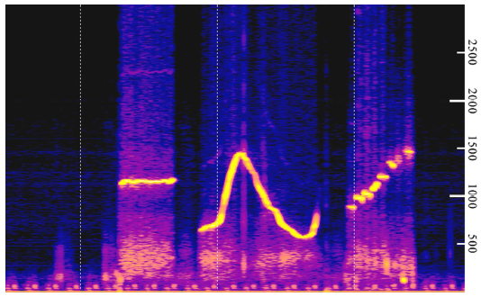
User Activities Detected Through Sound
Melody
Whistling
Notes:
Code Water and Hot Tea, which one belongs to which?

Slide 43
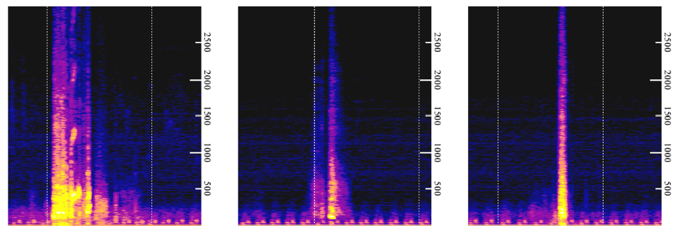
User Activities Detected Through Sound
Infer physical and mental wellbeing
Laughing
Sighing
Coughing
Non-verbal Sounds (Laughing, Sighing, Coughing)
Notes:
Code Water and Hot Tea, which one belongs to which?
The sound pattern for sighing (Figure 8: center) is somewhat similar to the sound of drinking hot beverages (Figure 5: right). But the first part of sighing (inhaling the air) is shorter than sipping when drinking hot beverages.

Slide 44
Classification Technique
Features:
Time-domain Feature
  Zero-crossing Rate (ZCR): differentiate voiced and unvoiced sound
Frequency-domain Feature
  Total Spectrum Power
  Brightness
  Spectral Rolloff and Flux
Classifier: SVM, Naïve Bayes, k-NN

Slide 45
Lab Evaluation
Activities to be classified (12 in total):
Seated,
Deep breath,
Eating cookies, Eating bread,
Drinking, Drinking with a sip;
Speaking; Whispering;
Whistling;
Laughing, Sighing, Coughing

Slide 46
Lab Evaluation
Participants:
  10 participants (9 male, 1 female, all in 20s and 30s), all in good health
Training and Testing Procedure
  Leave-one-participant-out cross validation
    Use the data from 9 participants for training and the data from the other participant for 1 test
  Leave-one-sample-per-participant-out cross validation
    Reserve one sample for one class from each participant as a test case and use the rest for training

Slide 47
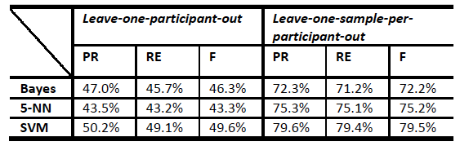
Lab Evaluation
Training the modeling with user specific samples will be helpful!
Comparison of two validation approaches
Notes:
Q: why the second protocol performs better than the first:
First: use other people’s data to predict yourself
Second: use your data to predict yourself
Intuition: voice/sound data is kind of personal data
In all techniques, the F-measure with the Leave-one-sample-perparticipant-
out protocol was about 25 – 30% higher than
one with the Leave-one-participant-out protocol (see Table 1).
This result indicates that the classifier should be trained for each user if the
samples for training are abundant.

Slide 48
Lab Evaluation
Q: What activities do you think that are more difficult to be distinguished from each other?
Seated,
Deep breath,
Eating cookies, Eating bread,
Drinking, Drinking with a sip;
Speaking; Whispering;
Whistling;
Laughing, Sighing, Coughing

Slide 49
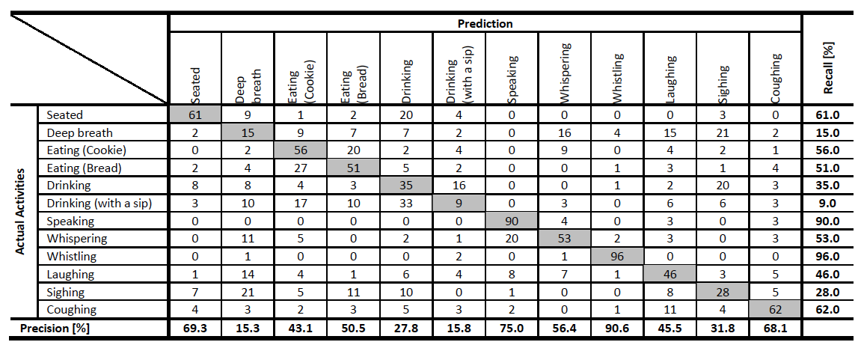
Lab Evaluation
The confusion matrix of the classification with
leave-one-participant-out protocol (SVM)
Notes:
Q: What activities do you think that will be easily misclassified?

Slide 50
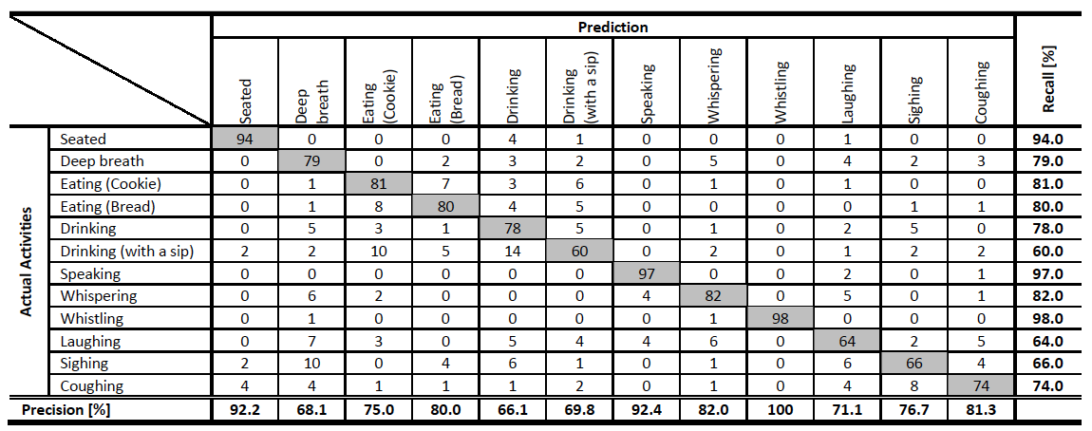
Lab Evaluation
Eating
Drinking
Decreasing the activity granularity would help improve accuracy as well.
The confusion matrix of the classification with
leave-one-sample-per-participant-out protocol (SVM)
Notes:
Decreasing the activity granularity would help to increase
the classification accuracy. For instance, we can combine
Eating cookies and Eating bread , and Drinking and
Drinking with a sip as Eating and Drinking ,

Slide 51
Small Scale In-the-Wild Evaluation
Participants:
  5 participants (3 male, 2 female, )
Focus on 4 activities
  Eating, drinking, speaking and laughing
Ground-truth:
  Ask users to wear another phone with cameras around neck to record user’s activities
Notes:
Challenges: It is in the wild, no control of user’s activity and a lot of background noises.

Slide 52
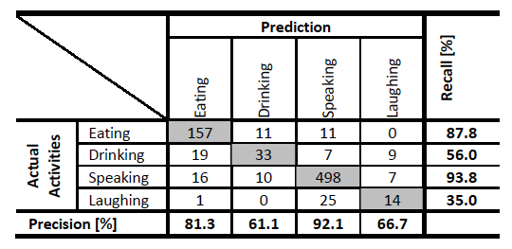
Small-scale In-the-Wild Evaluation
The confusion matrix of the SVM classification in our
small-scale in-the-wild study
Notes:
But generally, the accuracy for the drinking and laughing
activities was relatively low. As seen in Table 4 and 5, the
number of the instances for these two activities was small;
thus, more data may be necessary to examine the true
classification accuracy for these activities.

Slide 53
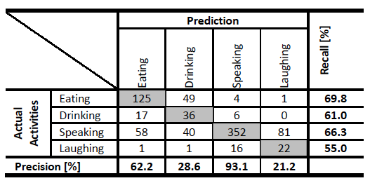
Small-scale In-the-Wild Evaluation
The confusion matrix of the Naïve Bayes classification in
our small-scale in-the-wild study
Notes:
We also note that the eating activities were identified fairly
accurately. This indicates that BodyScope can enhance
existing systems related to food consumption activities. For
example, Noronha et al . developed Platemate, which allows
the user to analyze her food consumption by taking a
picture of the food with a mobile phone and getting food
annotations through a crowdsourcing system [24]. With
BodyScope, a wearable camera (like SenseCam [15])
automatically can identify the moments when the user is
eating, and perform analysis on her food consumption
through Platemate.

Slide 54
A Demo Video
BodyScope on Youtube:
https://www.youtube.com/watch?v=ns-BIh8p8IU

Slide 55
Limitation and Future Work
Limited accuracy of the prototype
  F-measure: 79.5% for lab experiment and 71.5% for in-the-wild study
Users need to wear a special device that is very visible
  Build a more comfortable and less intrusive device
Only 12 activities are studied
  Sense more activities (e.g., smoking, sneezing, etc.)
Privacy issues have not been studied
  Voice and sound contains a lot of sensitive and personal information

Slide 56
Thank You!
The End.

