Slide 1
Social Sensing and CPS
Spring 2015 CSE 40437/60437
Prof. Dong Wang
Summary

Slide 2
Function
Component interaction
Error propagation
Real-time Scheduling
Resource Management
Time
Data Reliability & Info Overload
Social Media Sensing
Hadoop and MapReduce
Data
Social Sensing and CPS
Mobility
Mobile and Crowd-sensing
Automobile Sensing
Energy
Heterogeneous Sensor Platform
Smartphone Sensing
Body-area sensor networks
Privacy Issues
Medical sensing
Social

Slide 3
Function
Component interaction
Error propagation
Humans
Real-time Scheduling
Resource Management
Time
Data Reliability & Info Overload
Social Media Sensing
Hadoop and MapReduce
Data
Social Sensing and CPS
Cyber
Mobility
Mobile and Crowd-sensing
Automobile Sensing
Physical
Energy
Heterogeneous Sensor Platform
Smartphone Sensing
Body-area sensor networks
Privacy Issues
Medical sensing
Social

Slide 4
Function
Component interaction
Error propagation
Real-time Scheduling
Resource Management
Reliability is a critical challenge in CPS!
Time
Data Reliability & Info Overload
Social Media Sensing
Hadoop and MapReduce
Data
Increasing amount of data are generated by unreliable sources.
Social Sensing and CPS
Mobility
Mobile and Crowd-sensing
Automobile Sensing
Energy
Heterogeneous Sensor Platform
Smartphone Sensing
How to build reliable systems using unreliable data?
Body-area sensor networks
Privacy Issues
Medical sensing
Social

Slide 5

1ST Book on Social Sensing
New Book - Social Sensing: Building Reliable Systems on Unreliable Data:
Dong Wang, Tarek Abdelzaher, Lance Kaplan, Elsevier, 2015

Slide 6

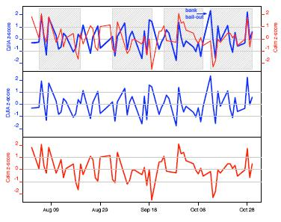
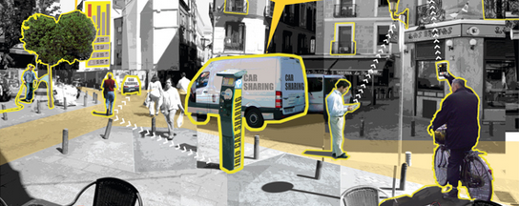
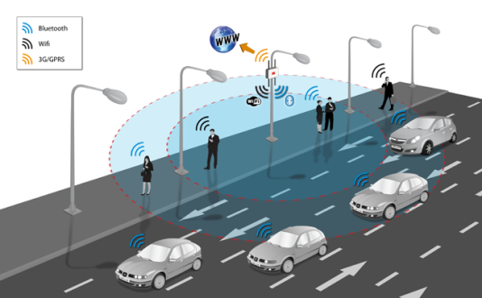
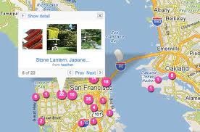

Social Sensing and CPS Makes a Smarter Planet
Social Sensing
Internet of Things
(Urban Environment)
Stock Prediction (Money)
Traffic Monitoring (Time)
Disaster Report (Lives)
Geo Tagging
(Smart City)

Slide 7

Social Sensing and CPS Makes a Smarter Planet
Social Sensing

Slide 8
Your feedback is valuable, please fill out the CIF survey ☺

