Slide 1
CSC113: Computer Programming (Theory = 03, Lab = 01)
Momina Moetesum
Computer Science Department
Bahria University, Islamabad

Slide 2
Repetition structures – II do/while & For Loop Structures
Week # 5

Slide 3
The do/while Repetition Structure
The do/while repetition structure is similar to the while structure,
Condition for repetition tested after the body of the loop is executed
Format/Syntax:
do {
statement
} while ( condition );
Example (letting counter = 1):
do {
cout << counter << " ";
} while (++counter <= 10);
This prints the integers from 1 to 10
All actions are performed at least once.

Slide 4
Do While Loop
action(s)
true
condition
false

Slide 5
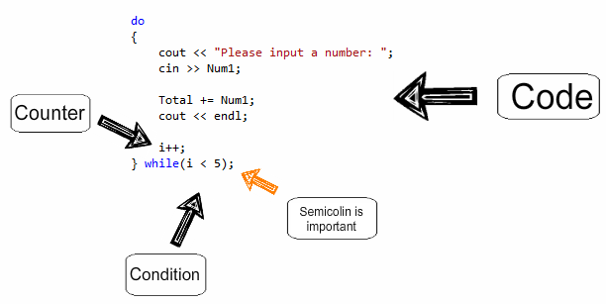
Format / Syntax

Slide 6
Example of do-while loop
#include<iostream>
#include<conio.h>
using namespace std;
void main()
{
int counter=1;
do
{
cout<<counter<<" ";
}
while(++counter <= 10);
getch();
}

Slide 7
The for Repetition Structure
The general format when using for loops is
for ( initialization; LoopContinuationTest; increment )
statement
Example:
for( int counter = 1; counter <= 10; counter++ )
cout << counter << endl;
Prints the integers from one to ten
No semicolon after last statement

Slide 8
The for Repetition Structure
For loops can usually be rewritten as while loops:
initialization;
while ( loopContinuationTest){
statement
increment;
}
Initialization and increment as comma-separated lists
for (int i = 0, j = 0; j + i <= 10; j++, i++)
cout << j + i << endl;

Slide 9
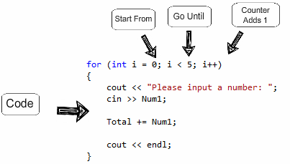
Format / Syntax

Slide 10
Examples using for structure
for( int i =1; i <= 100; i++)
for(int i = 100; i >= 1; i--)
for(int i = 7; i <= 77; i += 7)
for(int i = 20; i >= 2; i -=2)
for(int i = 2; i <= 20; i += 3)
for(int i = 99; i >= 0; i -=11)

Slide 11
Example
Program to sum the even numbers from 2 to 100
1 // Fig. 2.20: fig02_20.cpp
2 // Summation with for
3 #include <iostream>
4
5 using std::cout;
6 using std::endl;
7
8 int main()
9 {
10 int sum = 0;
11
12 for ( int number = 2;number <= 100; number += 2)
13 sum += number;
14
15 cout << "Sum is " << sum << endl;
16
17 return 0;
18 }

Slide 12
output
Sum is 2550

Slide 13
Variations using for loop
for( int number = 2; number <= 100; sum += number, number += 2)

Slide 14
Example of for loop
A person invests $1000 in a savings account yielding 5 percent interests. Assuming that all interest is left on deposit in the account, calculate and print the amount of money in the account at the end of the year for 10 years.
(Use a= p(1+r)^{n}) where:
p= invested amount
r= annual interest rate
n= number of years
a= amount at the end of nth year

Slide 15
Example of for loop
#include<iostream>
#include<conio.h>
#include <math.h>
#include<iomanip>
using namespace std;
void main()
{
double amount, principal = 1000.0, rate = .05;
cout<<"Year"<<"\t"<<"Amount on deposit"<<endl;
for(int year=1; year<=10;year++)
{
amount=principal*pow(1.0+rate, year);
cout<<setw(4)<<year<<setiosflags(ios::fixed | ios::showpoint)<<setw(21)<<setprecision(2)<<amount <<endl;
}
getch();
}

Slide 16
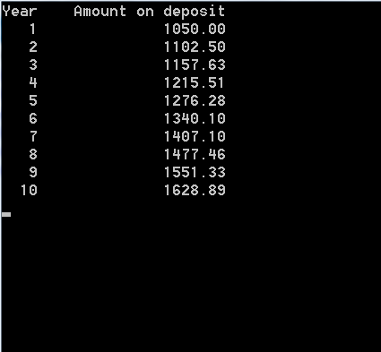
output

Slide 17
Using break in for loop
for(int i=1; i<=10; i++)
{
if(i==5)
break;
cout<<i<<" ";
}
1 2 3 4

Slide 18
Using continue in for loop
for(int i=1; i<=10; i++)
{
if(i==5)
continue;
cout<<i<<" ";
}
1 2 3 4 6 7 8 9 10

Slide 19
Self Practice
Write a program that prints following:
********
********
********
********
********
********
********
********

Slide 20
Self practice
Write a program using for loop that prints the product of the odd integers from 1 to 15.

Slide 21
Formulating Algorithms (Counter-Controlled Repetition)
Counter-controlled repetition
Loop repeated until counter reaches a certain value.
Definite repetition
Number of repetitions is known
Example
A class of ten students took a quiz. The grades (integers in the range 0 to 100) for this quiz are available to you. Determine the class average on the quiz.

Slide 22
Formulating Algorithms (Counter-Controlled Repetition)
Pseudocode for example:
Set total to zero
Set grade counter to one
While grade counter is less than or equal to ten Input the next grade Add the grade into the total Add one to the grade counter
Set the class average to the total divided by ten Print the class average
Following is the C++ code for this example

Slide 23
//grade calculating program
#include<iostream>
using namespace std;
int main()
{
int total=0;
int grade_counter=1;
int average, grade;
while(grade_counter<=10)
{
cout<<"Enter grade:";
cin>>grade;
total+=grade; //total=total+grade;
grade_counter++; //grade_counter+1;
}
average = total/10;
cout<<"Class Average ="<<average;
return 0;
}
Enter grade: 98
Enter grade: 76
Enter grade: 71
Enter grade: 87
Enter grade: 83
Enter grade: 90
Enter grade: 57
Enter grade: 79
Enter grade: 82
Enter grade: 94
Class average is 81

Slide 24
Essentials of Counter-Controlled Repetition
Counter-controlled repetition requires:
The name of a control variable (or loop counter).
The initial value of the control variable.
The condition that tests for the final value of the control variable (i.e., whether looping should continue).
The increment (or decrement) by which the control variable is modified each time through the loop.
Example:
int counter =1; //initialization
while (counter <= 10){ //repetition condition
cout << counter << endl;
++counter; //increment
}

Slide 25
Essentials of Counter-Controlled Repetition
The declaration
int counter = 1;
Names counter
Declares counter to be an integer
Reserves space for counter in memory
Sets counter to an initial value of 1

Slide 26
Formulating Algorithms with Top-Down, Stepwise Refinement (Sentinel-Controlled Repetition)
Suppose the problem becomes:
Develop a class-averaging program that will process an arbitrary number of grades each time the program is run.
Unknown number of students - how will the program know to end?
Sentinel value
Indicates “end of data entry”
Loop ends when sentinel inputted
Sentinel value chosen so it cannot be confused with a regular input (such as -1 in this case)

Slide 27
Formulating Algorithms with Top-Down, Stepwise Refinement (Sentinel-Controlled Repetition)
Top-down, stepwise refinement
begin with a pseudocode representation of the top:
Determine the class average for the quiz
Divide top into smaller tasks and list them in order:
Initialize variables
Input, sum and count the quiz grades
Calculate and print the class average

Slide 28
Formulating Algorithms with Top-Down, Stepwise Refinement
Many programs can be divided into three phases:
Initialization
Initializes the program variables
Processing
Inputs data values and adjusts program variables accordingly
Termination
Calculates and prints the final results.
Helps the breakup of programs for top-down refinement.
Refine the initialization phase from
Initialize variables
to
Initialize total to zero
Initialize counter to zero

Slide 29
Formulating Algorithms with Top-Down, Stepwise Refinement
Refine
Input, sum and count the quiz grades
to
Input the first grade (possibly the sentinel)
While the user has not as yet entered the sentinel
Add this grade into the running total
Add one to the grade counter
Input the next grade (possibly the sentinel)
Refine
Calculate and print the class average
to
If the counter is not equal to zero
Set the average to the total divided by the counter
Print the average
Else
Print “No grades were entered”

Slide 30
//grade calculating program
#include<iostream>
using namespace std;
int main()
{
int total=0;
int grade_counter=0;
int grade;
float average;
cout<<"Enter grade or -1 to end";
cin>>grade;
while(grade!=-1)
{
total+=grade;
grade_counter++;
cout<<"Enter grade or -1 to end";
cin>>grade;
}
if(grade_counter !=0)
{
average = total/grade_counter;
cout<<"Class Average ="<<average;
}
else
cout<<"No grade were entered";
return 0;
}

